Slide 1
Updates from the WMO/GAW Programme
Oksana Tarasova
WMO Science and Innovation Department

Slide 2
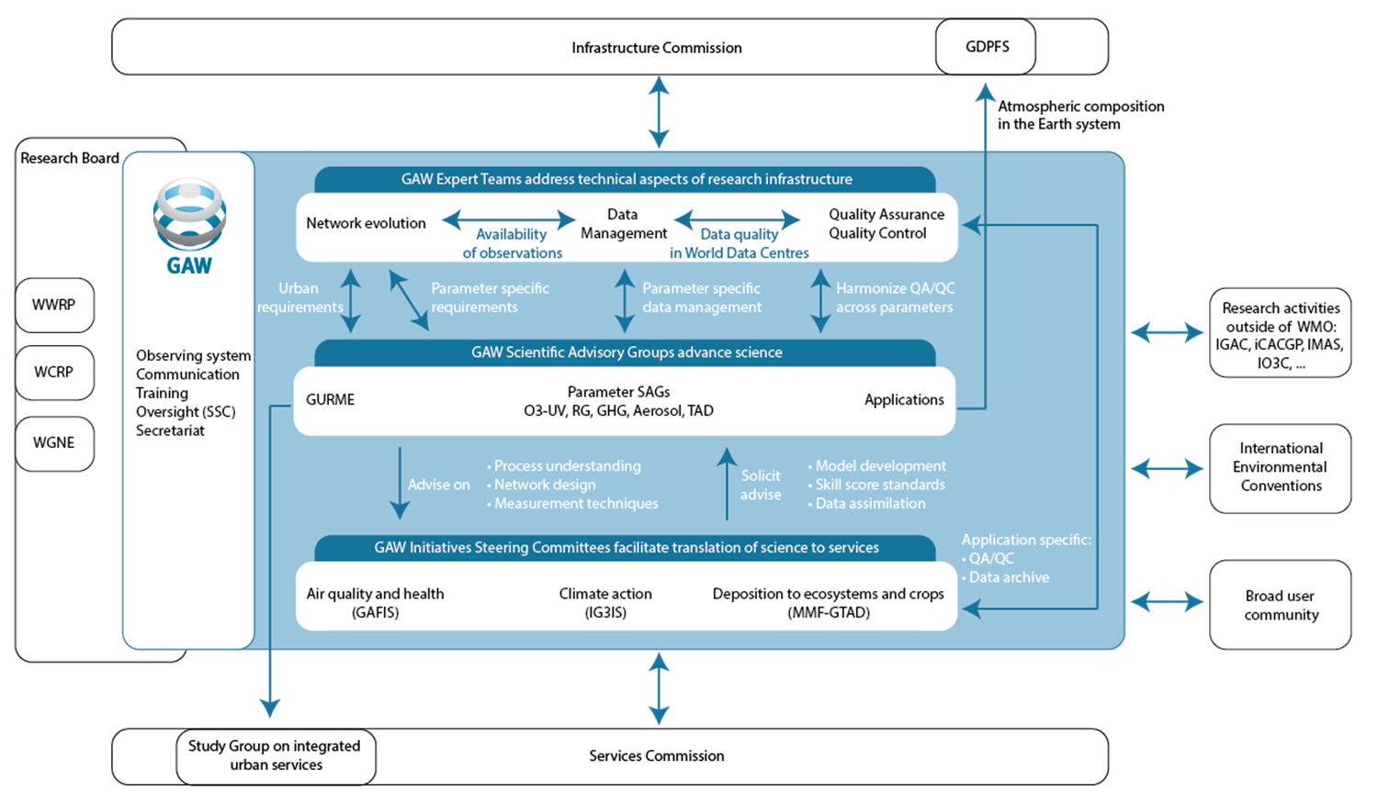
Internal organization of GAW
Activities follow GAW Implementation plan 2016-2023 (new plan for next 8 year period is under development).
“Stocktaking” happened at the GAW Symposium.
Scientific Steering Committee introduced several cross-cutting activities in Feb. 2021, with the most advance up to now related to capacity development and health.

Slide 3
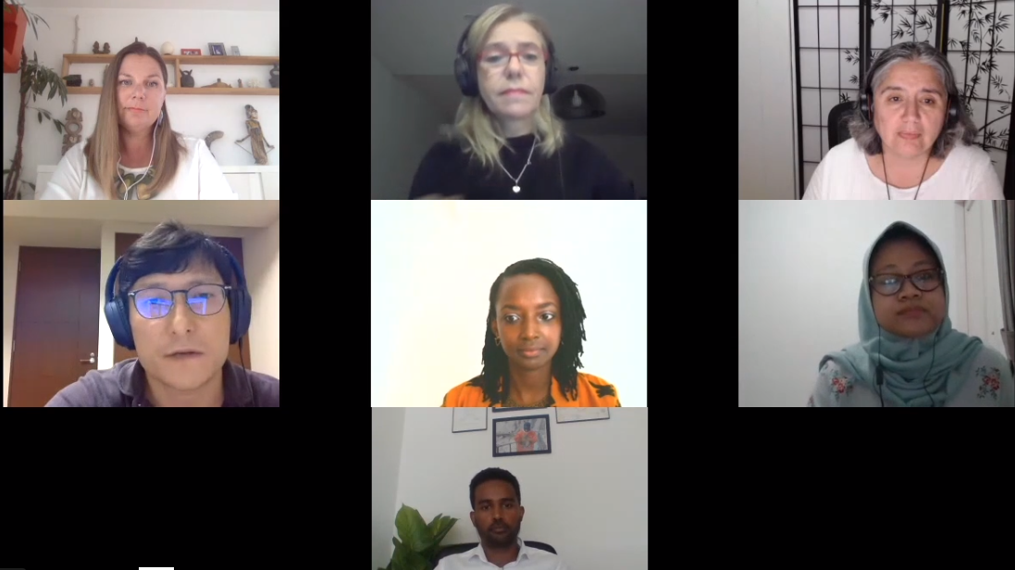
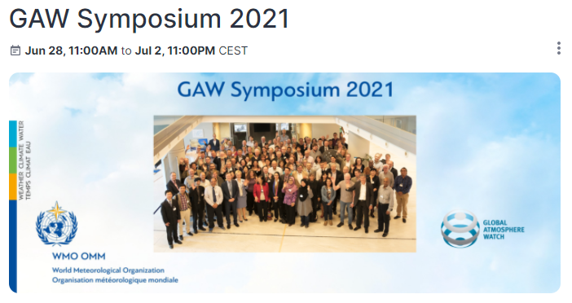
Strategic planning in GAW
GAW conducted the Quadrennial GAW Symposium from 28 June to 2 July 2021. It collected more then 300 participants from 70 countries. Follow up survey was conducted to provide the inputs to the next GAW Implementation plan (not much input collected).
The Symposium consisted of the following scientific sessions:
Science for services: The importance of atmospheric composition
Filling critical gaps in observations
Atmospheric composition, pandemics and support for a new health agenda
Earth system modelling and data management
On the last day, three panel discussions took place:
Young scientists and capacity building in GAW
Embracing diversity in GAW
Reflections on Symposium and way forward for GAW

Slide 4
LONG-TERM GOAL 3. ADVANCE TARGETED RESEARCH:
Leveraging leadership in science to improve understanding of the Earth system for enhanced services
Impact
FOCUS AREA/OUTCOME A:
FOCUS AREA/OUTCOME B:
FOCUS AREA/OUTCOME C:
FOCUS AREA/OUTCOME D:
STRATEGIC OBJECTIVE 3.1: Advance scientific knowledge of the Earth system
Outcome
Overarching challenges in Earth system scientific research, modelling, analysis and observations identified
Overarching challenges incorporated into science strategies and research implementation plans
Innovative research methods developed and communicated to Members
A new generation of leadership in science fostered
Intermediary outcomes
Physical basis of science
Guiding the community
Innovation
Capacity development
Key scientific papers covering advances in understanding the Earth system, incl. carbon, water & energy cycles, coupled processes, & quantifying and reducing uncertainties in observations and predictions/projections produced
Strategies to advance societal-relevant science information at the regional scale formulated
Critical gaps & emerging new research directions on improved undertanding of the Earth System identified to support DRR, agriculture, urban development, aviation, energy sector, etc.
Progress with implementation of WWRP/WCRP/GAW Plans, incl. regular reviews and updates of emerging science tracked. Survey the broad coupled model development community to identify priorities for seamless coupled model development
Scientific community broadened and opportunities created for increased knowledge transfer to all Members*
New structures, partnerships and activities identified and put in place to facilitate seamless observation and prediction development
Guidance on the applications of Artificial Intelligence and Machine Learning in WMO activities developed*
Recommendations on integration of coupled and ultra-high resolution modelling and data assimilation, exascale computing and the digital Earths concept into research programme activities developed
Innovative approaches and recommendations on the integration of political science, social psychology, anthropology, sociology, and interdisciplinary geospatial sciences developed
Early career scientists and networks meaningfully engaged in programmes' activities & events
Training on research methods on weather, climate, water and environmental topics organized*
Science education strengthened, academic communities better engaged, innovative educational tools implemented and support provided to Members and regions*
Outputs

Slide 5
LONG-TERM GOAL 3. ADVANCE TARGETED RESEARCH:
Leveraging leadership in science to improve understanding of the Earth system for enhanced services
Impact
FOCUS AREA/OUTCOME C:
FOCUS AREA/OUTCOME A:
FOCUS AREA/OUTCOME B:
FOCUS AREA/OUTCOME D:
STRATEGIC OBJECTIVE 3.2: Enhance the science-for-service value cycle ensuring scientific and technological advances improve predictive capabilities and analysis
Outcome
Capabilities for Earth system prediction and projection on all time and space scales improved
Forecast Future
Research to support user products and services enhanced
Research data management
Earth system analysis and re-analysis products developed
User community for co-design and development of services engaged and entrained
Intermediary outcomes
Inverse modelling and analysis products (past and present)
Co-design and cycle​
Novel methodologies and products developed in support of emerging weather, water, climate and environmental services*
Models and tailored forecasting products developed for specific sectors at regional scale (e.g. urban, aviation, health, agriculture, energy, etc.) using collaboration between natural and social scientists in support of adaptation*
Connections between different components of the Earth System improved through better process parametrization, data assimilation, constiuent exchange, etc
Research data is more efficiently linked to WMO systems (WIGOS, WIS, etc.) and extended towards data sources to support emerging services (composition data, new climate and hydrological datasets, crowd sourcing, etc)
Research datasets harmonized in support of assimilation, fusion, model initiation as well as verification purposes are created
Methodologies for impact based forecasting improved through integration of socio-economic, cultural, and other understanding
Novel methodologies for inverse modelling, coupled data assimilation and measurement model fusion and model benchmarking developed
Model performance improved e.g. through coordinated inter-comparison exercices, with a focus on user-relevant metrics.
Prototype systems/products created to support ecosystem services (deposition) and climate mitigation services (greenhouse gases)
Climate projections (CMIP), CORDEX downscaled to support adaptation and climate risk assessments by WMO Members*
User requirements for specific products established through social scientific enquiry and active user entrainment
Feedback (including the socio-economic community) from users actively sought in order to improve the quality and quantity of products/ services
Joint activities/projects with INFCOM/SERCOM developed including test prototyping which will ensure operational uptake
Continuous appraisal incorporated into all new products/services
Outputs

Slide 6
LONG-TERM GOAL 3. ADVANCE TARGETED RESEARCH:
Leveraging leadership in science to improve understanding of the Earth system for enhanced services
FOCUS AREA/OUTCOME A:
FOCUS AREA/OUTCOME B:
FOCUS AREA/OUTCOME C:
Impact
STRATEGIC OBJECTIVE 3.3: Advance and contribute to policy-relevant science
Outcome
Assessments carried out with stakeholders (e.g. for Montreal Protocol and Vienna Convention, LRTAP Convention, CCAC, GESAMP, Convention on Biodiversity etc.)
Specific documents and products produced (e.g. Technical reports on air pollution, deposition, stratospheric ozone, specific policy relevant data sets) in support of environmental policies
Assessments carried out with stakeholders (e.g. Sendai Monitoring, UNDRR, RISK-KAN etc)
Specific documents and products produced or contributed towards DRR policy (e.g. UNDRR Global Platform, Airborne Dust Bulletin)
Assessments carried out with stakeholders (e.g. intersessional IPCC reports, Global Stocktake, UNFCCC SBSTA, Antarctic Treaty, Arctic Council) addressing topics of carbon/climate neutrality, climate intervention, climate risks, adaptation and mitigation
Specific documents and products produced (e.g. GHG Bulletin, United in Science Report, 10 New Insights in Climate Science) in support of climate policy
Knowledge base for relevant environmental conventions and coalitions provided
The scientific basis to accelerate climate action strengthened
The knowledge base to advance Sendai objectives enhanced
Intermediary outcomes
Outputs

Slide 7
Initial brainstorming on new GAW IP
RISKS
TOOLS:
Observational infrastructure
Modeling and forecasting
Data management
Capacity development
Delivery mechanisms
HOW
(ways on how to deliver the objectives)

Slide 8
GAW -- Research Programme Focused on Enabling Atmospheric Composition Services
Approach: by advancing and enhancing atmospheric composition related services for society through improved understanding of the roles of aerosols, reactive gases and greenhouse gases in the Earth System
GAW SOs aligned with
WMO SP Goal 3: Research
GAW SO-1: Advance scientific knowledge
GAW SO-2: Improve predictive capabilities and analysis
GAW SO-3: Advance and contribute to policy-relevant science
AC @ Research Infra. Interface
AC @ Process
Understanding Interface
AC @ Weather
Interface
AC @ Climate
Interface
AC @ DRR
Interface
AC @ Env Policy
Interface
Atmospheric
Composition (AC) Programme Foci
These represent how our activities align with WMO SP and the other programs within the RB
Innovation in obs (Instruments, satel)
New techs for meas./model fusion, data assimilation
Bio/ocean/atm coupling
AI applications
Data discovery/
utilization, NRT, …
Capacity development
PBL
Emissions and attribution Deposition
Chemistry related to improved prediction
Better parame-terizations
Improved cloud/prec
S2S pred.
SDS
Fires
Emission inversion capability
Radiative forcing gases and aerosols
Biomass burning freq/intensity
Exacerbation of air pollution
Human health
Food security
Smoke
Dust storms
Urban environments
Montreal Protocol
LRTAP
Global stocktaking
SDGs

Slide 9
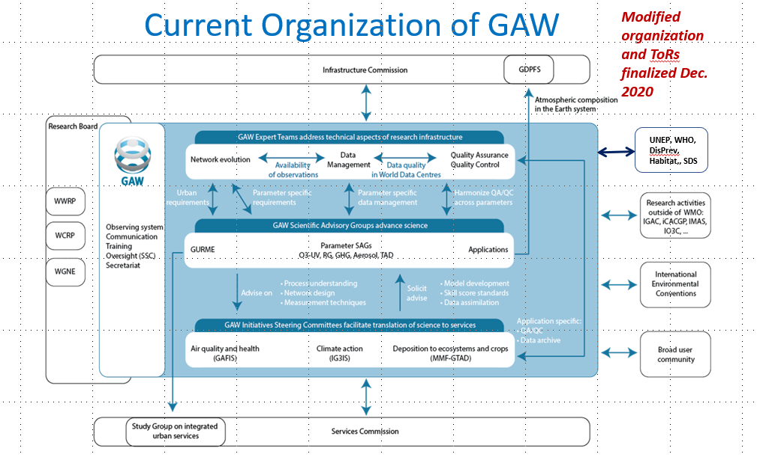
Need to also consider how best to organize ourselves moving forward
?
Timeline:
Last week of June 2022 – summary of consultations and first draft (please send your comments during May to increase relevance of GAW to the Convention)
6-7 October: face-to-face meeting in Geneva of extended SSC to prepare the final draft for submission to the RB session in December

Slide 10
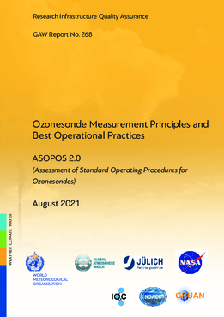
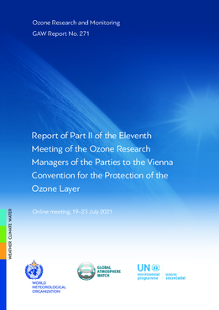
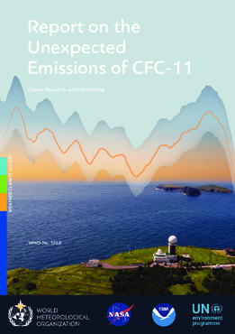
Support of environmental and climate policy
The annual GHG Bulletin was launched before COP26 as a background document for the climate policy (UNFCCC)
The Guidance was provided to the Montreal Protocol on the gaps in ozone observing network and research priority
Standard operating procedures for the ozone sondes measurement were finalized
Scientific Report of the Unexpected Emissions of CFC-11 makes use of atmospheric observations and advanced analysis tools for emission quantification
Plans:
WMO/UNEP Ozone assessment is to be finalized in July/August 2022
Modelling analysis as a follow up on the GAW coordinated study on COVID to be finalized in 2022

Slide 11
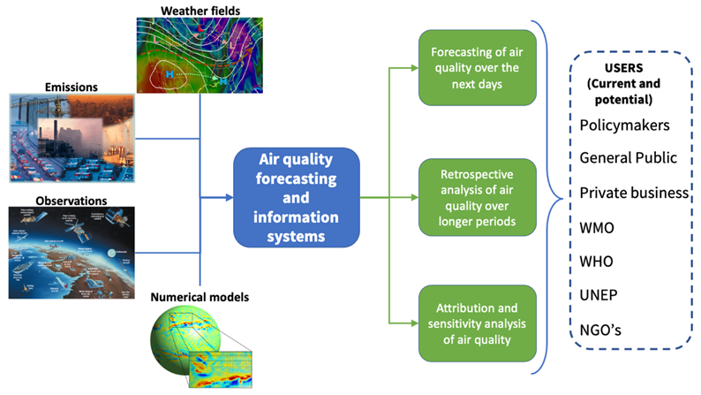
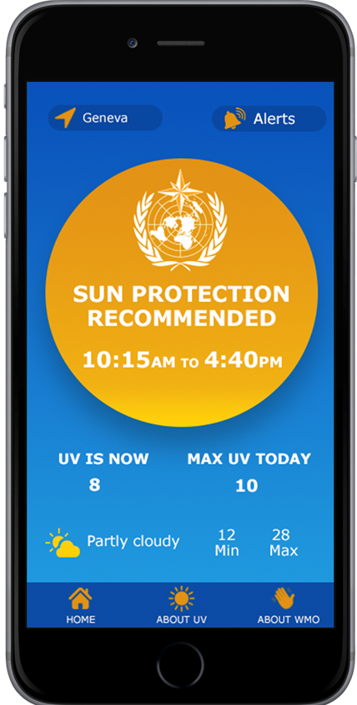
Support of the health sector
Global Air Quality Forecasting and Information System (GAFIS) initiative finalized its implementation plan in Feb 2022 and started Asian models intercomparison campaign in autumn 2021. Engagement with UNEP are being discussed.
New Bulletin was produced on Air Quality and Climate before the 7 September (the UN day for “Clean Air for Blue Sky”)
The App was launched in November 2021, it was developed jointly with health community (available in Google Store), can be adapted. 7 countries expressed an interest in adaptation
Air Quality and Climate connection expiratory animation was launched in September 2021
https://www.youtube.com/watch?v=s4ly6o-VT90

Slide 12
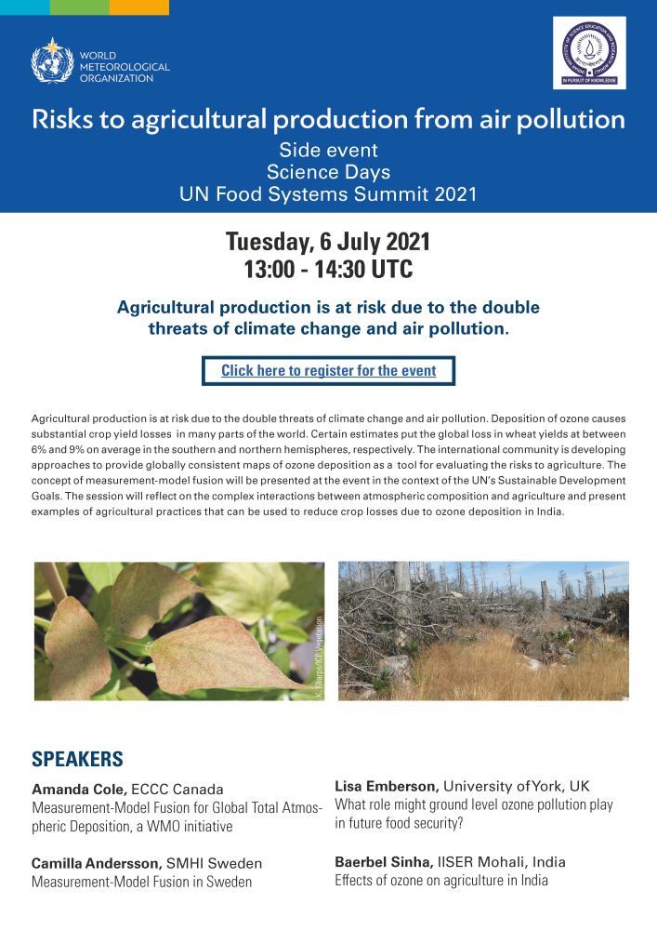
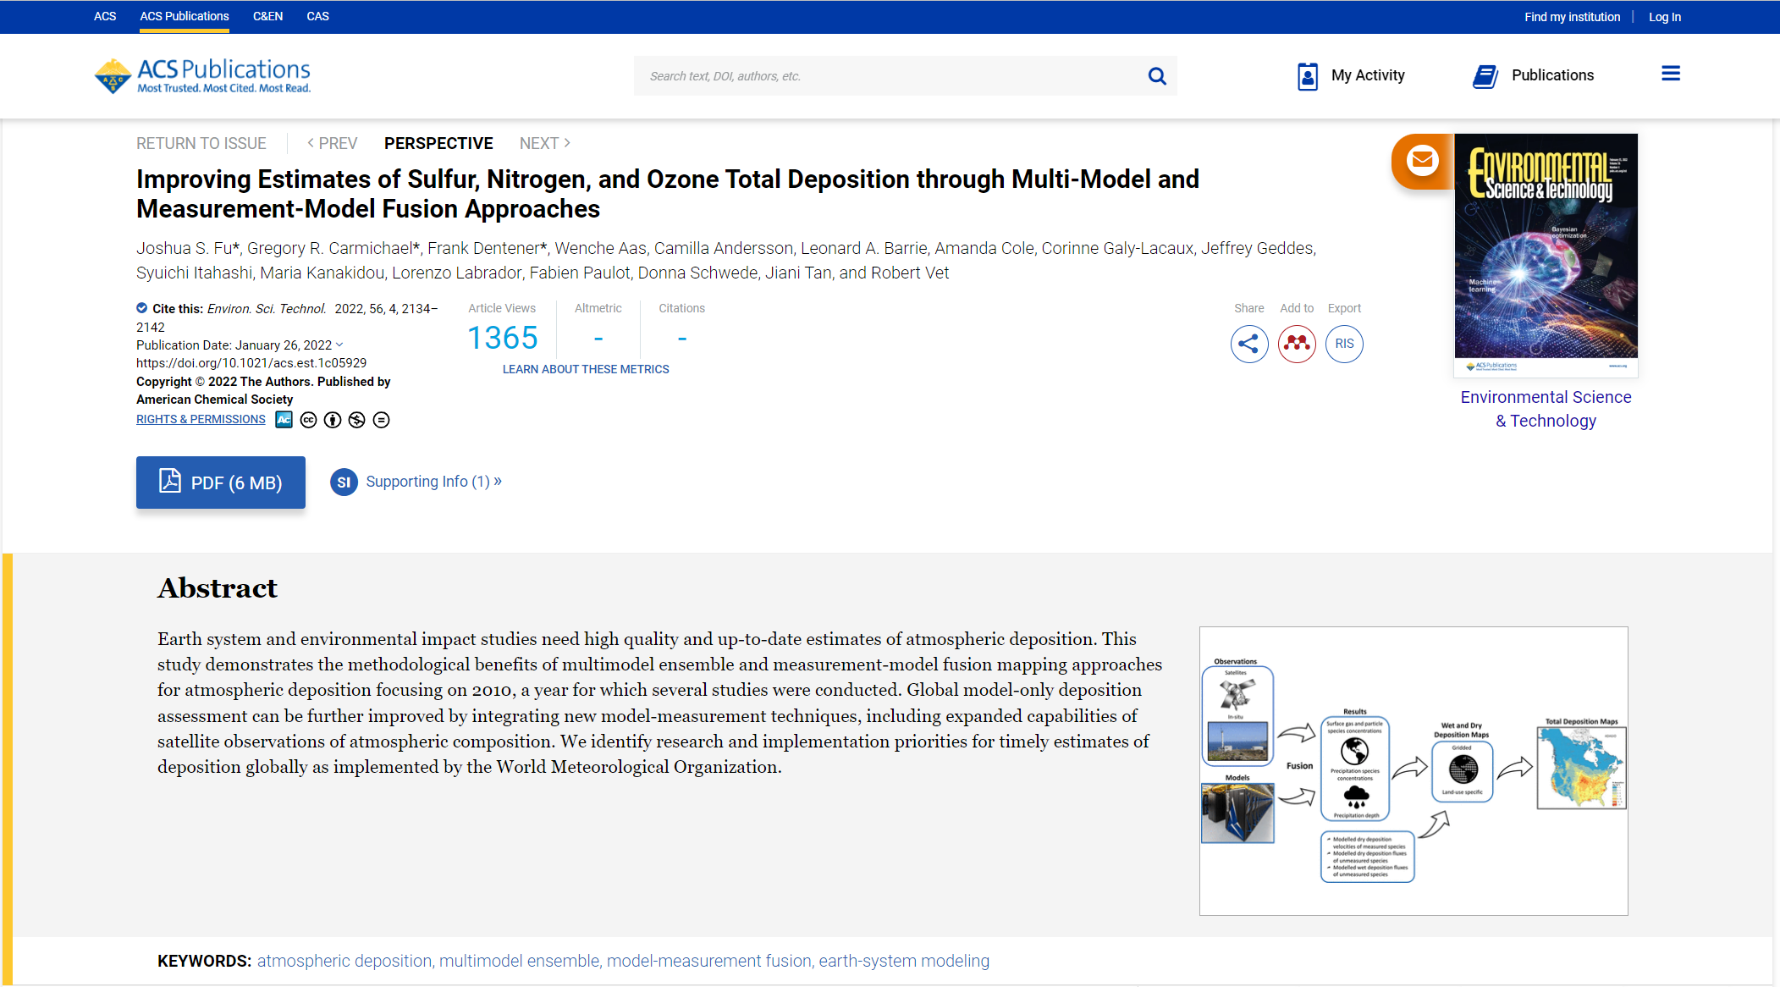
Measurement-Model Fusion for Global Total Atmospheric Deposition
MMF brings together best-available data and modelling results on precipitation chemistry, precipitation depth, air concentrations and dry deposition velocities to estimate wet, dry and total deposition.
Initiative was presented at the Science Days for the UN Food Systems Summit 2021
Swedish Environmental Research Institute to performs user and stakeholder mapping and develops user engagement strategy to be finalized in 2022
NILU collected the dataset for the development of the first prototype product for 2010
Plans:
Organized MMF techniques workshop in 2022 to follow up on the community paper (published in Jan 2022)

Slide 13
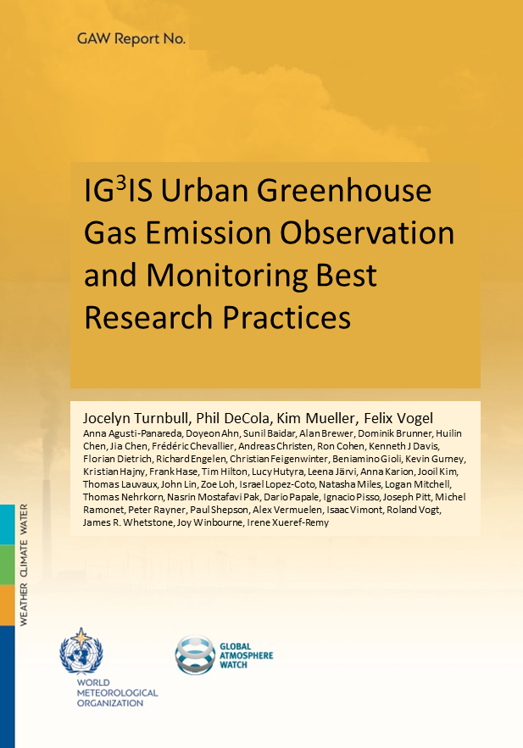
The Integrated Global Greenhouse Gas Information System (IG³IS)
Support the success of post-COP21 actions of nations, sub-national governments, and the private sector to reduce climate-disrupting GHG emissions through a sound-scientific, measurement-based user-driven approach.
IG³IS contributed to the UN Energy Compacts that was launched in January 2022
The project on CO₂ uptake by the bamboo forest funded by the Quadrature Climate Foundation started on 1 March 2022
IG³IS will provide contribution to the WMO GHG/Carbon Monitoring Workshop @ WMO HQ on “The case for a coordinated Global Greenhouse Gas Monitoring Infrastructure”
Refined MoU between WMO and UNFCCC will include an annex on IG³IS
IG³IS related submission was made by WMO for SBSTA 56 session in June 2022
Good practices document was developed, went through public review and will be launched on 1 June 2022 webinar

Slide 14
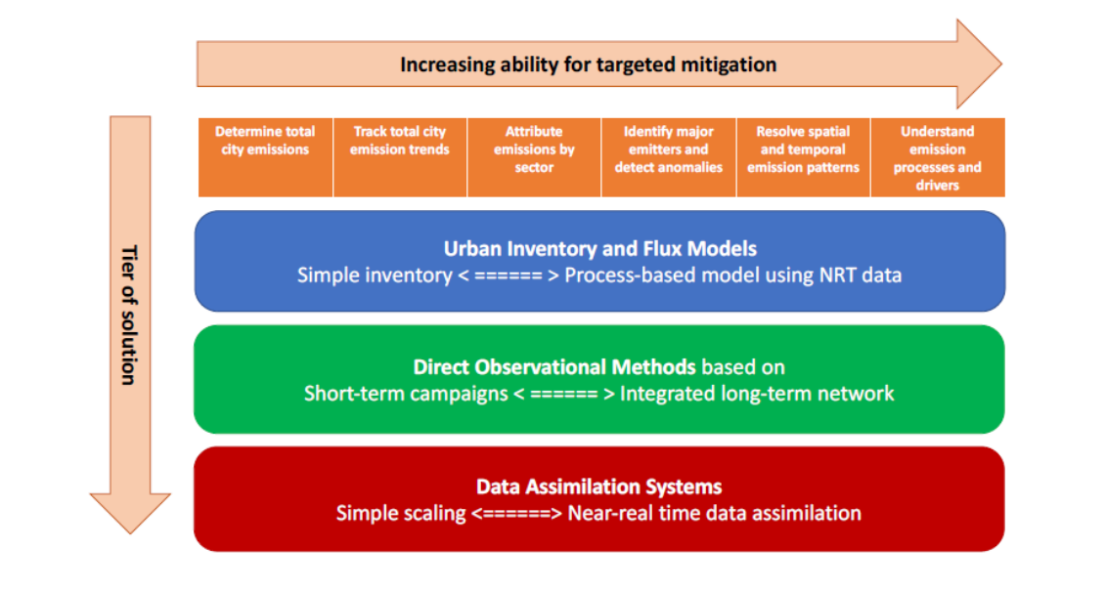
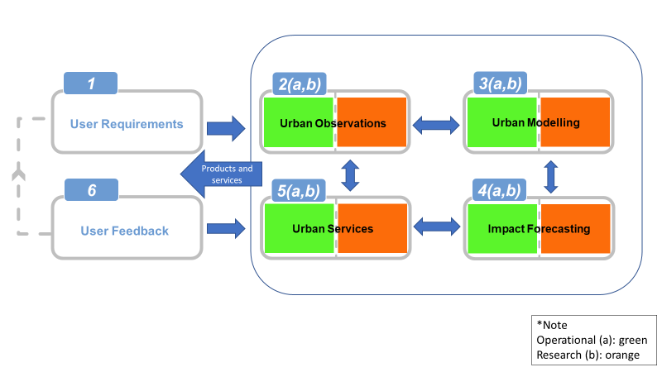
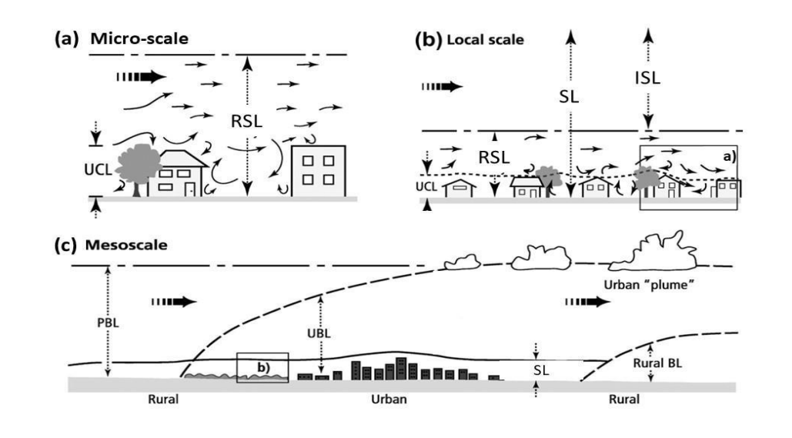
Urban Updates
GAW is contributing to the integration of urban-related activities with the Urban Workshop 13-15 June 2022
Bringing together diverse groups working on the WMO urban agenda
Take stock of the existing activities
Develop recommendations for improved coordination on urban-related activities
Launch of 3 documents at the Urban Workshop in May/June 2022
IG³IS Urban Greenhouse Gas Emission Observations and Modelling Good Practices on 1 June
Guidance to Measuring, Modelling, and Monitoring the Canopy Layer Urban Heat Island (led by GURME) on 20 May
Good Practices on High-Resolution Modelling for Integrated Urban Services (by Study Group on Integrated Urban Services) on 24 May
Registration and draft documents are available at
https://community.wmo.int/meetings/launch-3-urban-reports

Slide 15
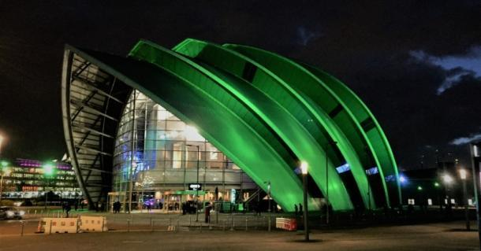
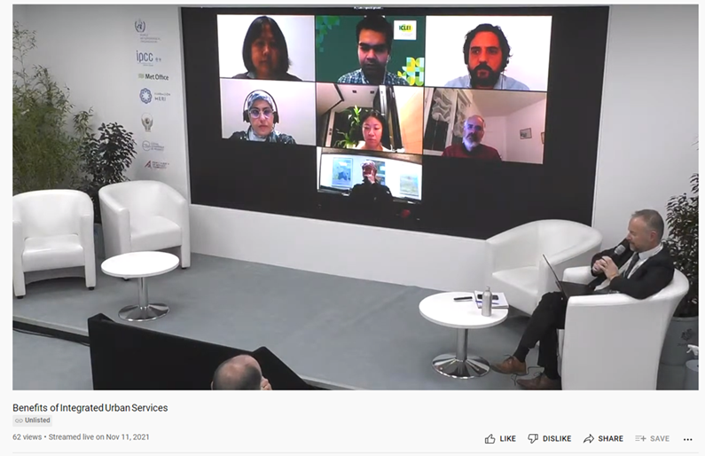
Major outreach events: COP26
IG³IS and Carbon Budget- Observations-based approach to support efficient mitigation of greenhouse gas emissions
4 November, 13:00 – 14:00 GMT
Atmospheric Deposition, the invisible threat – impacts on agriculture, ecosystem and oceans
6 November, 18:00 – 19:00 GMT
Air quality and health: lessons learned from COVID
11 November, 16.30 – 17:30 GMT
Benefits of Integrated Urban Services
11 November, 18:00 – 19:00 GMT
https://community.wmo.int/meetings/gaw-supported-side-events-ipcc-wmo-ukmo-pavilion-unfccc-cop26

Slide 16
Thank you!
Merci!

