Slide 1


New developments of heavy metal and POP pollution assessment
Ilyin I., Travnikov O., Gusev A., Batrakova N., Rozovskaya O. (EMEP/MSC-E)
Bank M., Ho Q.T. (Institute of Marine Research, Norway)

Slide 2
Research and cooperation activities of MSC-E
Eurodelta/Carb: Assessment of B(a)P and PM pollution
Case study with Poland: Assessment of PAHs levels
Hg pollution assessment (the Arctic, Case Study with Norway)
Heavy metals and POPs from wildfires
Contaminants of emerging concern
Marine protection (OSPAR, HELCOM)
Cooperation with WGE (use of moss data for analysis of trends)

Slide 3
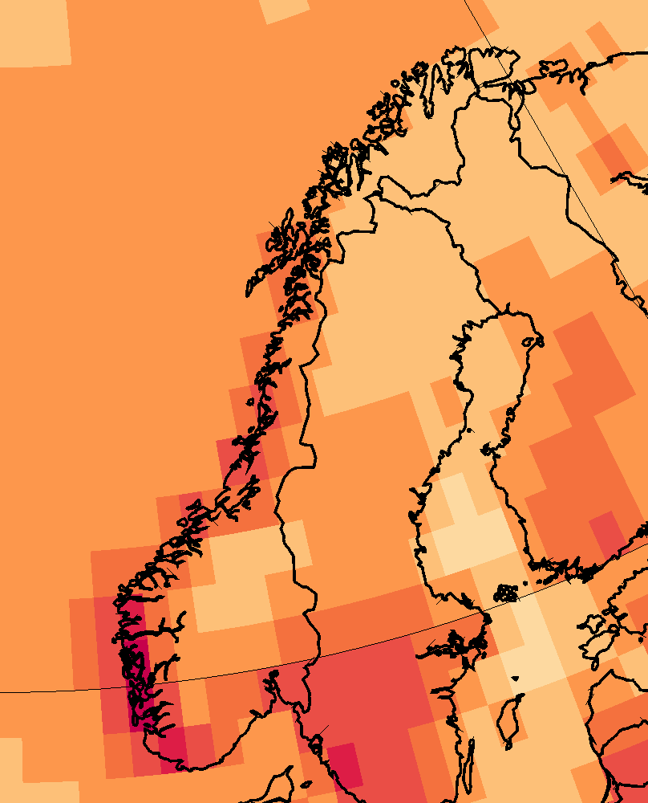
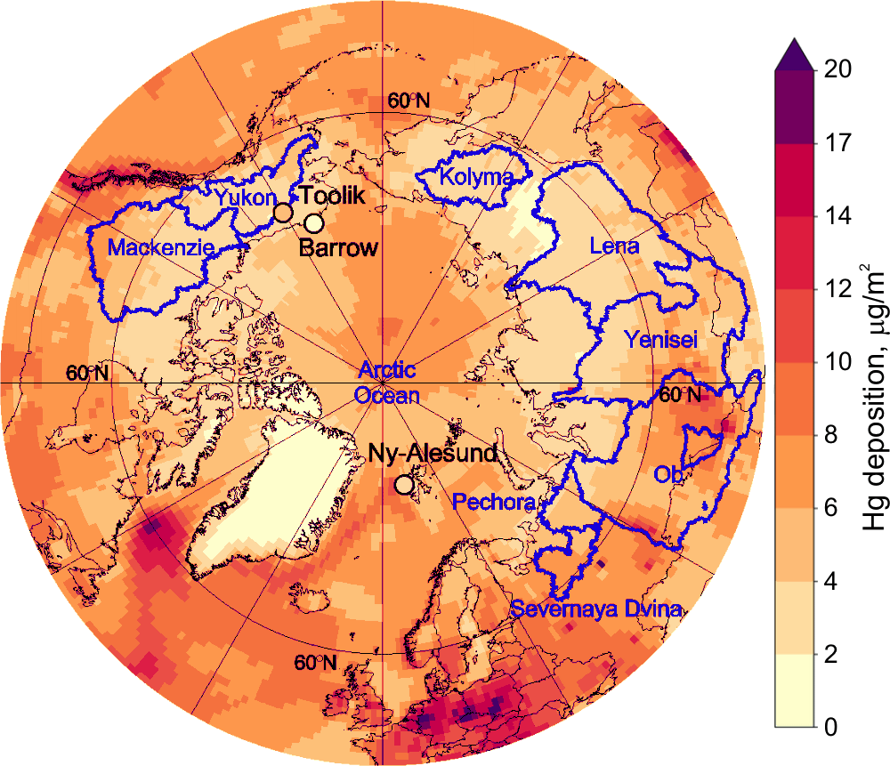
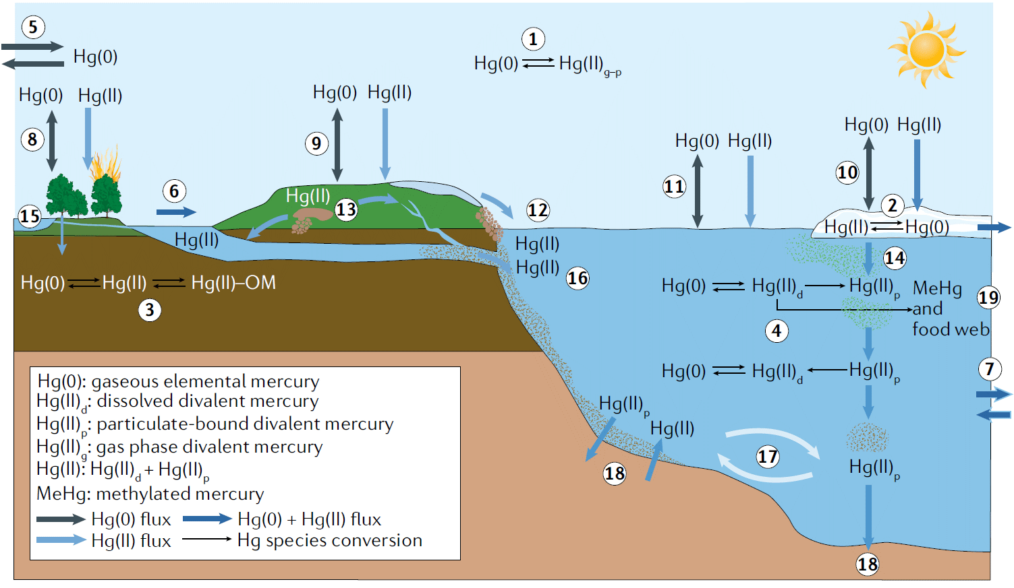
Mercury pollution assessment
EMEP/MSC-E contribution to the co-operative follow-up studies based on AMAP Hg Assessment
Norway
Hg atmospheric deposition
Hg cycling in the Arctic
Main topics:
Literature review of Hg sources, transport and fate in the Arctic
Update and evaluation of global Hg emissions inventory
Estimates of the present-day Hg mass budget in the Arctic
Analysis of factors affecting changes of Hg pollution in the Arctic (permafrost thaw, glacier and sea ice melt, wildfires, etc.)
330 Mg
2450 Mg
597000 Mg
272 Mg
1600 Mg
Dastoor et al. (2022)
Publications:
Dastoor et al. (2022) Nature Reviews Earth & Environment
Dastoor et al. (2022) Science of the Total Environment (in press)
Notes:
On-going assessment of mercury pollution covers a number of directions with particular focus on the Arctic pollution. MSC-E participated in co-operative studies, which follow up the recent AMAP Hg Assessment and include:
An extensive literature review of Hg sources, transport and fate in the Arctic
Update and evaluation of global Hg emissions inventory
Estimates of the present-day total Hg mass budget in the Arctic
And analysis of factors affecting changes of Hg pollution in the Arctic, such as permafrost thaw, glacier and sea ice melt, wildfires and so on
Two publications were prepared with contribution of MSC-E.
Here you can see the multi-model simulated Hg deposition to the Arctic and the mass budget estimates.
More detailed analysis of mercury pollution on a country scale was performed for Norway as a case study.

Slide 4
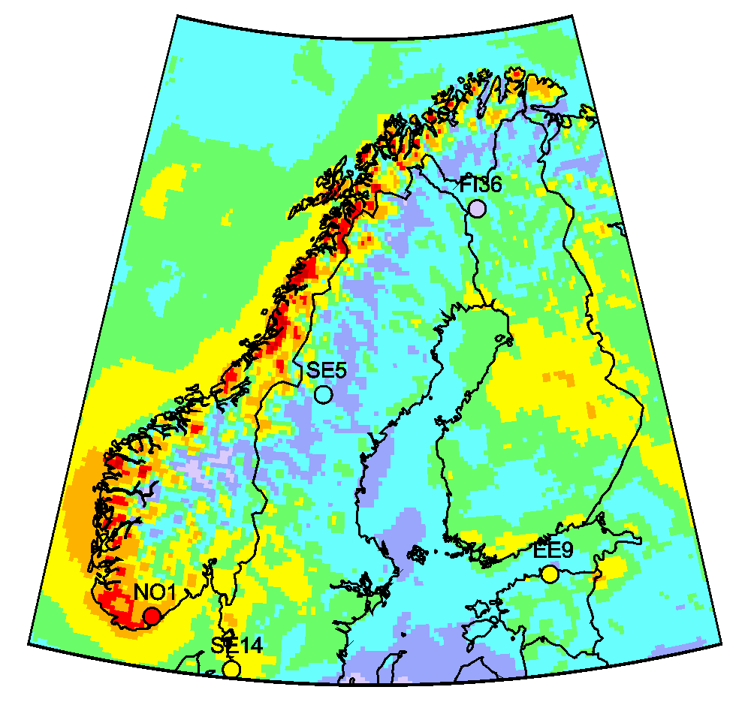
Case study: Hg pollution in Norway
EMEP/MSC-E contribution to the Norwegian Mercury Assessment 2022
Hg wet deposition (2015)
Contributors:
Norway: NILU, NIVA, NP, IMR, NEA, NIPH EMEP: MSC-E
Provided data and analysis:
Modelled spatial patterns of Hg levels in Norway and adjacent seas
Long-term trends (1990-2020) of Hg emissions, air concentration and deposition
Contribution to analysis of Hg levels and trends in biota (fish, bears, foxes)
Notes:
Results of this study were included to the Norwegian Mercury Assessment 2022. MSC-E collaborated with a number of national institutions providing data and participating in the analysis of
Spatial patterns of Hg levels in Norway and adjacent seas
Long-term trends of Hg emissions, concentration and deposition to the country
And contributed to study of Hg levels and trends in biota

Slide 5
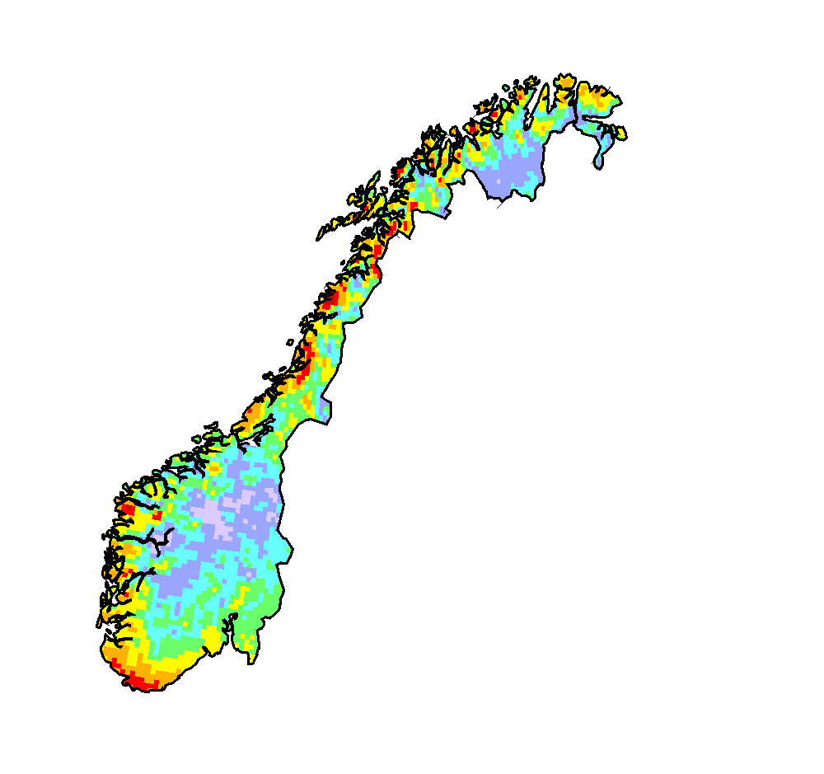
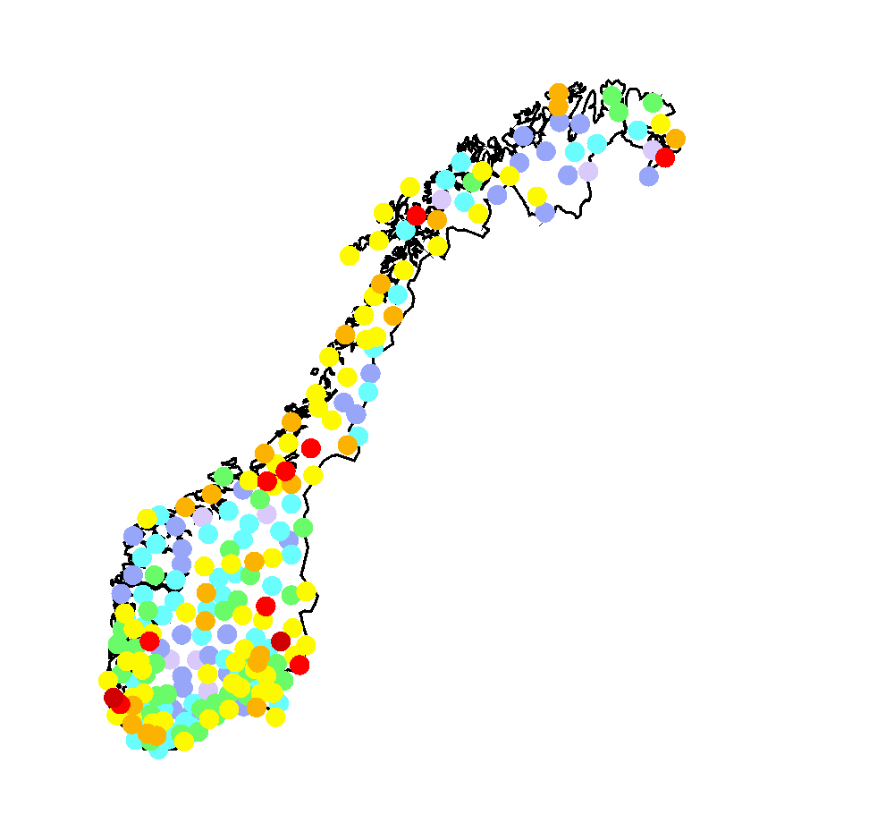
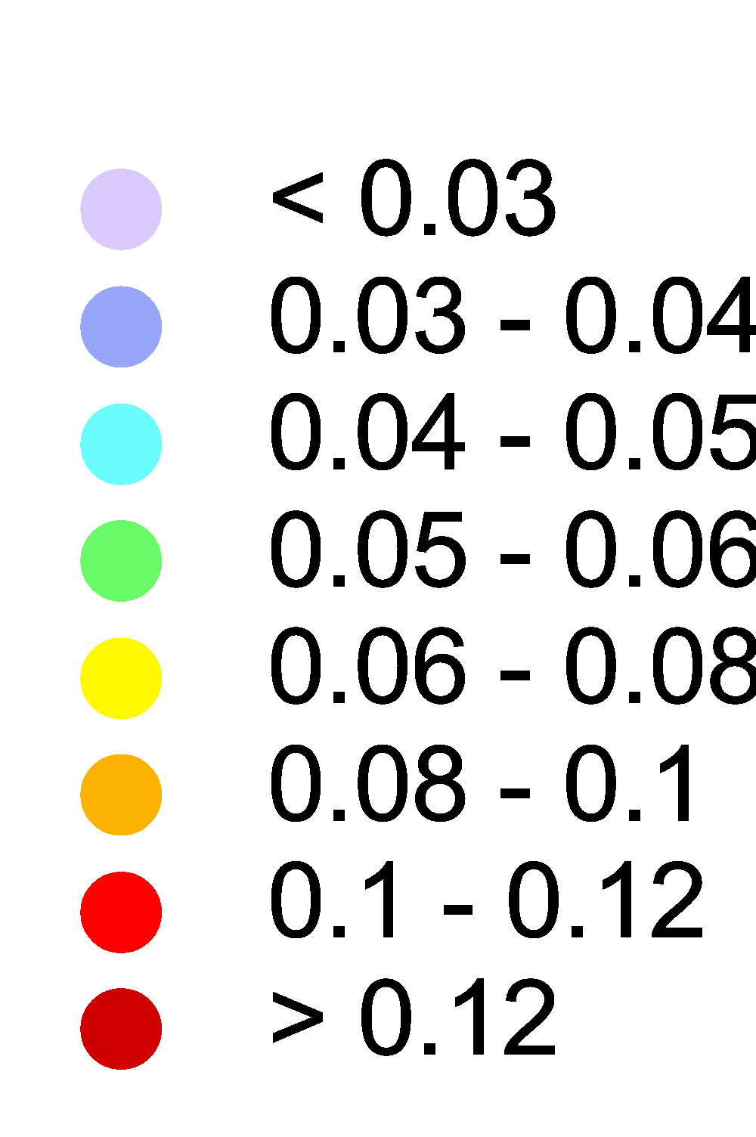
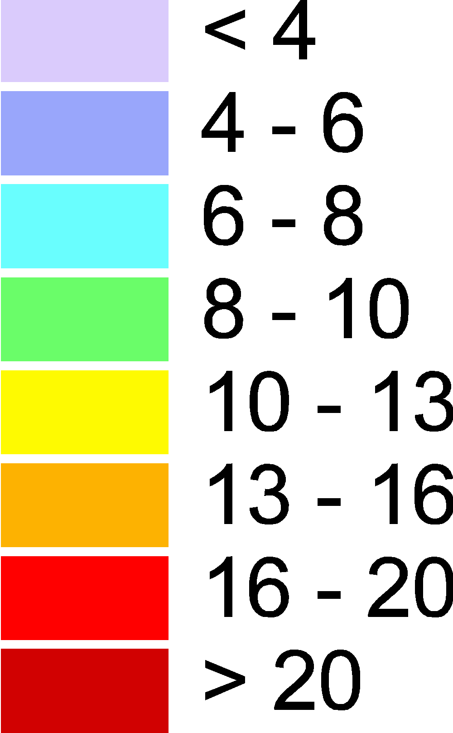
Case study for Norway: Spatial patterns of Hg deposition
Hg deposition (2015)
Hg in moss (2015)
Main features:
No significant north-south gradient of Hg deposition over the country
Elevated Hg levels over the southmost part of the country and along the coast
The lowest Hg deposition in the central and northern parts of the country
Discrepancies in spatial patterns of Hg deposition and Hg in moss require additional analysis
g/km²/y
μg/g
Notes:
Model analysis of the pollution patterns revealed:
No significant north-south gradient of Hg deposition over the country;
Elevated Hg levels over the southmost part of the country and along the coast;
The lowest Hg deposition in the central and northern parts of the country
In general the modelling results agree with measurements of Hg in moss performed by ICP Vegetation. However, there are some areas with significant discrepancies, which require further analysis.

Slide 6
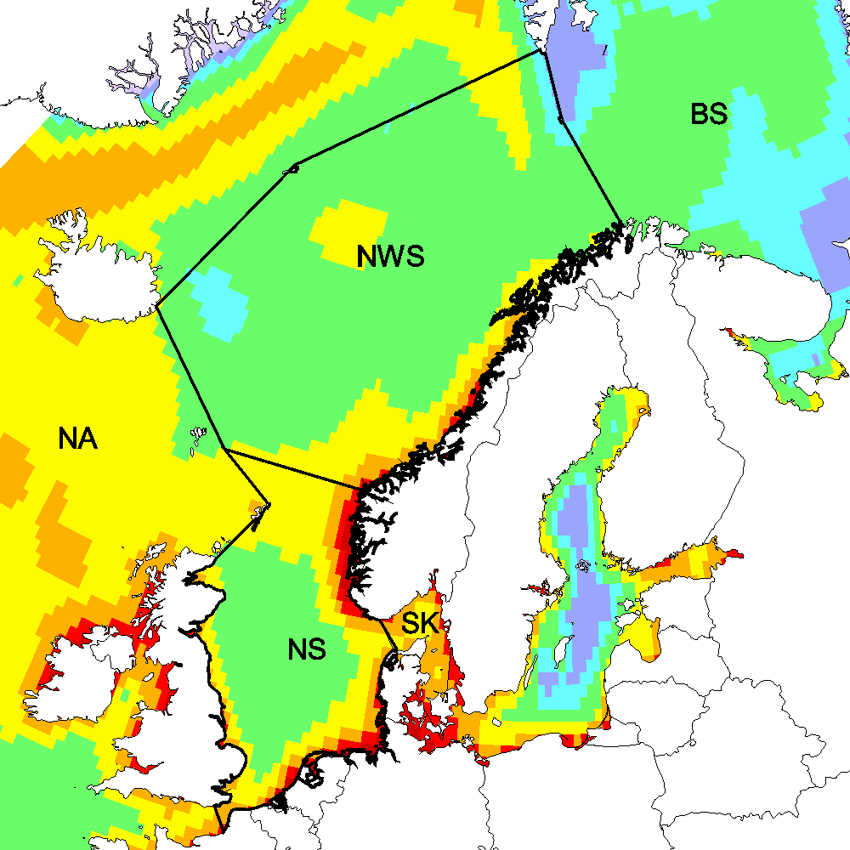
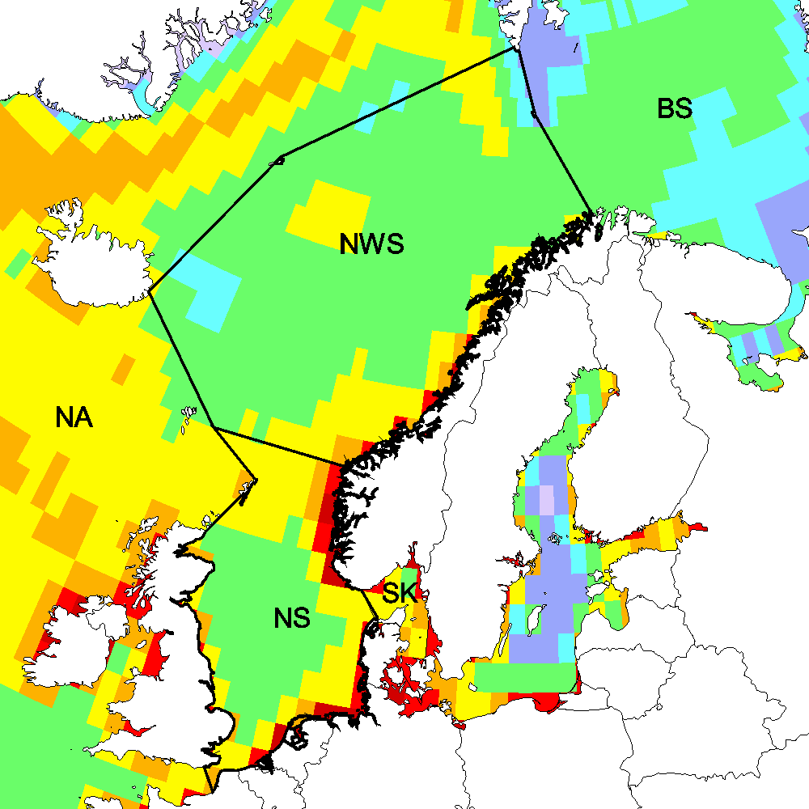
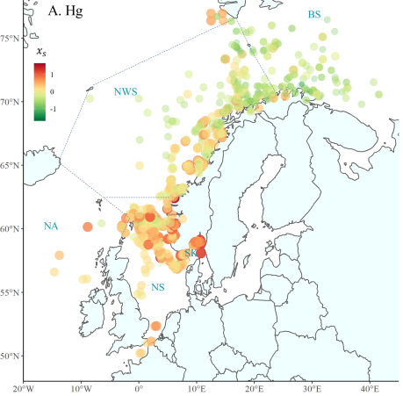
Case study for Norway : Hg deposition to aquatic regions
Hg deposition to the North East Atlantic (2015)
Hg concentration in marine fish (2006-2019)
Mean Hg deposition vs. Hg concentration in fish
Fish measurements
(Ho et al., 2021)
Note:
Hg levels in fish generally correlate with Hg atmospheric loads
Multi-model simulations
(GLEMOS, GEM-MACH-Hg, GEOS-Chem, DEHM)
Notes:
Spatial variation of Hg deposition to marine regions were also compared with Hg measurements in fish. The figures show comparison of spatial patterns of simulated Hg deposition and measured concentration in fish in the Northeast Atlantic and the Arctic. Mercury levels in fish generally correlate with Hg atmospheric loads with higher levels in coastal waters and the Northern Atlantic and lower levels in the Arctic. However, mercury levels in fish depend on many other factors that complicate the relationships. It is well seen in the analysis of long-term changes.

Slide 7
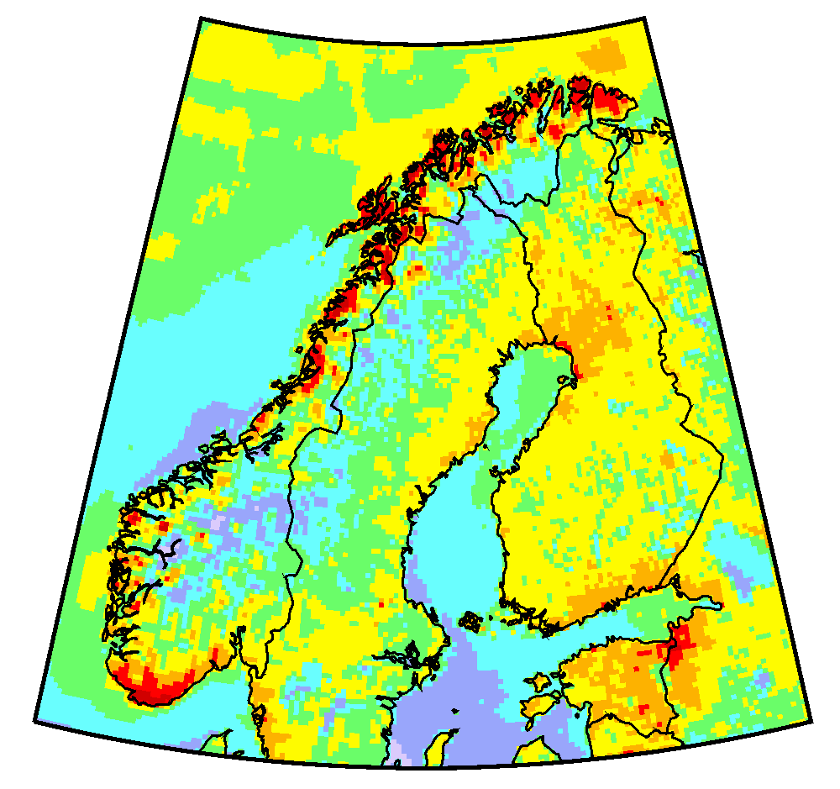
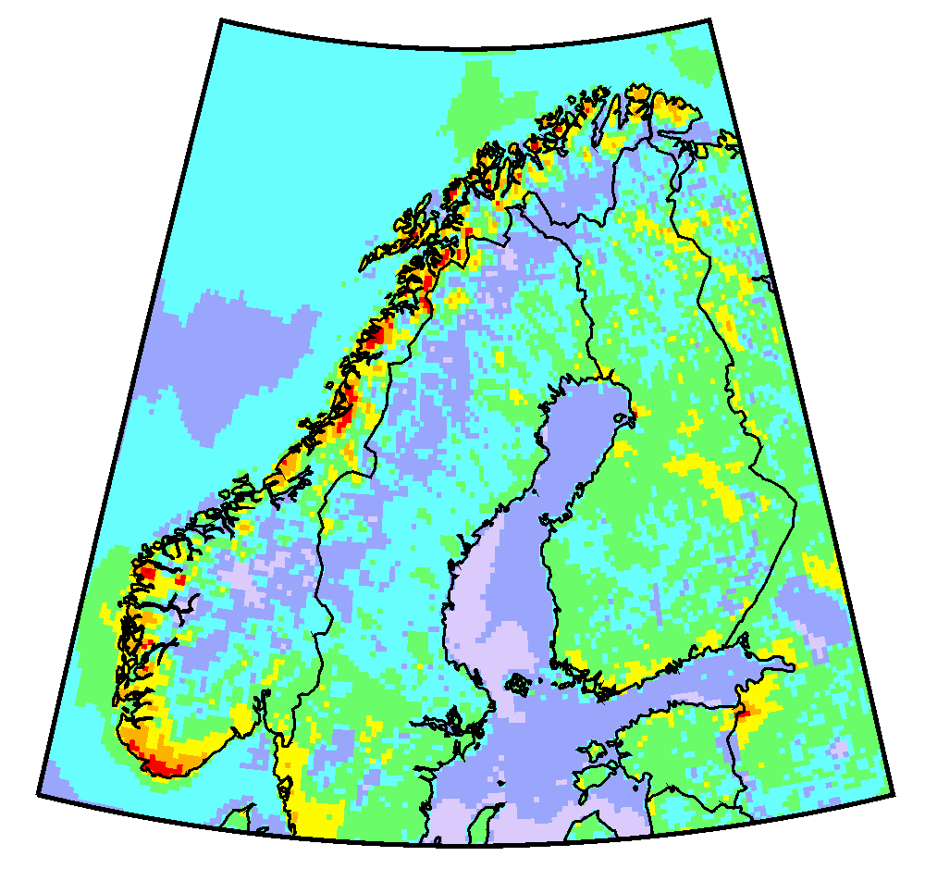
Case study for Norway : Long-term trends of Hg pollution
Hg deposition vs. Hg in fish (Greenland halibut )
Hg atmospheric deposition (GLEMOS)
2000
2015
Hg wet deposition (Birkenes/Lista)
Note:
Reduction of Hg levels in fish is stronger than decrease of Hg deposition
Notes:
Both modelling results and Hg atmospheric measurements show relatively small reduction of Hg deposition over past 30 years because of significant contribution of global mission sources, which has been changing slowly. In contrast, mercury levels in fish have decreased rapidly over the past 10 years. The reason for that could include such factors as food web complexity, individual diet, and fish migration.

Slide 8
Further directions of Hg research
Further study of Hg atmospheric chemistry in co-operation with other research groups
  Numerical experiments with new proposed Hg redox pathways and gas-particle partitioning
  Development of a new Hg chemical scheme for the GLEMOS model
Multi-model studies (global and regional) of Hg processes and cycling (in co-operation with TF HTAP)
  Review and evaluation of new global Hg emission inventories and projections
  Model experiments of Hg air-surface exchange and secondary emissions

Slide 9
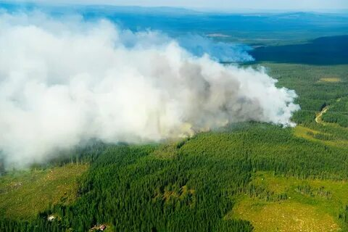
Effect of natural wildfires on B(a)P and heavy metal (Pb) pollution levels in the EMEP region
Motivation:
Large contribution of PM to the atmosphere because of wildfires
Potentially significant source of POPs and heavy metals
Objectives:
Overview of available data bases on wildfires
Evaluation of heavy metal and POP emissions from wildfires in the EMEP region
Simulation of the effect of the wildfires on pollution levels in the EMEP countries

Slide 10
Global biomass burning emission datasets
Data set | Spat. Resol. | Time range | Data products
GFED4s | 0.25°x0.25° | 2000-2020; 3-h, daily, monthly | Burned area; Burnt mass; Emission factors, incl. PM2.5
FINN | 1 km² | 2002-2020; Daily | Burned area; Burnt mass; Emissions of species, incl. PM2.5
GFAS1.2 | 0.1°x0.1° | 2003-present; Daily | Combustion rate; Burnt mass; Emission of species incl. PM2.5; Injection height
QFED2.4 | 0.1°x0.1° | 2000-present; daily, monthly | Emission of species incl. PM2.5

Slide 11




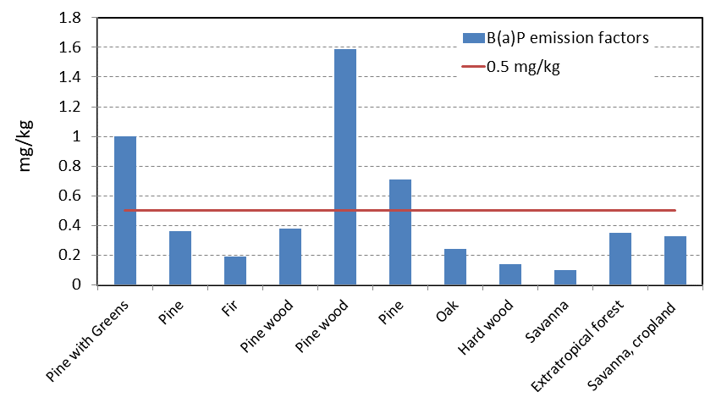
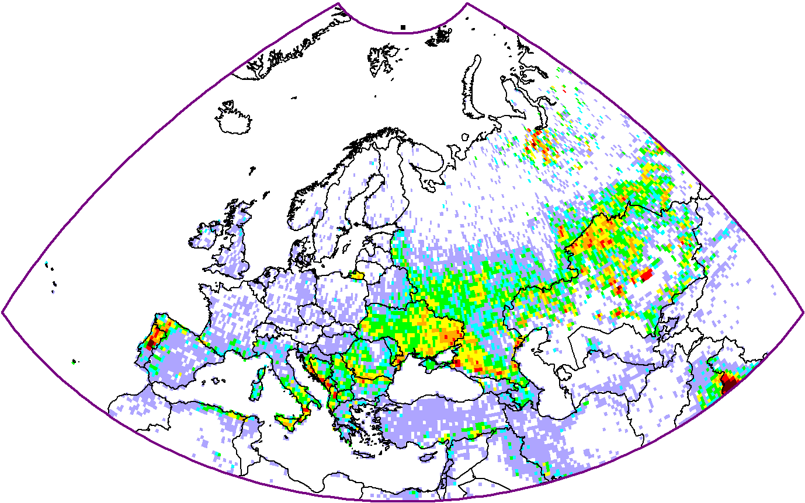
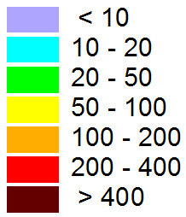
Approach to estimate emissions of B(a)P from wildfires
Wildfire emissions in the EMEP region in 2010-2020 (FINN data)
- B(a)P emission from wildfire;
- Burnt biomass;
- Emission factor
B(a)P emission factors (literature data)
Burnt biomass (FINN, 2017)
kt/y
Luo J. et al., 2020; Shen et al., 2013; Lammel et al., 2013
0.5 mg/kg used to estimate B(a)P emissions

Slide 12
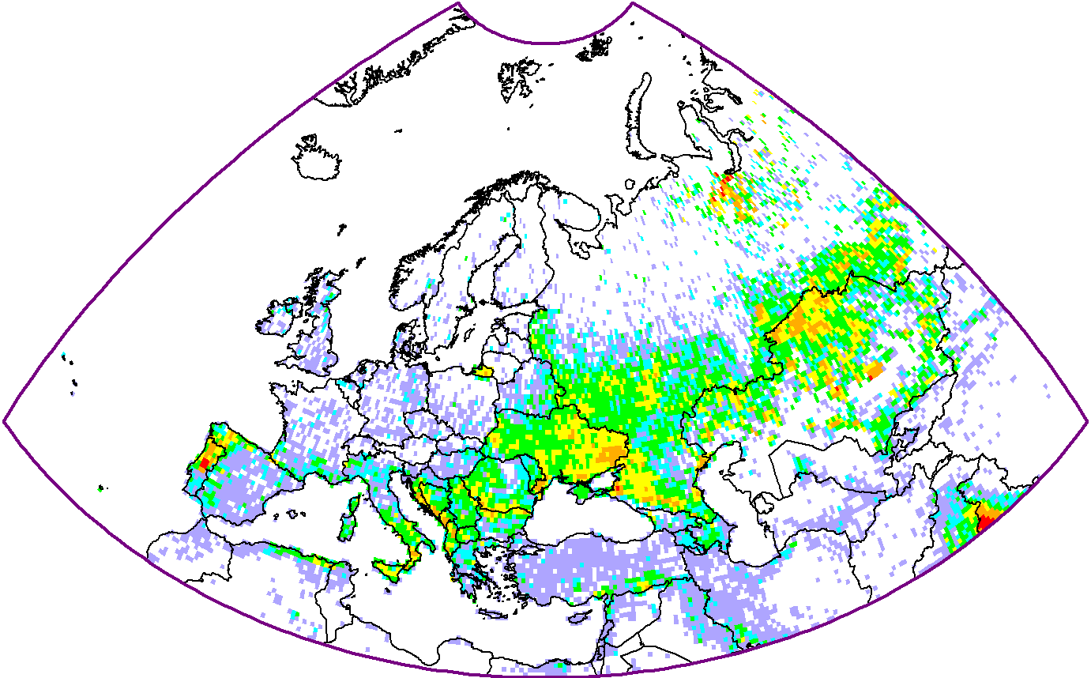
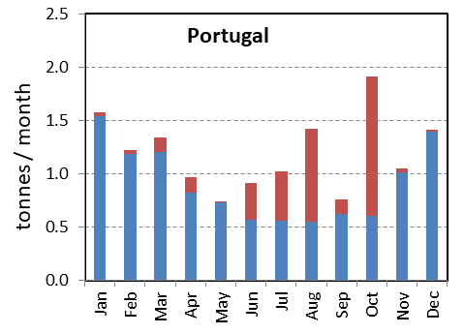
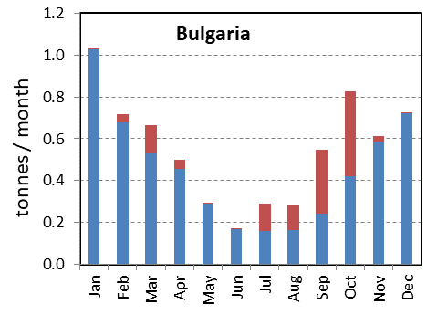
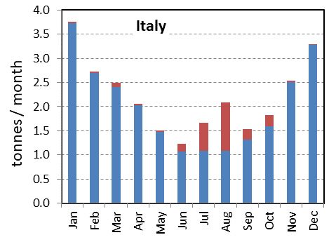
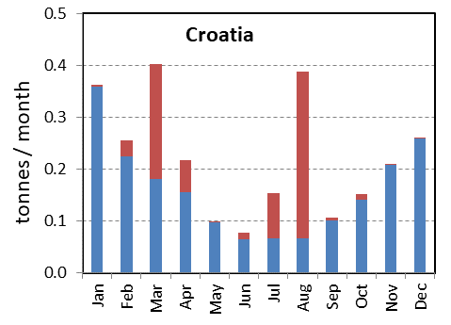
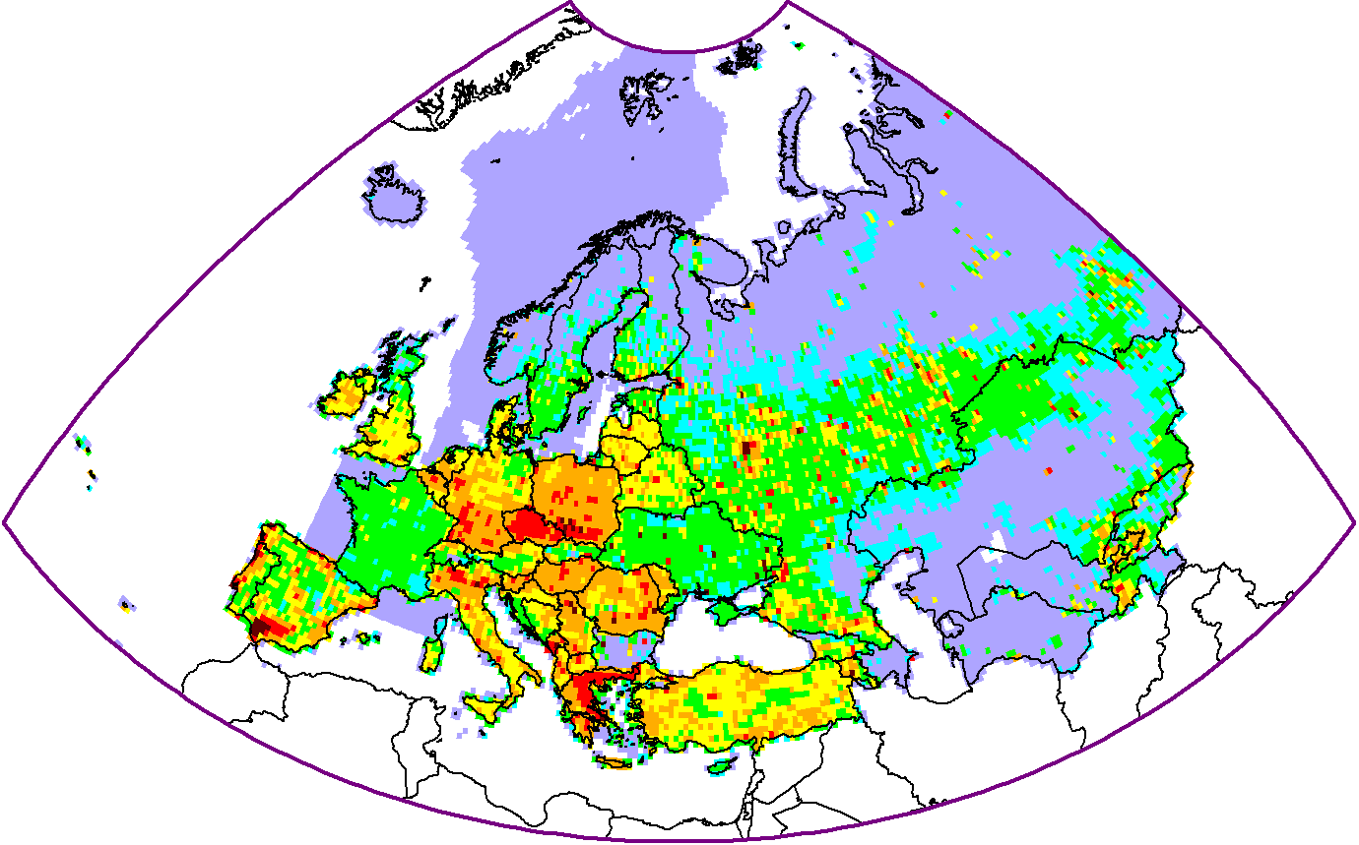
B(a)P emission from wildfires and anthropogenic sources in 2017
Annual emissions
Monthly emissions
Wildfire
Anthrop.
emission
Anthrop. emission
Wildfire emission
Low/moderate annual contribution for EMEP region (2% – 30% in S. and S-E. Europe)
High contribution in particular countries and months
2
5
20
50
150
500
g/km²/y

Slide 13
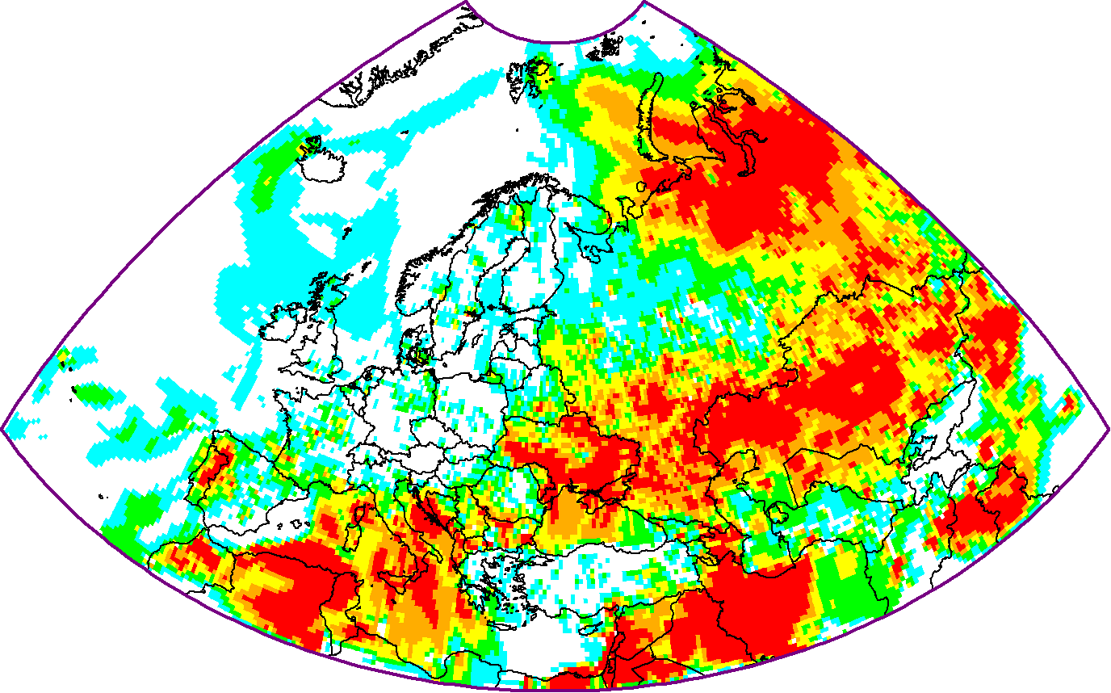
Effect of wildfires on B(a)P pollution levels (preliminary results!)
Contribution (%) of wildfires to B(a)P concentrations (August, 2017)
B(a)P concentration (anthrop. sources)
B(a)P concentration (contribution from wildfires)
Observed CO conc.
1
5
15
30
50
%
Observed PM2.5 conc.
Contribution to annual mean B(a)P concentration 5 – 20% in southern Europe and 20 – 50% in Eastern Europe and Central Asia
Further sensitivity tests, e.g., to vertical distribution, emission factor etc. are needed

Slide 14



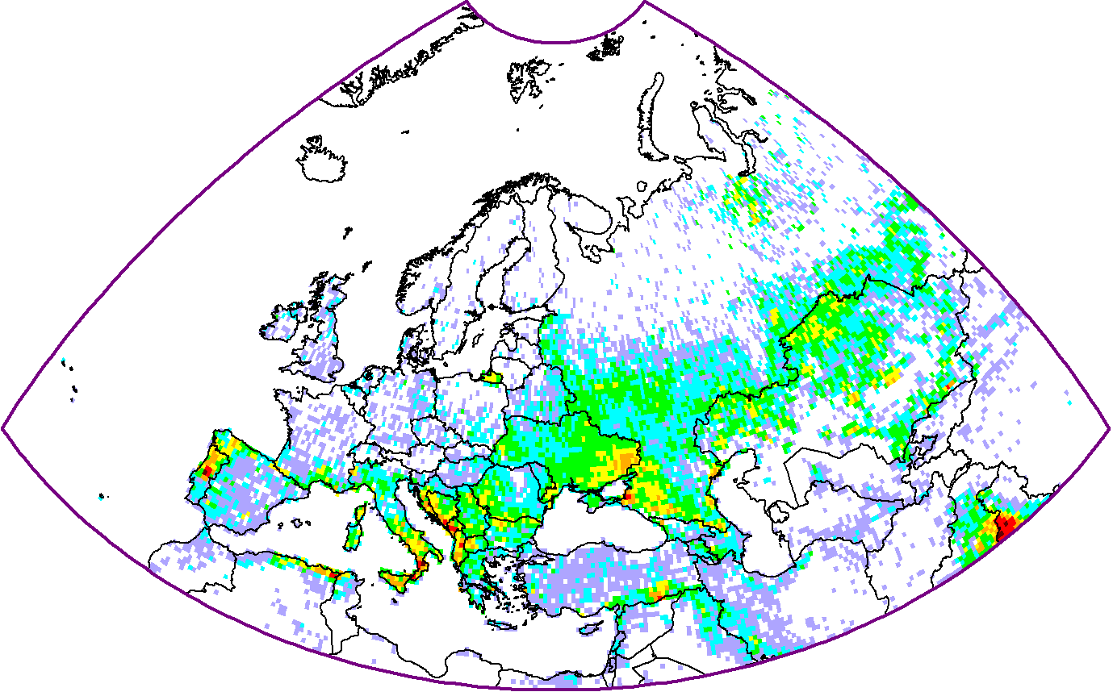
Pb emission from wildfires in 2017
Monthly emissions
- HM emission from wildfire;
- PM2.5 emission from wildfires;
- HM concentration in ash or air (plume)
Wildfire emission
Anthrop. emission
Wildfire emission
Low annual contribution for the EMEP region
High contribution in particular countries and months
1
5
20
50
150
500
g/km²/y

Slide 15
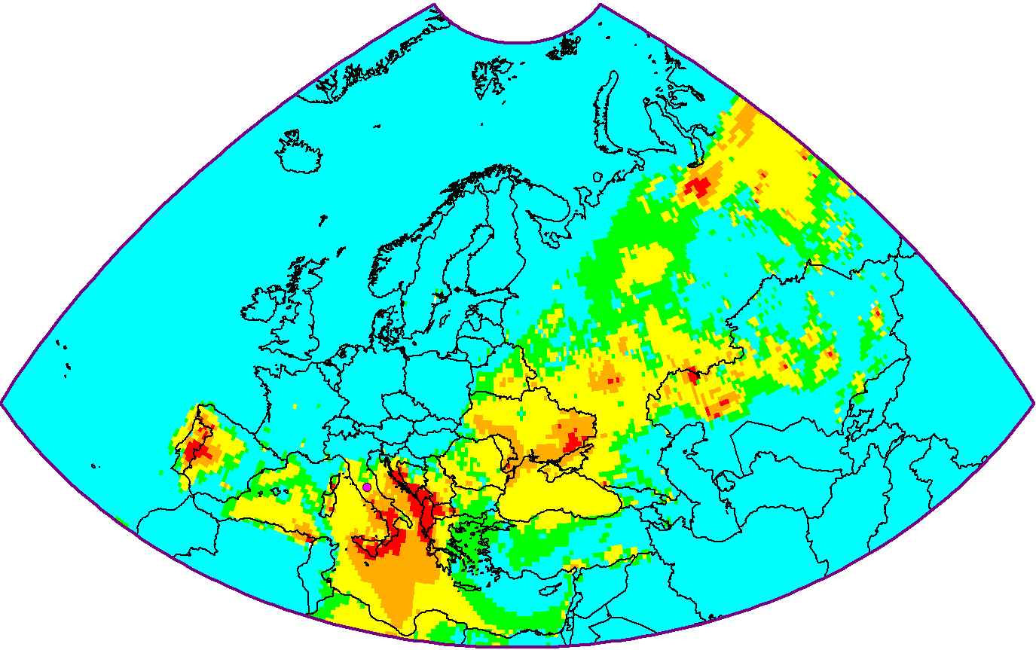
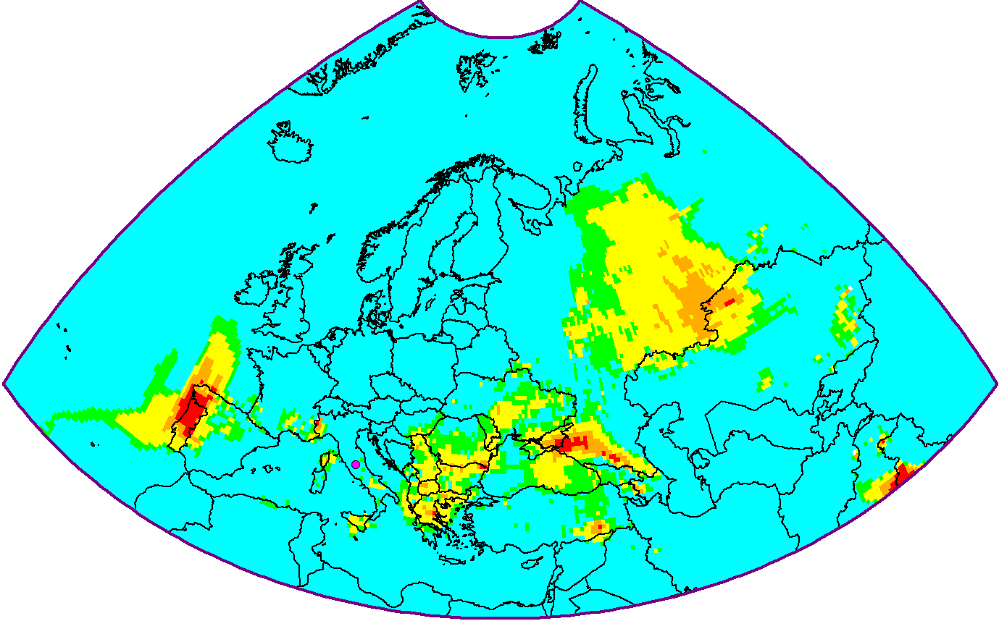
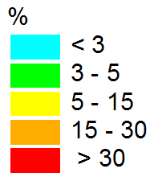
Effect of emissions from wildfires on Pb pollution levels
Contribution (%) of wildfires to Pb concentrations in 2017
August
October
Modelled Pb concentration from wildfires
Observed CO concentration
Observed PM2.5 concentration
Contribution of wildfires exceeds 30% in particular countries and months

Slide 16
Further research (wildfires)
Wildfires may have noticeable effect on heavy metal and POP levels
Testing other databases on wildfire emissions
Sensitivity study to input parameters (vertical distribution, emission factors, etc..)
Involve more measurement data on wildfire tracers for verification purposes
Expand the approach to other heavy metals and POPs

Slide 17
Contaminants of emerging concern (CEC)
Motivation:
Adverse effects on human health and ecosystems similar to the legacy POPs
Persistence in the environment and potential for long-range transport
CEC are targeted by a number of international organizations
HCBD, octa-BDE, PeCB, PBDE, PFOS, PCN and SCCP were included in the Protocol on POPs in 2009, HBCDD is a candidate for including
CLRTAP
HELCOM
Stockholm Convention
OSPAR
CEC
AMAP
ECHA
OECD
WHO

Slide 18
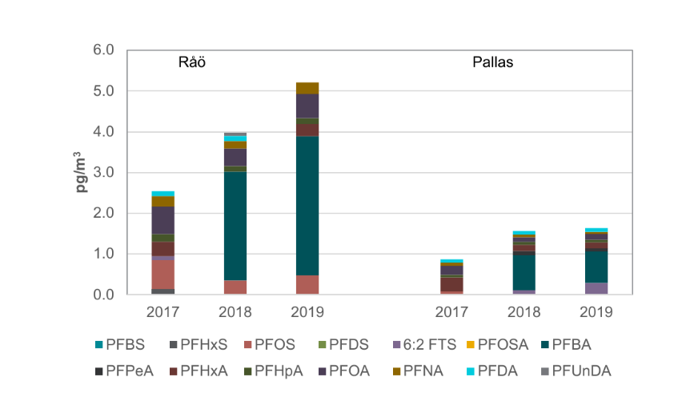
Monitoring of CEC
The EMEP monitoring strategy for 2020-2029 includes recommendation to monitor some of CEC
Data on CEC levels were reported from 8 EMEP sites since 2006
Data on CEC were also reported by national monitoring programmes (e.g. Norway, Sweden, Finland)
Increasing trends were detected at a number of sites in recent years (e.g., for PFAS components)
Observed air concentrations of PFAS components in 2017-2019 at stations Råö and Pallas
[Nationell luftövervakning, Sakrapport med data från övervakning inom Programområde Luft t.o.m 2019]

Slide 19
Emission of CEC
Guidance on preparation of CEC emission inventories being developed under the Stockholm Convention
Although CEC official EMEP emissions are not ready yet, a number of research-oriented inventories of regional and global emissions are available
Contaminant | Extent | Media | Data products | Ref.
PBDE, PCN, PeCBz, SCCP, dicofol, endosulfan, PCP, HCBD | UNECE-Europe | Air | Gridded sectoral emissions for 2000 | Denier van der Gon et al., 2005, 2007
PFOS | Global | Air | Totals for 1958-2030 | Wang et al., 2017
SCCP | Global | Air, surface water, soil | Totals for 1935 - 2015 | Glüge et al., 2016

Slide 20
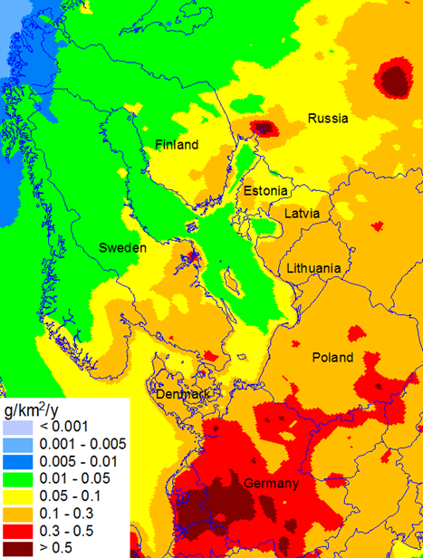
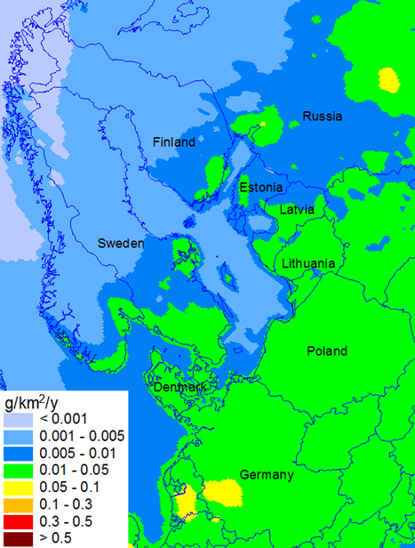
Model assessment of CEC
Modelling of BDE-99 deposition to the Baltic Sea (for HELCOM)
BDE-99 deposition
Modelled vs observed BDE-99 concentrations in air and in mosses at the EMEP station Birkenes
2000
2019
Obs. air conc.
Mod. air conc.
Conc. in moss
Preparatory work for modelling of other CEC (PFOS, SCCP, PCN, PeCBz, HBCDD):
review of sources and use
collection of monitoring data and emission inventories
collection of information on phys-chem. properties and modelling approaches

Slide 21
Potential directions of further research on CEC
Collaboration in the development of methodologies to estimate CEC emissions between EMEP and international organizations (e.g. UNEP Stockholm Convention, AMAP, HELCOM, and OSPAR) is essential for further progress in the assessment of CEC pollution.
Further collection of information on properties and fate of CEC in environmental media
Monitoring of CEC: measurements of a wider list of CEC at a larger number of EMEP sites, as well as evaluation of long-term trends, are needed
For some CEC, it is possible to use modelling approaches which were developed for the legacy POPs. At the same time, for number of CEC, other modelling approaches can be required
Workshop on CEC measurements and modelling in co-operation with TFMM and TF HTAP (2023)

