Slide 1
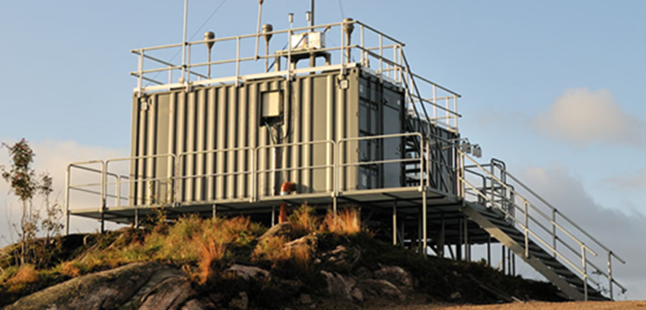
Update from EMEP-CCC, with focus on open data and «FAIRness»
EMEP-TFMM Web meeting, 3. May 2022
Kjetil Tørseth (kt@nilu.no)

Slide 2
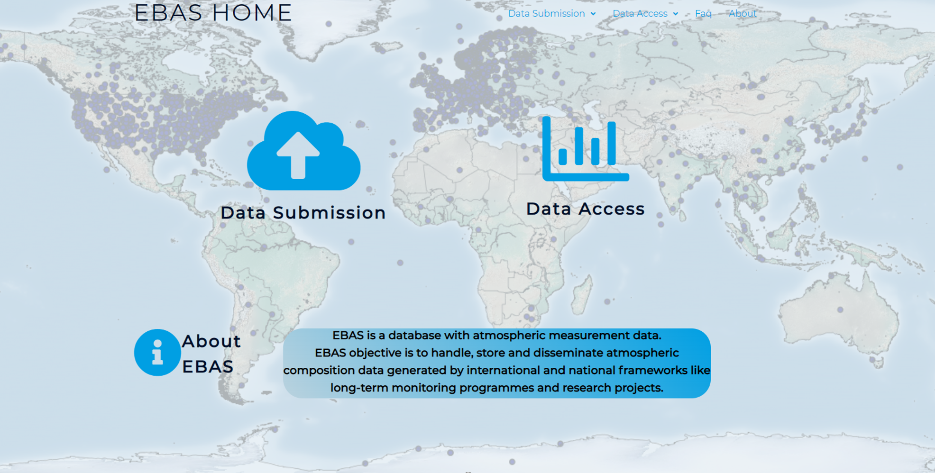
http://ebas.nilu.no

Slide 3
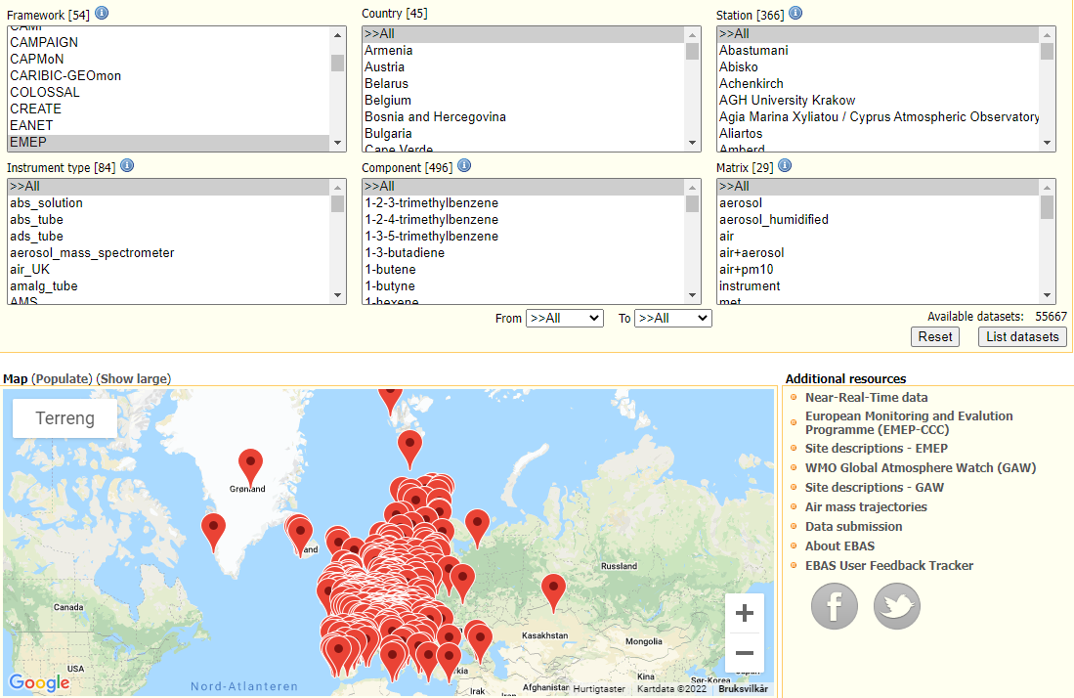

Slide 4
Access to data, statistics, aggregates, plots, maps, interpretations:
1) Generation of reports for higher level users
2) Self-service through web interface
3) Data on request to EBAS@nilu.no (NASA-Ames, NetCDF)
4) Machine to machine; data or metadata services
Services up and runnning
Copernicus/ECMWF
GEO Portal and NextGEOSS
SIOS
ACTRIS data portal
WMO WIS
MSC-W/AEROCOM
Services in development/implementation:
EOSC through ENVRI-FAIR
WMO – WIGOS
DOI-service: operational 2022
Licensing of data

Slide 5
Findable – Accessible – Interoperable - Resuable

Slide 6
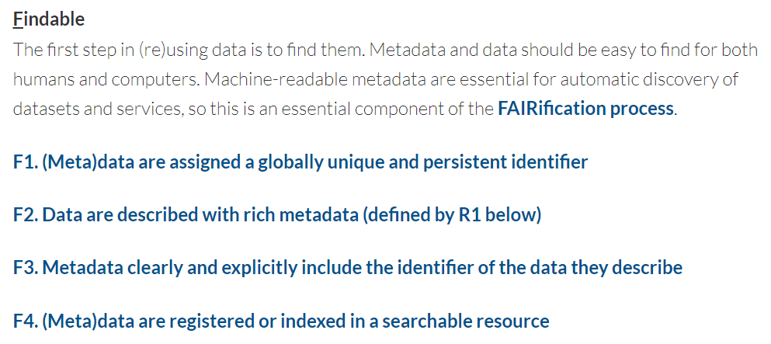

Slide 7
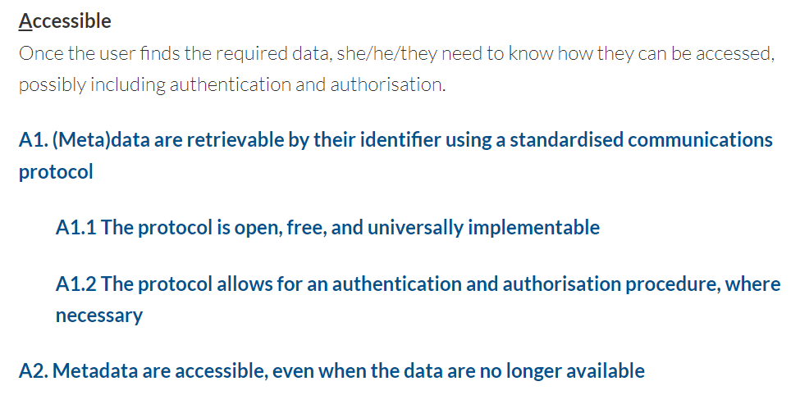

Slide 8
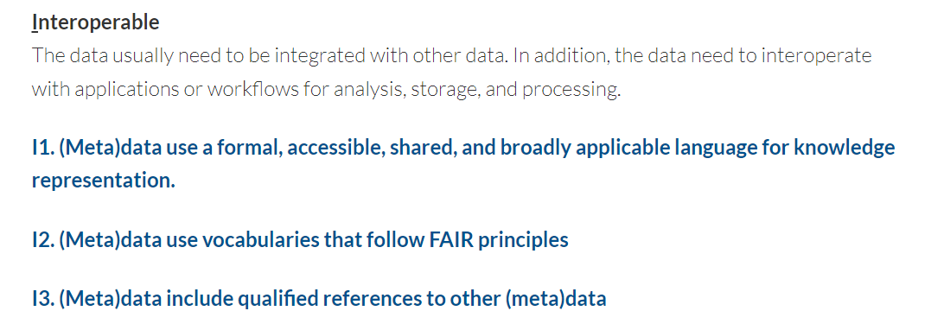

Slide 9
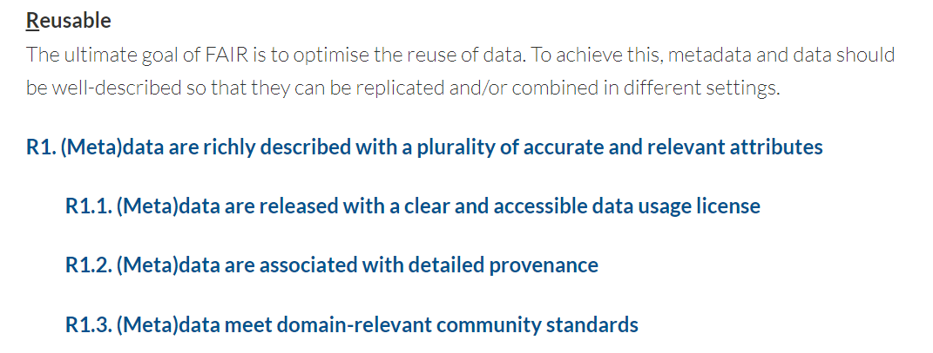

Slide 10
PID/DOI
Persistent Identifier e.g. Digital Object Identifier (DOI).
https://doi.org/10.21336/gen.h8ds-8596

Slide 11
Types of DOIs in EBAS
Primary DOI: granularity is by data submission
Secondary:
Submission series
Customized DOIs (extract DOIs)
Generic secondary DOIs (collection of DOIs)

Slide 12
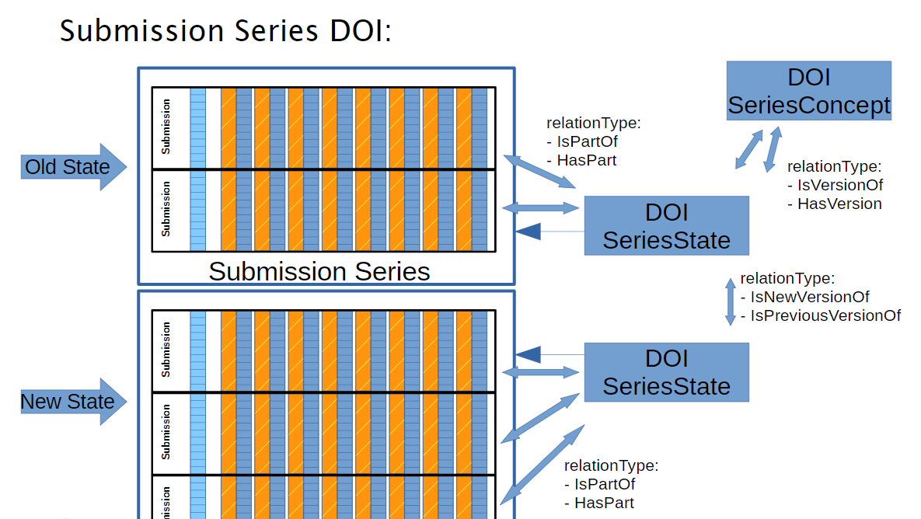

Slide 13
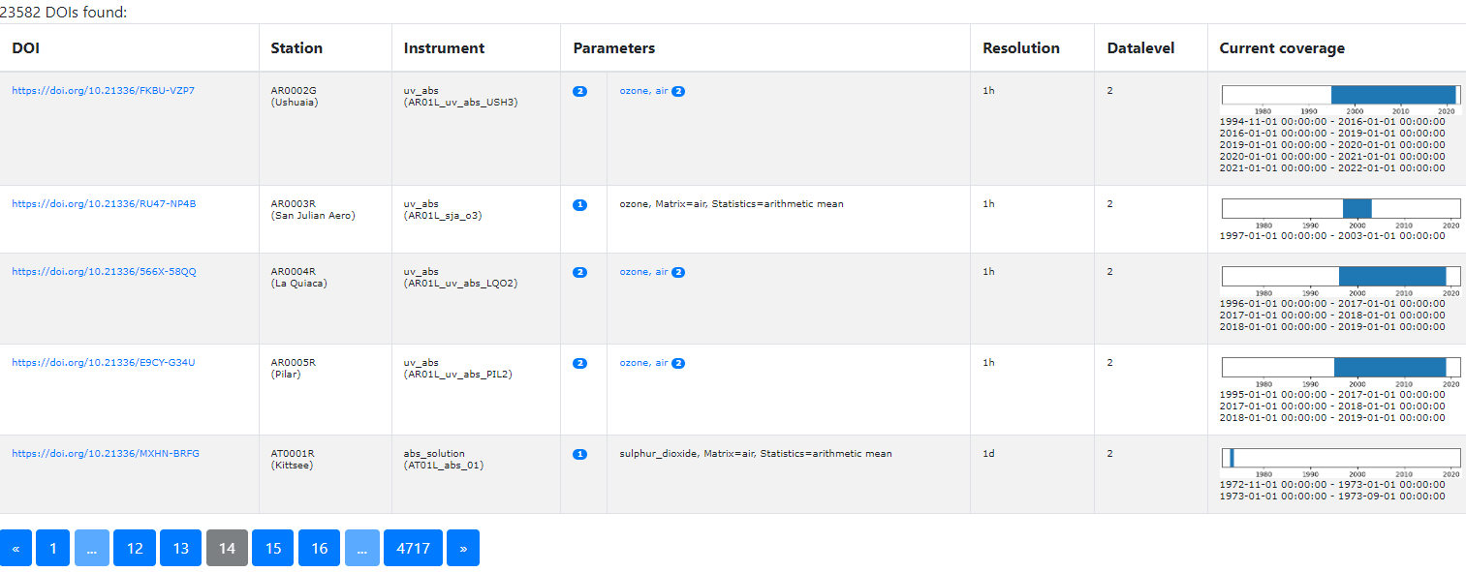

Slide 14
Licencing of data - Benefits of licencing for data providers, data centers, organisations and users - set regulations on data use - reserve against any form of liability - FAIR
- Creativity and IPR rights - generally no IPR rights on «objective data» - funding support does not generate IPR - «Sui generis database rights»
- Creative Commons is a commonly used licence - CC0 (no attribution) or CC BY4 (attibution required) - «Attribution» is not seen as a limiting condition towards «open data»

Slide 15
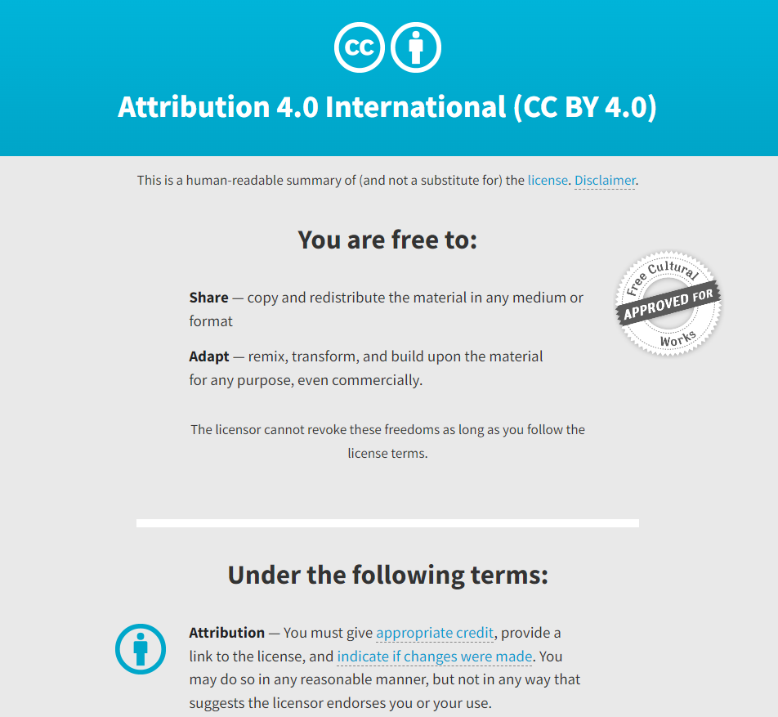
https://creativecommons.org/licenses/by/4.0/

Slide 16
Licencing
NILU wish to (based on our «sui generis database rights») licence all open data in EBAS:
CCBY4 with attribution to EBAS/NILU and EMEP/GAW/ACTRIS (frameworks),
and
a recommendation of contacting data originators when the use of data will benefit from their involvement (substantial use)
ACTRIS will use CCBY4, probably also GAW (discussions ongoing).

Slide 17
EMEP-CCC will prepare a note as a basis for a discussion at the coming EMEP Steering Body

Slide 18
ACTRIS – to be established this year

Slide 19
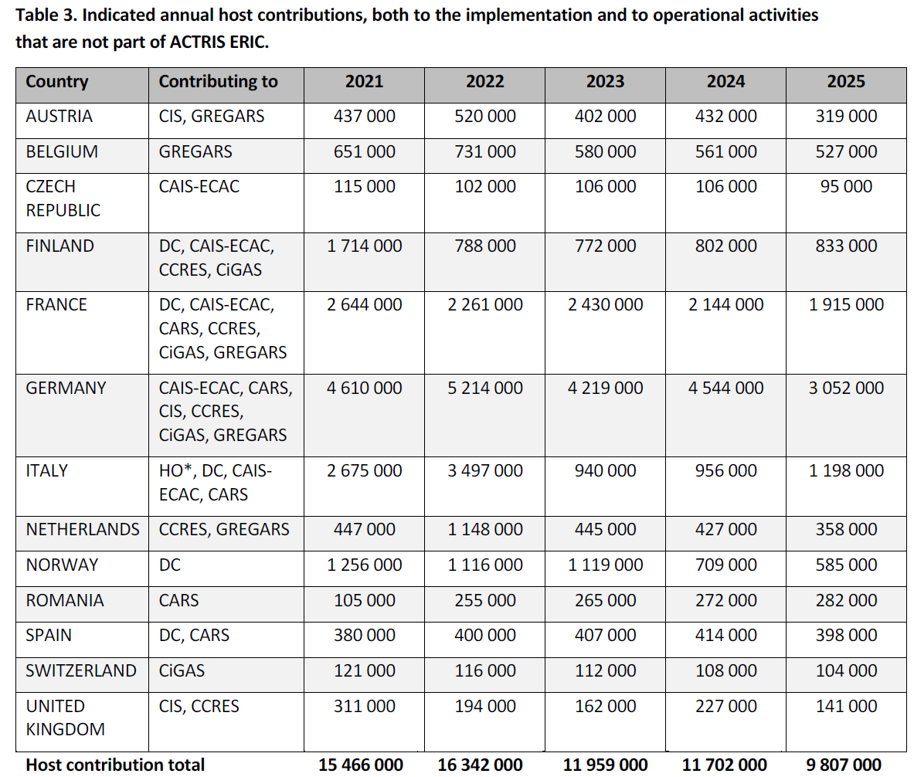
ACTRIS ERIC will be established in 2022
Labeling of National Facilities
Large overlap with EMEP/GAW

Slide 20
«Pilot study of added value of NRT-delivery of EMEP and ACTRIS QAQC’ed NO2 and O3 data, vs EEA data delivery»
In prep: Call to be expected soon!

Slide 21
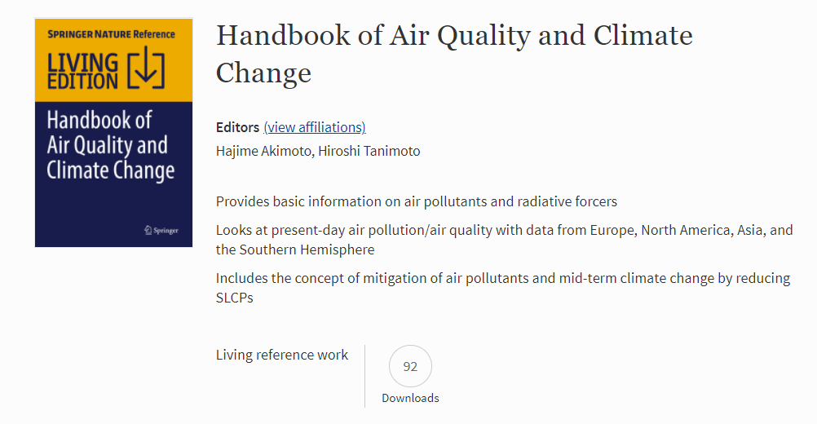
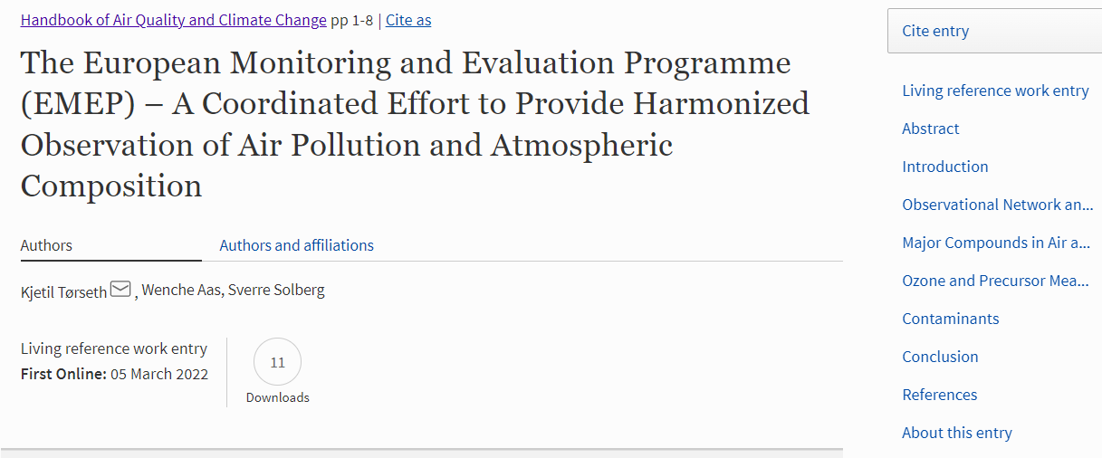
https://link.springer.com/referenceworkentry/10.1007/978-981-15-2527-8_10-1

Slide 22
Chemicals of Emerging Concern, workshop planned for 2023

