Slide 1
Forum for International Cooperation on Air Pollution
FICAP or 'The Forum'
John Salter - John.Salter@Defra.gov.uk
Anna Engleryd - Anna.Engleryd@swedishepa.se
Petra Hagström - Petra.Hagstrom@swedishepa.se
1

Slide 2
Background - Vision and Aims
Vision: To promote international collaboration towards preventing and reducing air pollution to improve air quality globally
Aim: To act as a forum for international exchange and mutual learning, to facilitate the sharing of science, technical and policy expertise internationally
2

Slide 3
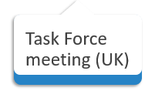
2022 – 2023 Workplan ambition
Website
Forum event (Sweden)
Summer 2022
Autumn 2022
Winter 2022
Spring 2023
2023
Outreach and engagement
Toolkits
3

Slide 4
Current activity
Presenting at meetings of ICPs and Task Forces under CLRTAP
Planning first Taskforce meeting between 10 – 12 October, Bristol, UK
Outreach and collaboration with other organisations and forums
Translation of convention documents identified as having global interest
4

Slide 5
First Task Force Meeting - UK
10-12th October 2022 in Bristol, UK
To help the Chairs set direction for the Forum.
To provide input into the topics for discussion and cooperation at the Forum.
To plan and support efforts to encourage a wide participation of Countries and interested experts to the Forum.
5

Slide 6
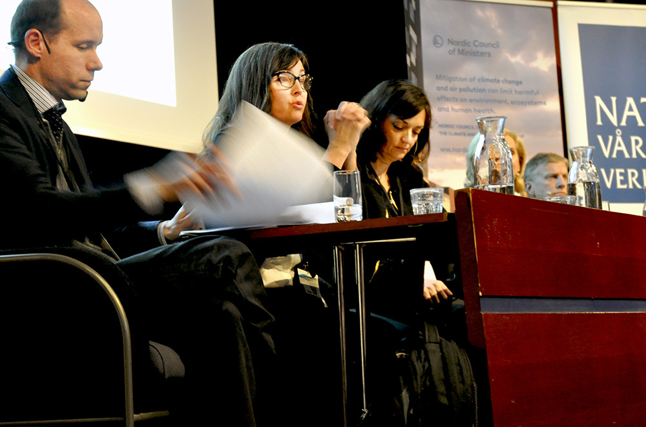
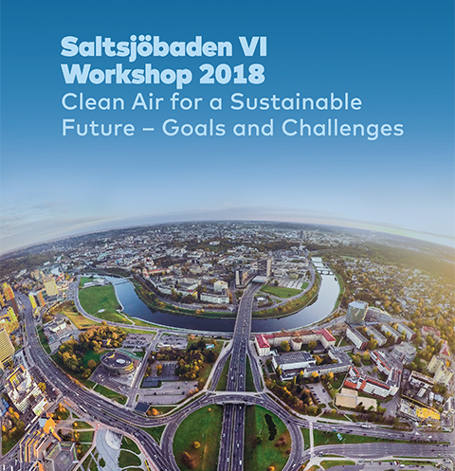
First Forum meeting 2023 – Sweden
Linked to the March 2023 Saltsjöbaden Workshop – Sweden
Aim to have an in-person event open for cooperation and collaboration
6

Slide 7
Discussion and suggestions in the chat:
What capacity building work is currently happening under the Task Force on Measurement and Modelling?
Do you see areas of collaboration between TFICAP and TFMM to reach outside UNECE?
Are there any materials/tools that TFICAP should be promoting from TFMM?
7

Slide 8
Get in contact
John Salter - John.Salter@Defra.gov.uk
Anna Engleryd - Anna.Engleryd@swedishepa.se
Petra Hagström - Petra.Hagstrom@swedishepa.se
8

