Slide 1
Trends in PM_{2.5} and chemical components at the French EMEP sites
Anna FONT, Aude BOURIN, Corentin GOUILLOU, Cécile DEBEVEC, Stéphane SAUVAGE
5 May 2022
23rd EMEP Task Force on Measurements and Modelling (TFMM)

Slide 2
Background
Fine particles (PM_{2.5}) are well-known to have an impact on climate, ecosystems as well as human-health
Background sites in western and central Europe exceeding the WHO limits (5 µg m⁻³ as annual limit; 15 µg m⁻ ³ as daily mean) (Bressi et al., 2021)
Chemical composition of PM_{2.5} essential to assess the sources contributing to mass concentrations
In France, five background sites monitored PM_{2.5} mass concentrations and chemical composition between 2014 – 2020
Temporal trends in PM_{2.5} is a common tool to evaluate changes over time and assess the impact of any possible policy aiming to reduce primary emissions
Trends in atmospheric components not only influence by changes in emissions but also changes in meteorology and transport patterns that might occur

Slide 3
Aims
To undertake the chemical mass balance of PM_{2.5} mass concentrations based on the main ions along the years at the five remote sites monitoring PM_{2.5} and chemical composition in France in 2014 – 2020.
  To review conversion factors used to calculate source concentrations especially that used to account organic matter (OM) from organic carbon (OC)
To evaluate trends in PM_{2.5} concentrations in association with changes in emission patterns removing any possible influence from meteorological and long-range transport characteristics

Slide 4
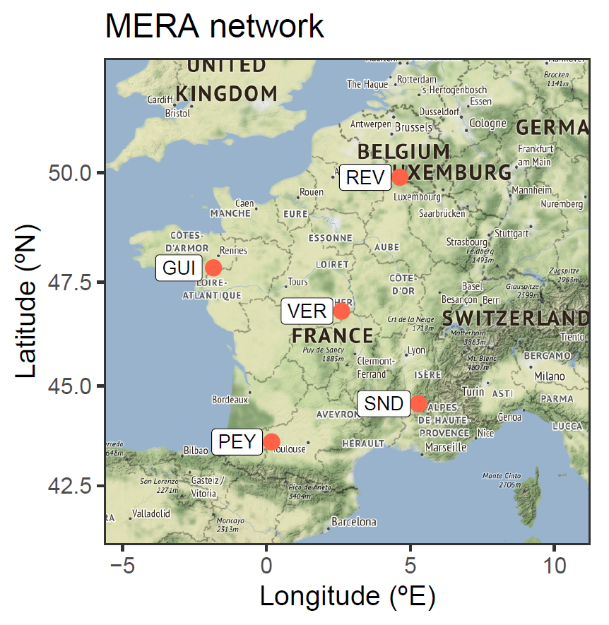
French EMEP network (MERA): PM_{2.5} chemical composition
MERA / EMEP sites where PM_{2.5} chemical composition is available for 2014 - 2020
PM_{2.5} hourly mass concentrations (TEOM, TEOM-FDMS, BAM, FIDAS)
Daily chemical composition every 6th day (14% year)
  quartz filters (Pallflex Tissuquartz 2500 QAT-UP, 47 mm in diameter) + Partisol 2025i
  OC & EC measurements: punch of 15 cm² is analysed by the Sunset instrument following EUSAAR2 protocol
  Ca²⁺, K⁺, Mg²⁺, Na⁺, NH₄⁺; and Cl⁻, NO₃⁻, SO₄²⁻ : digestion in pure water of a punch of 15.85 cm² and analysis ion chromatography
  Monthly field blanks; averaged by season and removed from filter measurements except for OC & EC
  No LOD correction applied

Slide 5
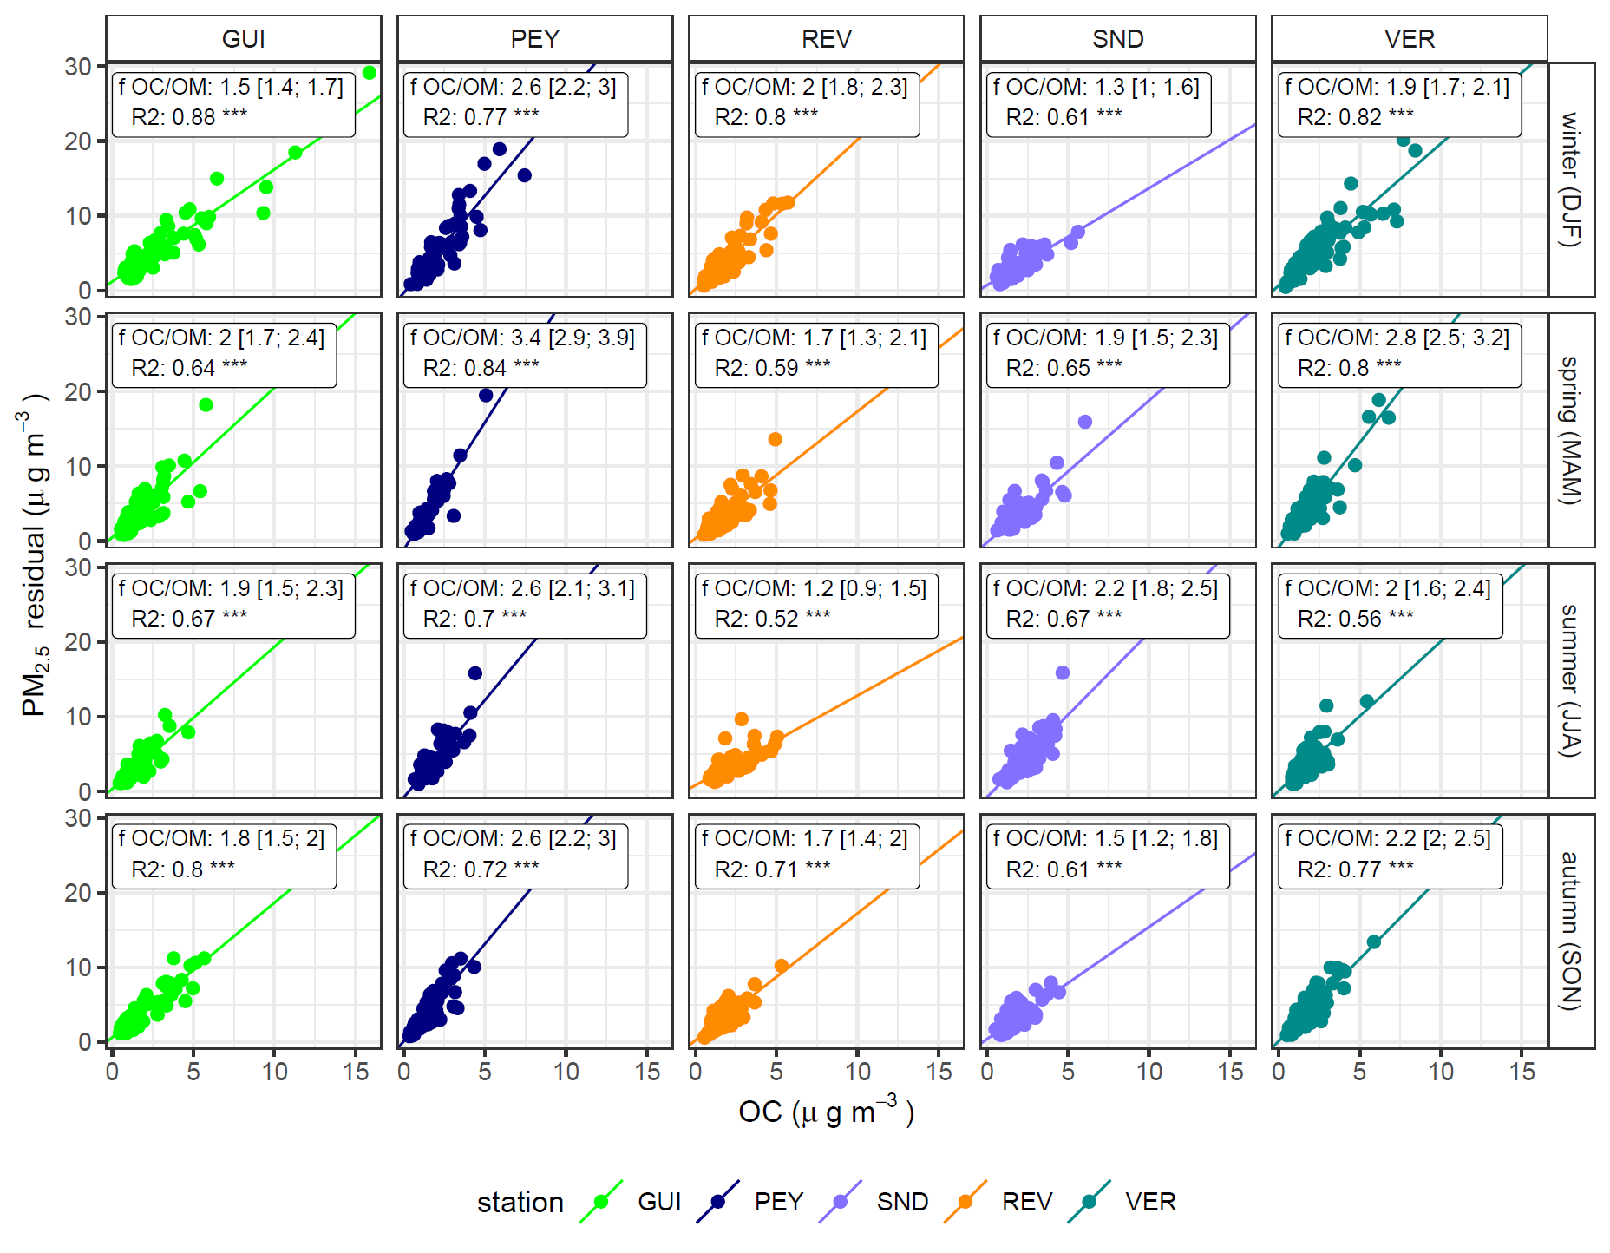
Mass closure calculations and OC to OM conversion factor
PM_{2.5} = [OM] + [EC] + [SIA] + [sea salt] + [mineral dust] + [trace elements] + ɛ (1)
[SIA] = [NO₃⁻] + [nss-SO₄²⁻] + [NH₄⁺] (2)
[OM] = f_{OC:OM} * [OC] (3)
Determination of f_{OC:OM} by site; and by season and site:
f_{OC:OM} = ([PM_{2.5}] – ([EC] + [SIA] + [sea salt] + [mineral dust] + [trace elements])/OC (3)
Fitted by OLS
Notes:
It is assumed that PM_{2.5} mass can be expressed as the addition of the main sources as:
PM_{2.5} = [OM] + [EC] + [SIA] + [sea salt] + [mineral dust] + [trace elements] + ɛ (1)
where OM stands for Organic Matter; SIA for secondary inorganic aerosols which includes nitrate, non-sea-sulphate and ammonium. Trace elements include metals and other trace elements as fine potassium from wood burning emissions. Trace metals were not routinely analysed at the MERA sites and therefore not included in the PM_{2.5} mass closure. ɛ refers to the error term.

Slide 6
Mass closure calculations and OC to OM conversion factor
PM_{2.5} mass closure: comparison with measurements
 |  | GUI | PEY | REV | SND | VER
Fixed f_{OC:OM} = 1.8 | Slope | 0.94 [0.91 – 0.98] | 0.71 [0.67 – 0.76] | 0.94 [0.91 – 0.98] | 0.95 [0.90 – 1.00] | 0.84 [0.82 – 0.87]
 | R² | 0.88*** | 0.70*** | 0.88*** | 0.72*** | 0.89***
 | Avg res (%) | 0.6 (7%) | 2.1 (28%) | -0.4 (-6%) | -0.6 (-11%) | 1.2 (16%)
Single f_{OC:OM} per site | Slope | 0.90 [0.87 – 0.94] | 0.90 [0.84 – 0.95] | 0.93 [0.90 – 0.96] | 0.95 [0.90 – 1.00] | 0.91 [0.88 -0.95]
 | R² | 0.88*** | 0.69*** | 0.89*** | 0.72*** | 0.88***
 | Avg res (%) | 1.0 (12%) | 0.5 (7%) | -0.2 (-3%) | -0.6 (-11%) | 0.4 (5%)
f_{OC:OM} season & site | Slope | 0.91 [0.88 – 0.95] | 0.91 [0.85 – 0.97] | 0.95 [0.92 -0.98] | 0.99 [0.94 – 1.04] | 0.93 [0.90 – 0.97]
 | R² | 0.88*** | 0.71*** | 0.88*** | 0.73*** | 0.88***
 | Avg res (%) | 0.6 (7%) | 0.4 (5%) | -0.1 (-1%) | -0.5 (-9%) | 0.4 (5%)
Better PM_{2.5} mass closure achieved → reduction unaccounted mass

Slide 7
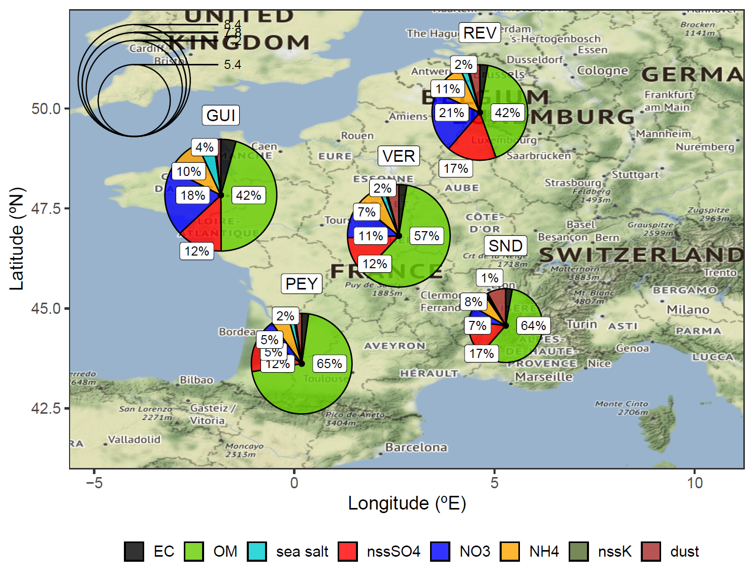
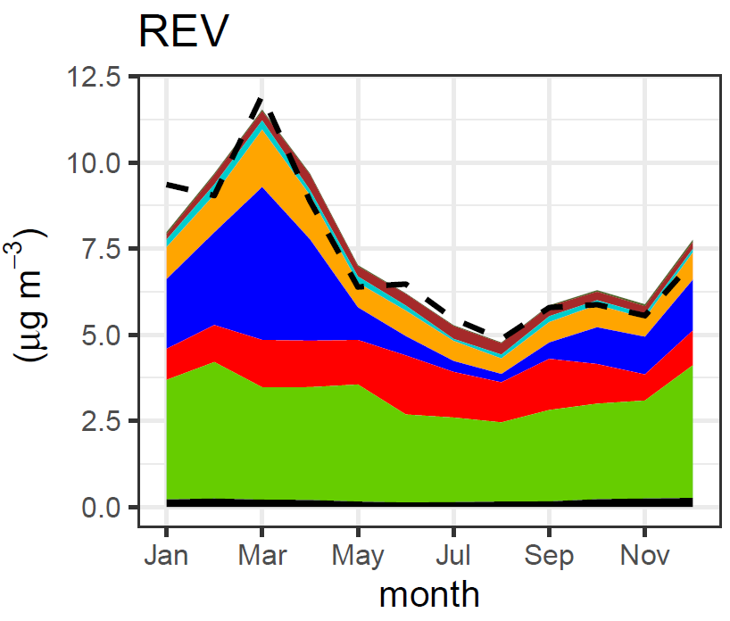
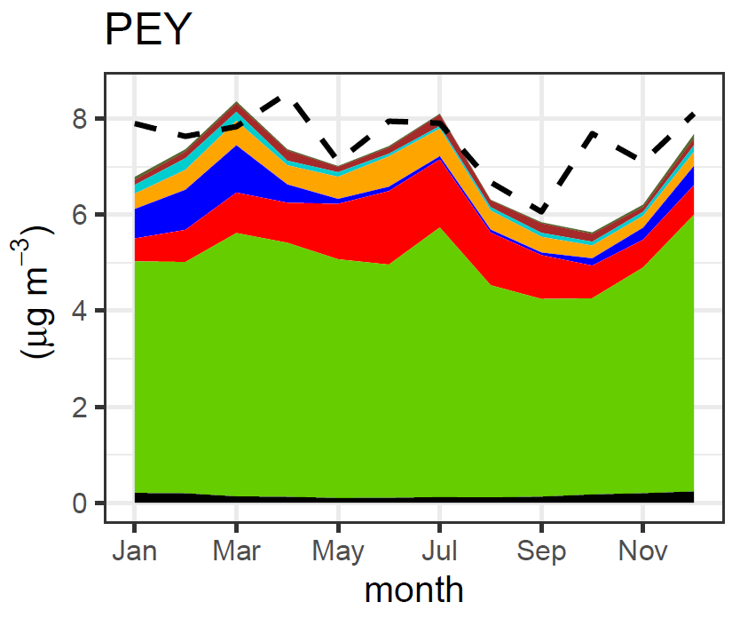
- - - PM_{2.5}

Slide 8
Methods: linear trends
Mann-Kendall test to evaluate if monotonic trends
Theil-Sen method to calculate the temporal trend (rate of change): median of all possible trends for all x-y date points combinations.
  Monthly means from hourly PM_{2.5} data
  Monthly means from daily PM_{2.5} and chemical composition data
Mean trends (95% confidence interval)
 | Hourly PM_{2.5} data |  | Daily MERA filters
site | Trend (µg m⁻³ year⁻¹) | Trend (% year⁻¹) | Trend (µg m⁻³ year⁻¹) | Trend (% year⁻¹)
GUI^{A} | -0.4 [-0.8, -0.1]* | -4.3 [-7.5, -0.8]* | -0.5 [-0.9, -0.2]** | -5.7 [-8.8, -2.3]**
PEY | -0.5 [-0.7, -0.3]*** | -5.5 [-7.2, -3.8]*** | -0.5 [-0.7, -0.3]*** | -5.7 [-6.9, -3.3]***
REV | -0.5 [-0.7, -0.4]*** | -6.1 [-7.5, -4.6]*** | -0.7 [-0.9, -0.4]*** | -7.2 [-8.9, -5.1]***
SND | -0.3 [-0.5, -0.1]** | -4.7 [-6.9, -2.4]** | -0.3 [-0.5, -0.1]** | -5.3 [-7.8, -2.7]**
VER | -0.6 [-0.9, -0.3]*** | -6.5 [-9.0, -4.1]*** | -0.7 [-1.0, -0.4]*** | -8.0 [-9.9, -5.3]***
^{A} trends calculated for 2014-2019
*** p < 0.001 ** p < 0.01 * p < 0.05 + p < 0.1

Slide 9
Methods: random-forest modelling for de-weathered time series
Primary emission rates, meteorological conditions and long-range transport patterns influence PM_{2.5} concentrations as well as its chemical components
Random-forest modelling is a machine-learning method based on decision-trees (Grange et al., 2017)
Multiple trees were built to reproduce concentrations using temporal, meteorological and transport explanatory variables using 70% of the data time series; the remaining 30% of the data is used to evaluate the performance of the model
De-weathered algorithm calculates the time series for a given atmospheric component based on an iterative
Limitation: chemical composition is based on daily filter measurements sampled every 6th day while meteorological and long-range transport data is available at a higher time resolution
  Proposed solution: use 3-hourly met data and long-range transport data to predict 3 –h chemical data; daily averages to compared modelled vs daily measured data

Slide 10
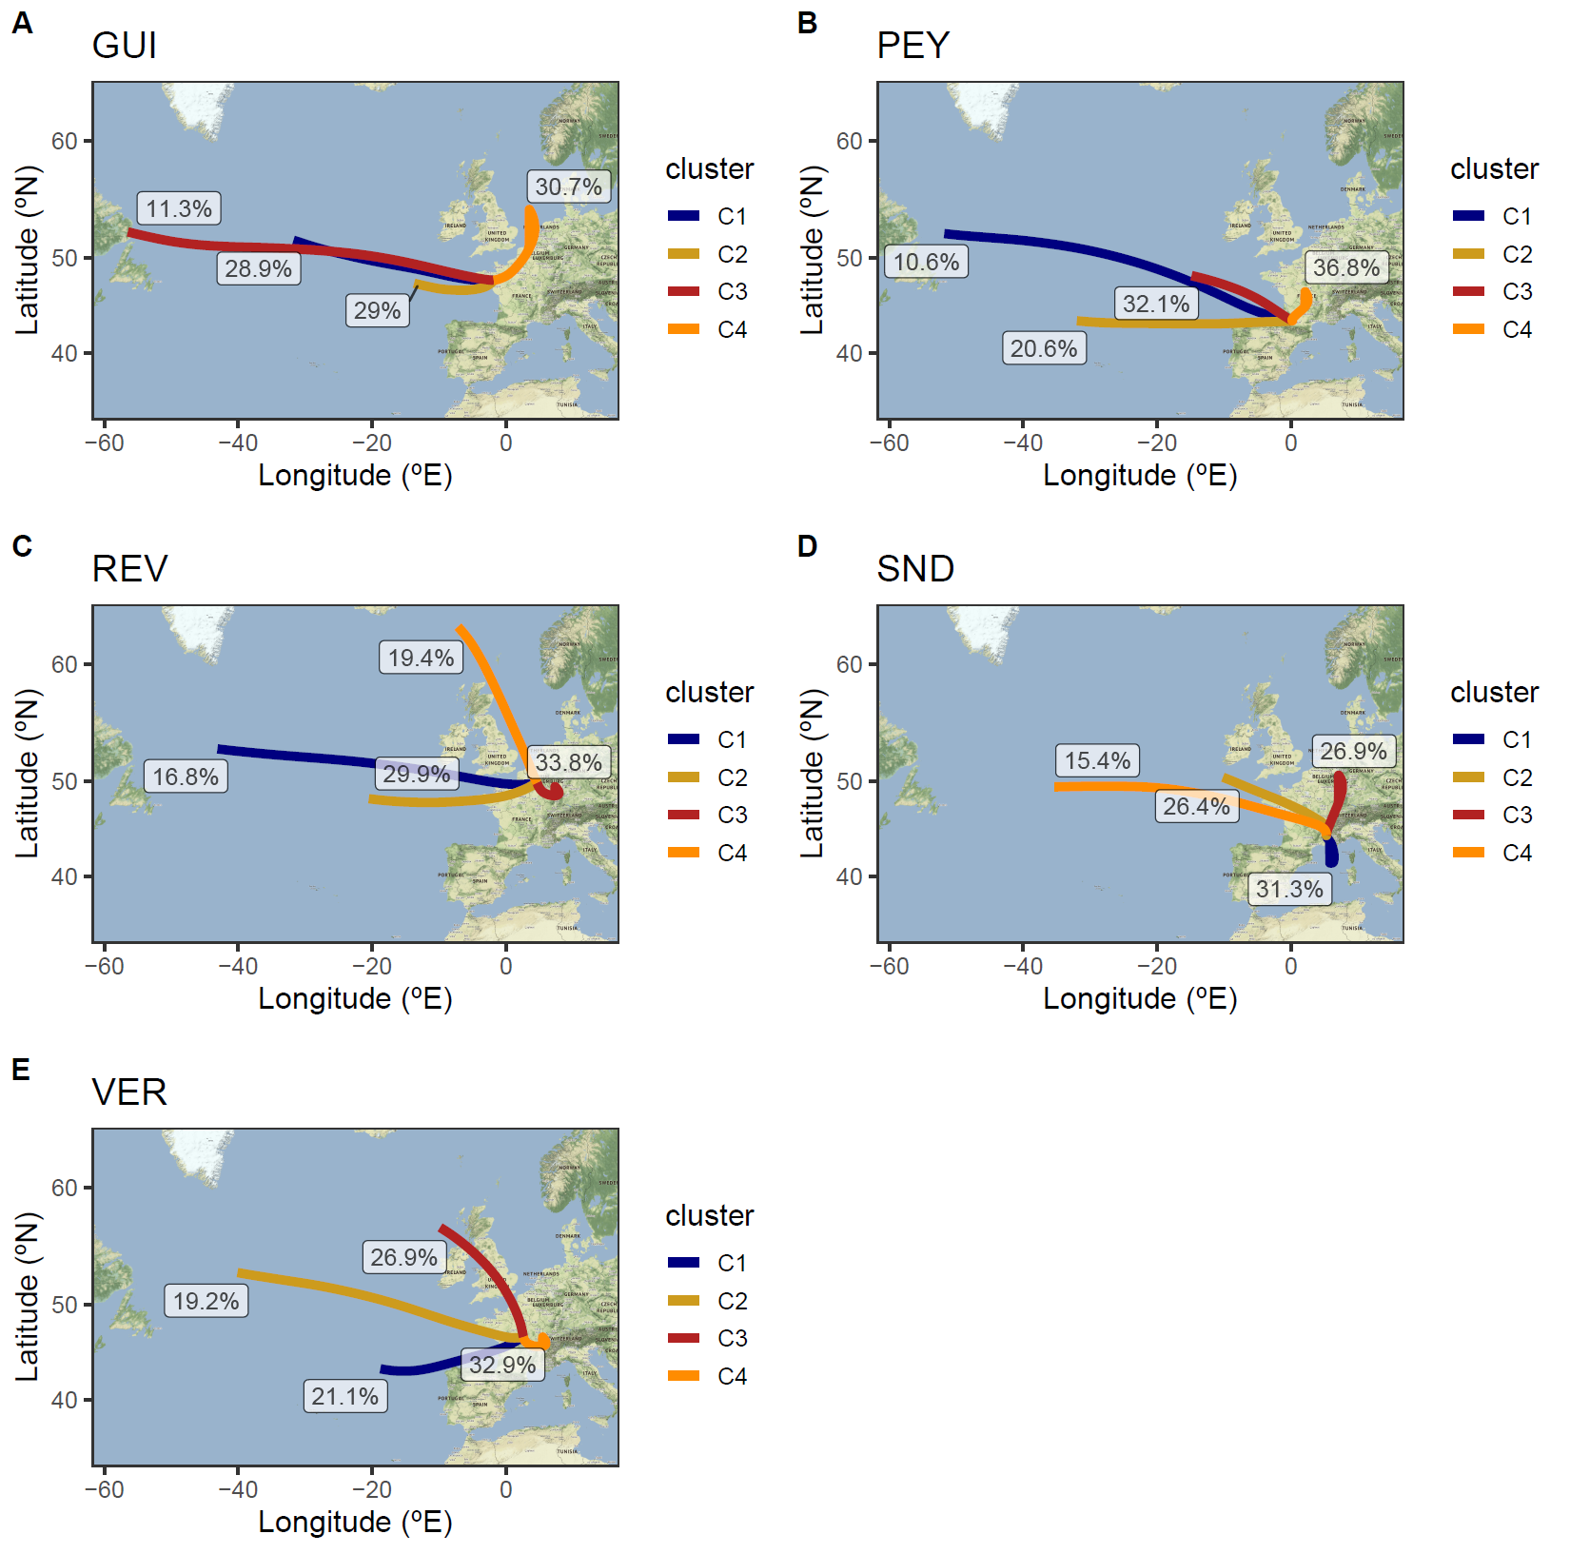
Methods: random-forest modelling for de-weathered time series
Main backtrajectory cluster
Temporal variables
  Day of the week
  Julian date (to capture seasonal variability)
  Decimal date (to capture long-term trends)
Meteorological variables
  Wind speed
  Wind direction
  Temperature
  Atmospheric pressure
  Relative humidity
  Mixing layer height (from GFS model)
  Precipitation at the site (from GFS model)
Long-range transport
  Backtrajectory cluster (Hysplit - GFS; release at 500 m)
  Cumulative rain along the trajectory
  Hour back main rain episode (> 0.2 mm)

Slide 11
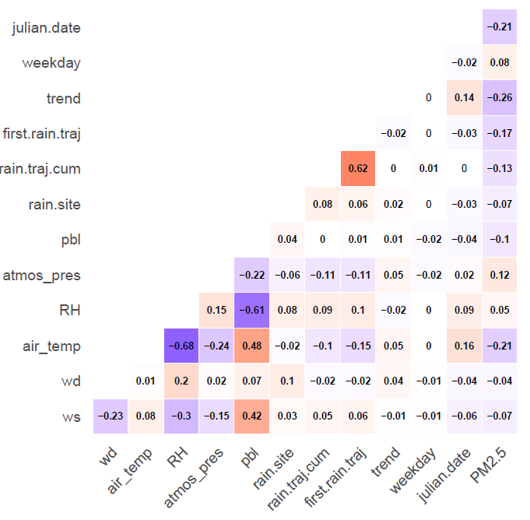
Methods: Pearson correlation between explanatory variables
Variables chosen:
Wind speed
Wind direction
Air temperature
Atmospheric pressure
Cluster
Cumulative rain along back-trajectory
Trend
Weekday
Julian date
Notes:
One of the advantages of RF modelling is that all variables can be included in the model even those which are correlated – however, to avoid overfitting the model, we excluded variables which were highly correlated. For instance, air temperature and relative humidity we negatively correlated (R = -0.68) and therefore only temperature was included. Similarly, PBL height and air temperature.

Slide 12
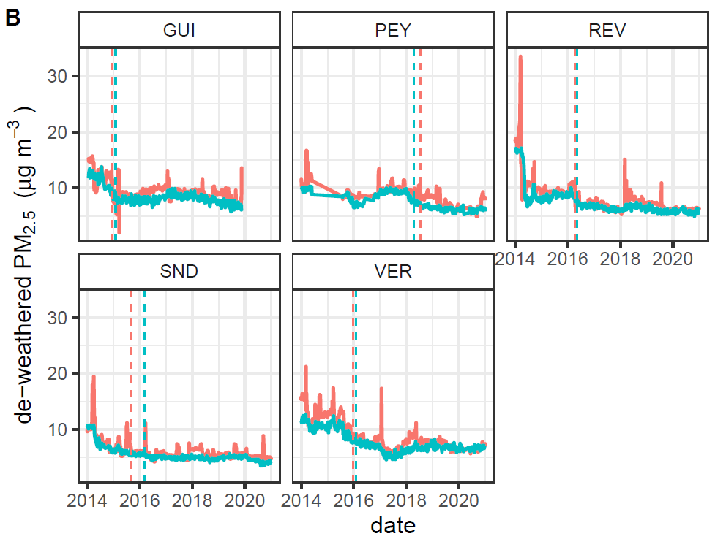

Comparison de-weathered time series: daily vs 3 h explanatory data
R² = 0.50
R² = 0.64
R² = 0.66
R² = 0.65
R² = 0.81
Vertical line: change point (based on the Buishand Range Test)

Slide 13
Comparison de-weathered time series: daily vs 3 h explanatory data
Evaluation of the random-forest model
 | Daily explanatory data |  |  | 3 h explanatory data
site | Slope [95% CI] | RMSE (µg m⁻³ ) | R² | Slope [95% CI] | RMSE (µg m⁻³ ) | R²
GUI^{A} | 0.752 [0.647, 0.873]*** | 5.09 | 0.41 | 0.940 [0.938, 0.942]*** | 1.67 | 0.96
PEY | 0.754 [0.642, 0.884]*** | 3.83 | 0.40 | 0,910 [0.908, 0.912]*** | 1.16 | 0.95
REV | 1.026 [0.881, 1.194]*** | 5.44 | 0.28 | 0.923 [0.921, 0.926]*** | 1.49 | 0.95
SND | 0.679 [0.593, 0.776]*** | 3.37 | 0.44 | 0.905 [0.903, 0.907]*** | 1.10 | 0.94
VER | 0.773 [0.687, 0.870]*** | 5.29 | 0.57 | 0.947 [0.946, 0.949]*** | 1.45 | 0.97
Linear trends (Theil Sen slope)
 | Daily explanatory data |  | 3-hourly explanatory data
site | Trend (µg m⁻³ year⁻¹) | Trend (% year⁻¹) | Trend (µg m⁻³ year⁻¹) | Trend (% year⁻¹)
GUI^{A} | -0.50 [-0.25, -0.79]*** | -5 [-3, -8]*** | -0.41 [-0.15, -0.69]*** | -4 [-2, -6]***
PEY | -0.57 [-0.45, -0.68] *** | -6 [-5, -7] *** | -0.64 [-0.48, -0.88]*** | -6 [-5, -7]***
REV | -0.51 [-0.41, -0.64] *** | -6 [-5, -7]*** | -0.63 [-0.56, -0.73]*** | -7 [-6, -8] **
SND | -0.36 [-0.26, -0.44] *** | -6 [-4 -7]*** | -0.30 [-0.19, -0.44]*** | -4 [-3, -6]***
VER | -0.62 [-0.35, -0.84] *** | -7 [-4, -9]*** | -0.96 [-0.67, -1.2]*** | -9 [-7, -11]***
^{A} trends calculated for 2014-2019
*** p < 0.001 ** p < 0.01 * p < 0.05 + p < 0.1

Slide 14
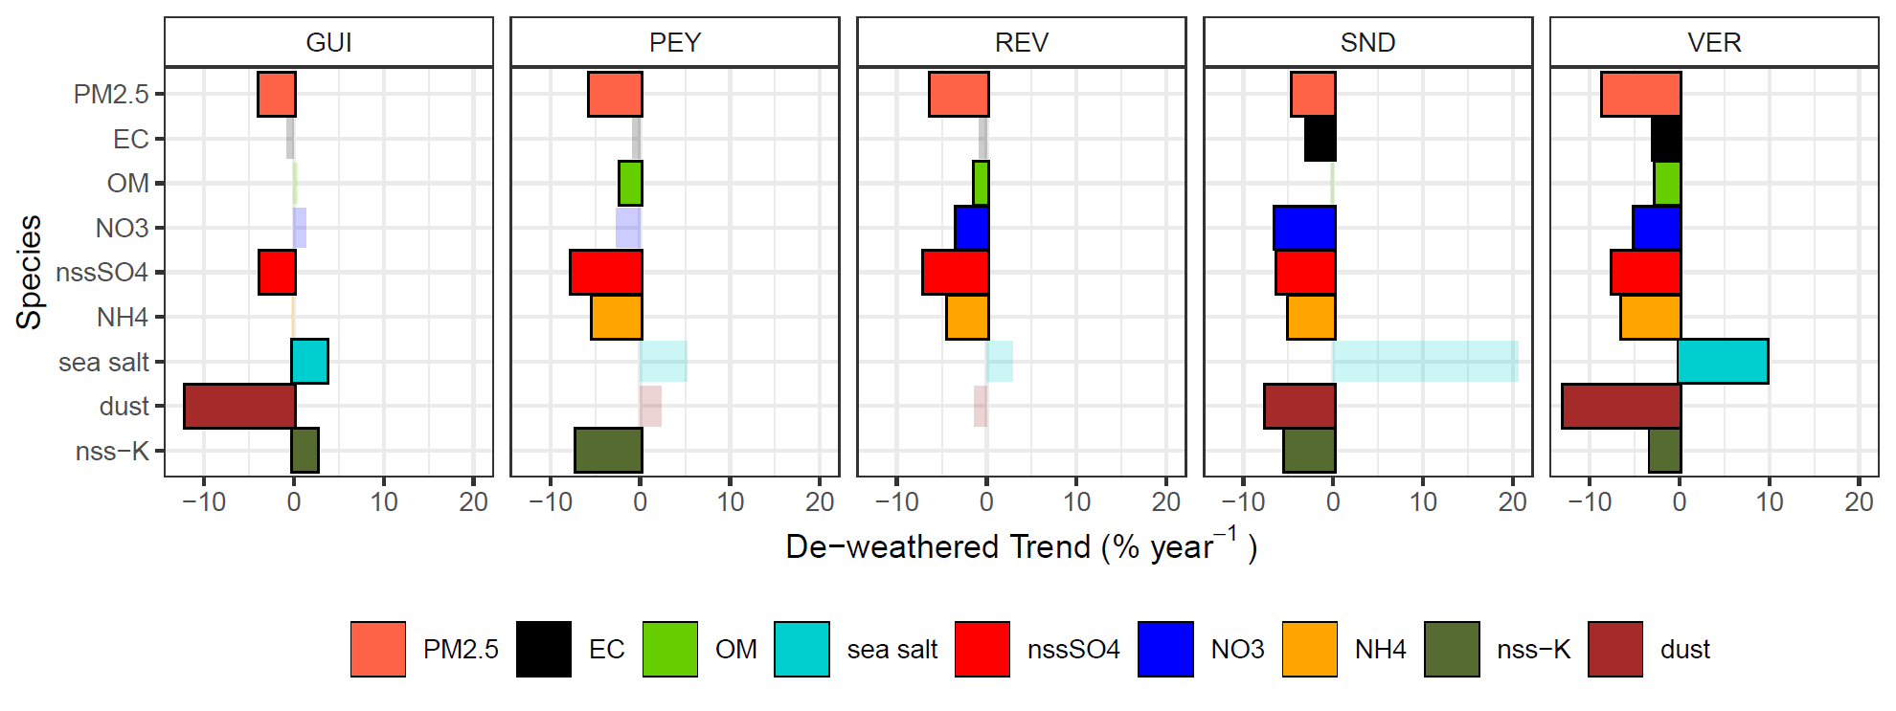
Results: Theil-Sen trends for de-weathered time series (3-h model)
Solid bar: trend significant at p<0.05
Notes:
All sites observed a decrease in the PM2.5 concentrations, at downward trends ranging from -4% year-1 to -9% year-1
At all sites, downward trends in PM2.5 were coincident with downward trends in nss-SO4 concentrations, with rates of -4% year-1 to -8% year-1
PEY, REV, SND and VER also osbserved a downward trend in NH4+ concentrations; REV, SND and VER also observed a decreased in NO3-
Three sites observed a decrease in nss-K+. At VER, the decrease in nss-K+ was coincidental with a decrease in both EC and OC, all three species with a downward trend at -3% year-1. SND the decrease in nss-K+ coincided with a decrease in EC (-5% year-1 and -3% year-1, respectively); at PEY, the decrease was only observed in the OM fraction (-7% year-1 and -2% year-1, respectively). GUI observed an significant increase in nss-K (3% year-1) but without an significant increase in either OM or EC.

Slide 15
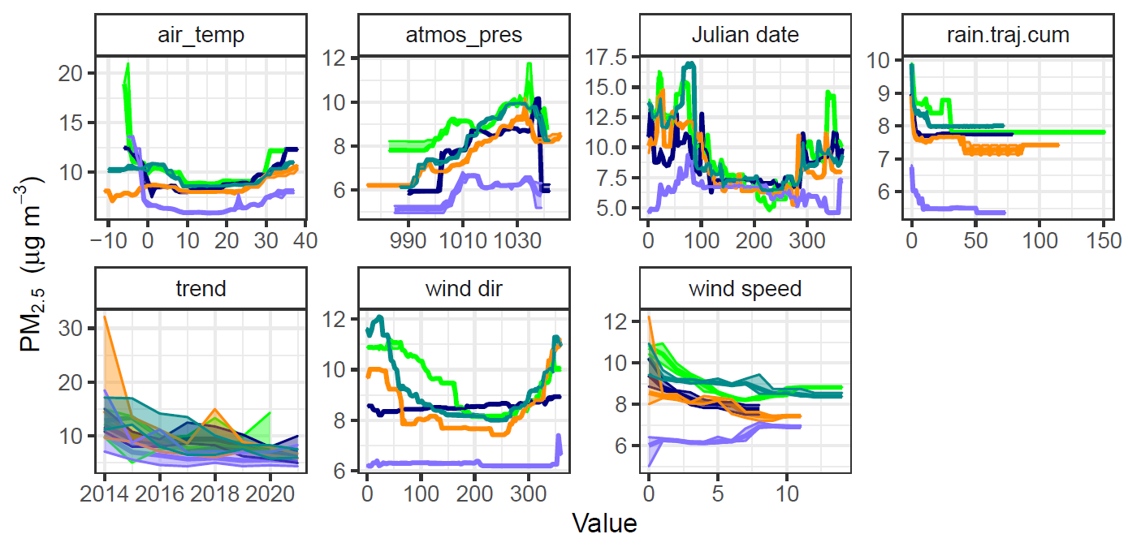
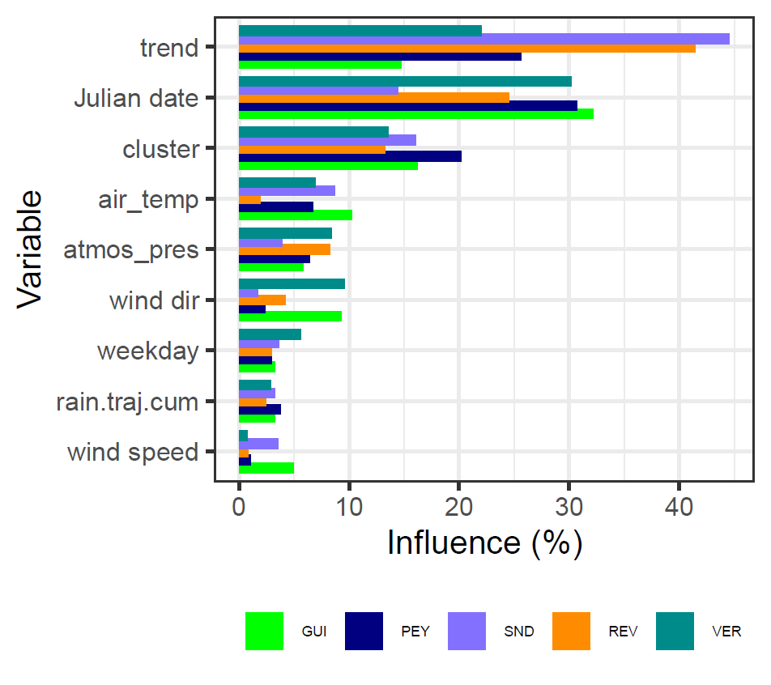
Results: influence of variables & partial dependency plots
PM_{2.5}
Notes:
One of the main advantages of Random-forest modelling is the quantification of the influence of each variable. For instance, for PM2.5 concentrations, both the long-term trends and the Julian daste were the most important variables at the MERA sites, depending on the site, explaining 15-40% of the PM2.5 variability. Then, the long-range transport, represented by the cluster, followed in terms of importance, explaining more than 10% of the PM2.5 variability. Tehn followed the meteorological variables, with air temperature being the most important variable.
Partial dependency plots (PDD) represents the mean PM2.5 concentration along the different values of a given explanatory variable keeping the other variables at their mean value. The PDD are also used to valiadate the model. For instance, concentrations of PM2.5 were higher at low temperatyre (below 0), decreasing at mild temperatures, increasing again when temperature raise above 20 degrees, probably associated with the increase of OM concentrations and SOA at hot temperatures.

Slide 16
Conclusions
Annual PM_{2.5} concentrations at background sites in France ranged from 4.8 µg m⁻³ to 11.6 µg m⁻³ for the period 2014 – 2020, with the majority of sites / years exceeding the annual WHO limit value (5 µg m⁻³ )
Better PM_{2.5} mass closure was achieved when using site and seasonal specific f_{OC:OM} ratios, with the unaccounted mass from -11% to 28% (fixed f_{OC:OM} = 1.8); to -9% to 7%.
The chemical composition of fine aerosols was at the French EMEP sites for 2014 - 2020: OM (42–65%), non-sea-salt sulphate (17–21%), nitrate (5–21%), ammonium (12–5%), mineral dust (2–9%), EC (2–4%), sea salt (1–4%) and non-sea-salt potassium (~1%).
OM was the main component of PM_{2.5} all year long
SIA contributed mostly in spring
The contribution of OM to PM_{2.5} was larger at the southern sites whereas the contribution of SIA was larger at the northern sites.

Slide 17
Conclusions
Better reproduction of PM_{2.5} concentrations by random-forest modelling when using 3-hourly met and long-range transport information (R² > 0.90 and RMSE < 1.5 µg m⁻³)
Temporal variables had greater role in explaining the variability in PM_{2.5} concentrations (15 – 45%); followed by the cluster variable (~15%) representing the long-range transport
De-weathered time series for PM_{2.5} and the main components were built using the RF modelling
All sites observed downward trends in PM_{2.5}, at a rate of -4 to -9% year⁻¹ for the period 2014 - 2020
Downward trends in PM_{2.5} were coincidental with the downward trends in nss-SO₄²⁻ (-4 to -8 % year⁻¹) associated with the decrease in SO₂ emissions (mean decrease of -8% year⁻¹ between 2014 – 2019 in France)
Reduction in NO₃⁻ concentrations from reduced NO_{X} emissions less evident at the French EMEP sites: 3 out of 5 sites observed significant downward trends (REV, SND and VER: -3% year⁻¹ to -6% year⁻¹). For 2014-2020, NO_{X} emissions in France decreased at a rate of -5% year⁻¹.
Reduction in biomass burning was observed with downward trends in nss-K⁺ at three sites (VER, SND and PEY: -3 to -7 % year⁻¹). One site observed a significant upward trend (GUI) (2% year⁻¹)

Slide 18
Trends in PM_{2.5} and chemical components at the French EMEP sites
Many thanks for your attention
Anna FONT, Aude BOURIN, Corentin GOUILLOU, Cécile DEBEVEC, Stéphane SAUVAGE
5 May 2022

Slide 19
Mass closure calculations and OC to OM conversion factor
f_{OC:OM}
Site | GUI | PEY | REV | SND | VER
f_{OC:OM} | 1.6 [1.5 – 1.7] | 2.7 [2.4 – 2.9] | 1.7 [1.5 – 1.8] | 1.8 [1.6 – 2.0] | 2.2 [2.0 – 2.3]
R² | 0.80*** | 0.75*** | 0.65*** | 0.65*** | 0.77***
N | 240 | 204 | 242 | 261 | 311
f_{OC:OM} DJF | 1.5 [1.4 – 1.7] | 2.6 [2.2 – 3.0] | 2.0 [1.8 – 2.3] | 1.3 [1.0 -1.6] | 1.9 [1.7 – 2.1]
R² | 0.88*** | 0.77*** | 0.80*** | 0.61*** | 0.82***
N | 59 | 52 | 64 | 64 | 85
f_{OC:OM} MAM | 2.0 [1.7 – 2.4] | 3.4 [2.9 – 3.9] | 1.7 [1.3 – 2.1] | 1.9 [1.5 – 2.3] | 2.8 [2.5 – 3.2]
R² | 0.65*** | 0.84*** | 0.59*** | 0.65*** | 0.80***
N | 68 | 45 | 57 | 55 | 69
f_{OC:OM} JJA | 1.9 [1.5 – 2.3] | 2.6 [2.1 – 3.1] | 1.2 [0.9 – 1.5] | 2.2 [1.8 – 2.4] | 2.0 [1.6 – 2.4]
R² | 0.67*** | 0.70*** | 0.52*** | 0.67*** | 0.56***
N | 51 | 48 | 60 | 77 | 73
f_{OC:OM} SON | 1.8 [1.5 – 2.0] | 2.6 [2.2 – 3.0] | 1.7 [1.4 – 2.0] | 1.5 [1.2 – 1.8] | 2.2 [2.0 -2.5]
R² | 0.80*** | 0.72*** | 0.71*** | 0.61*** | 0.77***
N | 62 | 59 | 61 | 84 | 84

Slide 20
PM_{2.5} mass closure
--- PM_{2.5}

Slide 21
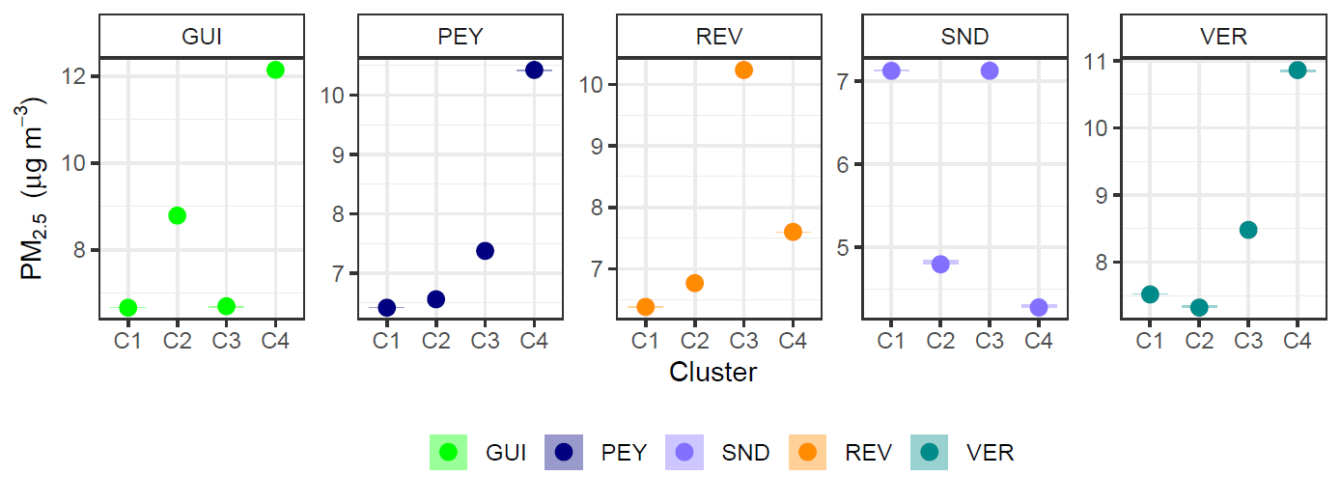
Results: partial dependency plots for the cluster variable

