Slide 1


Application of EMEP/uEMEP for the AAQD review process
Bruce Rolstad Denby, Agnes Nyeri, Qing Mu, Hilde Fagerli
+ IIASA: Zig, Gregor, Chris
TFMM 05.05.2022
© Ricardo plc 2017
Norwegian Meteorological Institute

Slide 2
Content
Preface
  Background
  The emissions
  A summary about the EMEP/uEMEP methodology
Calculations at Airbase station sites
Scenarios and exceedances at stations
Scenarios and exposure calculations
Summary
Bias adjustment
Norwegian Meteorological Institute

Slide 3

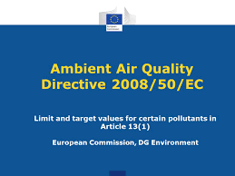






Preface
Norwegian Meteorological Institute

Slide 4
Background
Consortium consisting of Trinomics, Ricardo, Vito, IIASA and MET Norway are consulting for the Commission in their review of the European Ambient Air Quality Directives (AAQD)
Our task (MET Norway) is to take a range of future scenarios produced by IIASA with GAINS and calculate concentrations with EMEP and uEMEP for EU27 countries
The concentrations are used for health and economic impact assessment and to see the achievability of reaching the recently published WHO guidelines
Scenarios include Baseline and Maximum Feasible Technological Reduction (MFR) scenarios for the years 2015, 2020, 2030 and 2050 and a range of optimised scenarios derived from GAINS to achieve concentration levels for PM_{2.5} (5, 10, 15 and 20 ug/m³)
Pollutants include PM_{2.5}, PM₁₀, NO₂, O₃, BaP, CO, SO₂ and Benzene
Concentration fields are provided further to Vito and Ricardo for health and economic evaluation
Do not ask me any questions about the emissions
Norwegian Meteorological Institute

Slide 5
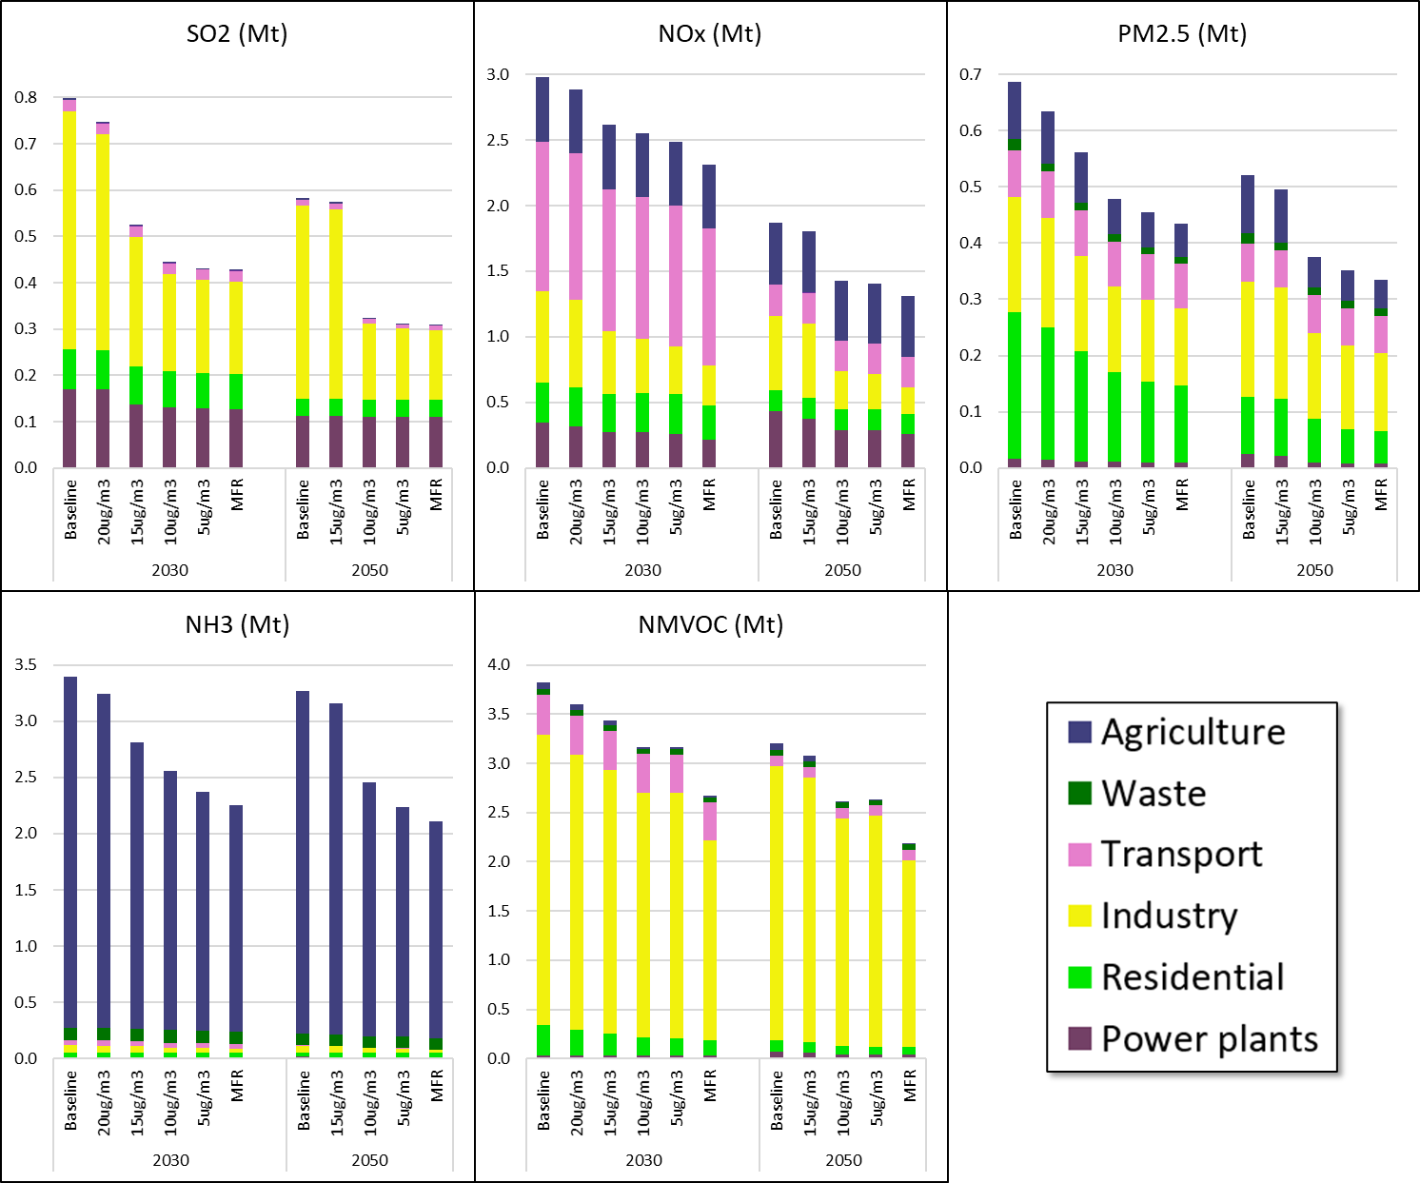
Emission trends and GAINS (all scenarios, including optimized cases)
Change in total EU-27 emissions by sector
Relates to 'background' concentrations – the indicated levels shall be met everywhere (if feasible according to the GAINS model assessment)
‘Attaining’ 20 and 15 µg/m³ PM_{2.5} concentration targets appears feasible and does not require significant additional reductions neither in 2050 nor 2030
Additional mitigation needs to increase strongly to ‘attain’ the more ambitious targets of 10 and 5 µg/m³ and reaches often near MFR levels for several pollutants
Key further reductions seem achievable in
  Residential sector (PM_{2.5})
  Industry (SO₂, NOx, VOC)
  Agriculture (NH₃)
Feasibility in some regions is an issue, both in 2030 and 2050, especially for 5 µg/m³ target
Norwegian Meteorological Institute

Slide 6
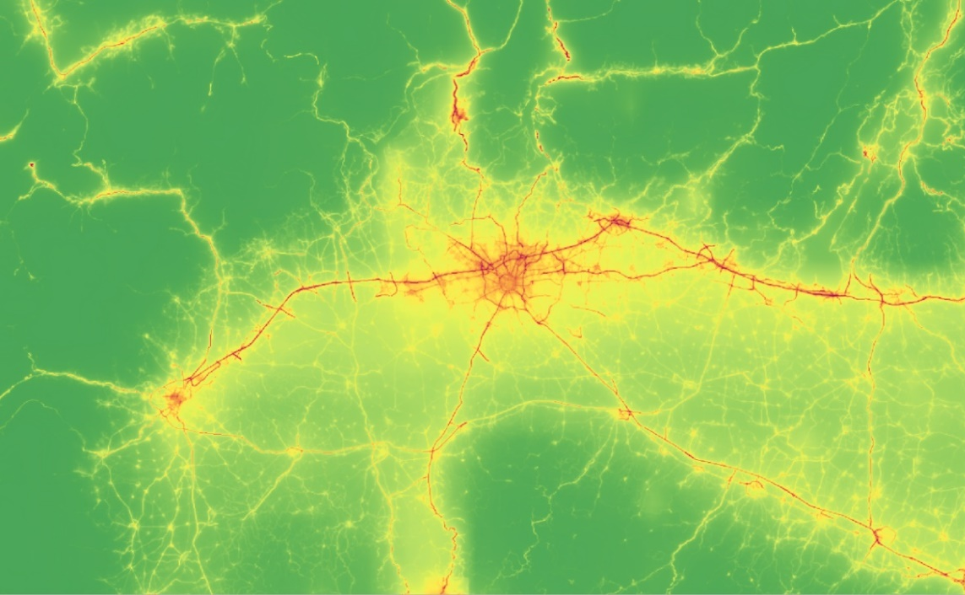
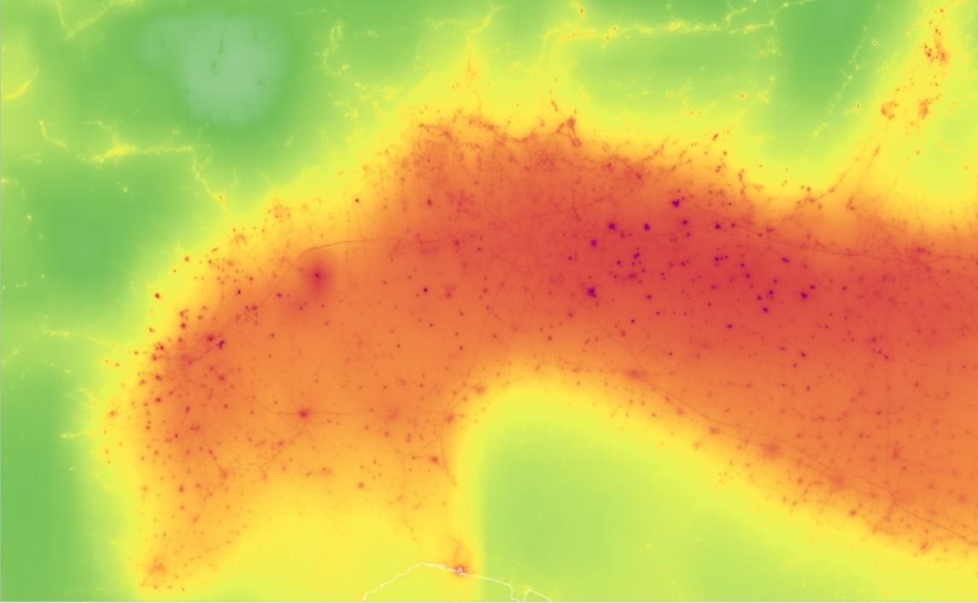


Modelling methodology
Concentrations are calculated using the EMEP model (0.1º) and then downscaled for selected sources using uEMEP
Downscaling is carried out at:
  25 m resolution at Airbase station sites for exceedance calculations
  250 m resolution for mapping and exposure calculations
Emission scenarios for the concentration calculations are provided by GAINS per country and these are spatially distributed using the gridded EMEP emissions (country submitted)
Calculations are made for the Baseline, MFR and OPTimised scenarios for the years 2015, 2020, 2030 and 2050
uEMEP
Milan region
Annual mean NO₂
Baseline scenario 2020
uEMEP
Milan region
Annual mean PM_{2.5}
Baseline scenario 2020
µg/m³
µg/m³
Norwegian Meteorological Institute

Slide 7
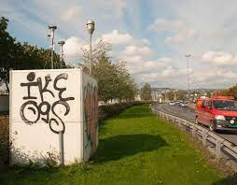
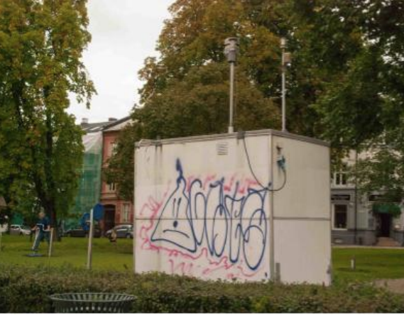
Calculations at station sites
Norwegian Meteorological Institute

Slide 8
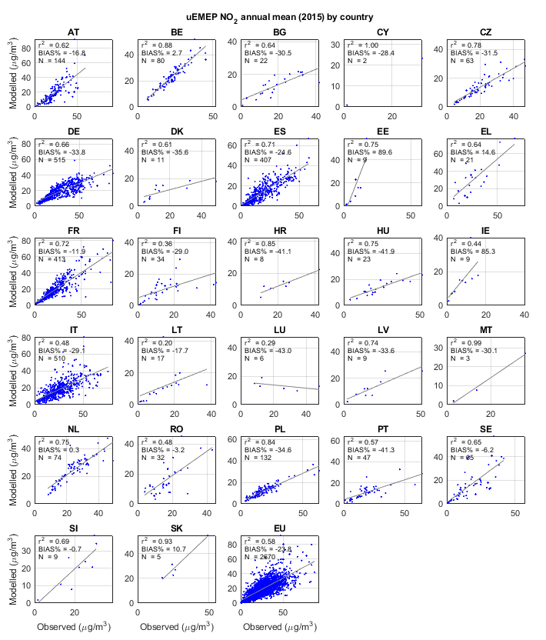
Station calculations
Comparison of modelled and observed concentrations at all Airbase sites for the reference year 2015
  Station bias for pollutants presented here:
    NO₂ = -23%
    PM_{2.5} = -19%
    SOMO35 = +1%
    BaP = +11%
  Bias for other pollutants calculated:
    PM₁₀ = -33%
    CO = -44%
    Benzene = -53%
    SO₂ = -26%
    O₃ 26th daymax = -23%
Significant negative bias for a number of pollutants
Impact of model/emission bias on the scenario calculations is addressed with a bias adjustment for NO₂ and PM_{2.5}
NO₂ annual mean concentrations 2015 EU27
Norwegian Meteorological Institute

Slide 9
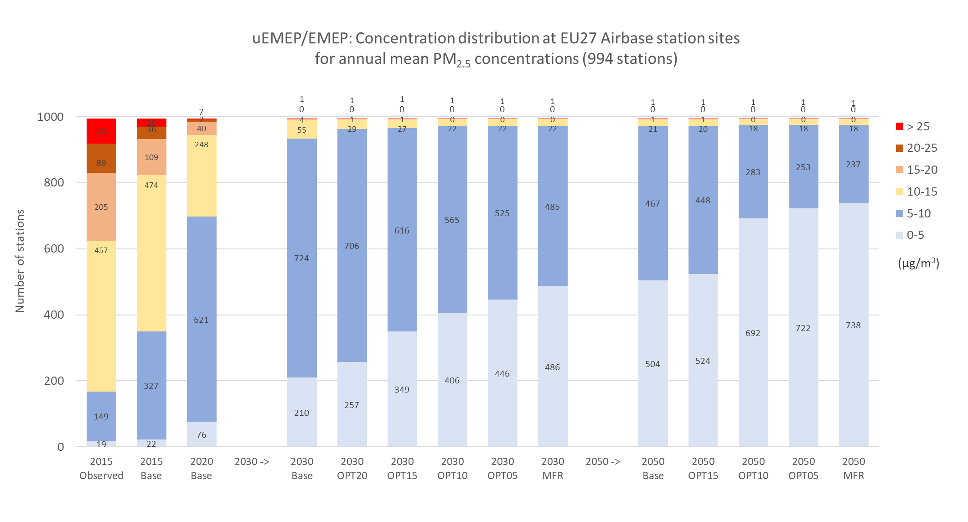
Station exceedances PM_{2.5}
Bias in 2015 reference calculation is clearly seen
In 2020 1% of Airbase measurement stations were in exceedance > 25 µg/m³
In 2030 few exceedances > 15 µg/m³
In 2050 few exceedances > 10 µg/m³
In 2030 and 2050 significant exceedances > 5 µg/m³
The one persistent exceedance in 2030 and 2050 is a traffic site in Stockholm (non-exhaust emissions)
Some difference between baseline and MFR
Reference
calculation
2030
2050
Norwegian Meteorological Institute

Slide 10
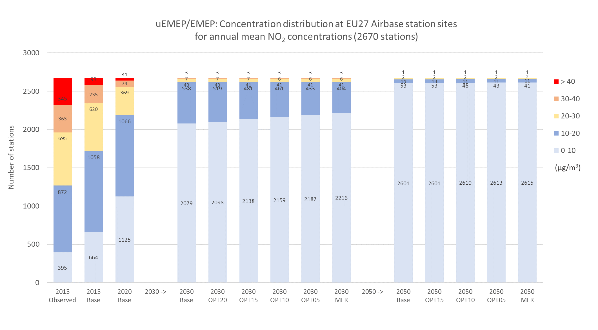
Station exceedances NO₂
Bias in 2015 reference calculation is clearly seen
In 2020 1% of Airbase measurement stations were in exceedance > 40 µg/m³
Large reductions in traffic NO_{X} emissions is the main driver for scenario reductions
In 2030 hardly any exceedances > 40 µg/m³
In 2050 few exceedances > 10 µg/m³
Persistent exceedances in 2030 and 2050 are at sites near Mediterranean ports
Little difference between baseline and MFR for NO₂
Reference
calculation
2030
2050
Norwegian Meteorological Institute

Slide 11
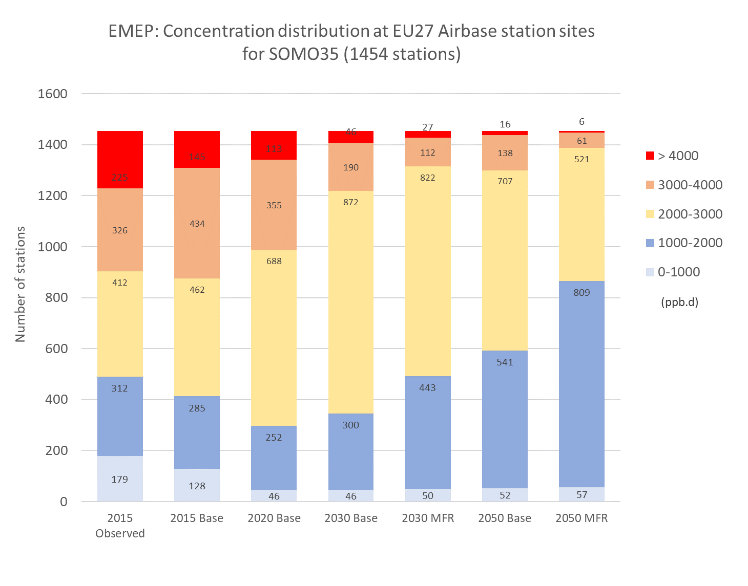
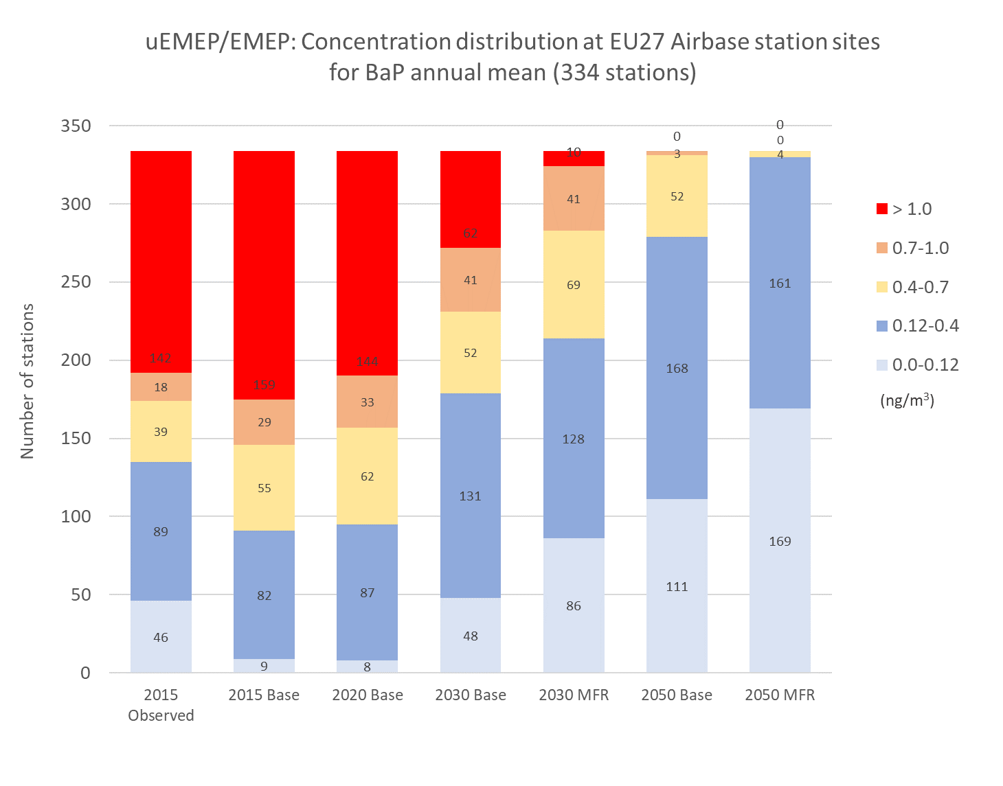
Station exceedances SOMO35 and BaP
SOMO35: health indicator
BaP: EU limit 1 ng/m³, WHO 0.12 ng/m³
Reference
calculation
2030
2050
Reference
calculation
2030
2050
Norwegian Meteorological Institute

Slide 12
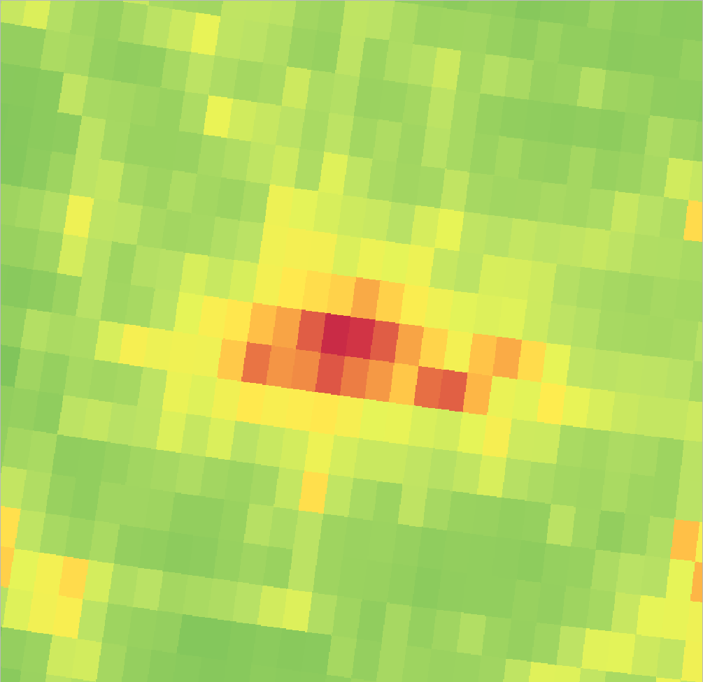
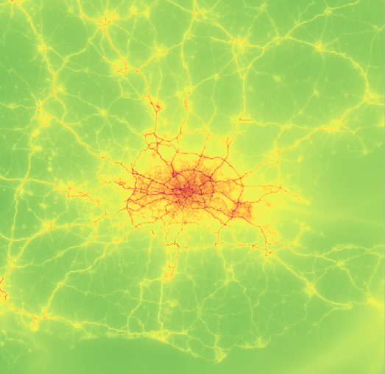
Mapping and exposure
Norwegian Meteorological Institute

Slide 13
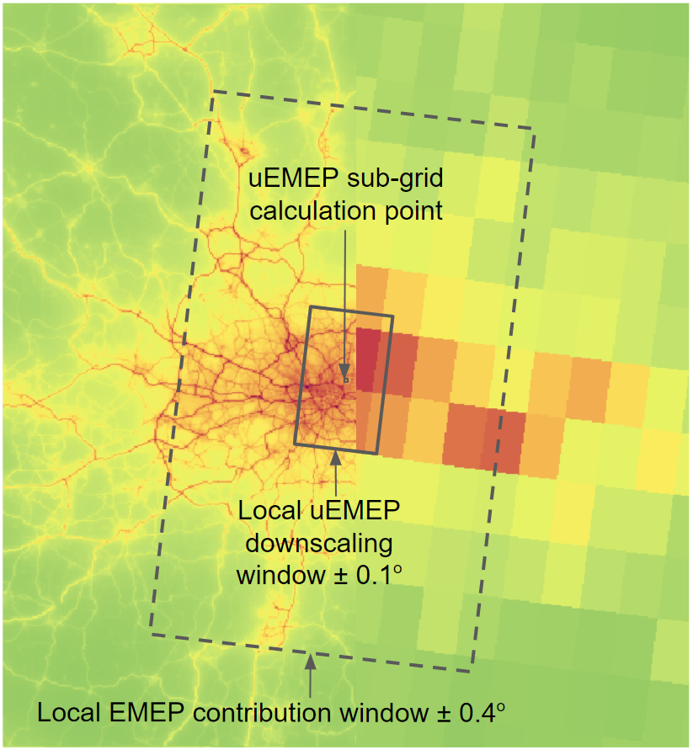
Explanation of the source contributions in EMEP and uEMEP
uEMEP
EMEP
Local downscaled uEMEP
  Downscaled source contributions from within a ± 0.1º window around the calculation point
  The major source for primary PM_{2.5} is residential combustion
Local EMEP
  Tracked EMEP contributions from within a ± 0.4º window around the calculation point, in addition to any downscaling
  Roughly 2/3 of all primary PM_{2.5} comes from within this local region
Non-local EMEP species
  Non-local PM_{2.5} species are from outside this ± 0.4º region
  Major natural source contributions are dust and sea salt
  Secondary PM_{2.5} makes up the majority of non-local contributions
Norwegian Meteorological Institute

Slide 14
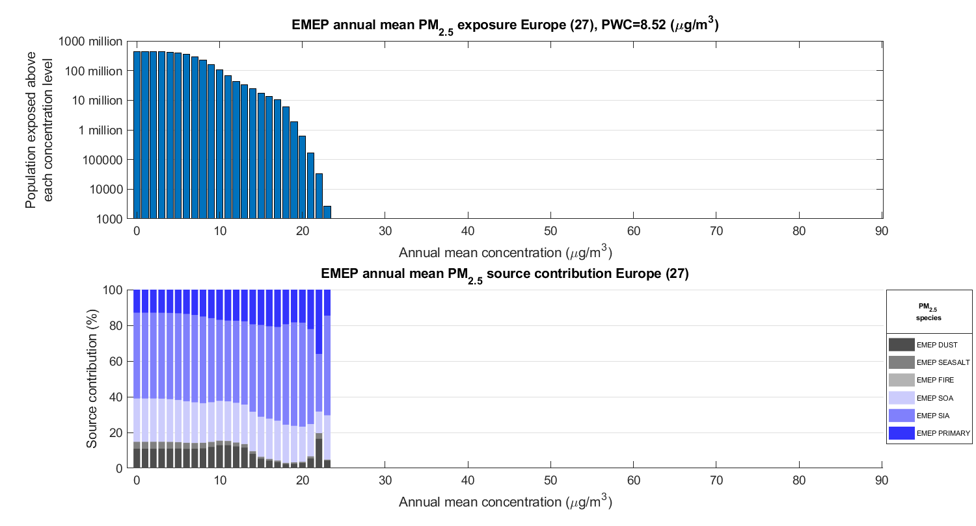
EMEP: Baseline 2020 annual mean PM_{2.5}
Population exposed above a given concentration (log scale)
Population exposure distribution, source contribution (%)
Norwegian Meteorological Institute

Slide 15
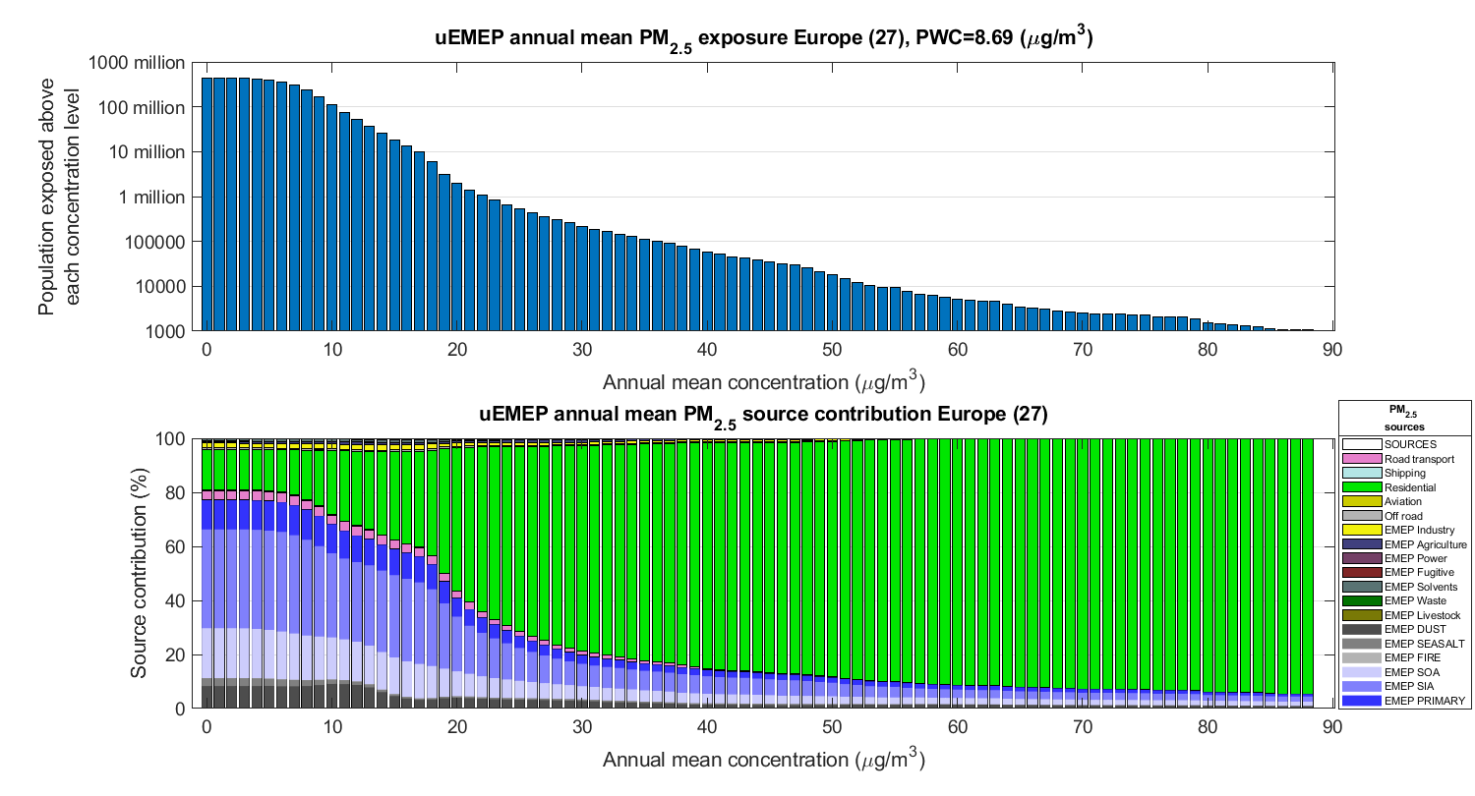
uEMEP: Baseline 2020 annual mean PM_{2.5}
Population exposed above a given concentration (log scale)
Population exposure distribution, source contribution (%)
Norwegian Meteorological Institute

Slide 16
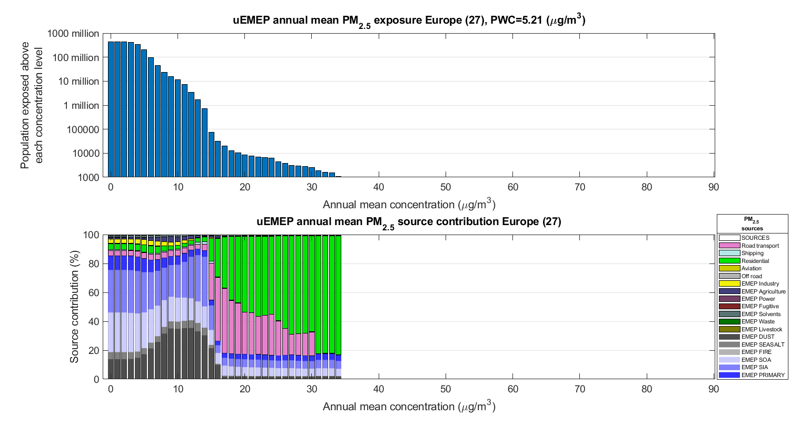
uEMEP: Baseline 2050 annual mean PM_{2.5}
Population exposed above a given concentration (log scale)
Population exposure distribution, source contribution (%)
Norwegian Meteorological Institute

Slide 17
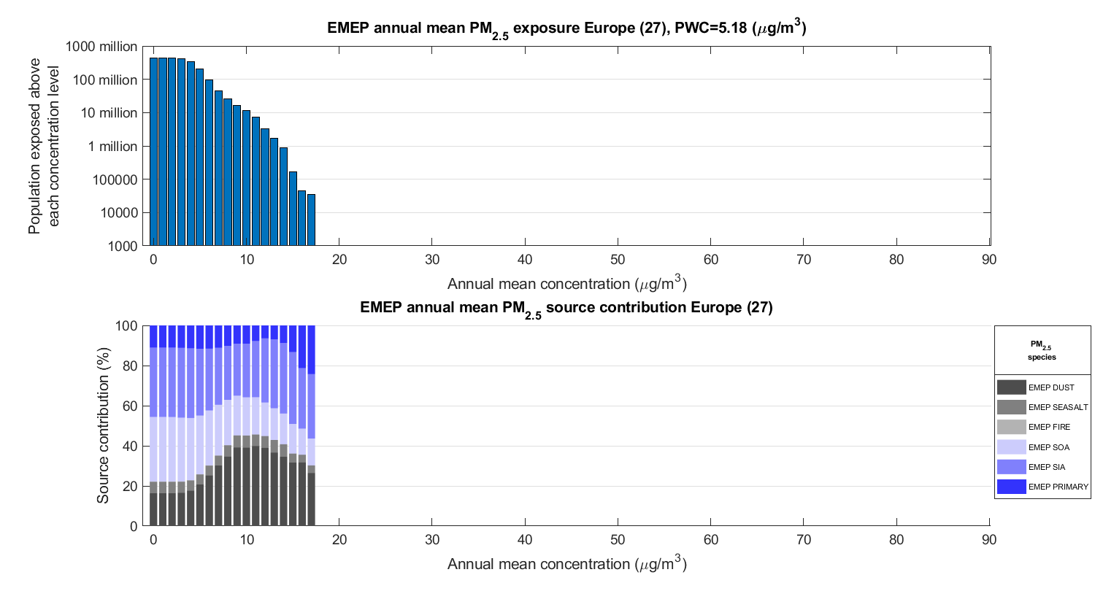
Indicator 1 – air pollutant concentrations and exposure: Exposure and sources
EMEP: Baseline 2050 annual mean PM_{2.5}
Population exposed above a given concentration (log scale)
Population exposure distribution, source contribution (%)
Norwegian Meteorological Institute

Slide 18
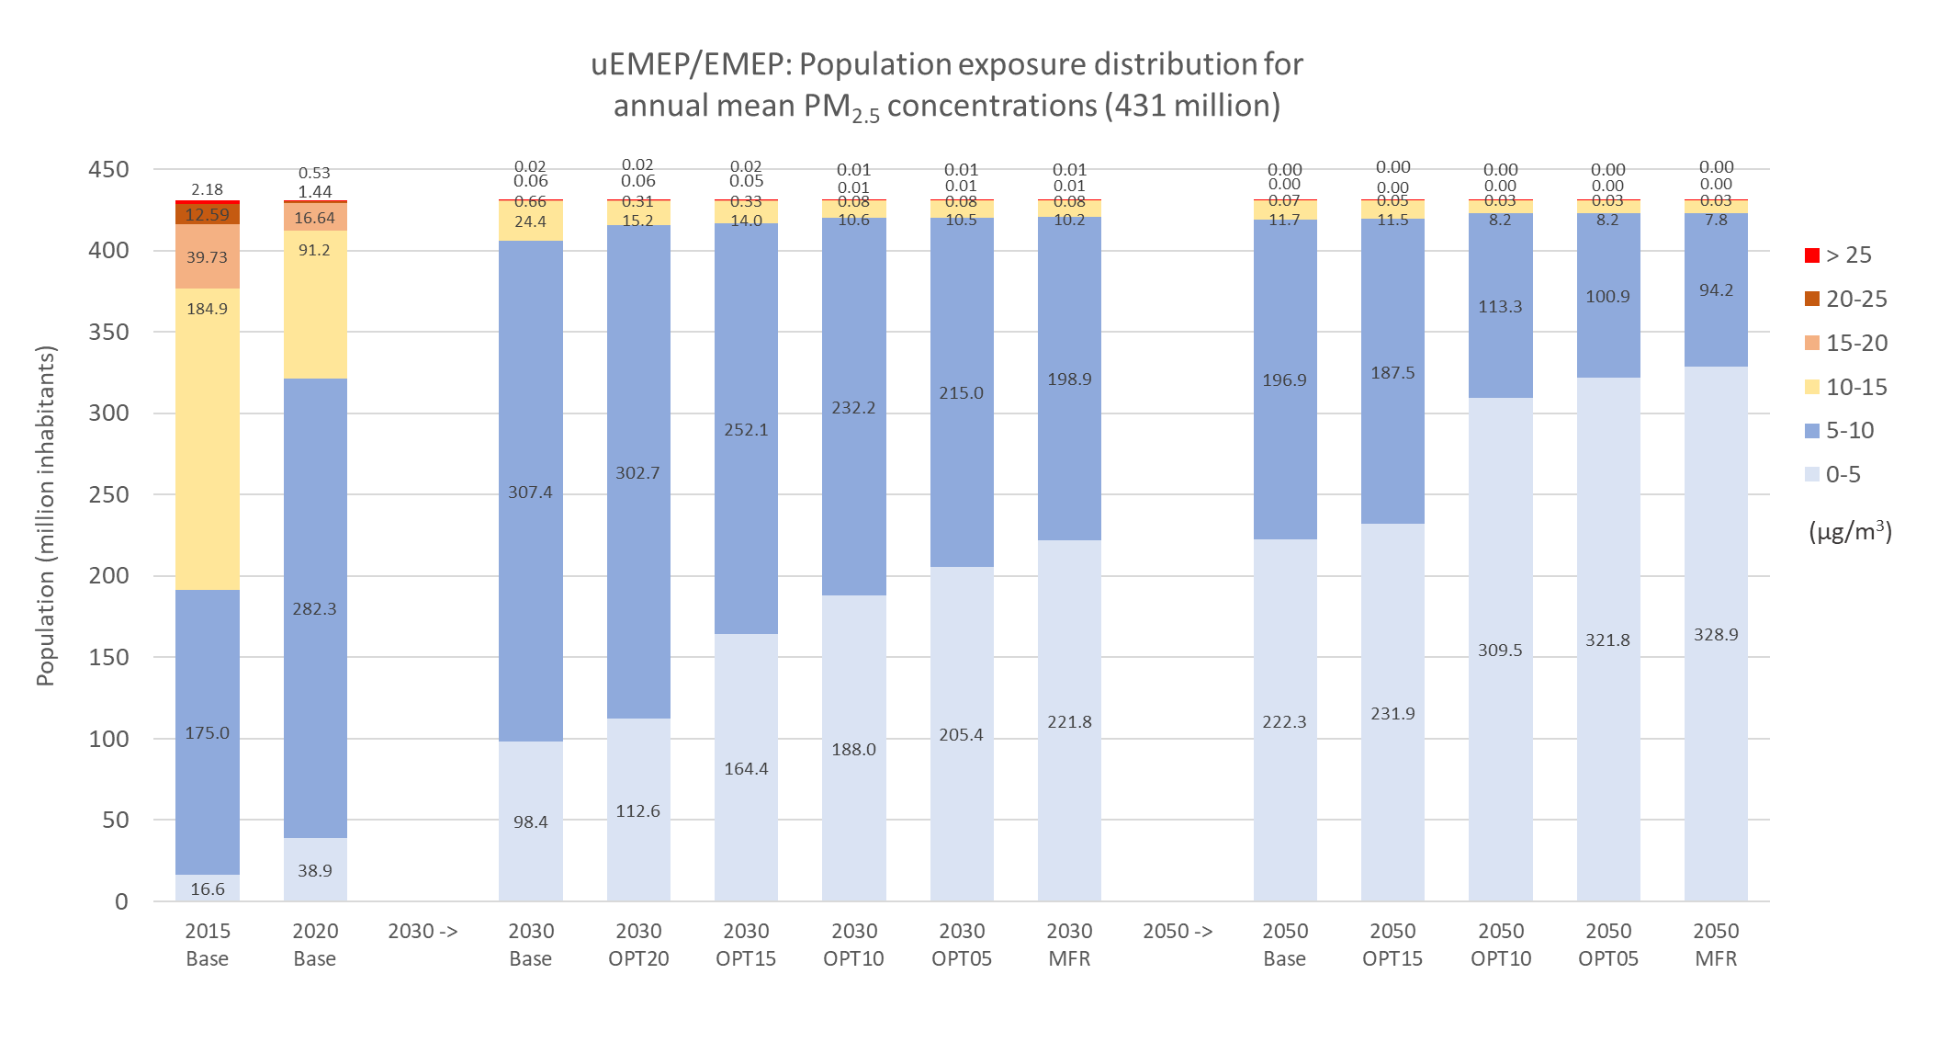
Population exposure PM_{2.5}
A general decrease in concentrations with years and optimised measures
In 2030 between 25 and 11 million inhabitants > 10 µg/m³
In 2050 between 12 and 8 million inhabitants > 10 µg/m³
In 2030 and 2050 significant exceedances > 5 µg/m³
2015, 2020
2030
2050
Norwegian Meteorological Institute

Slide 19

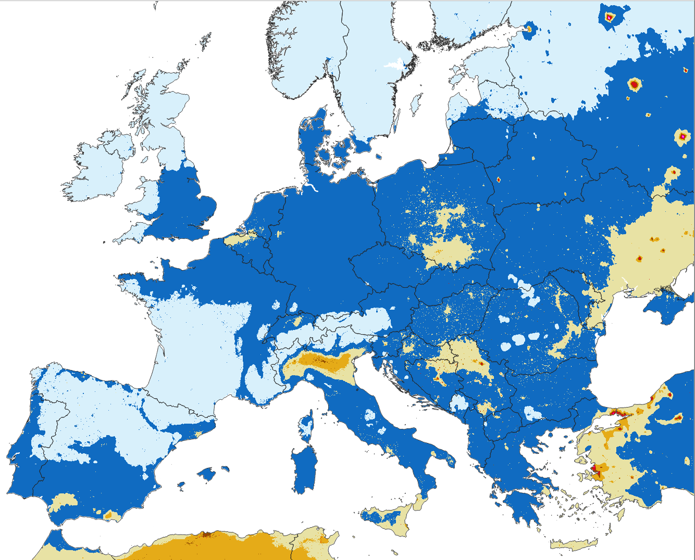
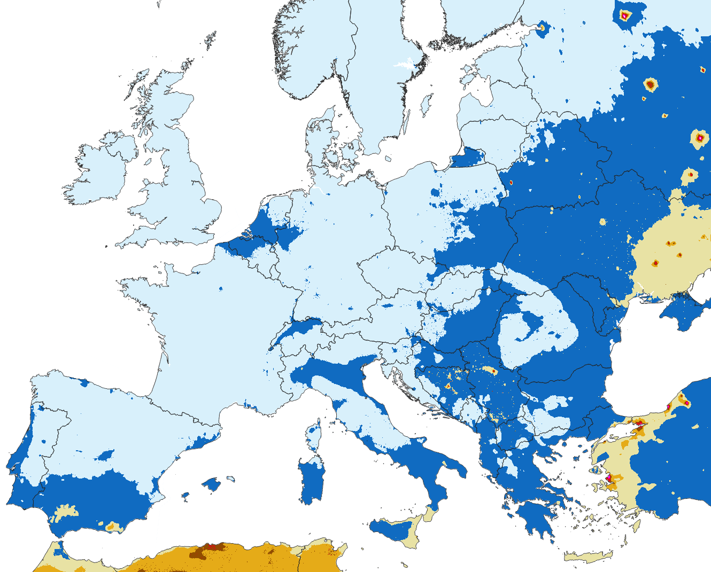
PM_{2.5} maps for Baseline 2020 and 2050
Baseline 2020
Baseline 2050
µg/m³
µg/m³
Norwegian Meteorological Institute

Slide 20
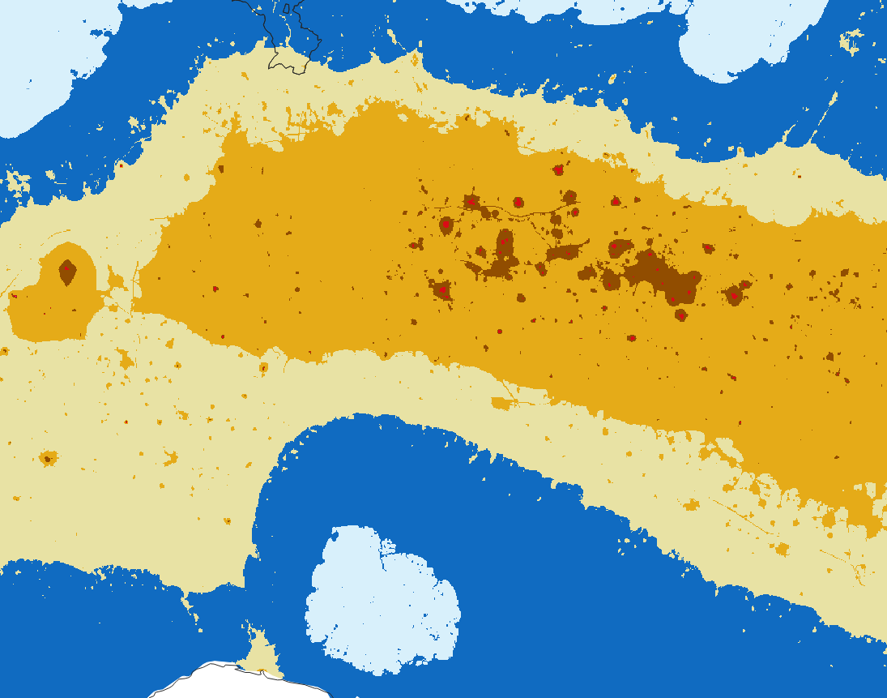
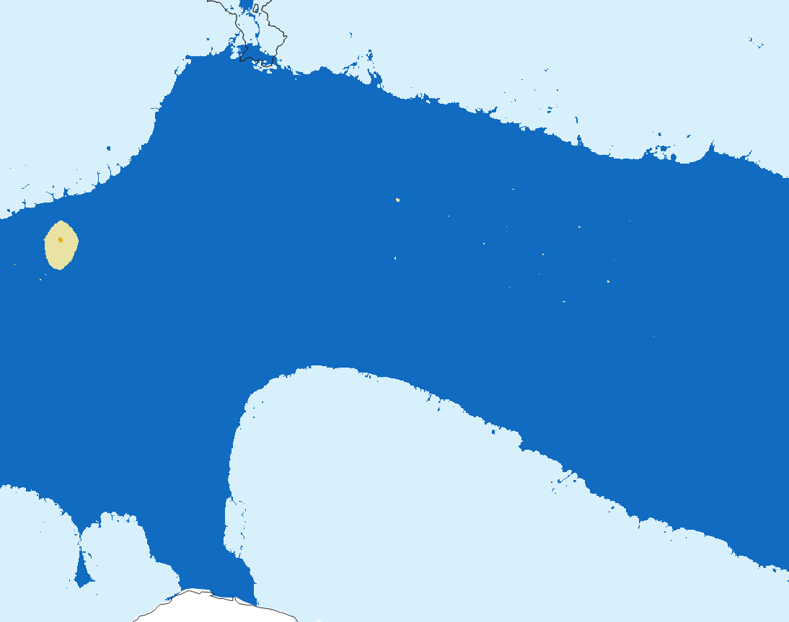
PM_{2.5} maps for Baseline 2020 and 2050
Baseline 2020
Baseline 2050
µg/m³
µg/m³
Norwegian Meteorological Institute

Slide 21
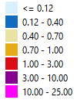
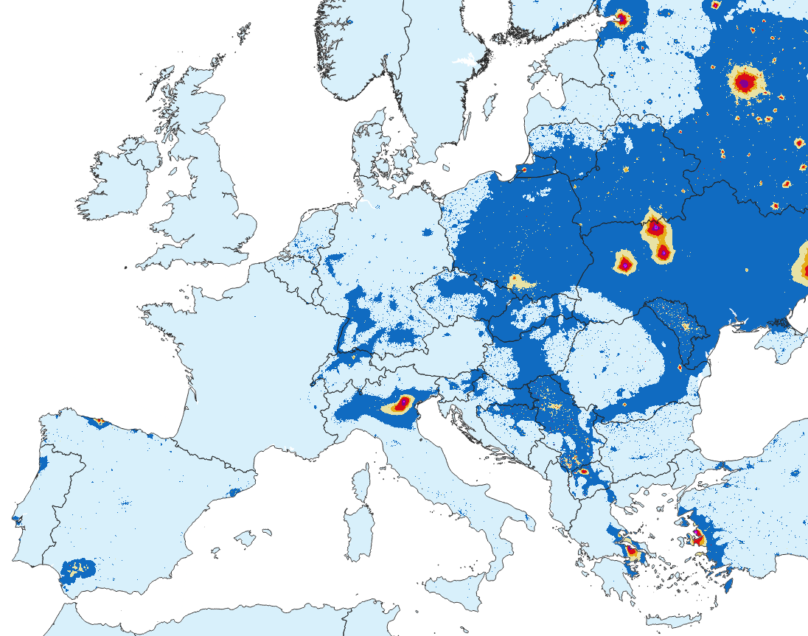
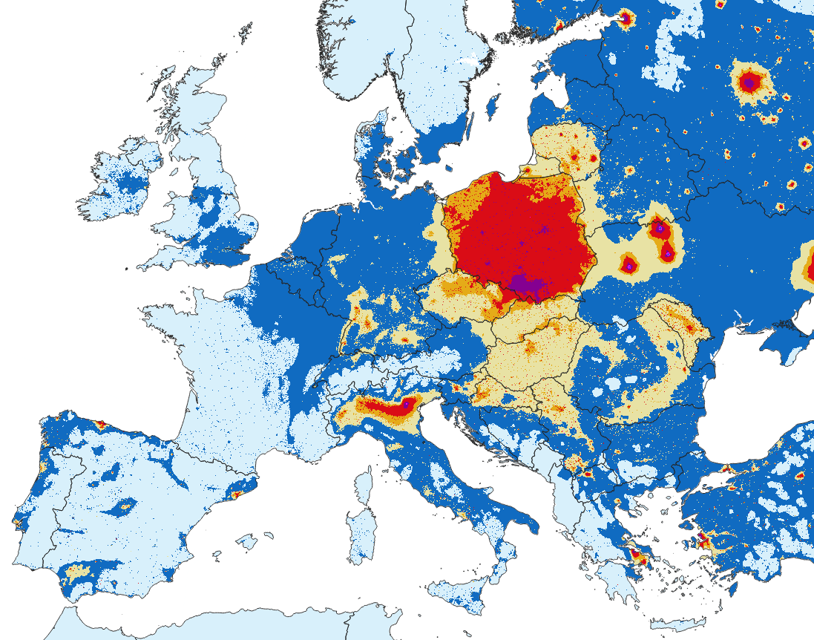
BaP maps for Baseline 2020 and 2050
Baseline 2020
Baseline 2050
ng/m³
ng/m³
Norwegian Meteorological Institute

Slide 22

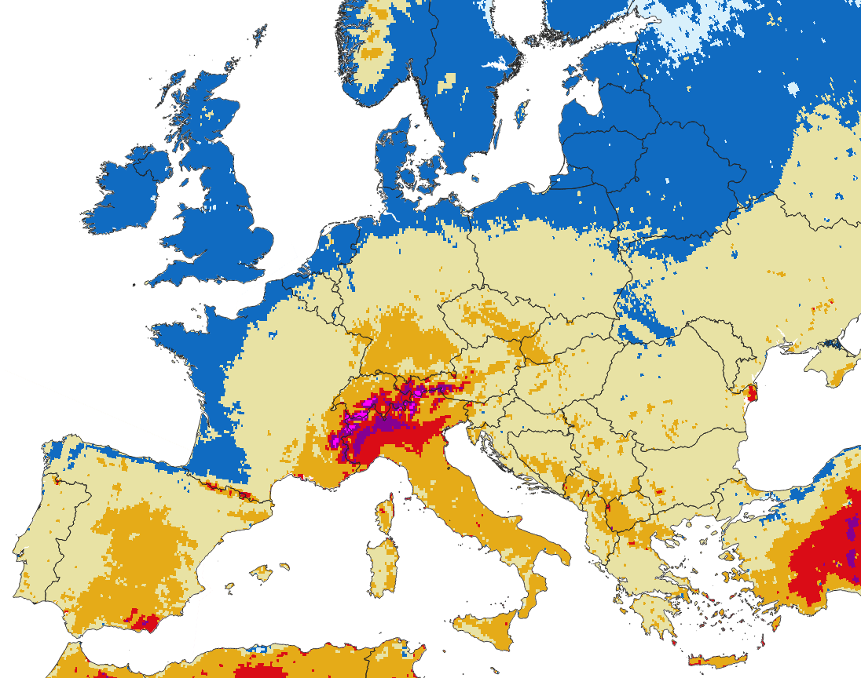
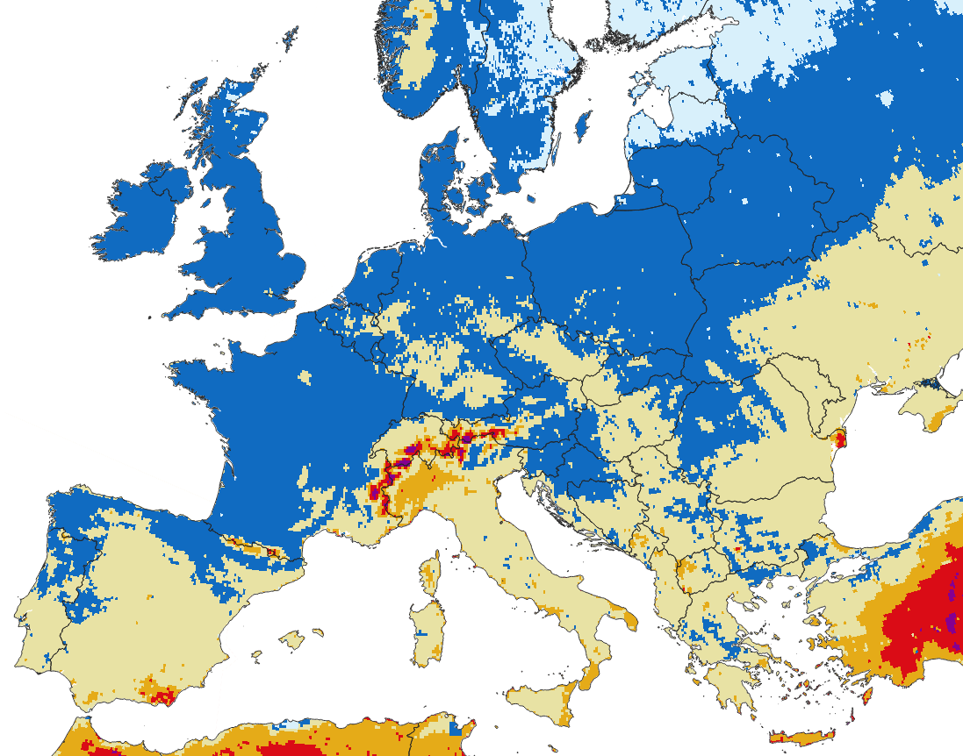
SOMO35 maps for Baseline 2020 and 2050
Baseline 2020
Baseline 2050
ppb.day
ppb.day
Norwegian Meteorological Institute

Slide 23
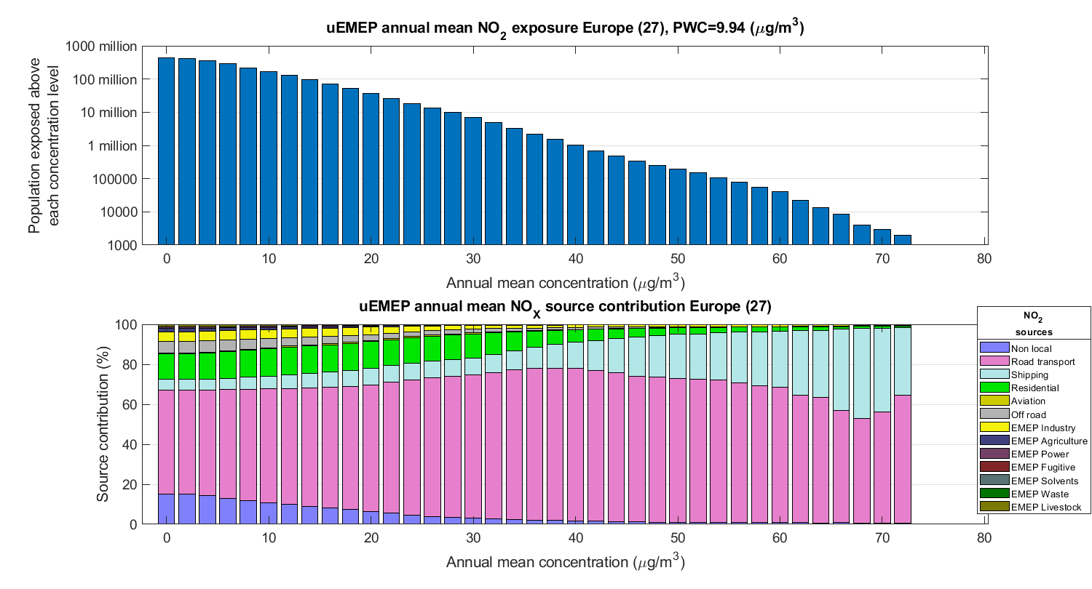
Baseline 2020 annual mean NO₂
Population exposed above a given concentration (log scale)
Population exposure distribution, source contribution (%)
Norwegian Meteorological Institute

Slide 24
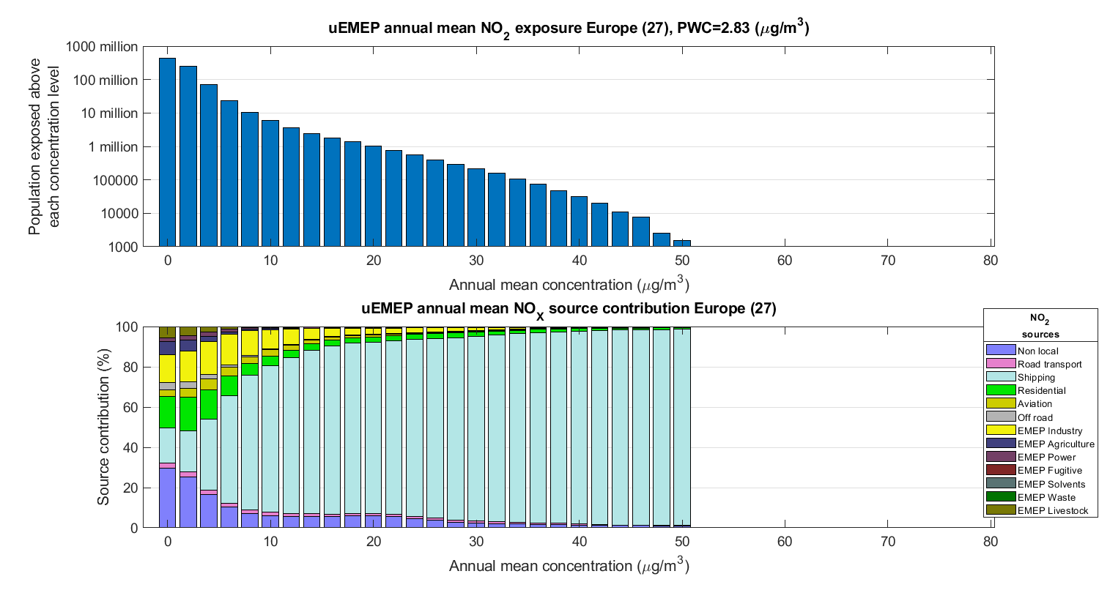
Baseline 2050 annual mean NO₂
Population exposed above a given concentration (log scale)
Population exposure distribution, source contribution (%)
Norwegian Meteorological Institute

Slide 25
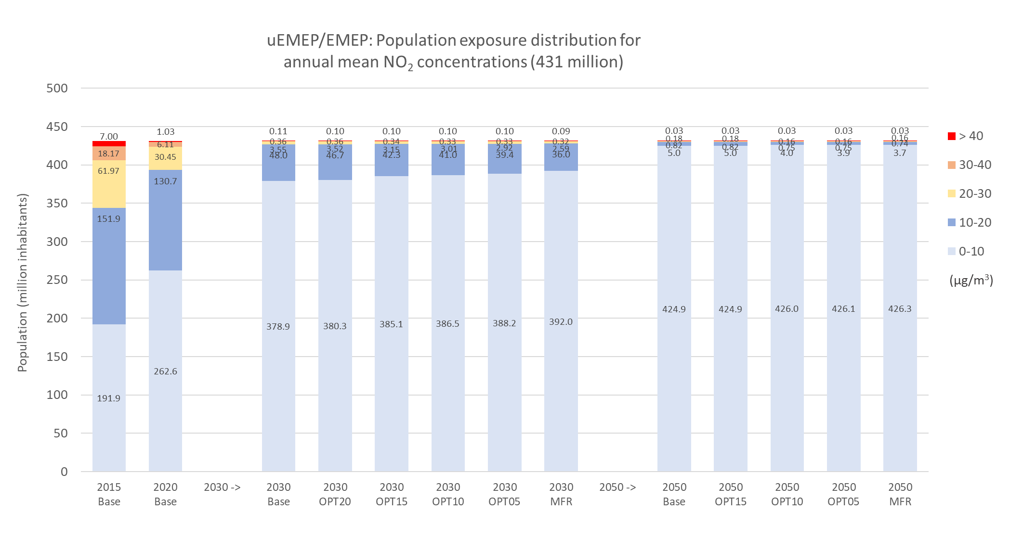
Population exposure NO₂
Similar distributions to the station calculations but with more lower concentrations
In 2030 hardly any exceedance > 40 µg/m³
In 2050 4 million inhabitants > 10 µg/m³
Persistent exceedances in 2030 and 2050 are at sites near Mediterranean ports (review national shipping emissions)
Little difference between baseline and MFR
2015, 2020
2030
2050
Norwegian Meteorological Institute

Slide 26

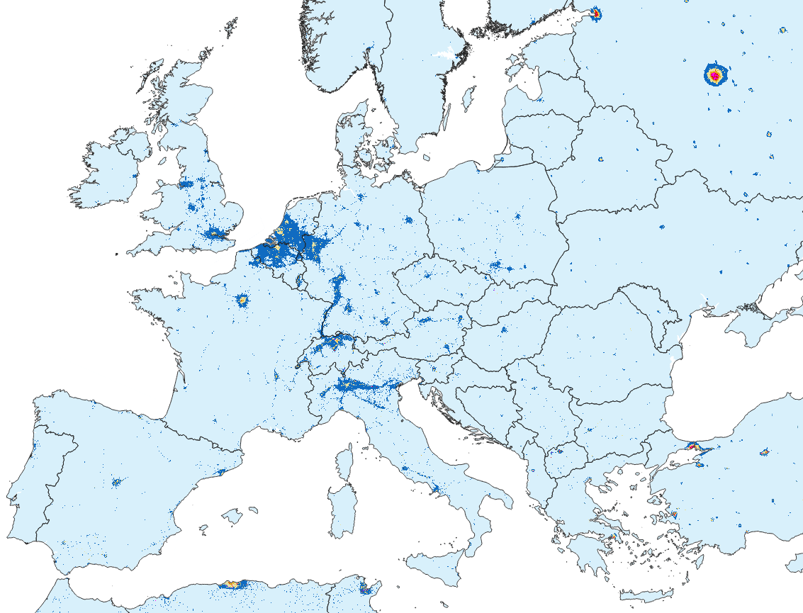
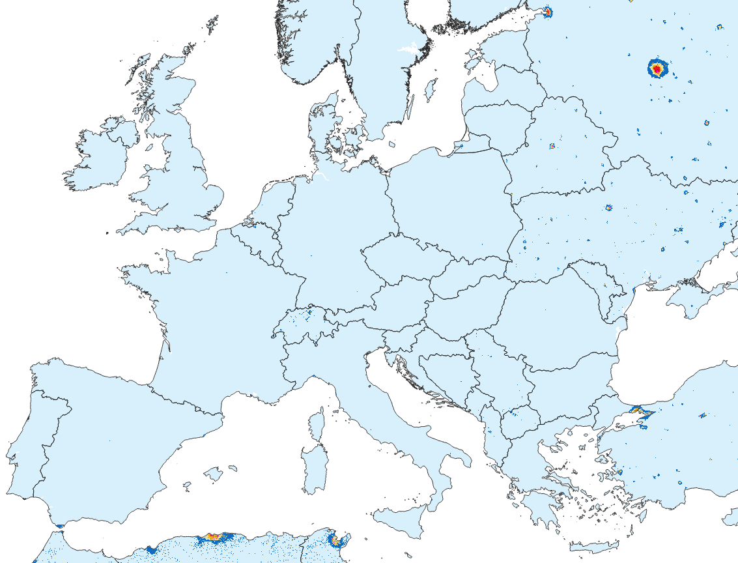
NO₂ maps for Baseline 2020 and 2050
Baseline 2020
Baseline 2050
µg/m³
µg/m³
Norwegian Meteorological Institute

Slide 27
NO₂ maps for Baseline 2020 and 2050
Baseline 2020
Baseline 2050
Norwegian Meteorological Institute

Slide 28
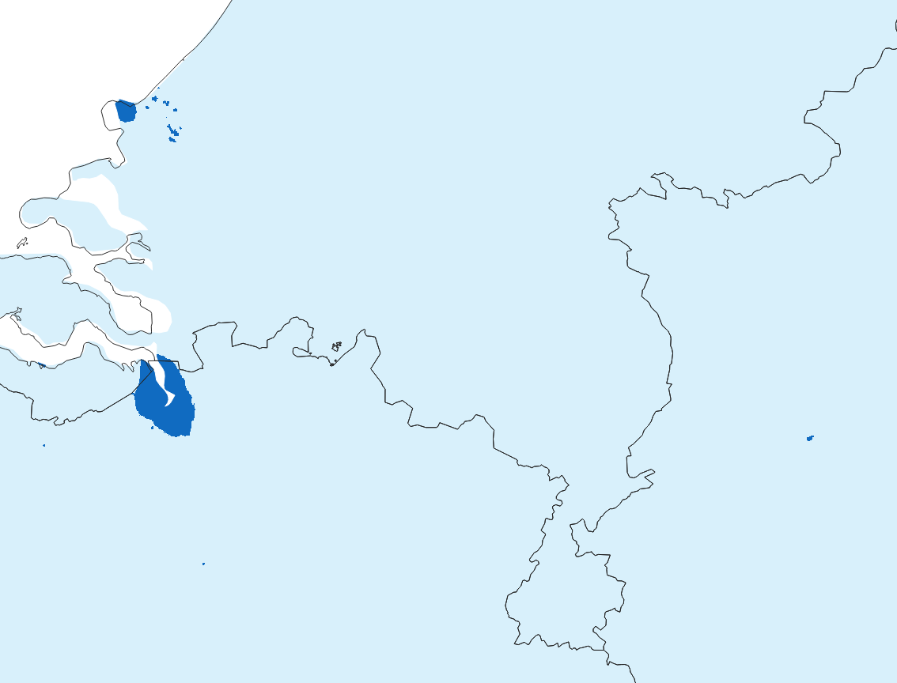
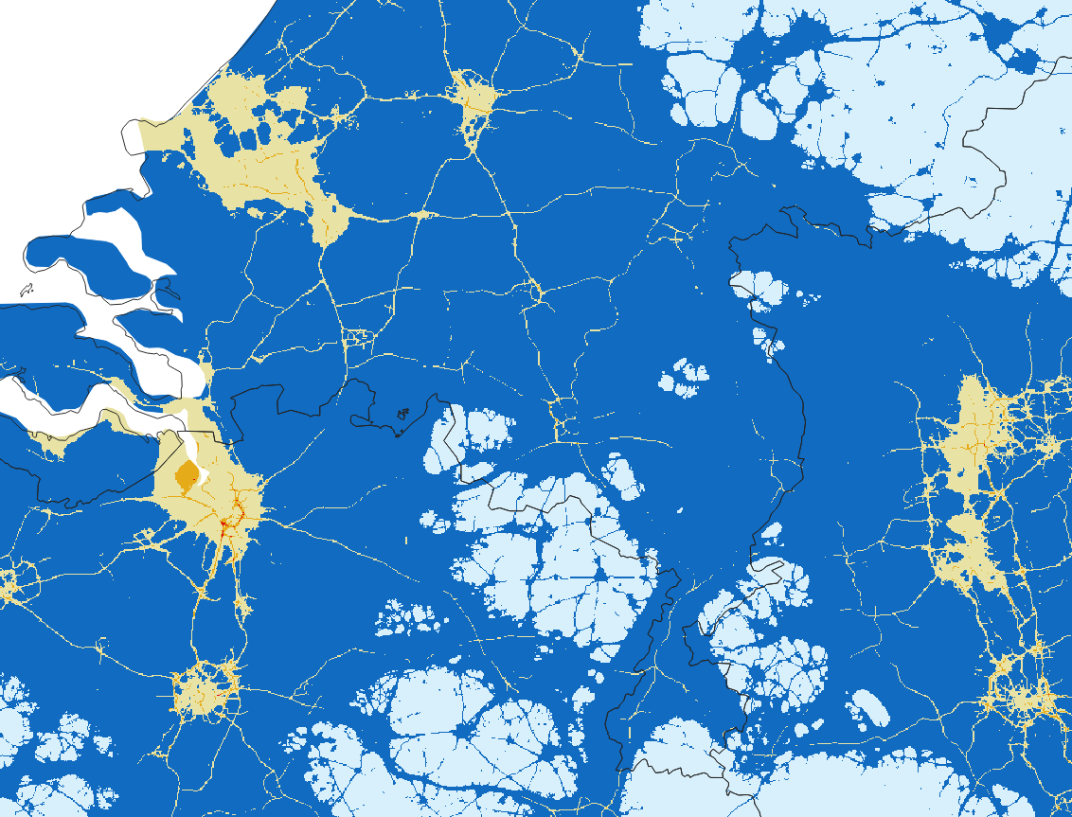
NO₂ maps for Baseline 2020 and 2050
Baseline 2020
Baseline 2050
µg/m³
µg/m³
Norwegian Meteorological Institute

Slide 29
Summary
The NO₂ station exceedance calculations indicate that:
  Currently ~4% of NO₂ stations measure annual mean concentrations > 40 µg/m³
  This will be close to 0 in 2030 and 2050
  In 2030 ~40% of NO₂ stations will measure annual mean concentrations > 10 µg/m³
  In 2050 this will be ~5%
In the present day, road traffic exhaust emissions dominate the NO₂ concentrations. A significant decrease in these emissions is expected over the coming decades and other sources will begin to dominate
The PM_{2.5} exposure calculations indicate that:
  Currently ~100 million inhabitants are exposed to PM_{2.5} concentrations > 10 µg/m³
  In 2050 this will reduce to ~10 million inhabitants
  In 2050 between 100 to 200 million inhabitants will still be exposed to PM_{2.5} concentrations > 5 µg/m³
When concentrations approach lowered threshold values then local emission sources, not always well defined in the emission inventories, become important and will need to be addressed individually at the local level.
There are still some inconsistencies in the national emissions and their spatial distribution that affect details in the results
  National shipping in the Mediterranean
  Residential combustion emissions in various countries
  Non-exhaust emissions in Nordic countries (not included in the scenarios)
Norwegian Meteorological Institute

Slide 30
Achievability
The likelihood of achieving various concentrations thresholds in 2030 for the baseline and MFR scenarios.
Green- very likely, orange – possible, red – difficult, purple – very (very) difficult
2030 scenario | Baseline | MFR
PM_{2.5} (annual) [µg/m³] | 20, 15, 10, 5 | 20, 15, 10, 5
PM₁₀ (annual) [µg/m³] | 30, 20, 15 | 30, 20, 15
NO₂ (annual) [µg/m³] | 30, 20, 10 | 30, 20, 10
O₃ (8-hour mean) [µg/m³] (25 days) | 120, 100 | 120, 100
SO₂ (annual) [µg/m³] | 20 | 20
CO (daily) [mg/m³] | 10 | 10
Benzene (annual) [µg/m³] | 5, 1.7 | 5, 1.7
BaP (annual) [ng/m³] | 1.0, 0.7, 0.4, 0.12 | 1.0, 0.7, 0.4, 0.12
Norwegian Meteorological Institute

Slide 31
Additional slides not to be used
Norwegian Meteorological Institute

Slide 32
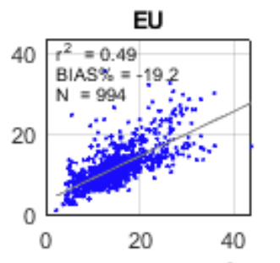
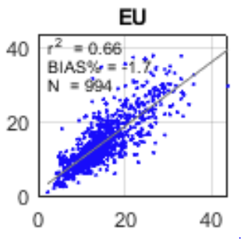
Bias adjustment
Norwegian Meteorological Institute

Slide 33
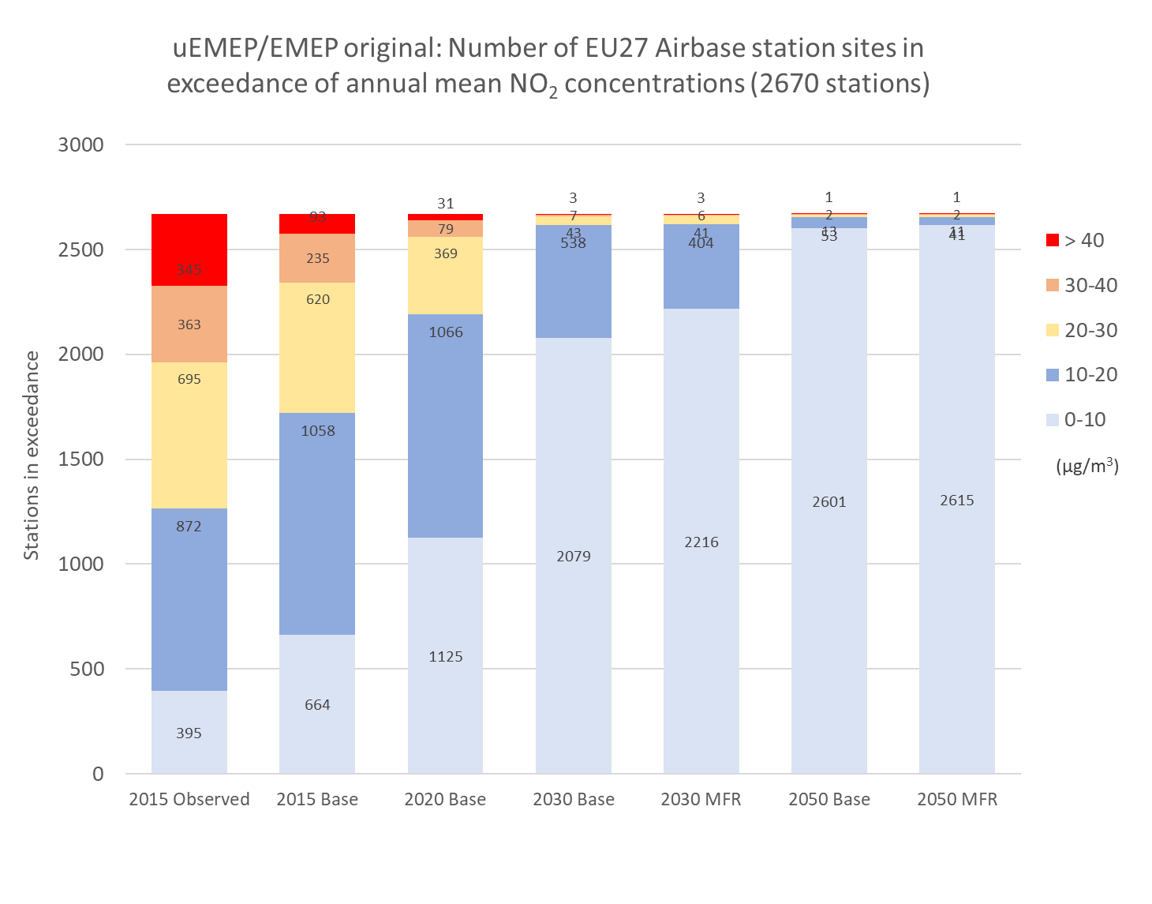
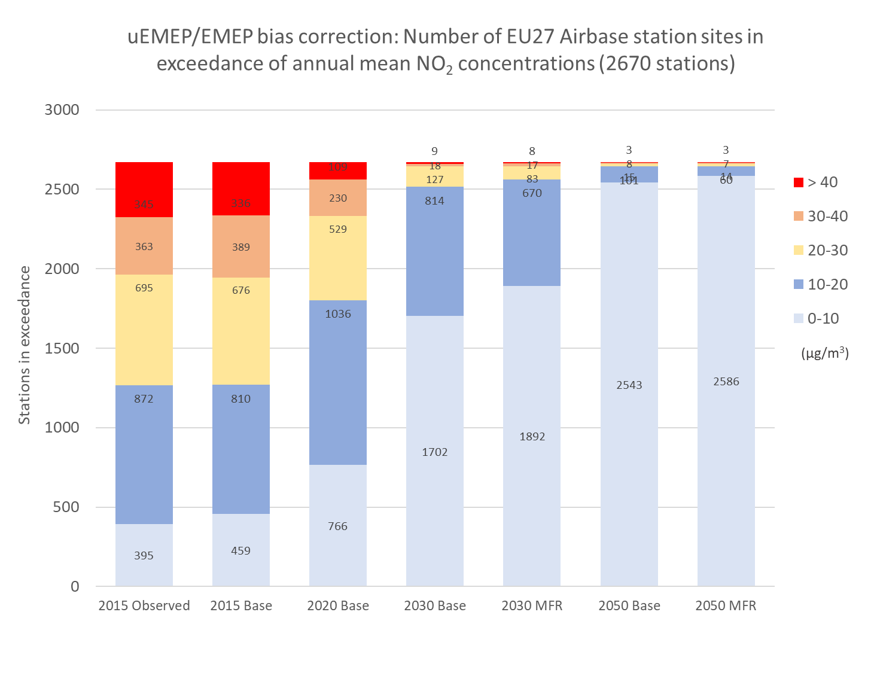
Bias adjustment NO₂
Bias adjustment is applied per country (EU27) to reflect country specific emission reporting. The same scaling factors are used for all scenarios. Scaling is applied to NO₂ and PM_{2.5}
Original Base and MFR scenarios NO₂
Bias corrected Base and MFR scenarios NO₂
Reference
calculation
2030
2050
Reference
calculation
2030
2050
Norwegian Meteorological Institute

Slide 34
PM_{2.5} maps for Baseline 2020 and 2050
Baseline 2020
Baseline 2050
Norwegian Meteorological Institute

Slide 35
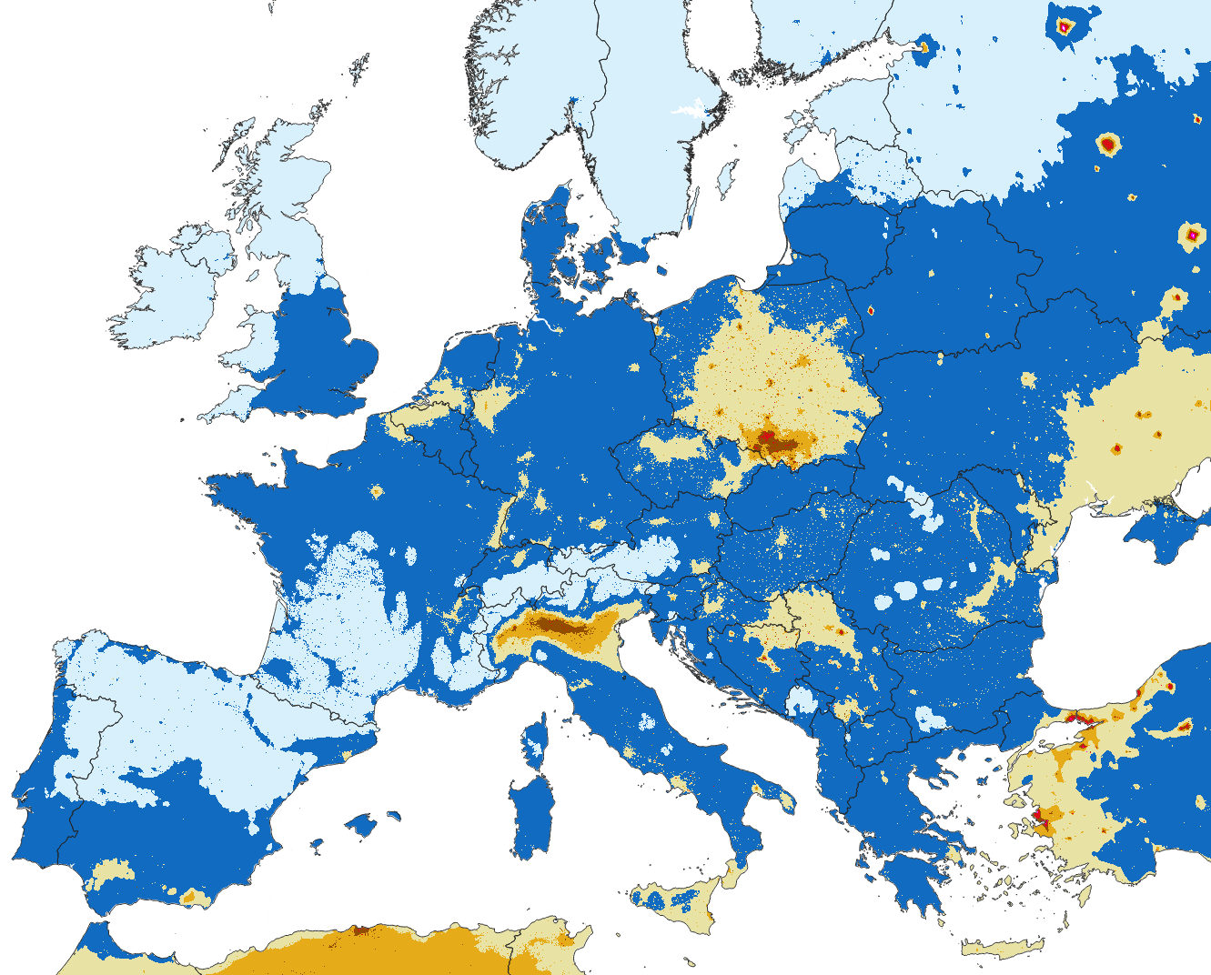
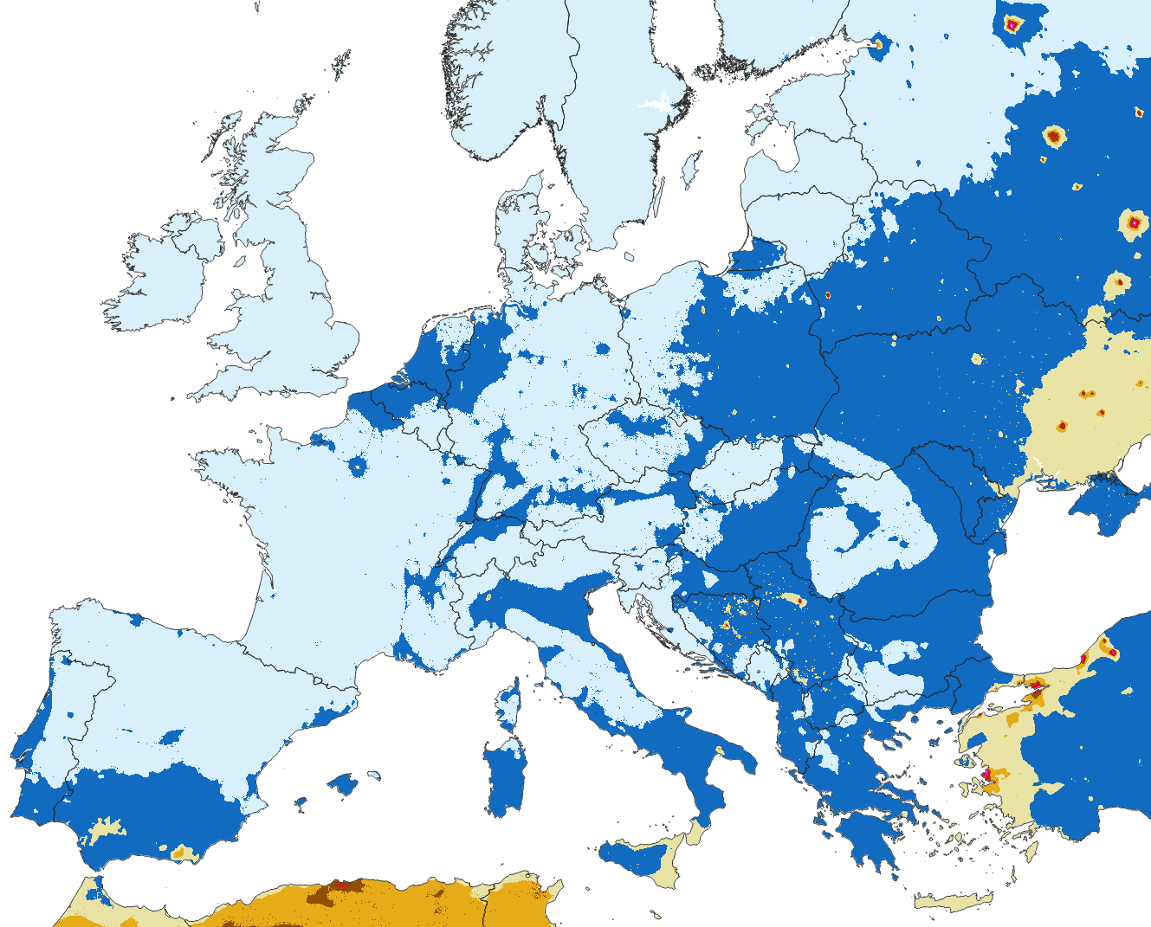
PM_{2.5} maps for Baseline 2020 and 2050: bias corrected
Baseline 2020 bias corrected
Baseline 2050 bias corrected
Norwegian Meteorological Institute

Slide 36
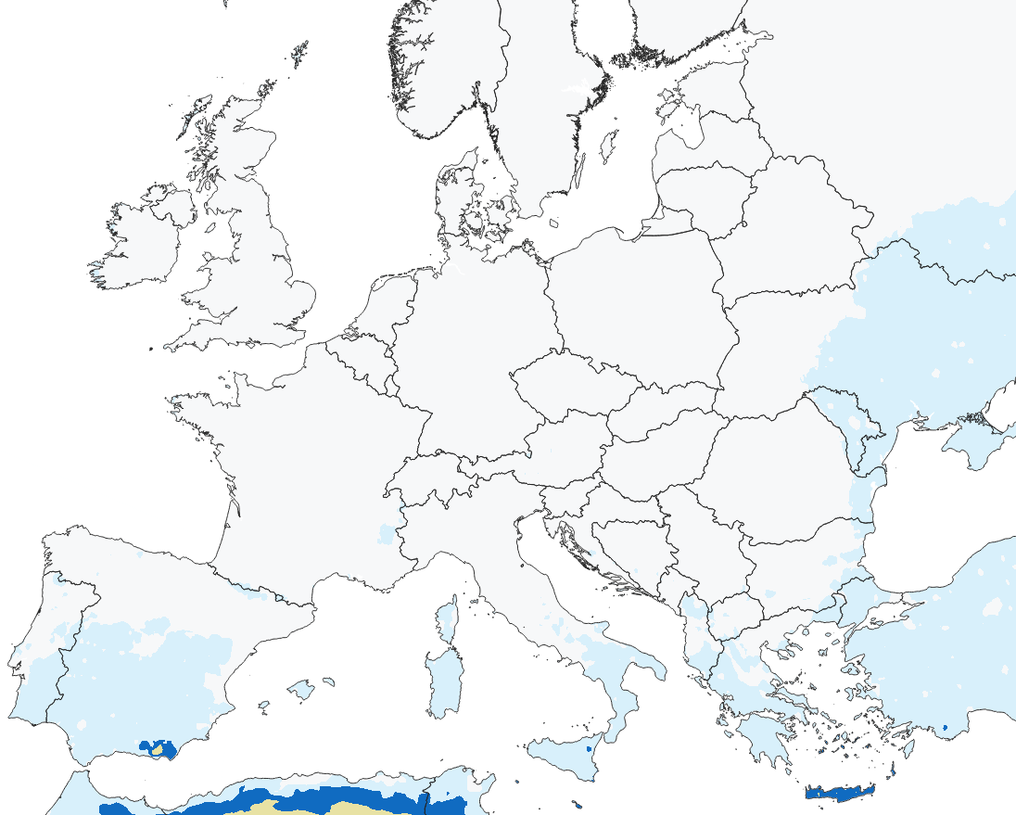

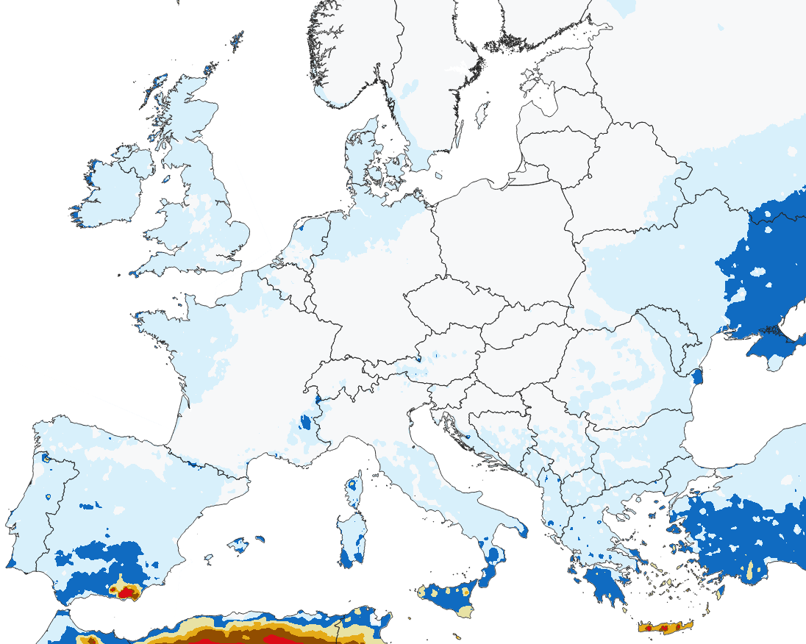
PM_{2.5} and PM₁₀ maps of natural contributions from wind blown dust and sea salt
PM2.5
PM10
Norwegian Meteorological Institute

Slide 37
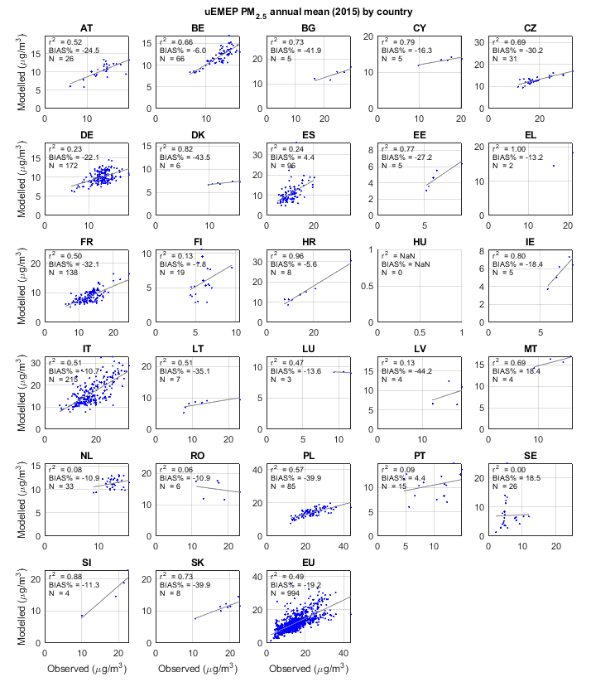
Indicator 1 – air pollutant concentrations and exposure: station calculations
Comparison of modelled and observed concentrations at all Airbase sites for the reference year 2015
  Station bias for pollutants addressed here:
    NO₂ = -23%
    PM_{2.5} = -19%
    SOMO35 = +1%
  Bias for other pollutants calculated:
    BaP = +11%
    PM₁₀ = -33%
    CO = -44%
    Benzene = -53%
    SO₂ = -26%
    O₃ 26th daymax = -23%
Large negative bias for a number of pollutants
Impact of model/emission bias on the scenario calculations is addressed with a bias adjustment for NO₂ and PM_{2.5}
PM_{2.5} annual mean concentrations 2015 EU27
Norwegian Meteorological Institute

Slide 38
Achievability
The likelihood of achieving various concentrations thresholds in 2030 for the baseline and MFR scenarios.
Green- very likely, orange – possible, red – difficult, purple – very (very) difficult
2030 scenario | Baseline | MFR
PM_{2.5} (annual) [µg/m³] | 20, 15, 10, 5 | 20, 15, 10, 5
PM_{2.5} (daily) [µg/m³] | - | -
PM₁₀ (annual) [µg/m³] | 30, 20, 15 | 30, 20, 15
PM₁₀ (daily) [µg/m³] | - | -
NO₂ (annual) [µg/m³] | 30, 20, 10 | 30, 20, 10
NO₂ (daily) [µg/m³] | - | -
NO₂ (hourly) [µg/m³] | - | -
O₃ (peak-season) [µg/m³] | - | -
O₃ (8-hour mean) [µg/m³] | (25 days) 120, 100 | (25 days) 120, 100
SO₂ (annual) [µg/m³] | 20 | 20
SO₂ (daily) [µg/m³] | - | -
SO₂ (hourly) [µg/m³] | - | -
CO (daily) [mg/m³] | 10 | 10
CO (8-hour) [mg/m³] | - | -
Benzene (annual) [µg/m³] | 5, 1.7 | 5, 1.7
BaP (annual) [ng/m³] | 1.0, 0.7, 0.4, 0.12 | 1.0, 0.7, 0.4, 0.12
Lead (annual) [µg/m³] | - | -
Arsenic (annual) [ng/m³] | - | -
Cadmium (annual) [ng/m³] | - | -
Nickel (annual) [ng/m³] | - | -
Norwegian Meteorological Institute

