Slide 1
European primary emissions in 2020 modulated by the COVID-19 pandemic disruptions
Marc GUEVARA¹, Oriol JORBA¹, Herve PETETIN¹, Hugo DENIER VAN DER GON², Jeroen KUENEN², Ingrid SUPER², Vincent-Henri PEUCH³ and Carlos PEREZ GARCIA-PANDO^{1,4}
¹ Barcelona Supercomputing Center, Barcelona, Spain
² TNO, Department of Climate, Air and Sustainability, Utrecht, the Netherland
³ European Centre for Medium-Range Weather Forecasts, Reading, UK
⁴ ICREA, Catalan Institution for Research and Advanced Studies, Barcelona, Spain
23nd EMEP Task Force on Measurement and Modelling Meeting
^{Online Meeting, 3-5 May 2022}
^{mailto: marc.guevara@bsc.es}

Slide 2
Outline
The CAMS Business-as-Usual & COVID-19 2020 emission datasets
Motivation
Methodoloy
Results
Intercomparison against other datasets (official and non-official inventories)
2021 – Is COVID-19 effect over?
Take home messages

Slide 3
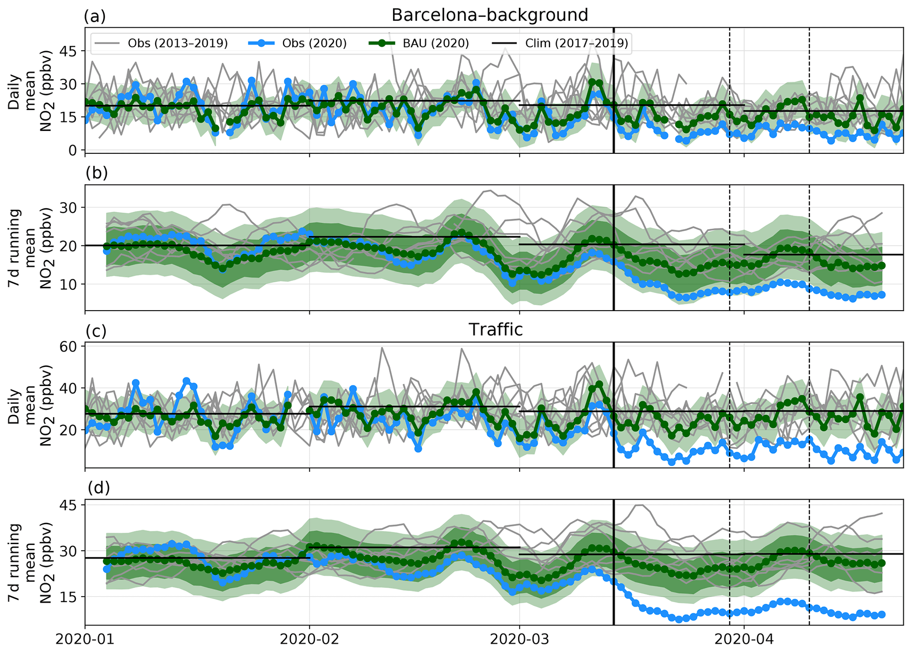
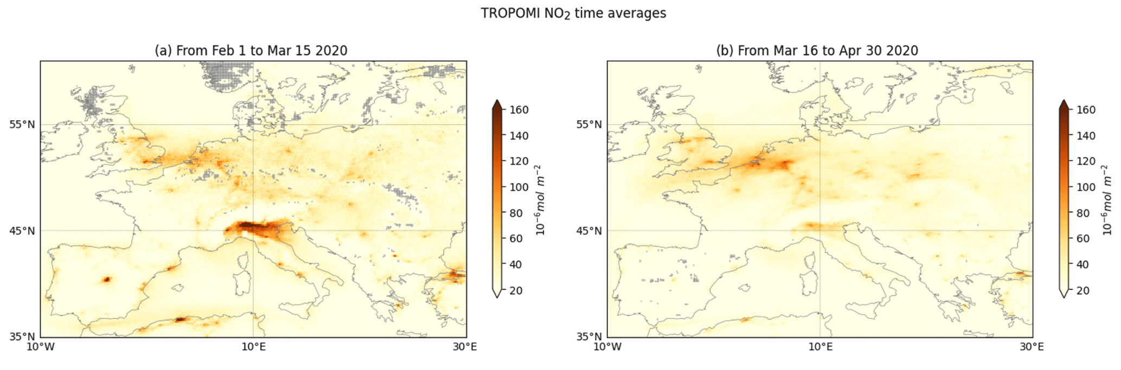
Motivation and objective
Several studies have assessed the impact of COVID-19 on air pollution through the use of ground-based or satellite observations combined with machine learning techniques.
A complete understanding requires also quantifying the reduction of primary emissions:
To understand the impact of the restrictions at the sector-, species- level
To produce emission datasets that can be used in air quality models
Barré et al. (2021)
Petetin et al. (2020)

Slide 4
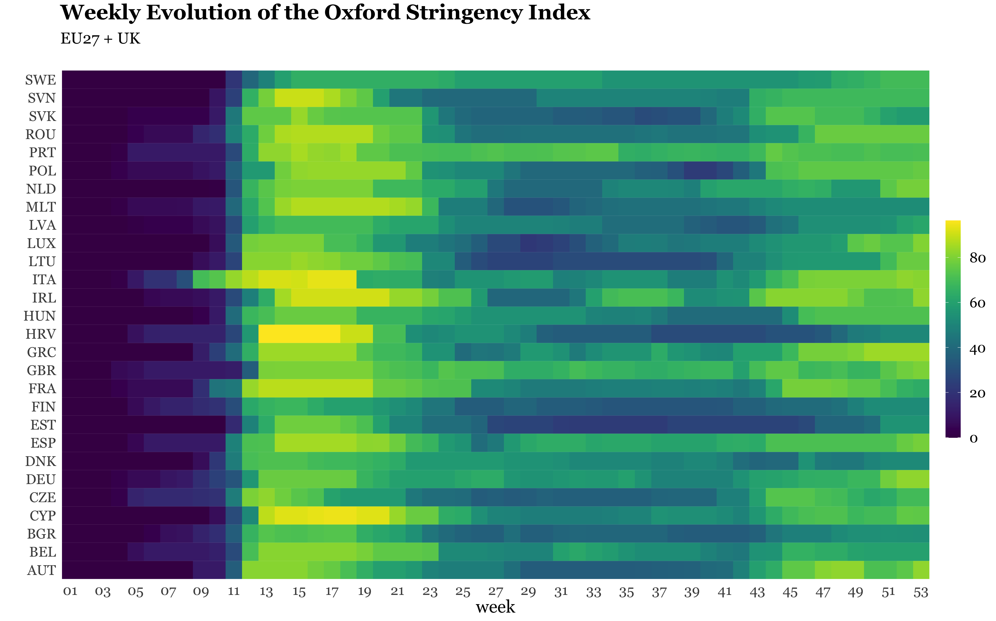
Motivation and objective
Weekly Evolution of the Oxford Stringency Index
(EU27 + UK)
Challenge
To capture heterogeneity of restrictions:
Across countries
Changes in time of the restriction levels
Diversity in the types of restrictions
Spring
lockdowns
Exit process
Fall
lockdowns
Hale et al. (2021)

Slide 5
Motivation and objective
Challenge
To capture heterogeneity of restrictions:
Across countries
Changes in time of the restriction levels
Diversity in the types of restrictions
Objective
To develop a dataset of emission adjustment factors:
Country-dependent
Vary in time (daily, weekly, monthly)
Sector/Pollutant-dependent

Slide 6
Methodology: Overview
Data-driven approach: Changes in emissions assumed to follow changes observed in measured time-series representing the main activities of each sector
Construction of adjustment factors: Ratio between the measured activity data for a given day and the value of this activity without the COVID-19 influence (baseline)
Sector | Sources of information
Energy industry | Electricity demand data: ENTSO-E (2021) Outdoor temperature: C3S (2017)
Manufacturing industry | Industrial Production Index: Eurostat (2021)
Residential/Commercial combustion | Mobility data: Google (2021) – Groceries, residences, workplaces stations, adjusted with energy consumption statistics
Solvents (industrial use) | Industrial Production Index: Eurostat (2021)
Fugitive emissions from fossil fuels | Industrial Production Index: Eurostat (2021)
Road Transport | Mobility data: Google (2021) – Transit stations adjusted with national measured traffic counts
Shipping | CAMS-GLOB-SHIP CO2 weekly emissions: Jalkanen et al. (2016)
Aviation | Airport movement statistics: EUROCONTROL (2021)
Off-road transport | Industrial Production Index: Eurostat (2021)

Slide 7
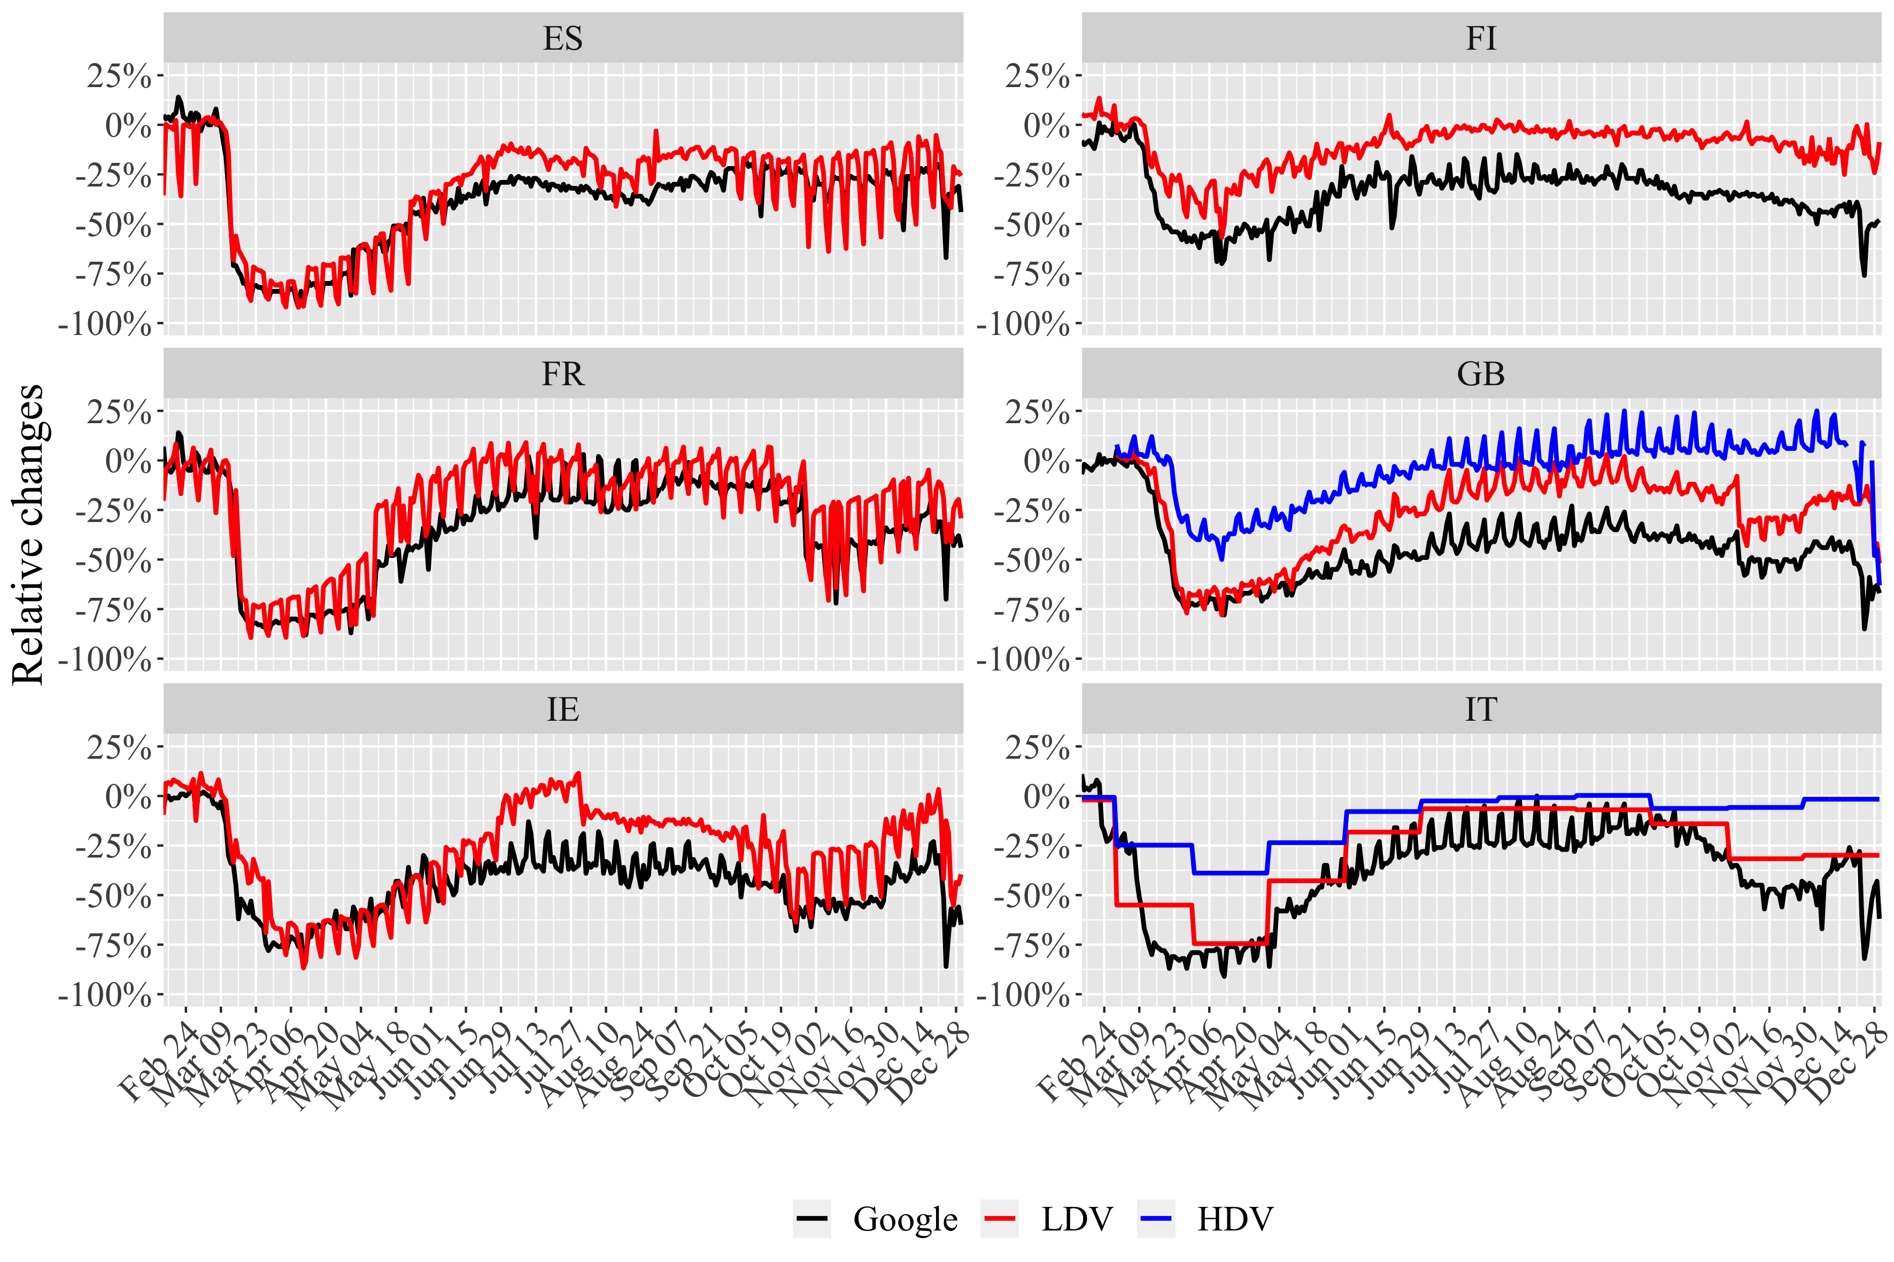
Methodology: Road transport
Google Mobility Reports (Google LLC, 2021) calibrated with trends from measured traffic counts:
In general, good agreement during lockdown period, but…
Google underestimates the recovery of light duty vehicles (LDV) activity during lockdown exit process
Google is not representative of changes observed in heavy-duty vehicles (HDV) – considered essential

Slide 8
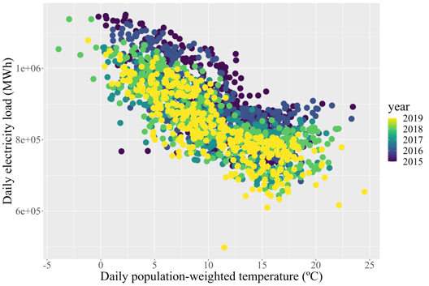
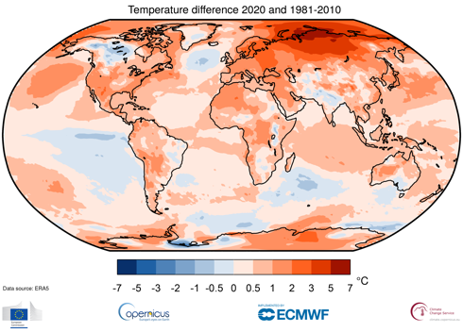
Methodology: Energy industry
Direct comparison between 2020 and pre-lockdown (2019) electricity demand levels would be influenced by the confounding effect of meteorological variability
Use of Artificial Intelligence to estimate 2020 business-as-usual electricity demand:
Gradient boosting machine model
Features: ENTSO-E electricity demand & population-weighted ERA5 temperature
Training period: Jan-Dec 2015-2019

Slide 9
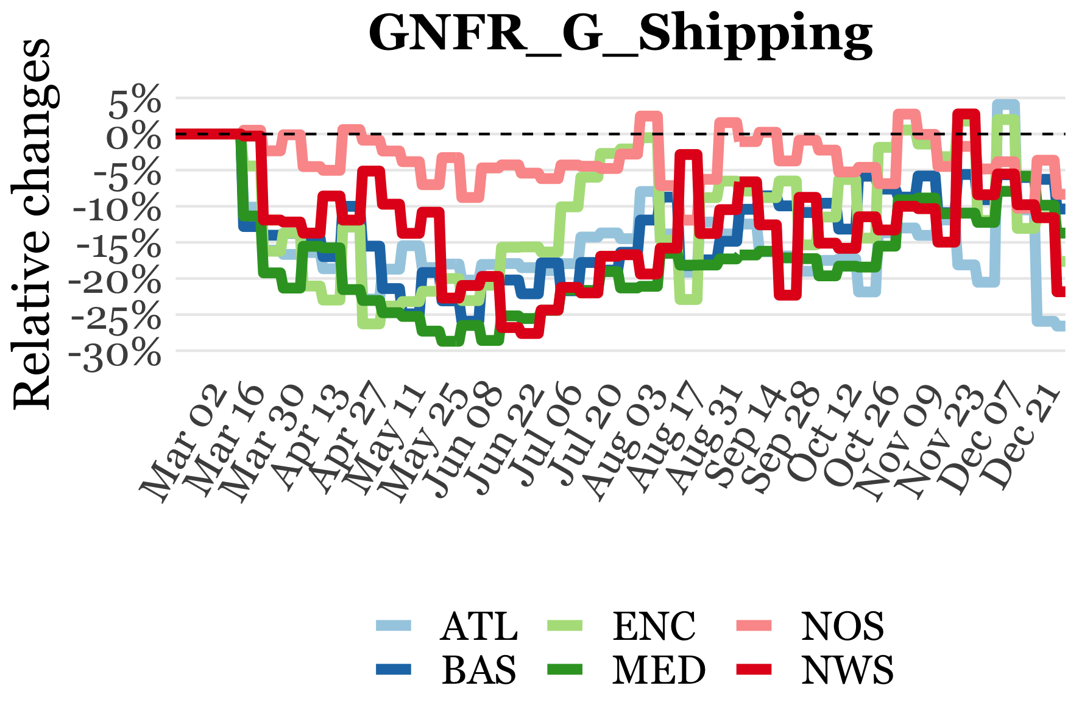
Results: Emission adjustment factors
Pollutant-dependency to consider heterogeneous impact across activities within the same sector
Sea region-dependency to consider heterogeneous impact across ship traffic categories

Slide 10
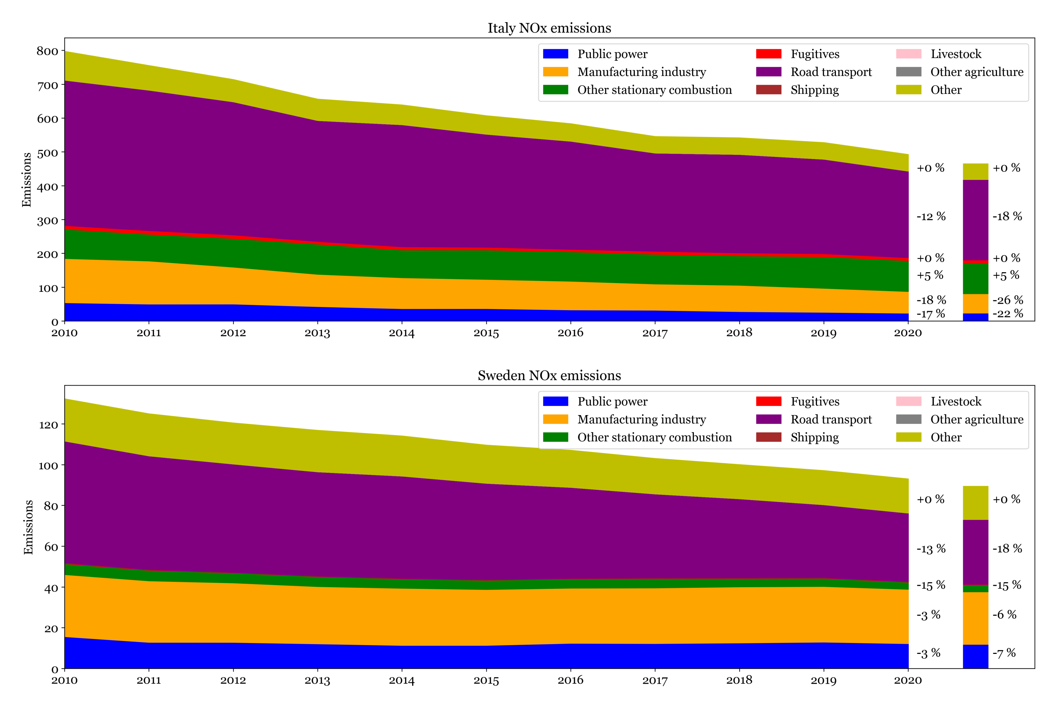
Results: Impact of COVID-19 on emissions
Combination of the adjustment factors with the CAMS-REG 2020 Business-as-Usual (BAU) gridded inventory (developed by TNO):
Extrapolation of CAMS-REG_v5.1 2018 to year 2020 including only the impact of non-COVID-19 factors (e.g. implementation of global sulphur cap, changes in heating degree day)
Resulting spatial and temporal disaggregated emissions to be used as input for AQ modelling (e.g. Eionet Report - ETC/ATNI 2021/16)

Slide 11
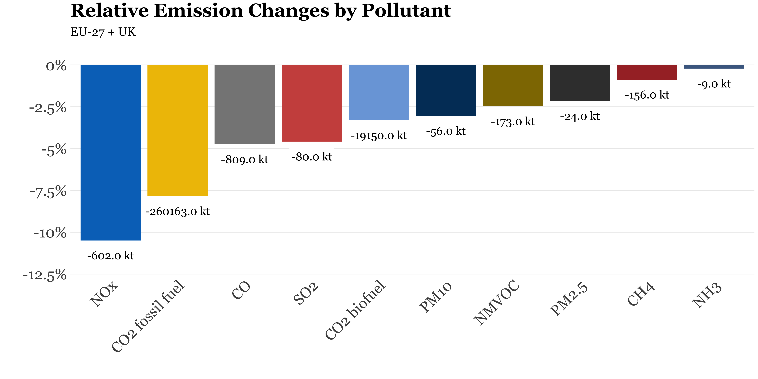
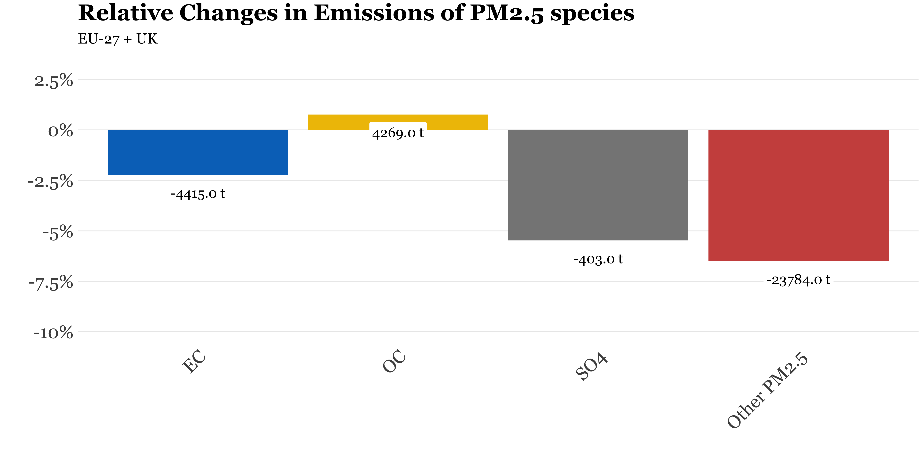
Results: Impact of COVID-19 on emissions
Pollutant breakdown:
Large contrast between decrease in NO_{x} (-10.5%) and PM10/PM2.5 (-3% and -2.1%).
NH₃ and CH₄ practically unaffected as they are linked to agricultural activities and waste management
Heterogeneous impact among PM2.5 species: from -5.5% for primary sulphates (SO₄) to + 0.8% for organic carbon (OC)

Slide 12
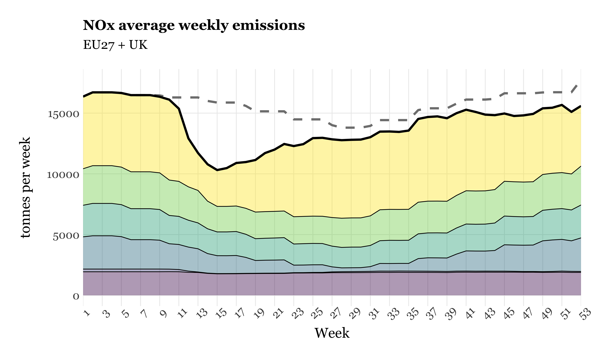
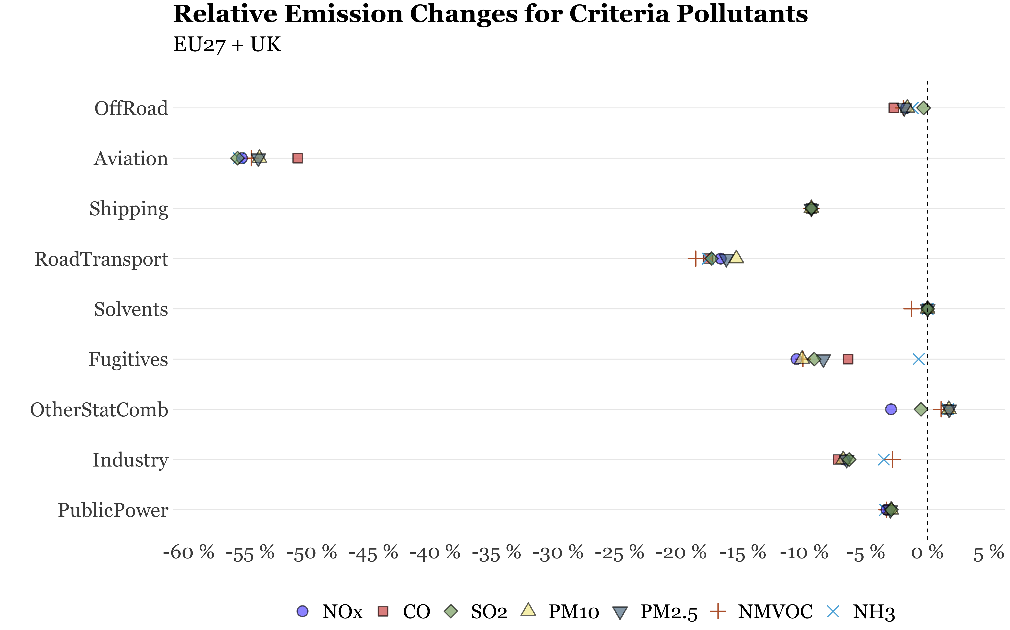
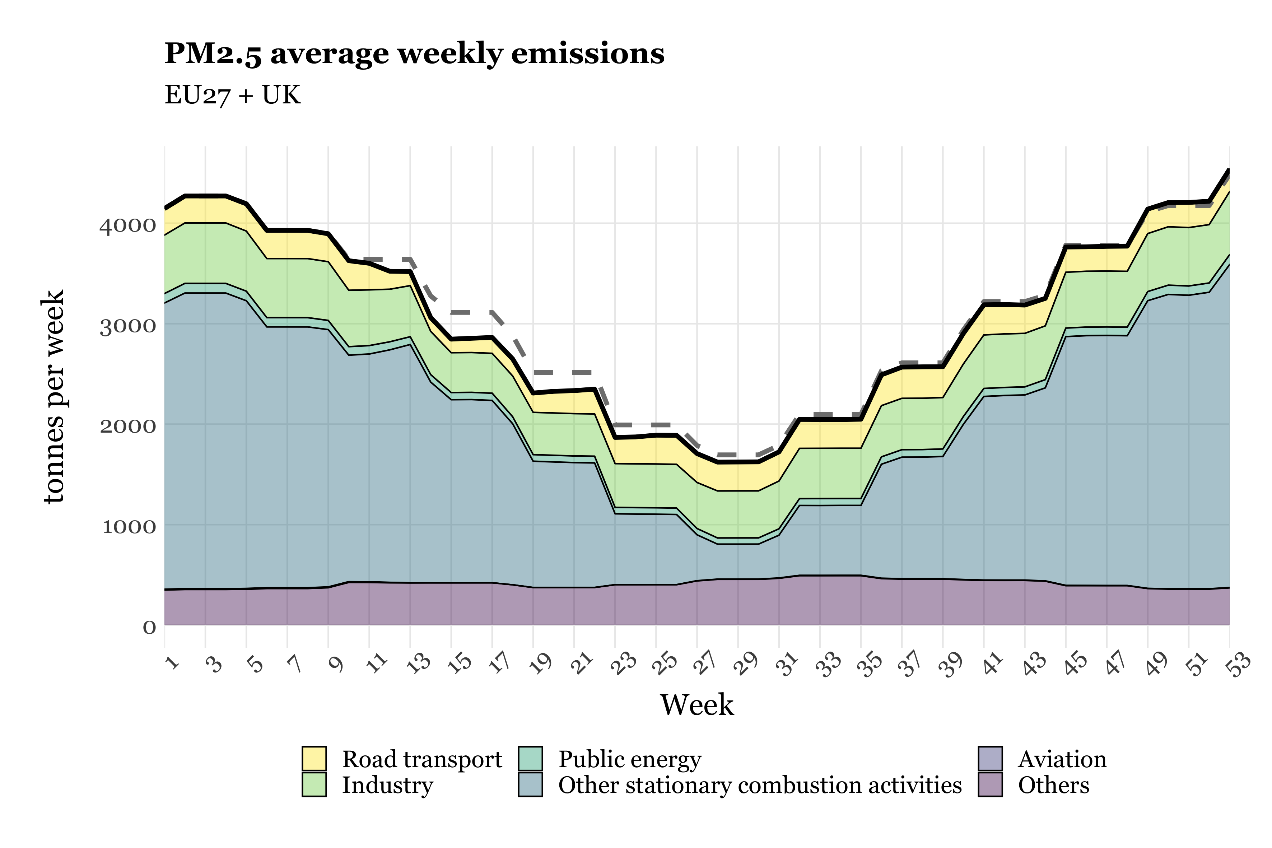
Results: Impact of COVID-19 on emissions
Business-as-usual
Business-as-usual

Slide 13
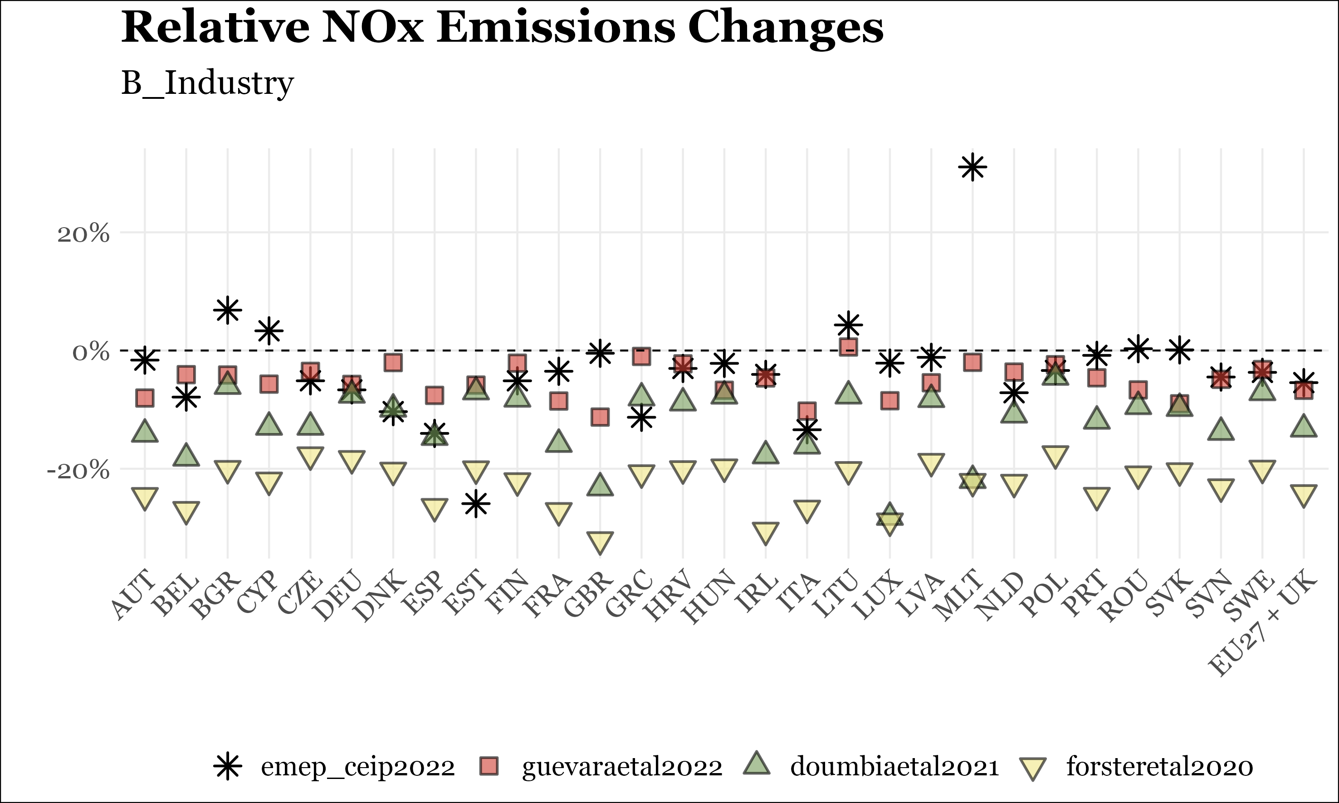
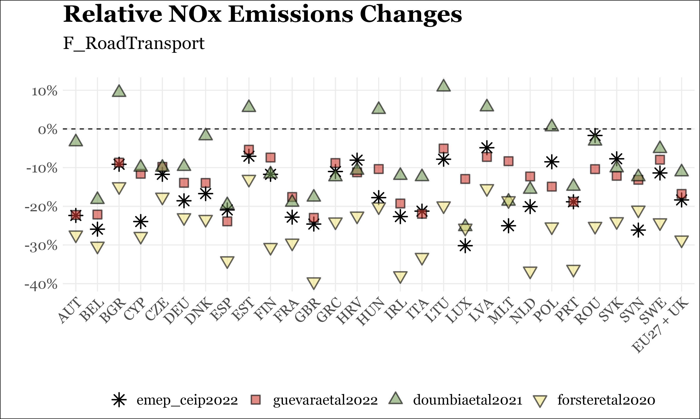
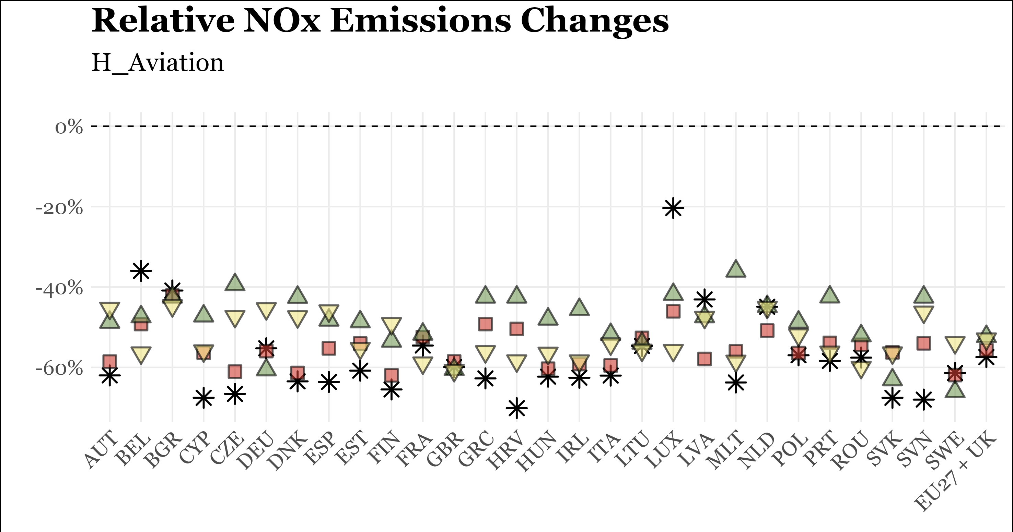
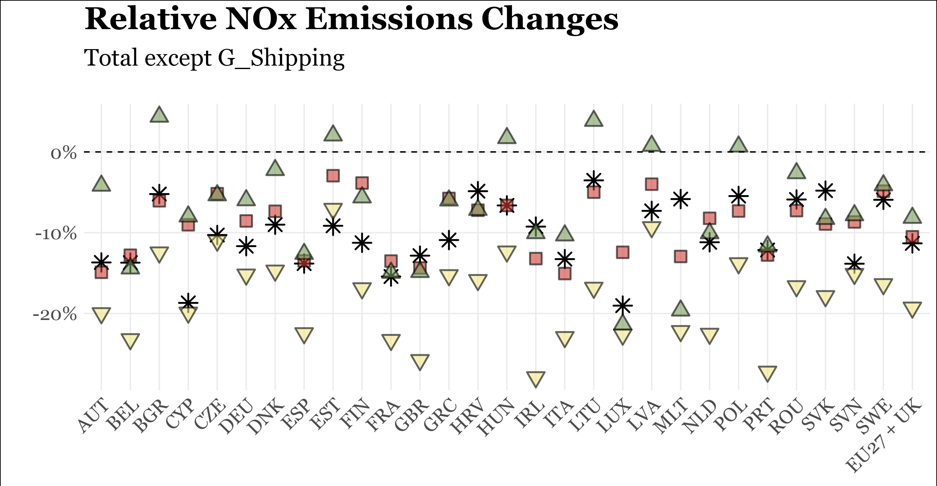
Intercomparison of emission changes
Official 2022 version EMEP inventories (2020 versus 2019) – preliminary submissions!
Non-official inventories (2020 versus 2020 BAU)

Slide 14
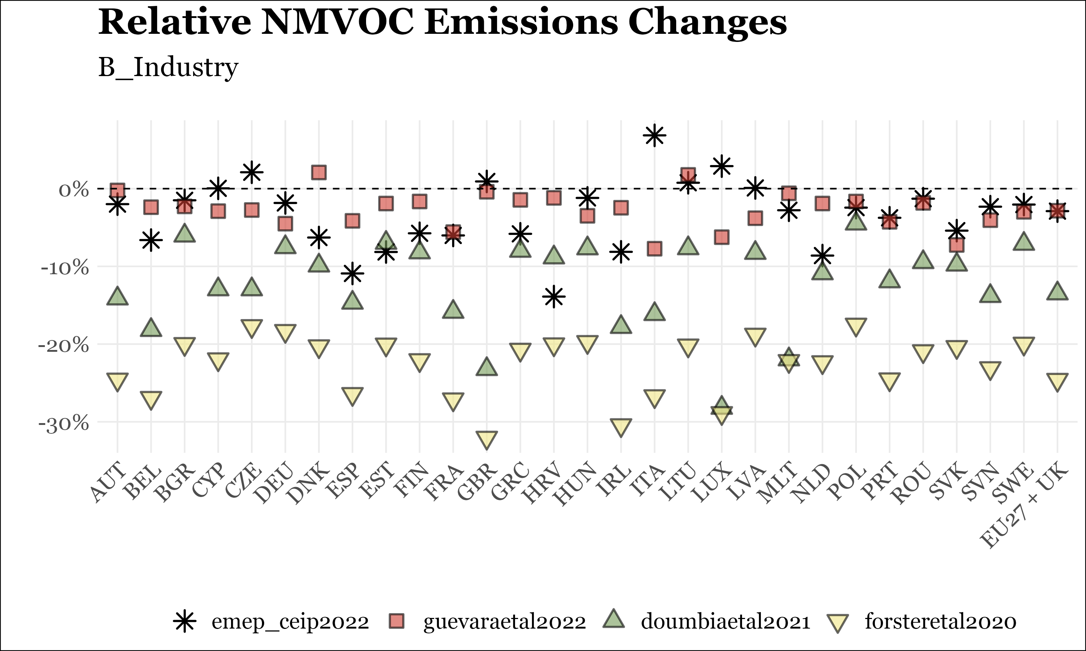
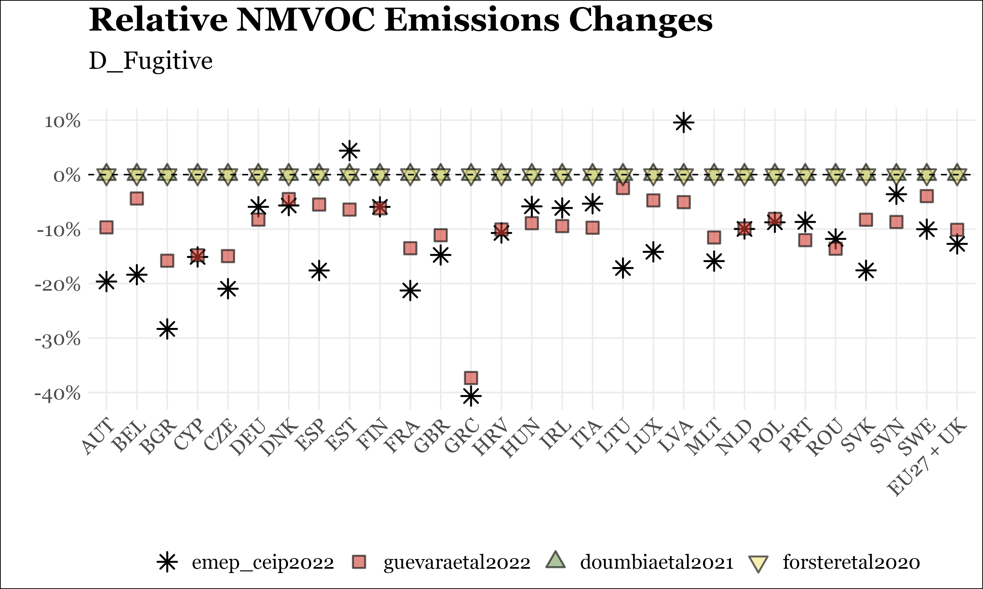
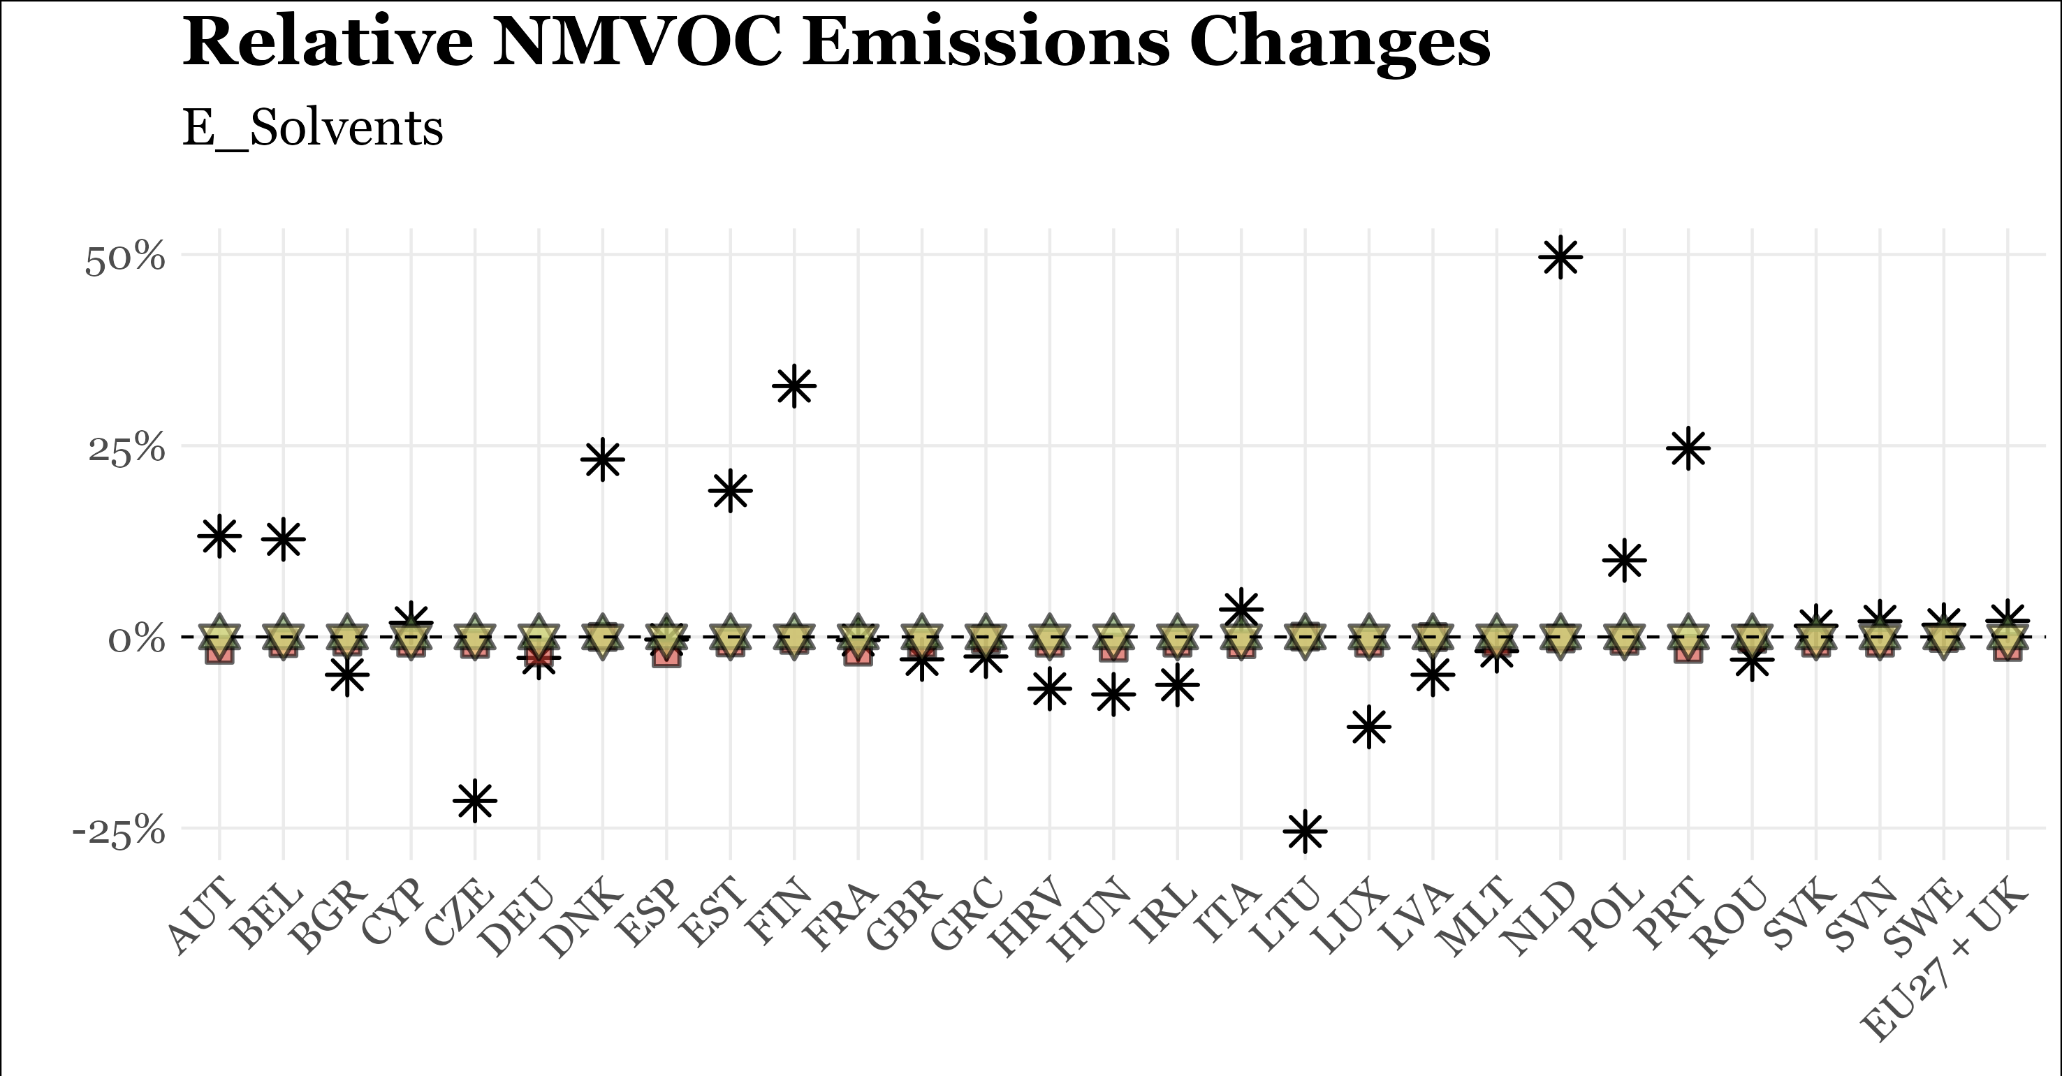
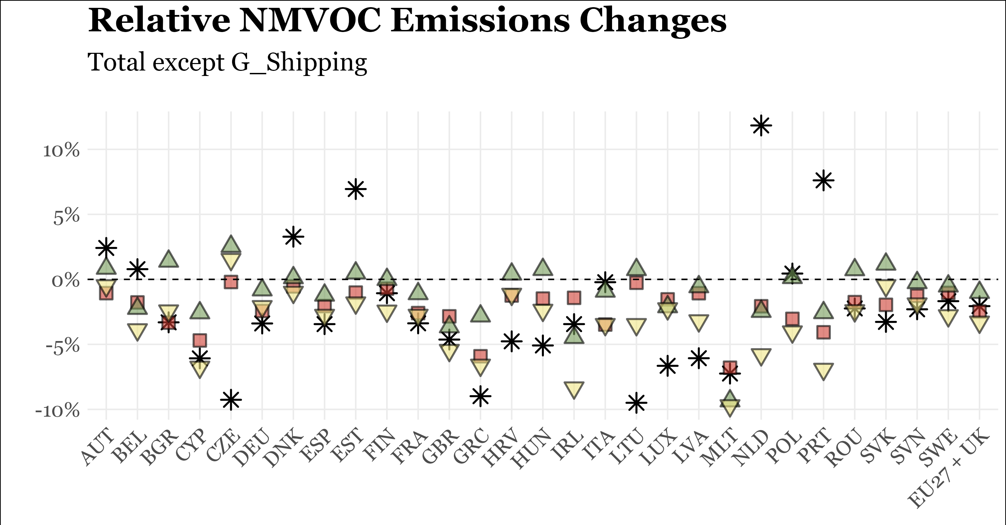
Intercomparison of emission changes
Official 2022 version EMEP inventories (2020 versus 2019) – preliminary submissions!
Non-official inventories (2020 versus 2020 BAU)
(2D3a - Domestic solvent use)
(+99%)
(+107%)
(+265%)
(-11%)
(-20%)

Slide 15
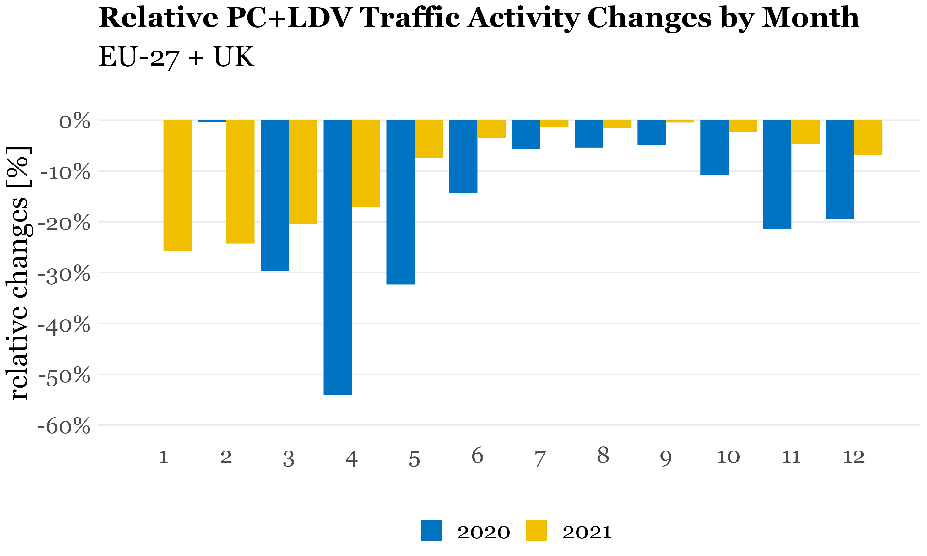
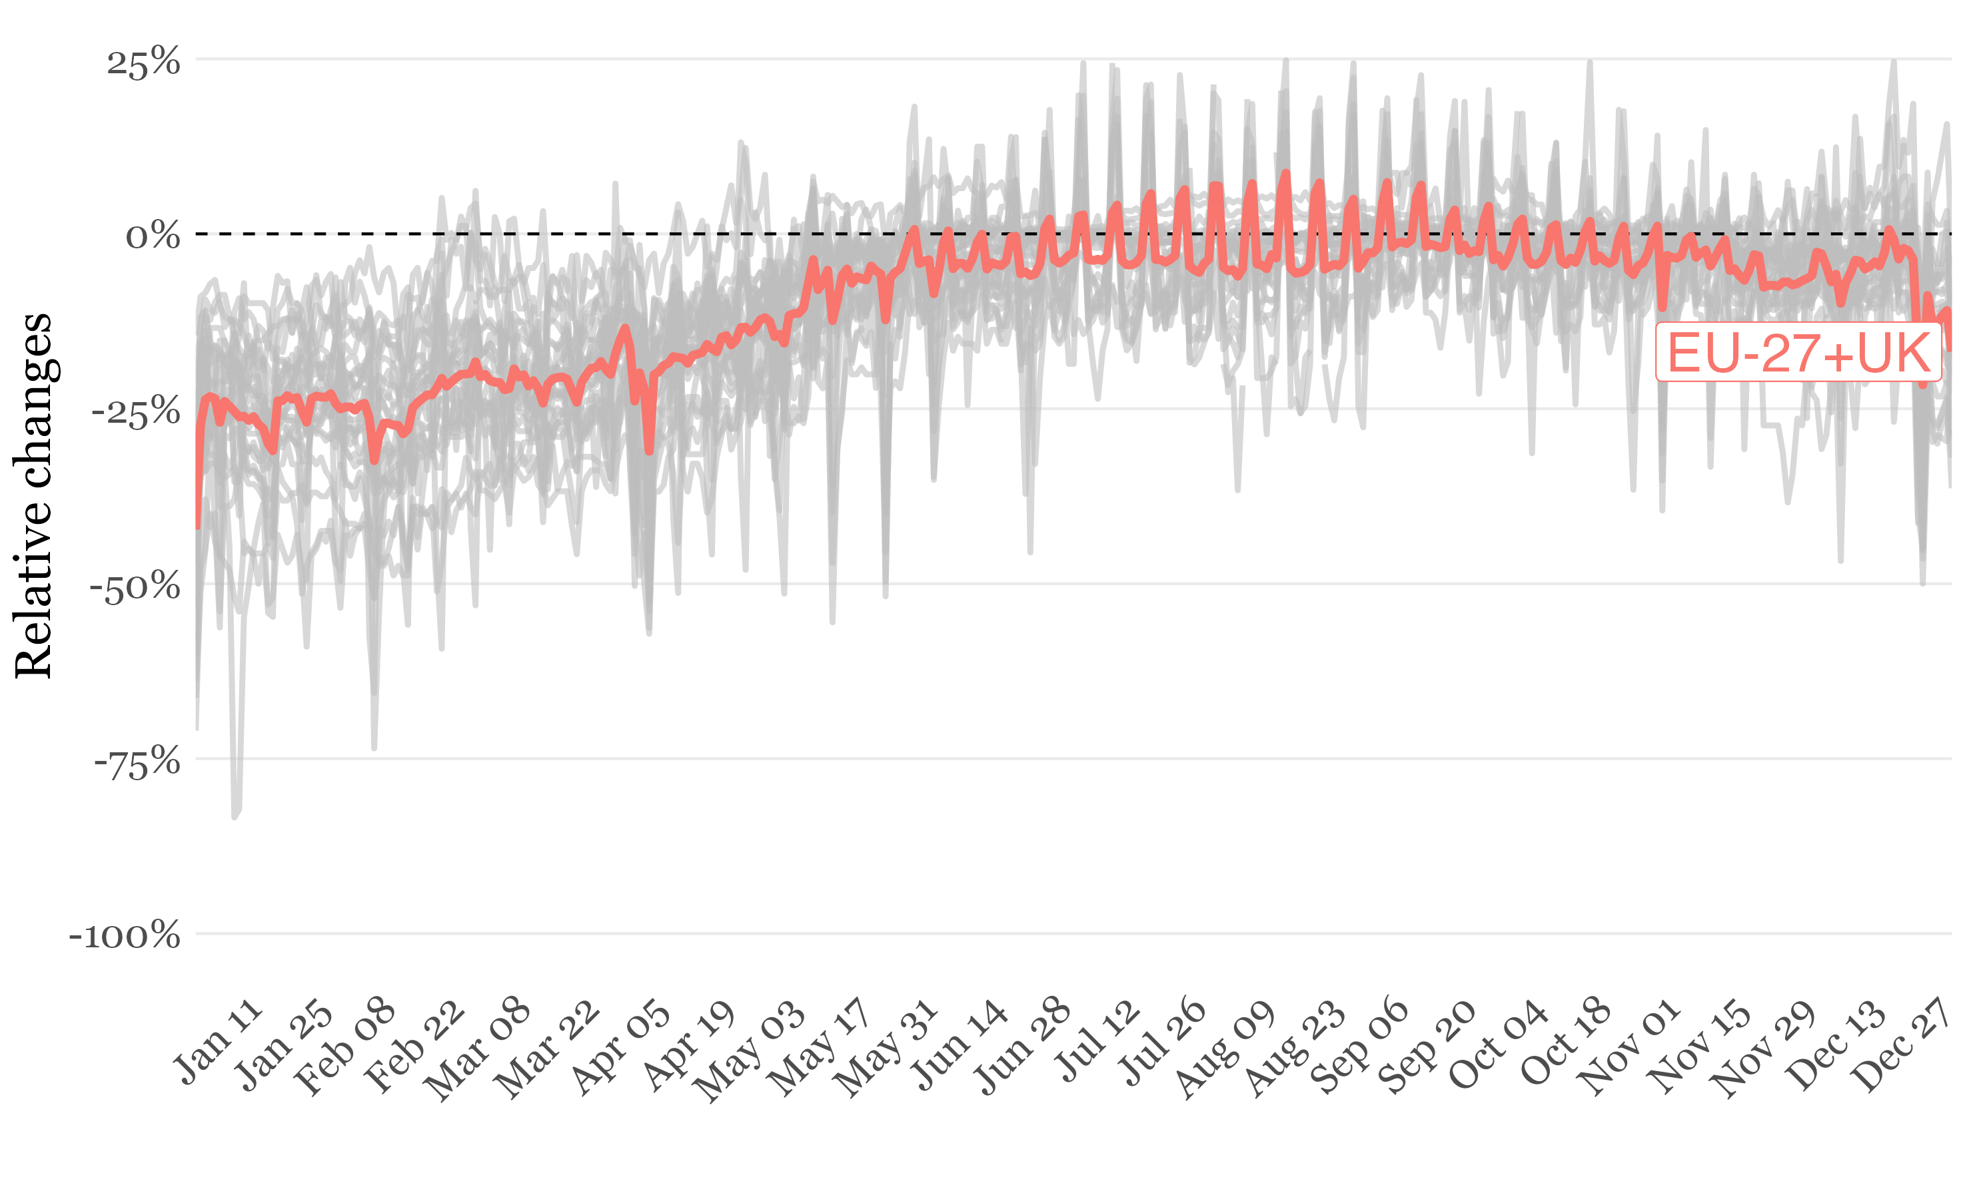
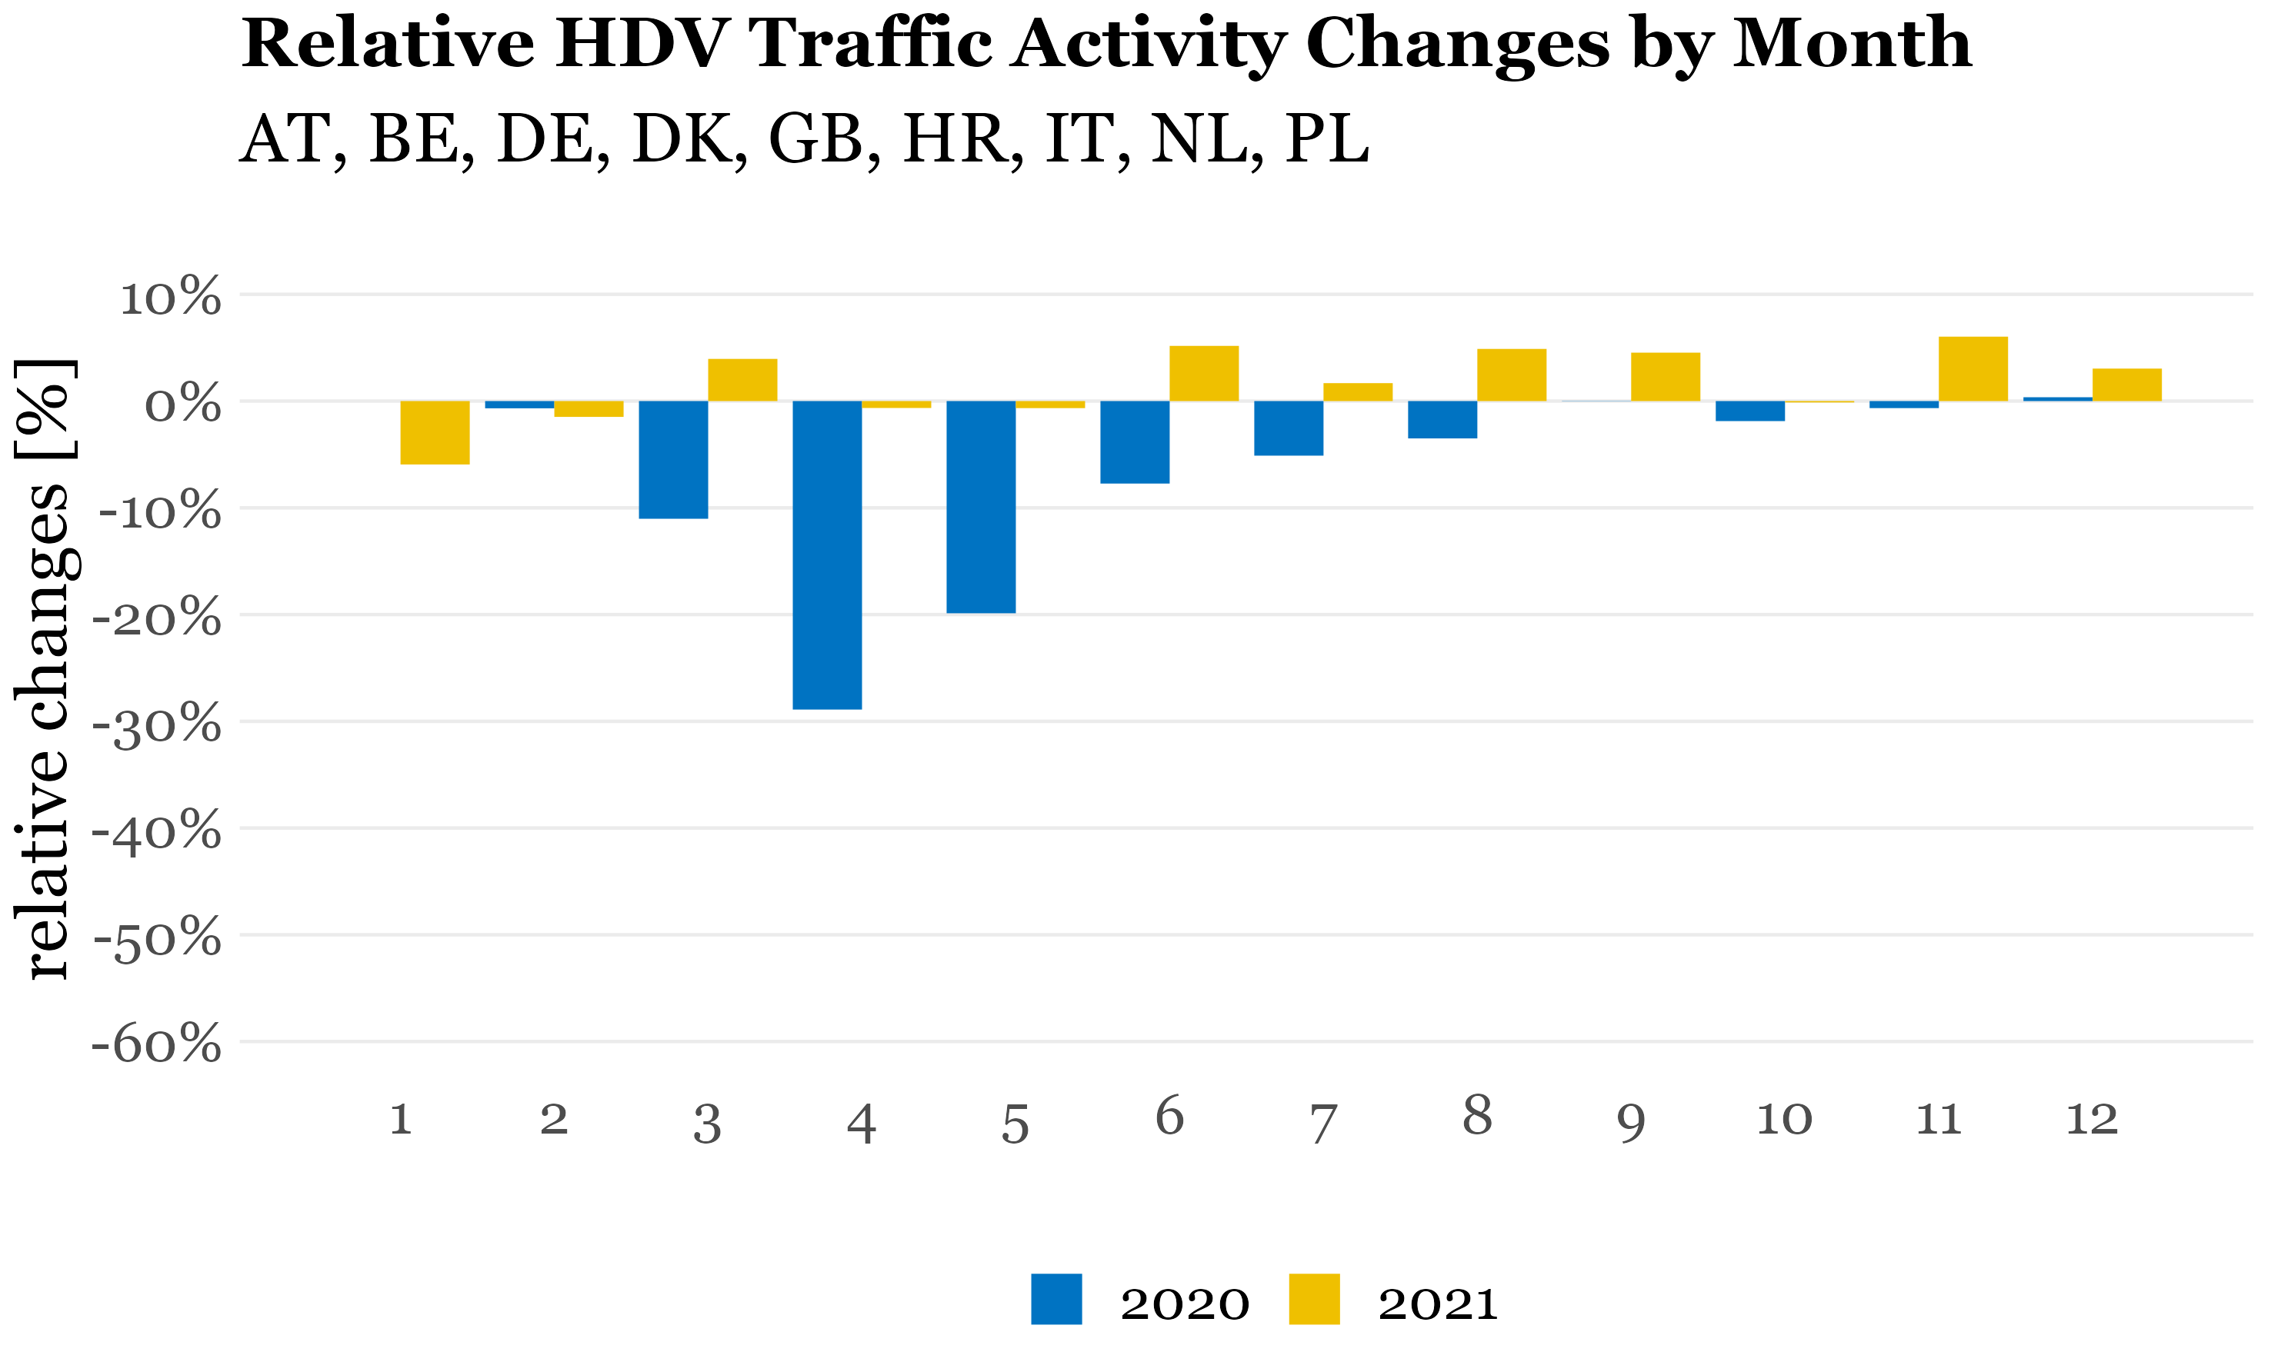
2021 – Is COVID-19 effect over?
PC+LDV activity significantly affected during 1st quarter of 2021
Negligible impact on HDV activity (increase when compared to 2019)
2021 daily adjustment factors for PC+LDV 2021 (EU-27+UK)
Annual mean: -16.5%
Annual mean: -9.6%
(grey lines represent individual EU countries)
Annual mean: -6.6%
Annual mean: +1.7%

Slide 16
Take home messages
New CAMS emission products to help quantifying the impact of COVID-19 lockdown policies:
CAMS COVID-19 Adjustment Factors: https://doi.org/10.24380/eptm-kn40
AMS-REG_v5.1 BAU 2020 gridded emissions: https://doi.org/10.24380/k966-3957
Description of both datasets and results: Guevara et al. (2022, ESSD, in press)
Key findings of the comparison between BAU and COVID-19 2020 scenarios:
Heterogeneous impact across species: in NO_{x} (-10.5%) and PM2.5 (-2.1%) emissions
Drops during 2nd round of lockdown were >50% lower than 1st round of lockdowns
Preliminary results of intercomparisons suggest CAMS COVID-19 adjustment factors well aligned with changes reported by official inventories
2021: mobility restrictions still affecting road transport emissions, specially during 1st quarter of the year (to be considered when running AQ simulations)

