Slide 1
AQ Forecasting in support of EMEP IMP 2022
A. Colette (INERIS)
M. Schulz (MetNO)
Ineris -
[CGR]
-
2723046
0.1

Slide 2
EMEP IMP 2022 Forecasting Challenge
A modellers Working Group was set up to reflect on the most appropriate strategy
INERIS: Augustin Colette (CAMS71/CAMS2_40/TFMM), Frédérik Meleux (CAMS71/CAMS2_40)
MetNO: Hilde Fagerli (MSC-W), Michael Schulz (CAMS71), Svetlana Tsyro (CAMS71)
ECMWF: Johannes Flemming, Mark Parrington, Luke Jones, Miha Razinger (CAMS)
Météo-France: Adrien Royer (CAMS2_40)
WMO: Oksana Tarasova (TFMM)
NILU: Wenche Aas (CCC)

Slide 3
EMEP IMP 2022 Forecasting Challenge
Identify a 1 week period favorable for O3 episode in a one month time window (mid-June to mid-July)
=> Obvious challenge of long forecast horizon
Scope:
Advance warning: Stations would like to be informed of triggering ~5-7 days in advance
Proposed organisation:
Meetings on Monday/Wednesday/Friday with INERIS/METNO/MF/ECMWF/NILU
Early warning notice one week ahead
Tbc: Leave the possibility to « lift » (i.e. cancel) the notice at the latest 5 or 3 days prior to the notified possible start
define a final date after which the sample will be launched, even in the absence of an episode
consolidate an email list towards participating monitoring stations

Slide 4
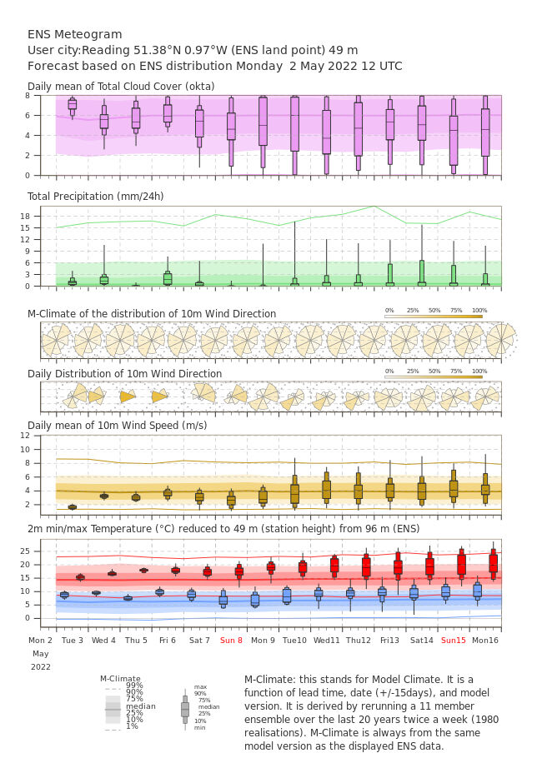
Long term forecasting (> 5days)
Rather a meteorological forecasting challenge
Ensemble 15 days forecasts (IFS/GEFS)
Probabilistic 45 days forecast
Need guidance of meteorological forecast experts
TFMM to provide definition of common criteria taking stock of past significant episodes
High pressure anomaly
Long air mass residence time / low surface winds
High solar radiation, absence of precipitation & cloud cover
2m Temperature anomaly > 4deg wrt climatology
Large scale: over 2-3 large countries (ex: PT/ES/FR, BE/NL/DE, IT/CH/Balkan etc..)

Slide 5
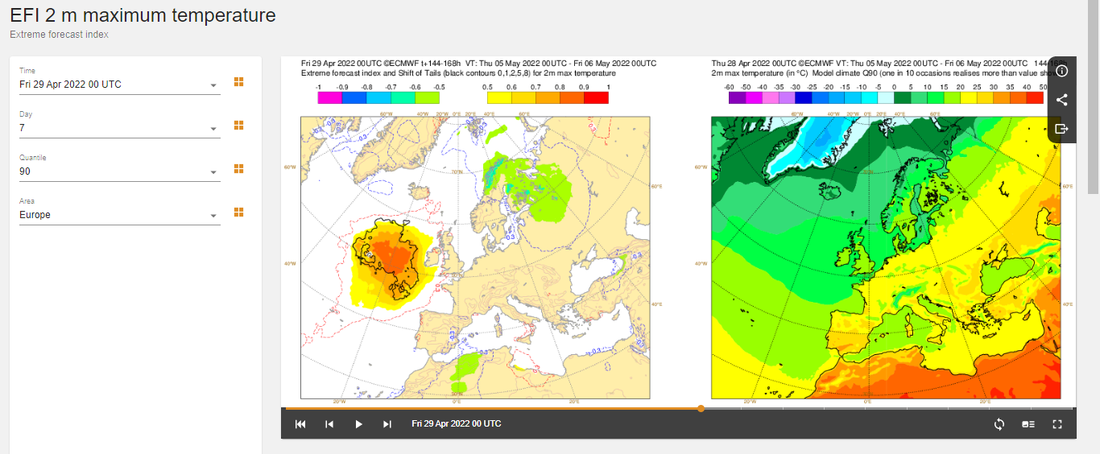
7 days ahead extreme indices
https://apps.ecmwf.int/webapps/opencharts/products/efi2web_2tmax?area=Europe&base_time=202204290000&day=7&quantile=90

Slide 6
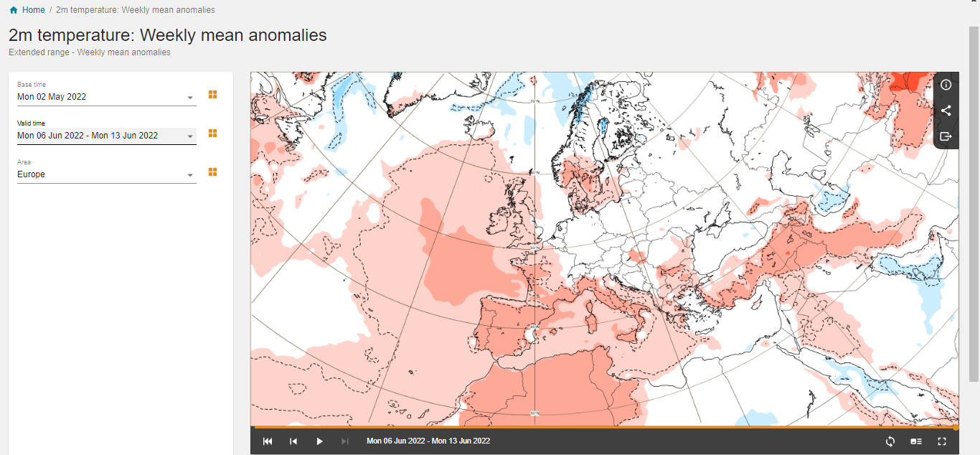
45 days ahead anomalies
https://apps.ecmwf.int/webapps/opencharts/products/extended-anomaly-2t?base_time=202205020000&projection=opencharts_europe&valid_time=202206130000

Slide 7
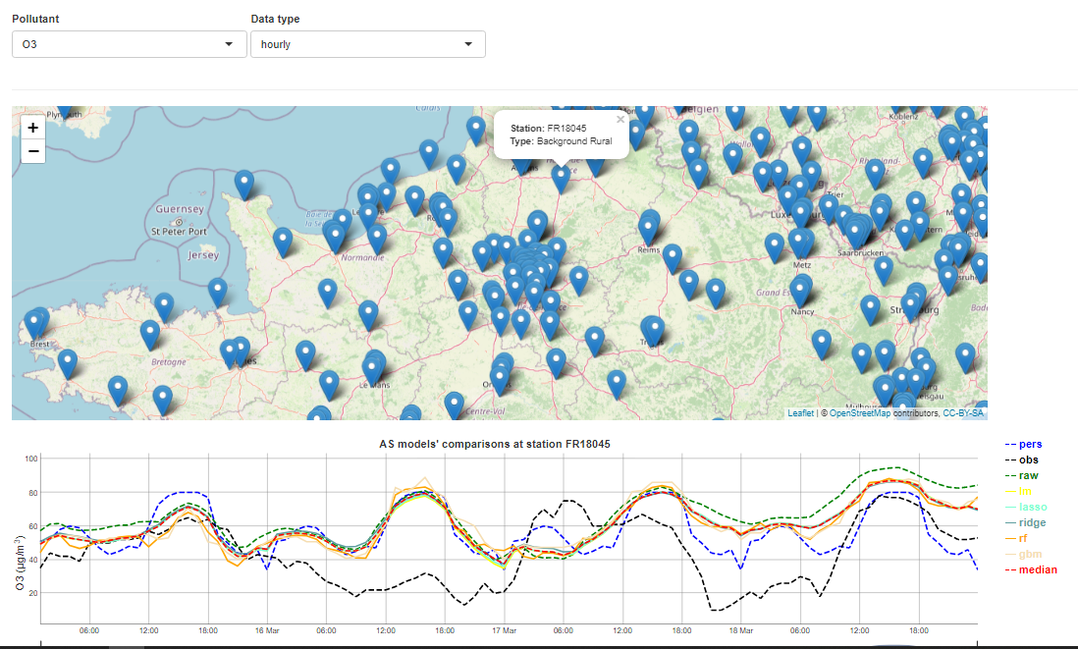
Short term forecasting (< 5 days)
CAMS Official Production
Regional/Global : https://regional.atmosphere.copernicus.eu/
Policy Products : https://policy.atmosphere.copernicus.eu/
Pre-Operational products
Model output statistics (machine learning coupled to CAMS)
National portals
www2.prevair.org
ACROSS products
Tbc…

