Slide 1


Welcome & introduction
TFMM co-chairs
Augustin Colette & Oksana Tarasova
23rd TFMM annual meeting, 3-5 May 2022
Remote Meeting

Slide 2
Welcome
Agenda of the meeting
Progress in 2022-2023 workplan
Review of Gothenburg protocol
Review of the CLRTAP science strategy 2020-2029

Slide 3
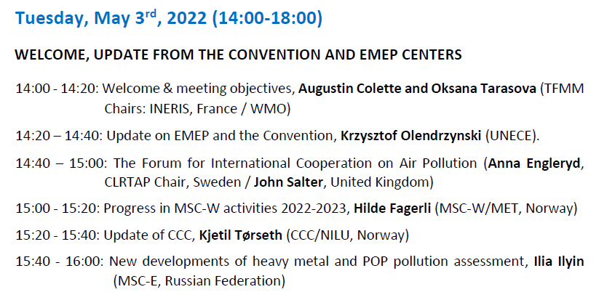
Tuesday 3/5 pm
Welcome
Meeting objective
Information from Convention and Centers

Slide 4
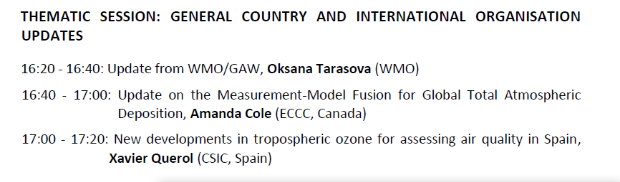
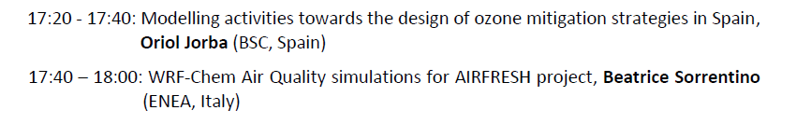
Tuesday 3/5 pm
Country & International organisation updates
Focus on O3

Slide 5
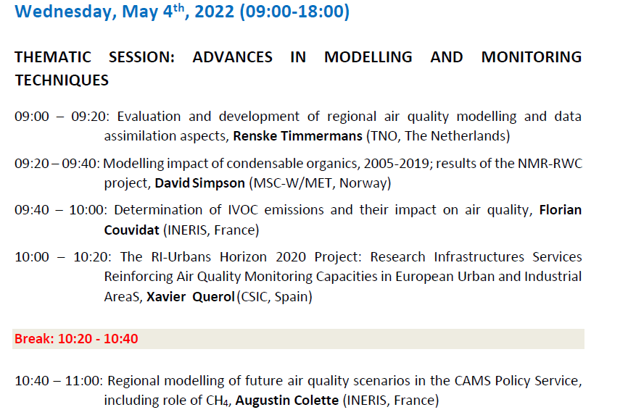
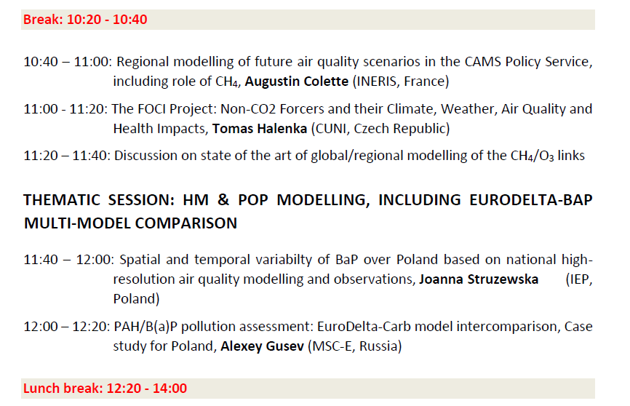
Wednesday 4/5 am
Modelling: CAMS, SVOC-IVOC
Monitoring: RI-Urbans
Prospective scenarios/regional/global modelling
BaP/Eurodelta

Slide 6
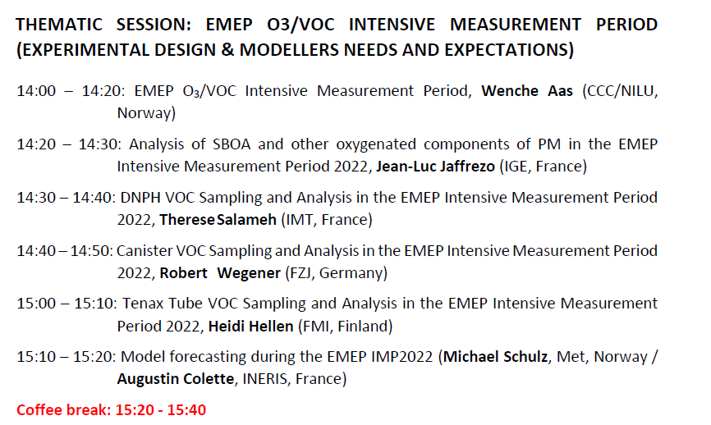
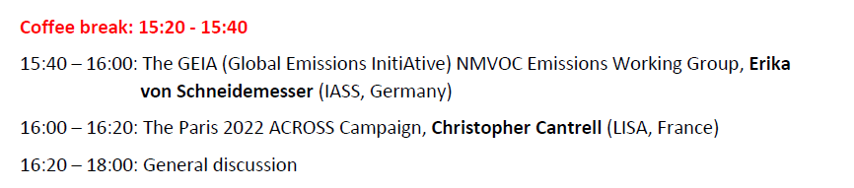
Wednesday 4/5 pm
O3/VOC Intensive Measurement Period
Sampling
Modelling (forecasting)
Expectations

Slide 7
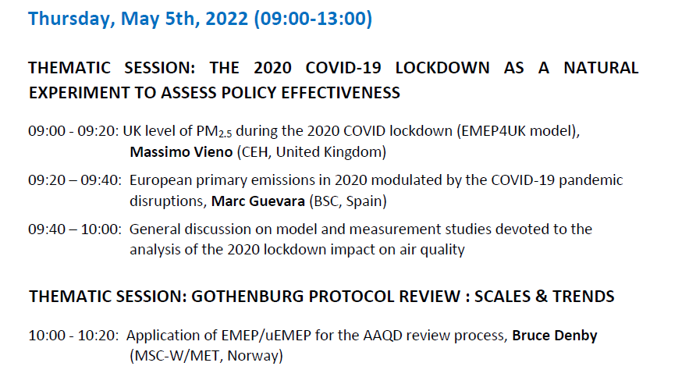
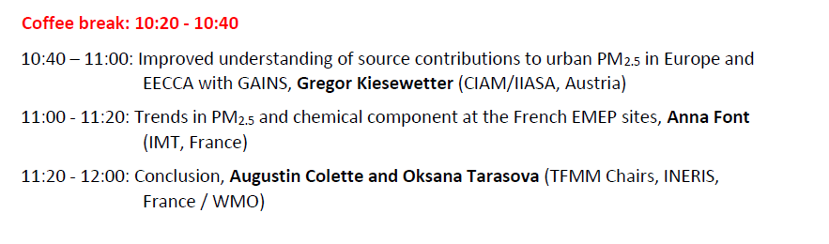
Thursday 5/5 aM
2020 Lockdown & AQ
Trends & scales

Slide 8
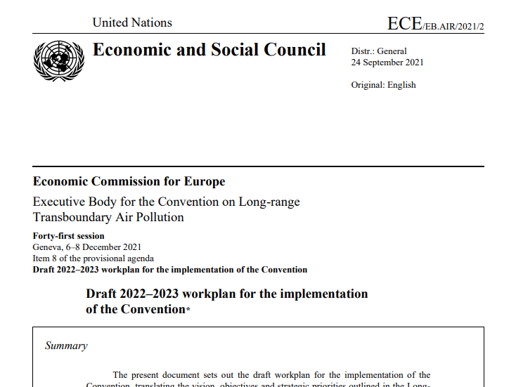
Progress in 2022-2023 workplan
UNECE > Meetings > 41st Exec Body
ECE/EB.AIR/2021/2 - Draft 2022–2023 workplan for the implementation of the Convention
https://unece.org/sites/default/files/2021-10/ECE_EB.AIR_2021_2-2113539E.pdf

Slide 9
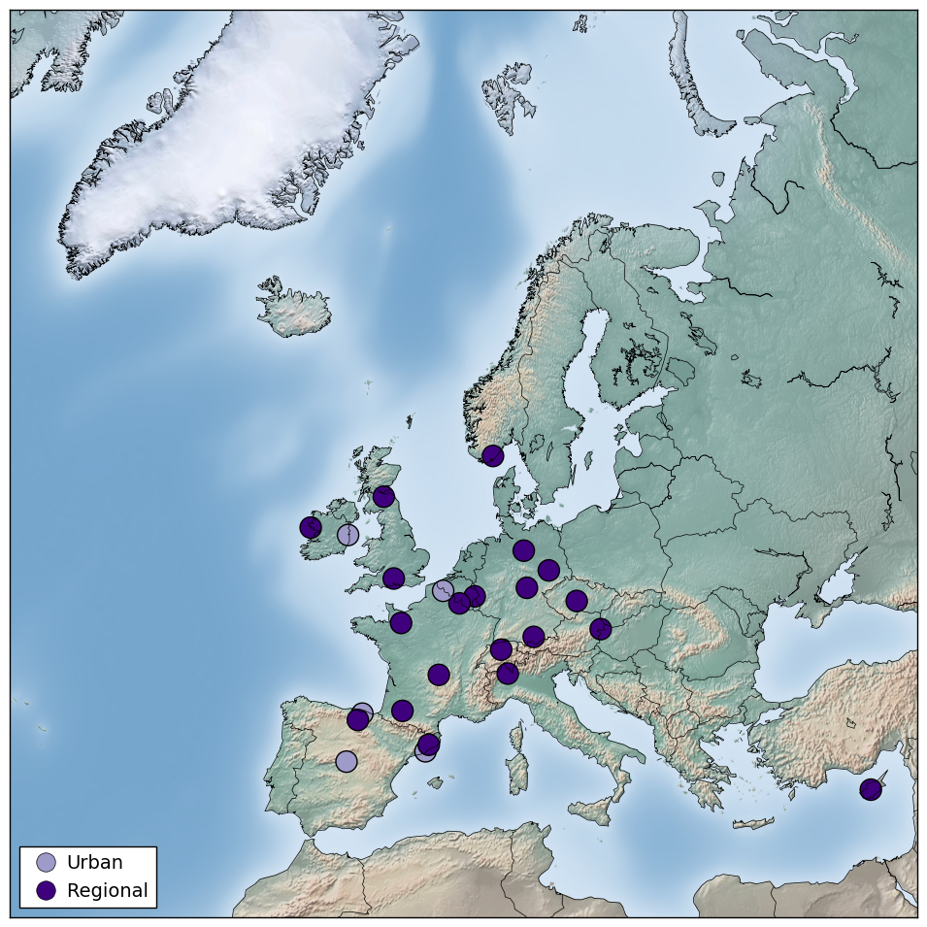
O3/VOC Intensive measurement period
The rationale of EMEP Intensives
  Not a full-scale in-situ campaign
  Rely on the strength of the existing EMEP network
  Encourage an incremental effort for a limited period of time, which can be supported mainly by national resources
2022/2023 O3/VOC EIMP
  Original proposal issued from TFMM brainstorm in 2021
  Now in formal 2022-2023 EMEP Workplan, with a twin objective:
    Knowledge of processes driving high O3 episodes in Europe (e.g. bio/anth VOC) [1.1.1.3]
    Strenghten the use of in-situ observations for models development and emission verification [1.1.1.4]
Current status
  Sampling strategy designed with CCC/TFMM/ACTRIS (see CCC update and Concept Note):
  About 30 sites planning to participate in 2022, potentially more in 2023: TFMM to seek expanding the geographic coverage, included by looking for additional financial support (e.g. ESIG)
  Campaign forecasting to be discussed with CAMS/WMO/ECMWF
  https://projects.nilu.no/ccc/tfmm/

Slide 10
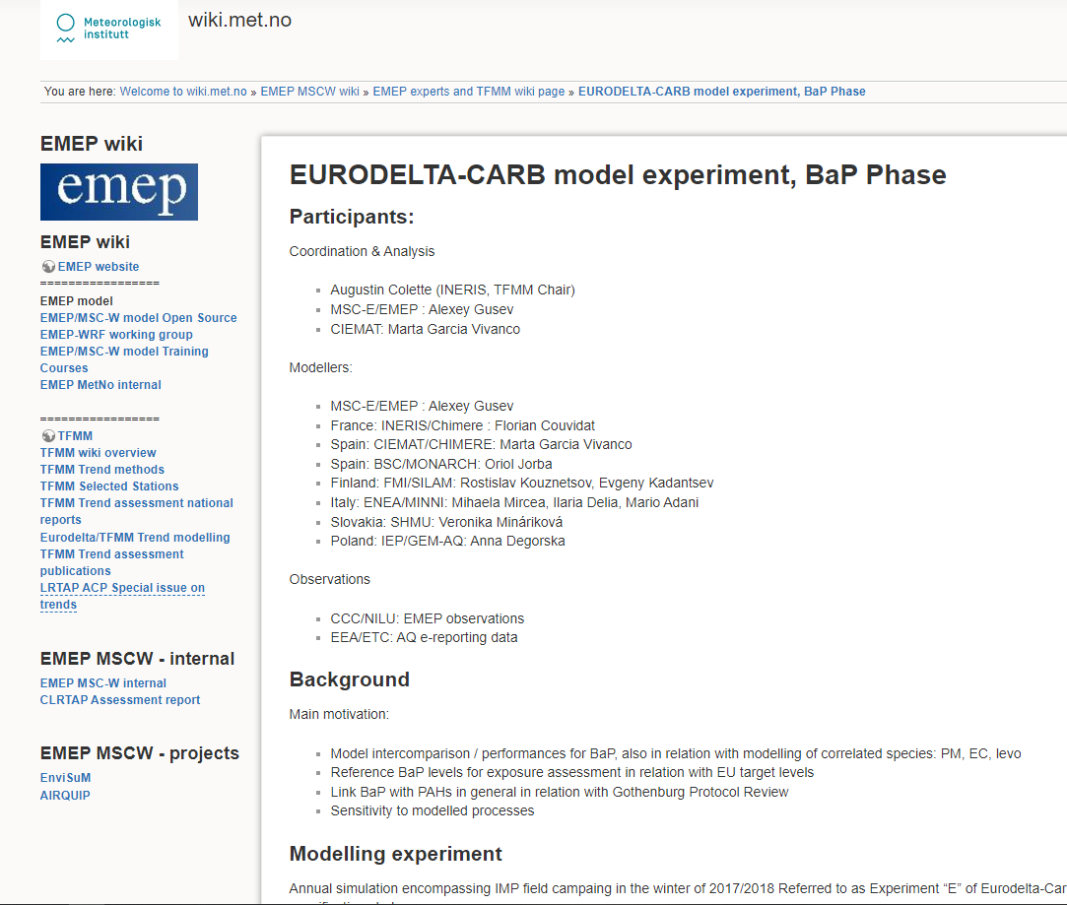
Heavy Metals & POPs
Eurodelta-BaP [1.1.1.5]
Modelling Experiment design
  https://wiki.met.no/emep/emep-experts/tfmmeurodeltacarb_bap
Coordination & Analysis
  MSC-East/EMEP : Alexey Gusev
  CIEMAT: Marta Garcia Vivanco
Modellers:
  MSC-E/EMEP : Alexey Gusev
  France: INERIS/Chimere : Florian Couvidat
  Spain: CIEMAT/CHIMERE: Marta Garcia Vivanco
  Spain: BSC/MONARCH: Oriol Jorba
  Finland: FMI/SILAM: Rostislav Kouznetsov, Evgeny Kadantsev
  Italy: ENEA/MINNI: Mihaela Mircea, Ilaria Delia, Mario Adani
  Slovakia: SHMU: Veronika Mináriková
  Poland: IEP/GEM-AQ: Joanna Strużewska
Observations
  CCC/NILU: EMEP observations
  EEA/ETC: AQ e-reporting data
Country case study (Hg/Norway) [1.2.1]
Global Source-Receptor relationship for combustion related POP&PM (w/ HTAP) [1.1.4.6]
Workshop on monitoring Chemical of Emerging Concern: 2023 [1.1.1.6]

Slide 11
condensable
Participation to Ad-Hoc Group on Condensable [1.1.2.5]
  Follow closely the developments towards including condensables either in national reporting or in gap-filling with « science–based » estimates (REF2)
    Keep track of methodological developments.
    Transparency/documentation is essential, it can become difficult to follow subsequent improvements. No reason for concern yet, but a need to keep the item high in the priorities
  Potential impact for modellers:
      Performances of including/excluding condensable
      Methodology on how to include condensables (handling semi/Intermediate VOCs)
Follow-up Eurodelta – « condensables »
  First phase completed, publication under progress
  Synergy between model & measurements
    Demonstrator/Feasability of the matching model tagged species & in situ source apportionment based on EMEP IMP 2017-2018 (coll. Actris/Collossal/EMEP)
    Future developement/improvement in collaboration with RI-Urbans H2020 project (ACTRIS/CAMS)

Slide 12
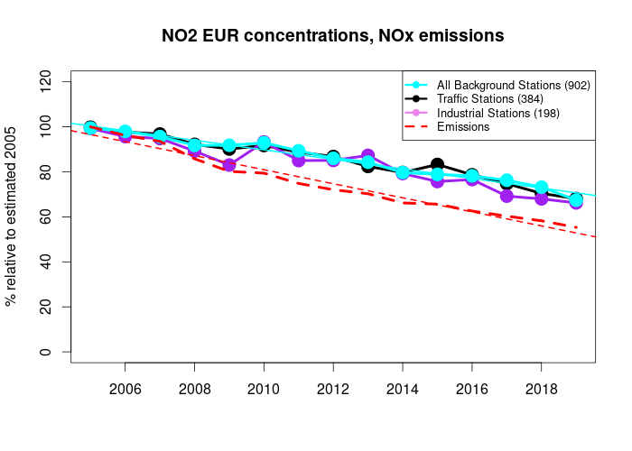
GothenBURG protocol Review
Taking stock of long-term trend analysis and key messages for policy effectiveness [1.1.1.1, 1.1.3.3]
  Observed and modelled trends, link with reported emission changes (Figure: example for NO₂)
Linkages of spatial scales [1.1.3.3] :
  Coll. with CAMS/HTAP: downscaling of global modelling (IFS) with regional models (EMEP/LOTOS/CHIMERE) [1.1.3.5]
  Evaluation of scenarios: Eclipse-v6 (IIASA) + Global Methane Assessment [1.1.3.7]
  Include impact assessment : PM_{2.5} exposure, O₃ crop PODy [1.1.1.14]
Fitness for purpose of monitoring & tools [1.1.1.1]
  Condensable (emission, models, measurement)
  O3/VOC: EMEP Intensive 2022 (emissions/models)
  Exposure / downscaling (uEMEP)
Observed NO₂ at AQ e-reporting stations and reported NOx emissions
Also available by country, Eionet Report - ETC/ATNI 2021/9
Observed & modelled NO₂ at EMEP stations and reported NOx emissions
EMEP Status Report, 2021, (Fig 4.3)

Slide 13
Key elements of the 2022-2023 workplan
1.1.1.1 Contribute to the Gothenburg Protocol review by:
(a) Taking stock of long-term trend analysis and key messages for policy effectiveness;
(b) Assessing the fitness for purpose of the monitoring and measurement tools to support policy (including recent developments on condensables, for instance).
and 1.1.3.3 Assessing observed trends in air pollution at the various scales, Linkages between global and regional air pollution
1.1.1.3 Prepare and conduct an intensive measurement period focused on improved understanding of high ozone pollution episodes
1.1.1.4 Review of the use of in-situ VOC measurements (including high quality and potential complementary sensors or passive methods) for the revision and improvement of chemistry-transport models across a range of spatial scales: from local (industrial and urban) to regional background sites
1.1.1.5 Perform a Eurodelta multi-model intercomparison exercise focusing on BaP
1.1.1.6 Investigating monitoring of chemicals of emerging concern (Workshop on measurement and modelling of new contaminants (2023))

Slide 14
Key elements of the 2022-2023 workplan
Contribute to 1.1.1.14 Ozone flux-based risk assessment for vegetation for air pollution scenarios (lead by ICP Vegetation)
Contribute to 1.1.2.5 Detailed analysis of the status of inclusion of the condensable component in PM emissions reported pa Parties (lead by CEIP and TFEIP)
1.1.3.5 Perform an evaluation of the impact of potential methane mitigation measures on regional ozone (workshop organized in 2023)
Contribute to 1.1.4.6 Elaborating global source/receptor relationships of combustion-related POPs and PM (lead TFHTAP)
Contribute to 1.2.1 Country-scale assessment of heavy metal and POP pollution (lead by MSC-E)
Contribute to 1.3.2 Cooperation with Climate and Clean Air Coalition (lead by Steering Body to EMEP and WGE)

Slide 15
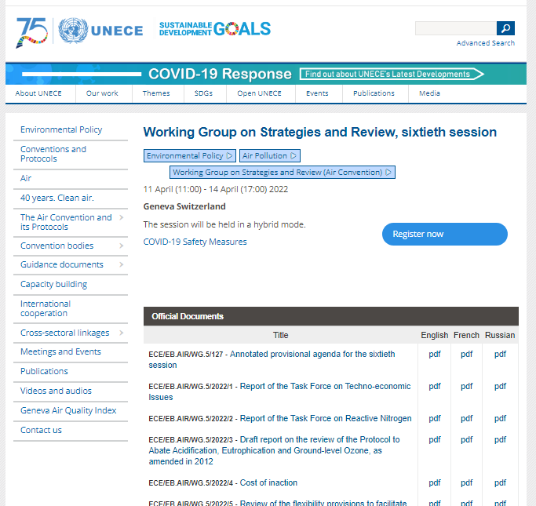
Gothenburg protocol Review
UNECE => Meetings, 60th Working Group on Strategies and Reviews:
https://unece.org/info/Environmental-Policy/Air-Pollution/events/360937
  IV. Measured and modelled atmospheric concentrations, emissions and deposition levels
  VI.E. Inclusion of condensables in reporting particulate matter emissions for residential heating
Send comments by email to the TFMM Chairs by 27/5

Slide 16
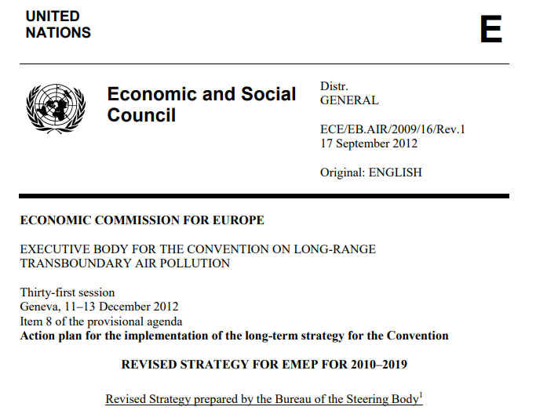
Revision of CLRTAP Science strategy 2020-2029
Joint Convention (EMEP & WGE) Strategy
UNECE > Convention Bodies > EMEP > Strategies
  https://unece.org/DAM/env/documents/2013/air/emep/Informal_document_no_20_Revised_Strategy_for_EMEP_for_2010-2019_clean_text.pdf
To be elaborated by TF, ICP, Center Chairs & Leads before the summer
=> Provide comments through SB representive in September

Slide 17
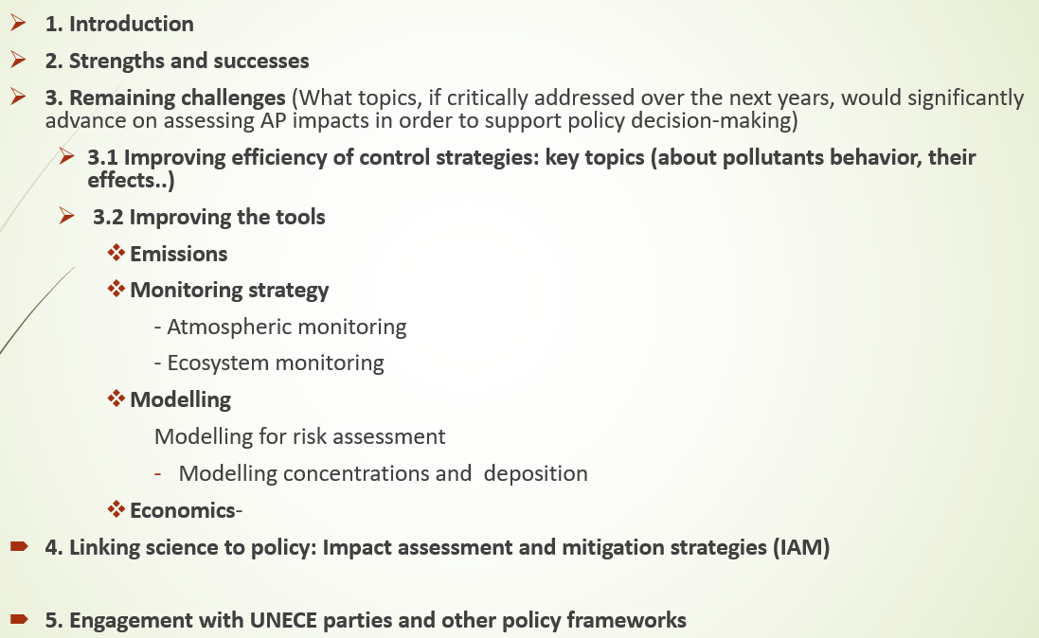
Revision of EMEP strategy 2020-2029

Slide 18
Strengths and successes (EMEP views)
Monitoring
  New monitoring strategy
  Good cooperation with other networks/ infrastructure : GAW, ACTRIS, AAQD network
  Field campaigns
  Continues update on SOPs, guidelines and quality assessment
  Focus on improving coverage and participation from EECCA
  Data flow and dissemination improved considerably including protocols etc (I.e. ENVRI-FAIR)- AC
  Data used in further contexts(e.g. : IPCC, Arctic, LRTAP-urban links), Copernicus
Pollutant modelling
  Model codes in open access
  Eurodelta experiments to confirm EMEP model quality held in the 2010-2019 period.
  Country pilot studies : focused on heavy metals and BaP
  Interaction with WGE community regarding ozone fluxes and the PoD metrics or the provision of deposition maps
  uEMEP development – multiscale approach

Slide 19
Remaining challengeS
Improving scientific understanding for improving effectiveness of control strategy: key topics
  For all pollutants : understanding the trends over the 20 past years with special focus on changes produced since 2010 on view of assessing abatement policies (e.g. ozone)
  Ozone : Chemical regimes (urban versus regional issues, changes in the last decades and impact on abatement policies), Incomplete description of VOCs (chemical profiles for anthropogenic and biogenic, assessment of biogenic precursors), role of Methane
  Nitrogen cycle and ammonia issue which is far to be solved
  Acidification and recovery from acidification
  Aerosol (speciation, natural contribution, secondary formation, origin of secondary organic aerosols and its associated health effects) *
  How to reduce secondary PM including Condensable
  PM deposition
  Heavy metals (Hg) and POPs (BaP, PAH) – contribution of secondary sources
  Impact on materials
  Health: new metrics, exposure to low levels, new WHO guidelines
  N-O3-biodiversity interactions
  Interactions between climate change and air quality/ecosystems (but we are not main group on climate …) – cross-cutting issue , all dimensions should be considered !
  Biodiversity and ecosystem services
  Update of empirical critical loads accounting for linkages between climate change and nitrogen impact
  Phosphorus data needed
  Pollutants of emerging concern (Microplastics..)
  (multi-) Scale issues

Slide 20
Remaining challengeS
Improving emissions data
  PM speciation (condensable, carbonaceous aerosols, nitrates (?)) and methane ← new issues related to the GP review) and SOA precursors
  VOCS speciation (update of sectoral emission profiles – country dependent)
  POPs and HM as parts of PM (need for consistent methodologies between various compounds; Speciation of Hg and congener composition of POPs : emissions not reported but critical for modelling
  Biogenic/natural emissions [NO, VOC (including speciation), dust - bare ground resuspension] – review of methods and temporal variability, uncertainty of current estimations (Europe and NH)
  Temporal variability – review of approaches
  Emission verification (inverse modelling, satellite observations, modelling)
  Linking the scales: multi-scale emissions system; consistency between the scales; activities through TFHTAP to consolidate global emissions datasets at the global and regional scales
  How to deal with shipping emissions
  Cooperation with source/emission measurement communities
  Issues related to residential sector
  Achieving sustainable funding for the EMEP/EEA guidebook
  Reporting:
      Revitalising the review processes to be more operational and focused on the most sensitive cases; consistency with the EU NECD processes
      Improving quality and consistency of reported emissions , including gridded emissions (eg. proxies used for spatial distribution)
      Linkages with UNFCCC processes
      Need to assess in depth institutional management of reporting processes in the Parties and link to the EU legislation processes
      Complementary information and emission reporting tools

Slide 21
Remaining challengeS
Monitoring
  Interaction between air pollutant concentration/deposition and effects and assessment of the efficiency of mitigation strategies (should be in line with the new monitoring strategy)
  Keep and update monitoring networks and further harmonise methods (also between EMEP and WGE)
  Expand the monitoring activities in the UNECE region
  Ensure data quality, timeliness and open data access to serve multiple clients (even outside the UNECE region) and other problems such as climate, biodiversity, land-use
  specific needs ; VOCS speciation in rural, industrial and urban areas should be expanded, NH3 (urban and in natural areas in cooperation with other networks and also in the perspective AAQD)
  Expand biological monitoring
  More sites measuring PM speciation needed, precursors should be added at the urban scale
  New monitoring means : satellite information, ceilometers, supersites ← how to integrate / intercalibrate with in-situ
  Carry-out biomonitoring to develop changes in biota and deposition on mosses
  Extend ecosystem monitoring networks to new types of ecosystems and new regions - Linkages with the NEC directive
  Pollutants of emerging concern
Modelling strategies
  Linking the scales : global / continental/ national / local ← two-way interactions + hotspots - need to address the downscaling aspects but also, in a wider perspective, how urban role interaction to the regional air pollution background – in collaboration with national modelling experts (EPCAC)
  interactions between EMEP and WGE databases and assessments and better couple AQ models and WGE tools ; moving towards higher resolution (impacts on material)
  Transport pathways and consequences of changing climate
  Resuspension of heavy metals due to air pollution and climate change and mobilisation for ecosystems
  Dealing with biodiversity and ecosystem services (linked with critical loads and levels)
  New generation of global models that could simulate methane parametrisations for O3
  HM/POPs: gaz/particle partitioning – Hg chemistry and air surface changes
  Deposition parametrisations (incl. dry deposition of N species)
  Marine issues
  Better use of data assimilation/data fusion methods to assess exposure studies (also for ecosystems). Problem of the availability of data to be used for such methods

Slide 22
Joint TFEIP/TFMM working group
TFEIP willing to better connect to the users of emission data => modellers
  Take stock of the lessons learned from reviewing the MS spatially distributed emissions (the EMEP gridded emissions) in 2020 & 2021 as part of the NECD inventory review process (update the guidance for spatial distribution of emissions);
  Make available in some form additional information necessary for users of emission data (AQ modellers) to use emission grids. This could include PM and VOC splits, emission timing, emission height profiles, condensables…
A similar « Wishlist » was elaborated at the 2013 Zagreb meeting (see TFMM website), now the scope is:
  Review the completeness of the list of topics
  Information sharing on developments in other Research & Service contracts (e.g. CAMS, FAIRMODE)
  Identify specific joint investigations in the bi-annual workplan
Jeroen Kuenen (TNO) will convey a web meeting in the coming months. If interested, TFMM participants should register they willingness to contribute to A. Colette.

