Slide 1
EMEP intensive measurement period Summer 2022 and summer 2023
NILU: Wenche Aas, Sverre Solberg, Norbert Schmidbauer, Karl Espen Yttri
Contribution from several ozone and VOC experts

Slide 2
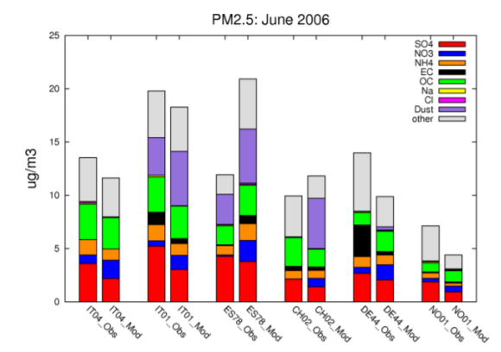
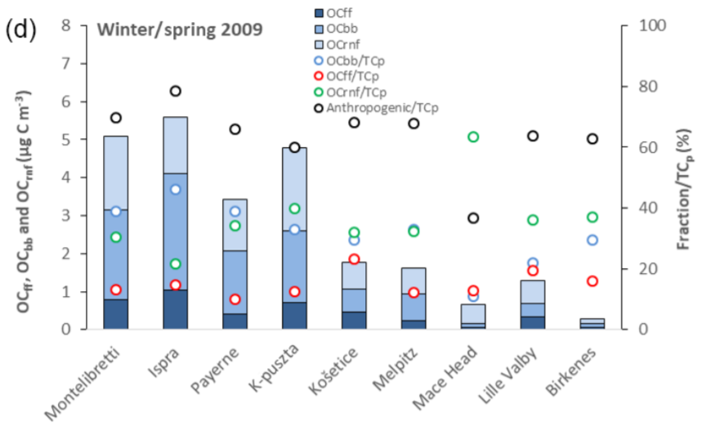
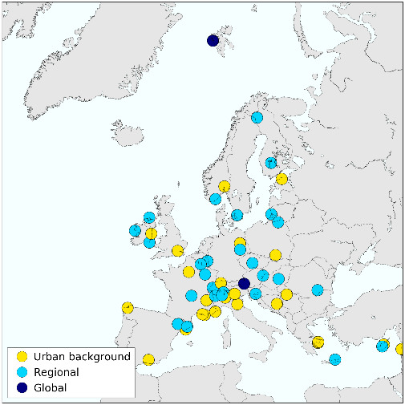
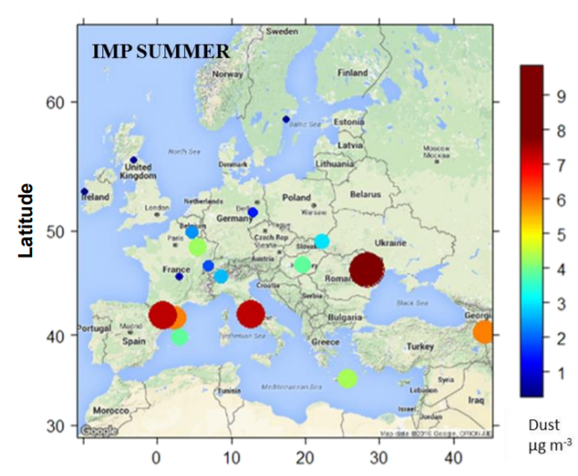
EMEP intensive measurement periods (IMP)
Every 3-4 years
A focus on specific areas with identified gaps:
Lack of observations
Improve model development
In emissions
Involve Parties (via TFMM)
Close cooperation with research programs and EU infrastructures
Conducted IMPs:
June 2006 and January 2007. Chemical composition of PM
Oct. 2008 and March 2009. Carbonaceous aerosols
2012. One year ACSM measurements
July 2012 and January 2013 Geochemistry of PM₁₀
2016 (and 2006) POP passive campaign
December 2017 - March 2018. Apportionment of eBC
Historically a large interest in aerosol related topics A strong wish to focus on ozone formation during summer heat waves

Slide 3
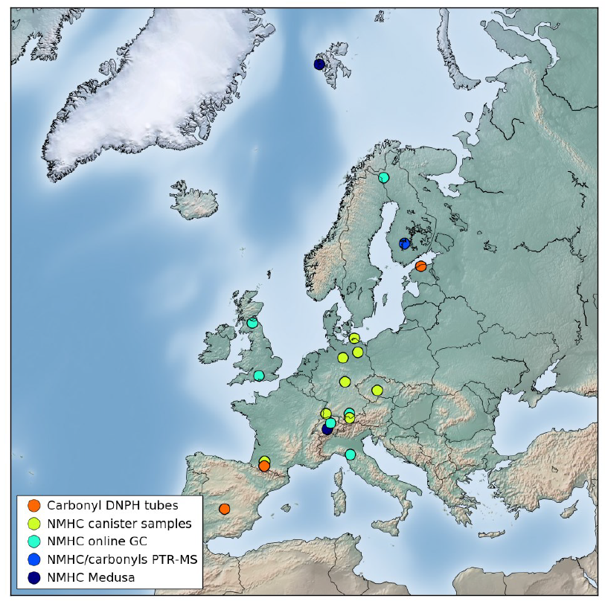
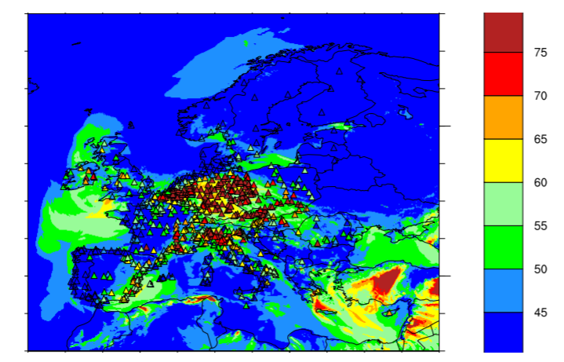
Objectives
Tropospheric ozone is an adverse environmental and health problem in Europe, with need for a better understanding:
Why are ozone episode levels typically underpredicted by atmospheric transport models?
How the reductions in NMVOC and NOx emissions impact on the summer episodes.
Better utilisation of EMEP VOC monitoring data
What is the effect of a warmer climate?
What is the level of secondary organic aerosol (SOA), especially from biogenic VOCs, during high O3 events?
Monitoring of VOCs in EMEP
The EMEP network is not targeted particularly for major ozone episodes:
Several sites with 1-2 samples per week.
Very few sites measuring oxygenated VOCs (O-VOC)
Hydrocarbons (NMHCs). Differences in the range of compounds and methods
Monoterpenes is hardly reported to EMEP
Modelled and measured daily max ozone [ppb] 4 July 2018. Data from EMEP and Airbase

Slide 4
Plan for setup for one week intensive sampling
Sites have ozone, NOx/NO₂ obs, several also EC/OC
Forecast the best week for high ozone levels to decide when to start the campaign
Extend regular EMEP observations Parties encouraged to:
include missing VOC component groups (NMHC, OVOC, Monoterpenes)
increase sampling frequency to daily sampling all the sites
Equip sites with continuous sampling if available (i.e. PTR-(ToF)-MS, GC/FID)
Additional manual sampling. Distribute devices and centralised analysis:
NMHC: Canister air sampling (FZ Jülich, Germany)
O-VOCs: DNPH cartridge (IMT, France)
Monoterpenes: Tenax tubes (FMI, Finland)
SOA tracers: Use part of EC OC filters from regular monitoring (IGE, France)
https://projects.nilu.no/ccc/tfmm/Concept_note_EIMP_o3_summer2022-2023_vers_march2022.pdf

Slide 5
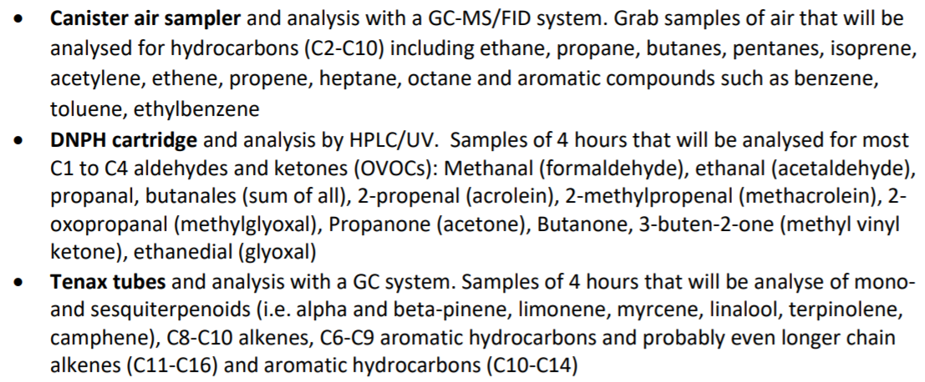
VOCs that will be measured
Talk by Robert Wegener
Talk by Therese Salameh
Talk by Heidi Hellen

Slide 6
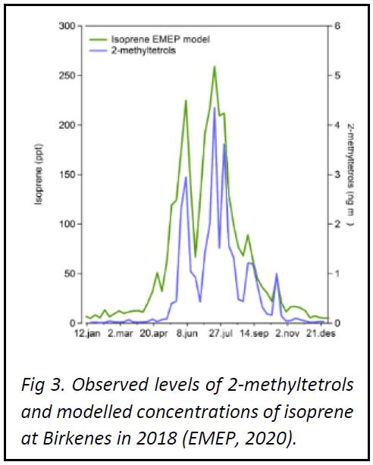
Secondary organic aerosol (SOA)
Oxidation products of VOCs partitioning to the particulate phase by nucleation and/or condensation
Important part of secondary air pollution along with O₃
Biogenic VOCs (BVOC), such as isoprene and monoterpenes, are important O₃ precursors and precursors of BSOA (Fig. 3)
BSOAs to be measured (Talk by Jean-Luc Jaffrezo):
Oxidation product of monoterpenes (α-pinene)
3-MTCA (3-methyl-1,2,3-butanetricarboxylic acid)
Oxidation products of isoprene
2-MTs (2-methyerythritol and 2-methylthreitol)

Slide 7
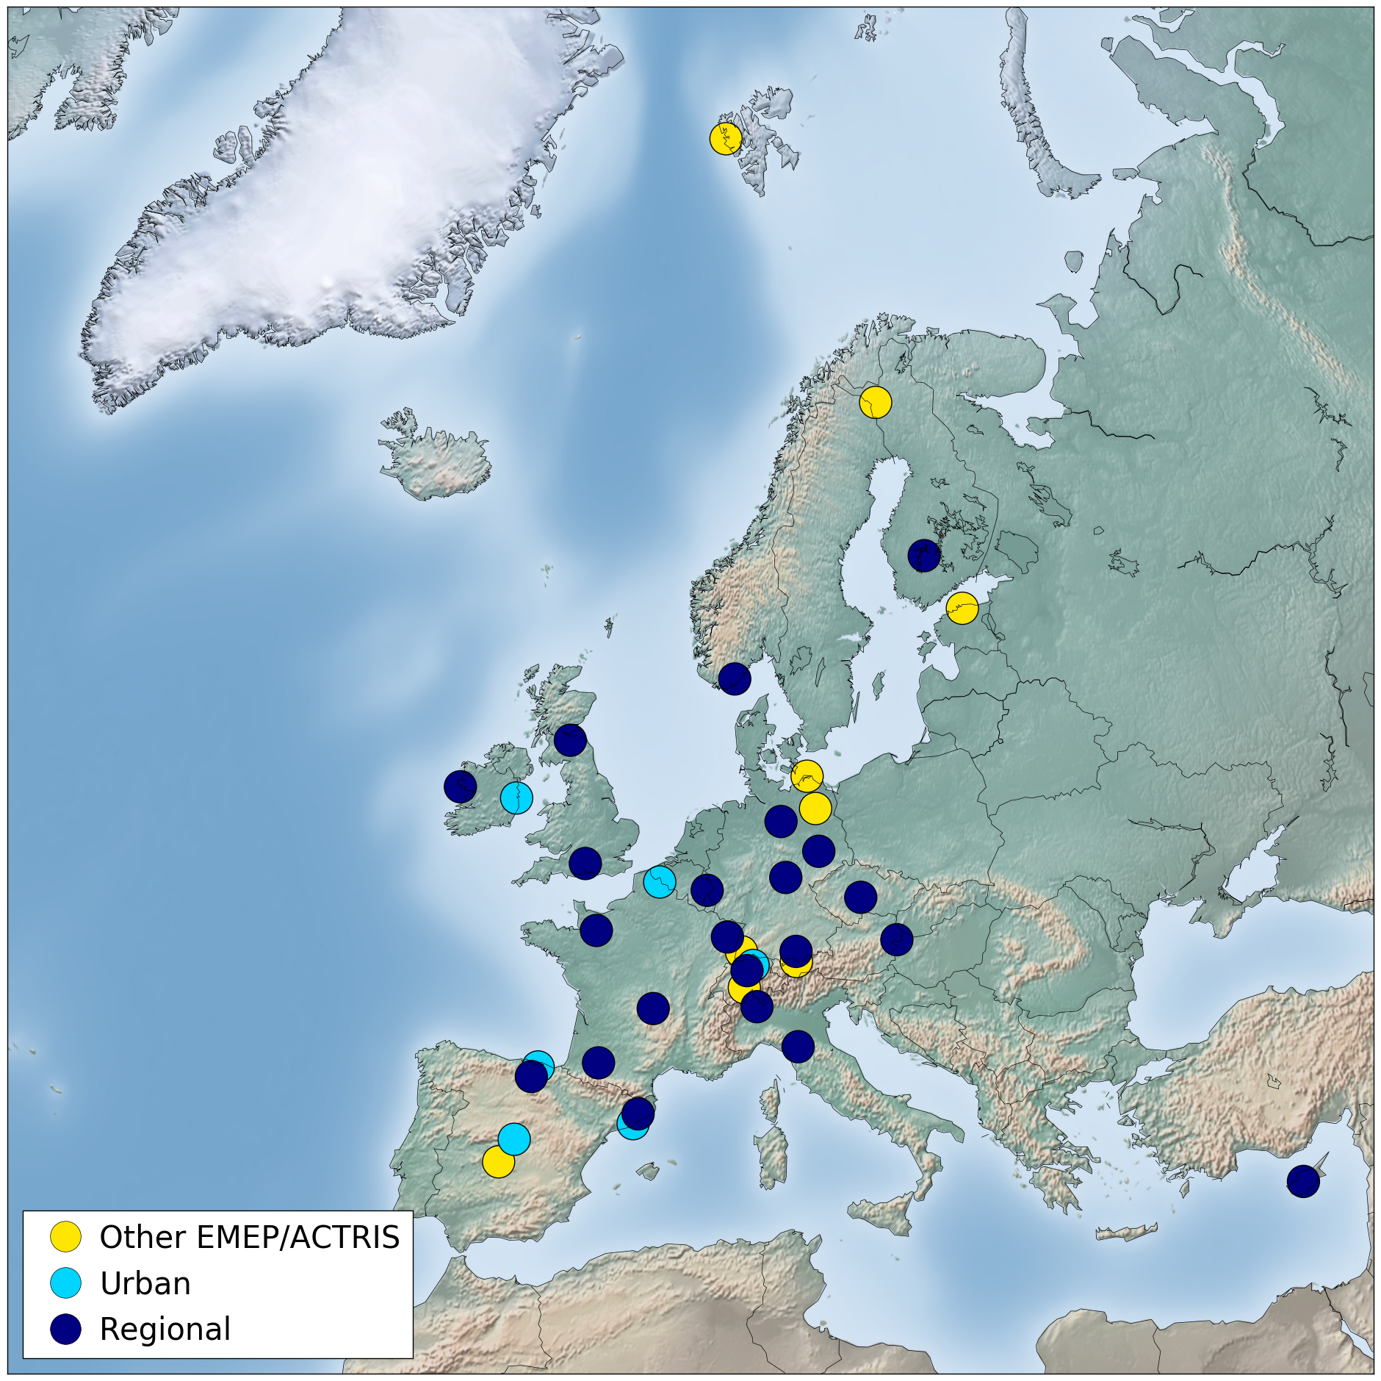
Sites participating
30 sites with complete program
6 urban
7-17 with centralised lab
Additional 7 with regular NMHC (“Other EMEP/ACTRIS”)
Possible to add 1-2 more site (may be sponsored)
Some sites/analysis will be sponsored by the solvent community

Slide 9
Timing of EIMP 2022
One week in the period 13 June – 25 July 2022
The ACROSS (Atmospheric ChemistRy Of the Suburban foreSt) project focuses on scientific research to understand the detailed chemistry and physics of urban air mixed with biogenic emissions (https://across.cnrs.fr)
Samplers for VOCs will be sent out in the beginning of June /end of May
A modelling team to forecast and decide when to start the campaign.
Parties will be noticed 1 week prior the start date.
If no large scale episode are foreseen, we will conduct the campaign 18-25 July
Sampling daily:
4 hours exposure /12.00- 1600) for DNPH
and for grab sampling (at 14.00) for canister.
2 or 4 hours sampling for Tenax tubes
24 hours EC/OC (or the sampling frequency as in regular monitoring)
Talk by Augustin/Michael

Slide 10
Remaining logistics and coordination
Ensure that all the sites have available pumps and mass flow controller. Find equipment to share and distribute to those not having this already (CCC coordinate this)
Provide information about OC/EC filters, i.e. sampler cut-off size; filter size and fraction available for SOA tracer analysis.
Check commitments and decide if we can/should invite 1-2 new sites
Gather information of shipping addresses and plan for deliveries. Define 1-2 persons per sites to ensure good communication.
Develop detailed sampling protocols for the sites (prepared by the central laboratories)
Consider parallel sampling with continuous observations at some sites?
Quality assurance by the central labs, harmonised with ACTRIS QA/QC
Make plans for publications and identify Pis.
Data submission to EBAS.

