Slide 1





23rd Task Force on Measurement and Modelling Meeting, 3-5 May, 2022
PAH/B(a)P pollution assessment at global,
regional and national scales
Alexey Gusev, Victor Shatalov, Olga Rozovskaya, Marta G. Vivanco, Mark R. Theobald, Victoria Gil, Juan L. Garrido, Florian Couvidat, Augustin Colette, Mario Adani, Mihaela Mircea, Ilaria D'Elia, Evgeny Kadancev, Rostislav Kouznetsov

Slide 2
PAH/B(a)P pollution assessment at global, regional, national scales
Outline:
Eurodelta-Carb multi-model assessment of B(a)P pollution (1.1.1.5*)
Case study on PAH/B(a)P pollution for Poland (1.2.1)
Global scale PAH emissions and pollution assessment (1.1.4.3)
* EMEP/WGE Work Plan elements (2022-2023)

Slide 3
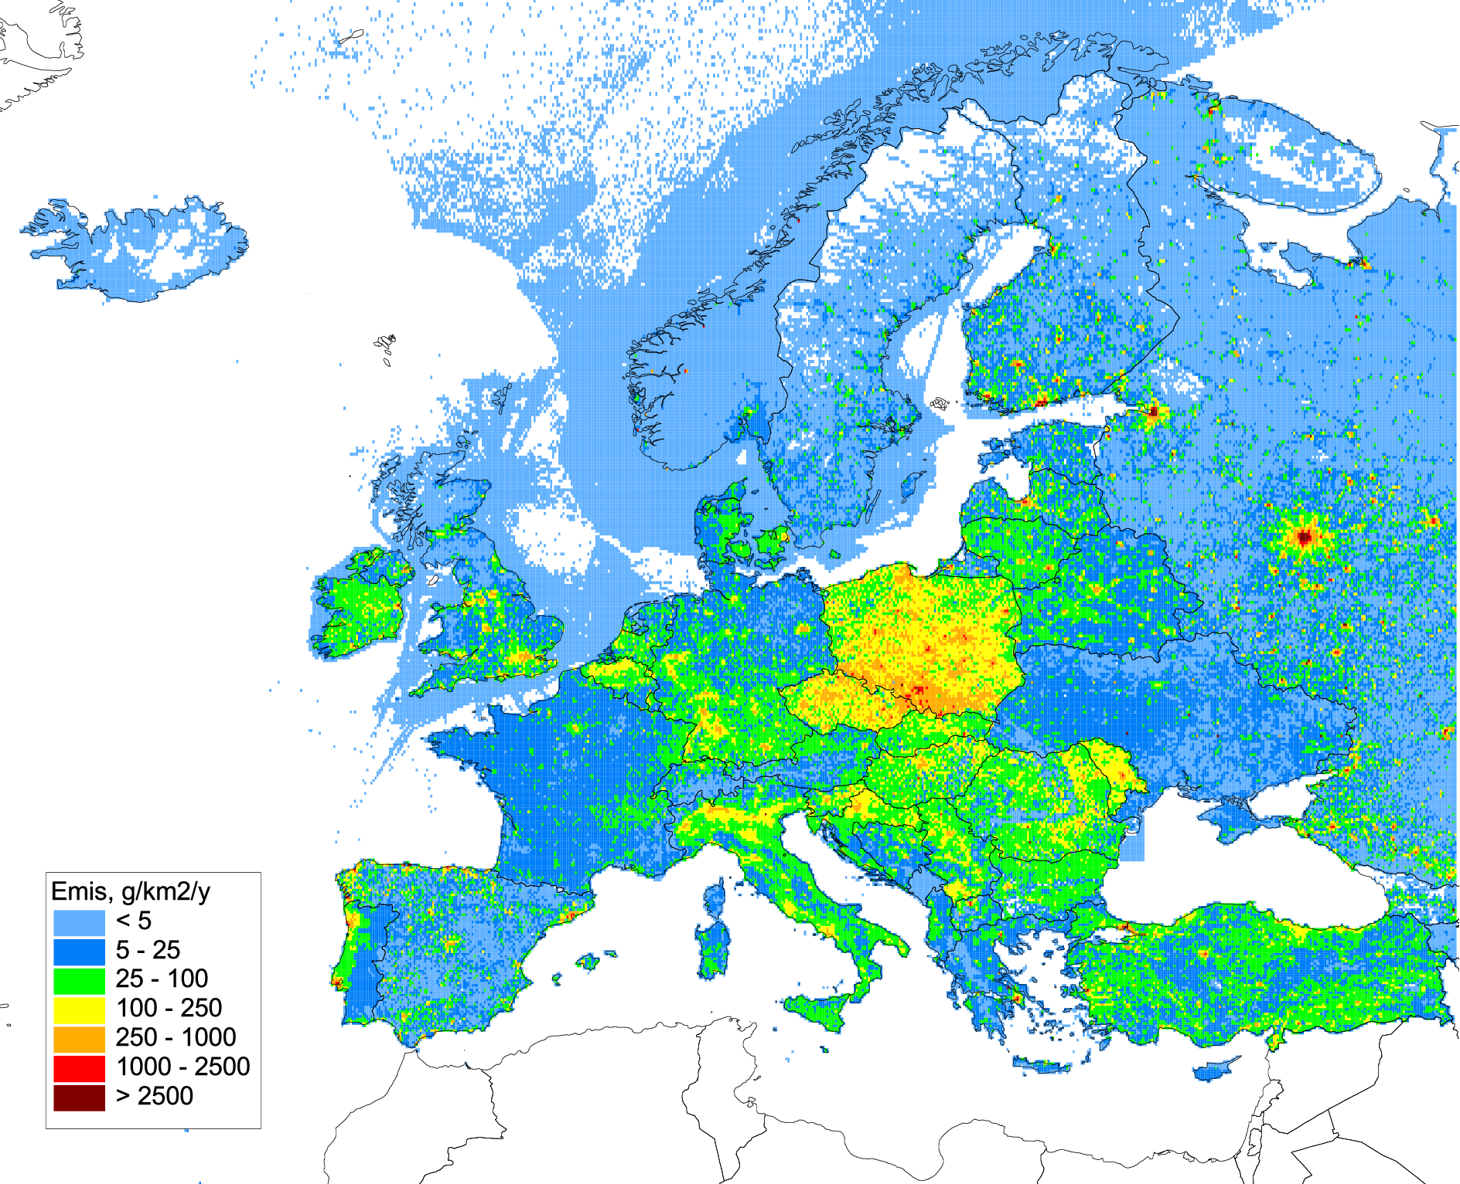
Multi-model study of B(a)P pollution
Contribution to Eurodelta-Carb model intercomparison project (TFMM)
Objectives:
Evaluation of B(a)P/PM emissions from residential combustion sector
Assessment of B(a)P pollution levels and exceedances of air quality guidelines
Analysis of transport and fate of B(a)P and PM components (OC, EC)
Participating models:
Model | Institution | Uploaded to FTP server
CHIMERE | CIEMAT (Spain), INERIS (France) | B(a)P
GLEMOS | EMEP/MSC-E | B(a)P
MINNI | ENEA (Italy) | B(a)P, O₃, OC, EC, PM2.5, …
SILAM | FMI (Finland) | B(a)P, O₃, OC, EC, PM2.5, …
Annual B(a)P emissions within
Eurodelta-Carb modelling domain (2018)

Slide 4
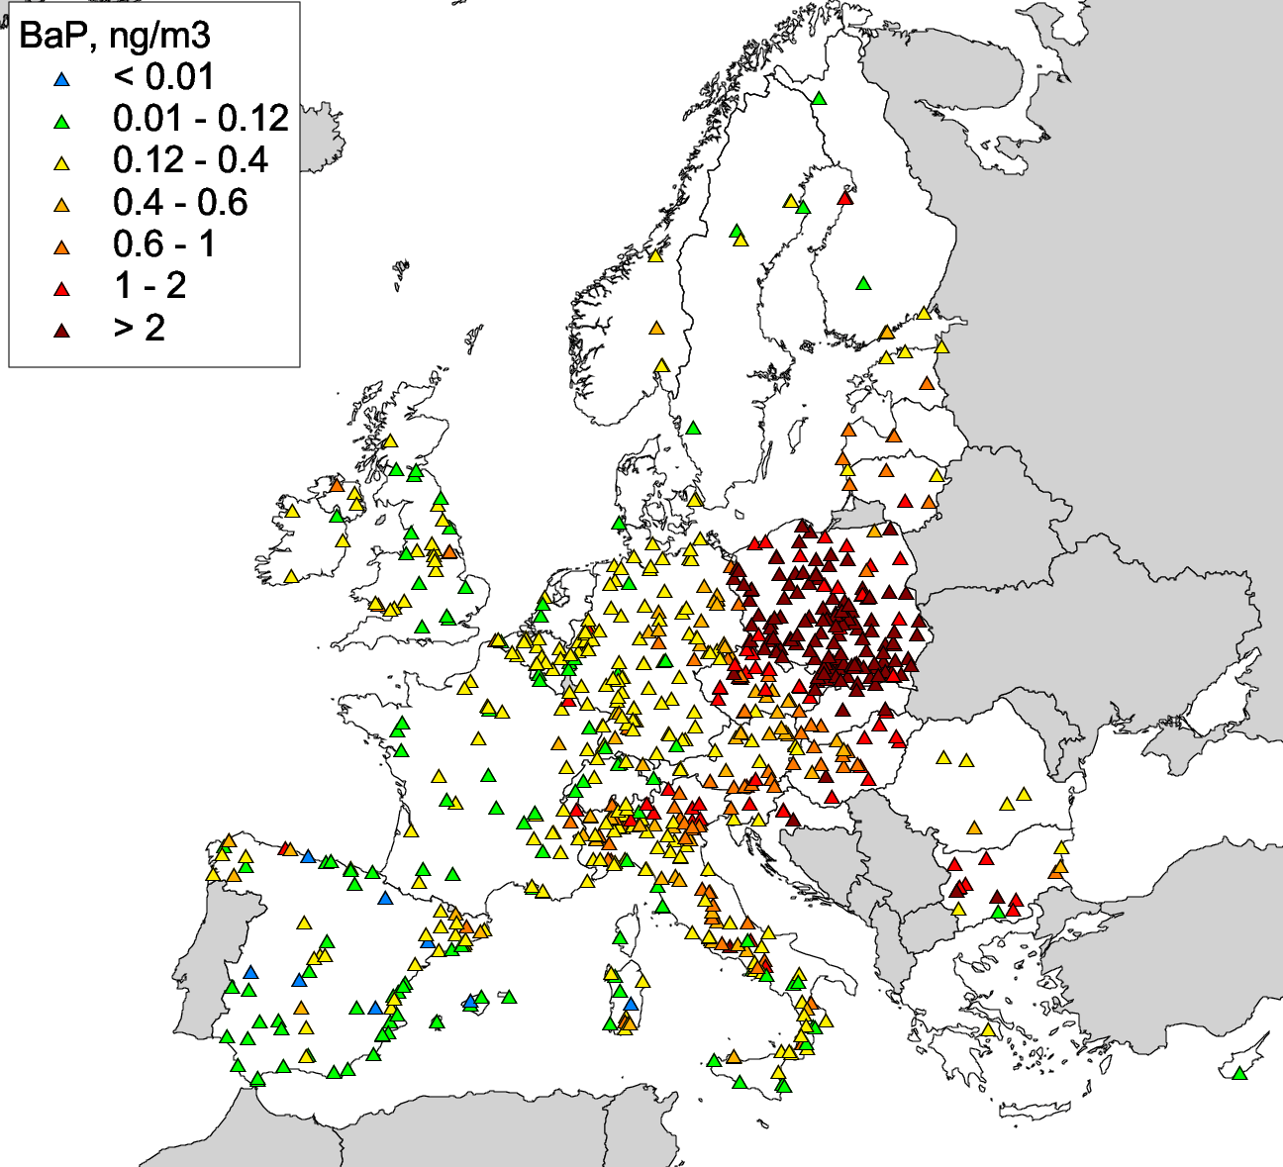
Multi-model study of B(a)P pollution: setup detailes
Model setup:
Identical to PM phase of Eurodelta-Carb, except for emissions and temporal coverage
Temporal coverage:
2017.12.01-2018.12.31 to cover EMEP/ACTRIS/COLOSSAL IMP (winter 2017/2018) and allow annual coverage
Emissions of B(a)P:
CEIP emission inventory for 2018 (submission of 2021)
Emissions of non-B(a)P species (SOx, NOx, PM2.5,…):
recommendation to use CAMS-REG-AP/REF2.1 emission inventory
Observations:
EMEP and EEA AQ e-reporting measurement data for 2017/2018
Model simulations:
Base case model run
Sensitivity model runs (will be discussed and agreed)
EEA AQ e-reporting B(a)P measurements (2018)

Slide 5
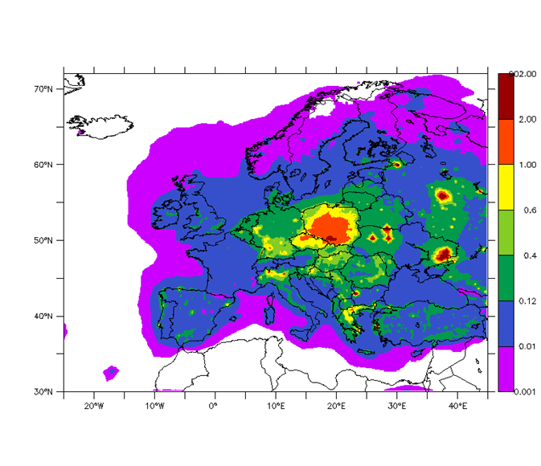
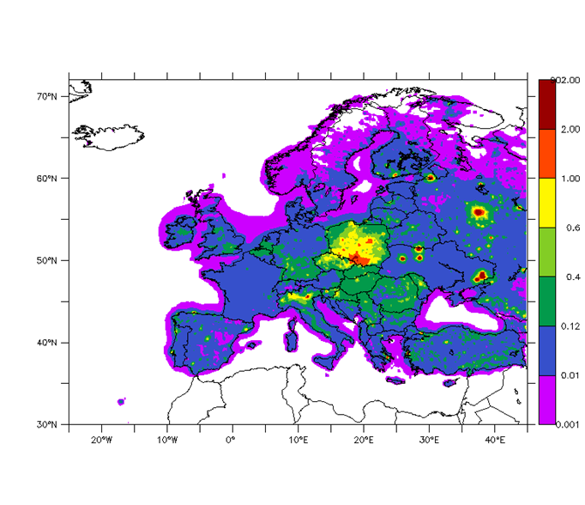
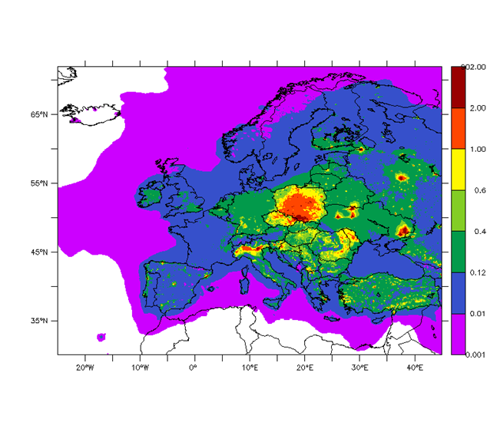
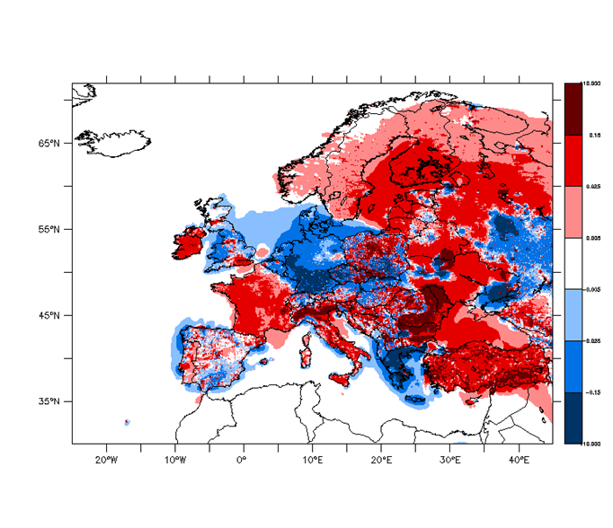
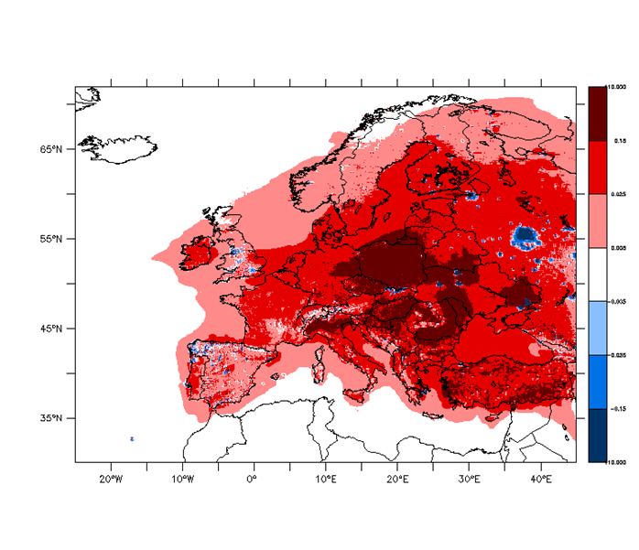
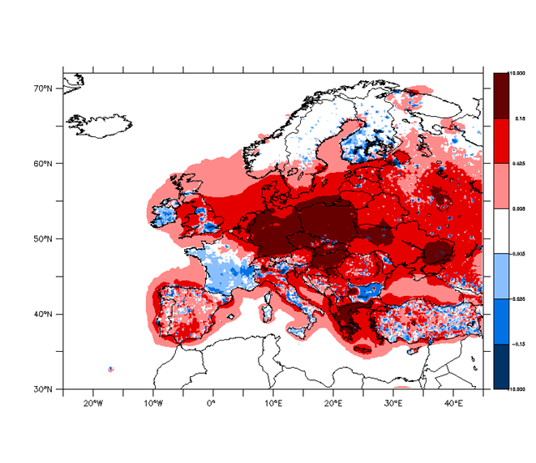


Base case run: preliminary results on B(a)P (2018)
GLEMOS
MINNI
CHIMERE
2.0
2.0
2.0
1.0
1.0
1.0
0.6
0.6
0.6
B(a)P in air,
ng m⁻³
0.4
0.4
0.4
0.12
0.12
0.12
0.01
0.01
0.01
0.001
0.001
0.001
Annual mean modelled B(a)P air concentrations (gas+particle)
CHIMERE-GLEMOS
0.15
0.15
0.15
0.025
0.025
Absolute difference,
ng m⁻³
0.025
0.005
0.005
0.005
-0.005
-0.005
-0.005
-0.025
-0.025
-0.025
-0.15
-0.15
-0.15

Slide 6
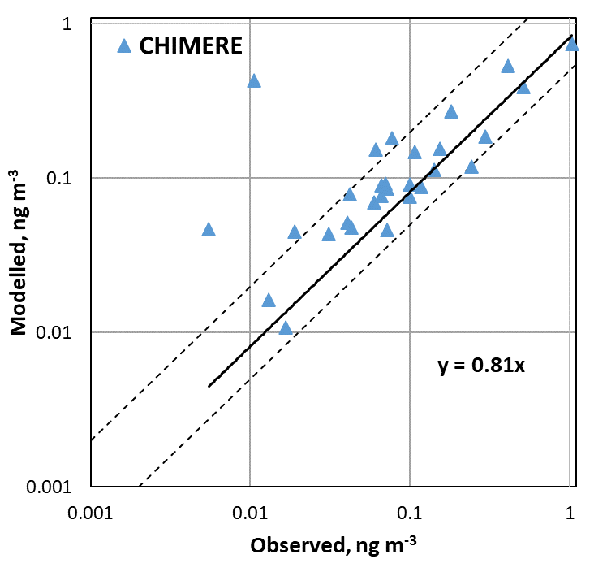
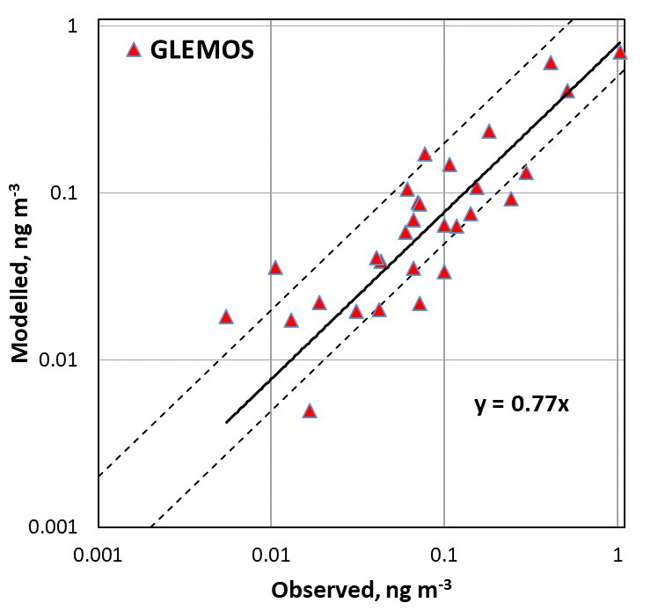
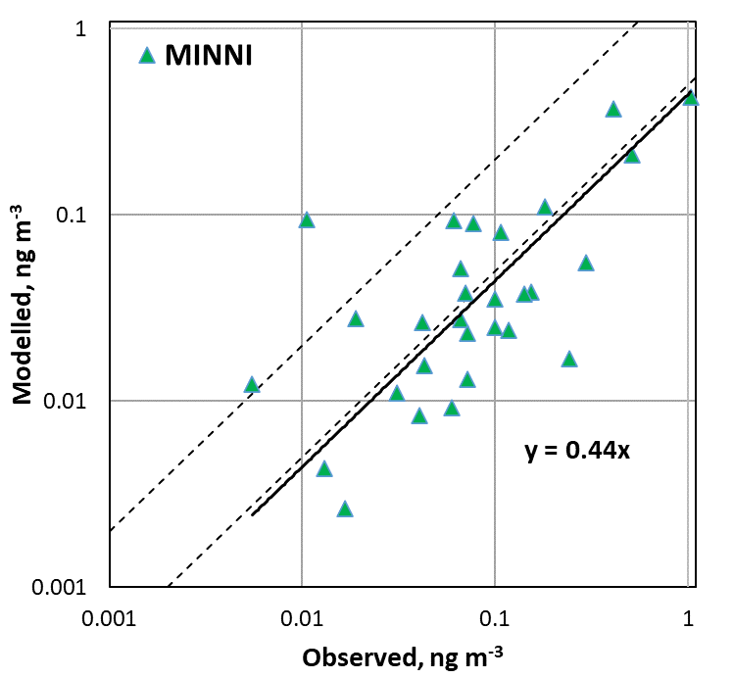
Base case run: modelled vs observed (EMEP stations)
Annual mean B(a)P concentrations (2018), 29 EMEP stations
x2
x0.5
 | CHIMERE | GLEMOS | MINNI
Bias | 8% | -16% | -52%
Correlation | 0. 84 | 0.91 | 0.87
Factor 2 | 23 | 20 | 9
High altitude stations (> ~900m) were excluded

Slide 7
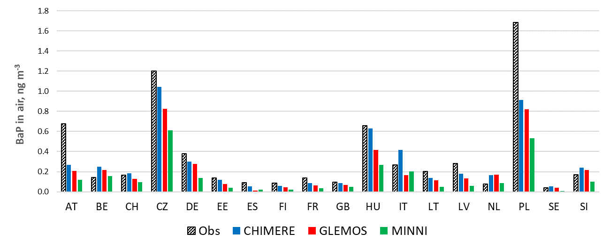
Base case run: modelled vs observed (AQ e-reporting stations)
Annual mean B(a)P concentrations, 95 background rural stations (2018)
 | CHIMERE | GLEMOS | MINNI
Model bias | -20% | -38% | -60%
Correlation | 0.91 | 0.94 | 0.91

Slide 8
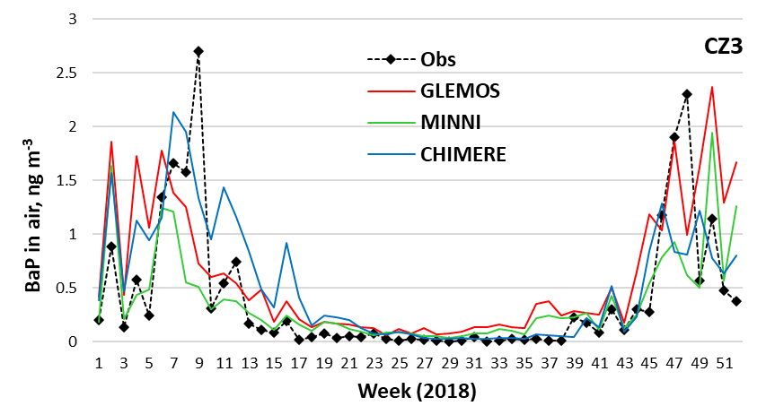
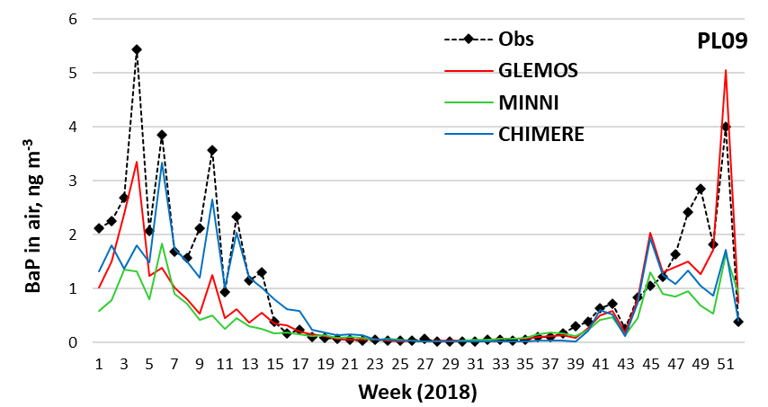
Base case run: B(a)P intra-annual variations (2018)
General remarks on the results:
Good agreement with annual mean EMEP measurements
Generally good agreement with annual mean AQ e-reporting measurements with some exceptions
Intra-annual variability of B(a)P was captured by the models
Differences in model estimates may be attributed to different emission temporal profiles used in models as well as other parameters (e.g. meteorology, concentrations of reactants, …)

Slide 9
Eurodelta-Carb B(a)P study: proposals of further steps
1. Continue analysis of models performance and differences:
Detailed comparison of modelling results vs measurements of AQ e-reporting
Compare modelled B(a)P gaseous/particulate concentrations ratio between models
Comparison of B(a)P concentrations in precipitation and deposition fluxes with measurements of EMEP stations
Comparison of selected meteorological parameters used in model simulations and measurements (list of parameters to be discussed)
Comparison of modelled and observed OC, EC, O₃ concentrations used in model simulations with measurements of ACTRIS/COLOSSAL campaign and of EMEP stations
2. Sensitivity/scenario model runs:
Model simulations with unified B(a)P temporal emission profiles
Experimental scenario of B(a)P emissions using the TNO PM/condensables emission inventory REF2 (to be discussed)
3. Technical meetings and publications:
Organize technical zoom meeting to discuss current progress in the analysis and further steps
Description of progress of the study in the EMEP Status Report of HMs/POPs 2022
Presentation of the study at the 21st HARMO conference in Aveiro, Portugal (27-30 September 2022)

Slide 10
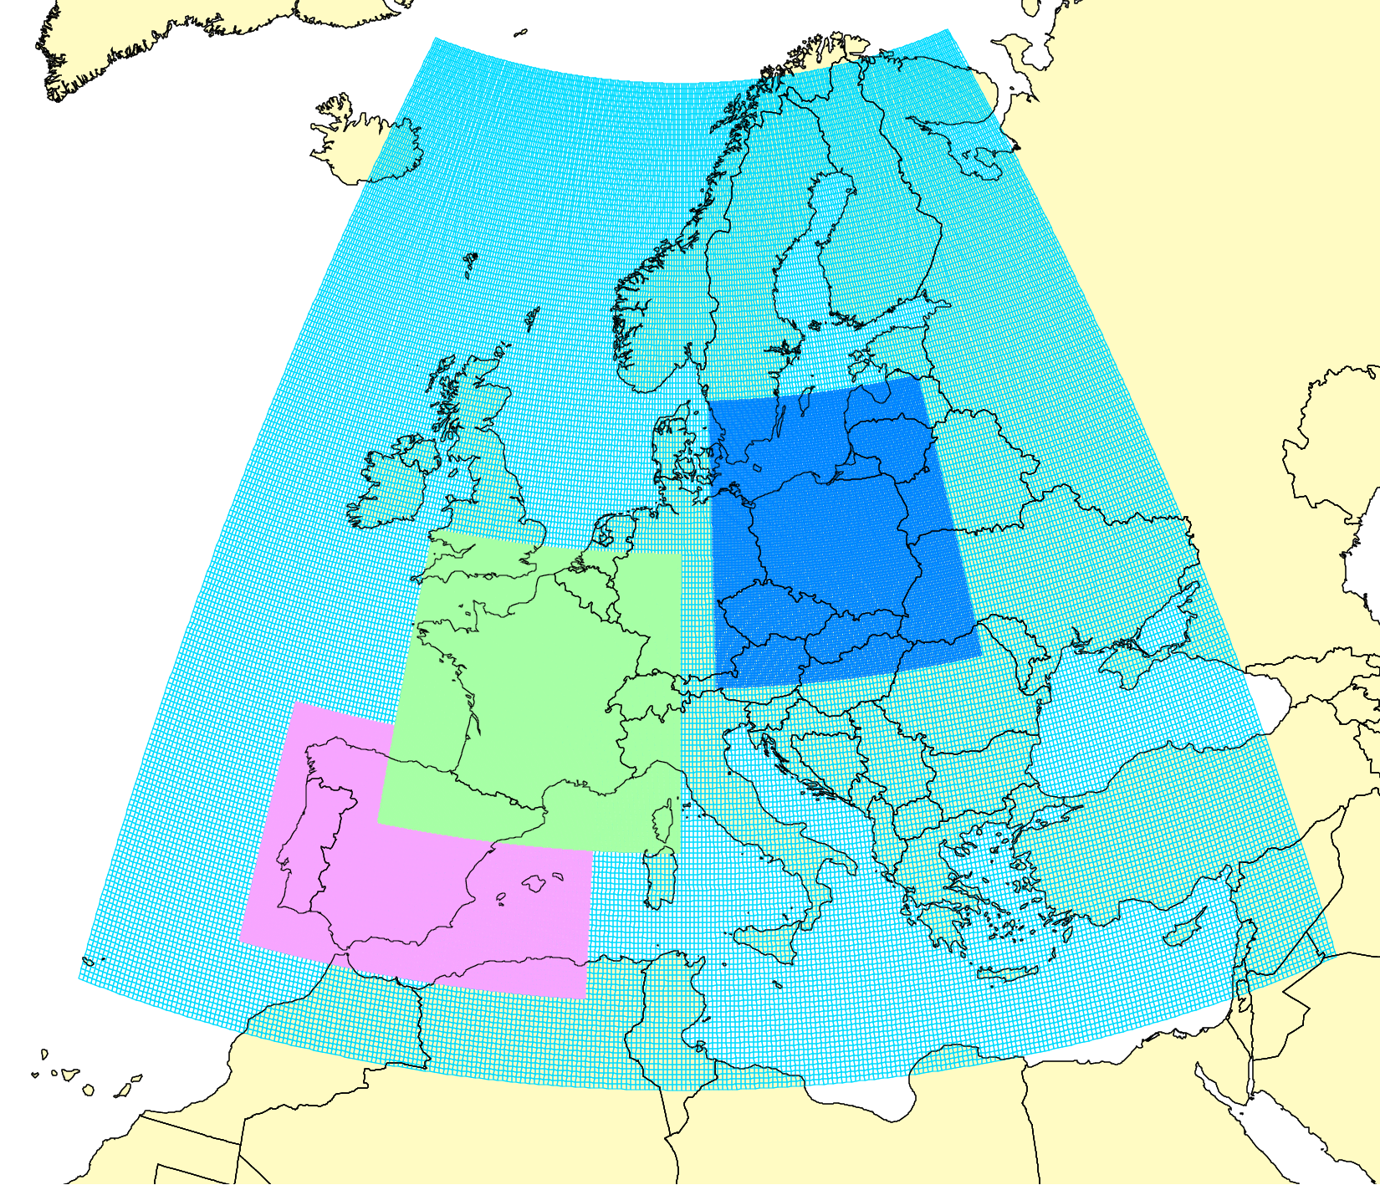
PAH assessment: case study on PAH/B(a)P pollution in Poland
Series of joint research studies of MSC-E and experts from Spain, France, Poland to improve PAH pollution assessment (2017-present)
Case study for Poland - objectives:
Evaluation of updated national emission inventory of 4 PAHs (B(a)P, B(b)F, B(k)F, I(cd)P) for EMEP
Model assessment of pollution levels of 4 PAHs in Poland and comparison with EMEP and EEA measurements
Estimation of exceedances of the EU and WHO air quality guidelines for PAHs
Model intercomparison (GLEMOS, GEM-AQ) to support further improvement of emissions data and analysis of pollution trends
Modelling domains
Poland
France
Spain

Slide 11
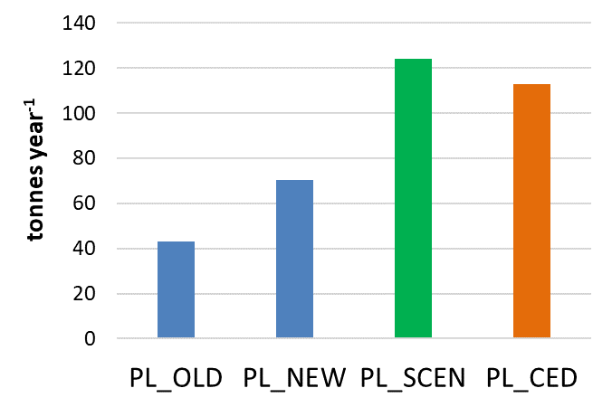
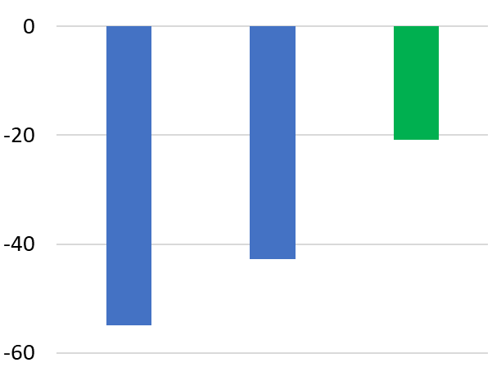
PAH assessment: case study on PAH/B(a)P pollution in Poland
Phase I – B(a)P (2020-2021):
Evaluation of updated national B(a)P emission inventory:
- previous inventory for EMEP (PL_OLD) – used before 2020
- updated inventory for EMEP (PL_NEW) – used starting from 2020
Experimental model simulations using scenario B(a)P emissions
based on the level of uncertainty (PL_SCEN)
B(a)P emission in PL (sector C, 2018)
GLEMOS model bias (2018), %
Alternative inventory: National inventory based on Central Emission database (PL_CED) [Gawuc et al., Atmosphere, 2021]
PL_OLD PL_NEW PL_SCEN

Slide 12
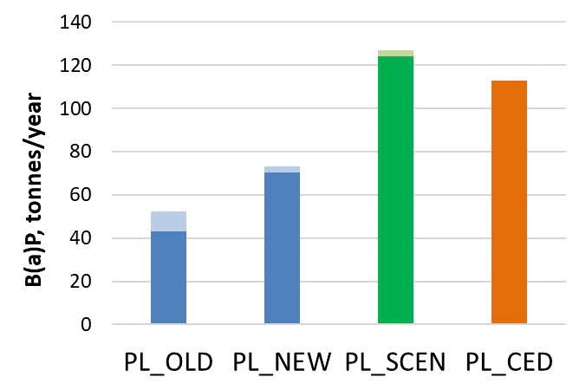
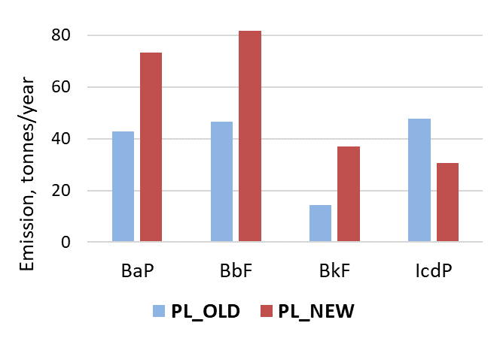
PAH assessment: case study on PAH/B(a)P pollution in Poland
Phase I – B(a)P (2020-2021):
Evaluation of updated national B(a)P emission inventory
Experimental model simulations using scenario B(a)P emissions
based on the level of uncertainty (PL_SCEN)
Phase II – B(b)F, B(k)F, I(cd)P (2022-2023):
Analysis and update of model parameterization
for B(b)F, B(k)F, and I(cd)P
Evaluation of updated national emission inventory
of B(b)F, B(k)F, and I(cd)P
Evaluation of exceedances of air quality guidelines for 4PAHs
Dark colors indicates Residential Combustion sector

Slide 13
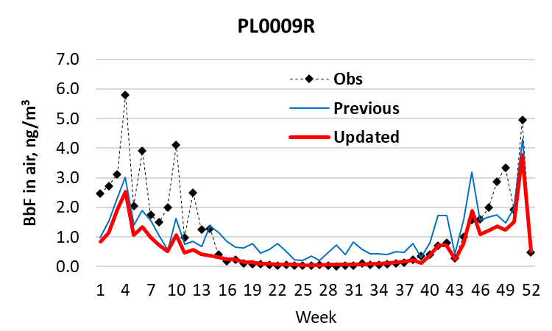
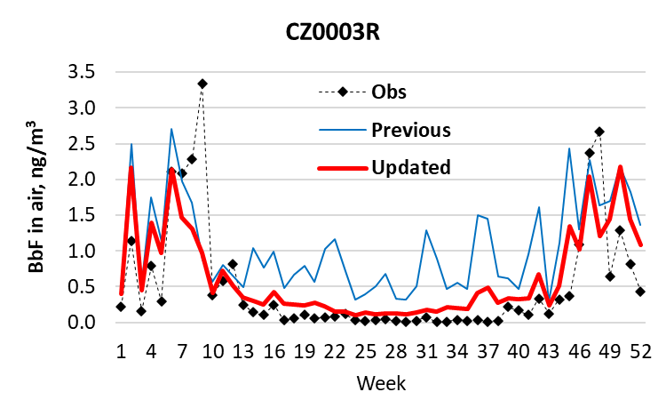
Refinement of model parameterization for B(b)F, B(k)F, and I(cd)P
Previous model parameterization (GLEMOS v2.2.1):
Gas-particle partitioning:
adsorption scheme based on subcooled liquid vapor pressure [Junge, 1977; Pankow, 1987]
Degradation in particulate phase:
none
Updated model parameterization (GLEMOS v2.2.2):
Gas-particle partitioning:
adsorption to BC & absorption to OM
[Lammel & Lohmann, 2004]
Degradation in particulate phase:
OM fraction [Kahan et al., 2006],
BC fraction [Perraudin et al., 2007]
Modelled vs observed B(b)F air concentrations

Slide 14
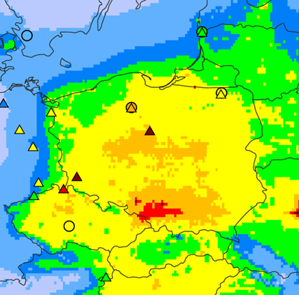
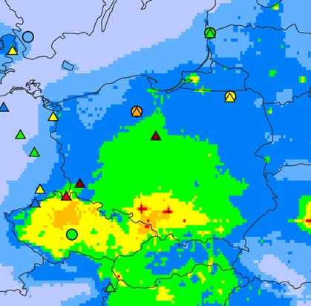
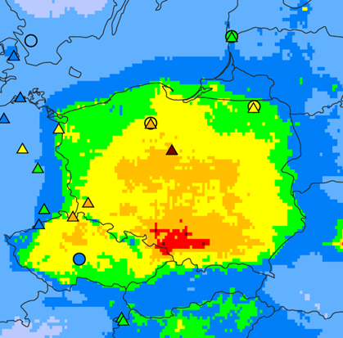
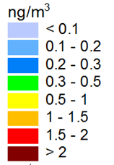
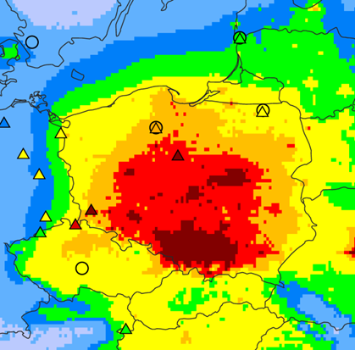
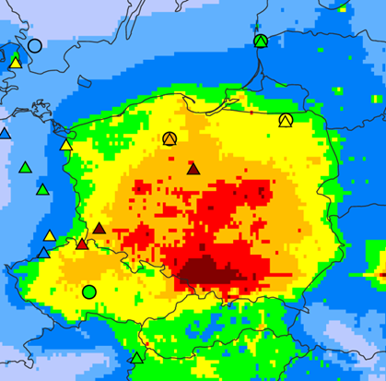
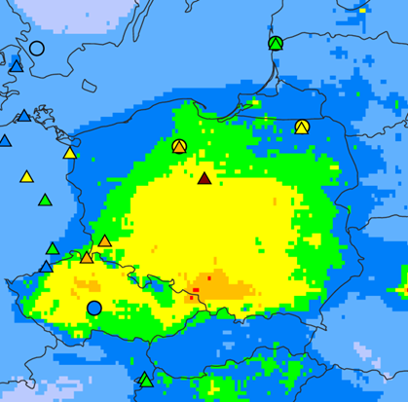
Evaluation of updated PAH emission inventory: modelling results
B(b)F
B(k)F
I(cd)P
PL_OLD
PL_NEW
Modelled B(b)F, B(k)F, I(cd)P annual mean air concentrations (2018), GLEMOS v2.2.2, resolution 0.1°x0.1°
Measurements of background rural and suburban stations (BR+BS) of EMEP ( ) & EEA AQ e-reporting ( )

Slide 15
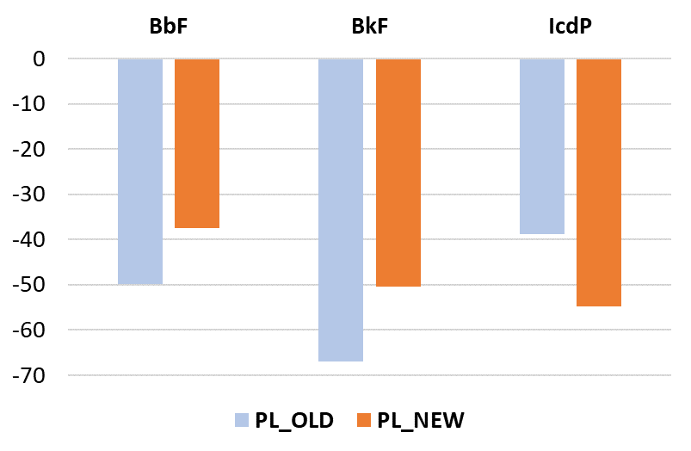
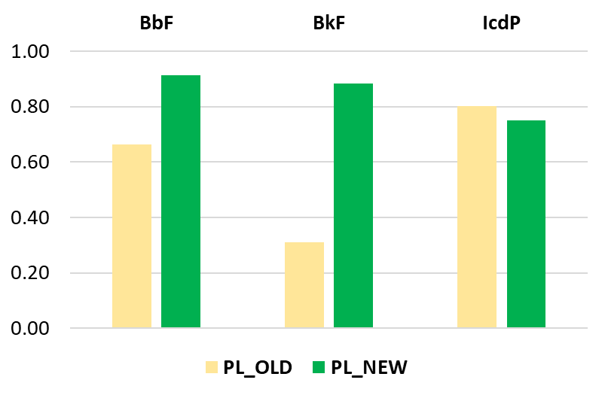
Evaluation of updated PAH emission inventory: modelled vs observed values
Comparison with data of Background Rural + Suburban stations for 2018 (about 19 stations):
Decrease of model bias for B(b)F and B(k)F, but increase for I(cd)P
Increase of correlation for B(b)F and B(k)F, but decrease for I(cd)P
Increase of Factor of 2 parameter from by 30% for B(b)F and B(k)F, but decrease by 10% for I(cd)P
Bias, %
Correlation

Slide 16
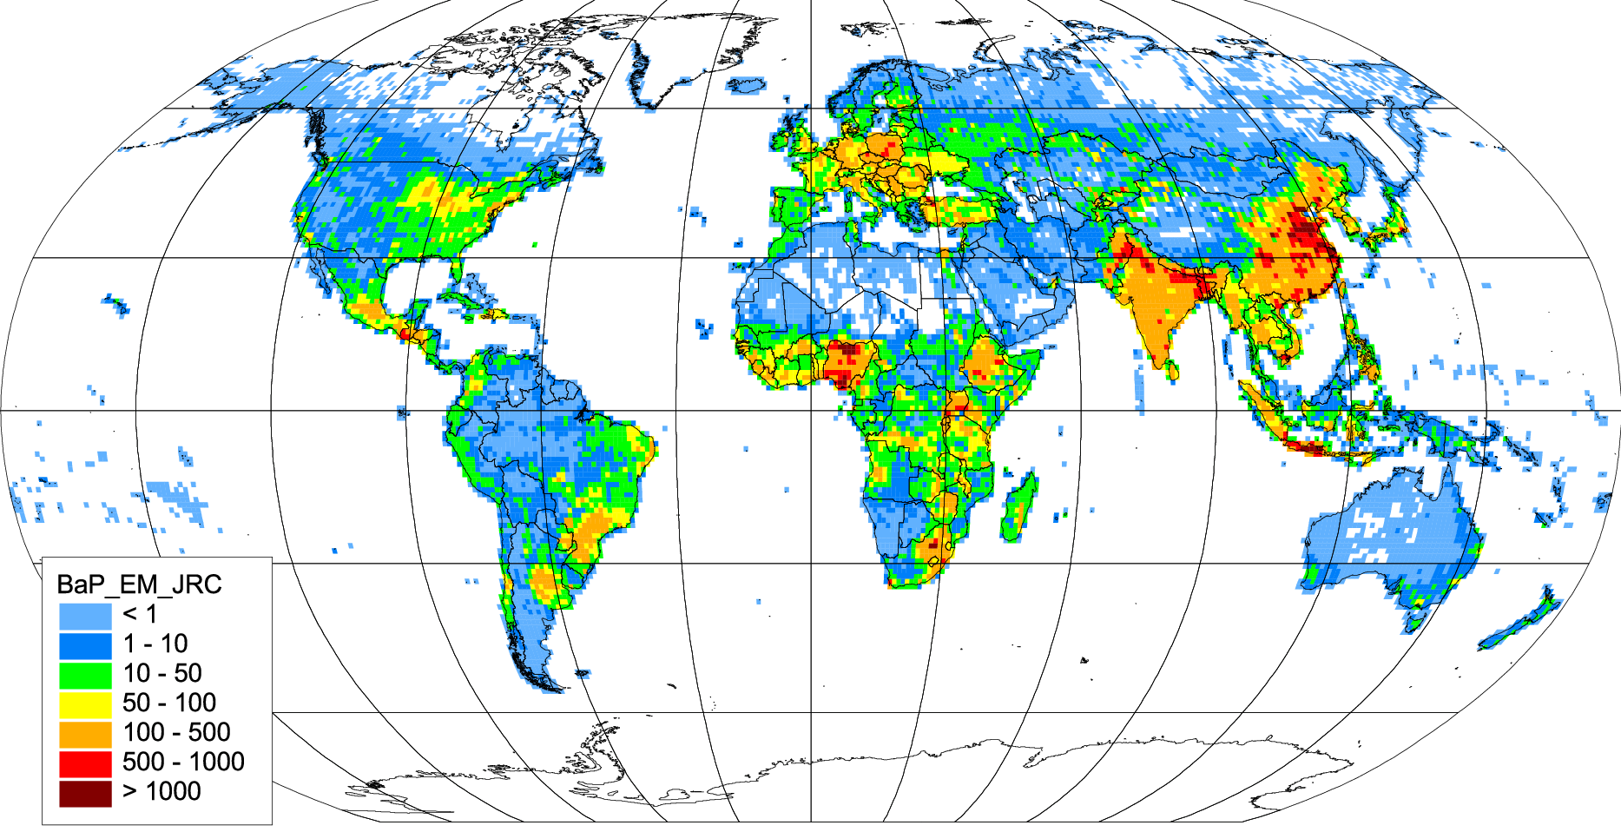
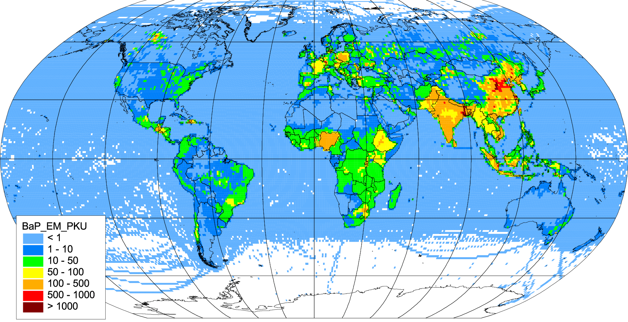
Global scale PAH pollution assessment
Recent activities:
Release of global scale JRC emission inventory EDGARv6.0_toxPOPs (4PAHs, PCDD/Fs, PCBs, HCB) in April 2022
Update of global scale PKU-Fuel (China) emission inventory (16PAHs, PCDD/Fs) in ~ summer 2022
B(a)P emissions, 2018, EDGARv6.0_toxPOPs
Characteristics of inventories:
Resolution: 0.1°x0.1°
Time period: several decades
Emissions: by sectors, by countries Intra-annual variations: monthly
B(a)P emissions, 2014, PKU-Fuel

Slide 17
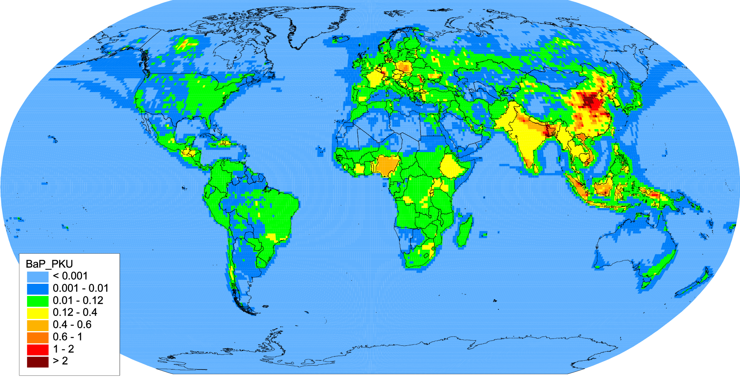
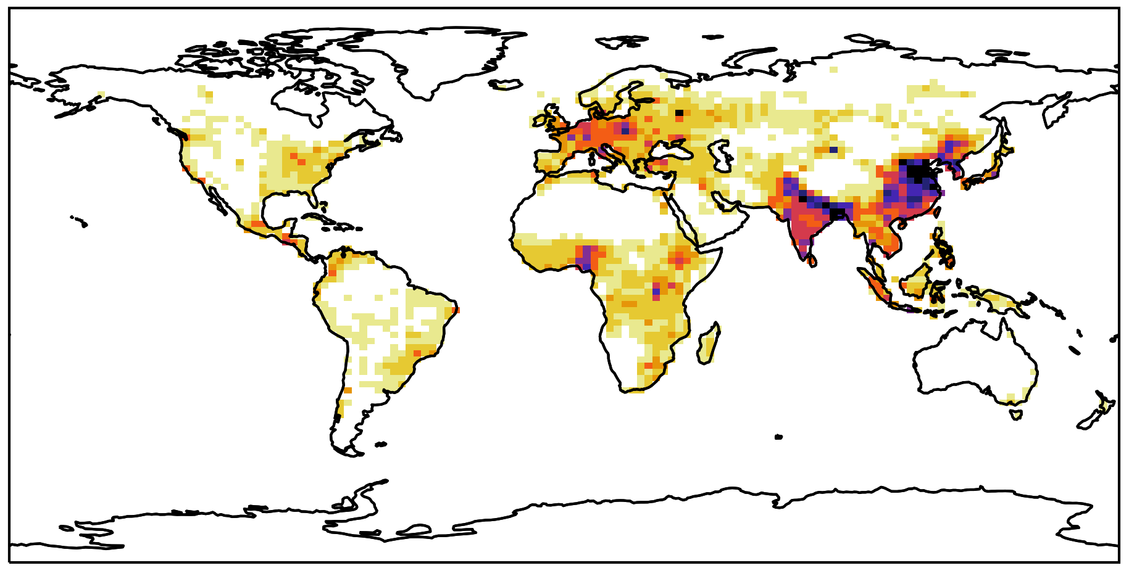
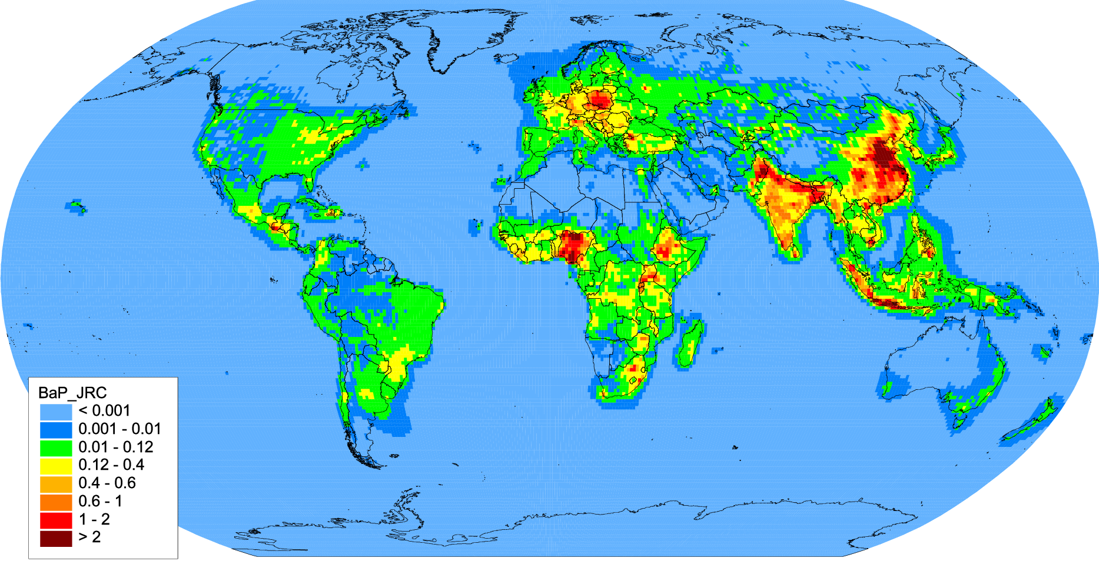
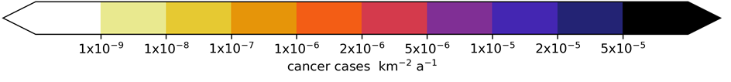
Global scale PAH pollution assessment
Contribution to the forthcoming TF HTAP meeting (25th May 2022)
Recent activities:
Evaluation of JRC EDGARv6.0_toxPOPs emission inventory for B(a)P using GLEMOS model for 2018
Global scale risk assessment for 16PAHs + N-PAHs using
GEOS-Chem and PKU-Fuel inventory (Kelly et al, GeoHealth, 2021)
Modelled B(a)P concentrations (GLEMOS)
Based on PKU-Fuel (2014)
B(a)P accounts for 11 % of human cancer risk from PAH mixture
Based on EDGARv6.0_toxPOPs (2018)

Slide 18
Proposals of further activities on PAHs
Research activities
  Multi-model simulations of B(a)P pollution (EuroDelta-Carb): analysis of results and publication
  Case study on B(a)P pollution in Poland: multi-model simulations, analysis of trends
  Global scale PAH pollution assessment (in co-operation with TF HTAP): contribute to evaluation of global emission inventories and multi-model assessment
  Co-operation
  Data exchange with TF Health on B(a)P/PAH concentration and exceedances of target values to assess population exposure
  Co-operation with international organizations (HELCOM, OSPAR, …)

