Slide 1




CAMS Policy Service:
Global/Regional Modelling of Prospective Air Quality Scenarios
Augustin Colette, Palmira Messina, Adrien Chantreux, Florian Couvidat (INERIS, FR)
Renske Timmermans, Jeroen Kuenen, Richard Kranenburg (TNO, NL)
David Simpson, Anna Maria Katarina Benedictow (MET, NO)
Johannes Flemming (ECMWF, DE)
TFMM Online Meeting 4 May, 2022

Slide 2
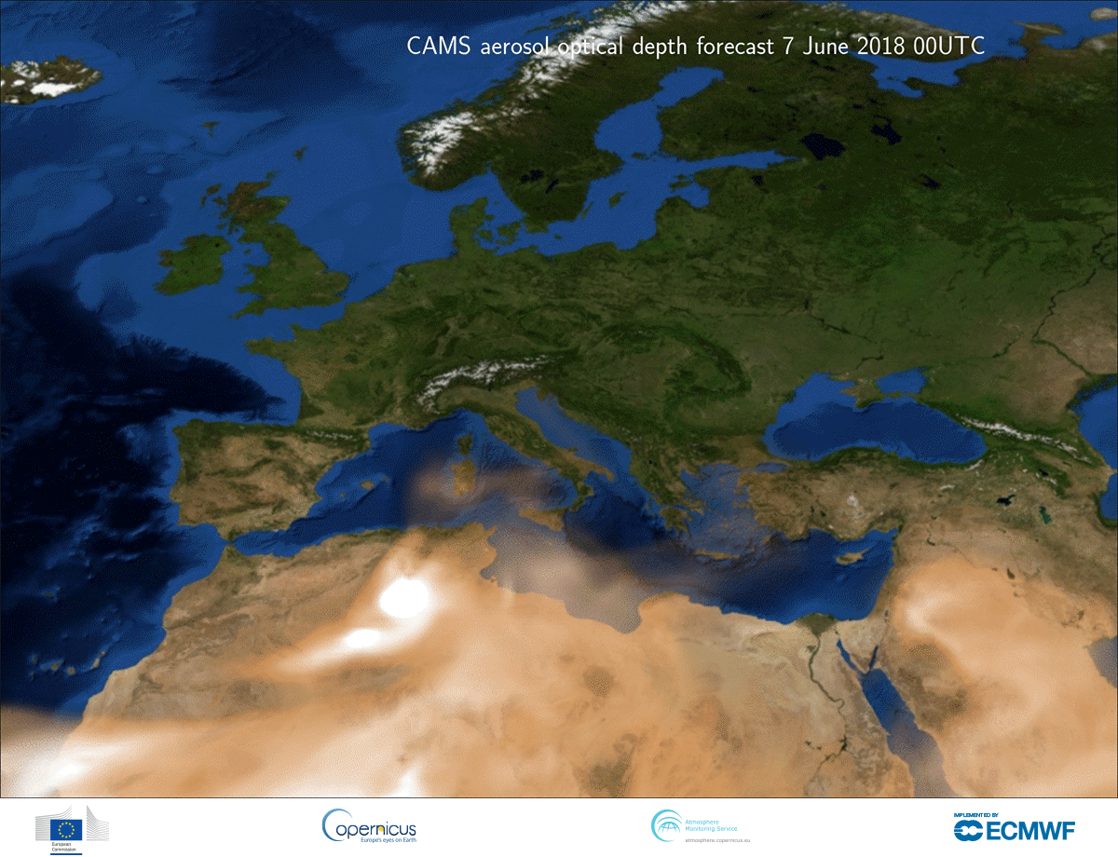
What CAMS provides to support EU policy?
EU Member States are responsible for the implementation of the Air Quality Directives:
  air quality monitoring strategy (measurement and modelling);
  air quality objectives (limit and target values);
  analysis of main drivers of air pollution episodes, including transboundary and natural contributions;
  information to the general public;
  design and implementation of short-term and long-term action plans to comply with AQ objectives.
CAMS provides relevant Europe-wide information products:
  air quality forecasts and (re)analyses;
  natural contributions: dust, sea salts, forest fires;
  European-scale emission inventories;
  policy tools co-designed with MS to meet their needs.

Slide 3
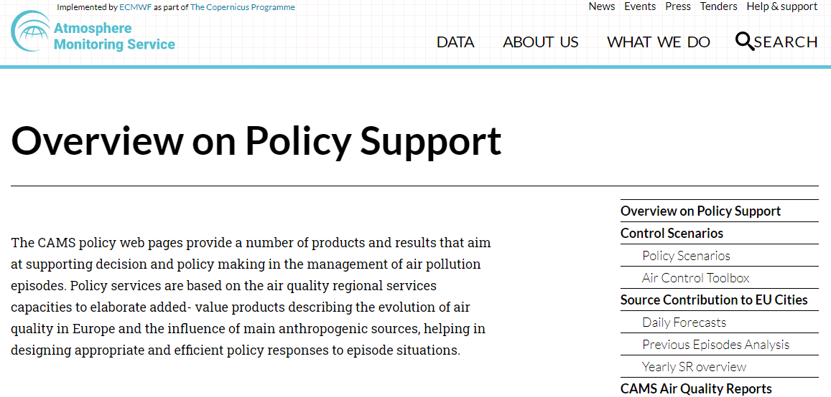
Focus on the policy products
policy.atmosphere.copernicus.eu
Led by INERIS, contribution from MetNo, NILU, TNO
Assessment reports
  Air pollution maps: regulatory and health indicators
  Trends
  Understanding episodes
  Interim (June Y+1) / Validated (Oct Y+2)
Air Control Toolbox (ACT)
  Influence of the activity sectors
  Interactive tool to build scenarios
  Source apportionment & chemical regime
Source-receptor analysis in EU countries
  Weight of AP long range transport in the largest cities
  Influence of neighboring countries
  Chemical speciation
  Episode Report Analysis
Interaction with Policy Users
  Policy User Workshop
  Collaborative studies JRC/DG-ENV/EEA
No compliance checking, no planning tools
  Improving our understanding of air pollution patterns and episodes in Europe : long range transport, natural sources, activity sectors, trends…

Slide 4
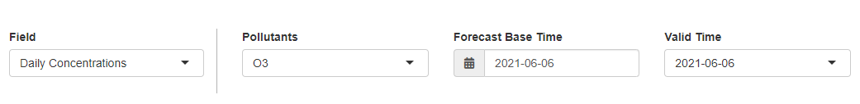
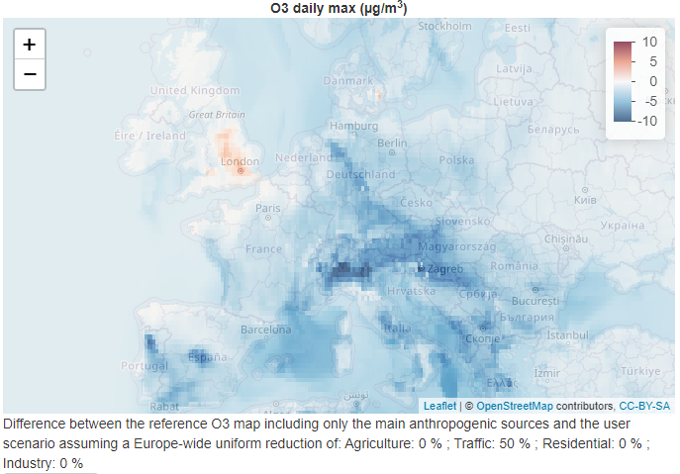
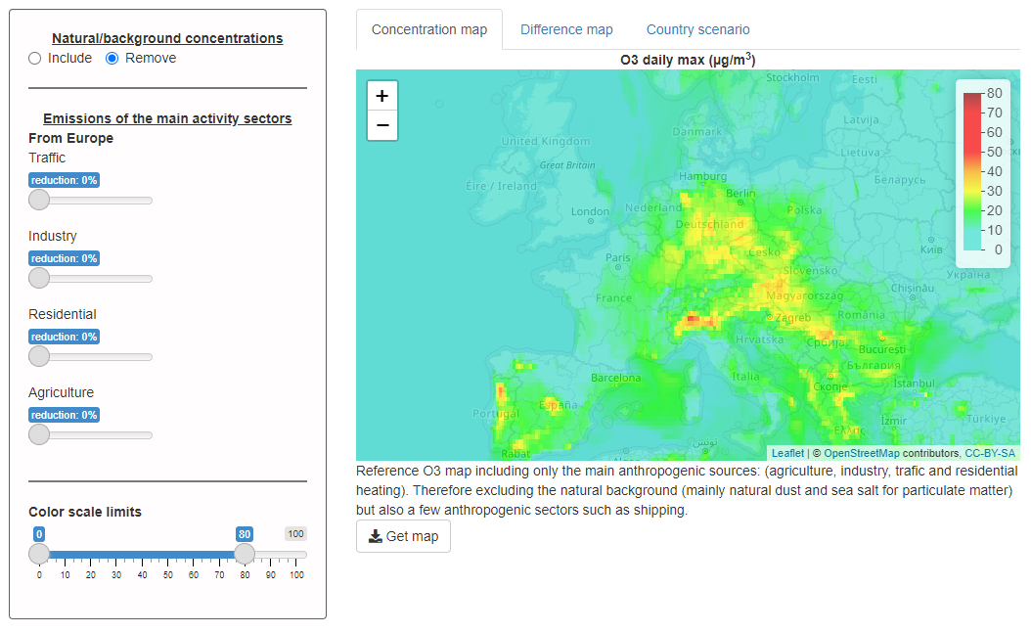
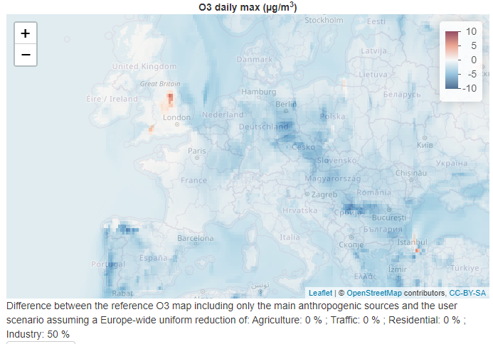
The air control toolbox (ACT: CHIMERE)
-50% TR
-50% IND
https://policy.atmosphere.copernicus.eu/CAMS_ACT.php

Slide 5
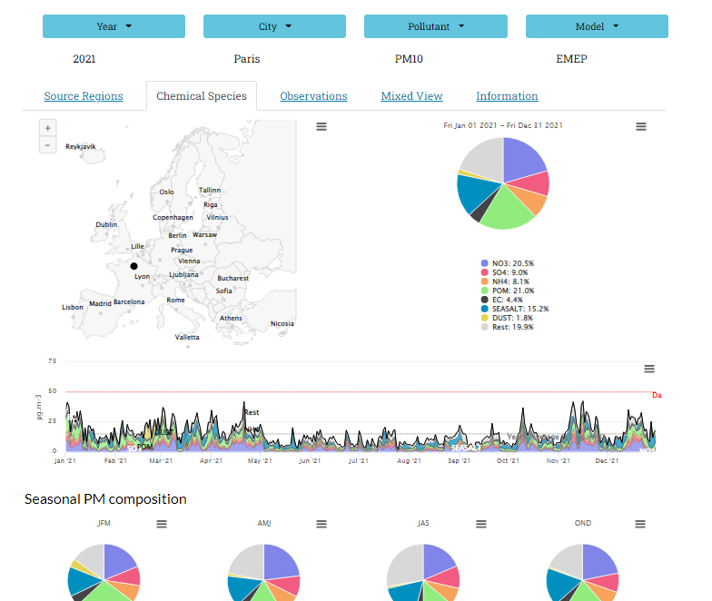
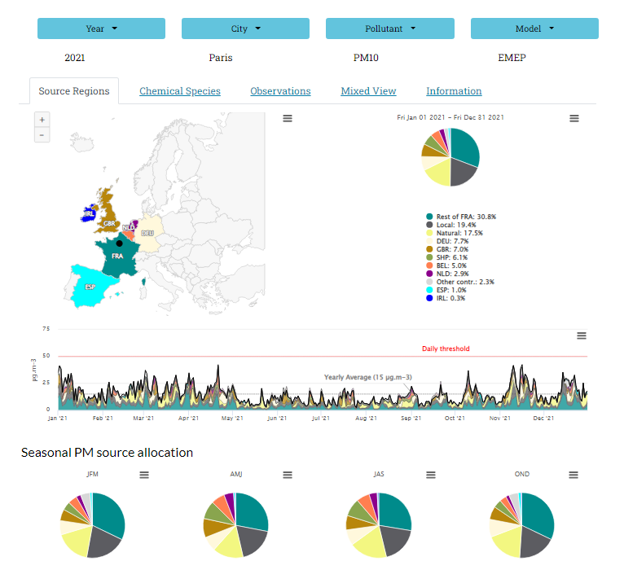
Source receptor allocation service (EMEP&LOTOS)
https://policy.atmosphere.copernicus.eu/YearlyStatistics.php

Slide 6
Prospective scenario analysis
Model prospective scenarios
  ENSEMBLE of Regional Chemistry Transport Models (CHIMERE, LOTOS-EUROS, EMEP)
  Nested in a global model using identical emission projections (IFS)
Baseline reference for 2015:
  CAMS-GLOB-ANT-v4.2 for the global scale, and CAMS-REG-v4.2 for the regional scale
Projection for 2050
  IIASA CLE/MFR ECLIPSE v6 scenarios
No | Scenario | Scenario year | Short description
0 | BASE | 2015
1 | CLE (current legislation) | 2050 | Current Legislation: baseline scenario for 2050
2 | Agriculture | 2050 | CLE with additional reductions (MFR) in agriculture
3 | Health | 2050 | CLE with additional reductions (MFR) in all sectors except agriculture
4 | MFR (maximum feasible reduction) | 2050 | Maximum Feasible Reduction for all sectors
5 | MFR+FFPO (fossil fuel phase out) | 2050 | A complete fossil fuel phase-out applied on top of the MFR scenario, leading to significant additional emission reductions
6 | CH4-red (50% CH4 reduction) | 2050 | Current emissions (as in 2015), with only a change in CH4 emissions (reduced by 50%)

Slide 7
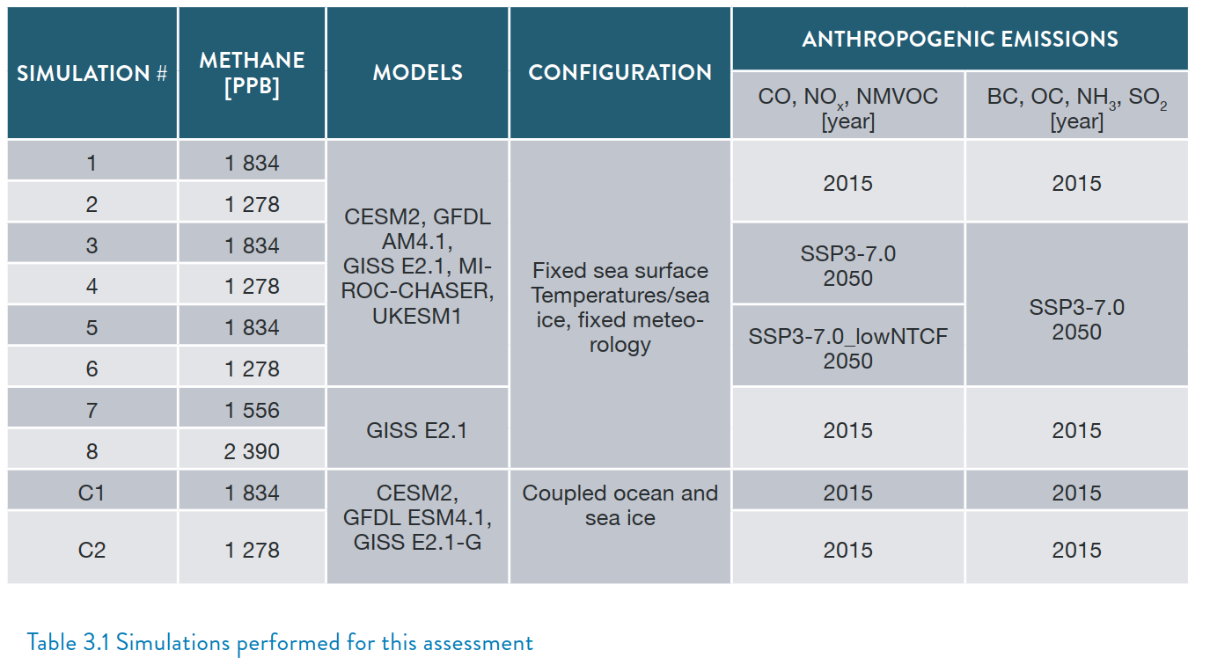
Methane scenarios
The main CH4 effect for European O3 will be through the Global (IFS) Boundary conditions
Methane concentrations are prescribed in the Global and Regional Models
Box Model CH4 concentrations for ECLIPSE CLE/MFR Scenarios
Additional sensitivity:
  50% anthrop CH4 emission reduction => 30% reduction in concentrations (1298ppb instead of 1875 for 2015)
  To be compared to Scenarios #1&2 of the UNEP Global Methane Assessment
Prescribed methane concentration calculated for the ECLIPSE V6b scenarios using a box model by Dirk Olivie (MetNo) in AMAP
UNEP GMA 2021

Slide 8
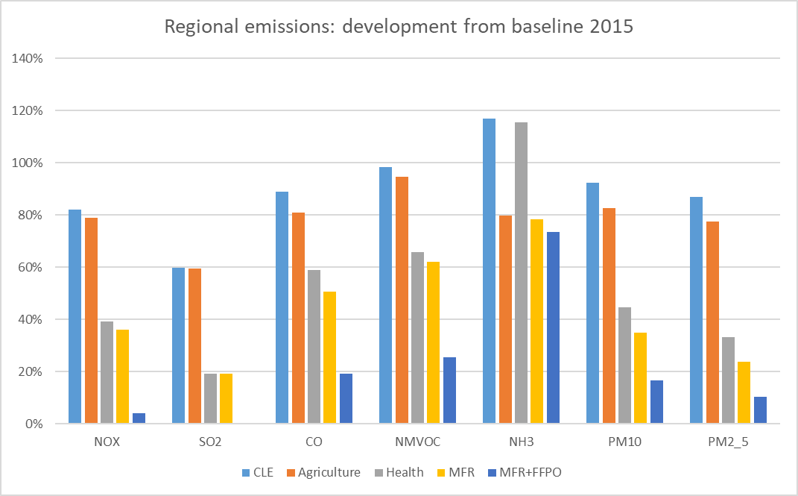
Emission scenarios
Total emissions in the different scenarios, expressed as a ratio with the baseline emissions for 2015

Slide 9
Model results

Slide 10
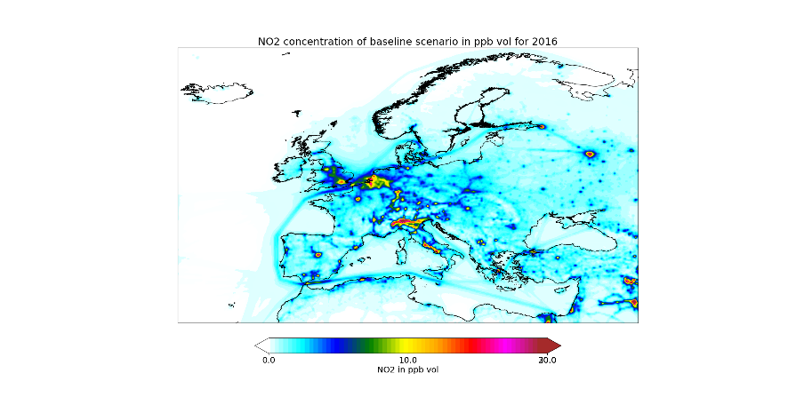
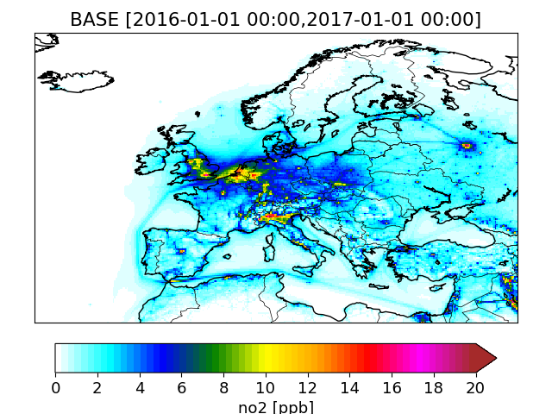
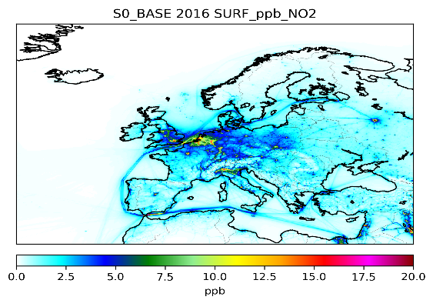
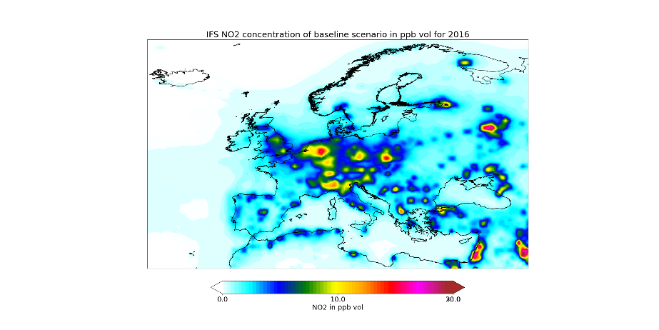
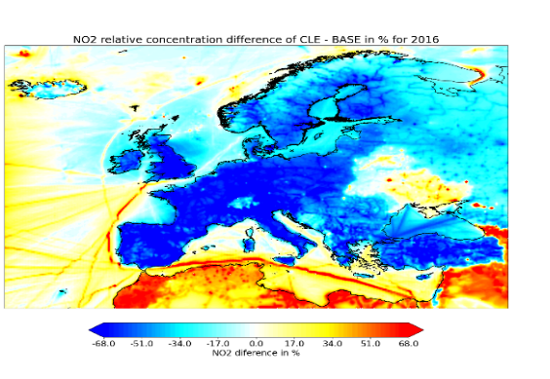
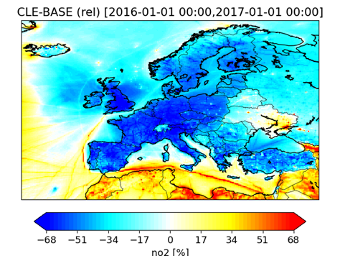
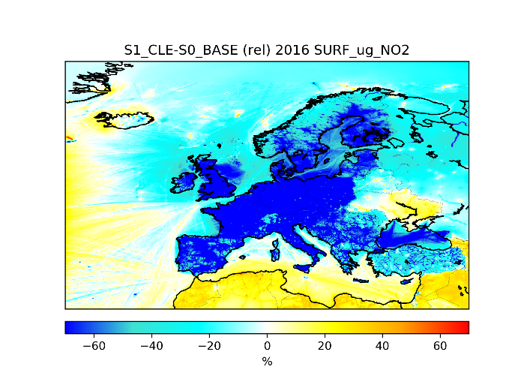
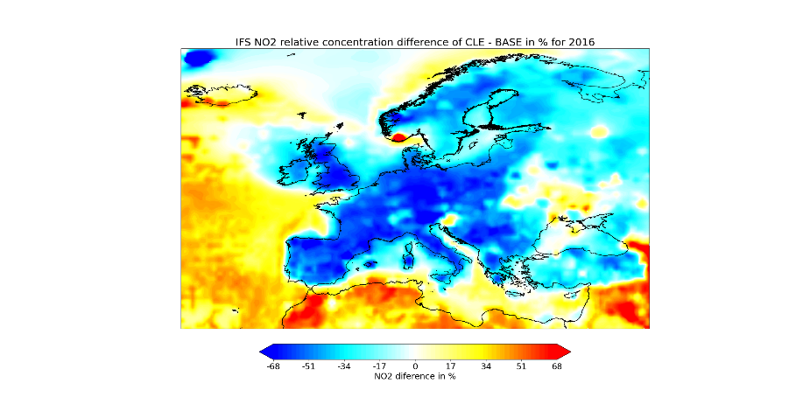
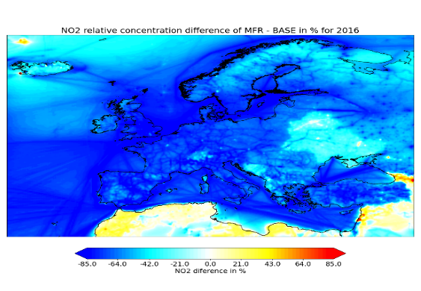
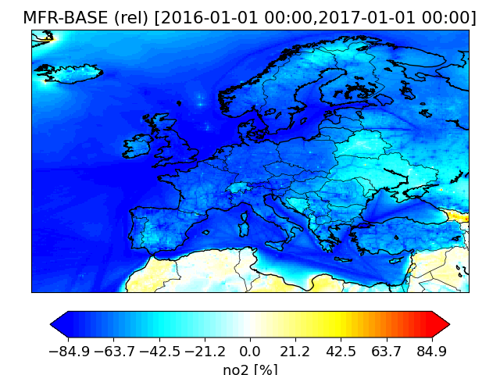
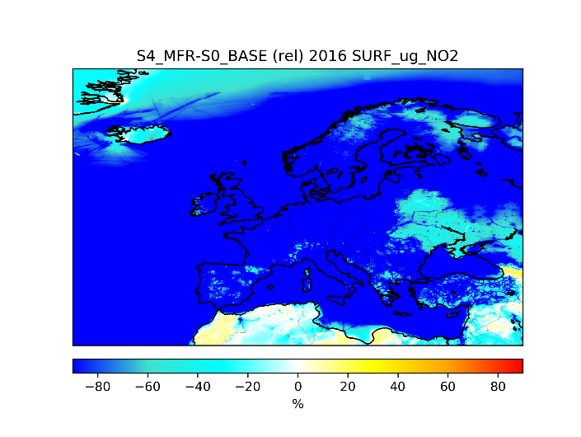
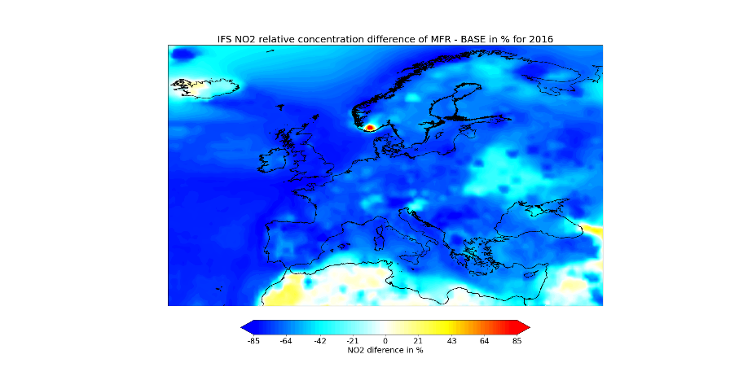
NO2 annual mean
CHIMERE
LOTOS-EUROS
EMEP
IFS
BASE
CLE-BASE
MFR-BASE
Consistent qualitative response in regional/global models (exc. resolution effect in IFS)

Slide 11
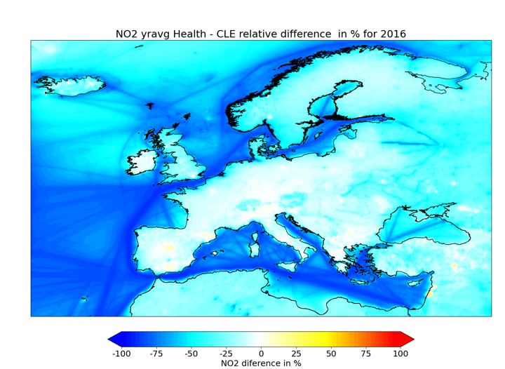
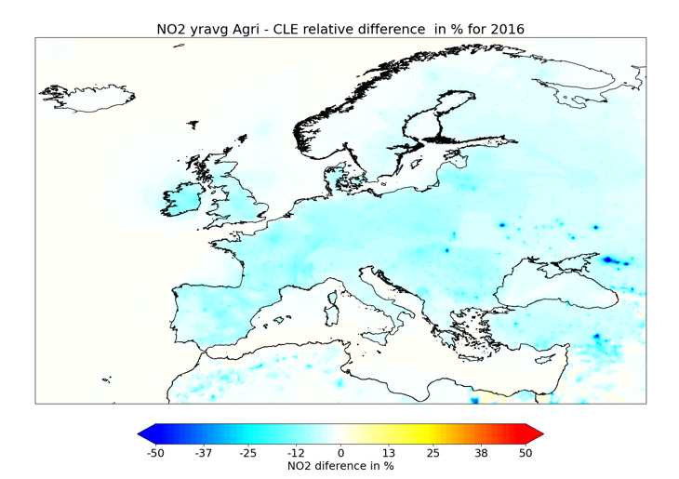
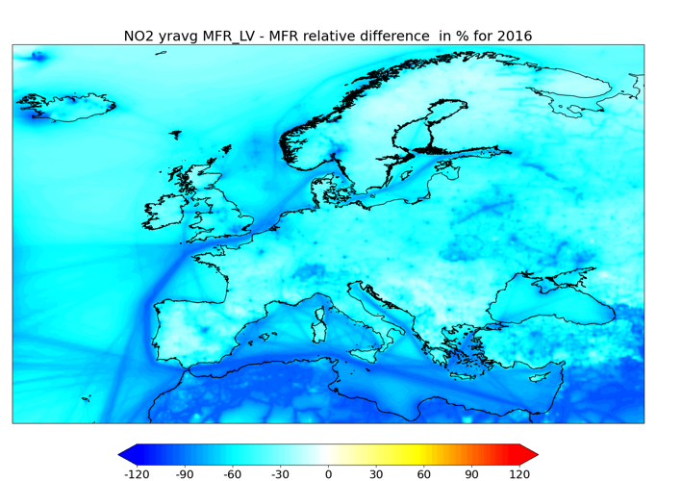
PM2.5 (CHIM)
Added value of AGRI/HEALTH/Fossil scenarios
Health scenario - CLE
Agriculture scenario - CLE
FFPO- MFR
« Health »: limited gain in NOx over land surface in MFR compared to CLE
Large benefit of Fossil Fuel Phase Out (FFPO) in addition to MFR

Slide 12
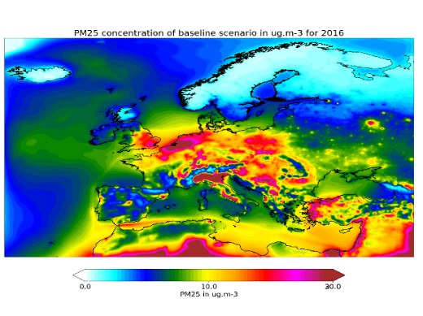
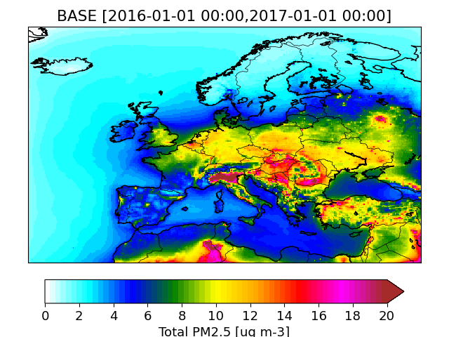
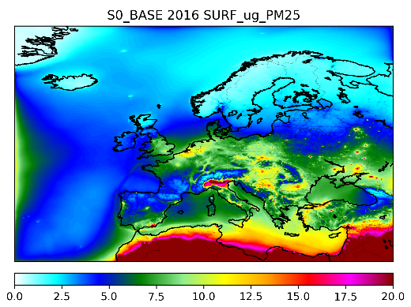
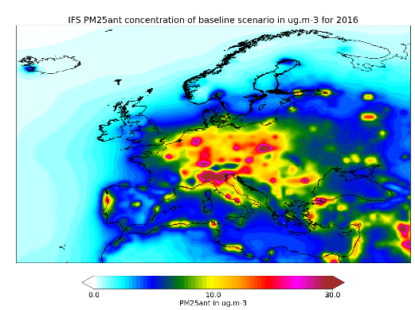
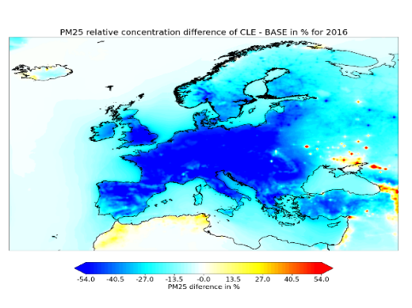
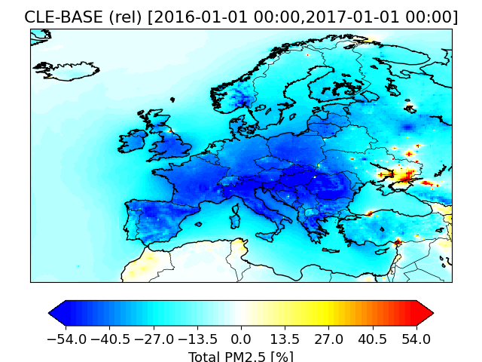
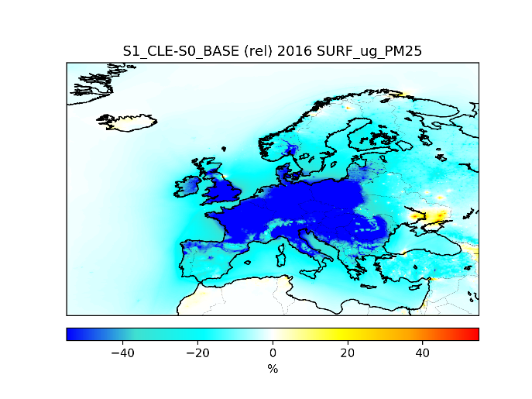
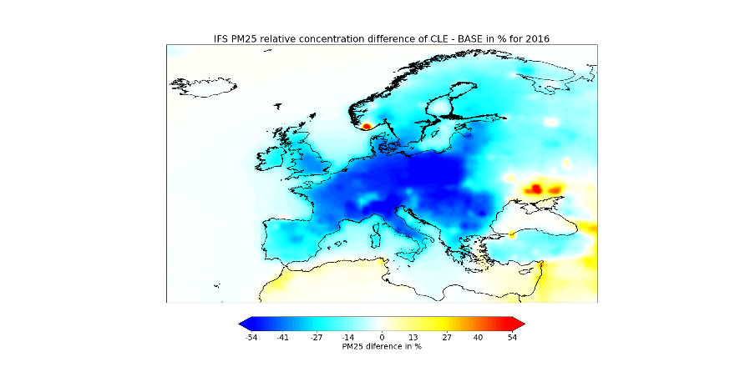
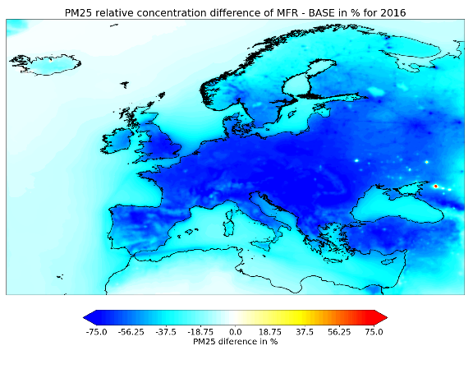
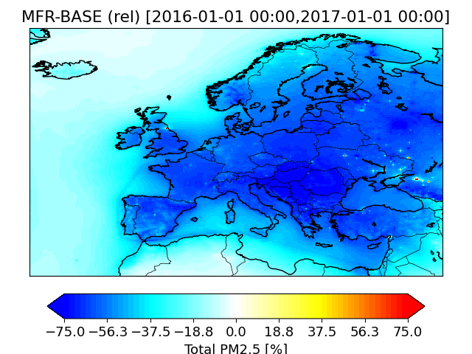
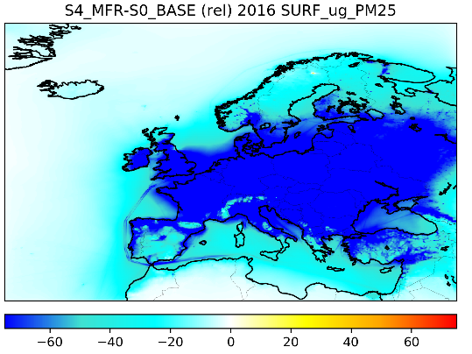
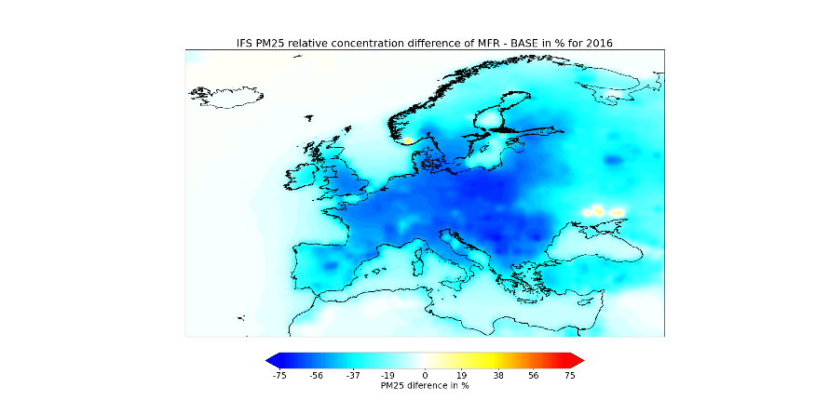
PM2.5 annual mean
CHIMERE
LOTOS-EUROS
EMEP
IFS
BASE
CLE-BASE
MFR-BASE
Consistent qualitative response in regional/global models (exc. resolution effect in IFS)

Slide 13
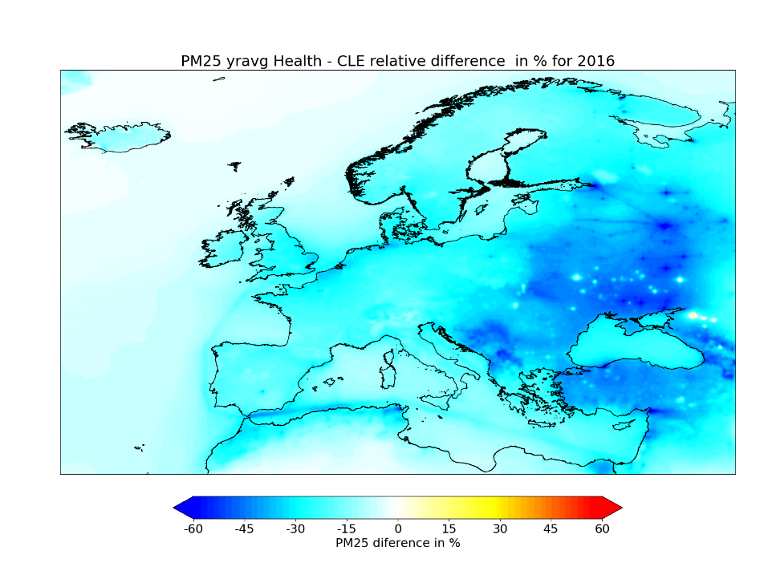
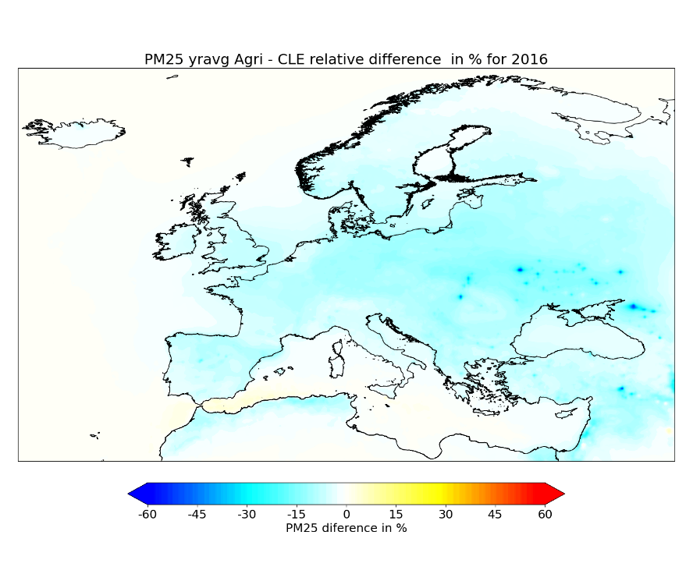
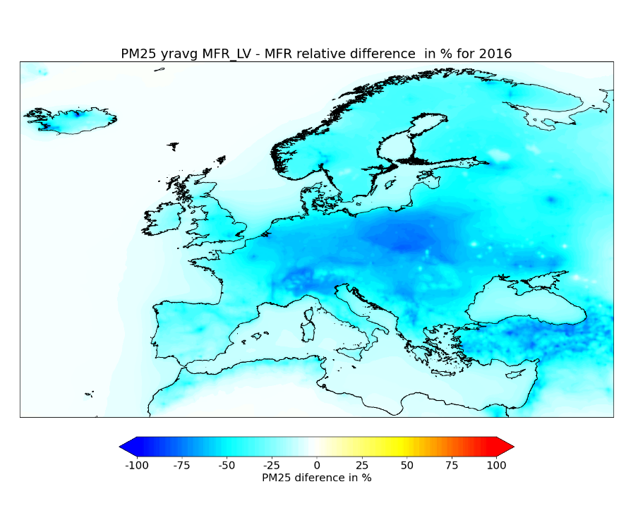
PM2.5 (CHIM)
Added value of AGRI/HEALTH/Fossil scenarios
Health scenario - CLE
Agriculture scenario - CLE
FFPO- MFR
« Health »: larger benefit than « agri » for PM2.5
Large benefit of Fossil Fuel Phase Out (FFPO) in addition to MFR

Slide 14
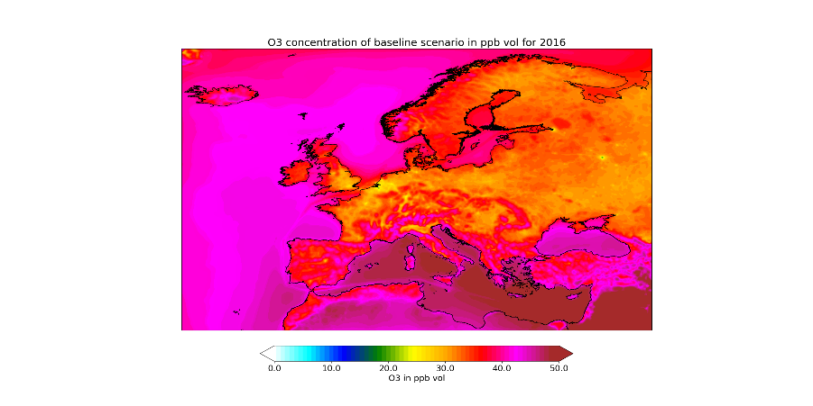
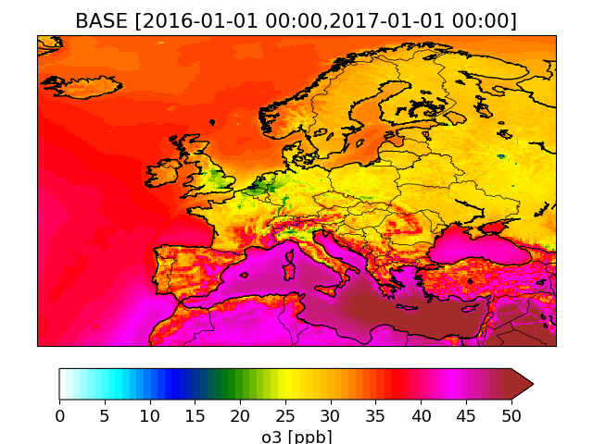
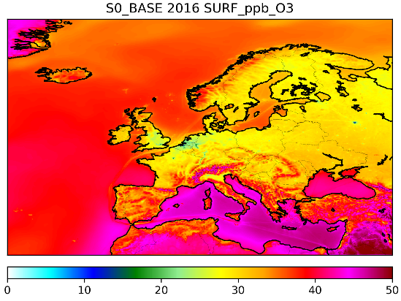
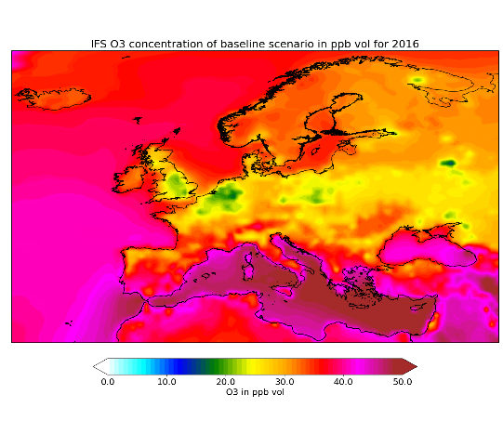
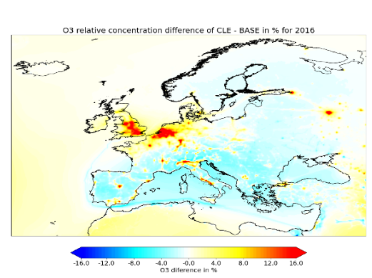
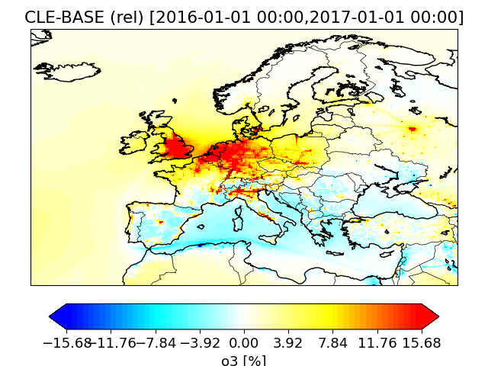
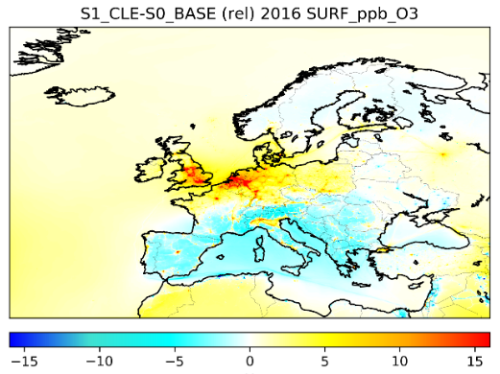
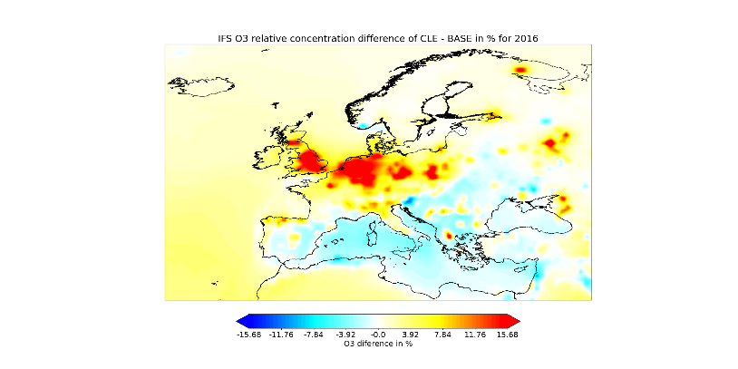
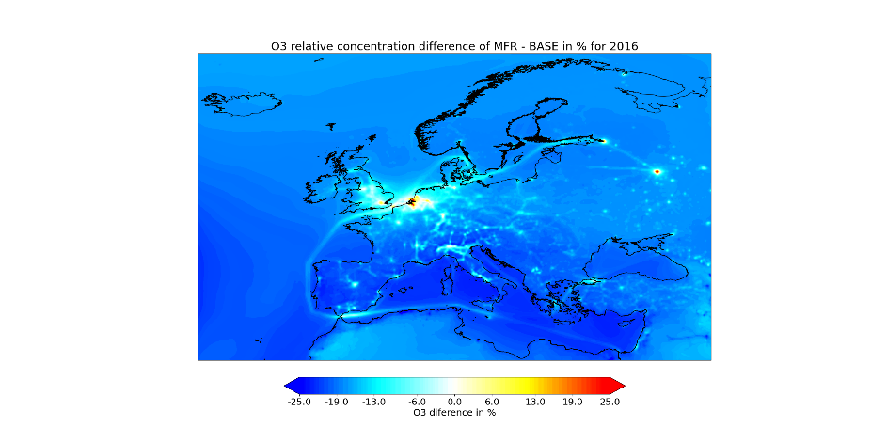
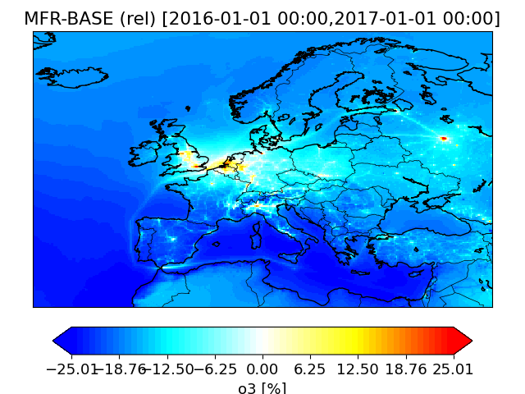


O3 annual average
CHIMERE
LOTOS-EUROS
EMEP
IFS
BASE
CLE-BASE
MFR-BASE
Consistent qualitative response in regional/global models (exc. resolution effect in IFS)
IFS is not the model will the lowest titration high NOX areas for BASE (2015)

Slide 15






CH4 Scenarios: O3 avg
BASE
LOW_CH4
Relative difference
LOW_CH4 - BASE
CHI
IFS
Consistent qualitative response to low CH4 scenario between CHIM and IFS

Slide 16






CH4 Scenarios: SOMO35
BASE
LOW_CH4
Relative difference
LOW_CH4 - BASE
CHI
IFS
Consistent qualitative response to low CH4 scenario between CHIM and IFS

Slide 17






CH4 Scenarios: AOT40
BASE
LOW_CH4
Relative difference
LOW_CH4 - BASE
CHI
IFS
Consistent qualitative response to low CH4 scenario between CHIM and IFS

Slide 18






CH4 Scenarios: 4MDA8
BASE
LOW_CH4
Relative difference
LOW_CH4 - BASE
CHI
IFS
Consistent qualitative response to low CH4 scenario between CHIM and IFS

Slide 19








O3: difference Scenarios - BASE
O3avg
AOT40
SOMO35
4MDA8
CHIMERE
IFS (global)
Very consistent qualitative response between CHIMERE &IFS for all scenarios and metrics: except for 4MDA8 (maybe not a good metric for models..)
Susbtantial difference in the absolute differences, especially for peaks
CLE leads to some O3 increases (titration)
lowCH4 less efficient than MFR, more efficient for high exposure areas (AOT40/SOMO35) than elsewhere

Slide 20
Conclusion
Multi-Model approach to explore emission reduction scenarios
  Eclipse v6 for BASE/CLE/MFR
  Sensitivity for Agriculture / Health / Fossil Phase Out / Methane
Model simulations completed in May 2022, ongoing analysis
  Consistent qualitative results between regional (CHIMERE/LOTOS/EMEP) and global (IFS) models
  Subtantial differences in absolute reduction magnitude
  Forthcoming:
    Generalise the multi-model evaluation
    Quantitative evaluation
    Exposure averaged by country (health & crops: POD)
  European analysis to be completed by the summer, please contact us if interested to use these model outputs for national analyses

Slide 21
THANK YOU FOR YOUR ATTENTION augustin.colette@ineris.fr

Slide 22
Additional slides

Slide 23

NO_{x} emissions (kton/yr) in different scenarios, per country group (left panel) and per GNFR category (right panel)

Slide 24

Figure 4 PM_{2.5} emissions (kton/yr) in different scenarios, per country group (left panel) and per GNFR category (right panel)

Slide 25

Figure 5 NH₃ emissions (kton/yr) in different scenarios, per country group (left panel) and per GNFR category (right panel)

