Slide 1


Determination of IVOC emissions and their impact on air quality
  Florian Couvidat
  Alexandre Albinet (INERIS), Grazia Lanzafame (INERIS), Isaline Fraboulet (INERIS), Yao Liu (Gustave-Eiffel University)
  Jean-Marc André (Citepa)

Slide 2
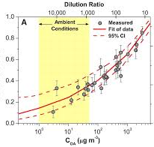
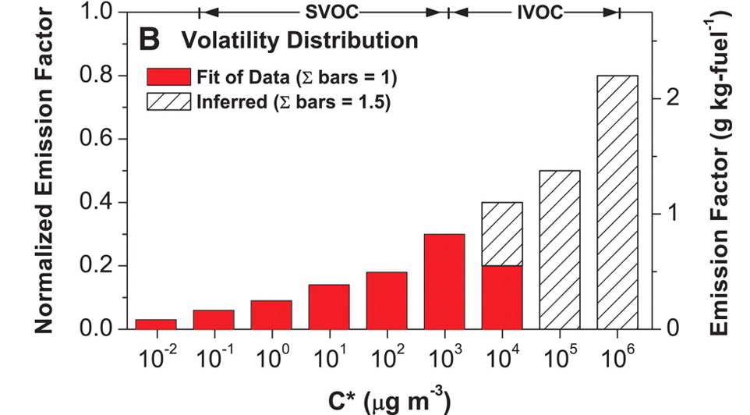
SVOC and IVOC: a modeling issue
Semivolatile organic compounds (SVOC)
Fraction of COSV in the particle phase
Historically, models assumed that POAs (primary organic aerosol) were non-volatile:
  Robinson et al (2007) introduces the notion of semi-volatility: any compound exists in the gas phase and the organic phase (at different concentrations according to their volatility)
  Authors choose to distribute the POA according to a volatility curve and to represent them in the air quality models via the gas/particle partitioning of the SVOC (according to the ambient conditions)
Volatility continuum between PM and VOC
  No clear distinction between POA, SVOC and VOC
  Robinson et al (2007) chose to name all organic compounds with a saturation concentration (C*) below 10⁴ µg/m3 as SVOCs. Many other classifications exist in the literature.
  SVOCs can be considered as the compounds in particulate form at emission after cooling and dilution
Organic aerosol loading

Slide 3
SVOC and IVOC: a modeling issue
IVOC: intermediate volatility organic compounds
Robinson et al. (2007) realizes that there is a volatility gap between the SVOCs (C* < 10⁴ µg/m3, lower volatility from heptadecane, C17) and the VOC emissions used in models:
  To use anthropogenic emission inventories, redistributing NMVOC emissions over the different species is necessary.
    Use of speciation studies by GC/MS
    Based on the identified fraction of VOC
  Generally, there is an unidentified UCM (Unresolved Complex Mixture) which corresponds to the least volatile part of the emissions
  Gap between SVOC emissions (C17) and the speciation tables used in the models (up to C12). These "missing" compounds are potentially very good precursors of secondary organic aerosol
The “IVOC issue” is mainly due an emission allocation problem in models (not a matter of missing emissions as often presented in modelling studies)

Slide 4
The EVORA project
Aim of the project:
Measuring the distribution by volatility of organic compounds of different representative passenger cars
Estimating IVOC emissions for other sectors
Evaluate the impact on air quality with the CHIMERE model
First campaign (June 2018):
Euro 5 gasoline indirect injection (Vehicle 1, V1)
Euro 5 Diesel with a catalyzed particle filter (V2)
Euro 3 Diesel, no particle filter (V3)
Euro 3 gasoline indirect injection (V4)
Experiments on the chassis dynamometer of the Gustave-Eiffel University
Second campaign (September 2019)
• Euro 4 gasoline indirect injection (V5)
• Euro 4 Diesel without particle filter (V6)
• Euro 5 gasoline direct injection (V7)
• Euro 5 Diesel with additivative particle filter (V8)

Slide 5
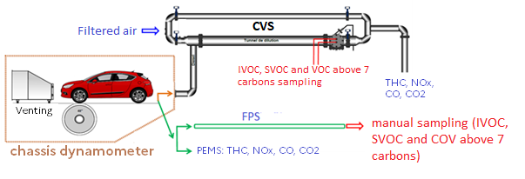
Experimental setup
Two different setups :
  Campaign 1 : use of constant volume sampler (CVS) ⇒ dilution factor between 30 and 100
  Campaign 2 : double stage constant flow dilution ⇒ dilution factor between around 10-20
Three different cycles:
• Artemis Motorway: hot start
• Artemis Urban : hot start
• WLTC : start at ambiant temperature with 4 phases represntative of different driving conditions

Slide 6
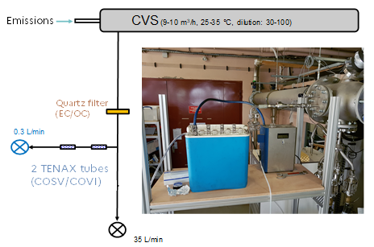
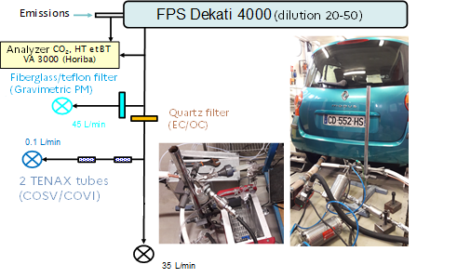
Sampling strategy
Campagne 1
Campagne 2

Slide 7
Anatycal strategy
Targeted analysis:
Cylic and linear alkanes
Aromatic (Benzene, Toluene, Ethylbenzene, Xylene)
PAH
Non-targeted analysis:
Split of chromatograms per volatility (linear n-alkanes used as reference compounds) => repartition per volatility bins
A method was developped and validated to determine the volatility split of the gas and particle phases. thermal desorption + GC/MS (TDU-GC/MS)
Zhao et al., 2016

Slide 8
Results
1st campaing < 2nd campaign
CVS (V1-V4) < FPS (V5-V8)
Emission factor (mg/kg of fuel)
Gas phase
All cycles
Significant losses of IVOC and SVOC when using the CVS?
Similar results observed by UGE
(Louis et al., 2017)
Euro 5, Gasoline (V7)
Euro 3, Gasoline (V4)
Euro 5, Diesel (V8)
Euro 3, Diesel (V3)
Euro 5, Gasoline (V1)
Euro 4, Diesel (V6)
Euro 5, Diesel (V4)
Euro 4, Gasoline (V5)

Slide 9
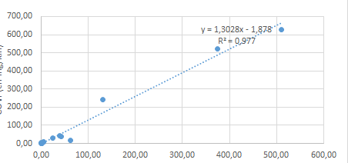
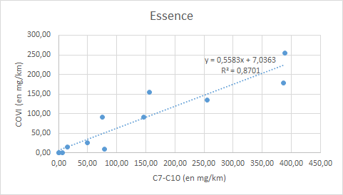
Estimation of IVOC emissions
Normalized emissions
Use of normalized emission factors to solve the issue of differences among the different vehicles
No correlation between IVOC and regulatory measurements of VOC emissions and with emissions of the targeted VOC
Normalization to C7-C10 emissions (compounds with volatility between heptane and decane)
By combining these results to emission speciation data, we estimated the emissions of C7-C10 => estimation of IVOC emissions:
  25% IVOC in NMVOC exhaust emissions for diesel vehicle in France. Around 2 kT in 2018.
  33% IVOC in NMVOC exhaust emissions for gasoline vehicle in France. Around 10 kT in 2018.
Diesel
Gasoline
IVOC (in mg/km)
IVOC = 1.3*C7-C10
for Diesel vehicles
= 0.55*C7-C10
for gasoline vehicles
C7-C10 (in mg/km)
C7-C10 (in mg/km)

Slide 10
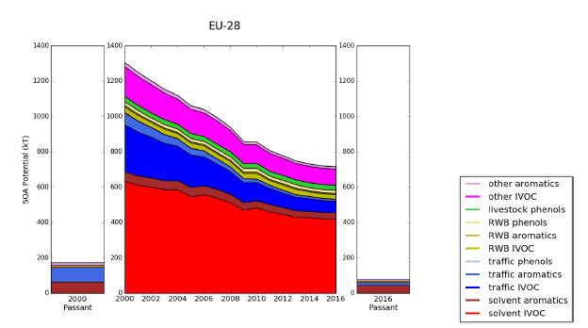
Estimation of IVOC emissions
Other sectors
New estimation
  Robinson et al. (2007) methodology: Use of speciation data (source CITEPA) to evaluate IVOC based on the UCM
  Between 17 and 38% of emissions form the solvent sector could be considered as IVOC
  MacDonald et al. (2018), compounds above 11 carbons represent aroud 40% of VCP (volatile chemical products) emissions
  In 2018 for France, 176 kT of IVOC emitted :
    Solvents 74% of IVOC emissions
    Road traffic 8%
    Wood burning 7%
SOA potential (in kT)
Based on the speciation database used in CHIMERE

Slide 11
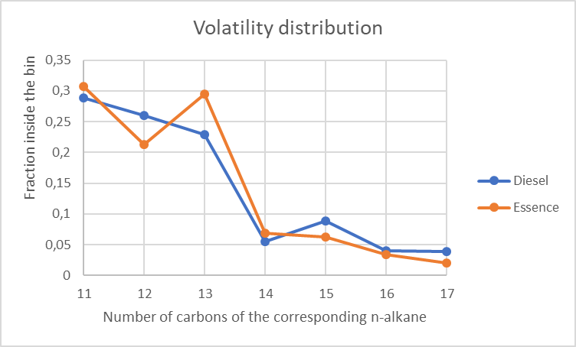
Impact of IVOC emissions on SOA modeling
CHIMERE simulation with two SOA formation :
  Simplified VBS approach of the H²0 (Couvidat et al., 2012)
  VBS-Gecko (Lannuque et al., 2020). VBS approach based on Gecko.
Volatility distribution
  Based on MacDonald et al. (2018) for all sectors except for road trafic (data from the EVORA project)
No significant variability between the type of vehicles and the cycles

Slide 12
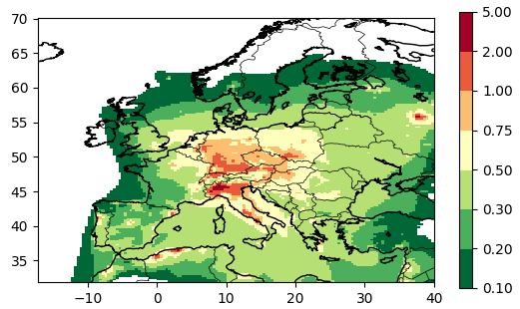
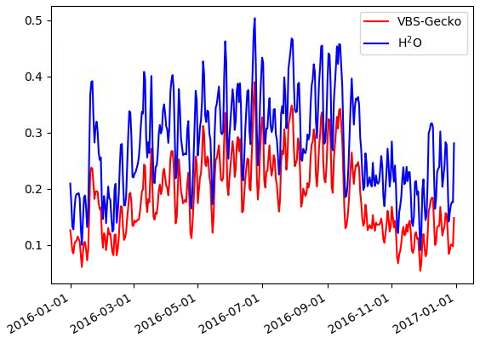
Impact of IVOC emissions on SOA modeling
Summer AOS concentrations from IVOCs with H²O (en µg/m³)
Simulation over Europe 2016
Evolution of daily averaged concentrations over Europe of AOS from IVOCs ( µg/m³)
between 50 % and 80 % of anthropogenic SOA due to IVOC emissions

Slide 13
Conclusions
A large part of IVOC in the NMVOC emissions. But different protocols for the different campaigns. The deposition at the walls of IVOC and SVOC could affect the results of the first campaign.
Normalized IVOC emissions to C7-C10. The sampling methodology could be improved to evaluate the volatility distribution of all COV (and not only above 7 carbons) => easier to normalize emissions
Sector contributing to IVOC emissions:
Solvent sector 74% of emissions
Road traffic 8% of emissions
Wood burning 7% of emissions
The impact of IVOC emissions was estimated using the CHIMERE model:
In summer, 50-80% of anthropogenic SOA could be due to IVOC emissions
Annual SOA concentrations of IVOCs can reach 1 µg/m3 especially in Central Europe

