Slide 1
In depth evaluation of CAMS regional model systems within CAMS_61 project – connection with Eurodelta-Carb
TFMM workshop- 12 May 2020
R. Timmermans/E. Dammers/H. Denier van der Gon - TNO
H. Fagerli/H. Brenna/A. Mortier/J. Gliss/J. Griesfeller/D. Simpson - Met-Norway
A. Colette/B. Raux - INERIS
V. Petiot - Meteo France
And all modelling teams contributing to C50 and Eurodelta-Carb

Slide 2
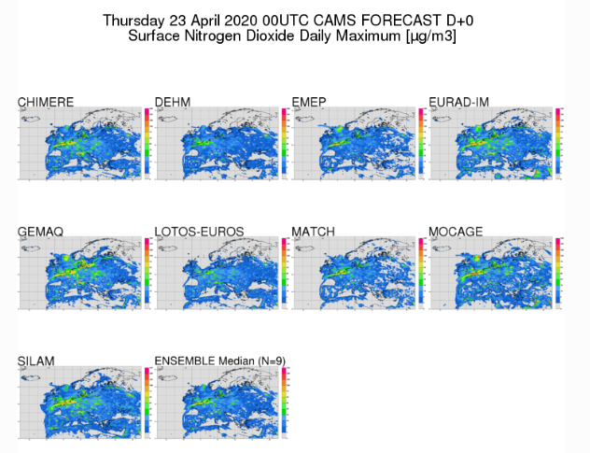
CAMS_61 project
Objective: Improve the quality of CAMS regional air quality forecasts and analyses over Europe
a in depth assessment of the CAMS regional forecasts and a prioritized list of proposed model developments
best practices for coupling forecasts to analyses, and
model-agnostic tools for the data assimilation of Sentinel-4 and 5p observations.

Slide 3
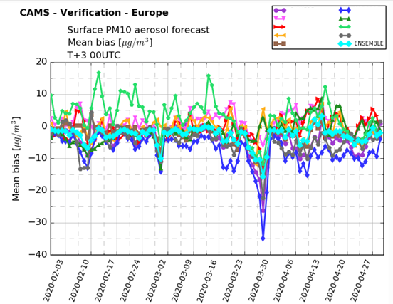
In-depth assessment of the CAMS Regional Systems
WP 6110 In-depth assessment of the CAMS Regional Systems to identify future development needs (lead: Met Norway)
Evaluation of the operational CAMS regional forecast data
Aim: Overview of situations where the forecast (ensemble or specific models) differ significantly from observations. Explanations or hypotheses of reasons.
Where do all models go wrong? Where do we see large spread or outliers?
Regional and seasonal variations, different meteorological conditions and different lead times of the forecast.

Slide 4
In-depth assessment of the CAMS Regional Systems
Specific attention to episodes with high air pollution (severe health effects, considerable public attention, magnify important processes):
High ozone in Southern but also Central Europe (due to meteorological conditions and/or stagnant high-pressure systems).
Dust Aerosol contribution in Southern Europe.
PM episodes in late winter/early spring in Central Europe (due to agricultural ammonia emissions).
PM and NO₂ episodes in winter (due to stagnant air, inversions, and enhanced use of wood burning for residential heating) (or high loads of road dust resulting from the use of studded tires in the Nordic countries).
Notes:
These episodes can have severe health effects and receive considerable public attention. In addition, episodes magnify and emphasize important processes (e.g. chemistry, meteorological conditions, sources of emissions), and enable a better understanding of underlying problems in the model systems or input data. Therefore, the performance of the CAMS ensemble and the specific models during events with high air pollution will be investigated, for instance:

Slide 5
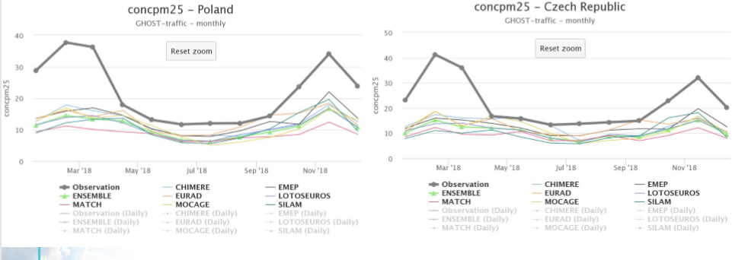
First evaluations CAMS regional 2018 forecasts
Eastern Europe large underestimation PM2.5 winter → residential combustion wood, missing condensables in emission inventory

Slide 6
Connection Eurodelta-Carb
In Connection to Eurodelta-Carb exercise
Evaluate model performance PM10 in winter
Effect of including condensables (REF2 versus REF1 emissions) for improving winter performance
Comparison to EEA observations
Evaluate model performance EC, and biomass and fossil fuel fractions
Comparison to EMEP/ACTRIS/COLOSSAL IMP campaign data
Again consistent approach with regard to condensables is important

Slide 7
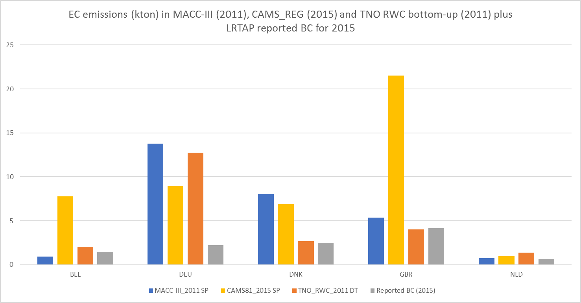
EC in REF1 and REF2 inventories
Actual EC/OC fraction smaller when you include condensables
But REF1 uses filterable EC/OC fraction for all countries to derive EC whether they include condensables or not in their reported PM2.5 emissions
For countries that include condensables in their PM2.5 emissions, the derived EC emissions in REF 1 will be too high
REF2 includes condensables and thus has smaller EC/OC fraction
Shift to inclusion of condensables in Belgium and GBR but still same EC/OC split used on PM emissions
MACC- III - 2011
CAMS 2015 – REF1
Reported for 2015
Notes:
Ref2 en reported BC for BEL, DNK, GBR now show a good match. (That is important because the ref2 EC is derived using a profile while reported BC is official reported by the country, so independent – although not entirely ofcourse)

Slide 8
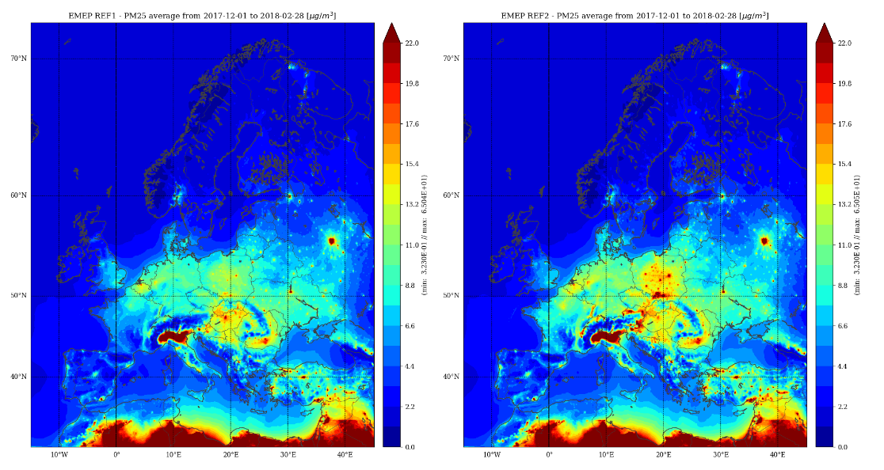
Impact inclusion condensables on PM2.5/PM10 during winter campaign
Inclusion of condensables leads to increased PM2.5 and PM10 levels
REF 1
REF 2
Result from Eurodelta-Carb exercise by Metno and Valentin Petiot (Meteo-France)

Slide 9
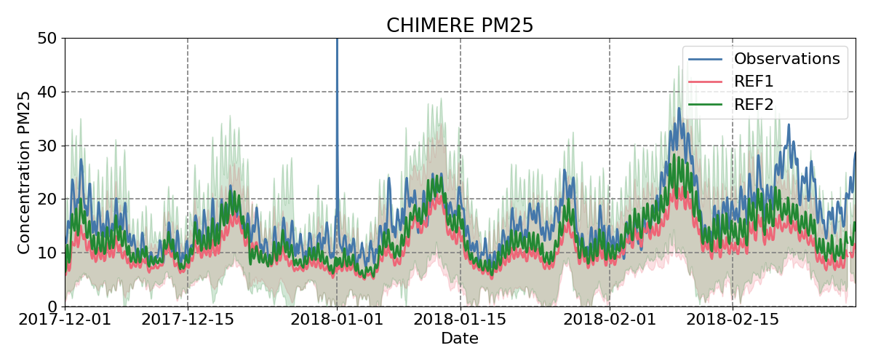
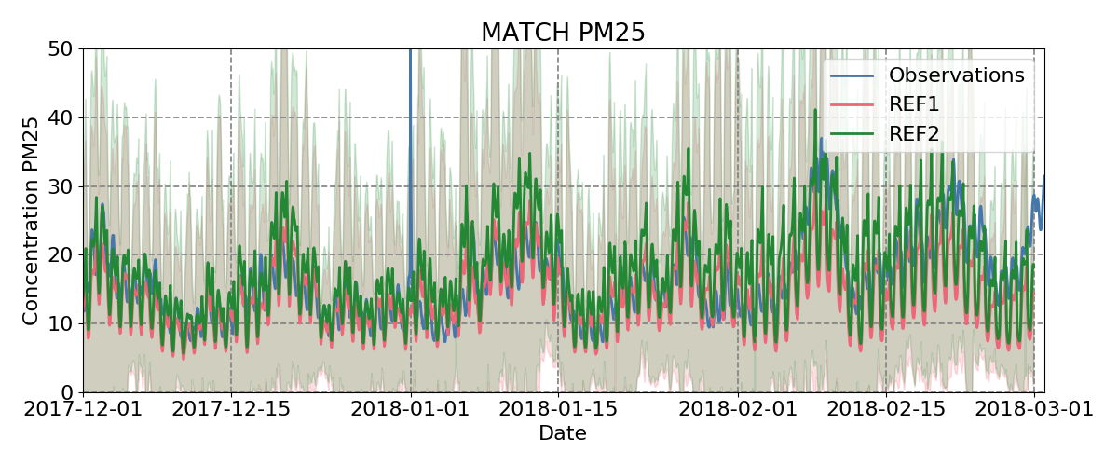
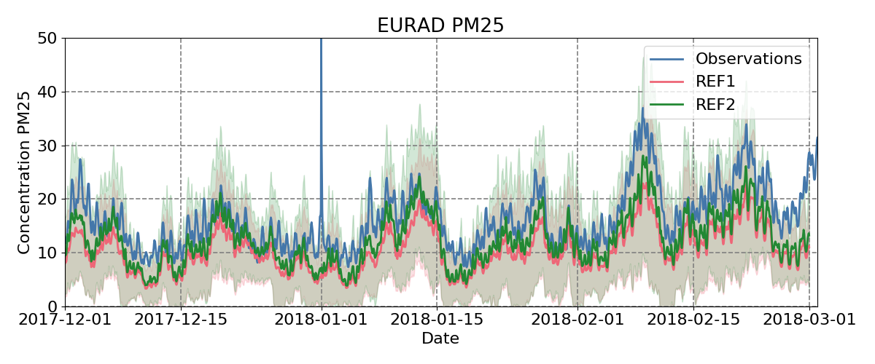
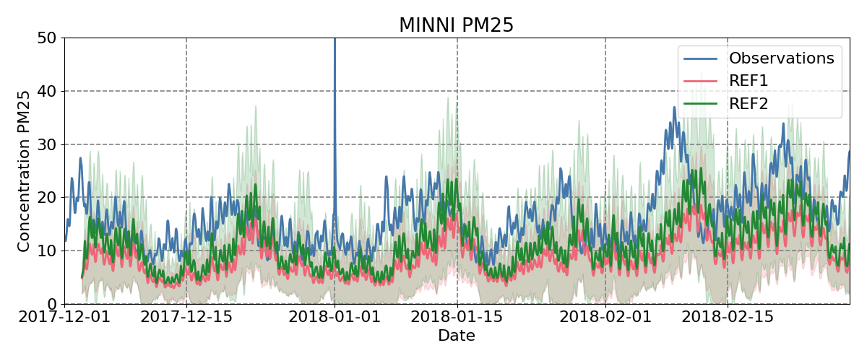
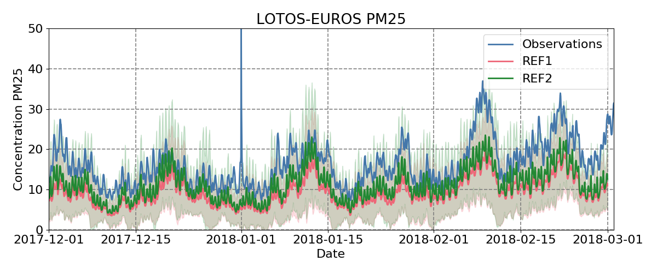
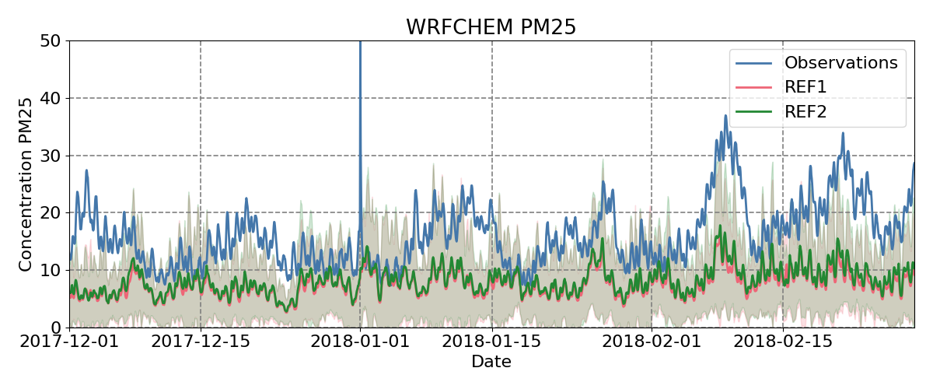
Improved performance of PM2.5 in winter time
Result from Eurodelta-Carb exercise by Enrico Dammers (TNO)

Slide 10
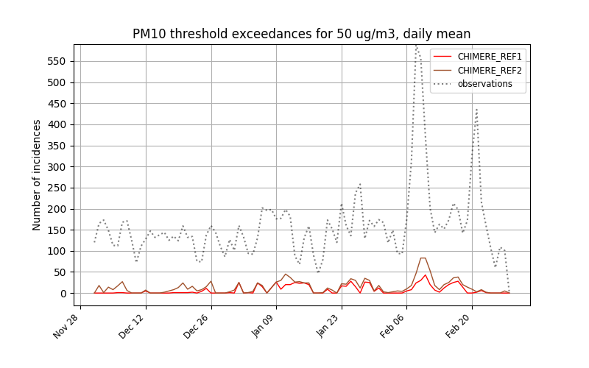
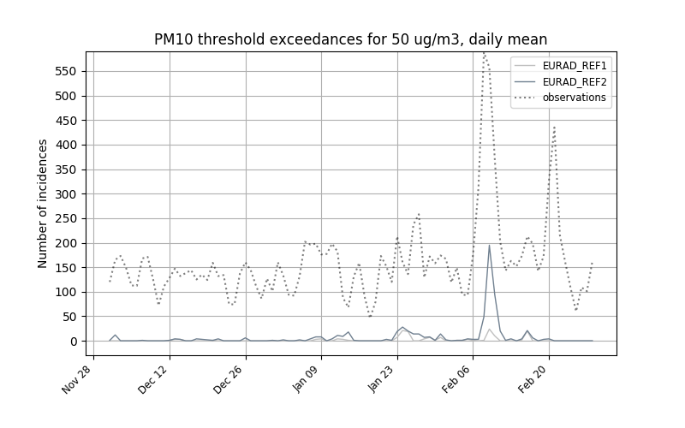
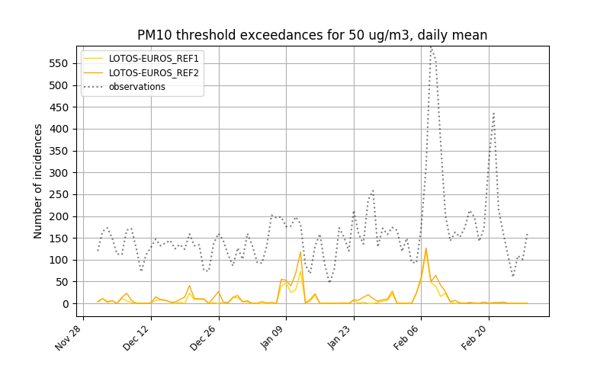
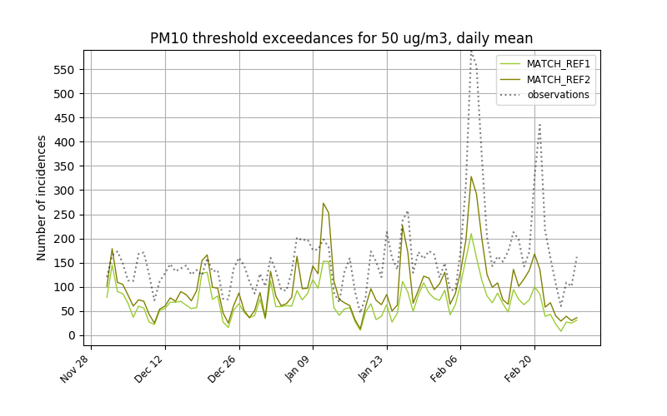
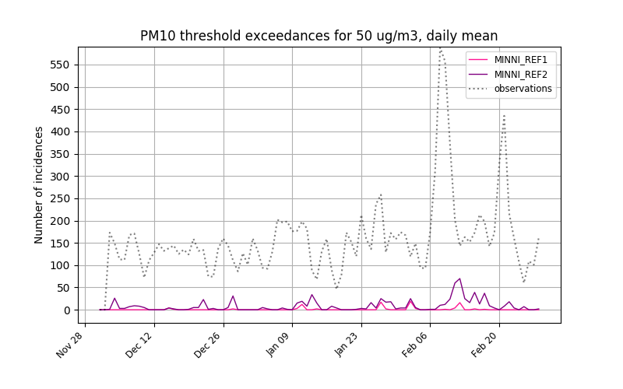
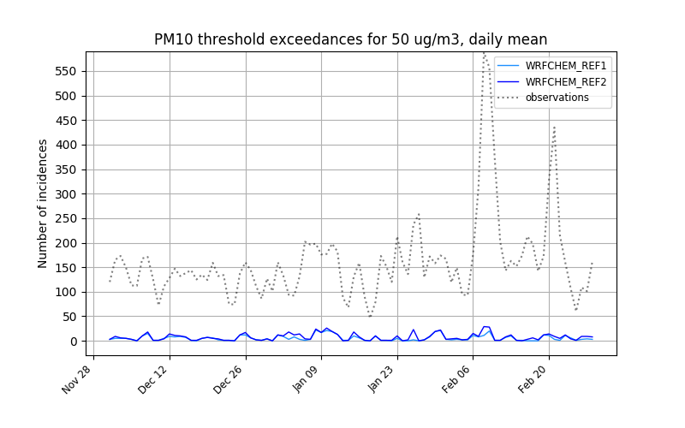
Exceedances detections improved
Result from Eurodelta-Carb exercise by Blandine Raux (Ineris)
Notes:
Models difficulty to represent high PM10 during stable cold winter conditions
Typically something we will study in CAMS 61 project --. Extra runs with speciated PM

Slide 11
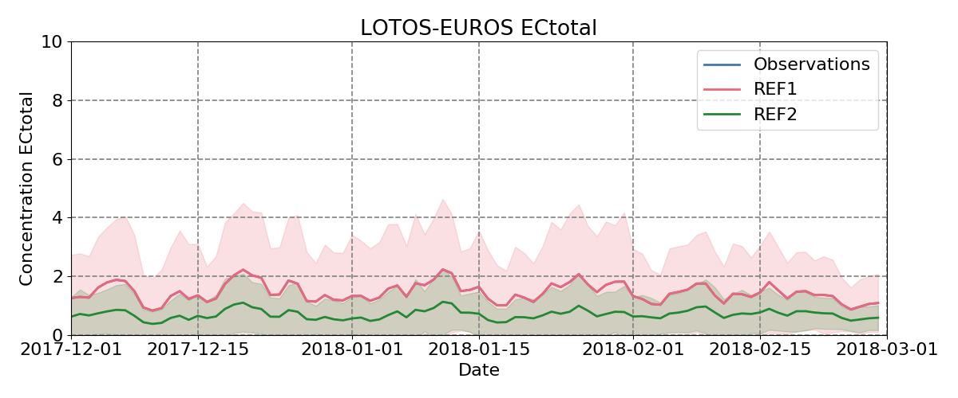
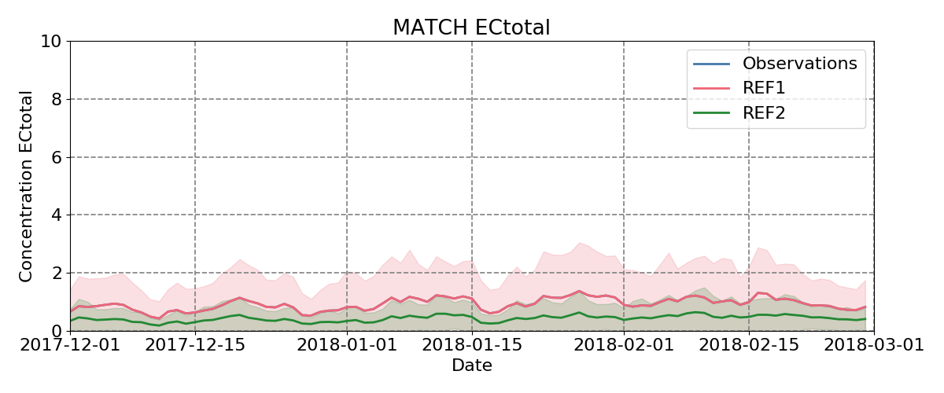
EC fine total – REF1 versus REF2 at EEA AQ reporting measurement locations
Total EC_{fine} decreases from REF1 to REF2 → because EC/OC factors are lower

Slide 12
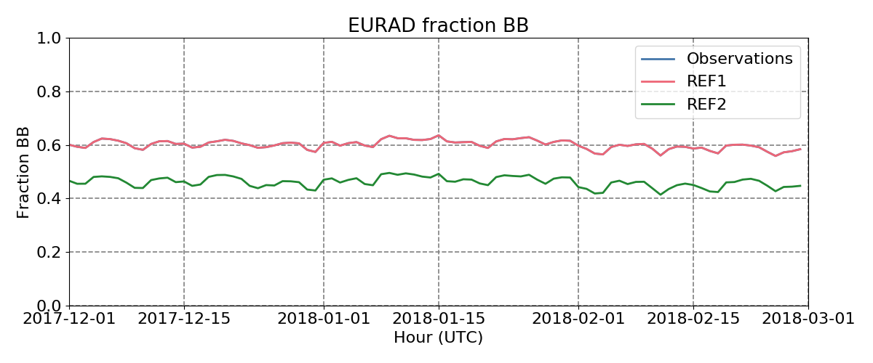
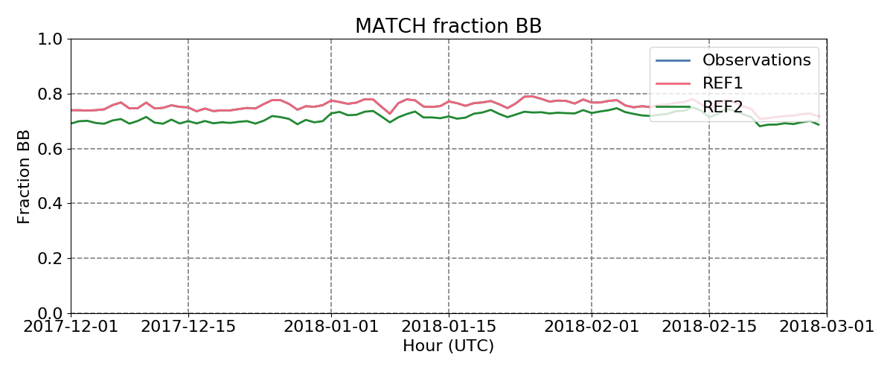
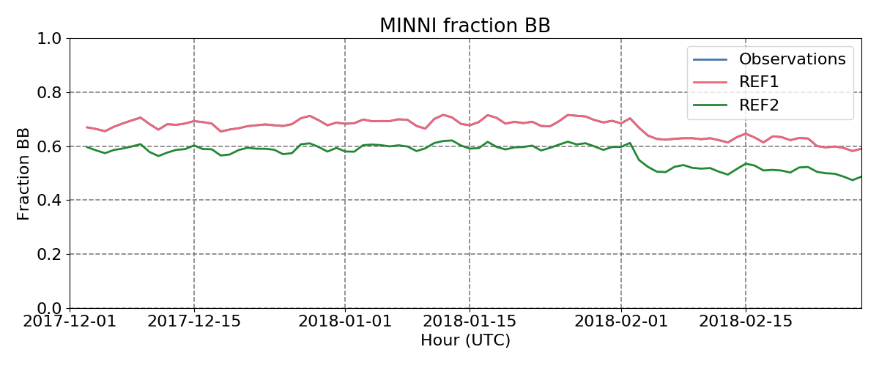
Some first results Eurodelta-Carb – EC fraction from BB at EEA AQ reporting stations
ECwb / (ECwb + ECff ) fraction also goes down when going from REF1 to REF2
Some models may include actual temperature dependency for residential combustion emissions and/or traffic

Slide 13
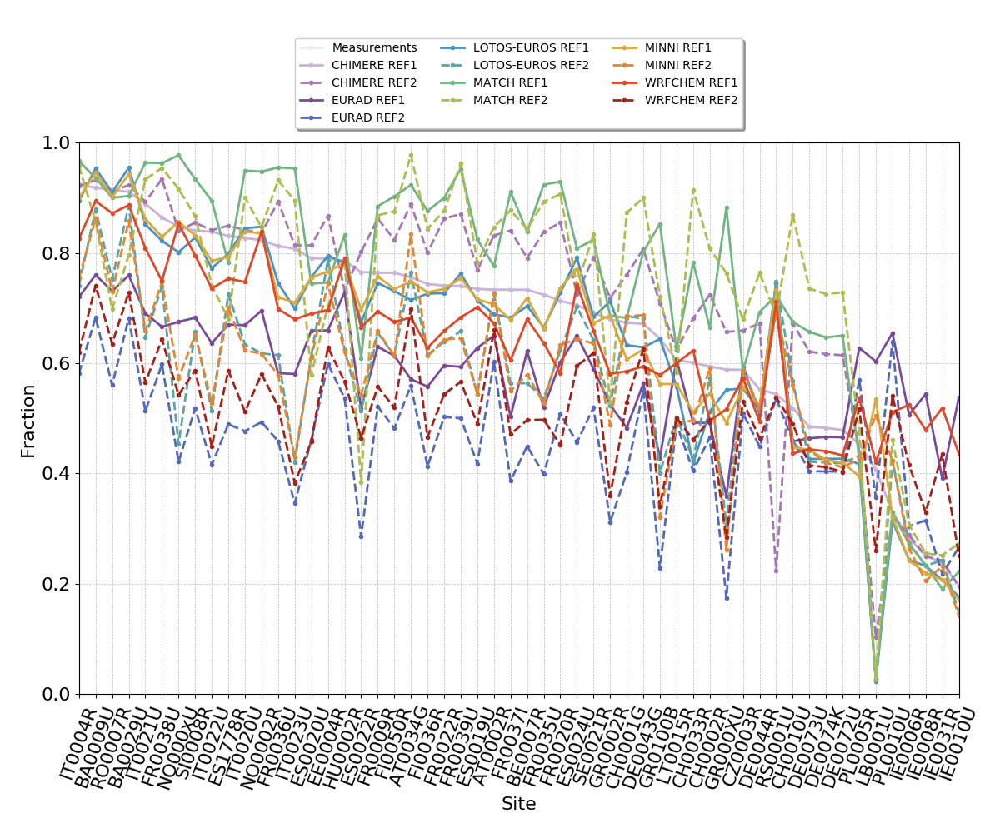
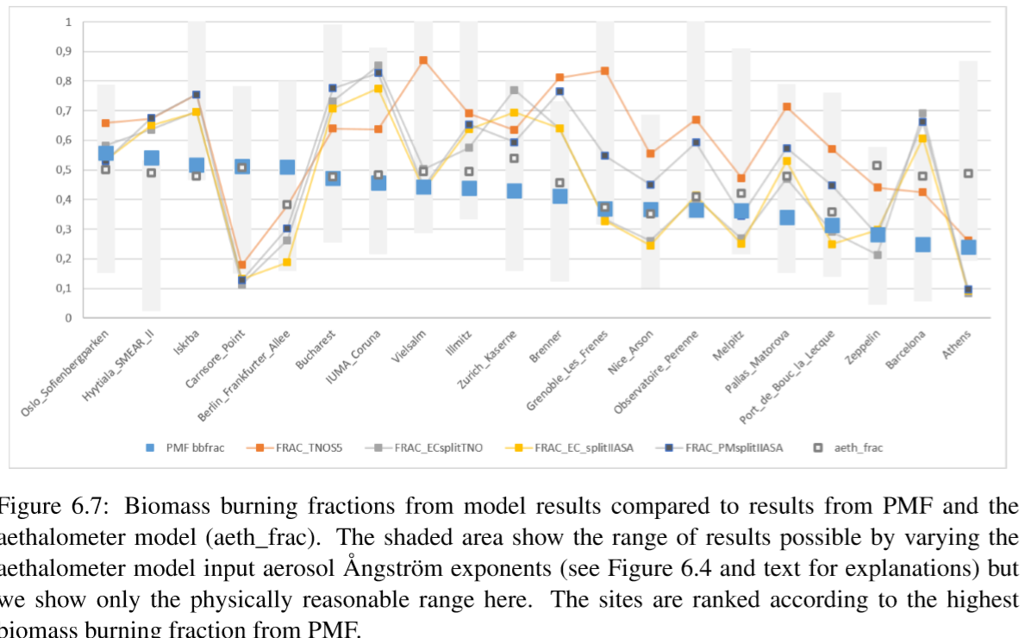
Comparison ECbb fraction at campaign locations, no observations yet
Eurodelta models, all times– no obs
EMEP model Ecbb fraction (only collocated) + Obs.

Slide 14
Outlook
Evaluate in more detail underestimation of PM in winter periods
Model re-runs in CAMS 61 project with a.o. speciated PM output
Provide recommendations for model improvements
Compare modelled EC (and its BB and FF fractions) with observations from EMEP/COLOSSAL/ACTRIS IMP campaign
In connection to Eurodelta-Carb exercise, more model outputs have become available in recent days and more expected
Observations will be available soon

