Slide 1
Evolutions of the measurement program
& QA/QC of the French EMEP monitoring network
A. Bourin, S. Sauvage, C. Debevec, E. Tison, I. Fronval, B. Herbin, P. Coddeville
IMT Lille Douai
21th Task Force on Measurements and Modelling Meeting
11 - 13 May 2020, Online Meeting

Slide 2
the French EMEP monitoring network
History
1978 – convention LRTAP
Major ions, pH atmospheric deposition
Acidification & Eutrophisation
1990 Scient. & Tech. Coord. LCSQA/IMT LD
SO₂, SO₄²⁻
1992 Photochemical oxydant
Ozone, VOCs
1998 Heavy metals, particles et POPs
Heavy metals deposition, PM₁₀
2004/107/EC Directive
Inorganics, gases, PM_{tsp}
PM_{10, 2.5}
2008/50/EC Directive
PM_{2.5} (inorg. ions, EC/OC)
PAHs deposition, PM₁₀
2020 to be continued

Slide 3
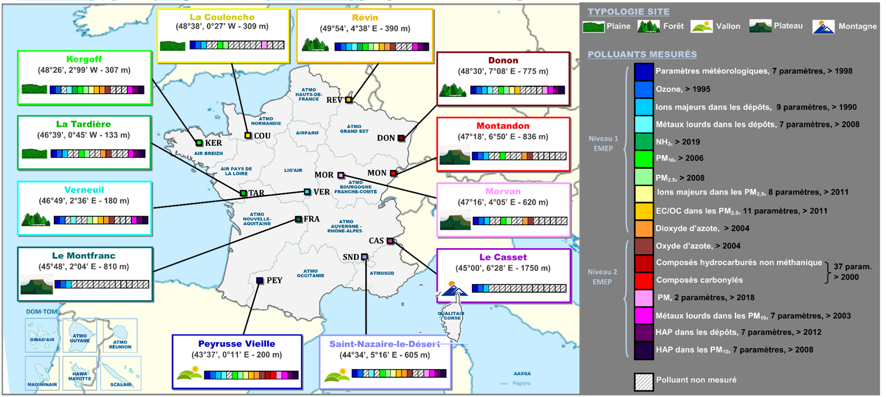
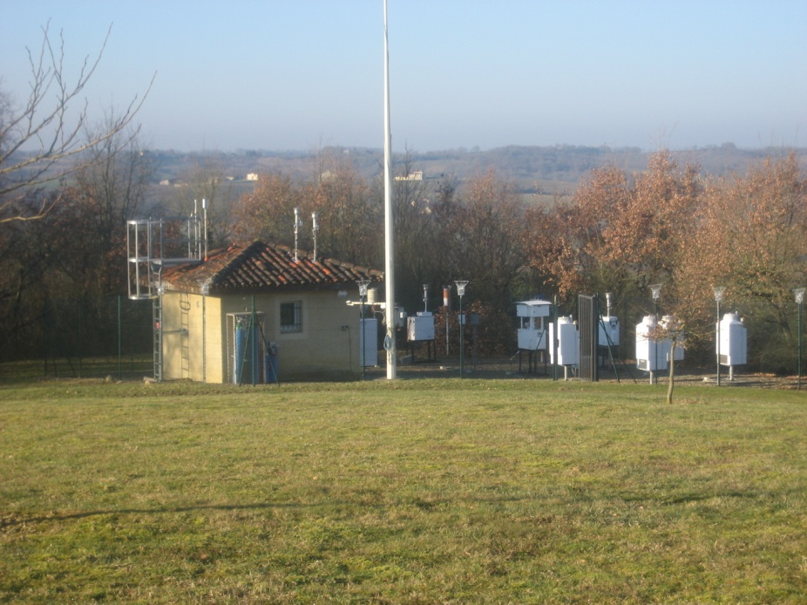
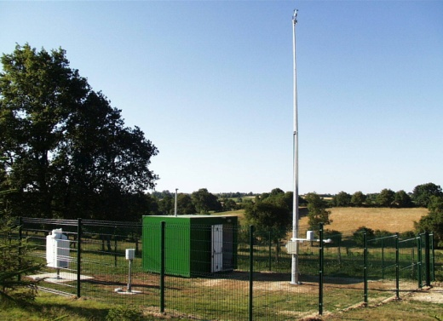
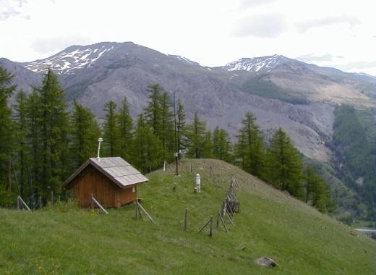
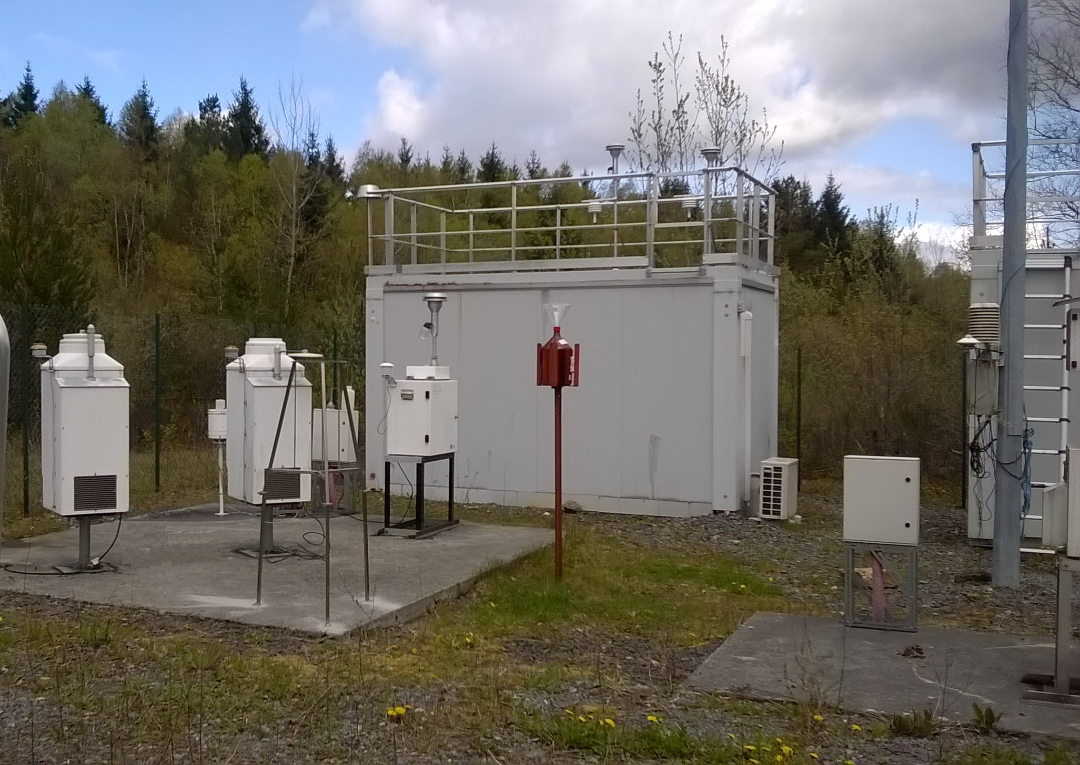
the French EMEP monitoring network
Current
Site typology
Mountain
Plain
Forest
Valley
Plateau
Monitoring program
Meteorology
Ozone
Inorganic compounds in precipitation
Heavy metals in precipitation
EMEP level 1
NH₃
PM₁₀
PM_{2.5}
Inorganic compounds in PM_{2.5}
Organic compounds in PM_{2.5}
NO₂
NO
HCNM
EMEP level 2
Carbonyls
PM₁, size distribution, number concentration
Heavy metals in PM₁₀
PAHs in precipitation
PAHs in PM₁₀
Not measured
Peyrusse Vieille FR0013
La Tardière FR0015
Le Casset FR0016
Revin FR009

Slide 4
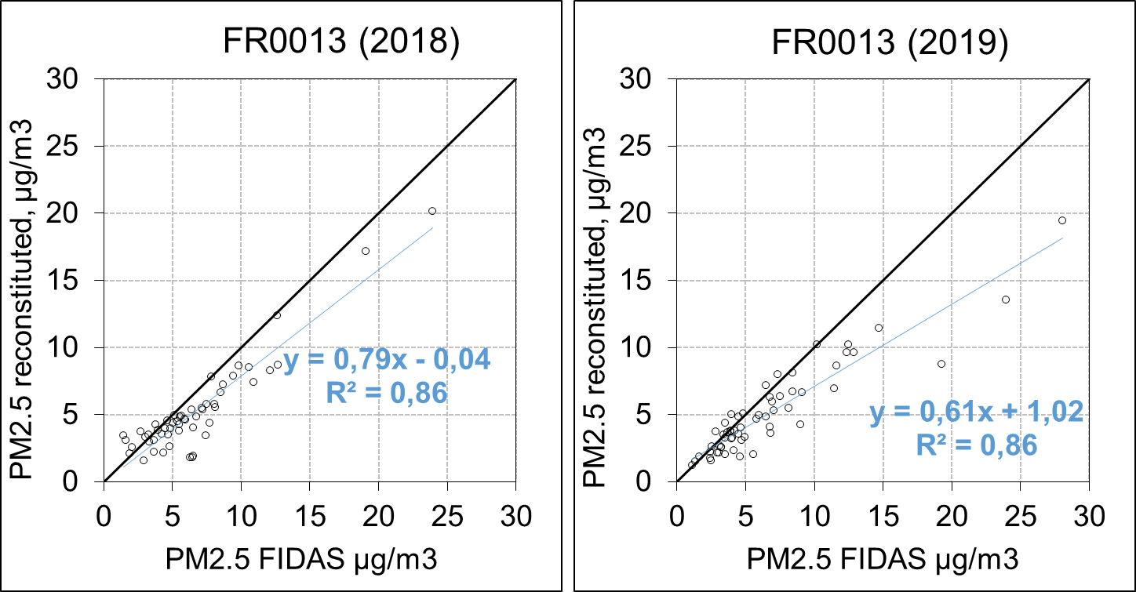
the French EMEP monitoring network
Recent and future changes
Particles
Replacement of PM monitors by an optical aerosol spectrometer
PM_{2,5 ,} PM₁₀ - EMEP level 1
PM₁ - EMEP level 2
PM_{4,} PM_{tot} - not required
the particle number concentration Cn
the particle size distribution from 180 nm to 18 µm
Simultaneous measurement of PM2,5 and PM10 mass concentrations
Better assess the aerosol fractions (from coagulation mode)

Slide 5
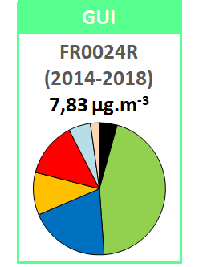
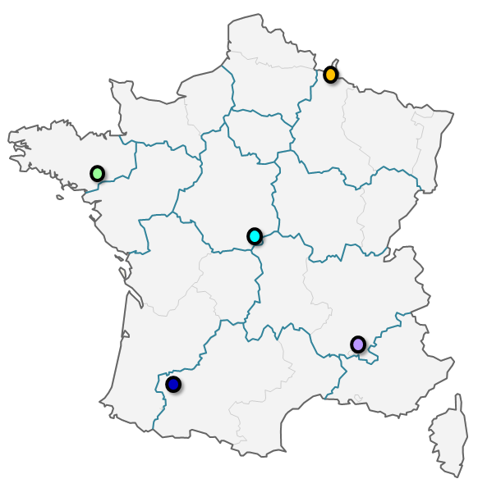
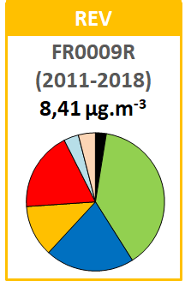
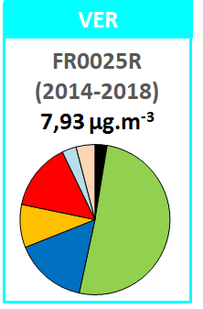
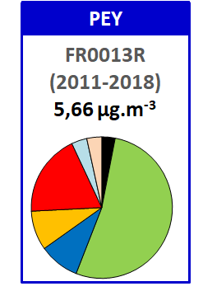
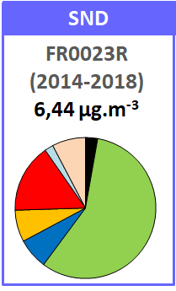
the French EMEP monitoring network
Recent and future changes
Particles : what we observed from multiannual chemical composition of PM_{2,5} (filters)
Spatial gradient in major component
organic in the South
inorganic in the North
Major compounds in PM_{2,5}
EC OM NO₃⁻ NH₄⁺ SO₄²⁻
Sea salt Mineral dust
FR0009R :EMEP station code (sampling period)
8,41 µg m⁻³ : mean mass concentration in PM_{2,5}
Debevec et al., 2020

Slide 6
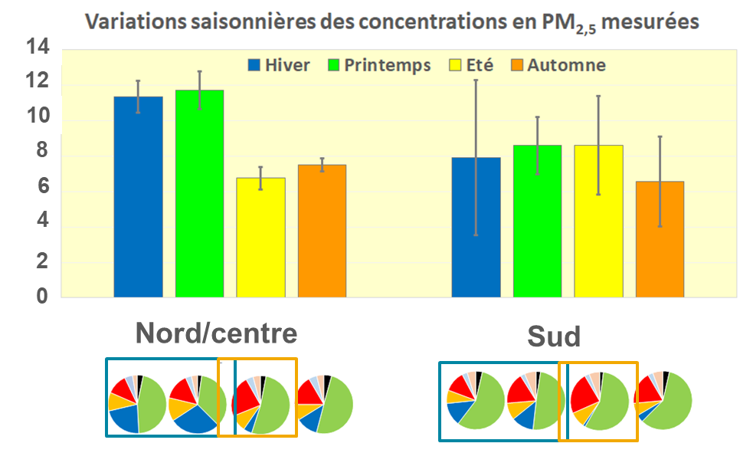
the French EMEP monitoring network
Recent and future changes
Particles : what we observed from multiannual chemical composition of PM_{2,5} (filters)
Spatial gradient in major component
organic in the South
inorganic in the North
Seasonal contrast of mass concentration
Influenced by the variability in main component
Winter/spring (OM + SIA)
Summer (OM + nssSO₄²⁻)
winter
spring
summer
autumn
PM_{2.5} mass (µg/m³)
North/Centre
South
EC OM NO₃⁻ NH₄⁺ SO₄²⁻
Sea salt Mineral dust
Debevec et al., 2020

Slide 7
the French EMEP monitoring network
Recent and future changes
Particles : what we observed from multiannual chemical composition of PM_{2,5} (filters)
Spatial gradient in major component
organic in the South
inorganic in the North
Seasonal contrast of mass concentration
Influenced by the variability in main component
Winter/spring (OM + SIA)
Summer (OM + nssSO₄²⁻)
Main Drivers of PM_{2,5} chemical composition
Variability of sources
Transport of air masses and meteorological conditions

Slide 8
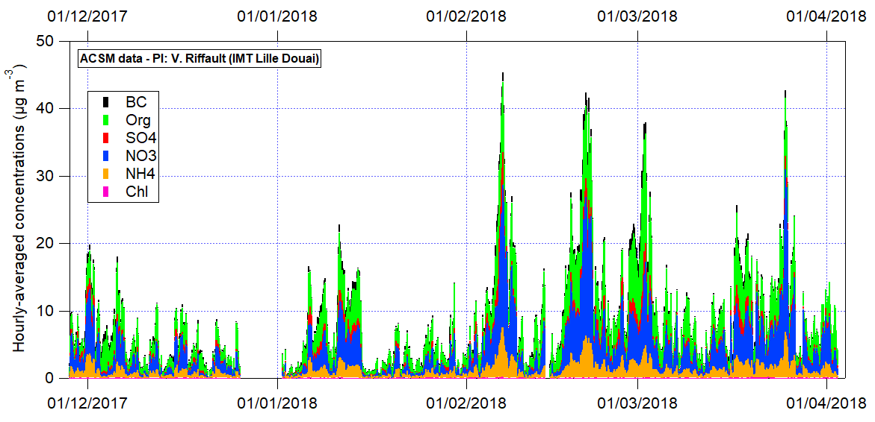
the French EMEP monitoring network
Recent and future changes
Particles
Development suggested for high temporal resolution for PM composition
chemical composition of non-refractory particles + particle light absorption coefficient – EMEP level 2
Better identify drivers of chemical composition
High time resolution : variability related to emission and processes
Comparison urban/background at a regional scale to help understanding PM episodes

Slide 9
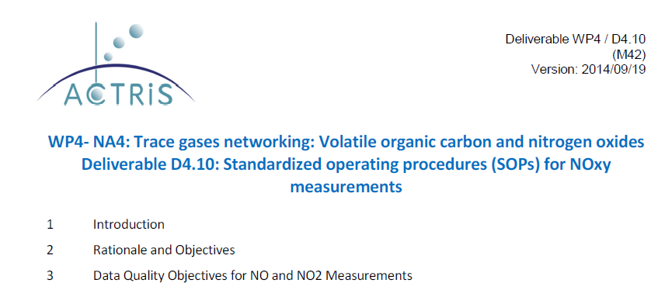
the French EMEP monitoring network
Recent and future changes
Development of gaseous measurements
real-time gas concentration analyzer
NO₂ (trace level & selective analyzer) - EMEP level 1
ACTRIS recommendations : type of analyzer, QA/QC and data validation process
Significant quality improvement for NO₂ data
NO (ppb)
NO₂ (ppb)

Slide 10
the French EMEP monitoring network
Recent and future changes
Urban sites
Development of gaseous measurements
real-time gas concentration analyzer
VOCs – NMHC + OVOC - EMEP level 2
Already a unique dataset of 20 years long
Higher time resolution -> diurnal variability of some compounds
Primary sources tracers+ photochemical processes tracers
Link with secondary pollutants (ozone and SOA)
Background sites
Percentage of changes
Waked et al., 2016

Slide 11
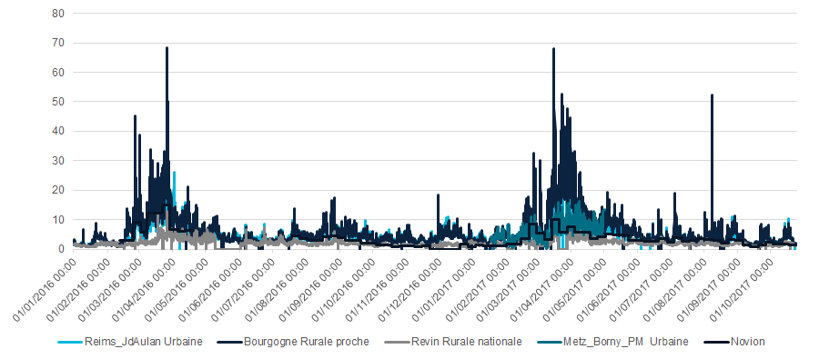
the French EMEP monitoring network
Recent and future changes
Development of gaseous measurements
real-time gas concentration analyzer
Ammonia – EMEP level 3
Online analyzer with high time resolution
Emission inventory evaluation -> location of sites in contrasted area
Better knowledge of frequent secondary PM episode (spring)
NH₃ (µg/m³)
AMP’AIR 2018

Slide 12
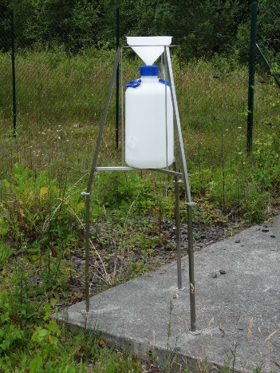
the French EMEP monitoring network
Recent and future changes
Heavy metals in atmospheric deposition
bulk samplers
High contribution of undissolved fraction
Geographical spread
Seasonality -> dust resuspension

Slide 13
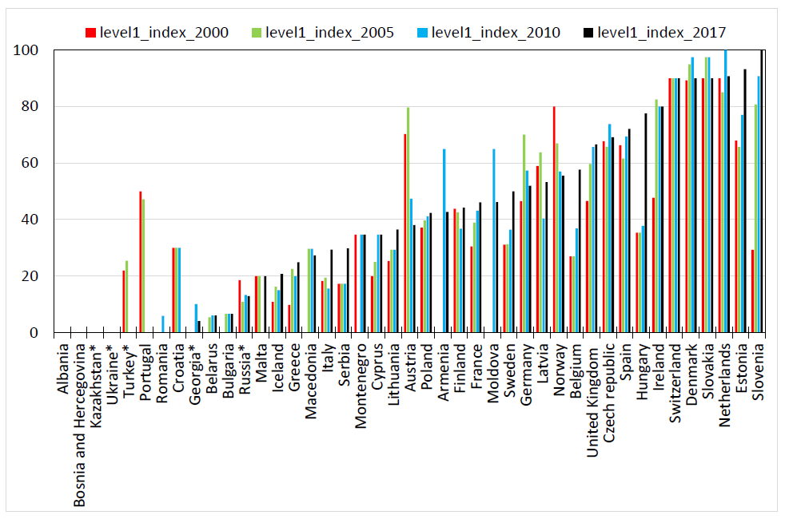
the French EMEP monitoring network
Conclusion
2017 implementation for the EMEP monitoring strategy (Level 1)
EMEP Status report 2019

Slide 14
Thank you for listening !

