Slide 1
Integration of the work between EMEP and WGE
(focused on precipitation and ICP-IM)
Milan Vana

Slide 2
Outline
Current stage
Benefits of individual ICP´s for EMEP
Precipitation
Co-located EMEP and ICP-IM stations
EMEP and ICP-IM – detailed comparison of activities
The future

Slide 3
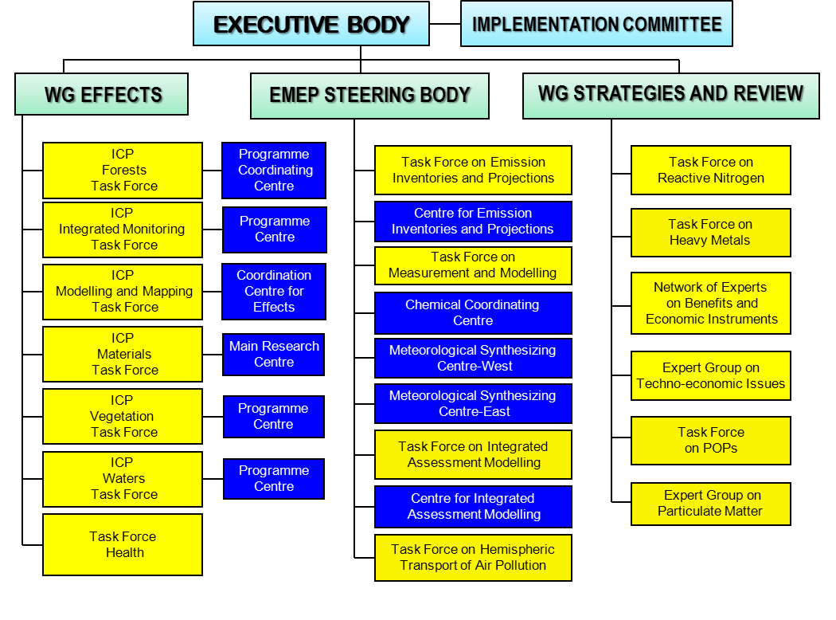

Slide 4
Precipitation measurements in individual ICP´s
ICP-Integrated monitoring
wet, bulk, throughfall, steamflow – monthly data – 30 sites
ICP- Forests
wet bulk, throughfall, steamflow – monthly data - 700 sites

Slide 5
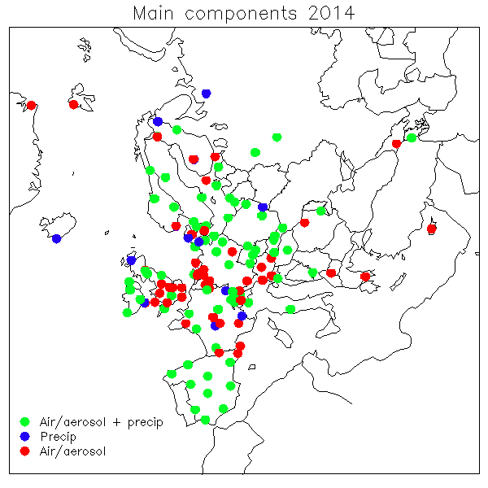
Station network : EMEP x ICP-IM (6 co-located stations)

Slide 6
International Cooperative Programme on Integrated Monitoring of Air Pollution Effects on Ecosystems (ICP IM)
The overall aim of integrated monitoring was originally to determine and predict the state and change of terrestrial and freshwater ecosystems in a long-term perspective with respect to the impact of air pollutants, especially nitrogen and sulphur.
This was to provide one basis for decisions on emission controls and assessment of the ecological impact of such controls within Convention on Long-range Transboundary Air Pollution of the UNECE.
However, the full implementation of the Integrated Monitoring Programme will allow the ecological effects of tropospheric ozone, heavy metals and persistent organic substances to be determined.
Implementation of the Programme will provide a major contribution to the international data requirements for examining the ecosystem impacts of climatic change, changes in biodiversity and depletion of stratospheric ozone.
A primary concern is the provision of scientific and statistically reliable data that can be used in modelling and decision making.
The main emphasis is to establish consistent time series for environmental variables rather than establishing representative surveys across the UNECE region.

Slide 7
ICP-IM Subprogrammes
Meteorology
Air chemistry
Precipitation chemistry
Throughfall
Steamflow
Runoff water chemistry
Groundwater chemistry
Soil water chemistry
Soil chemistry
Foliage chemistry
Litterfall chemistry
Vegetation
Heavy metals and POPs.

Slide 8
Future
Further integrate the work between EMEP and WGE
A common web site for all WGE activities (together with EMEP)
Common databases ???
Joint workshops ???

Slide 9
EMEP/WGE activities in a larger perspective
New needs for data for performance review of the Protocols as well as for further amendments may occur by 2018-2020(?). The time up to that may give an opportunity for reconsidering organisation and priorities, in particular in the long term
There are needs for EMEP/WGE competence and data in a variety of international organisaitons and processes outside CLRTAP. These should be identified and (formal) discussions on collaboration should be undertaken.
The European Commission indicated that there is a need for updated information from EMEP/WGE around 2020 in connection with a new policy round within the EU.
The inclusion of effects-oriented monitoring in the EU NERC Directive presently under negotiation will stabilize monitoring systems and increase the interest of Member States in the functioning of the ICPs and related centres.

