Slide 1


The added value of European Twin urban regional/remote Supersites to transboundary pollution
to urban level
Marco Pandolfi
(EGAR Group IDAEA-CSIC)
3–5 May 2017, Prague, Czech Republic

Slide 2
Proposed methodology
Application of Positive Matrix Factorization (PMF) model to PM chemical speciated data simultaneously collected at Twin Sites (statistical procedure for identifying and quantifying the sources of air pollutants at a receptor location)
Application of the Lenschow approach to the obtained PMF source contributions (Determination of the urban increments by activity sector)
3–5 May 2017, Prague, Czech Republic

Slide 3
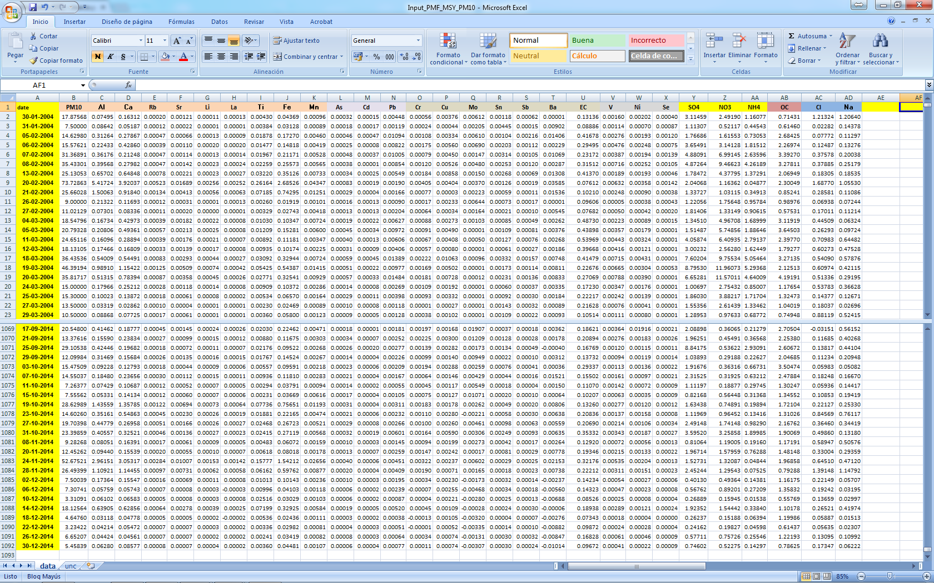
POSITIVE MATRIX FACTORIZATION (PMF)
Source contribution
Source profile
3–5 May 2017, Prague, Czech Republic

Slide 4
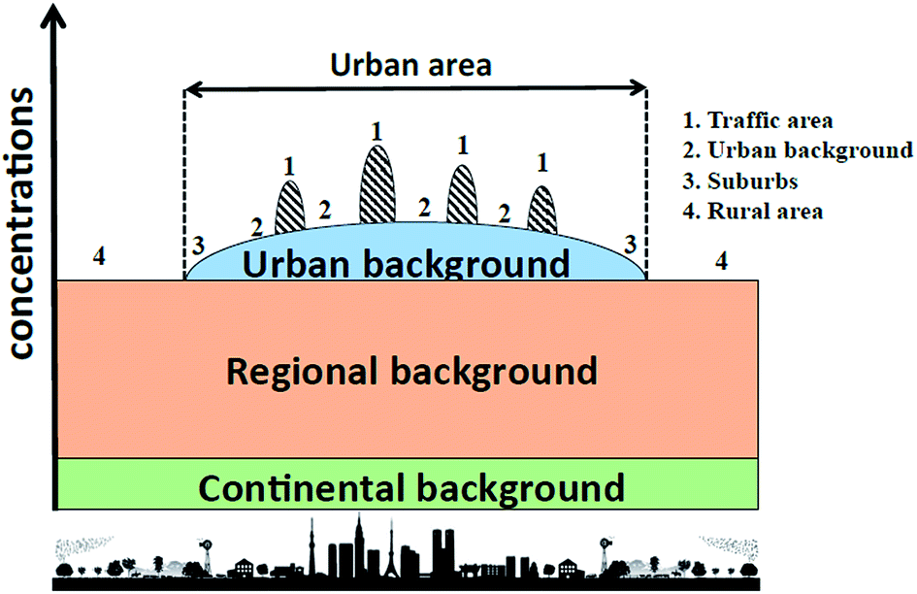
LENSCHOW APPROACH
Well known limitations:
  i.e. contribution of urban pollution to regional levels
  qualitative technique (a lot of assumptions needed), but it gives the possibility to distinguish between local or not-local sources
3–5 May 2017, Prague, Czech Republic

Slide 5
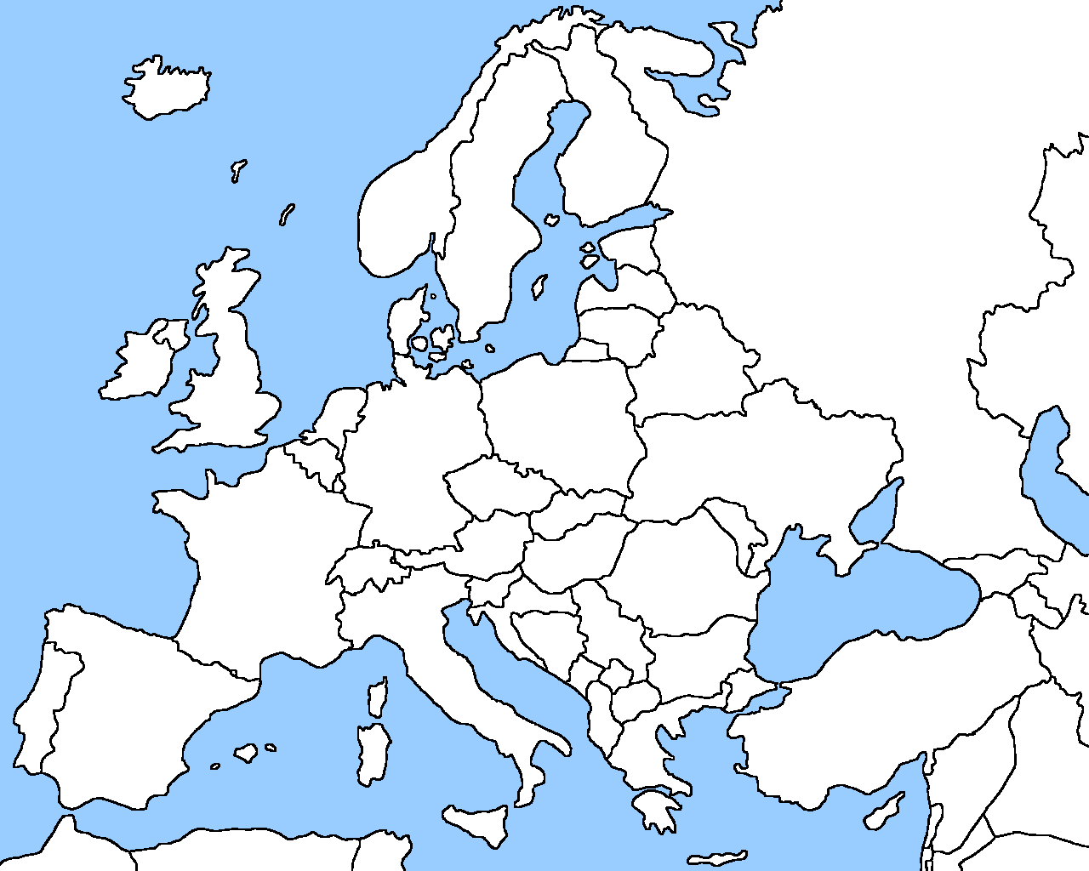
CANDIDATE SITES
Spain (done)
  Barcelona (UB), Montseny (RB), Montsec (Mountain)
  > 7 years of data available
  Full chemical speciation available
Switzerland (done)
  Zurich-Kaserne (urban background), Paierne (rural).
  2 years of data available (not continuous)
  Full chemical speciation available
France (done)
  Revin (RB), Lens (UB), Roubaix (traffic).
  1.5 years of data available
  Full chemical speciation available
United Kingdom (not possible yet)
  London: Marylebone Road (roadside), London, North Kensington (urban background) and Harwell (rural);
  Chemical speciated data at RURAL site for 2016 not yet available
  No trace elements at UB site (minor PM sources not detectable)
Germany (?)
  Leipzig (traffic-urban)/Melpitz (regional) (van Pinxteren et al., Faraday Discuss., 2016, 189, 291)
Sweden (not possible)
  Stockholm: Hornsgatan – street; Torkel knutssonsgatan – urban background; Aspvreten – rural
  Only short measurement campaigns;
  At RB site only SIA and OC/EC available ; Thus only Traffic and UB sites available for PMF application
3–5 May 2017, Prague, Czech Republic

Slide 6
SPAIN: Barcelona (UB), Montseny (RB), Montsec (Mountain)
Barcelona: 41°23’24.01’’ N, 02°6’58.06’’ E, 64 m a.s.l.
Montseny: 41°46’45.63’’ N, 02°21’28.92’’ E, 720 m a.s.l.
Montsec: 42°3’ N, 0°44’ E, 1570 m a.s.l.
Common period used for this analysis : 2010 – 2014
Possibility to update (2010 – 2016)
Data from EGAR Group (IDAEA-CSIC , Barcelona, Spain)
3–5 May 2017, Prague, Czech Republic

Slide 7
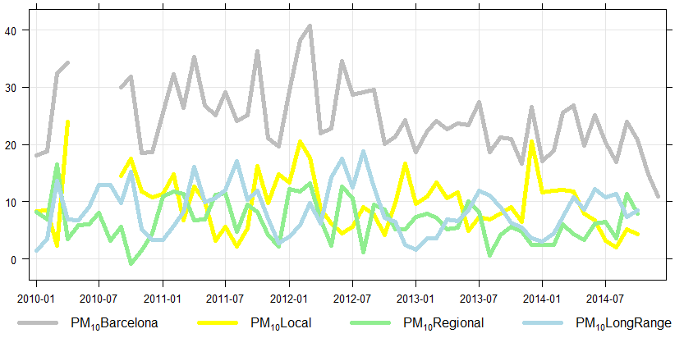
SPAIN: Barcelona (UB), Montseny (RB), Montsec (Mountain)
DJF
JJA
DJF
JJA
DJF
JJA
DJF
JJA
DJF
JJA
JJA mostly regional/
long range
DJF mostly local
PM10 [μg/m³]
3–5 May 2017, Prague, Czech Republic

Slide 8
SPAIN: Barcelona (UB), Montseny (RB), Montsec (Mountain)
BCN
MSY
MSA
Heavy-Oil combustion
Mineral
Marine
Secondary sulfate (SSA)
Industrial
Organic
Traffic
Secondary nitrate (NSA)
3–5 May 2017, Prague, Czech Republic

Slide 9

Marine
Industrial
Mineral
LOCAL
Barcelona measuring
station 5 km far from
the coast
REGIONAL
Emissions from the Barcelona
Metropolotan Area and valley
Saharan dust
(summer; sporadic but intense)
TRANSBOUNDARY
μg/m³
Local dust
Resuspension +
regional wind blown dust
Heavy-Oil
combustion
NO₂ + availability
of NH₃ In Barcelona
Secondary
nitrate
Strong summer
formation and
recirculation
Organic
2010-2014
PMF source contributions
μg/m³
Port of Barcelona
Agriculture/
farm
Secondary
sulfate
Vehicles in
Barcelona
Traffic
PM
Strong summer
formation and
recirculation
μg/m³
month
month
month

Slide 10
LOCAL
REGIONAL
TRANSBOUNDARY
2010 – 2014 Barcelona (BCN)
Traffic (3.2; 14%)
Marine (2.8; 13% of PM₁₀ mass)
WINTER (DJF)
Vehicles in
Barcelona
Barcelona measuring
station 5 km far from
the coast
PM₁₀ (22.6 μg/m³)
μg/m³; %
BCN
BCN
Sec. sulfate (1.7; 8%)
Industrial (0.2; 1%)
Emissions from the Barcelona
Metropolotan Area and valley
BCN
BCN
BCN
Mineral (2.1; 9%)
Heavy-oil (2.0; 9%)
Sec. nitrate (4.3; 19%)
Organic (5.7; 25%)
Local dust
resuspension
Port of Barcelona
Agriculture/
farm
BCN
BCN
BCN
BCN
NO₂ + availability
of NH₃ In Barcelona

Slide 11
LOCAL
REGIONAL
TRANSBOUNDARY
2010 – 2014 Barcelona (BCN)
Traffic (2.8; 12%)
Marine (4.3; 17% of PM₁₀ mass)
SUMMER (JJA)
Vehicles in
Barcelona
Barcelona measuring
station 5 km far from
the coast
PM₁₀ (25.2 μg/m³)
μg/m³; %
BCN
BCN
Sec. sulfate (2.4; 10%)
Industrial (0.2; 1%)
Emissions from the Barcelona
Metropolotan Area and valley
BCN
Strong summer
formation and
recirculation
BCN
BCN
Mineral (3.8; 15%)
Heavy-oil (3.6; 15%)
Sec. nitrate (2.7; 11%)
Organic (4.5; 18%)
Local dust
resuspension
NO₂ + availability
of NH₃ In Barcelona
Saharan dust
(summer)
Port of Barcelona
BCN
BCN
BCN
BCN
Agriculture/
farm
Strong summer
formation and
recirculation
Low NH3 levels
at Montseny (?)

Slide 12
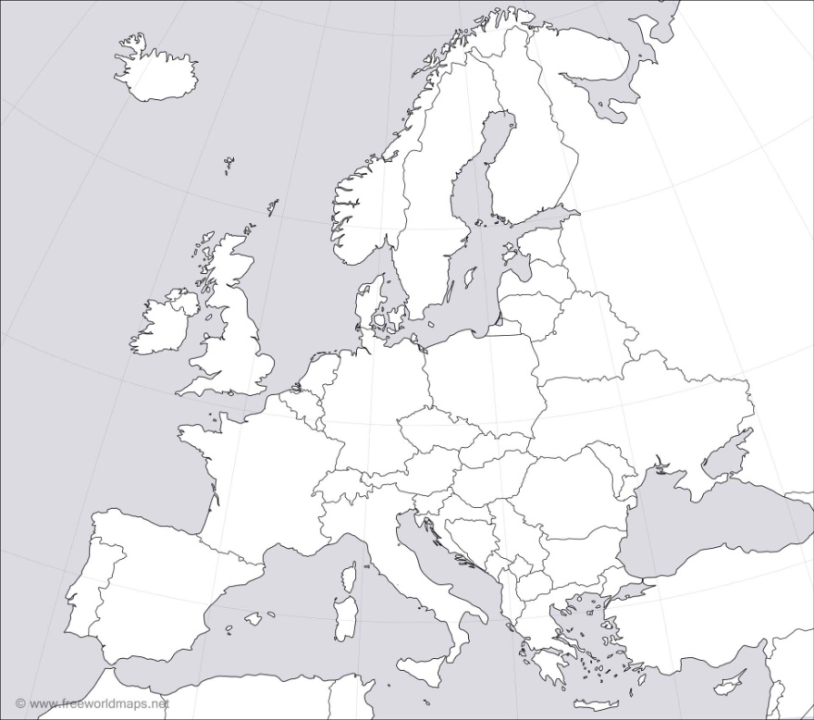
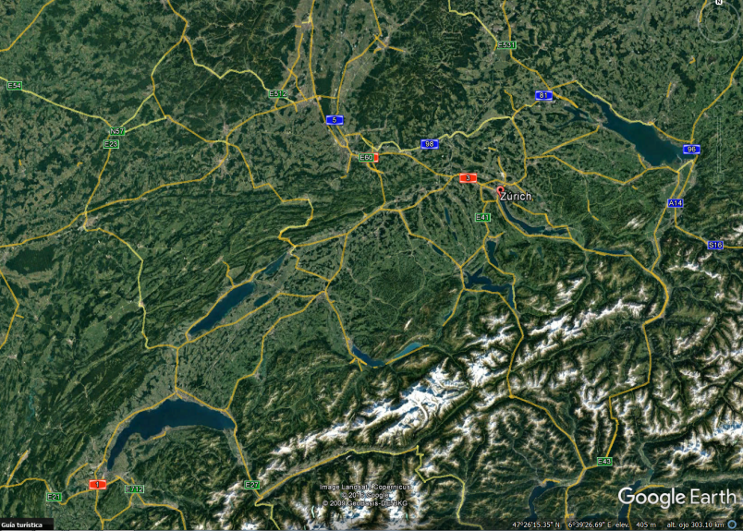
SWITZERLAND: Zurich (UB), Payerne (RB)
Zurich: 47°22’36.42’’ N, 8°31’44.70’’,E, 410 m a.s.l.
Payerne: 46°49’12’’ N, 06°57’ E, 491 m a.s.l.
Common period used for this analysis : Aug 2008 – Jul 2009
Data from Christoph Hueglin (EMPA, Switzerland)
Zurich
Payerne
3–5 May 2017, Prague, Czech Republic

Slide 13
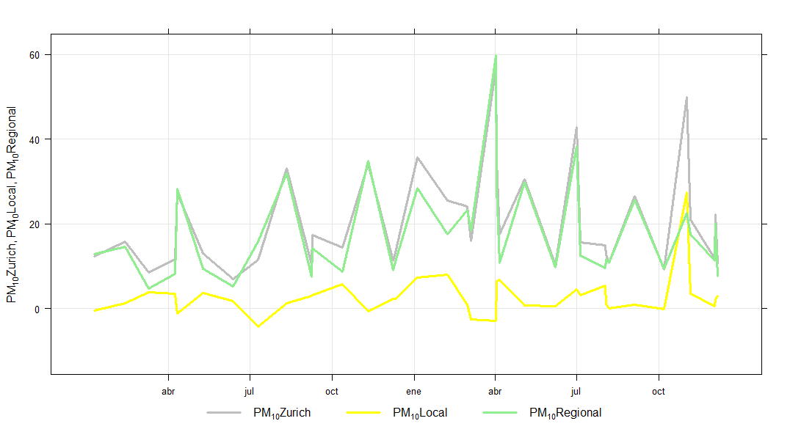
SWITZERLAND: Zurich (UB), Payerne (RB)
Mostly regional
PM10 [μg/m³]
3–5 May 2017, Prague, Czech Republic

Slide 14
Local contribution to the levels measured at ZUE
ZURICH + PAYERNE
Regional contribution to the levels measured at ZUE
Na-Mg Rich
Wood burning
Road traffic
Difficult to asses the
different contributions
of this source
μg/m³
Secondary
Nitrate
Secondary
Sulfate
Mineral
μg/m³
month
month
month
3–5 May 2017, Prague, Czech Republic

Slide 15
LOCAL
REGIONAL
SUMMER (JJA)
2008 – 2009 Zurich (ZUE)
WINTER (DJF)
PM₁₀ (13.7 μg/m³)
PM₁₀ (24.2 μg/m³)
Traffic (2.8 μg/m³; 17%)
Na-Mg rich (3.0 μg/m³; 22%)
Traffic (3.1 μg/m³; 13%)
Na-Mg rich (2.1 μg/m³; 9%)
WC (0.8 μg/m³; 5%)
NSA (0.3 μg/m³; 2%)
WC (5.9 μg/m³; 24%)
NSA (10 μg/m³; 42%)
SSA (5.3 μg/m³; 39%)
Mineral (3.2 μg/m³; 23%)
SSA (3.5 μg/m³; 14%)
Mineral (1 μg/m³; 4%)
3–5 May 2017, Prague, Czech Republic

Slide 16
PM₁₀ source apportionment
(PMF model + Lenschow) (Aug2008 – Jul2009)
PM_{2.5} source apportionment in the GAINS model (2009)
ZURICH
Nat/Int
PM_{2.5}
PM₁₀
GAINS (PMF+Lenschow)
3–5 May 2017, Prague, Czech Republic

Slide 17
FRANCE: Roubaix (Tr), Lens (UB), Revin (RB)
Roubaix: 50°42'24''N, 3°10'51''E, 31 m a.s.l.
Lens: 50°26'13''N, 2°49'37''E, 47 m a.s.l.
Revin: 49°54'28.008''N, 4°37'48''E, 395 m a.s.l.
Common period used for this analysis : Jan 2013 – May 2014
Data from Esperanza Perdrix, Véronique Riffault, Stéphane Sauvage (IMT, lille Douai, France),
Olivier Favez (INERIS, France)
3–5 May 2017, Prague, Czech Republic

Slide 18
Traffic
Urban
Regional
Simultaneous PM (132 samples)
methanesulfonic acid
Marine Aged
Makes sense: This
Marine source is aged
(note the difference
with Sea Salt)
Marine Biogenic (MSA)
Sea Salt
Mineral
Mainly wind
blown dust
Roubaix and Lens closer
to the coast compared
to Revin. Oversetimation of
“UB” contribution
Roubaix and Lens closer
to the coast compared
to Revin. Overestimation of
“UB” contribution
Arabitol and mannitol
Glucose and mannose
Oxalate
Strongly regional; but also
has “UB”
contributions:
Oxalate formed from
vehicle emissions ?
BB
Important “UB” and regional
contributions
SSA
Clearly, regional/long-range
Land Biogenic
Clearly, regional/long-range
Sugar and sugar alcohol, emitted by the primary biogenic emission
Primary biogenic aerosol consists of plant debris (cuticular waxes, leaf fragments, etc.), humic matter, and microbial particles (bacteria, fungi, viruses, algae, pollen, spores, etc.).
Traffic
Clearly local
Polluted soil
NSA
Local “non-soil” + regional
polluted soil (past industrial
emissions)
Urban (from vehicles);
Regional (Farms ?)
PM10

Slide 19
Traffic
Urban
Regional
NSA (1.9; 7.8%)
2013 – 2014 ROUBAIX (RBX)
RBX
Marine biogenic (0.03; 0.1% of PM₁₀ mass)
Polluted soil (3.6; 14.6%)
WINTER (DJF)
Roubaix and Lens closer to the coast compared to Revin. Oversetimation of “UB” contribution
PM₁₀ (24.9 μg/m³)
μg/m³; %
RBX
RBX
Traffic (6.0; 24.0%)
Sea salt (1.5; 6.0%)
Roubaix and Lens closer to the coast compared to Revin. Oversetimation of “UB” contribution
RBX
RBX
RBX
Marine aged (3.2; 12.7%)
Land biogenic (0.6; 2.3%)
Clearly, regional/long-range
RBX
RBX
Mineral (0.9; 3.6%)
Oxalate (0.7; 2.7%)
Biomass burning (3.6; 14.5%)
SSA (1.3; 5.2%)
Strongly regional; but also
has “UB”
contributions:
Oxalate formed from
vehicle emissions ?
Important “UB” and regional
contributions
Wind
blown dust
Clearly, regional/long-range
RBX
RBX
RBX
RBX

Slide 20
Traffic
Urban
Regional
NSA (0.8; 3.5%)
2013 – 2014 ROUBAIX (RBX)
RBX
Marine biogenic (1.9; 8.6% of PM₁₀ mass)
Polluted soil (4.0; 17.9%)
SUMMER (JJA)
Roubaix and Lens closer to the coast compared to Revin. Oversetimation of “UB” contribution
PM₁₀ (24.9 μg/m³)
μg/m³; %
RBX
RBX
Traffic (3.9; 17.5%)
Sea salt (0.3; 1.4%)
Roubaix and Lens closer to the coast compared to Revin. Oversetimation of “UB” contribution
RBX
RBX
RBX
Marine aged (3.5; 12.5%)
Land biogenic (1.1; 5.0%)
Clearly, regional/long-range
RBX
RBX
Mineral (0.7; 3.2%)
Oxalate (1.6; 7.1%)
Biomass burning (0.0; 0.0%)
SSA (2.5; 11.0%)
Strongly regional; but also
has “UB”
contributions:
Oxalate formed from
vehicle emissions ?
Important “UB” and regional
contributions
Wind
blown dust
Clearly, regional/long-range
RBX
RBX
RBX
RBX

Slide 21
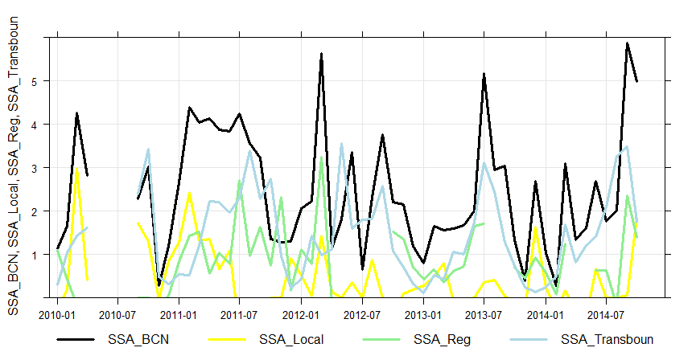
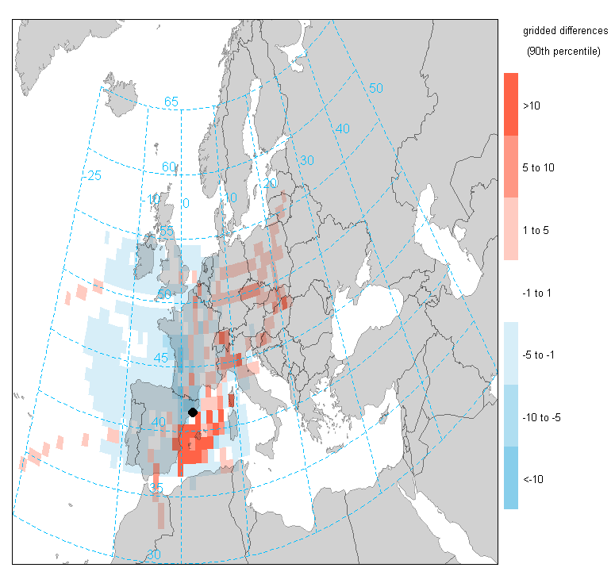
5-days back
SSA Barcelona
(SPAIN)
90th pc
mean
3–5 May 2017, Prague, Czech Republic

Slide 22
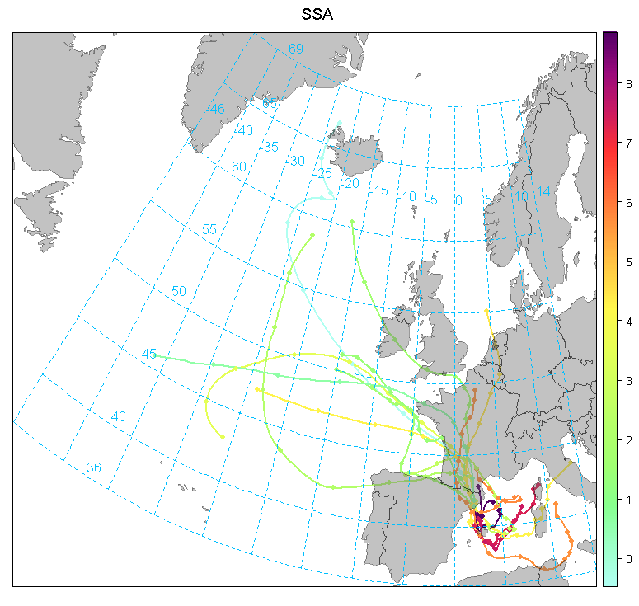
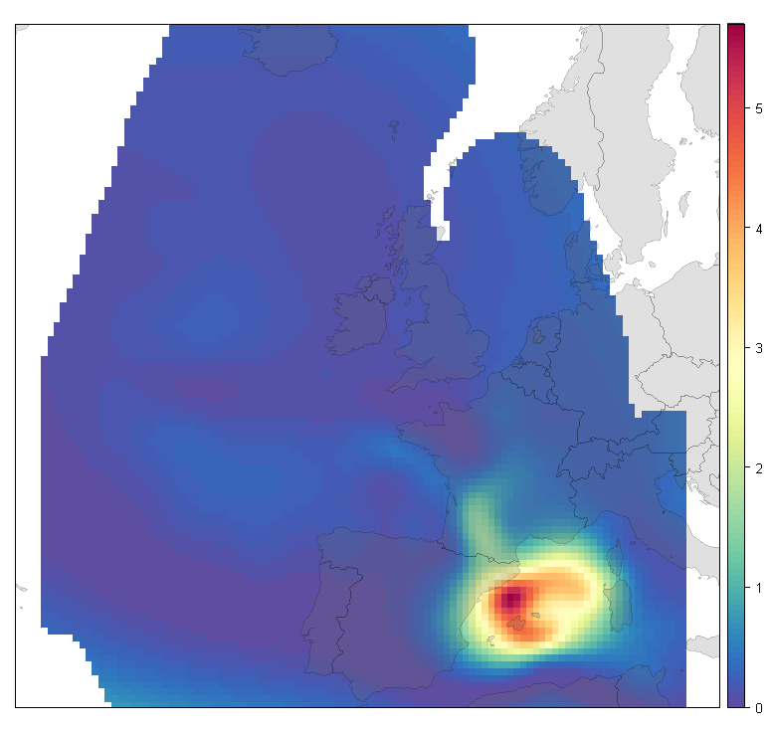
5-days back
SSA Barcelona
(SPAIN)
90th pc
mean
25/06/2013-12/08/2013
3–5 May 2017, Prague, Czech Republic

Slide 23
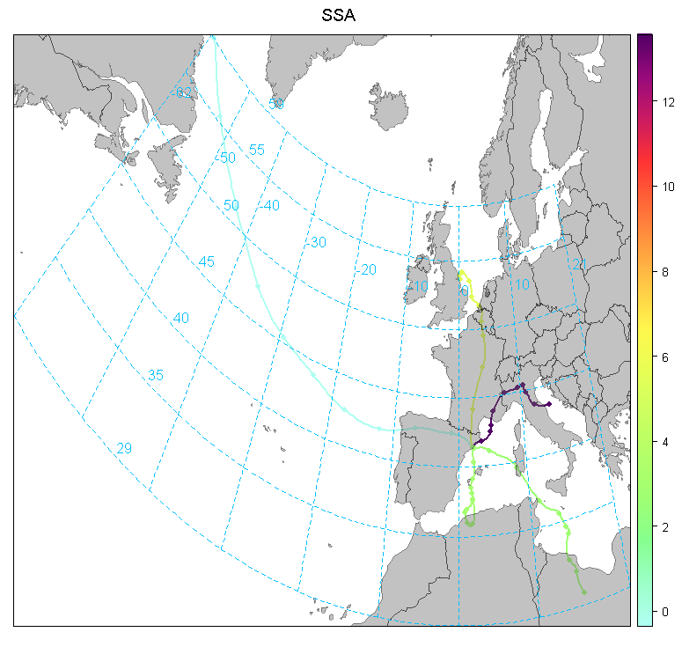
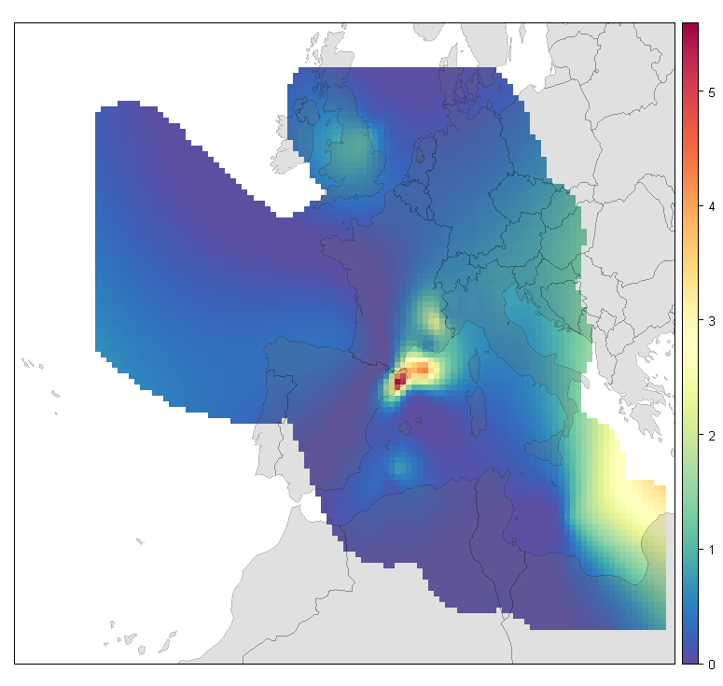
5-days back
SSA Barcelona
(SPAIN)
90th pc
mean
19/03/2012-04/04/2012
3–5 May 2017, Prague, Czech Republic

Slide 24
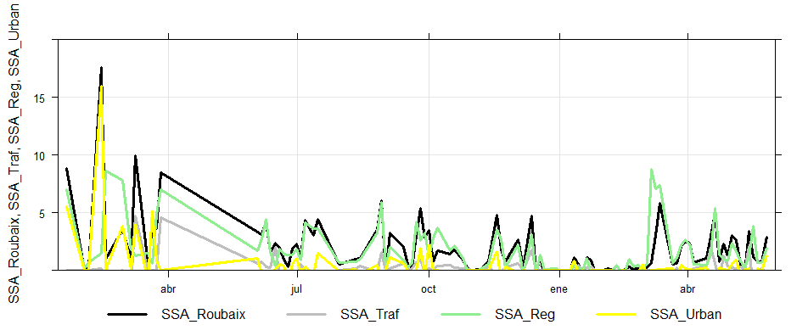
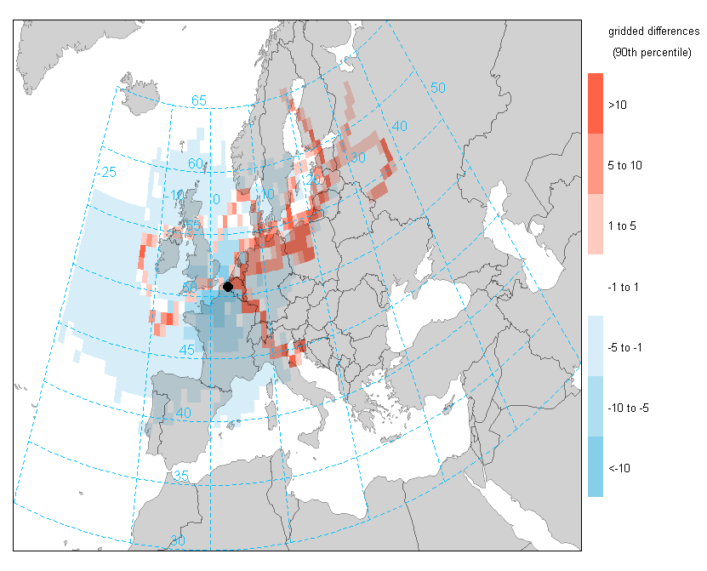
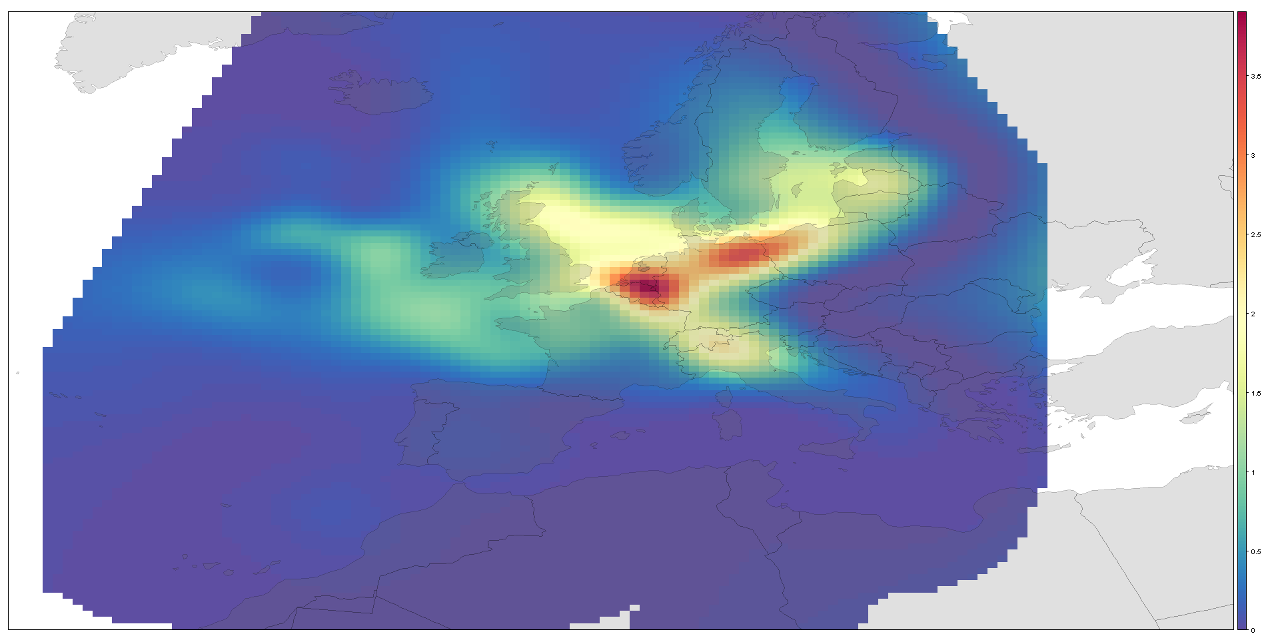
5-days back
SSA Roubaix
(FRANCE)
3–5 May 2017, Prague, Czech Republic

Slide 25
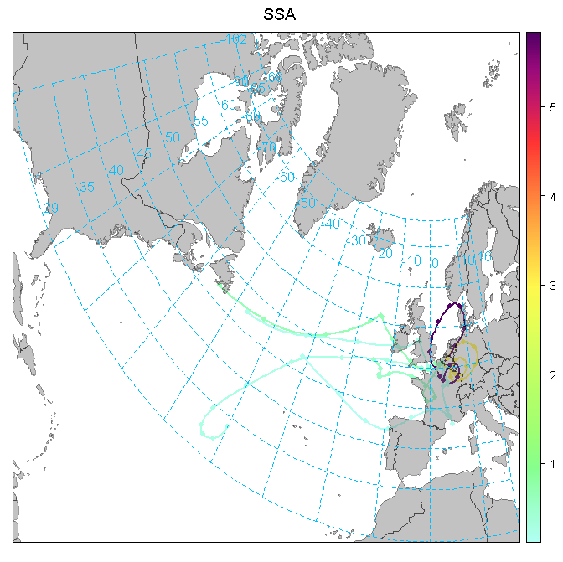
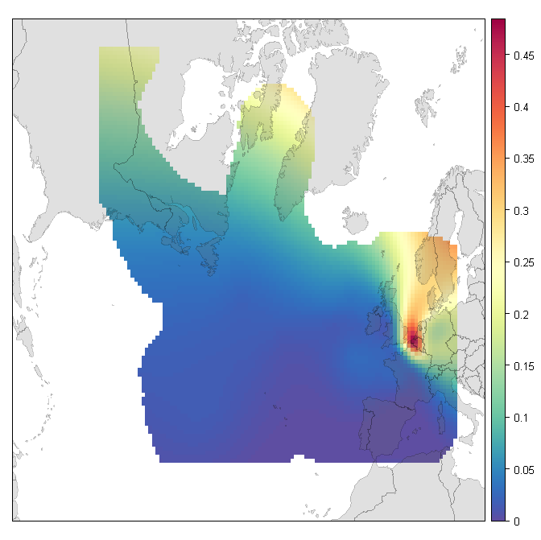
5-days back
SSA Roubaix
(FRANCE)
25/02/2014 – 21/03/2014
3–5 May 2017, Prague, Czech Republic

Slide 26
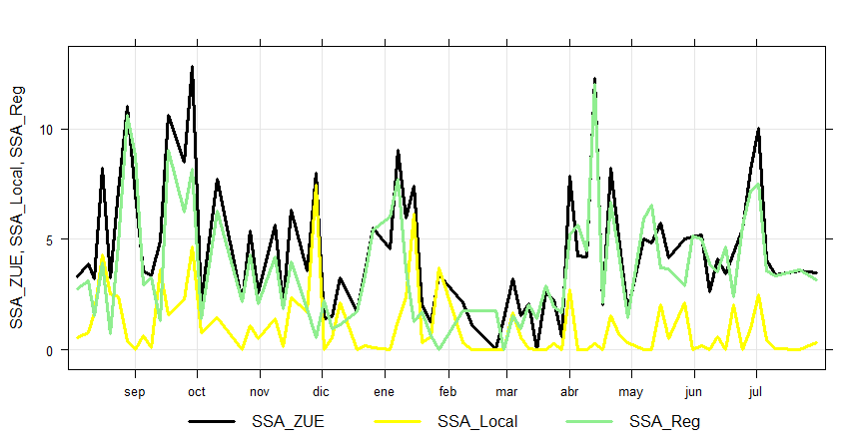
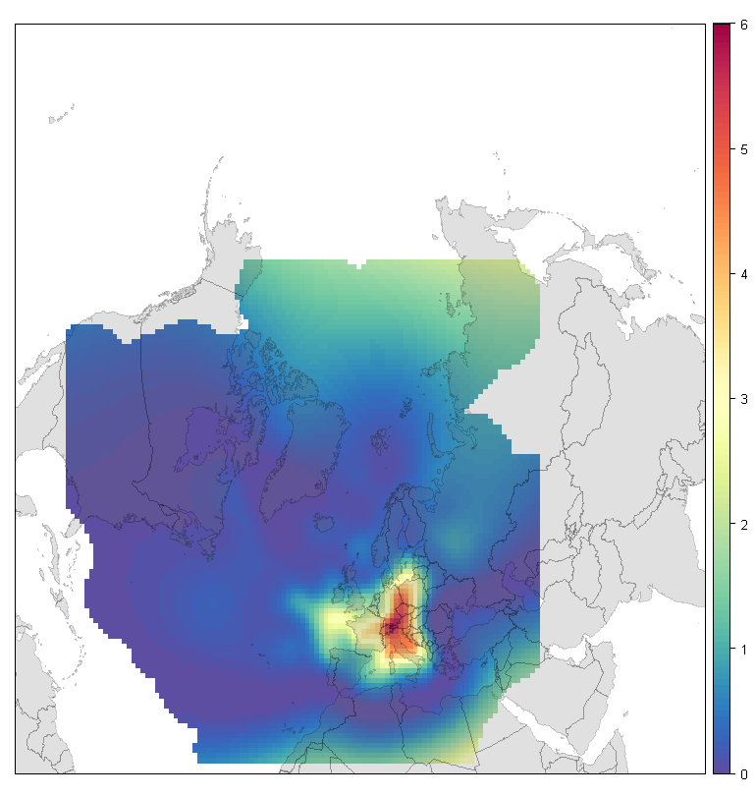
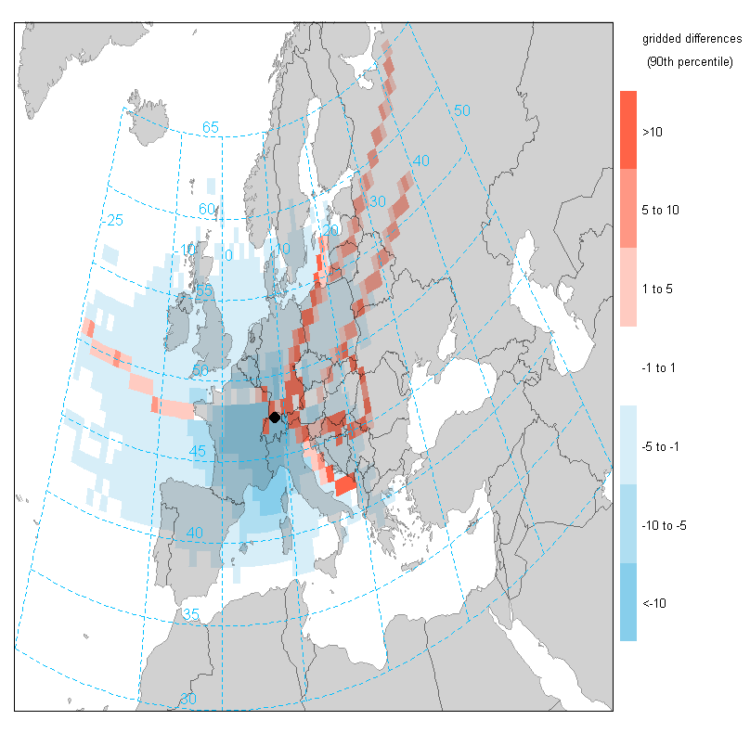
5-days back
SSA Zurich
(SWITZERLAND)
90th pc
mean
3–5 May 2017, Prague, Czech Republic

Slide 27
08/04/2011
EXCEEDANCES
PM10
Barcelona
(SPAIN)
PM₁₀ = 54 μgm⁻³
NSA = 10 μgm⁻³
V-Ni= 12 μgm⁻³
Mineral= 11 μgm⁻³
SSA= 11 μgm⁻³
Organics= 6 μgm⁻³
Traffic= 8 μgm⁻³
3–5 May 2017, Prague, Czech Republic

Slide 28
EXCEEDANCES
PM10
Barcelona
(SPAIN)
15/03/2012
PM₁₀ = 66 μgm⁻³
NSA = 20 μgm⁻³
V-Ni= 12 μgm⁻³
Mineral= 7 μgm⁻³
SSA= 10 μgm⁻³
Organics= 5 μgm⁻³
Traffic= 7 μgm⁻³
3–5 May 2017, Prague, Czech Republic

Slide 29
The added value of European Twin urban regional/remote Supersites to transboundary pollution
to urban level
Experimental PM chemical speciated data used for this analysis
Application of robust receptor modeling technique (PMF model) for source identification and apportionment:
  source profiles do not change significantly over time
  receptor species do not react chemically or undergo phase partitioning (solid/gas or solid/liquid) during transport from source to receptor (i.e., they add linearly).
PMF model ↔ Urban increment by activity sector
Monthly - seasonal urban increments (>1 yr well distributed data)
Quite robust urban increments calculated for specific sources expaining 50-80% of PM mass
Model “validation”
Limitations of the Lenschow approach
  assumption of uniform regional background
  oversimplification of certain processes i.e. those concerning secondary particles (negative increment)
  underestimation of urban sources (i.e. Barcelona/summer)
3–5 May 2017, Prague, Czech Republic

Slide 30

The added value of European Twin urban regional/remote Supersites to transboundary pollution
to urban level
Including data from dedicated measurement campaigns
Aethalometer data (hourly ff and wb contributions to BC) ….night time & daytime
THANK YOU !
marco.pandolfi@idaea.csic.es
3–5 May 2017, Prague, Czech Republic

Slide 32
LOCAL
REGIONAL
TRANSBOUNDARY
2010 – 2014 Barcelona (BCN)
Traffic (2.8; 12%)
Marine (4.3; 17% of PM₁₀ mass)
all data
Vehicles in
Barcelona
Barcelona measuring
station 5 km far from
the coast
PM₁₀ (24.6 μg/m³)
μg/m³; %
BCN
BCN
Sec. sulfate (2.4; 10%)
Industrial (0.2; 1%)
Emissions from the Barcelona
Metropolotan Area and valley
BCN
Strong summer
formation and
recirculation
BCN
BCN
Mineral (3.8; 15%)
Heavy-oil (3.6; 15%)
Sec. nitrate (2.7; 11%)
Organic (4.5; 18%)
Saharan dust
(summer)
Local dust
resuspension
Port of Barcelona
Strong summer
formation and
recirculation
BCN
BCN
Agriculture/
farm
BCN
BCN
NO₂ + availability
of NH₃ In Barcelona

Slide 33
Traffic
Urban
Regional
NSA (2.7; 9.6%)
2013 – 2014 ROUBAIX (RBX)
RBX
Marine biogenic (0.6; 2.1% of PM₁₀ mass)
Polluted soil (5.6; 19.6%)
all data
Roubaix and Lens closer to the coast compared to Revin. Oversetimation of “UB” contribution
PM₁₀ (28.6 μg/m³)
μg/m³; %
RBX
RBX
Traffic (6.0; 21.0%)
Sea salt (0.9; 3.0%)
Roubaix and Lens closer to the coast compared to Revin. Oversetimation of “UB” contribution
RBX
RBX
RBX
Marine aged (2.9; 10.2%)
Land biogenic (0.8; 2.8%)
Clearly, regional/long-range
RBX
RBX
Mineral (1.8; 6.3%)
Oxalate (1.1; 4.0%)
Biomass burning (2.0; 6.9%)
SSA (1.9; 6.7%)
Strongly regional; but also
has “UB”
contributions:
Oxalate formed from
vehicle emissions ?
Important “UB” and regional
contributions
Wind
blown dust
Clearly, regional/long-range
RBX
RBX
RBX
RBX

Slide 34
Local contribution to the levels measured at ZUE
ZURICH + PAYERNE
Regional contribution to the levels measured at ZUE
Na-Mg Rich
Wood burning
Road traffic
Difficult to asses the
different contributions
of this source
μg/m³
Secondary
Nitrate
Secondary
Sulfate
Mineral
μg/m³
month
month
month
3–5 May 2017, Prague, Czech Republic

