Slide 1
Deposition trends in Europe for the period 1990-2010, in the framework of the EURODELTA III project – Updated results
Mark R. Theobald, Marta G. Vivanco, Wenche Aas, Mario Adani, Camilla Andersson, Bertrand Bessagnet, Gino Briganti, Andrea Cappelletti, Giancarlo Ciarelli, Augustin Colette, Florian Couvidat, Kees Cuvelier, Massimo D'Isidoro, Hilde Fagerli, Astrid Manders, Kathleen Mar, Mihaela Mircea, Noelia Otero, Maria-Teresa Pay, Valentin Raffort, Yelva Roustan, Martijn Schaap, Svetlana Tsyro, Peter Wind
18th Task Force on Measurement and Modelling Meeting
Prague, Czech Republic, 3-5 May 2017

Slide 2
Outline
Aims of the study
Model performance assessment for wet deposition and atmospheric concentrations
Analysis of observed/modelled trends in wet deposition for the period 1990-2010
Absolute versus relative trends
The influence of dry deposition on total deposition
Conclusions

Slide 3
Questions to answer
Can the models estimate wet deposition for the period 1990-2010 with sufficient accuracy?
Can the models reproduce the observed trends in wet deposition?
What are the reasons for the differences between the models and between modelled and observed trends?

Slide 4
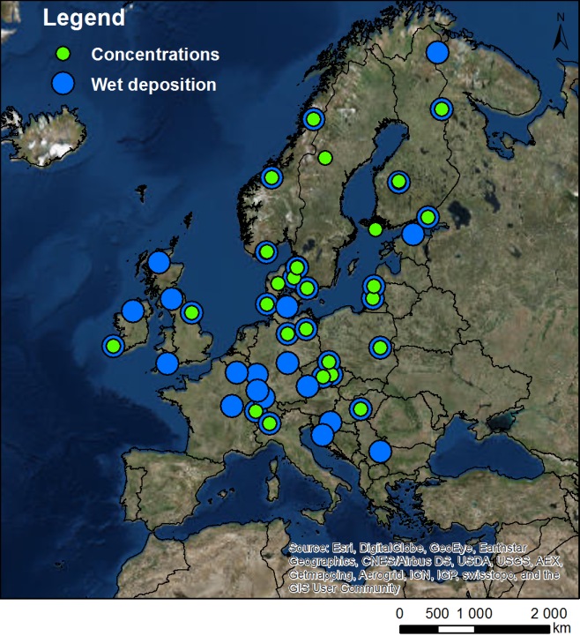
Datasets Used
Variables (annual, seasonal)
Wet deposition of oxidised N (WNOx) Wet deposition of reduced N (WNHx) Wet deposition of S (WSOx)* Total oxidised N = HNO₃ + PM₁₀-NO₃ (TNO3) Total reduced N = NH₃ + PM₁₀-NH₄ (TNH4) Total sulphur = SO₂ + PM₁₀-SO₄ (TSO4) * Precipitation
* Not including sea-salt sulphate
Simulations (1990-2010)
Chimere (CHIF) EMEP MSC-W (EMEP) Lotos-Euros (LOTO) MATCH MINNI
Simulations (1990, 2000, 2010)
Chimere (CHIF) CMAQ (CMAQB) EMEP MSC-W (EMEP) Lotos-Euros (LOTO) MATCH MINNI Polair3D (POLR) WRF-Chem (WRFC)
Observations (EMEP sites: 1990-2010)
Wet deposition (41 sites) Precipitation (41 sites) Concentrations (29 sites)
Notes:
Sulphur measurements are sea-salt sulphate corrected
Observations provided by Wenche (NILU)
New model for this assessment: MATCH
We now have MINNI simulations for the period 1990-2010
WRF-Chem is participating in the exercise but the data have not been included in this analysis

Slide 5
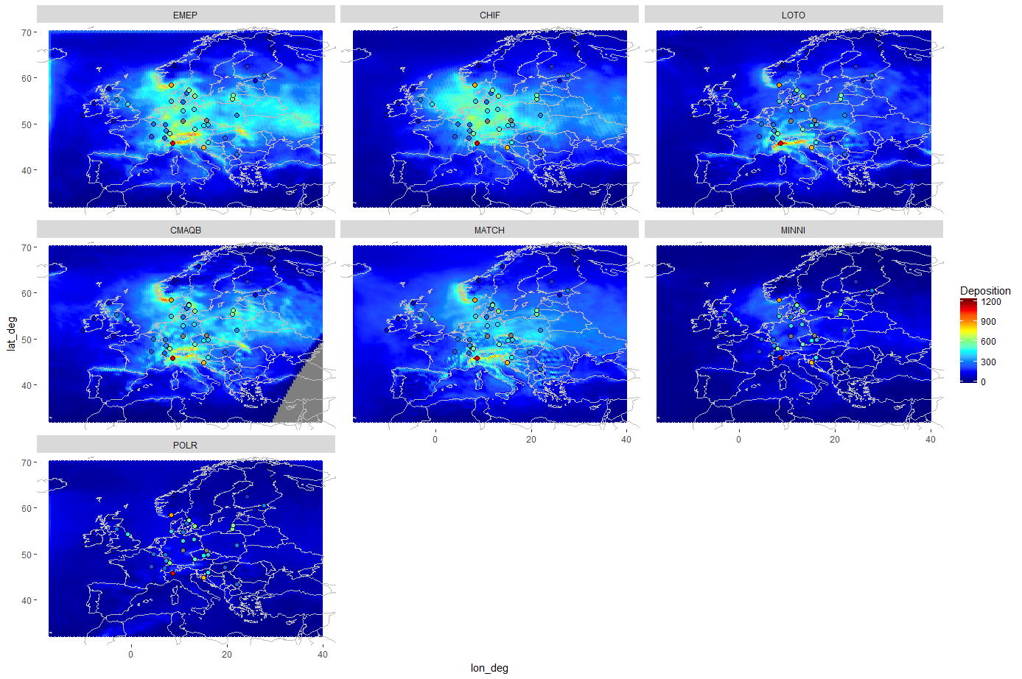
1990 Base Year
WNOx (mg N m⁻² yr⁻¹)
EMEP
CHIF
LOTO
CMAQB
MATCH
MINNI
POLR
Notes:
POLR and MINNI estimate the lowest rates

Slide 6
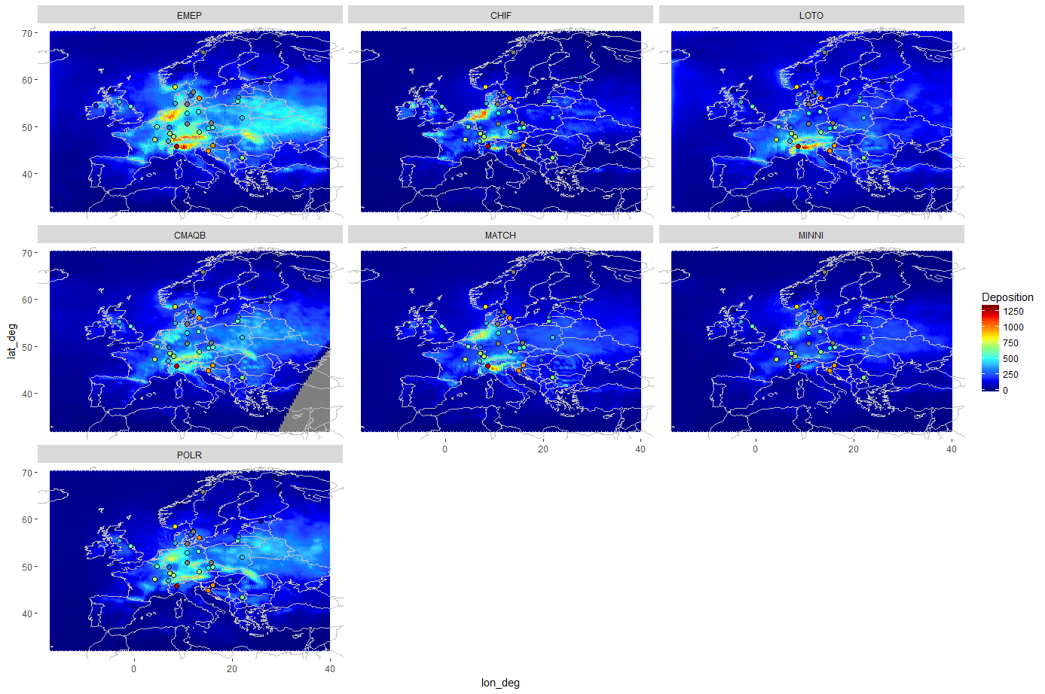
1990 Base Year
WNHx (mg N m⁻² yr⁻¹)
EMEP
CHIF
LOTO
CMAQB
MATCH
MINNI
POLR
Notes:
EMEP highest, MINNI lowest
POLR similar to other models (different to WNOx)

Slide 7
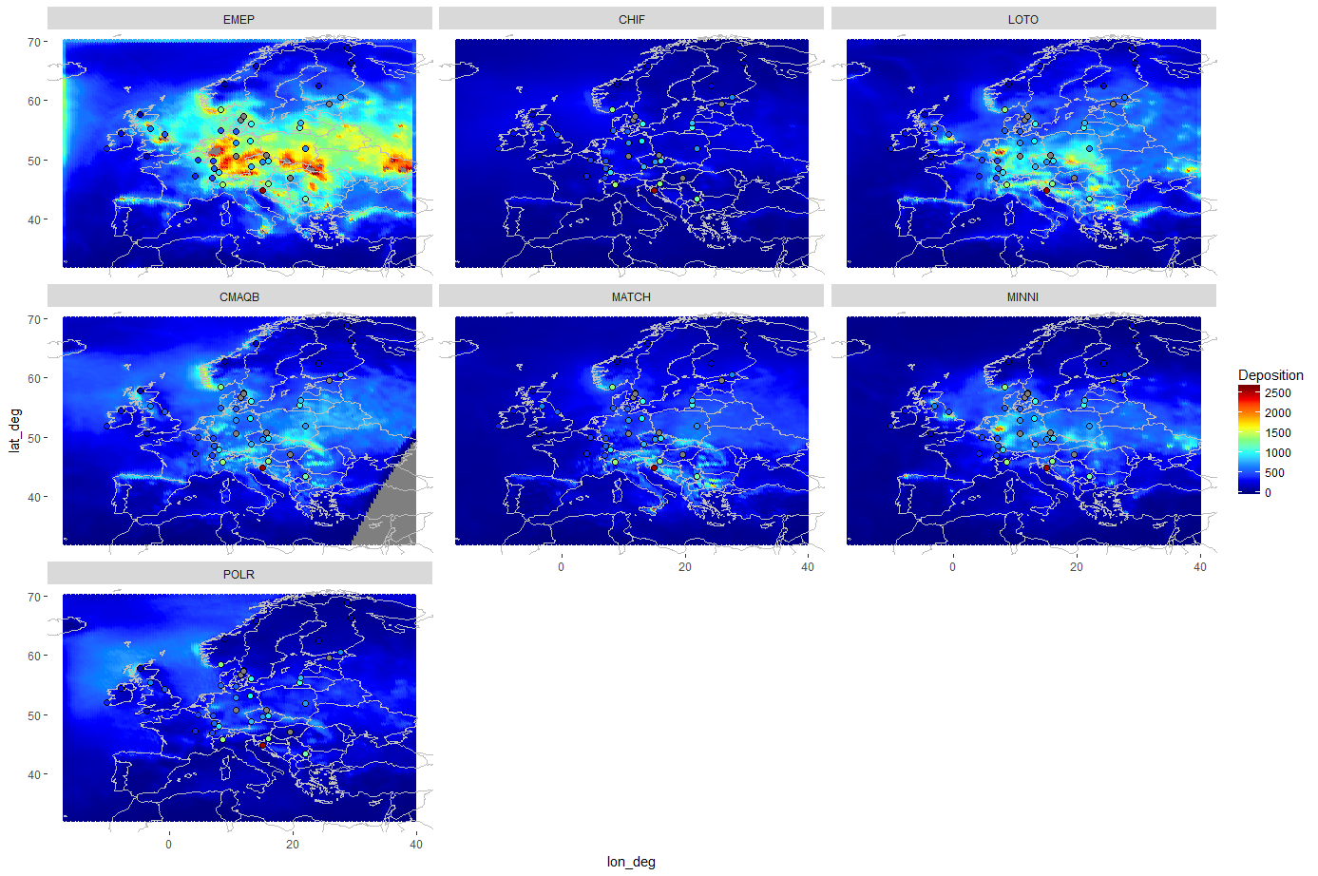
1990 Base Year
WSOx (mg S m⁻² yr⁻¹)
EMEP
CHIF
LOTO
CMAQB
MATCH
MINNI
POLR
Notes:
EMEP – highest
CHIF - lowest

Slide 8
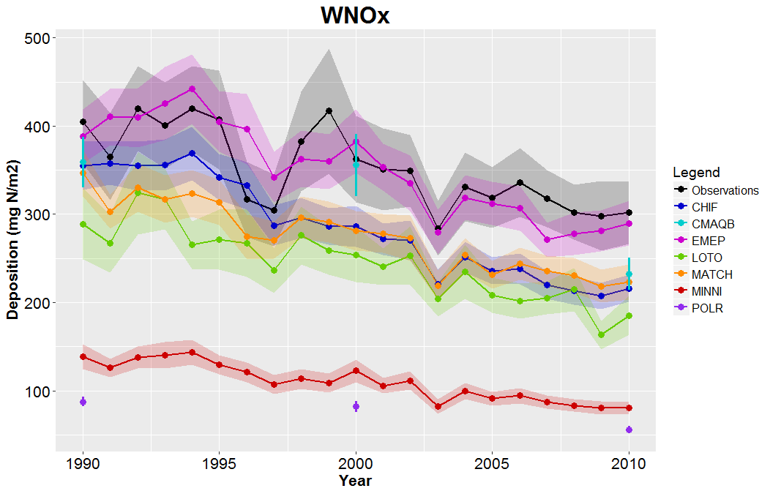
21 year time series (1990-2010) – Mean of all sites
WNOx (mg N m⁻² yr⁻¹)
Notes:
Mean deposition rates (average over all measurement sites)
Continuous line: Models with full 21 year simulations
Individual points: Models with only 1990, 2000, 2010 data (CMAQB and POLR)
MINNI, POLR : Lowest

Slide 9
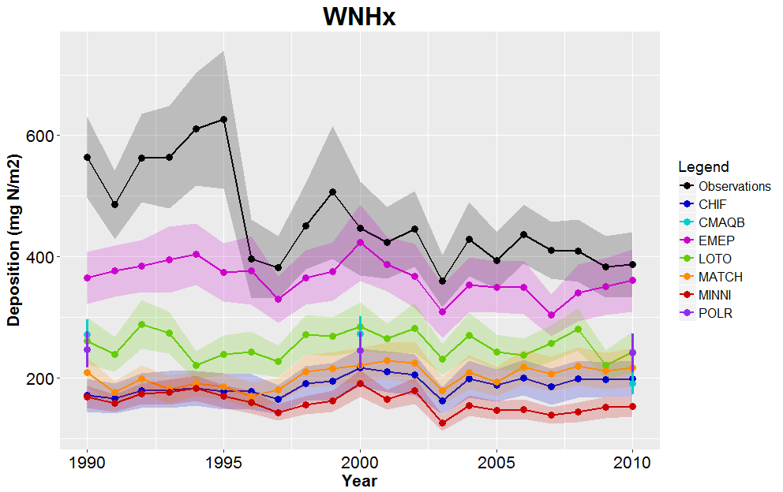
21 year time series (1990-2010) – Mean of all sites
WNHx (mg N m⁻² yr⁻¹)
Notes:
Models generally lower than observed
Drop in observed values in the middle of the 90s that is not reproduced by the models
This is not generalised and is due to the influence of a few sites, especially two sites in eastern France (Donon and Morvan)

Slide 10
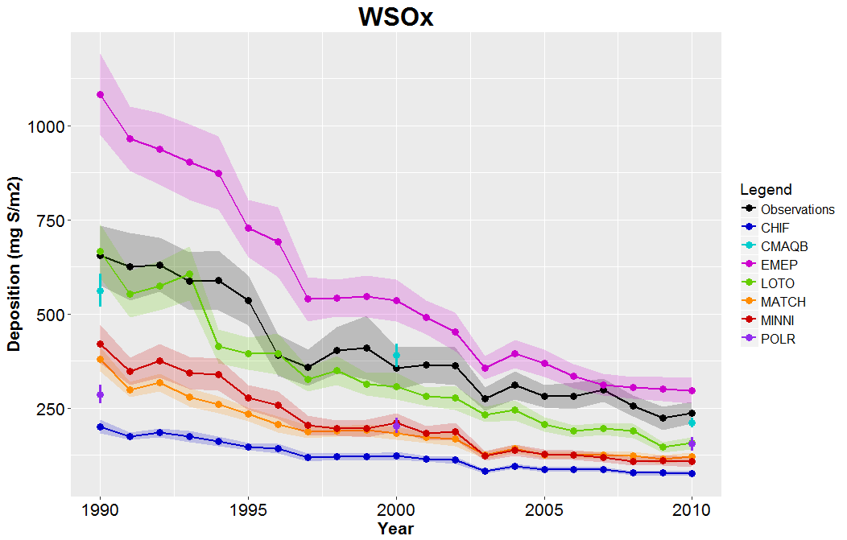
21 year time series (1990-2010) – Mean of all sites
WSOx (mg S m⁻² yr⁻¹)
Notes:
Most models lower than observed, except EMEP, which is higher
Large spread in model estimates

Slide 11
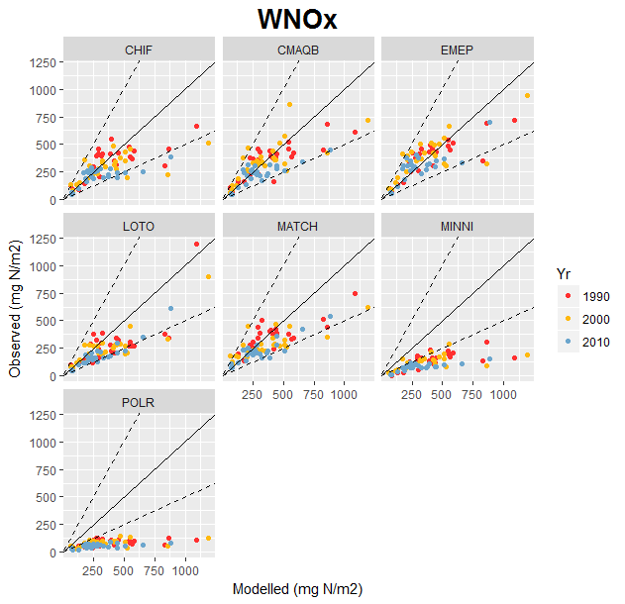
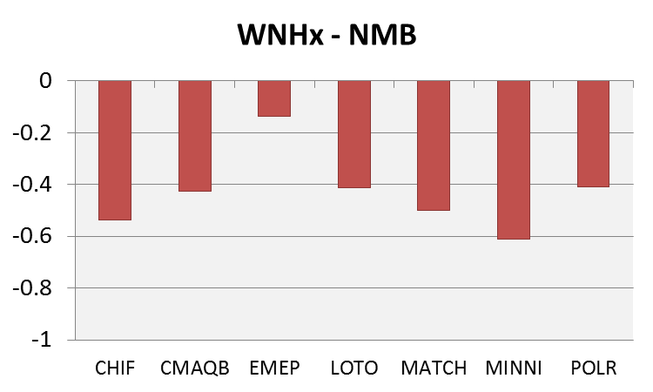
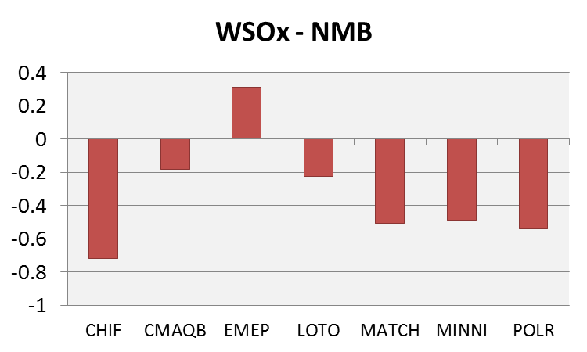
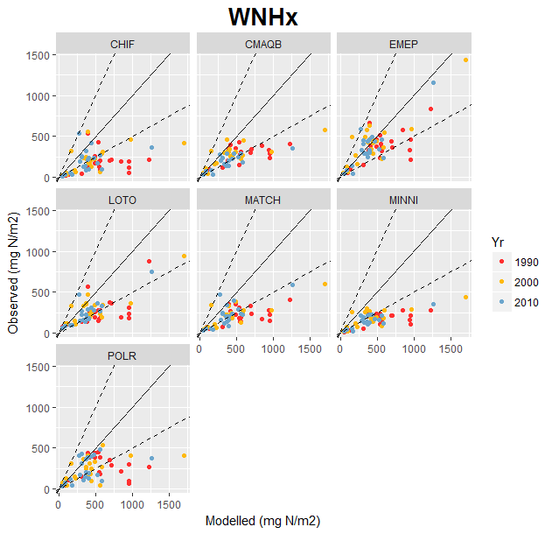
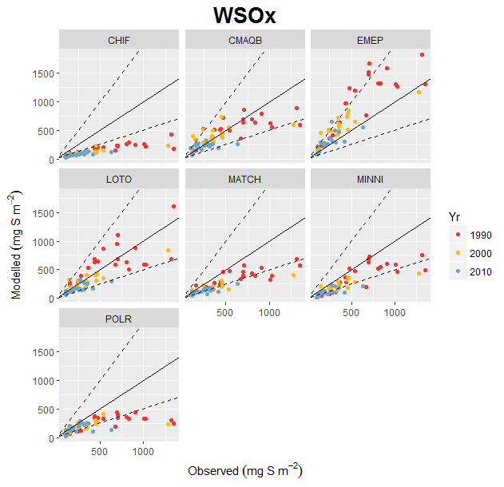
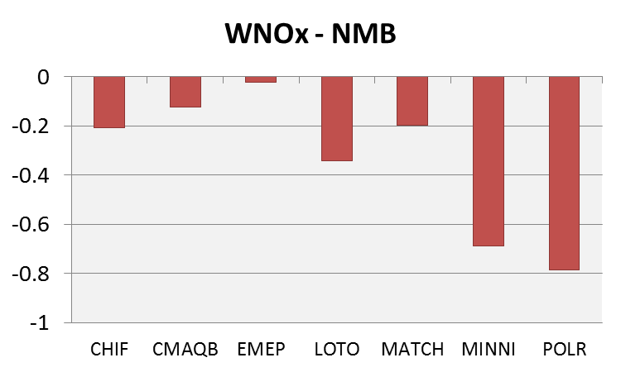
Model Performance (All 7 models) – (1990, 2000, 2010)
Notes:
Using data for 1990, 2000, 2010 only so that we can include all models
Only showing one statistic, NMB, in order to not overcomplicate. NMB is fairly illustrative of the problems the models have with underestimating wet deposition
Generally all models underestimate wet deposition, apart from EMEP for WSOx

Slide 12
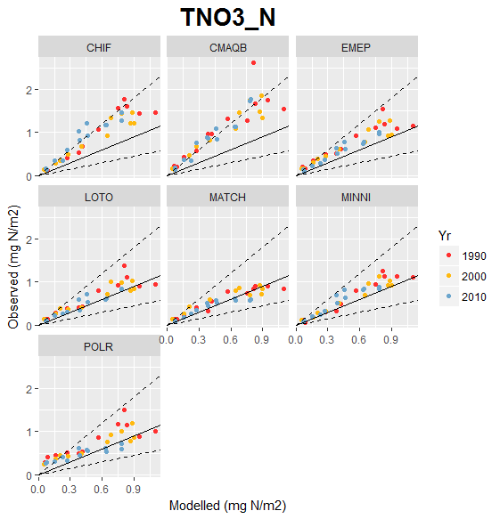
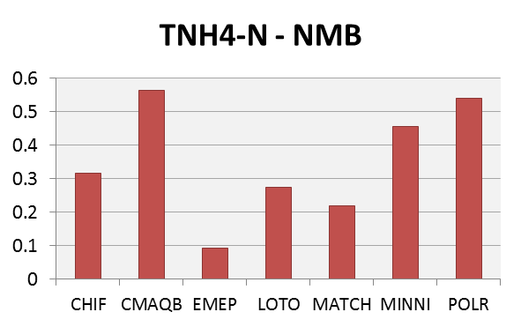
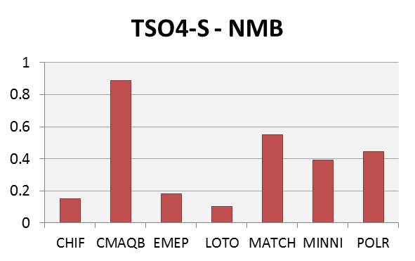
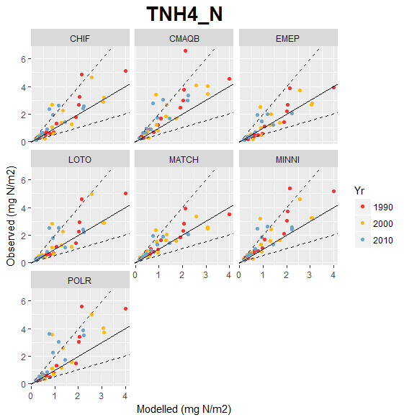
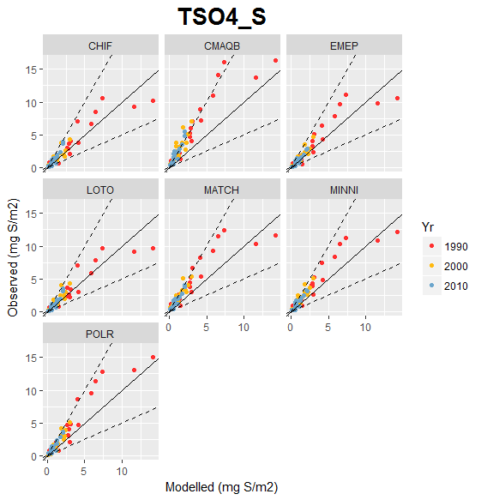
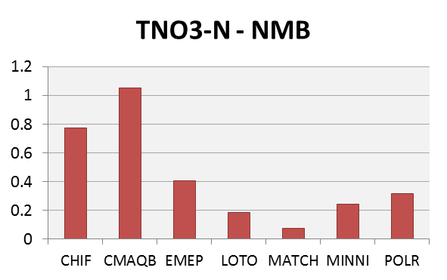
Relationship with concentrations
Notes:
All models tend to overestimate concentrations

Slide 13
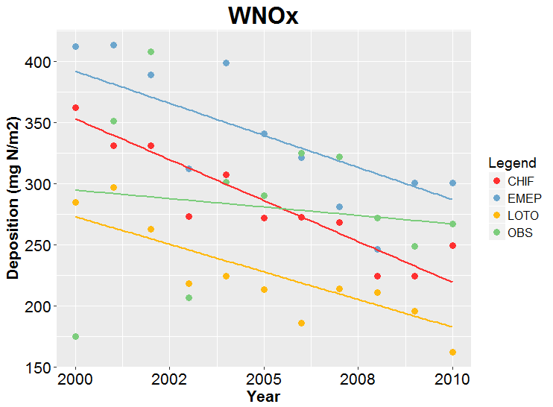
Trend Calculation (1990-2000, 2000-2010)
Conditions: Observations for > 75% of period
Trend calculation: Sen’s slope method
Relative trend = Trend/Estimated value at start of period
Trend significance: Mann Kendall method (p < 0.05)
e.g. Randomly chosen site
(DE002R)
Relative trends (yr⁻¹)
-2.7% (***)
-2.1% (***)
-2.5% (***)
-0.9% (ns)
Notes:
Linear trends have been assumed
Need to point out that there are two trends: the absolute trend (in mg N (or S) /m2/yr) and relative trend (in %/yr)
We have focussed on the absolute trends although later we compare them

Slide 14
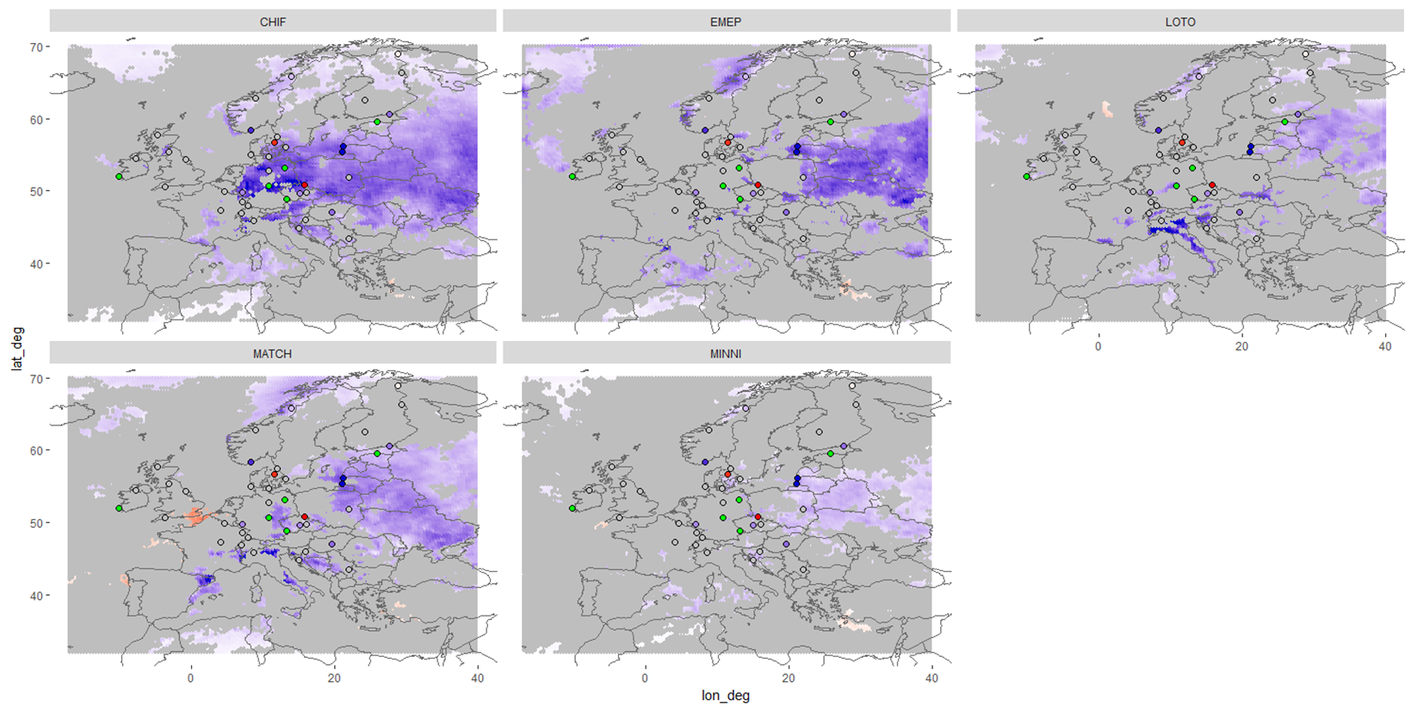
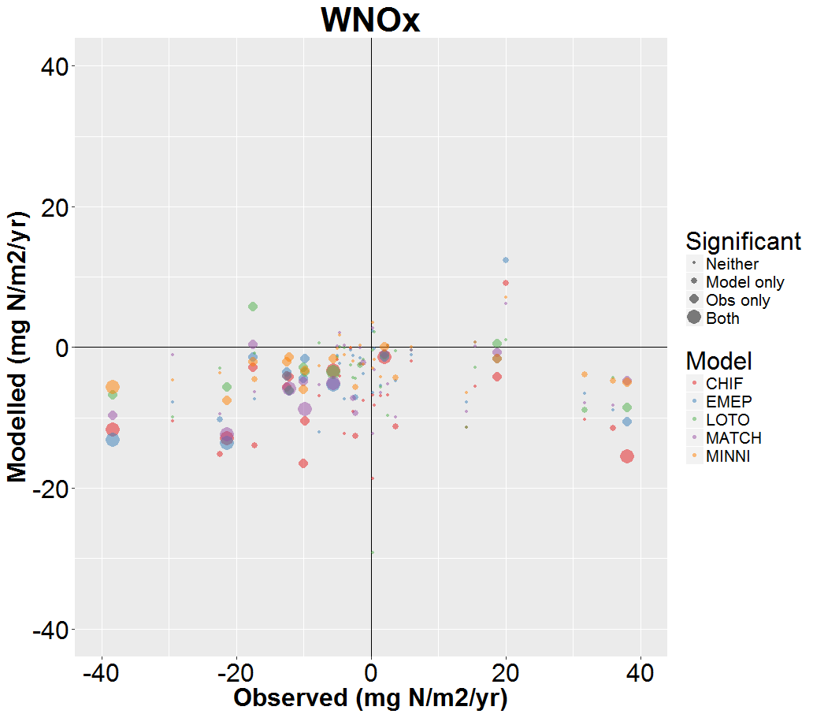
Spatial distributions of measured and modelled trends
WNOx 1990-2000 (mg N m⁻² yr⁻¹)
CHIF
EMEP
LOTO
Not sig.
No data
MATCH
MINNI
Modelled vs. Measured Trends
Notes:
Just looking at the period 1990-2000
WNOx
With regards to the spatial distributions of the trends, most of the statistically significant observed trends of WNOx (both increasing and decreasing) for the period 1990-2000 are located in the centre and eastern side of the domain
The five models also estimate the most significant trends (decreasing only) in the east of the domain although they fail to capture the large observed increasing and decreasing trends.

Slide 15
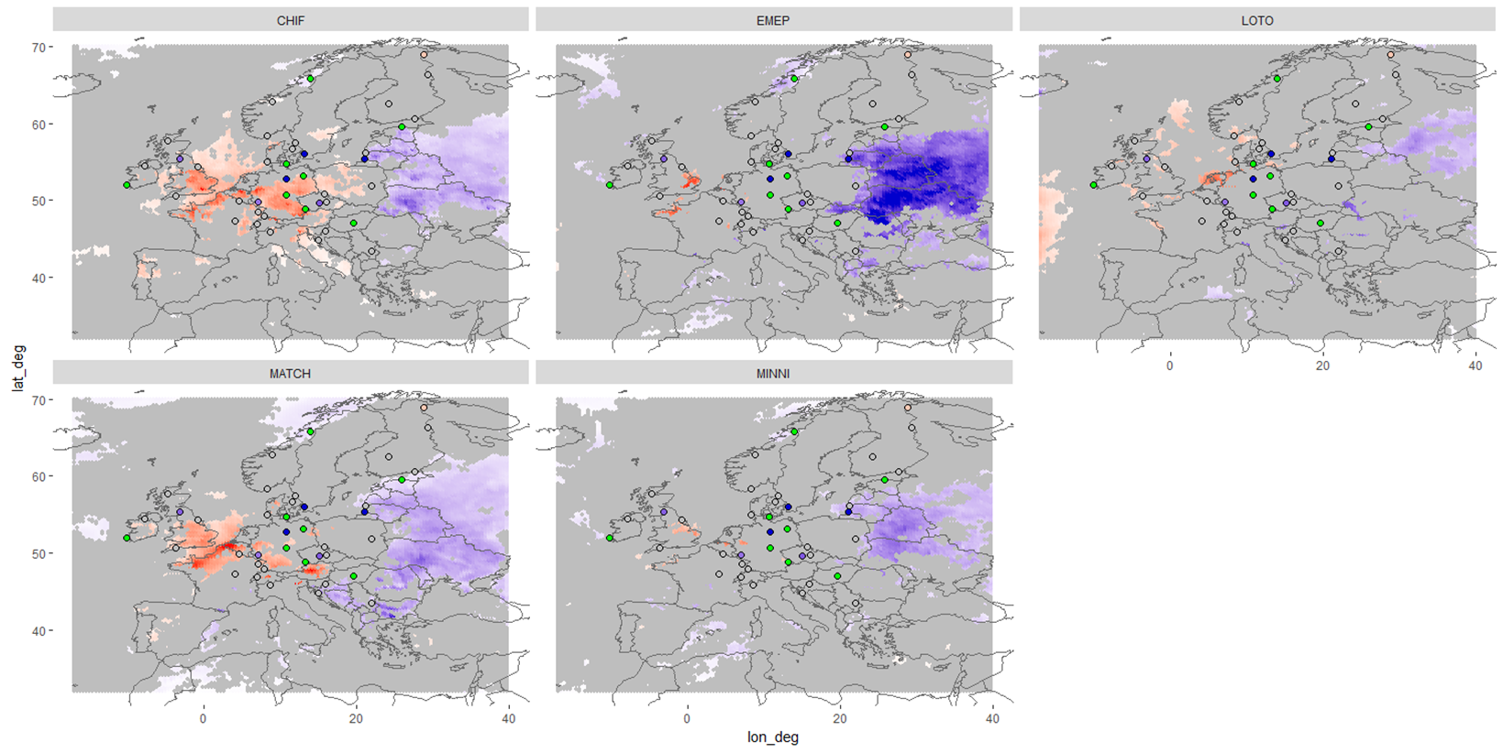
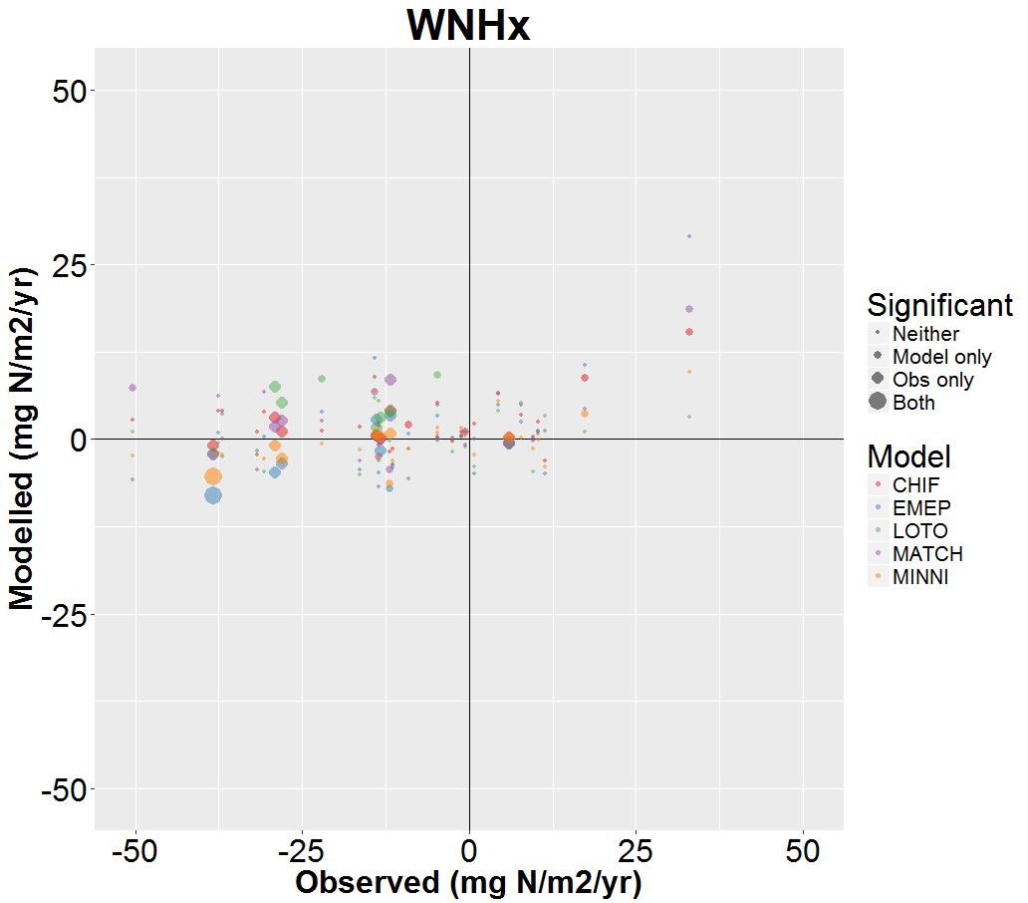
Spatial distributions of measured and modelled trends
WNHx 1990-2000 (mg N m⁻² yr⁻¹)
CHIF
EMEP
LOTO
Not sig.
No data
MATCH
MINNI
Modelled vs. Measured Trends
Notes:
WNHx:
the observations show significant trends (all but one decreasing) across the domain whereas the models estimate decreasing trends in the east and increasing trends in the west.
The EMEP model estimated the largest decreasing trends.

Slide 16
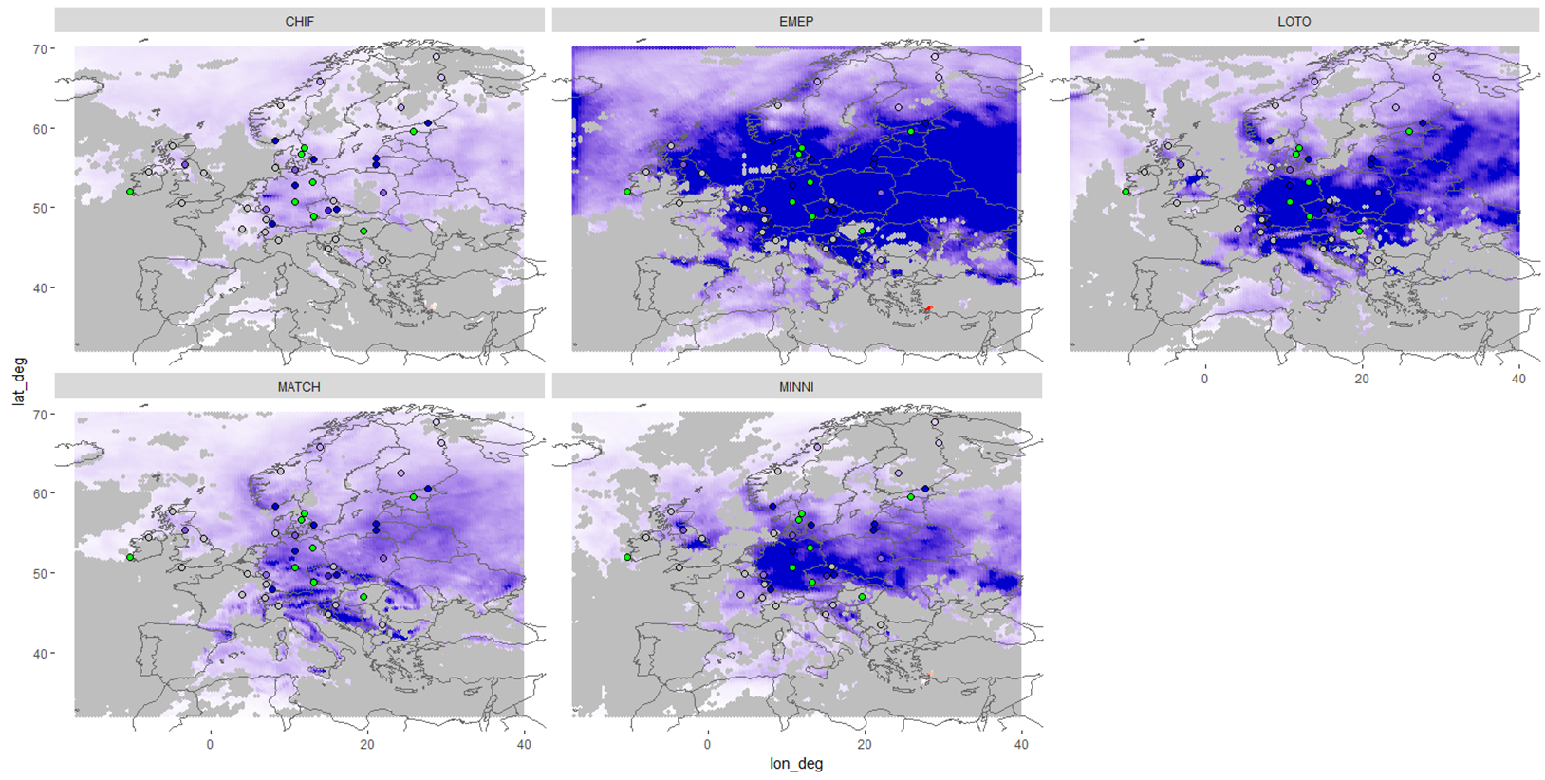
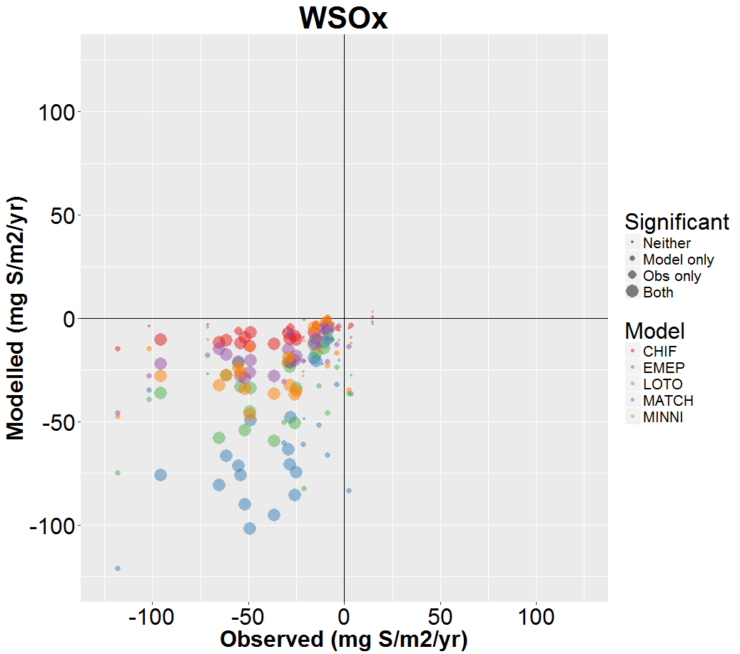
Spatial distributions of measured and modelled trends
WSOx 1990-2000 (mg N m⁻² yr⁻¹)
CHIF
EMEP
LOTO
40
-40
Not sig.
No data
MATCH
MINNI
Modelled vs. Measured Trends
Notes:
WSOx
All significant observed trends for WSOx for the period 1990-2000 are decreasing trends and are distributed throughout the central and northern part of the domain.
The models similarly estimate more significant trends in these areas of the domain and estimate the largest decreasing domains in the central and eastern parts of the domain, with EMEP estimating the largest values.

Slide 17
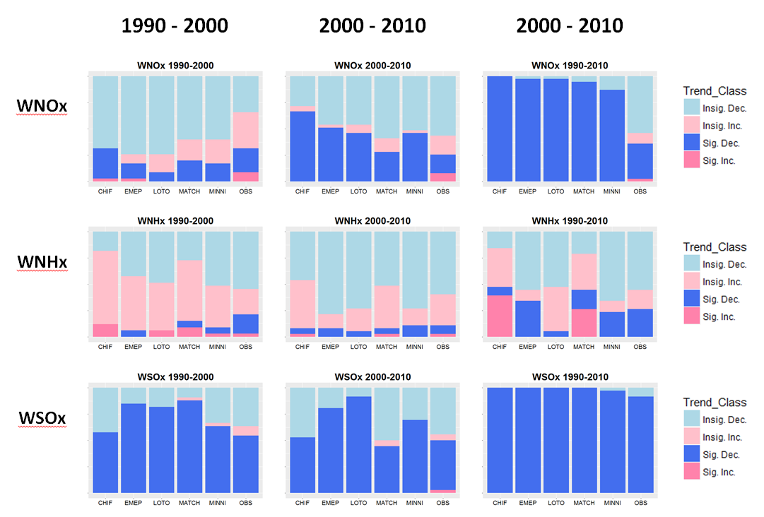
Analysis of significant trends
1990 -2010

Slide 18
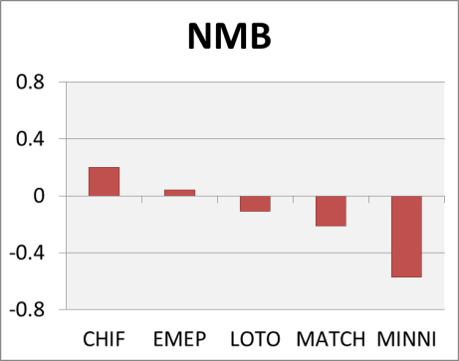
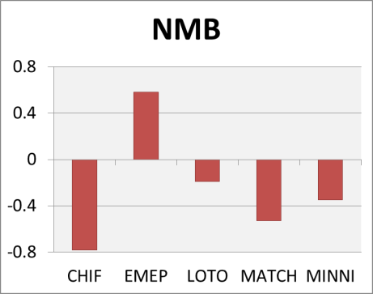
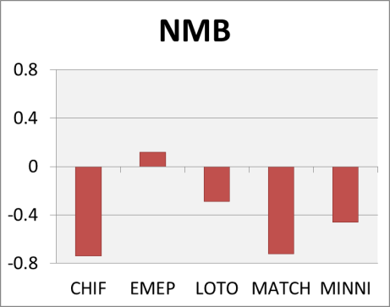
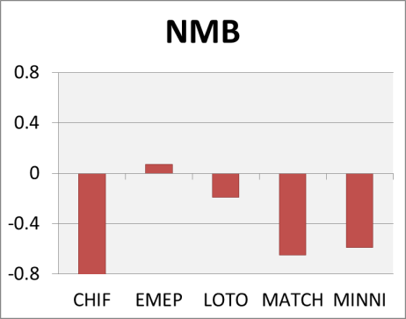
Analysis of significant trends
1990 -2010

Slide 19
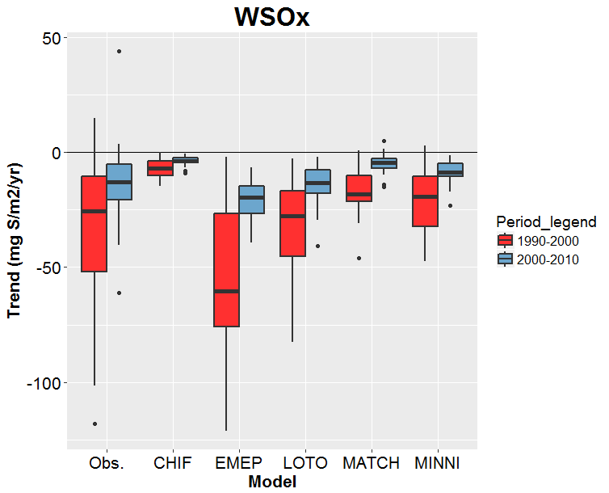
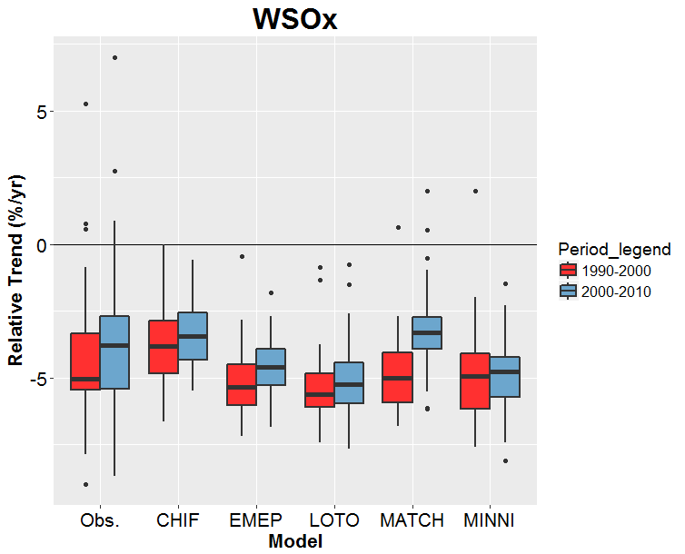
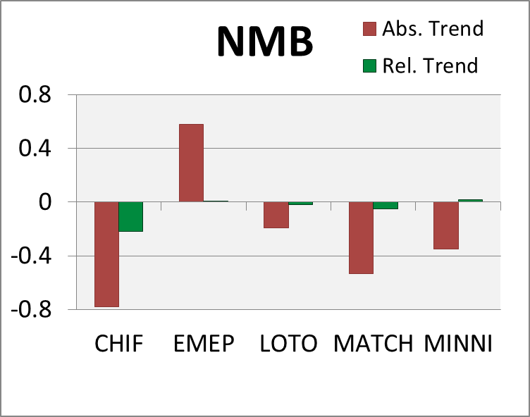
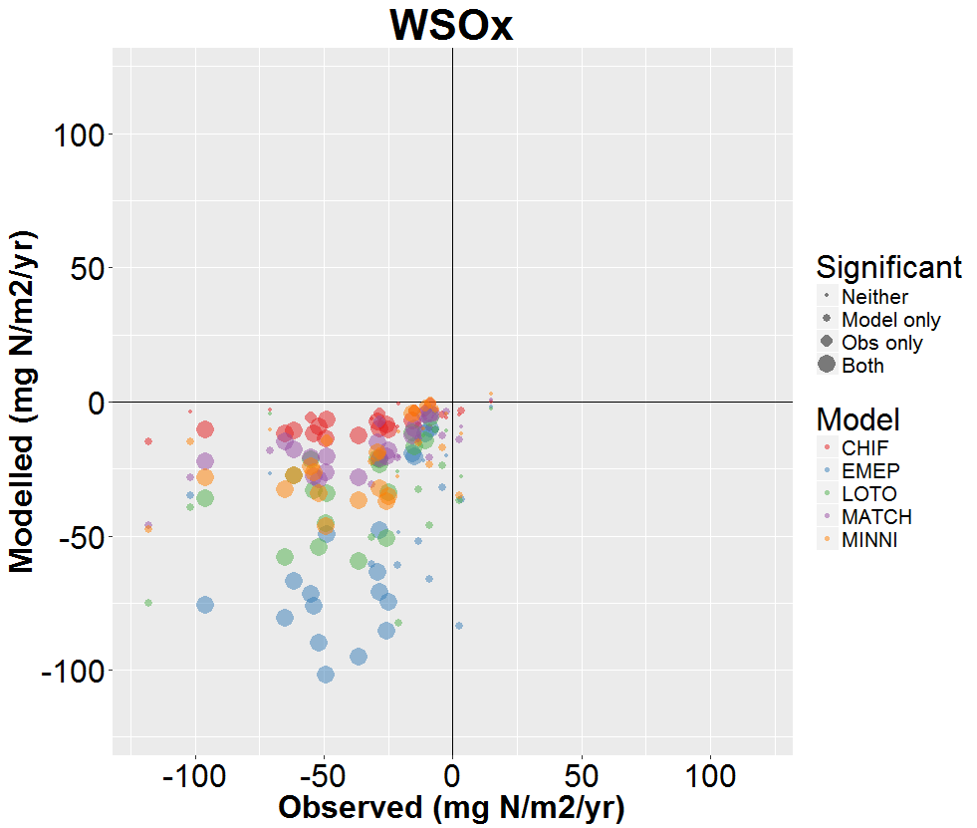
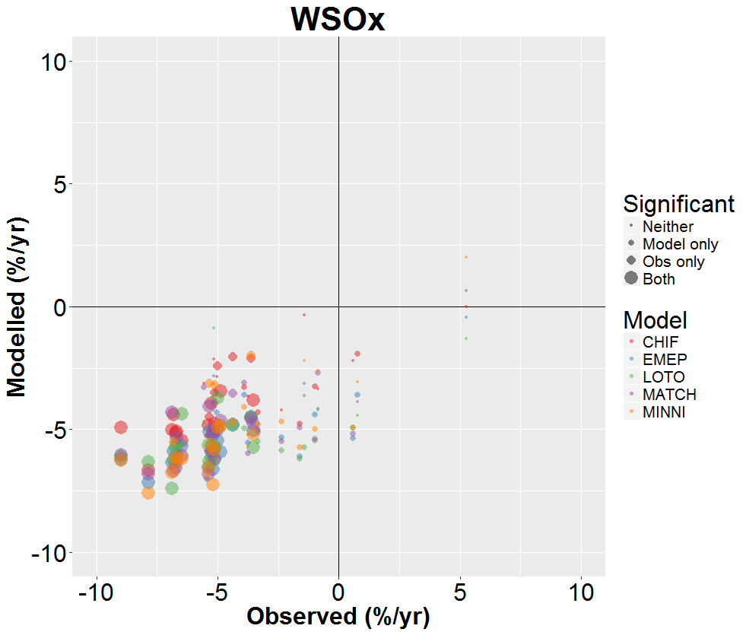
Relative vs Absolute Trends (e.g. WSOx)
Absolute trends
Relative trends
1990 - 2000
1990 - 2000

Slide 20
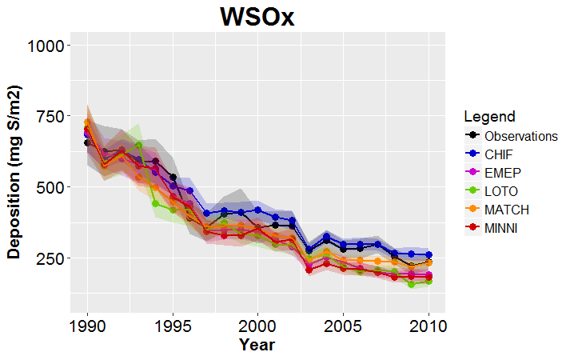
Obtaining more robust time series through measurement-model fusion
If the models are better at estimating relative changes in deposition then maybe we can obtain more reliable estimates of future deposition by correcting the models for an initial period for which measurements exist.
Very simple example:
1) Calculate the model correction (e.g. bias correction) for the initial period (3 years, in this example)
Initial period
2) Apply the correction to the rest of the time series
Model | Correction Factor
CHIF | 3.40
EMEP | 0.64
LOTO | 1.06
MATCH | 1.91
MINNI | 1.67

Slide 21
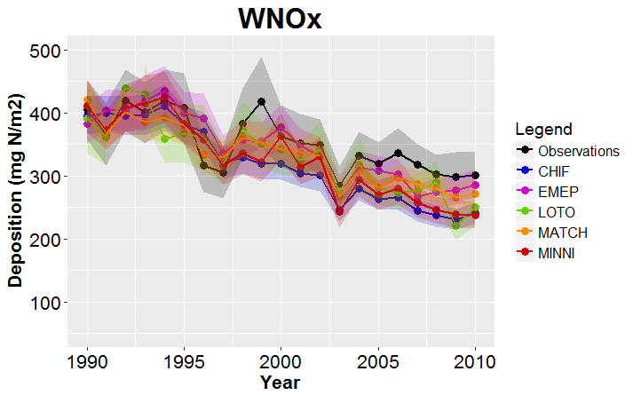
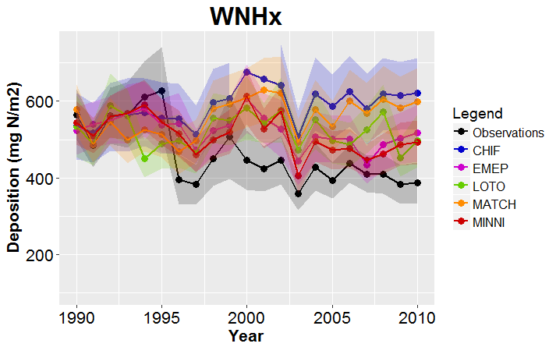
Time series of bias-corrected models

Slide 22
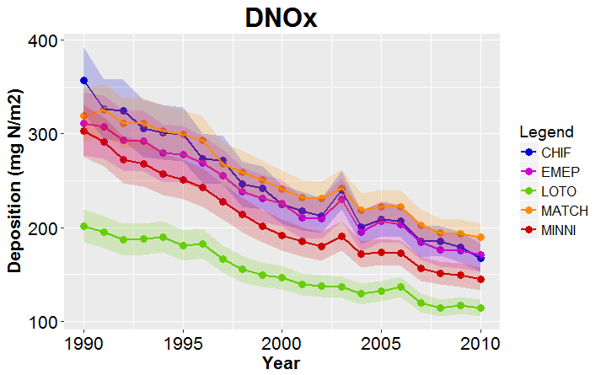
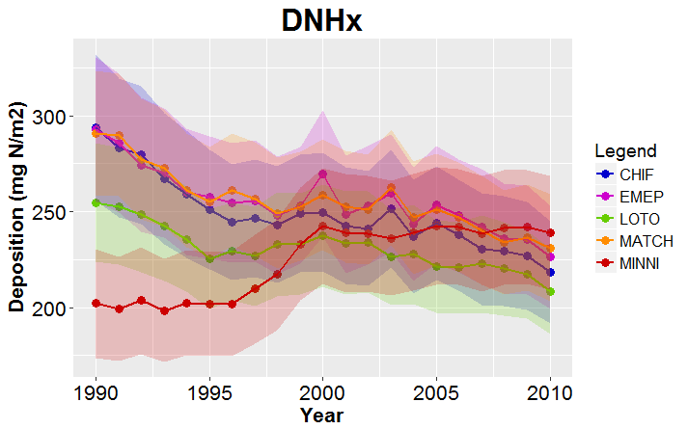
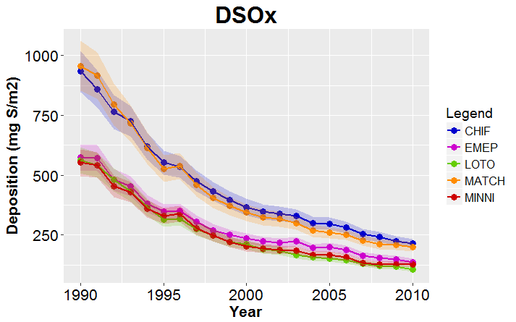
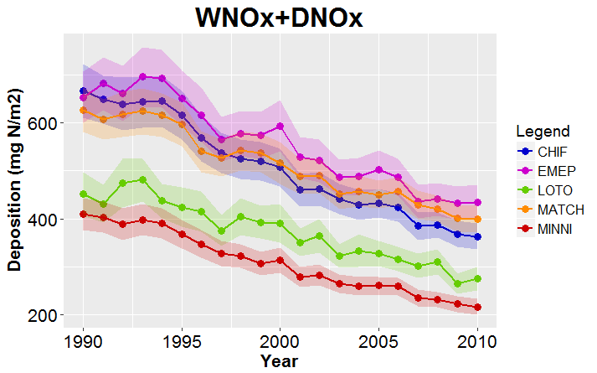
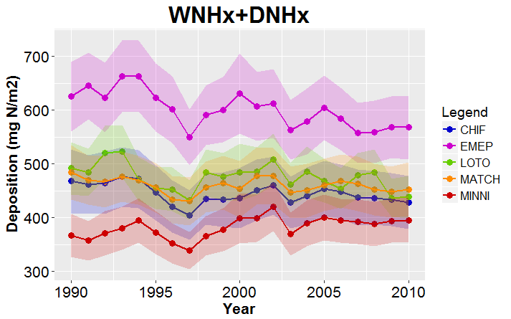
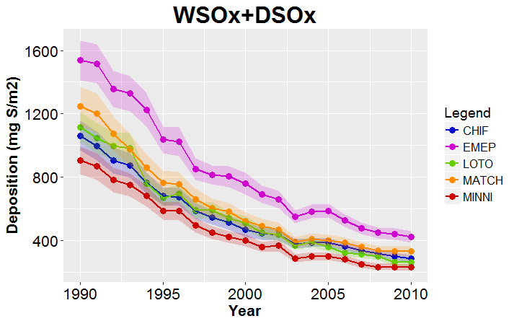
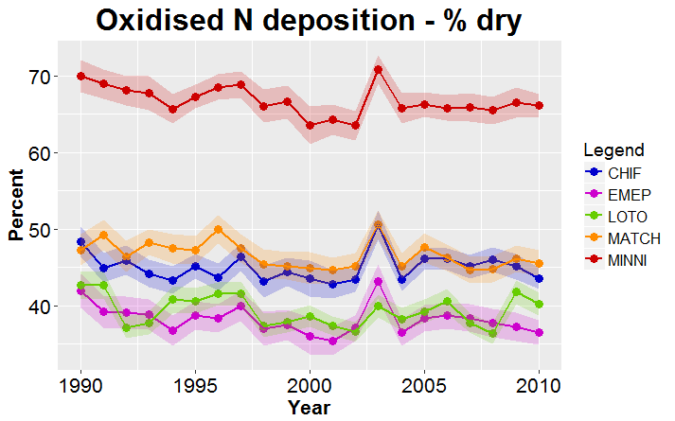
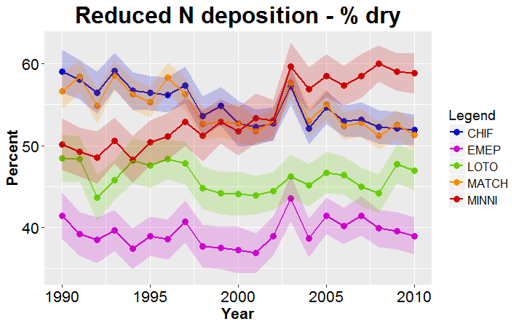
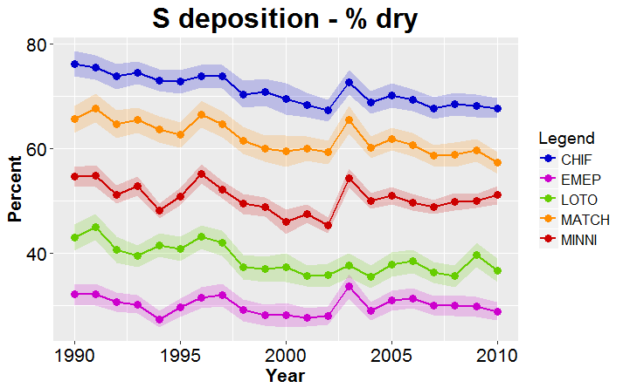
Don’t forget the dry!

Slide 23
Questions to answer - Revisited
Can the models estimate wet deposition for the period 1990-2010 with sufficient accuracy?
Can the models reproduce the observed trends in wet deposition?
What are the reasons for the differences between the models and between modelled and observed trends?
Although there is a general underestimation of wet deposition (with the exception of EMEP for WSOx), some models perform better than others
Most of the observed trends for WNOx and WNHx are not significant (using our methodology) and so assessment is difficult. For WSOx, for which most observed trends are significant, the models tend to overestimate the decreasing trends. Model performance is better for relative trends
Complex task to evaluate this for multiple models although some analysis has been done looking at the influence of gas/particle scavening and dry deposition

Slide 24
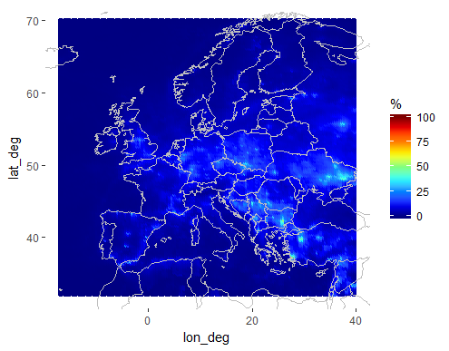
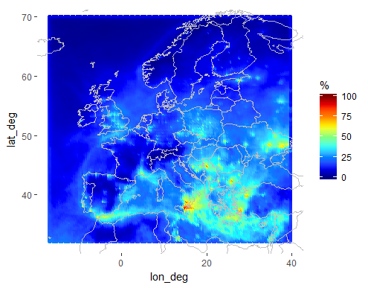
EDIII: framework to improve models.
Case of CHIMERE. Why is WSOx so low?
Underestimation of contribution from scavenging of SO₂?
CHIF
EMEP
MATCH
Proportion of WSOx coming from SO₂
Notes:
CHIMERE gives substantially lower WSOx than the other models
This points to a possible problem with the wet deposition parameterisation
The model estimates a lower proportion WSOx coming from scavenging of SO2 than e.g. EMEP or MATCH, which could be part of the problem

Slide 25
EDIII: framework to improve models.
Case of CHIMERE. Why is WSOx so low?
Underestimation of contribution from scavenging of SO₂?
Overestimation of dry deposition?
Notes:
CHIMERE, along with MATCH, estimates the highest rates of sulphur DRY deposition, which could contribute to the underestimation of WET deposition

Slide 26
Conclusions
The models tend to underestimate rates of wet deposition (except EMEP for WSOx) and overestimate atmospheric concentrations
WNOx Trends: Most of the models tend to underestimate the observed decreases in deposition (modelled trends are more significant)
WNHx Trends: Observed and modelled trends are smaller than those for WNOx (very few trends are significant)
WSOx Trends: All models except EMEP overestimate the observed decreasing trends for all periods (the majority of which are significant)
The relative trends seems to be more robust than the absolute trends suggesting that more reliable estimates of future deposition can be obtained through measurement-model fusion
The contribution of dry deposition to the total is substantial and varies widely between models (mean contributions of 30 – 80%)
Thanks for your attention!

