Slide 1
Evaluation of ICP-IM Forest damage Subprogram data and heavy metals in moss (in Russia)
Institute of Global Climate and Ecology
Gromov Sergey
Konkova Elizaveta
Ekaterina Pozdnyakova

Slide 2
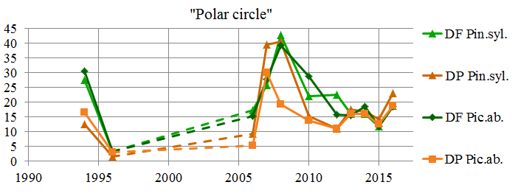
Cooperation with ICP- IM (Forest damage subprogram)
Correlation coefficients Between defoliation and depigmentation (P = 0.05)
Picea abies | Pinus sylvestris
0,861 | 0,698
Correlation between coniferous was not found
Correlation coefficients
R(DF&DP) | R(DF&DP)
Picea abies | Pinus sylvestris
0,649 | 0,748
R(DP&DP) | R(DF&DF)
Conifer. | Conifer.
0,862 | 0,938

Slide 3
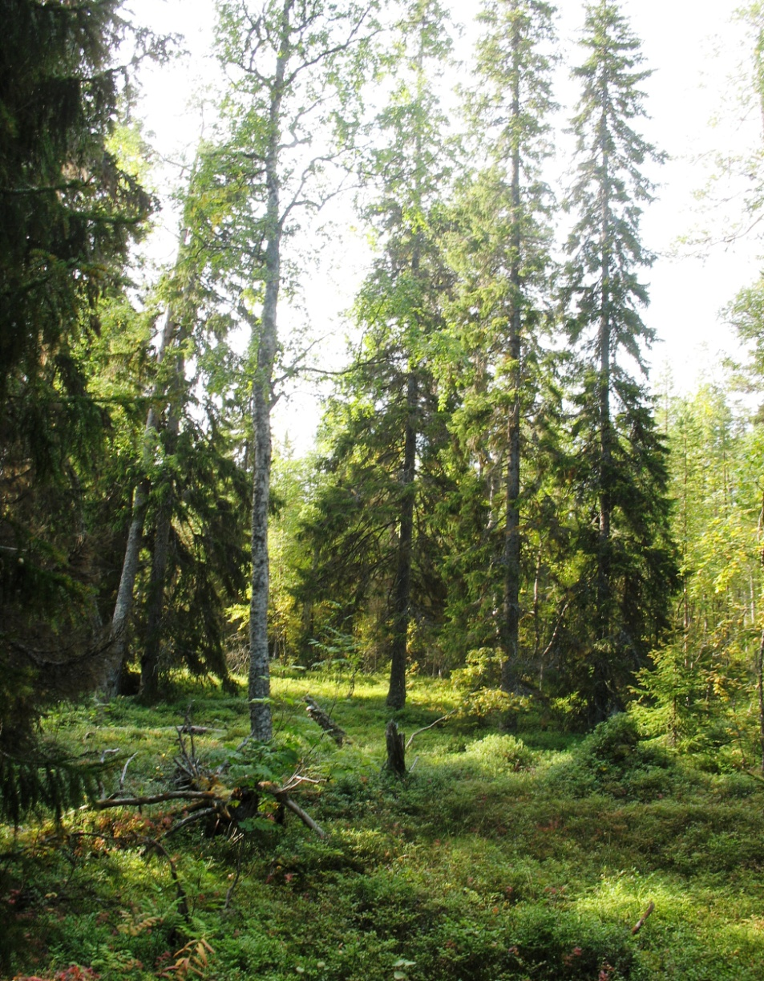
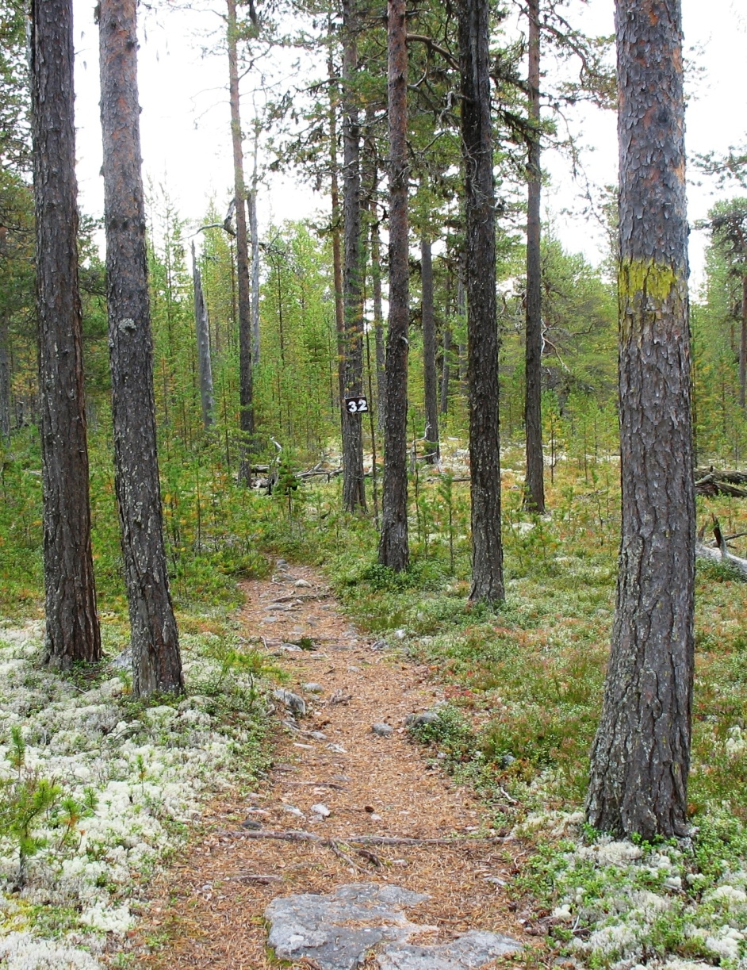
Stands "Polar circle“ (White Sea Biological Station)
fir-wood
pinery

Slide 4
Correlation with precipitation pollution. "Polar circle“ and Pinega
Correlation with wet deposition (current (c) and previous (p) year)
Correlation with concentrations in precipitation(current (c) and previous (p) year)

Slide 5
Correlation with precipitation pollution. "Polar circle“ and Janiskoski
Correlation with wet deposition (current (c) and previous (p) year)
Correlation with concentrations in precipitation(current (c) and previous (p) year)

Slide 6
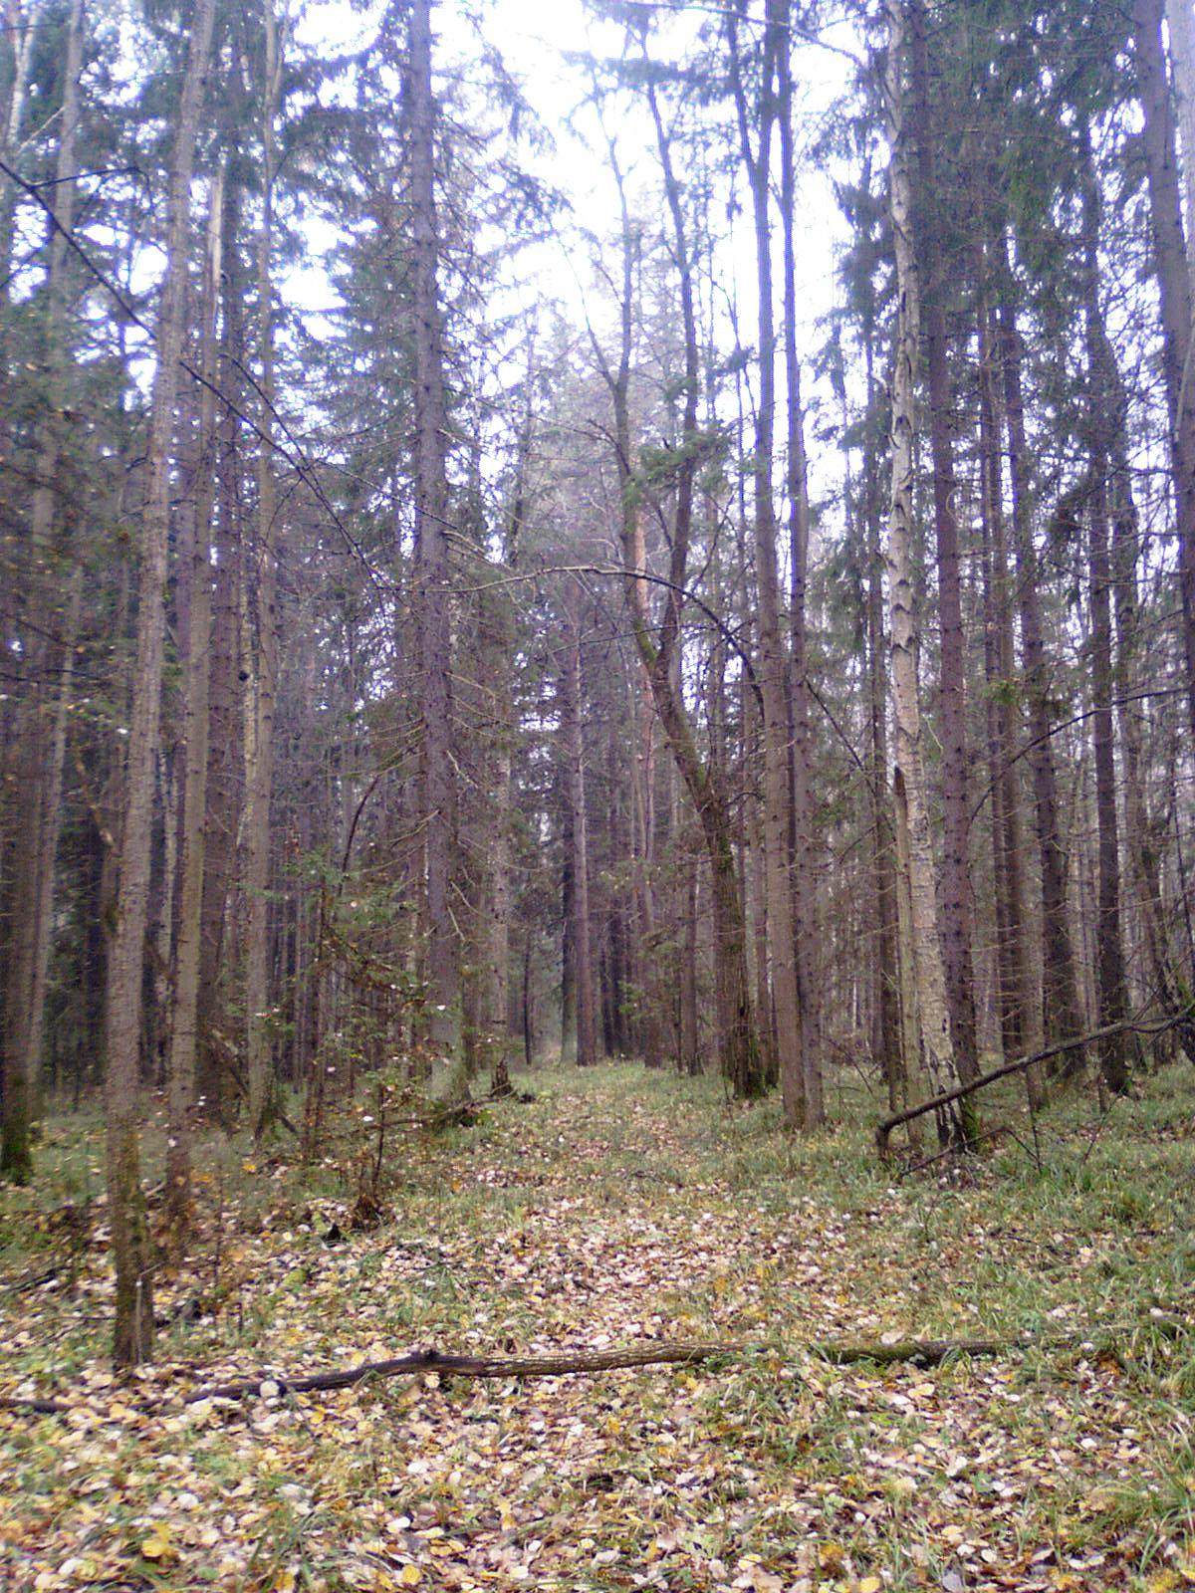
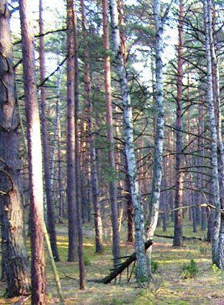
Stands Prioksko-Terrasny Biosphere Reserve
fir-wood
pinery

Slide 7
Correlation with precipitation pollution. Prioksko-Terrasny BR
Correlation with wet deposition (current (c) and previous (p) year)
Correlation with concentrations in precipitation(current (c) and previous (p) year)

Slide 8
Correlation with heavy metals in precipitation and with air pollutants. Prioksko-Terrasny BR
Coniferous | Parameter | Correlation with wet deposition |  |  |  | Correlation with concentrations in precipitation
 |  | Hg | Pb | Cd | Cu | Hg | Pb | Cd | Cu
Picea abies L. | Defoliation | 0.62 P | 0.64 C | -0.51 P |  |  | 0.63 C
Pinus sylvestris L. | Depigmentation |  |  |  | -0.85 P
Picea abies L. | Depigmentation | 0.57 P | 0.55 C |  | 0.58 C |  | 0.57 C |  | 0.56 C
Pinus sylvestris L. | Defoliation |  |  |  | -0.72 P
Correlation with air pollutants
Coniferous | Parameter | S - (SO4) | N - (NO3) | N - (NH4) | S - (SO2) | Pb | Cd
Pinus sylvestris L. | Defoliation | -0.62 P | -0.70 P |  | 0.63 C
Picea abies L. | Defoliation |  |  |  |  | 0.52 C | 0.59 C
Pinus sylvestris L. | Depigmentation | -0.56 P | -0.59 P |  | 0.71 C
Picea abies L. | Depigmentation |  |  |  |  | 0.70 C | 0.72 C

Slide 9
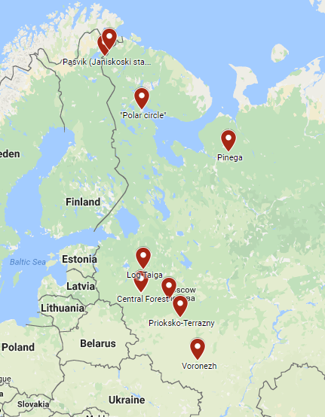
Cooperation with ICP- vegetation
Sampling was provided accordance with the requirements ICP-vegetation
Sampling time : July-October 2016
Types of mosses:
Pleurozium schreberi (At most sampling points); Hilocomium spledens (Log Taiga, Pinega, Pasvik(1 of 3)).
Measurements were performed by "Joint institute for nuclear research"
Elements: Na,Mg,Al,Cl,K,Ca,Sc,V,Cr,Mn,Ni,Co,Fe,Zn,As,Se,Br,Sr,Rb,Mo,Cd, Sb,I,Ba,Cs,La,Sm,Tb,Hf,Ta,W,Au, Th,U

Slide 10
Enrichment factors of mosses
Calculation was carried out according to the formula :
Territory | Na | K | Ca | Mg | Al | Cl | Mn | Fe | Zn | Rb | Cr | V | Ni | As | Cd | Sb
Janiskoski | 1,03 | 20,56 | 9,87 | 0,75 | 0,31 | 153,3 | 37,45 | 1,87 | 110,3 | 9,05 | 3,46 | 0,79 | 30,93 | 213,9 | 331,9 | 25,21
“Polar circle” | 4,75 | 217,9 | 60,59 | 9,41 | 8,28 | 304,3 | 372,7 | 7,84 | 301,2 | 186,7 | 12,05 | 12,67 | 22,41 | 1043 | 1569 | 46,40
Pinega | 3,51 | 123,7 | 25,36 | 3,74 | 0,60 | 370,1 | 165,4 | 0,69 | 129,8 | 47,3 | 1,73 | 1,12 | 6,86 | 10,98 | 296,3 | 18,10
Central Forest | 0,55 | 41,52 | 13,79 | 1,83 | 1,12 | 76,00 | 81,32 | 0,97 | 53,90 | 11,00 | 1,75 | 1,82 | 3,35 | 51,73 | 289,0 | 17,11
River "Bolshaya sestra" | 0,41 | 18,88 | 6,86 | 1,02 | 1,21 | 28,62 | 38,60 | 0,92 | 26,67 | 3,71 | 2,11 | 1,84 | 1,88 | 33,29 | 268,8 | 17,44
Prioksko-Terrasny | 0,29 | 14,49 | 5,97 | 0,72 | 0,96 | 51,41 | 50,81 | 0,97 | 19,49 | 6,94 | 1,76 | 1,35 | 2,47 | 21,54 | 83,2 | 17,56
Voronezh | 0,30 | 2,35 | 1,45 | 0,10 | 0,24 | 10,55 | 2,01 | 0,57 | 2,94 | 0,66 | 1,07 | 0,30 | 0,55 | 6,27 | 51,0 | 3,10

Slide 11
Thank you for attention!

