Slide 1
Formaldehyde in ambient air of industrial areas of Belarus: simple Gaussian model application for a sector impact assessment
S.Kakareka, J.Kokosh
Institute for Nature Management,
Minsk, Belarus
18th Task Force on Measurement and Modelling Meeting
Prague, Czech Republic, 3-5 May 2017

Slide 2
Rationale
impact assessment for a set of facilities of an industry sector are necessary for development planning;
existing dispersion models with regard to stationary sources are too laborious in application for a few facilities located in different cities as whole parametrization of sources (including hourly time series of emissions) and meteorology is necessary;
current air emission inventories at industrial facilities allow to get yearly maximum emission rates for sources which reflect full load (i.e one value for a source) but do not show real variations of emission rates;
simple modeling approach is desirable which allow to operate with available sources emission inventory data.

Slide 3
Goals of study:
Elaboration of a simple methodology of facilities impact assessment onto air quality and health
Facilities ranking on their impacts
Purposes
Proposals for industry in view of possibilities of formaldehyde (and other VOC) releases reduction at wood-processing;
Proposals for city authorities in view of ecology improvement at impacted sites and explanation of high concentration values (episodes).
Tasks:
Methodology elaboration and sources parametrization;
Dispersion modelling;
Formaldehyde air measurement (case studies) at sources and impacted areas for modelling verification;
Meteorological and landscape factors influencing dispersion assessment;
Air concentrations impact assessment.

Slide 4
The proposed approach makes it possible to obtain the values of the maximum formaldehyde air surface concentrations created by groups of sources at different distances and dispersion conditions.
The approach was tested on an example of formaldehyde emissions by wood-processing industry enterprises (production of laminated wood materials) – greatest industry source of formaldehyde.

Slide 5
Model selection
Simple Gaussian model based onto Pasquil-Gifford dispersion equation and dispersion parameters was used.
Main parameters:
emission rate, g/s,
source height,
stack diameter,
wind speed,
Sy and Sz - dispersion coefficients in the horizontal and vertical directions.

Slide 6
Main stages
Facilities data collection;
Sources parametrisation and grouping according to the height, flue gas speed, temperature ets. and location;
Modelling of formaldehyde maximum concentrations at distance from 100 to 3000 meters for standard conditions (1 m/s wind speed, 20 degrees C) for 6 Pasquil stability classes (A-F);
Assessment of population impacted by high concentrations of formaldehyde;
Determination of meteorological and landscape parameters for industrial sites which impact the dispersion;
Comparative characterization of facilities by their impact onto air quality and population and their classification.

Slide 7
Formaldehyde emission sources aggregation and parametrization
More than 90% of formaldehyde emissions in the woodworking industry of Belarus are due to the production of laminated wood materials.
There are about 240 sources of formaldehyde emissions at wood-processing facilities having different heights, stack diameters, off-gas velocity and other parameters that affect the emission dispersion. For geoecological analysis, information on sources was aggregated taking into account their geographical location and basic parameters.
The first level of aggregation is the enterprise itself. In total, laminates are produced in 11 enterprises in Belarus.
The second level of aggregation is the industrial site. Most of the enterprises are located within the same industrial area within the same city, but a number of enterprises are located at two sites (OJSC Ivatsevichdrev) or have branches in other cities (JSV Kronospan, OJSC Gomeldrev).

Slide 8
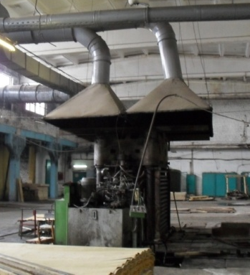
Scheme of geoecological analysis of wood-processing industry of Belarus
1st level (Facility)
Annual production
Annual emission
2nd level (Site)
Annual emission
Area, location
Number of shops
12 facilities in 10 cities
15 sites
3rd level
(Shop)
Number of sources
Area, location, shape
27 shops
4th level (Group of sources)
Flow and emission rate
Temperature
Stack height and diameter
45 groups

Slide 9
Formaldehyde emission sources aggregation and parametrization
The third level of aggregation is the workshop. Usually within the industrial site of the enterprise there are main shops - particle board, MDF, plywood (depending on the profile of the enterprise), as well as shops for the production of resins, which are also sources of formaldehyde emissions.
The fourth level of aggregation is a group of sources homogeneous in height (the main one, in addition to the mass of emissions, is the parameter that affects the surface concentrations). The characteristics of the source groups include the maximum emissions, average height, average stack diameter, average velocity and temperature of the flue gases, and the effective stack height for standard conditions (20 ° C, 760 mm Hg, wind 1 m/s). A total of 45 groups of sources of formaldehyde emissions have been identified.

Slide 10
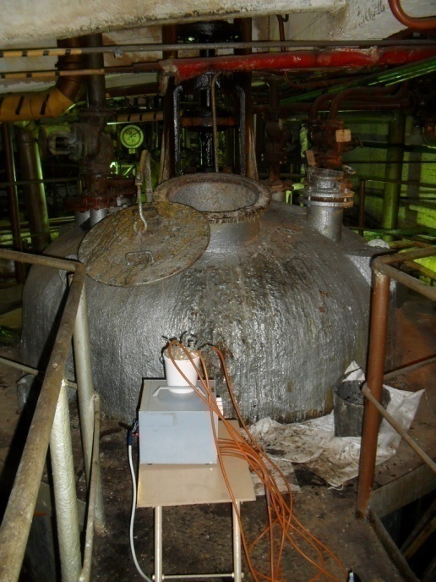
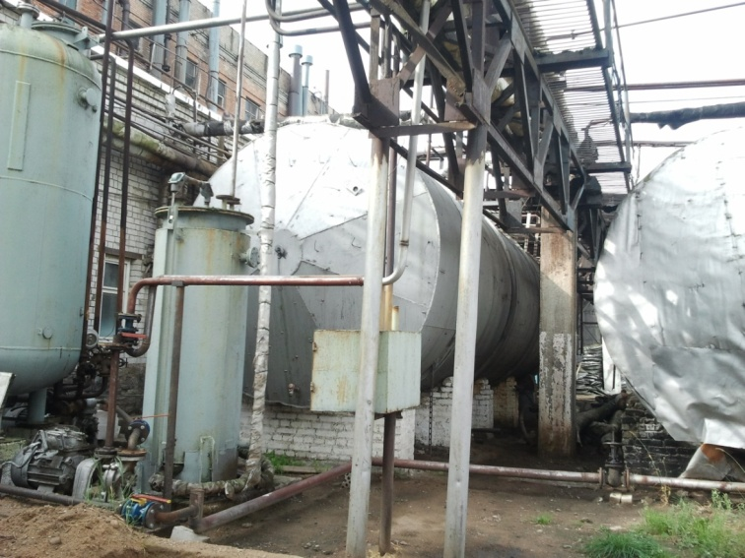
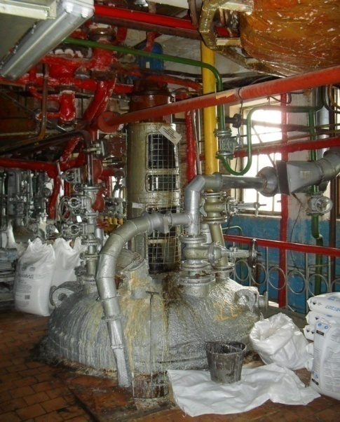
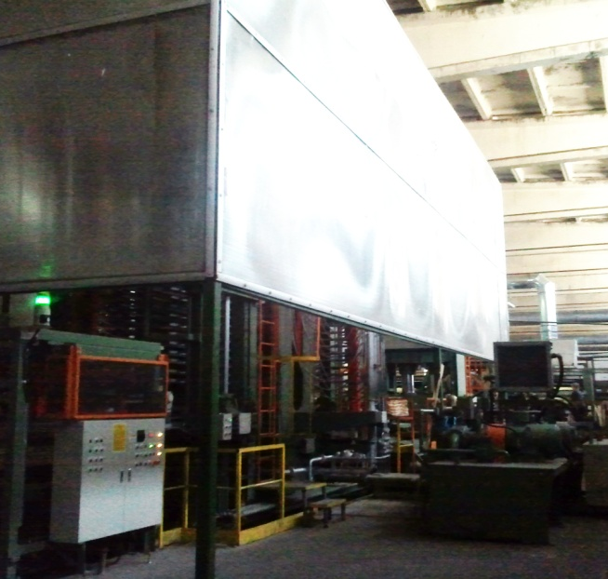
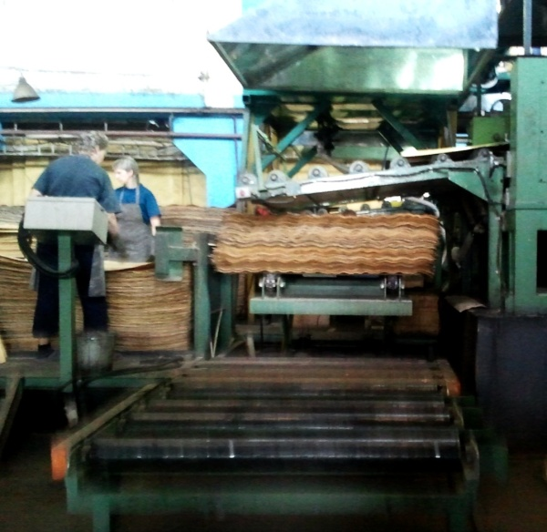
Stationary sources of formaldehyde releases
Reservoirs for products and materials
Plywood presses
Reactors
Plywood dryers

Slide 11
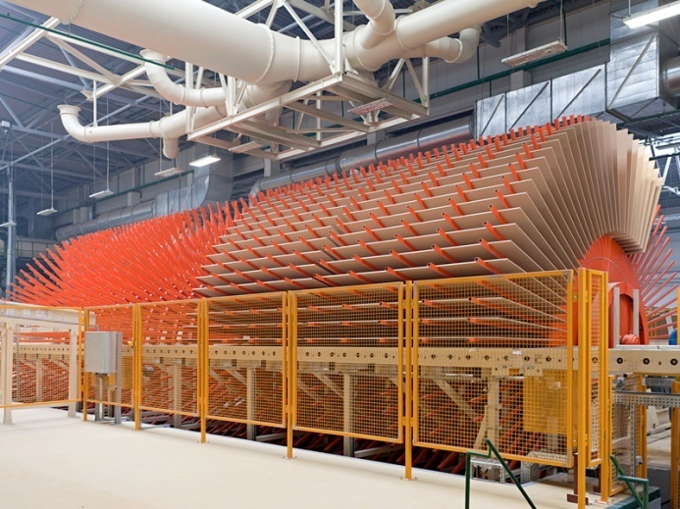
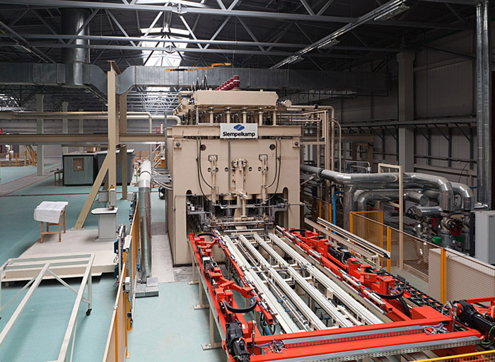
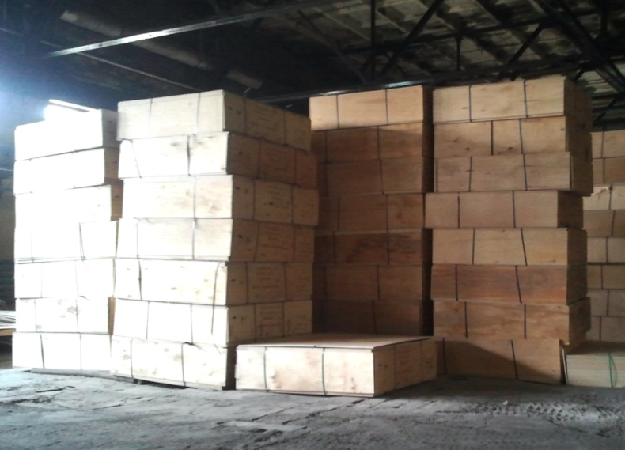
Plywood warehouses
Chipboard and laminwood production lines

Slide 12
Modelling results
The maximum surface concentrations at a distance from 100 to 3000 m from source groups for 6 stability classes (A-F) were estimated.
For A and B class air concentrations exceeding MPL (30 μg/m³) may be found at distances up to 200 m from sources, for C class – up to 300 m, for D class – up to 600 m, for E class – up to 900 m, for F class – up to 1500 m.
From 45 source groups 16 groups can form air concentration exceeding MPL.
Necessity to account possible overlapping of plumes was analysed.

Slide 13
Modelled maximum formaldehyde air concentrations for various types of wood products at different distances from sources of emission (C stability class)

Slide 14
Verification
For verification of modelled results data on formaldehyde measurements in impacted areas of 6 wood-processing facilities were used.
Measurement points at the distance 100 m and more were accounted.
For comparison real meteorological conditions (temperature, air pressure, wind speed, stability class) at time of measurements were accounted.
At wind speed <0.5 it was assumed equal 0.5.
Real work load of the equipment at the facility was accounted.

Slide 15
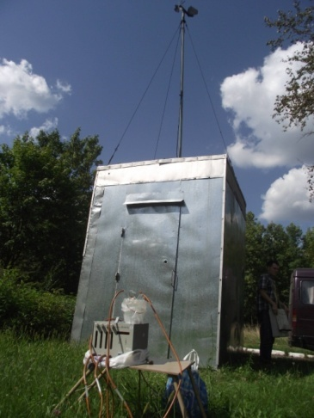
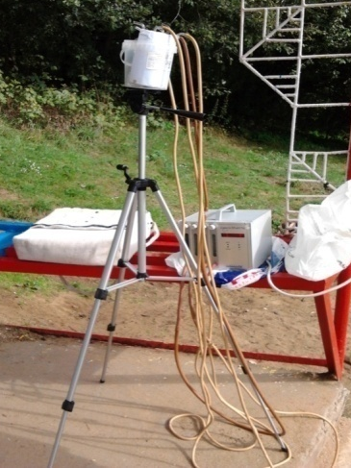
Measurement of formaldehyde in emissions and ambient air of impacted areas
Methodology:
- air aspiration through liquid absorbents, parallel measurement near release source and outside downwind and upwind with measurement of sources parameters and meteorology;
-photocolorimetric detection of formaldehyde in liquid absorbents;
stack parameters and land features detection.
Tested sites
- workshops and industrial sites (plywood and chipboard production, resins production) – obsolete and modern

Slide 16
Ratio between the measured and calculated values of formaldehyde air concentrations
The analysis showed a certain convergence of the calculated and measured concentrations of formaldehyde taking into account numerous difficulties of plume measurements.

Slide 17
Ranking of facilities/sites by air impact
Obsolete (4)
Partially modernized (5)
Modern (6)
Technical condition
City (9)
City/village (2)
Village (4)
Location
wind speed profile
roughness
Facilities/Sites
< 0,4 m (6)
0,4-0,5 m (5)
> 0,5 m (4)
Maximum formaldehyde concentrations
Low (5)
Average (4)
High (6)
Population impacted
Population in 0,5 km zone
< 100 people (2)
100 - 1000 people (9)
> 1000 people (3)

Slide 18
Conclusions
The proposed approach made it possible to rank the wood processing enterprises according to the level of impact on the air environment and population.
The performed simulation showed that high concentrations of formaldehyde under unfavorable conditions can be fixed at a considerable distance from the enterprises. A significant increase in the zone of maximum surface concentrations with high atmospheric stability is shown.
On the basis of the obtained results, it is possible to estimate the cumulative effect of the enterprises of an industry.
Proposed approach can be accounted for improvement of current system of emission inventory and emission limits establishing.

Slide 19
- facilities of other sectors testing; - further modelling/measurement exercises (other VOC, ammonia..); - verification against AERMOD modelling; - impact assessment sophistication; - problems to be solved for effective dispersion modelling: - unstable work of emission generating installations; - poor data on history of activity of emission sources; - numerous diffuse sources which are not accounted; - lack of meteorology data with fine resolution.
Ways forward

Slide 20
Thank you for your attention!

