Slide 1
High resolution simulations for the Netherlands with OPS and EMEP4NL
Eric van der Swaluw, Wilco de Vries, Jan Aben, Roy Wichink Kruit, Ferd Sauter, Guus Velders, Addo van Pul (RIVM)
Bruce Rolstad Denby, Peter Wind, Hilde Fagerli (EMEP)
Massimo Vieno (CEH)

Slide 2
The OPS model
NH₃ in 2014
concentration -and deposition maps over the Netherlands produced on a yearly basis (AERIUS & GCN projects).
Calculation tool is the OPS-model, a plume model with a Lagrangian trajectory model for long range transport.

Slide 3
The OPS model
NH₃ in 2014
concentration -and deposition maps over the Netherlands produced on a yearly basis (AERIUS & GCN projects).
Calculation tool is the OPS-model, a plume model with a Lagrangian trajectory model for long range transport.
The Netherlands ranks second
in value of agricultural export
(The Economist, 2014).

Slide 4
The OPS model
NH₃ in 2014
concentration -and deposition maps over the Netherlands produced on a yearly basis (AERIUS & GCN projects).
Calculation tool is the OPS-model, a plume model with a Lagrangian trajectory model for long range transport.
The OPS model is statistical: concentration
and deposition values are calculated for
different stability classes, and the annual
averaged value is obtained by summation
of these values, weighted with their relative
frequencies of occurrence.

Slide 5
The OPS model
NH₃ in 2014
concentration -and deposition maps over the Netherlands produced on a yearly basis (AERIUS & GCN projects).
Calculation tool is the OPS-model, a plume model with a Lagrangian trajectory model for long range transport.
- 1 km resolution
- meteo 2014
- emission NL 2013
- emission BTL 2012
- calibrated map (0.83)
- OPS V4.4.4

Slide 6
Comparison between calculations & measurements
Calculation - Measurement

Slide 7
Motivation for the use of EMEP4NL
OPS model has been criticized: chemistry and large scale transport are parameterized
A comparison between OPS model and grid model
EMEP4NL was fit-for-purpose to run at high resolution (2 km)
The NH₃ concentrations can be modeled to even higher resolution with the uEMEP model (presentation Bruce Rolstad Denby)

Slide 8
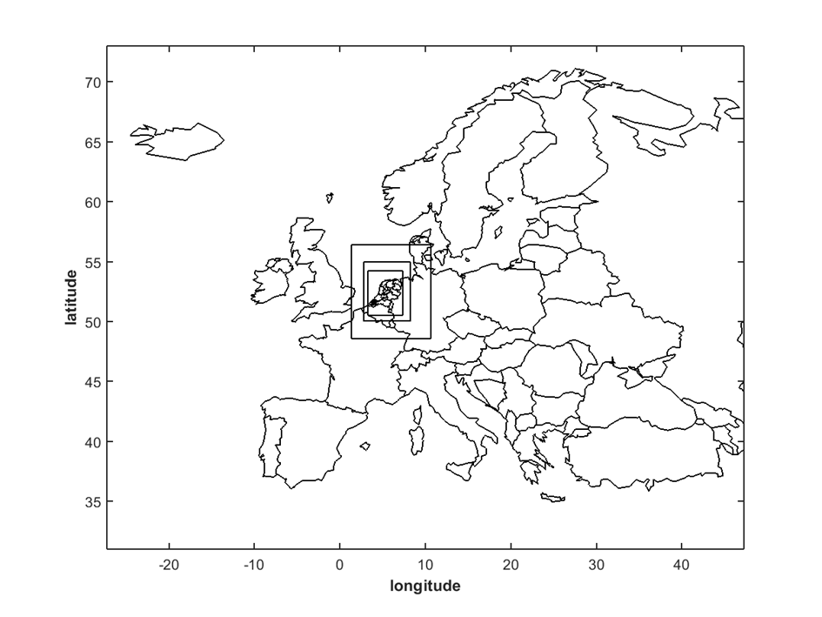
The EMEP4NL grid
EMEP rv4.10
WRF v3.8
0.50⁰
↓ /3
0.17 ⁰
↓ /3
0.06 ⁰
↓ /3
0.02⁰
↓
2 km

Slide 9
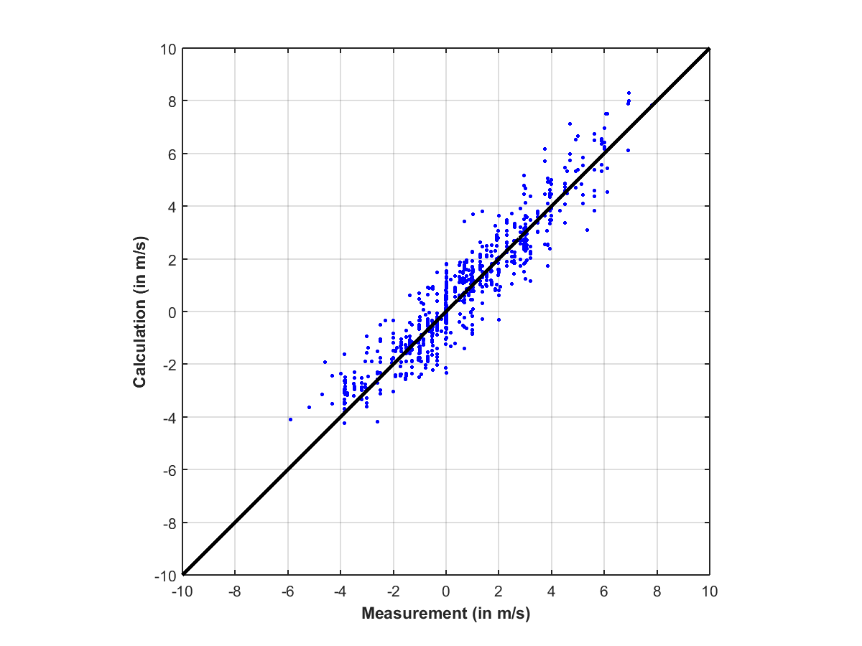
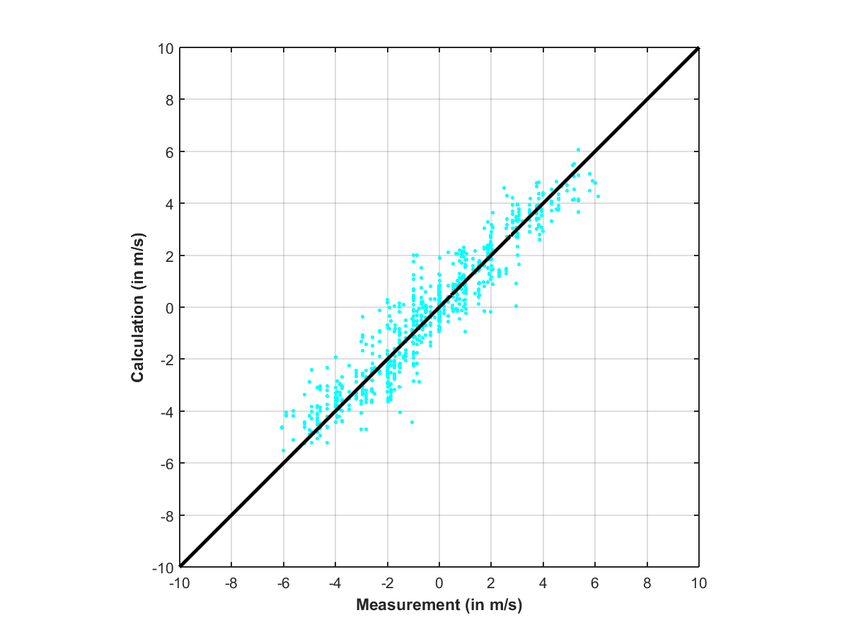
WRF performance at MET office Netherlands (KNMI)
U
V

Slide 10
NH₃ 2014
0.50⁰

Slide 11
NH₃ 2014
0.06⁰

Slide 12
NH₃ 2014
0.02⁰

Slide 13
Calculations versus measurements
0.50⁰

Slide 14
Calculations versus measurements
0.06⁰

Slide 15
Calculations versus measurements
0.02⁰

Slide 16
A comparison of OPS and EMEP4NL
EMEP rv4.10

Slide 17
A comparison of OPS and EMEP4NL
OPS V4.5.1

Slide 18
A comparison of OPS and EMEP4NL
OPS V4.5.1

Slide 19
A comparison of OPS and EMEP4NL
EMEP rv4.10

Slide 20
Conclusions
OPS model covers the whole range from low to high values, but overestimates NH₃ concentrations
EMEP4NL model was easy to handle and install from the current rv4.10 EMEP version
The EMEP4NL covers the low range of NH₃ concentrations but underestimates NH₃ concentrations in source regions
The Eastern part of the Netherlands is overestimated in both models

Slide 21
Future work with EMEP4NL
Trend analysis of longer period (2006-2015) for NH₃
Compare OPS, EMEP4NL and uEMEP
simulate the variation in emissions in time (e.g. manure application).
A project on implementing DEPAC* into EMEP
Couple EMEP4NL with Harmonie data
* Deposition module in OPS

