Slide 1
TFMM-Trends, Paris, 17-18Nov2014
A Visualization/Analysis Tool for
Modelled Trends
Model - to - Model
Model - to – Observations/Emissions
C. Cuvelier, ex JRC - European Commission
Contributions from EMEP, INERIS, TNO
Support from Concawe
Trend analysis issues:
-- Multi model comparison (with observations)
-- How to communicate results in an easy way

Slide 2
Objectives
Objectives
Tool for Trend Analysis
Multi – Model (model intercomparison)
Multi - Pollutant
Gases, PM, Depositions
Multi – Geo (zooming)
Europe (Land, Sea), Countries (39),
Regions (428), Cities (477), Stations
Detailed Shape files (polygons of lon-lat)
Add Observational and Emission trends

Slide 3
The Tool
Trend Analysis Tool based on experience
CityDelta, EuroDelta, POMI, HTAP, DeltaTool
Criteria
Easy to install
Easy to use
Acting directly on Model output
Fast – handle large amounts of data
Centralized data management
PC and Linux

Slide 4
EuroDelta3
Model
Model
Model
Read-only Database
Model results: Example ED_MODEL_ED25_PM10_HL_20090225.nc (nx,ny,ntime)
Meteo: KZ, PBL, RAIN, T2M, U10, USTAR (H)
Gas: APINEN, H2O2, HCHO, HNO3, ISOP, NH3, NO, NO2, O3, PAN, SO2, VOC (H,D)
PM: PM25, [ASOA, BSOA, DUST, EC, NA, NH4, NO3, OPOM, OPPM, POMS2, SO4, TPOM]-25 (H,D)
PM10, [ASOA, BSOA, DUST, EC, NA, NH4, NO3, OPOM, OPPM, POMS2, SO4, TPOM]-10 (H,D)
Dep: DNHx, DNOx, DSOx, WNHx, WNOx, WSOx (D)
Trend Analysis TOOL
All pollutants
Zoom: Country, region, City, Station
Indicators (e.g. O₃excD, O₃somo35, PM₁₀excD,
NO₂excD, … etc)
Regression: Linear, Exp, Sen, … etc
Add Observational data
Add Emission dat a

Slide 5
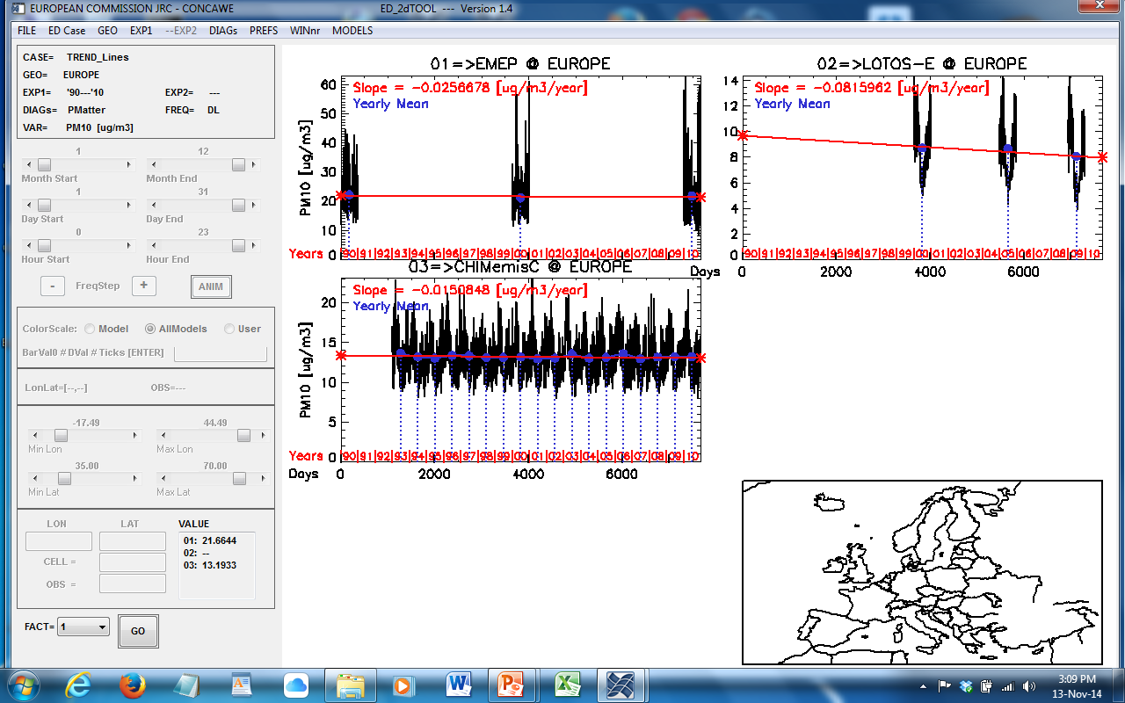
Multi-Geo

Slide 6
EU
Year Selection, Multi-Species

Slide 7
Some examples
Some examples of Trends
EMEP-MSC-W (Svetlana): 1990, 2000, 2010
LOTO-E (TNO, Astrid): 2000, 2005, 2009
CHIMERE (INERIS, Augustin): 1993,---,2010
(constant emissions, no abatement)
Projection from original domain on ED domain
Meteo ??
Emissions ??

Slide 8
EUROPE PM₁₀ [ug/m3/year]

Slide 9
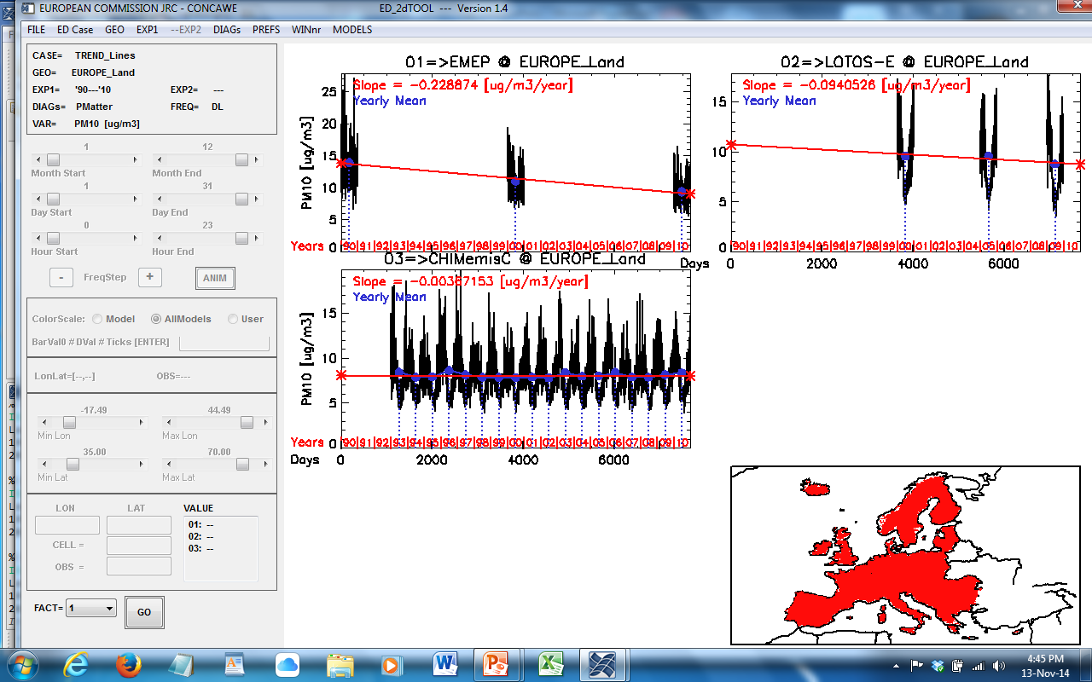
EUROPE-Land PM₁₀ [ug/m3/year]

Slide 10
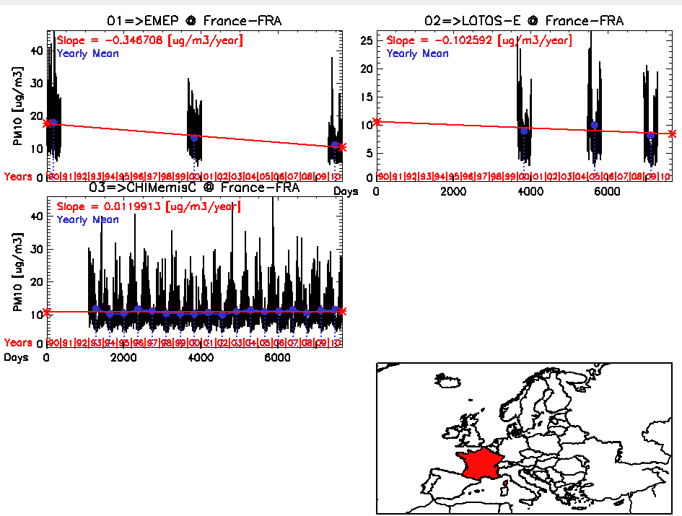
FRANCE PM₁₀ [ug/m3/year]

Slide 11
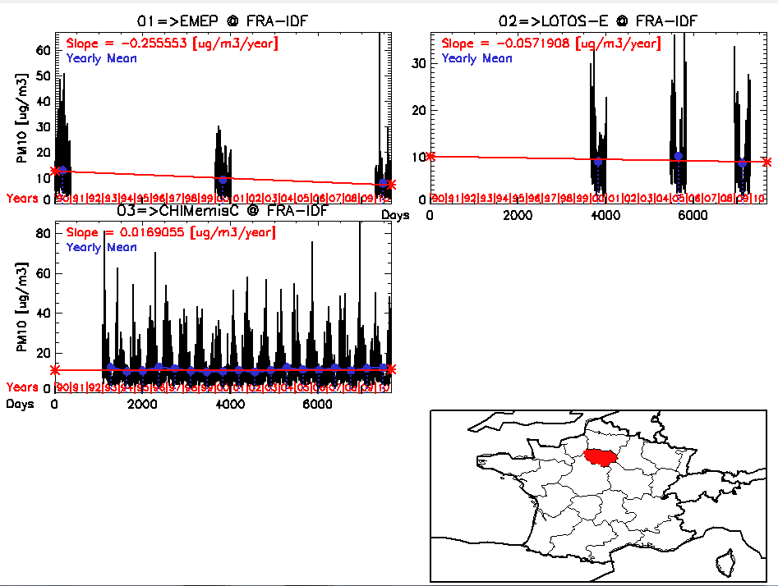
FRANCE-IdF PM₁₀ [ug/m3/year]

Slide 12
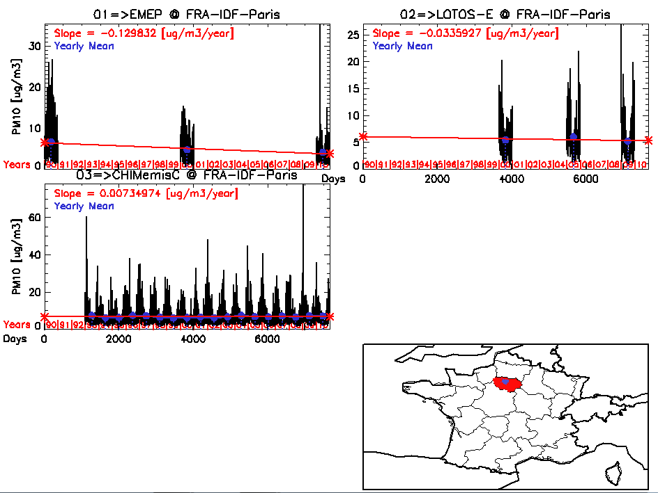
FRANCE-IdF-Paris PM₁₀ [ug/m3/year]

Slide 13
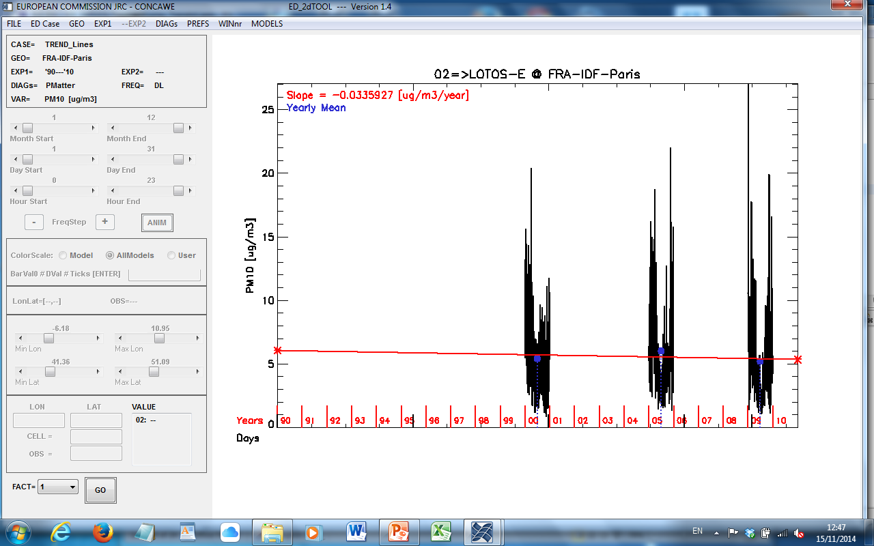
FRANCE-IdF-Paris PM₁₀ [ug/m3/year]
LOTOS-E

Slide 14
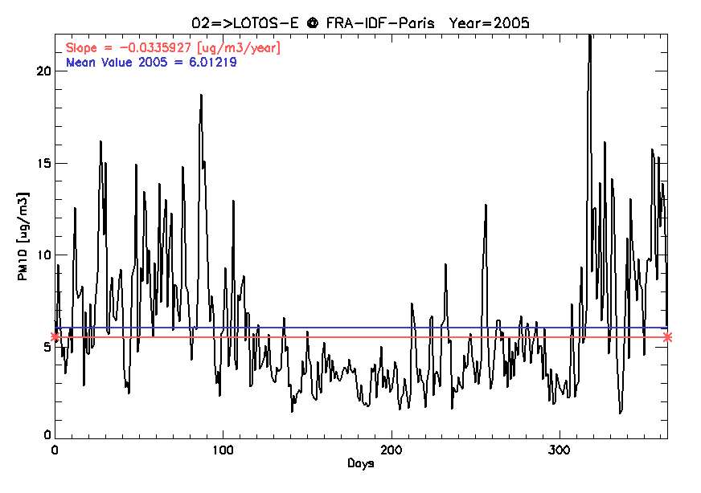
FRANCE-IdF-Paris PM₁₀ [ug/m3/year]
LOTOS-E 2005

Slide 15
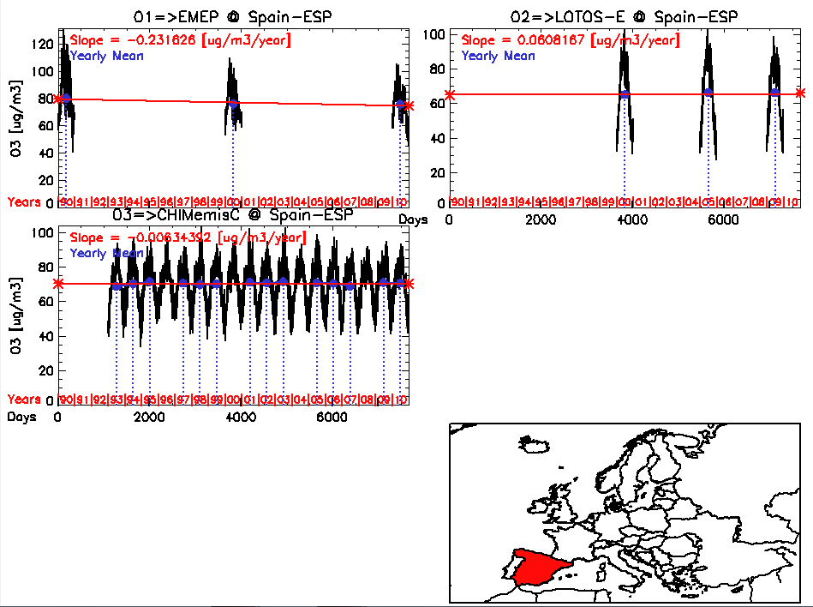
SPAIN O₃ [ug/m3/year]

Slide 16
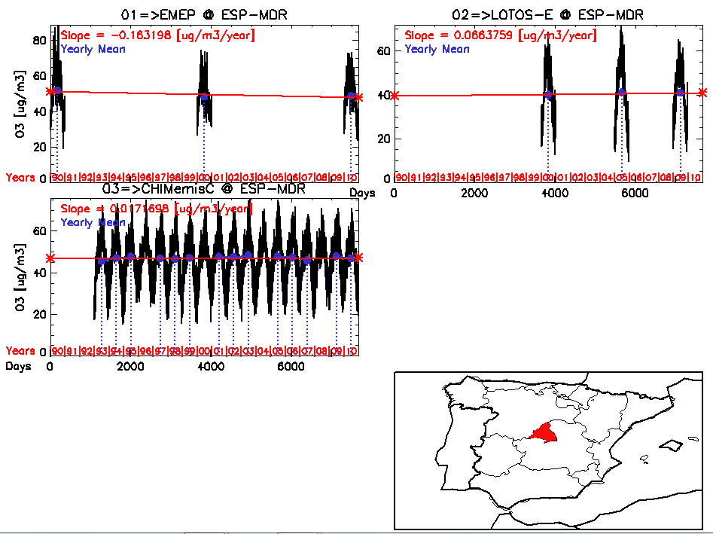
SPAIN-MDR O₃ [ug/m3/year]

Slide 17
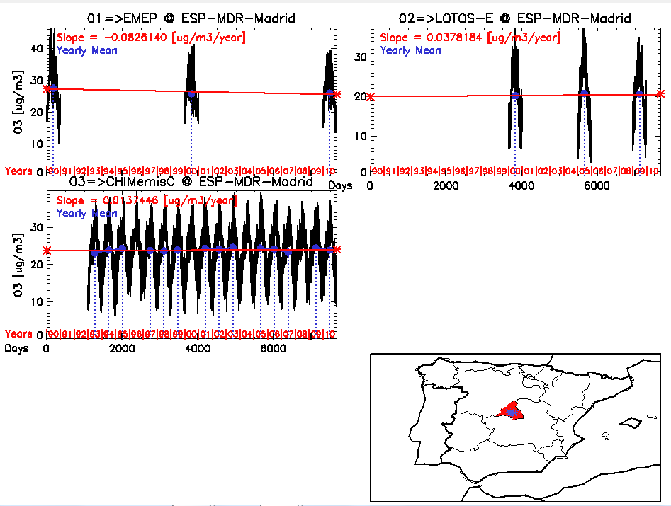
SPAIN-MDR-Madrid O₃ [ug/m3/year]

Slide 18
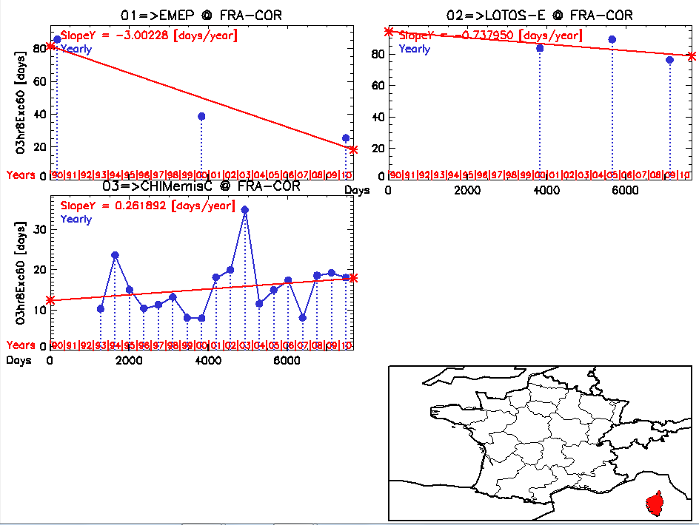
FRANCE-CORSE O₃ExcD60 [days/year]

Slide 19
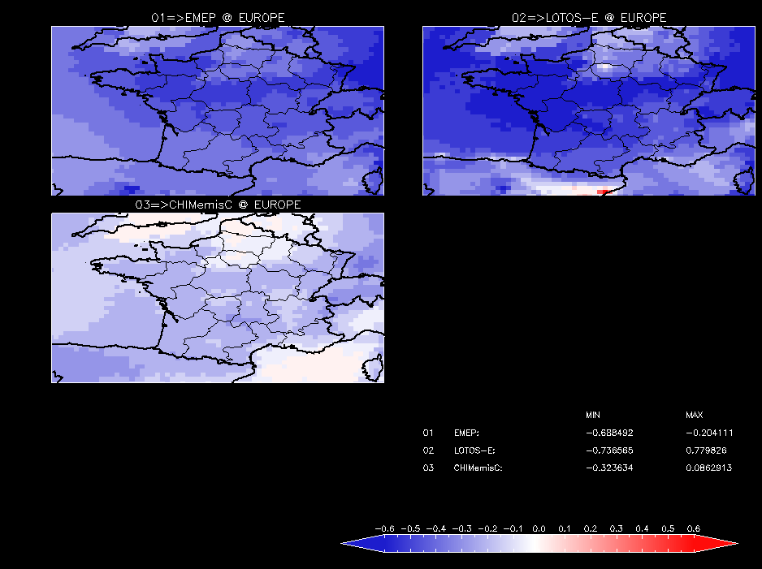
FRANCE PM₁₀ [ug/m3/year]

Slide 20
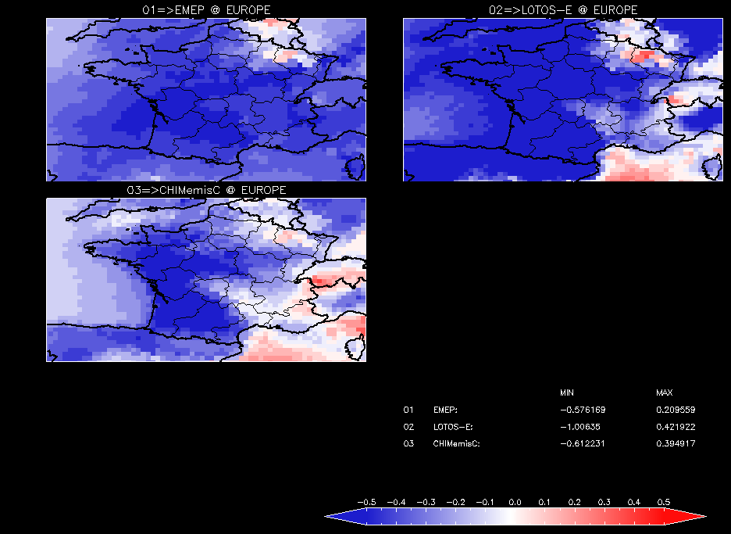
FRANCE O₃ [ug/m3/year]

Slide 21
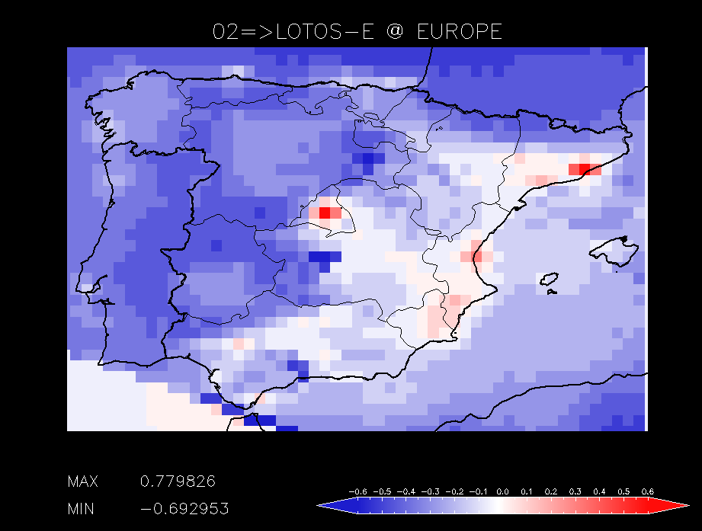
SPAIN PM₁₀ [ug/m3/year]
LOTOS-E

Slide 22
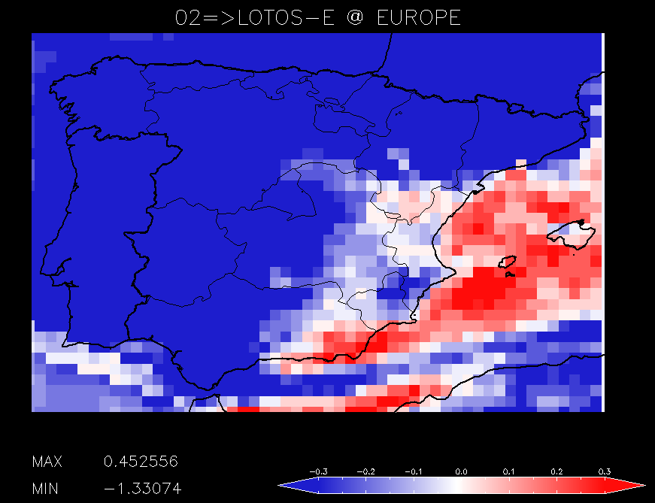
SPAIN O₃ [ug/m3/year]

Slide 23
Final Remarks
To complete
Add Observational trends (validation)
Add Emission trends
Visualization/Analysis Tool
Easy to install
Easy to use
Acting directly on Model output
Fast – handle large amounts of data
Centralized data management
PC and Linux
EuroDelta: Trend model exercise

