Slide 1
Martin Schultz Institute for Energy and Climate Research 8: Troposphere (IEK-8), Forschungszentrum Jülich, Germany
TFMM meeting on
Pollutant trends
Paris, 17-18 Nov 2014
Data quality and trends

Slide 2
Surface ozone trend analysis, 1998-2011
15 „Mountain“ sites – data from GAW, EMEP, Airbase
ALL YEAR
Site,
alt., m
No discernible pattern with respect to altitude (nor longitude or latitude)
Uncertainty of trend estimate varies among sites
What is the role of data quality in this?
PhD thesis O. Lyapina, Jülich 2014

Slide 3
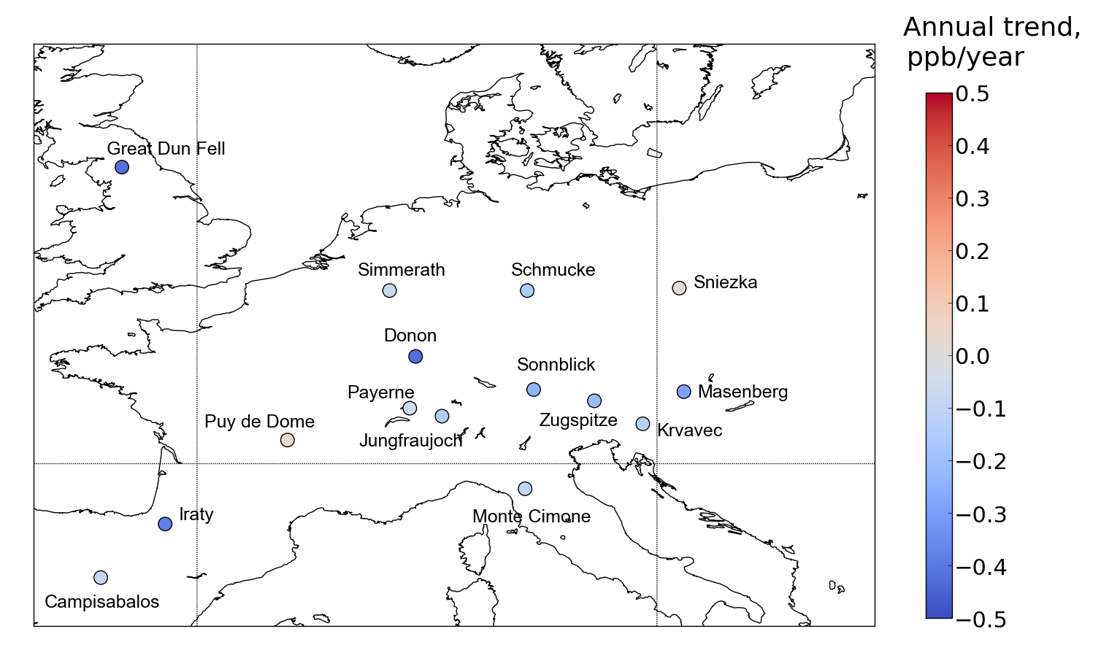
Trend analysis , 1998-2011
15 „Mountain“ sites – data from GAW, EMEP, Airbase
PhD thesis O. Lyapina, Jülich 2014

Slide 4
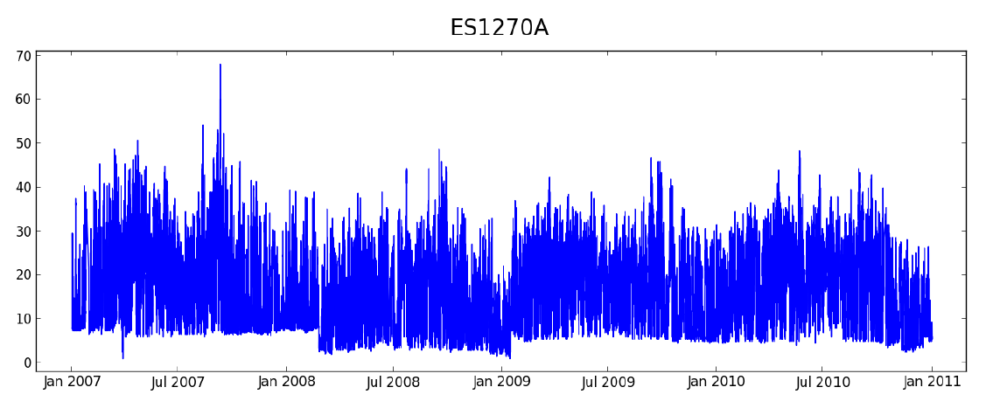
What is „bad data“?
Example: surface ozone data from Airbase V8
ES1270A: Hermanos Felgueroso, Spain (traffic, urban)
Ozone [µg m⁻³]
One should expect zero ozone frequently due to ozone titration with NO
There are obvious baseline fluctuations
Baseline jumps in March 2008 and again in January 2009
What is going on in April 2007?
Is this only an offset or also a gain problem?

Slide 5
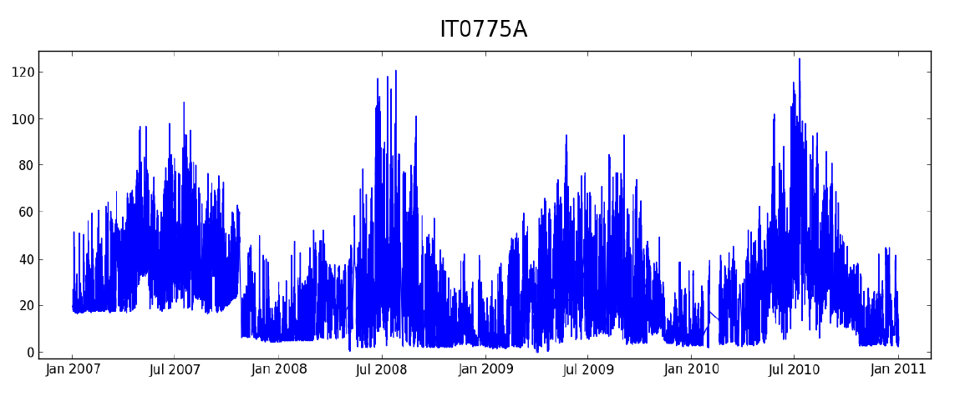
What is „bad data“?
Second example: surface ozone data from Airbase V8
IT0775A: Colico, Italy (background, suburban)
Ozone [µg m⁻³]
Titration events primarily in winter expected, some similarity of seasonal cycles
There are obvious baseline fluctuations
Number of zero ozone events differs a lot between years
Amplitude of seasonal cycle is rather variable

Slide 6
What can go wrong?
Measurement errors
Bad station/instrument/inlet line set-up
Calibration errors
Malfunctioning instrument
Interferences
Data processing errors
Program errors / user mistakes
Data archival problems
Metadata errors / inconsistencies
Unit conversion errors
Dataset version mismatch
Data user mistakes
Wrong interpretation of data or metadata
Program errors in analysis software

Slide 7
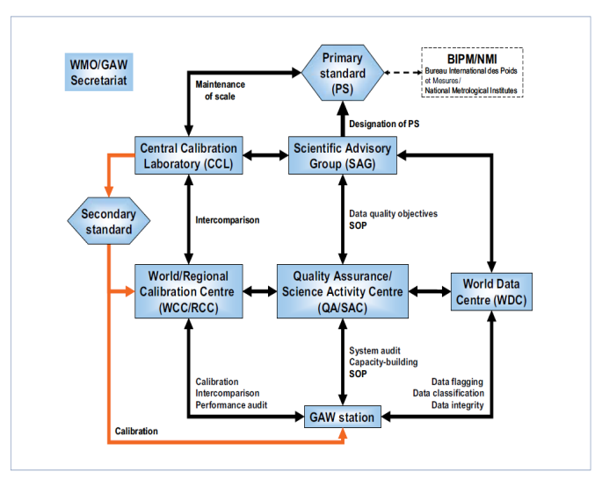
Measurement errors
QA/QC efforts often focus on reducing measurement errors
Example: GAW Quality Assurance Framework
Need to ensure:
Calibration against one consistent standard
Traceability of calibration
Adherence to standard operating procedures and guidelines
Complete documentation of measurement and instrument changes
(This also requires trained and trustworthy personnel!)

Slide 8
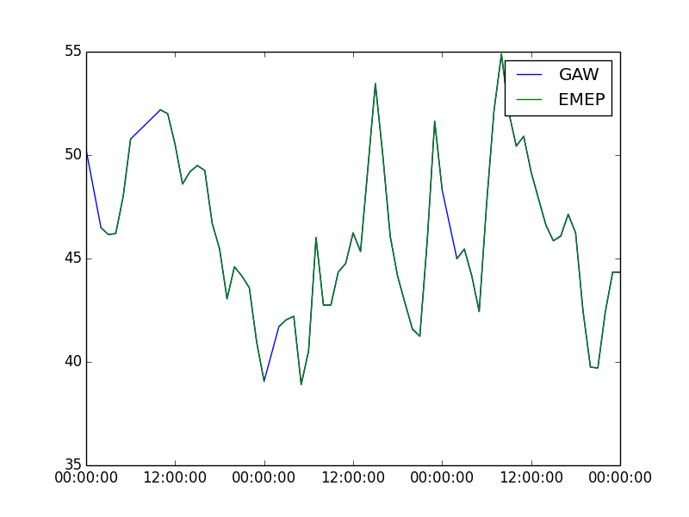
Data processing / archival / use errors
These need more attention – in particular across different networks!
Example: GAW versus EMEP
Station Giordan Lighthouse, Malta (GLH, MT0001R)
Ozone [nmol mol⁻¹]
✓
2012-06-01
2012-06-02
2012-06-03

Slide 9
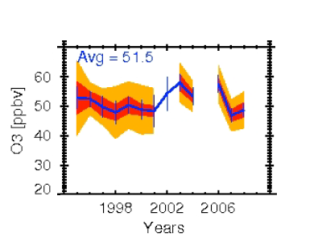
The need for „complete“ data
Impact of sampling frequency on uncertainty
MOZAIC data over Frankfurt
morning flights
resampled to 12/month
resampled to 4/month
JJA
800 hPa
Figure from Saunois et al., ACP 2012

Slide 10
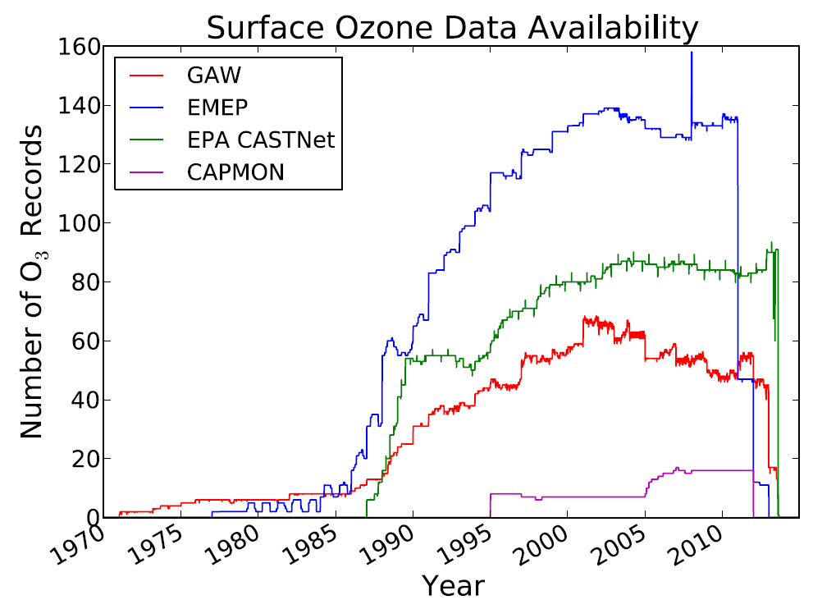
The need for „complete“ data (2)
Impact of changes in the measurement network
Changes in geographical distribution, local emission sources, station type of area, …
Figure courtesy E. Sofen, York U.

Slide 11
Quality assurance through „closure“
Pseudo steady state:
O₃ + NO → O₂ + NO₂
NO₂ + hν (+O₂) → NO + O₃
RO₂ + NO → RO + NO₂
Background site
50
O_{x} = O₃ + NO₂
40
30
O₃
O₃, NO₂ [ppb]
20
10
NO₂
0
11:00
11:01
11:02
11:03
11:04
11:05
11:06
Concurrent measurements of O₃, NO, and NO₂ can inspire trust in the ozone data record.
Notes:
dNO2/dt = k1*NO*O3 + k2*NO*RO2 – j*NO2
With dNO2/dt = 0:
NO2 = NO * (k1*O3 + k2*RO2)/j
Under polluted conditions RO2 small, thus
NO2 = k1/j * NO * O3
Example: k1 = 1.9e-14 cm3 molec-1 s-1 (@298K, JPL, 2011)
J = 8e-3
Lo = 2.46e19 (@298K, 1013 hPa)
O3 = 40 ppb = 9.85e11
NO = 10 ppb = 2.46e11
NO2 = 5.75e11 = 23 ppb

Slide 12
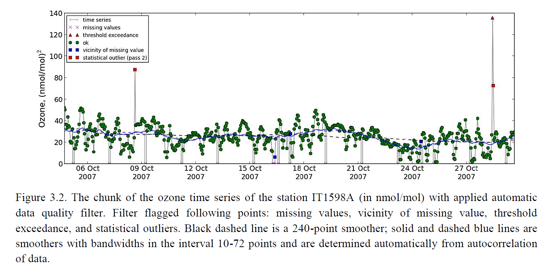
Statistical filtering
PhD thesis O. Lyapina, Jülich 2014

Slide 13
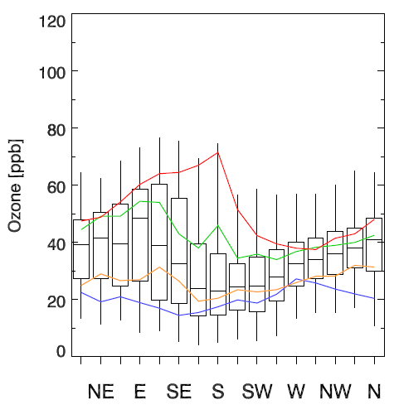
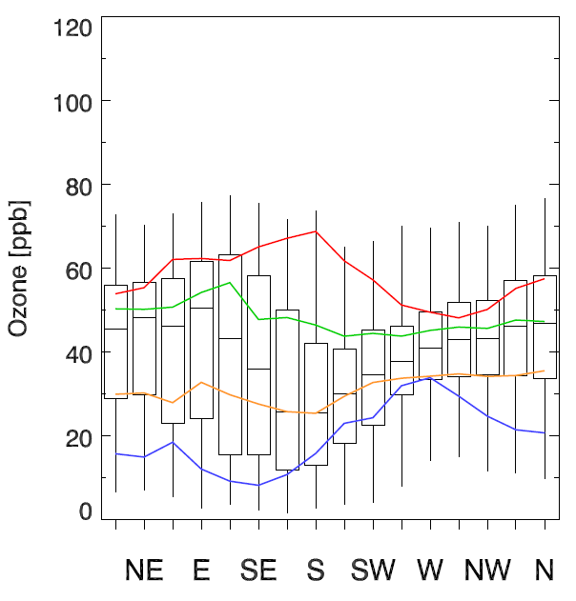
Quality assurance through analysis of ozone-meteorology patterns
Frontal passages lower summertime ozone concentrations → test neighbouring sites for similarity
Stagnant high pressure systems lead to ozone build-up → test neighbouring sites for similarity
Large-scale circulation advects „large-scale“ pollution features → compare statistics in background wind sectors
Unfortunately, meteorological data from air quality sites is often hard to obtain!
OBS
MODEL
DJF
MAM
JJA
SON
Station Langenbrügge,
Germany (DE0002):
52.8 N, 10.8 E, 74m
Data from 1990-2000
Daytime only

Slide 14
Discussion
What are the DQOs for trend analysis? Do we want to quantify trends < 0.5 ppb/year, or does it suffice to say there is no trend > 0.5 ppb/year?
How to ensure that DQOs are met in archived data?
How to determine which records are „good“?
Should we filter time series?
What is a robust sampling frequency?
How to exploit large-scale background features/consistency between stations?
How to make use of meteorological information in quality control of air pollution data?
How can we use models to help quality testing observations?
Can we achieve „closure“ for a sufficient number of sites?

