Slide 1
TFMM – Trends
Emissions of air pollutants for 1990-2010
Augustin Colette [augustin.colette@ineris.fr]
Elsa Real, Bertrand Bessagnet
Institut National de L’Environnement Industriel et des Risques

Slide 2
Emissions of air pollutants for 1990-2010
Overview of available sources of information
  Will ultimately be used for the modelling
Criteria for selection
  Completeness 1990-2010
  Available by activity sector, spatially gridded
  Key pollutants: NOx, NMVOC, SOx, NH3, PM or BC&OC

Slide 3
Emissions of air pollutants for 1990-2010
Regional datasets preferred to global inventories
  (EMEP or GAINS preferred to EDGAR, ACCMIP…)
EMEP emissions used in modelling lacks PM before 1999
GAINS has been revised in 2014 for 1990-2010 (ECLIPSE-V5)
  Provided by Zig Klimont & Chris Heyes
=> ECLIPSE-V5 is a good candidate
  Need to benchmark wrt other sources to assess uncertainties
  Also an issue since other sources are used in global models (used for Boun. Cond.)

Slide 4




Emission details
EDGAR / ACCMIP / MACCCity
  Primarily designed for chemistry-climate
  MACCCity: monthly, ACCMIP before 2000, RCP85 after
EMEP:
  « as used in models »
ECLIPSE-V5
  GAINS national totals (updated after TSAP2013)
  provided for all RCP sectors (energy, industry, solvent use, transport, agriculture, open burning of agricultural waste, residential combustion, and waste treatment)
  Spatially at 0.5 resolution based on RCP-consistent proxies.

Slide 5
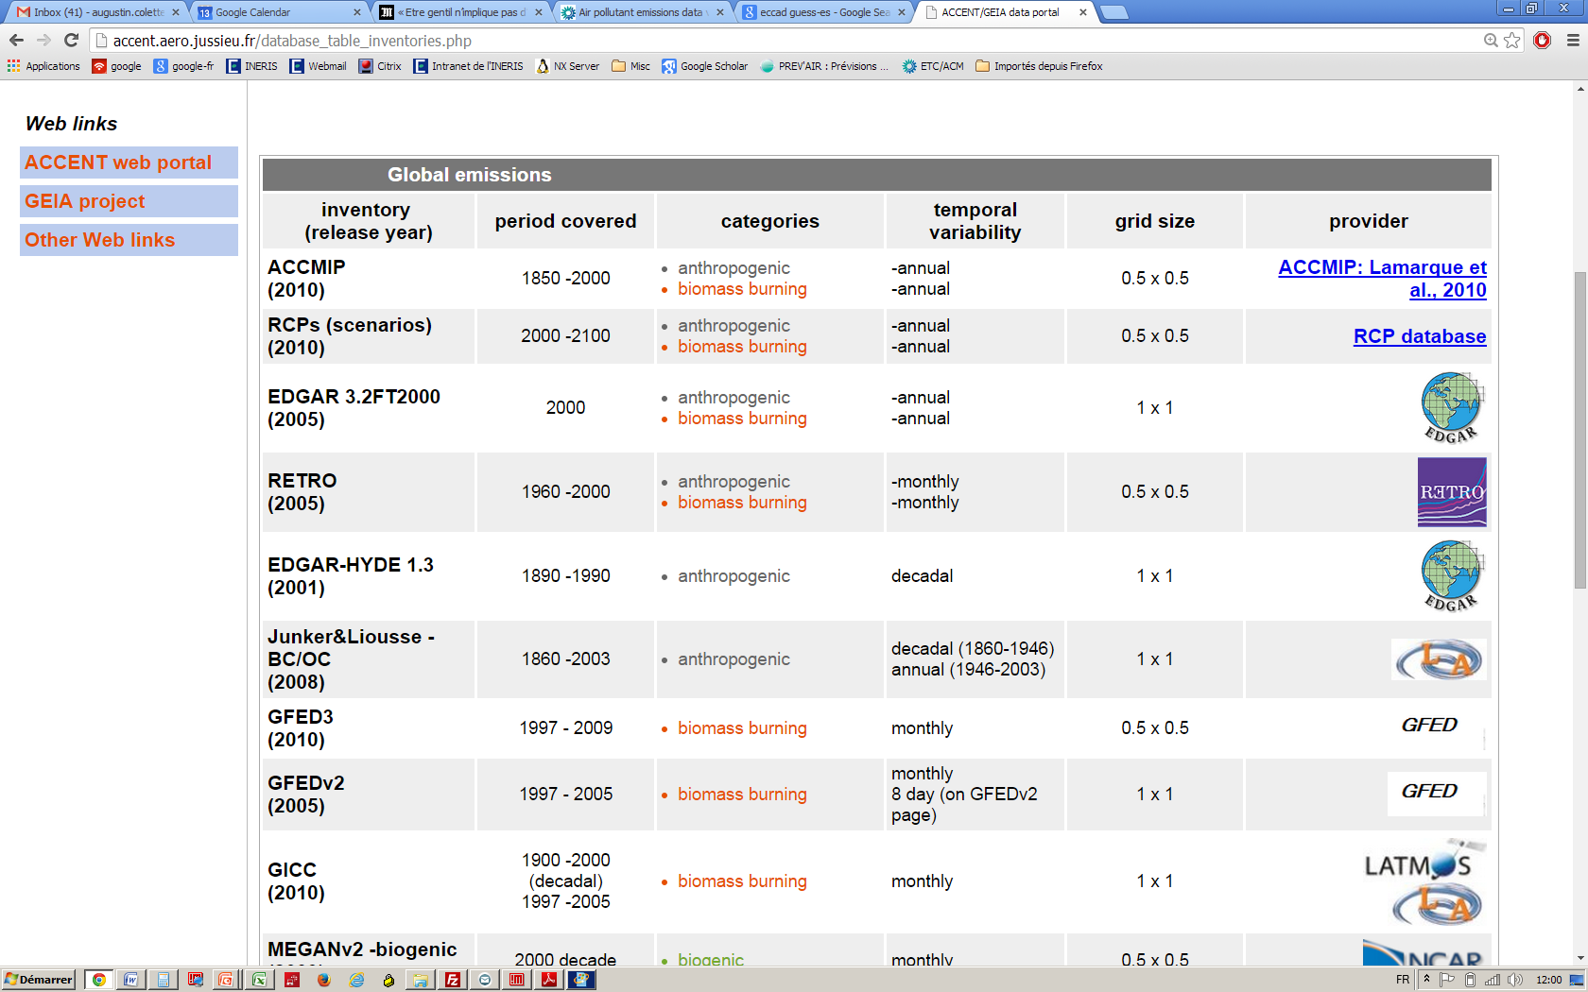

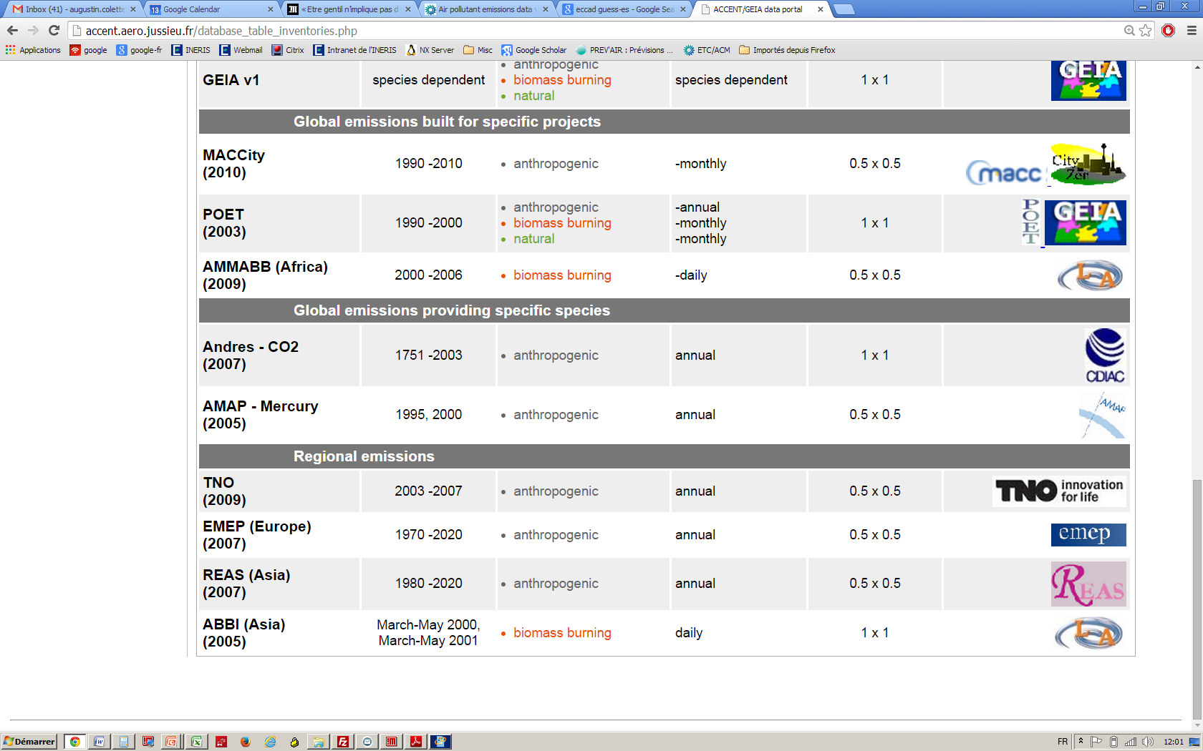
EDGAR v4.2
1965-2008

Slide 6
Available species

Slide 7
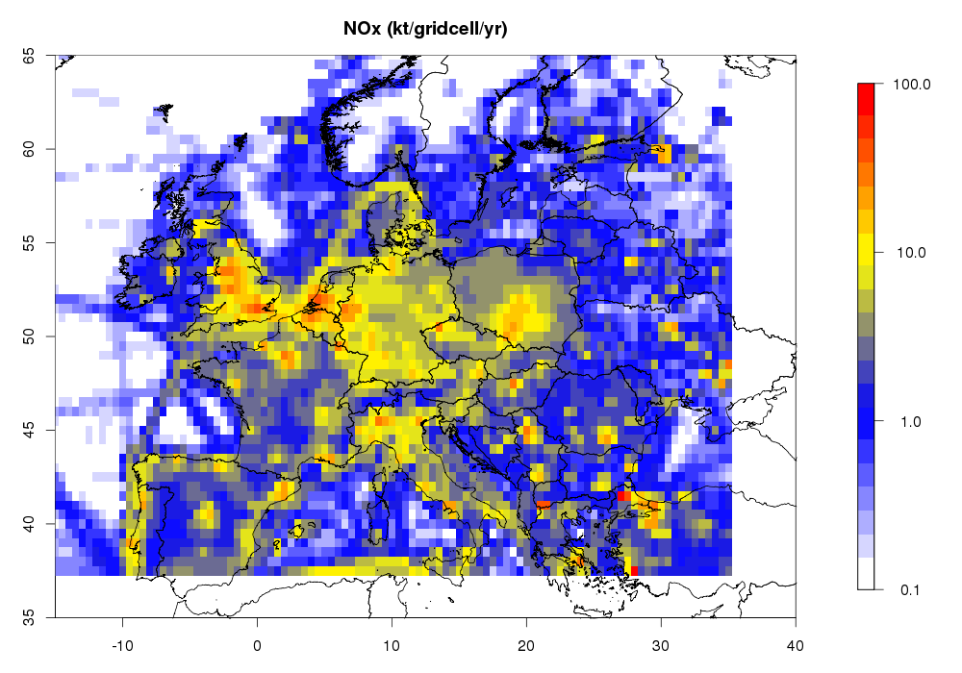
Quantitative Comparisons over Europe
Domain used for comparison :
  Longitude: min= -15; max= +35
  Latidude: min=37.5; max=65

Slide 8
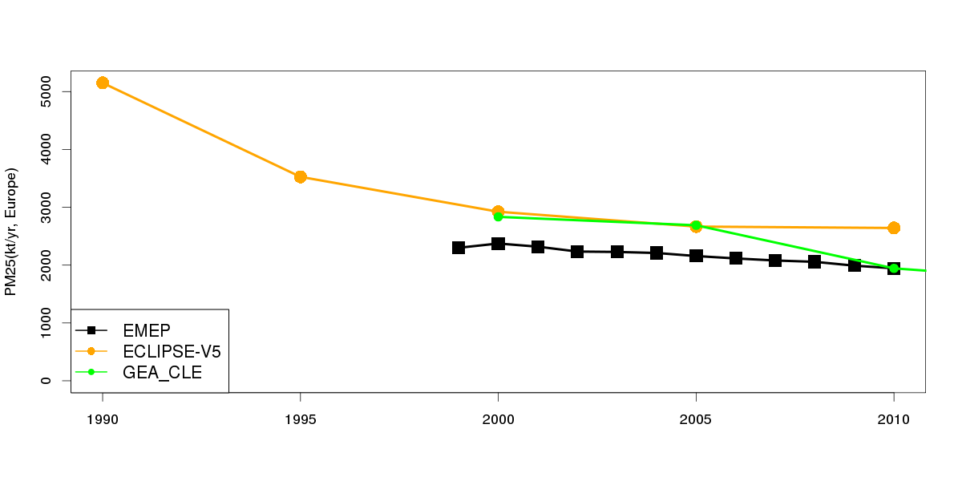
PM25
EMEP/ECLIPSE quite different for recent years

Slide 9
PM25: by sector
EMEP/ECLIPSE difference moslty due to Residential, Industry, Agriculture

Slide 10
PM25: trends by sector
Despite differences in totals, trends by sector are broadly similar

Slide 11
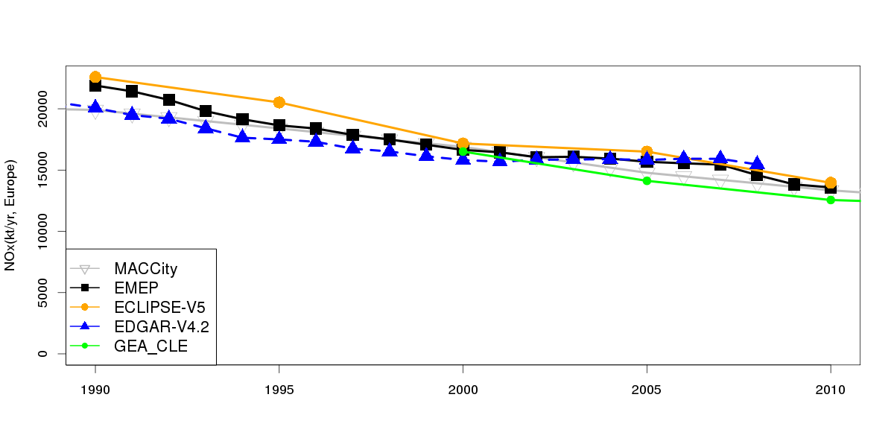
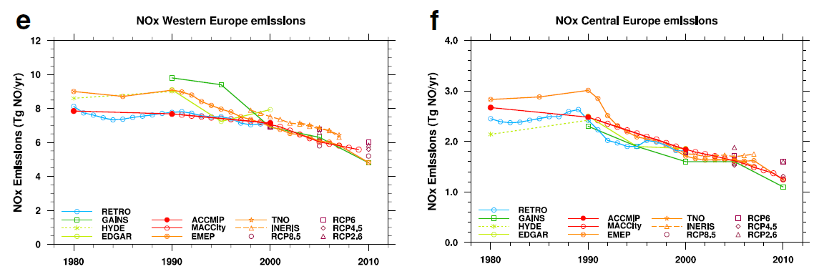
NOx
GAINS
ECLIPSE still higher than other sources but not as much as in Granier et al. 2011
Granier CC, 2011

Slide 12
NOx: transport
The overestimation in ECLIPSE is due to land transport, the difference is constant over 20yrs

Slide 13
NOx: Energy
Decreasing trend:
ECLIPSE > EMEP > MACCCity

Slide 14
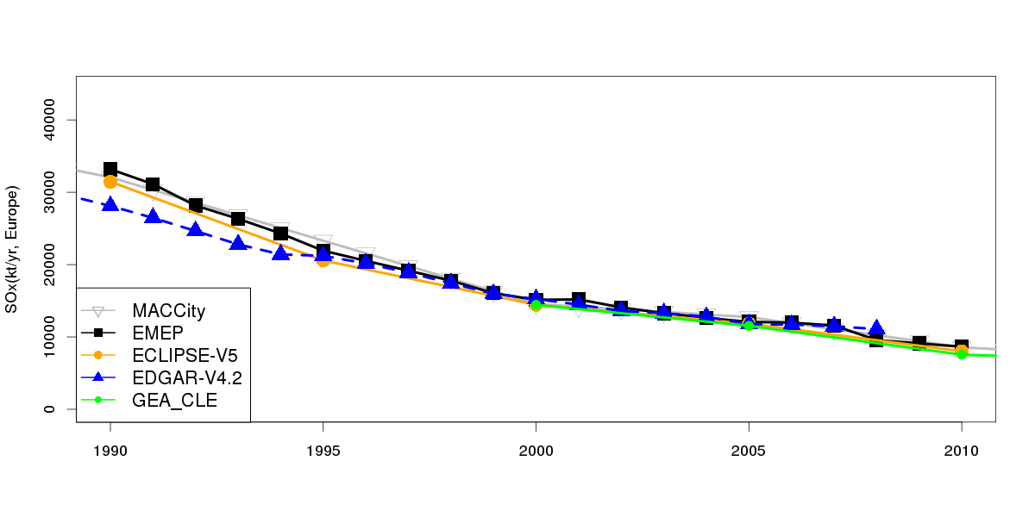
SO2
All the sources are quite consistent
(except EDGAR)

Slide 15
SO2: by sector
Slight discrepancies at sectoral level:
Might have an impact on spatialisation

Slide 16
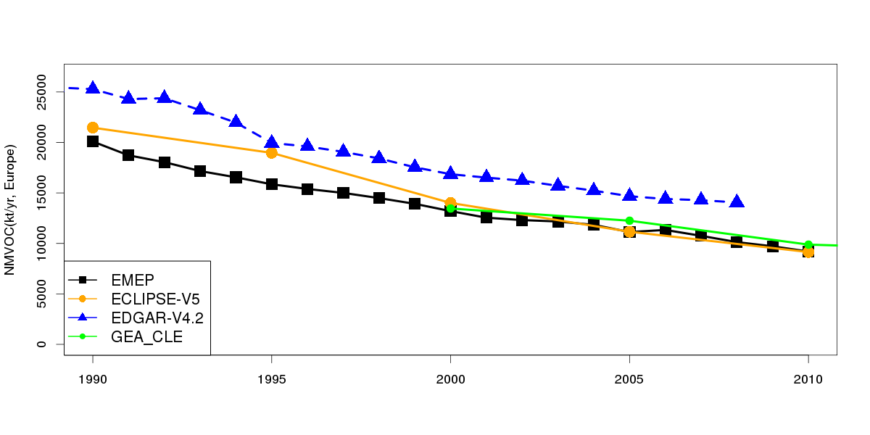
NMVOC
Large uncertainties, especially for EDGAR
The discrepancy EMEP/ECLIPSE in the 1990s is a concern

Slide 17
NMVOC: by sector
Discrepancy EMEP/ECLIPSE due to « other transports »

Slide 18
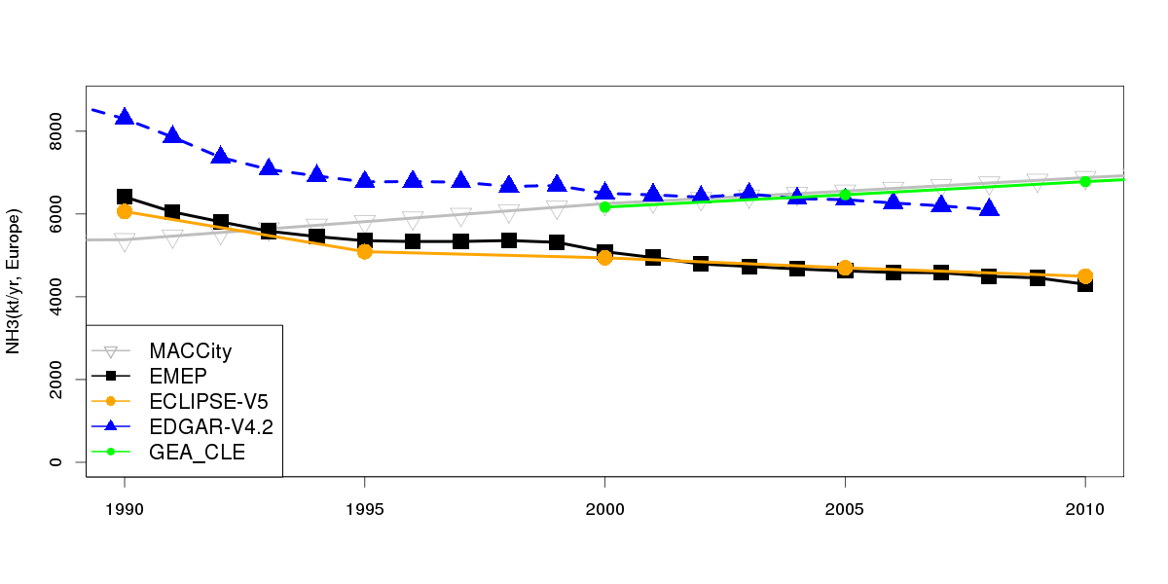
NH3
ECLIPSE & EMEP quite consistent
MACCCity & GEA: less focus on NH3

Slide 19
Conclusions & Questions for Discussion
On the paper, ECLIPSE-V5 is a good source for AQ hindcast over Europe
Benchmarking with other sources show:
  PM: not much comparison possible
  NOx slighlty high compared to other sources, but constant in time
  SO2 very consistent
  VOC: large spread
  NH3: good consistency EMEP/ECLIPSE

Slide 20
Open issues
Are there gaps at national level that do not appear on these Europe-wide comparisons?
  Esp. for PM: not reported before 1999
How to deal with NO/NO2 changes ?
To be discussed by Bertrand tomorrow:
  Using Country-totals ?
  Spatial distribution: ECLIPSE or in-house ?
  Temporal profiles ?

Slide 21
PM25 gap filling in EEA dataviewer
“Linear extrapolation was performed if one or several years at the beginning or at the end of a time series were missing, and if at least 5 consecutive years showing a clear trend (r2 ≥ 0.6) were available. Extrapolation 'backwards' was never allowed to result in negative values. “ extract from the EEA Technical report No 12/2014 ( European Union emission inventory report 1990–2012 under the UNECE Convention on Long-range Transboundary Air Pollution (LRTAP)

