Slide 1

InGOS
Integrated non-CO₂ Greenhouse gas Observing System
Task Force for Measurements and Modeling
Gozo (Malta), 19 April 2012

Slide 2
InGOS target
improving and extending
the European observation capacity
for non-CO₂ greenhouse gases

Slide 3











InGOS partners: 34
And more !!!!

Slide 4
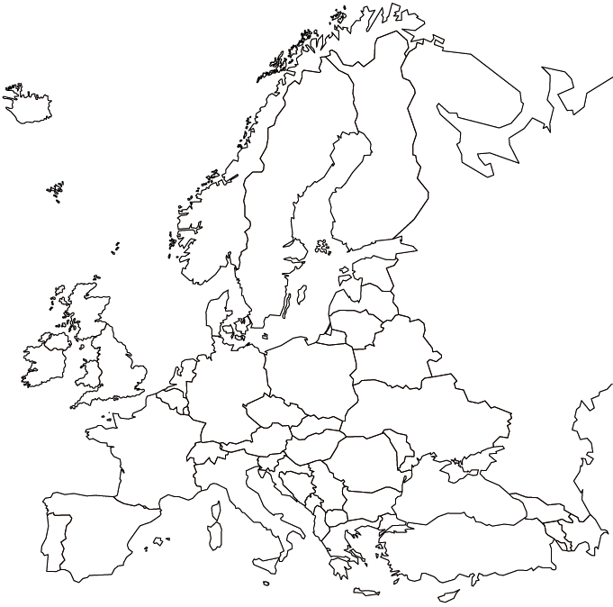
InGOS existing infrastructure
Flux sites
Tall towers
Ocean observations
Airborn measurements
Total column (up)
Satellite data (down)
Data centre
Isotope Lab
Cal gas Lab

Slide 5




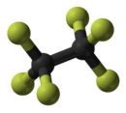
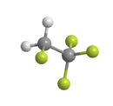
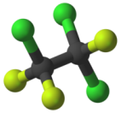
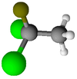

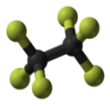

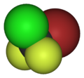
The InGOS gases
Methane (CH₄)
Nitrous Oxide (N₂O)
Sulphur Hexafluoride (SF₆)
Radon (²²²Rn)
Waterstof (H₂)
CF₄
C₂F₆
Halocarbons (many different species)
SO₂F₂
C₂Cl₃F₃
CFC 113
C₂H₂F₄
_{HFC-134a}
C₂H₃Cl₂F
HCFC-141b
CBrClF₂
Halon1211
CCl₄
C₃F₈

Slide 6
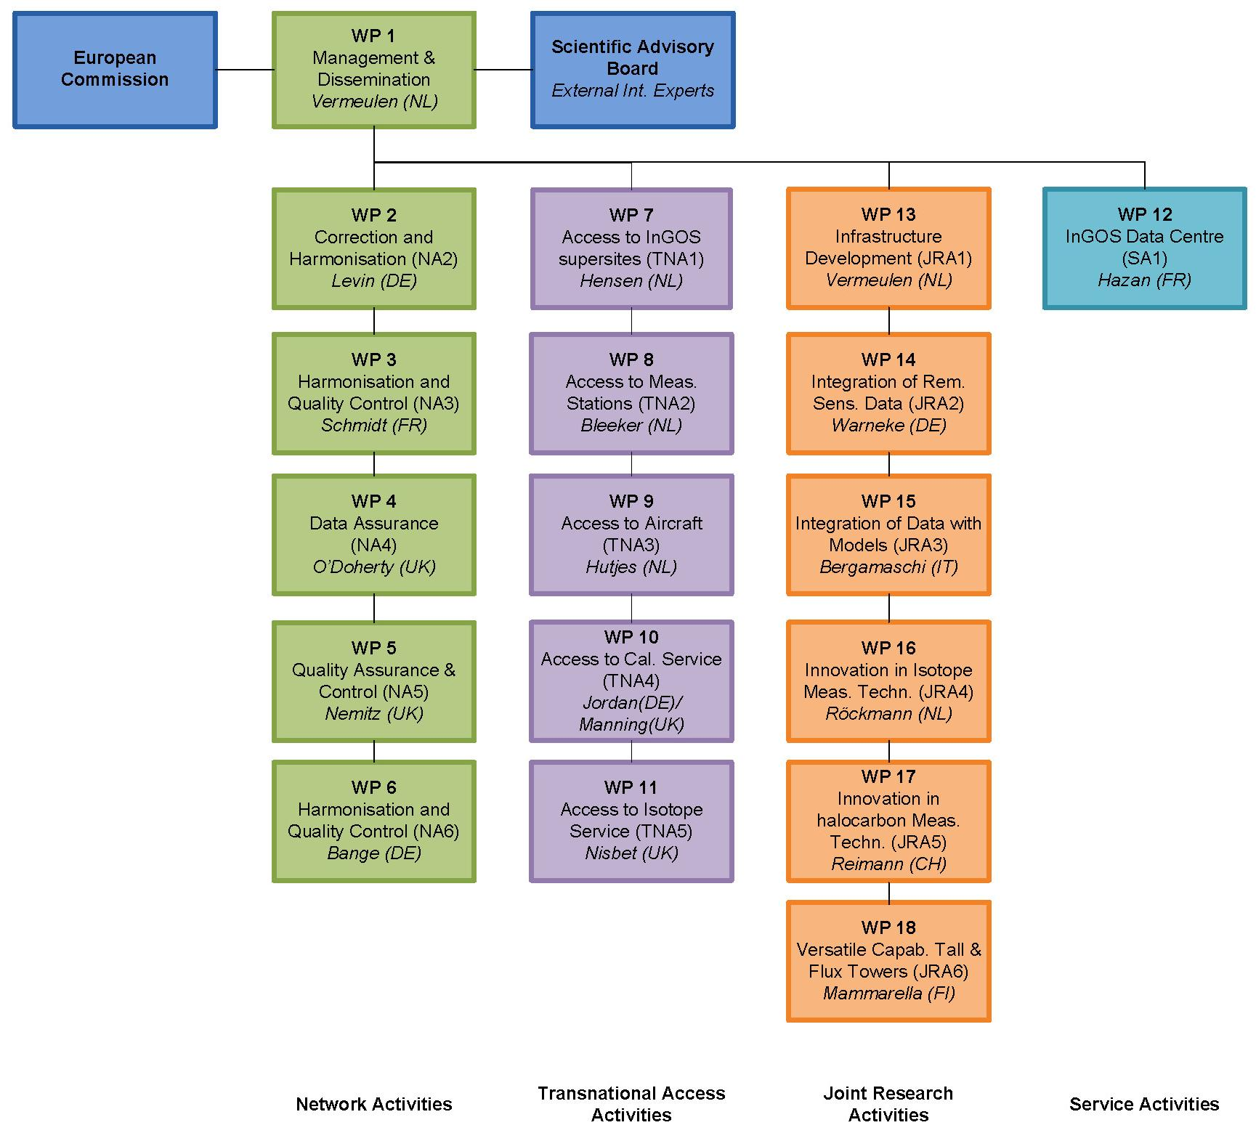
InGOS Structure
Network Access Research Service
(Na1-6) TNA JRA SA

Slide 7

InGOS Structure
NA1: Running the project & reporting to EU
Network Access Research Service
(Na1-6) TNA JRA SA
NA1

Slide 8


Network:
Harmonisation
NA 2,3,4: Harmonisation
NA2
Historic data
Network Access Research Service
(Na1-6) TNA JRA SA
NA3
New Data
NA4
New Data

Slide 9
Data & cal.centre
NA 2,3,4
Calibrations
Network Access Research Service
(Na1-6) TNA JRA SA
Atmosphere (CEA)
Flux data (UNITUS)
Halocarbons (NILU)

Slide 10
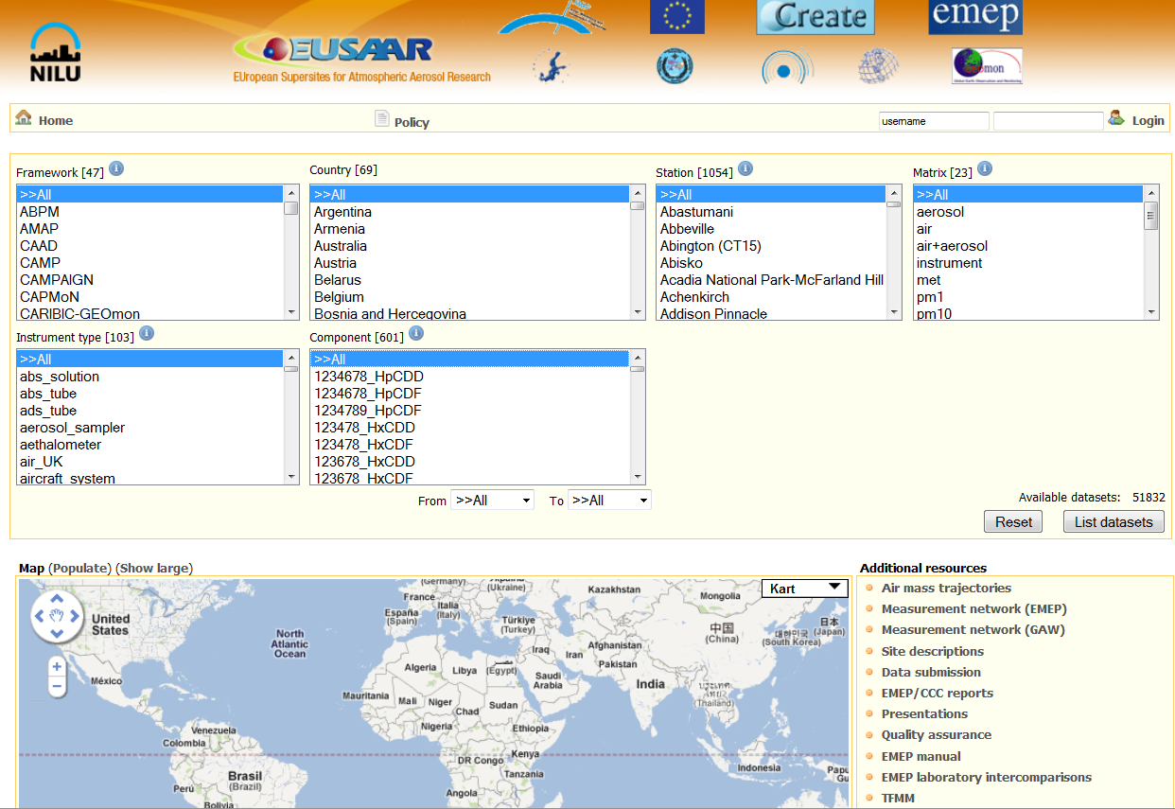
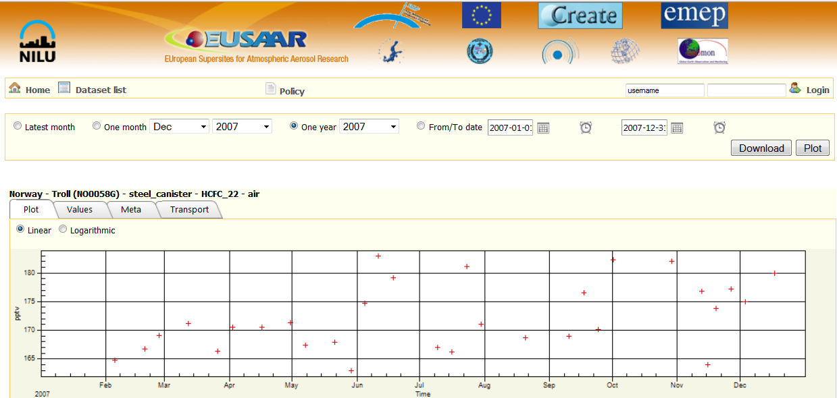
Data centre (2)
EBAS – EMEP database
Hosts data from the EMEP monitoring programme, but also a lot of data from other projects and programmes such as: AMAP, HELCOM, EUSAAR, ACTRIS, EUCAARI, HTAP, etc.

Slide 11
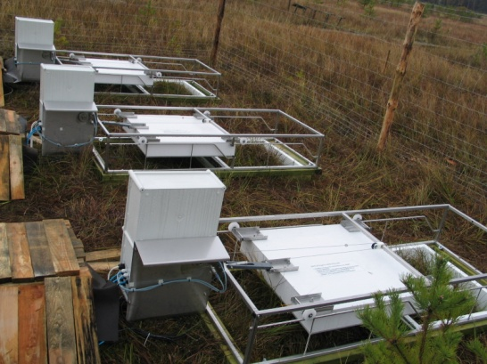
Network:
Flux Harmonisation
NA 5: Harmonisation for Flux data
Network Access Research Service
(Na1-6) TNA JRA SA
Atmosphere (CEA)
Flux data (UNITUS)
Halocarbons (NILU)

Slide 12
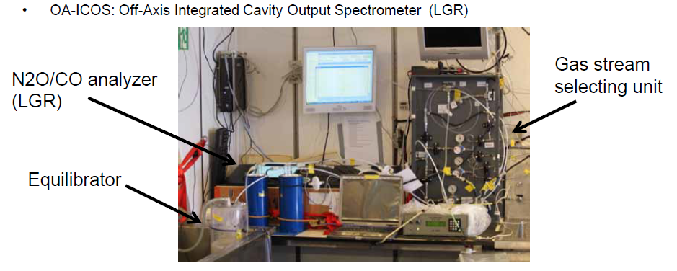

Network:
Ocean
NA 6: Ocean data
Calibrations
Network Access Research Service
(Na1-6) TNA JRA SA
MEMENTO (IFU)
[MarinE MethanE and NiTrous Oxide database

Slide 13
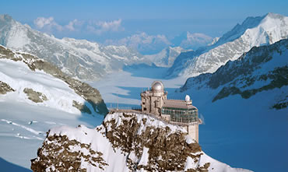
Access to stations
& facilities
6 ‘super’-sites
  Stations where JRA campaigns are hosted
14 observing stations
2 aircrafts for CH₄ flux variability
Calibration service & Cucumber rotation
¹³CH₄ isotope service
Network Access Research Service
(Na1-6) TNA JRA SA

Slide 14
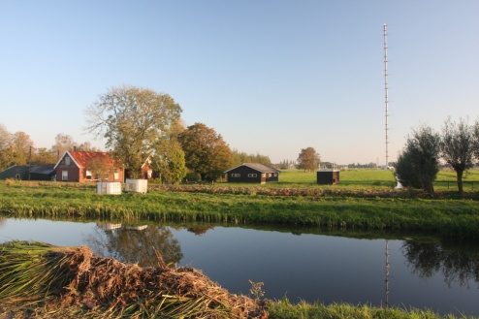
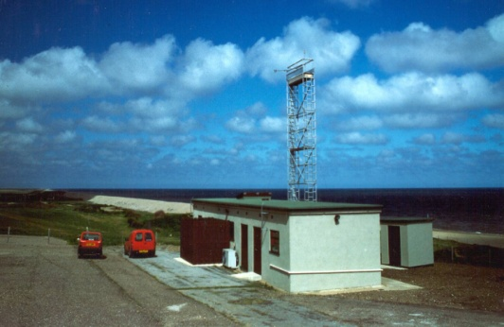
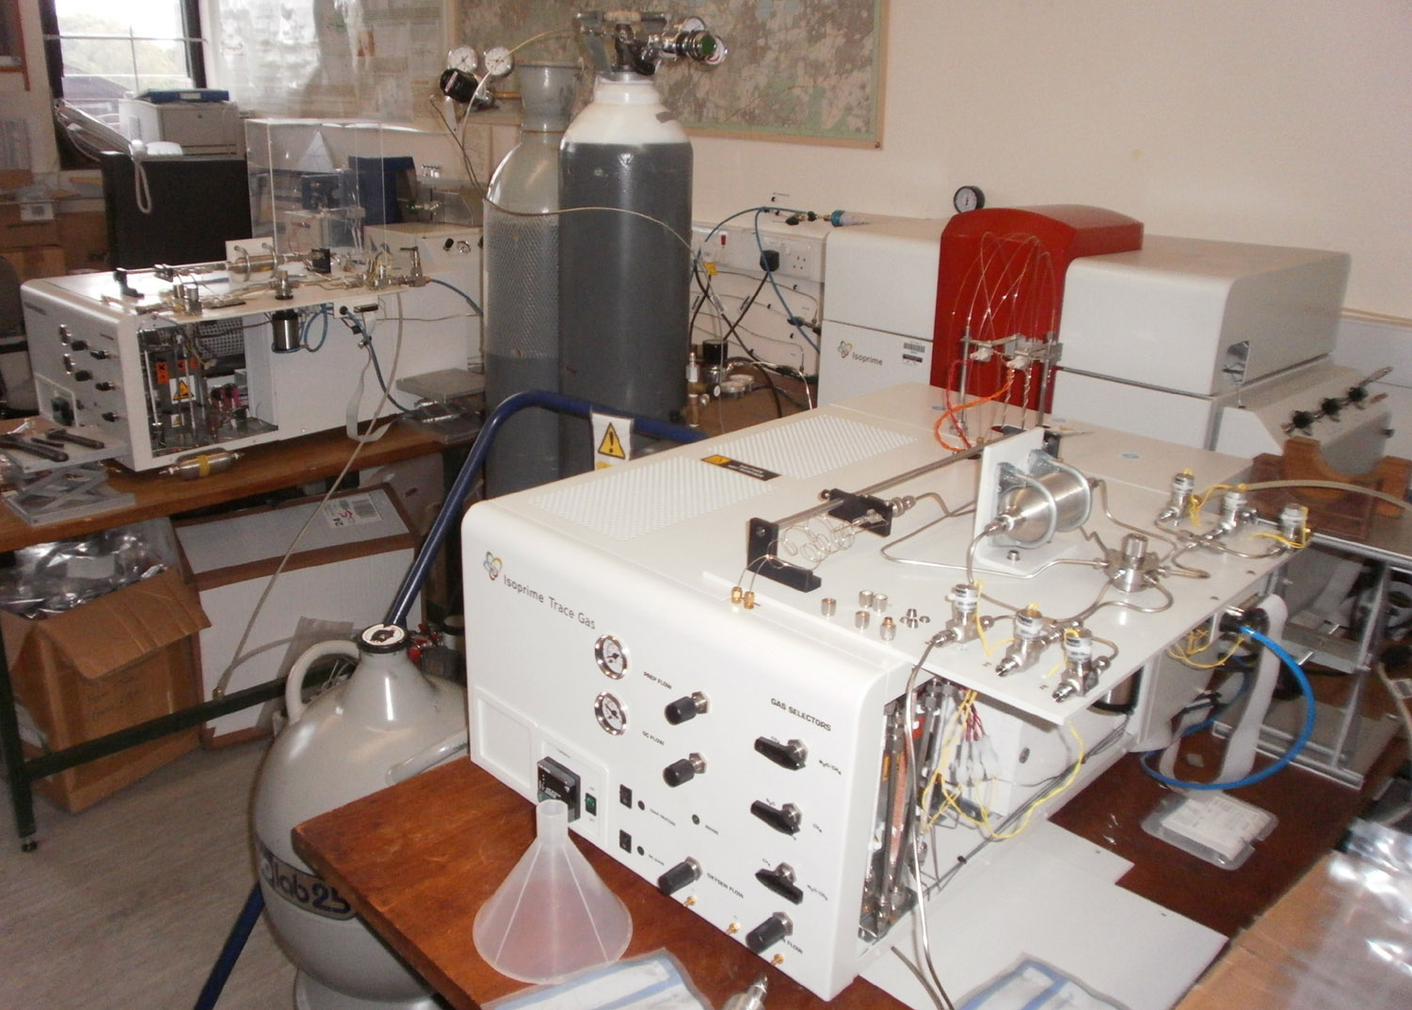
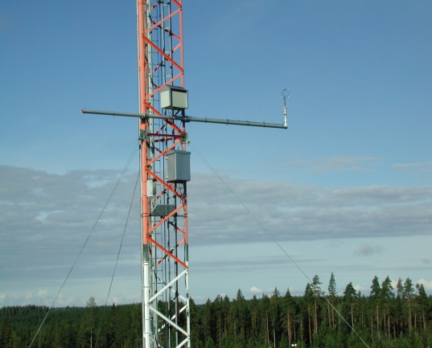
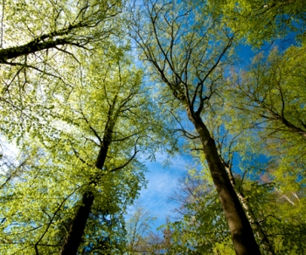
TNA: Supersites
CABAUW
200m NL (ECN)
Weybourne
UK (UEA)
GGLES
London (RHUL)
SMEAR II Hyytiala
127m Fin (UHEL)
Willow Field & beech
forest (Dk, RISOE)
Easter Bush (UK,CEH)

Slide 15
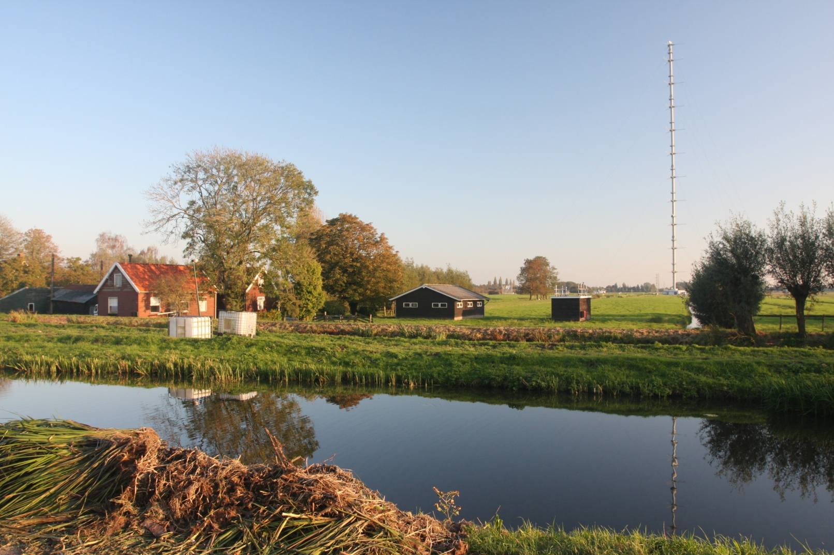
TNA: Supersites
CABAUW 200m Netherlands

Slide 16
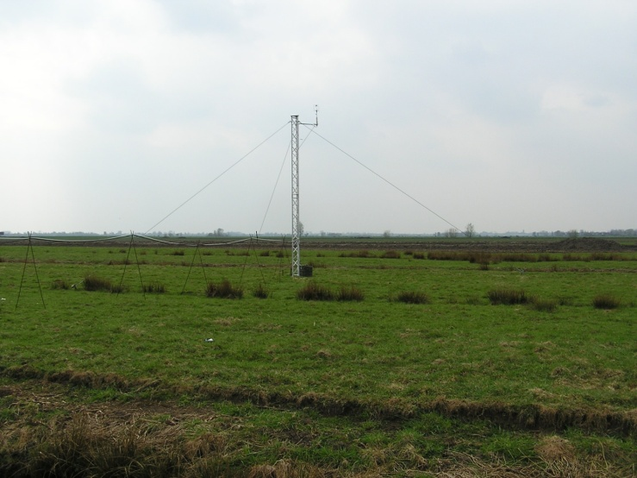
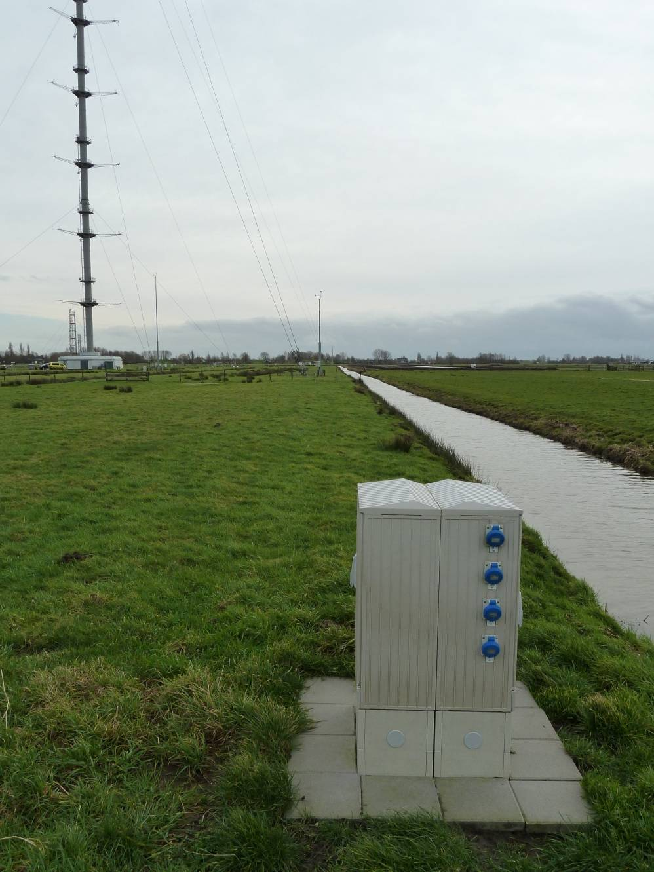
Announcement:
Methane flux campaign
June this year
Open for attendance
Cabauw NL
  QCL (ARI)
  Picarro
  Los Gatos
  Licor
Next year: N₂O in UK

Slide 17

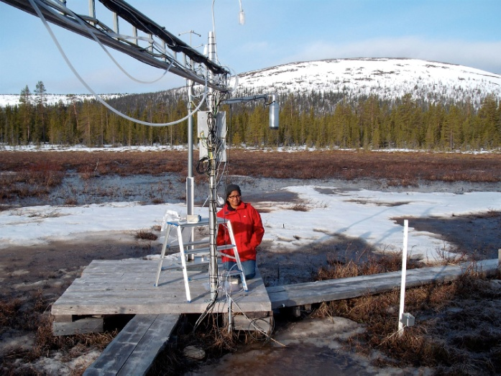
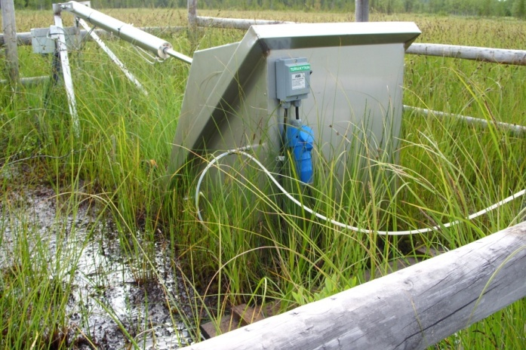
TNA: Observing stations
Jungfraujoch Grignon & Orleans
Las Majadas
Mace Head Kasprowy Wierch
London (GGLES) Hegyhátsál tall tower
Angus tall tower POLWET
Lutjewad Pallas
Horstermeer Norunda

Slide 18
TNA: Airplanes
TNA=“rent a plane”

Slide 19
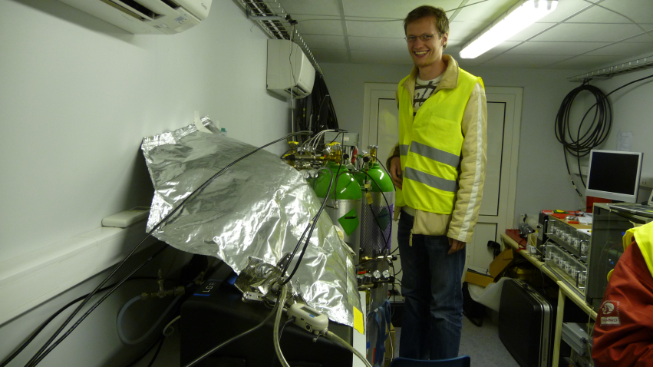
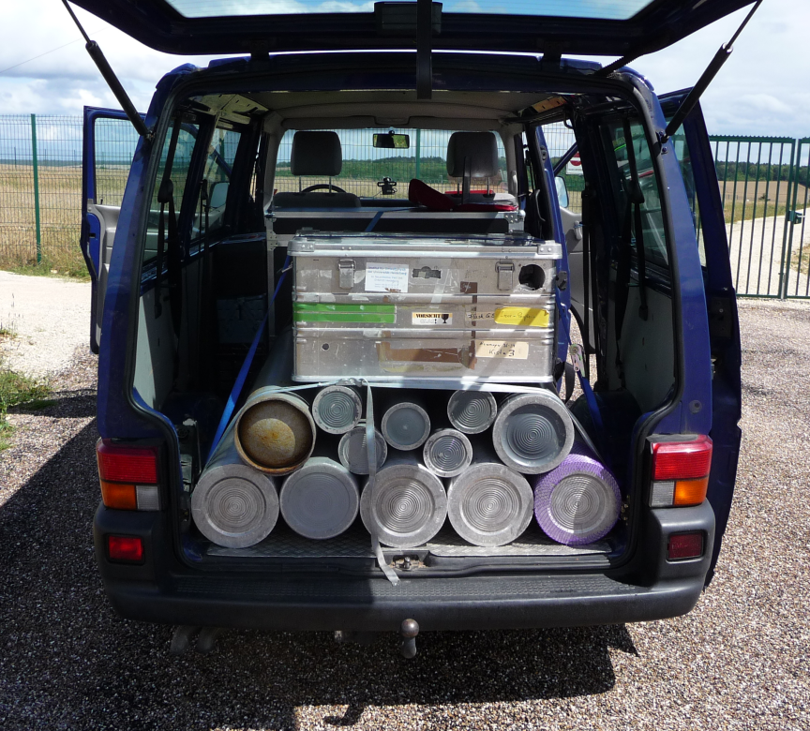
Joint Research:
New techniques
FTIR spectrometry
Sam Hammer

Slide 20
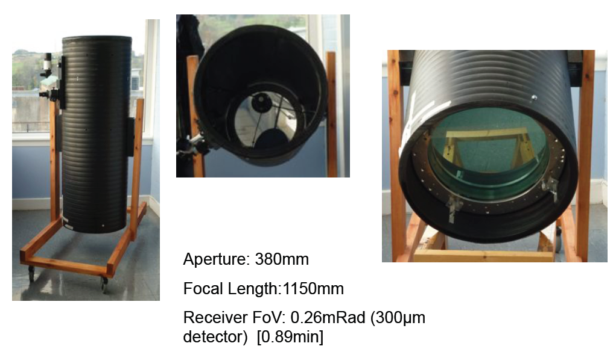

Joint Research:
New techniques (2)
Dial
GC of FTIR

Slide 21

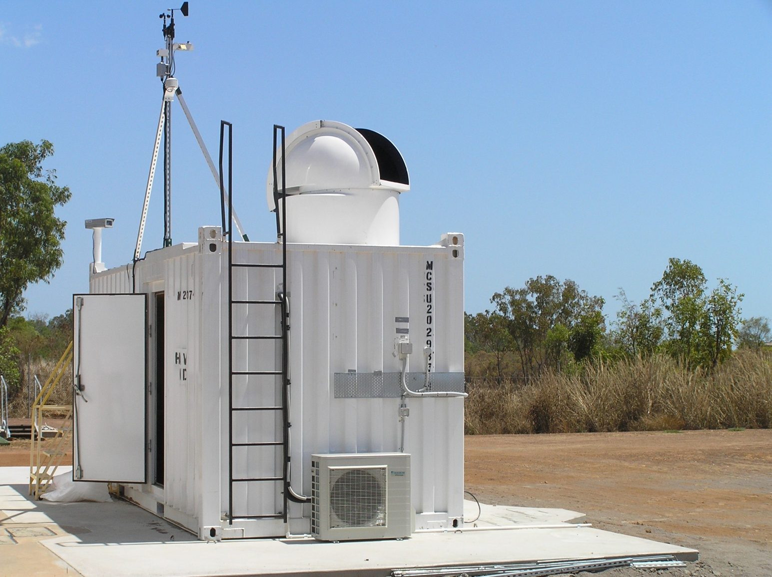
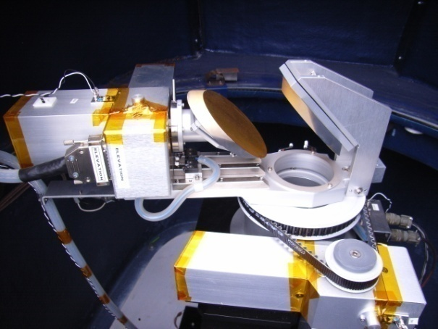
Link with remote sensing
TCCON presentatie NZ

Slide 22
Data to models

Slide 23
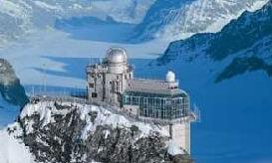
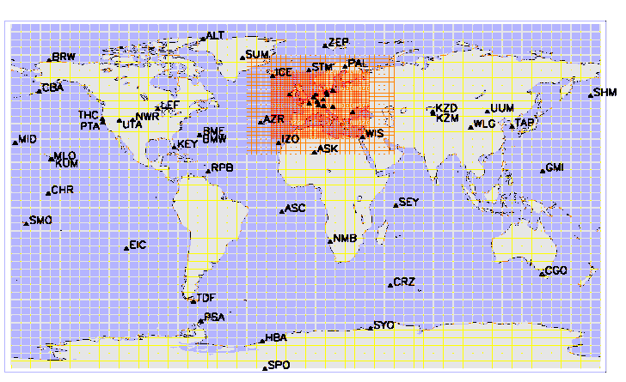

atmospheric measurements
inverse atmospheric model
top-down
GHG emissions
verification
bottom-up
E = AD x EF
Activity Data
Emission Factors
large uncertainties e.g.
N₂O from agricultural soils
CH₄ from landfills, coal
mining, gas leaks

Slide 24
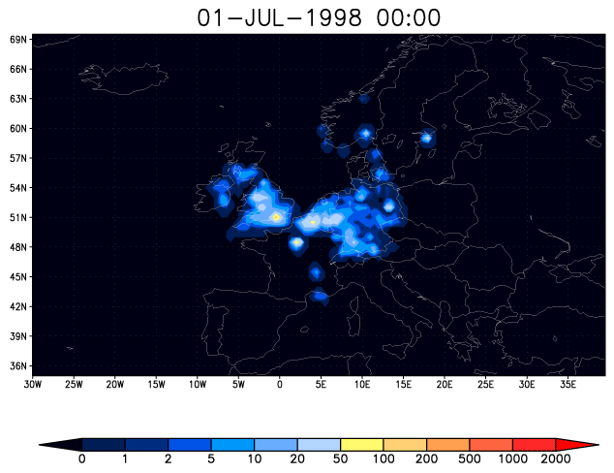
atmospheric measurements
inverse atmospheric model
top-down
GHG emissions
verification
bottom-up
E = AD x EF
Activity Data
Emission Factors
large uncertainties e.g.
N₂O from agricultural soils
CH₄ from landfills, coal
mining, gas leaks

Slide 25
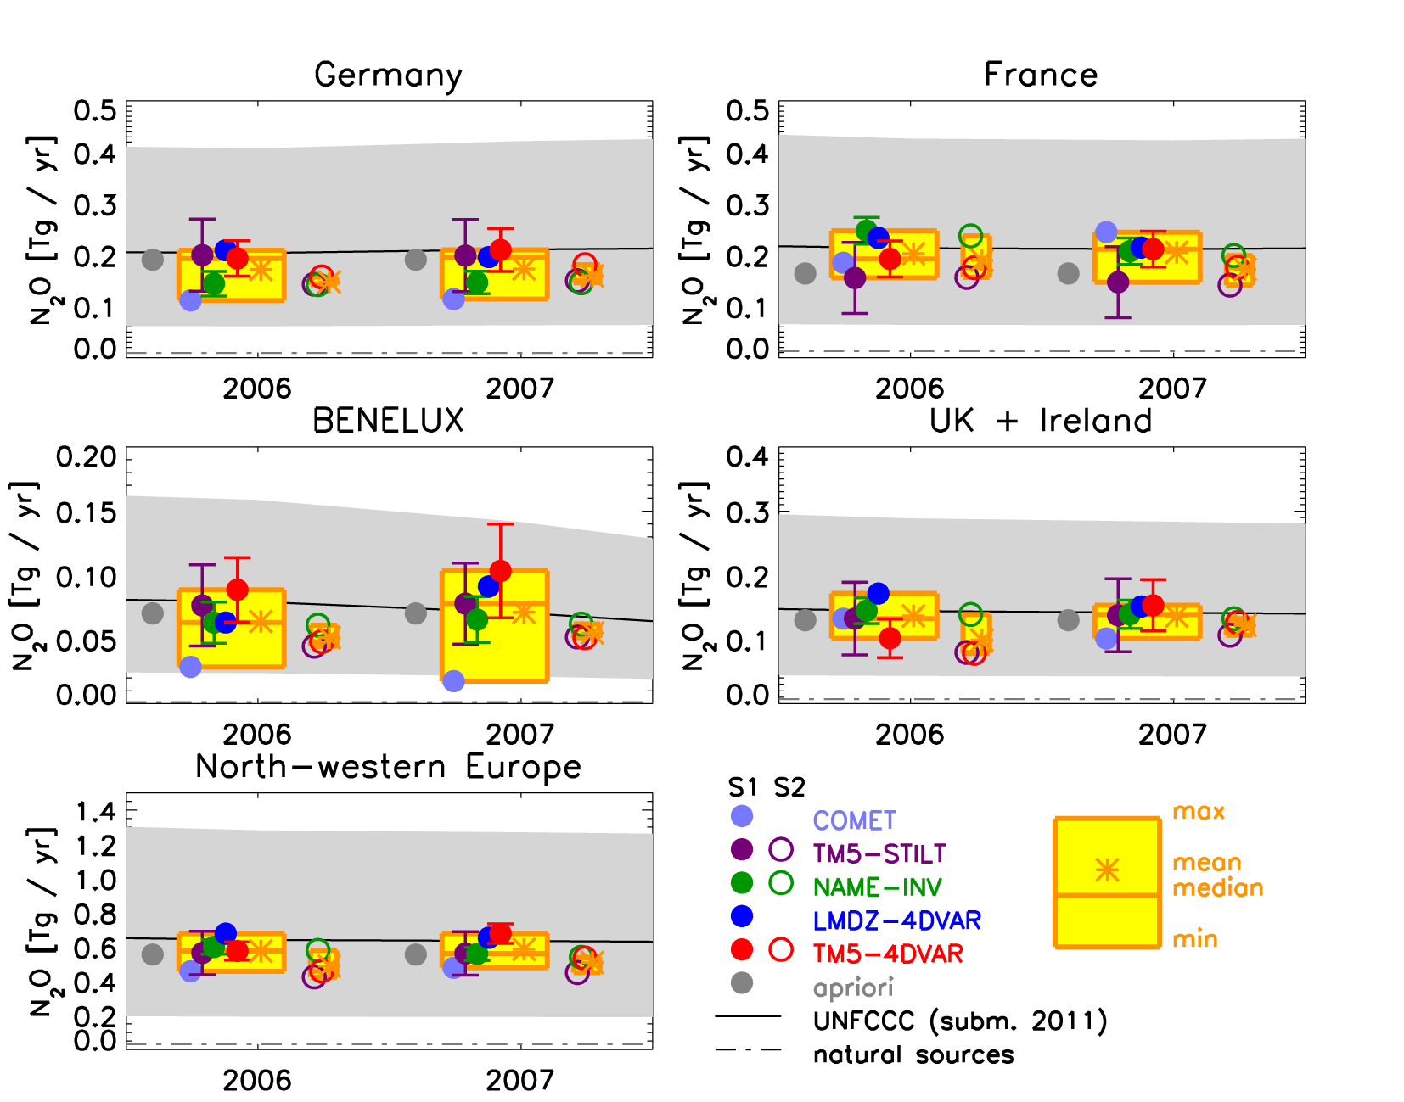
European N₂O emissions - country totals NWE
UNFCCC uncertainties ~ +100% / -70%

Slide 26
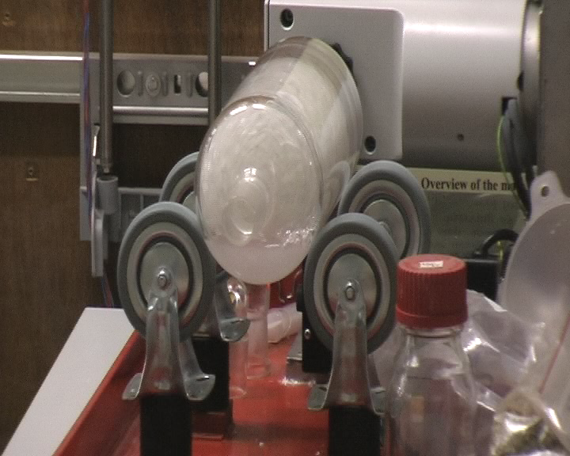
Joined Research
Isotopes
Keeling plot bronnen
In situ laser vs ms

Slide 27
Joined Research
Istotopes
Notes:
Trace Gas preconcentrator and IsoPrime mass spectrometer analysis of δ¹³C of CH4 and δ¹³C and δ¹⁸O of CO₂ in 75cm³ air samples, since March 2003. ~0.05‰ sd for CH₄
Second instrument since 2011.
NIWA cryogenic extraction line (1996-)
CRDS in lab and Barra, Ascension, Falklands. PP1 for CO, H₂

Slide 28
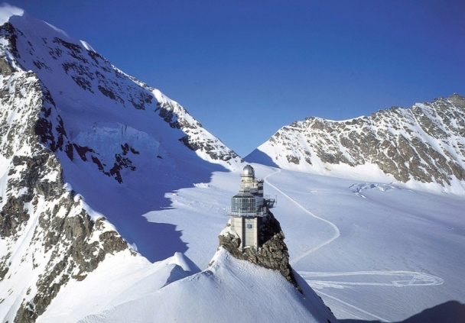
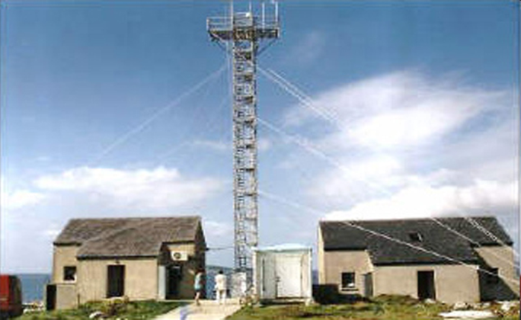
Joined Research
Halocarbons
F-gas sessie
Stefan Reimann
On-line
SOGE
AGAGE

Slide 29
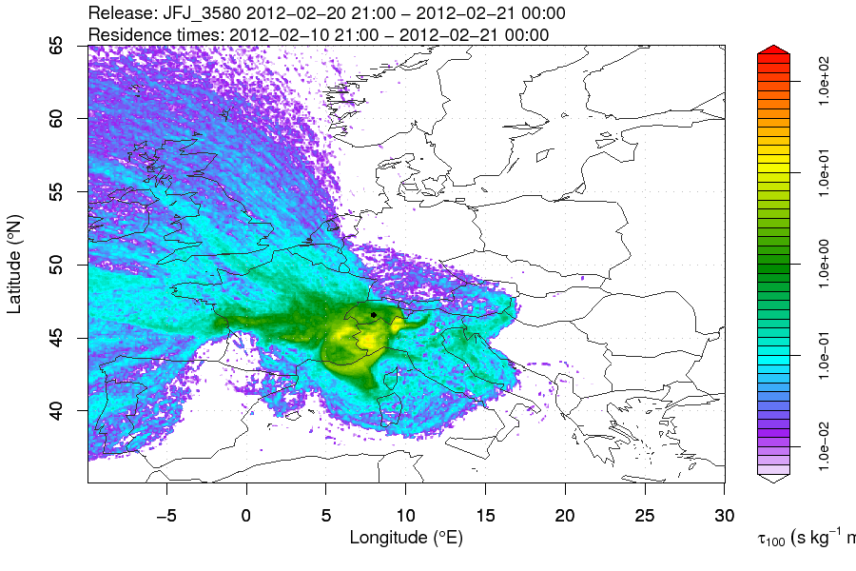
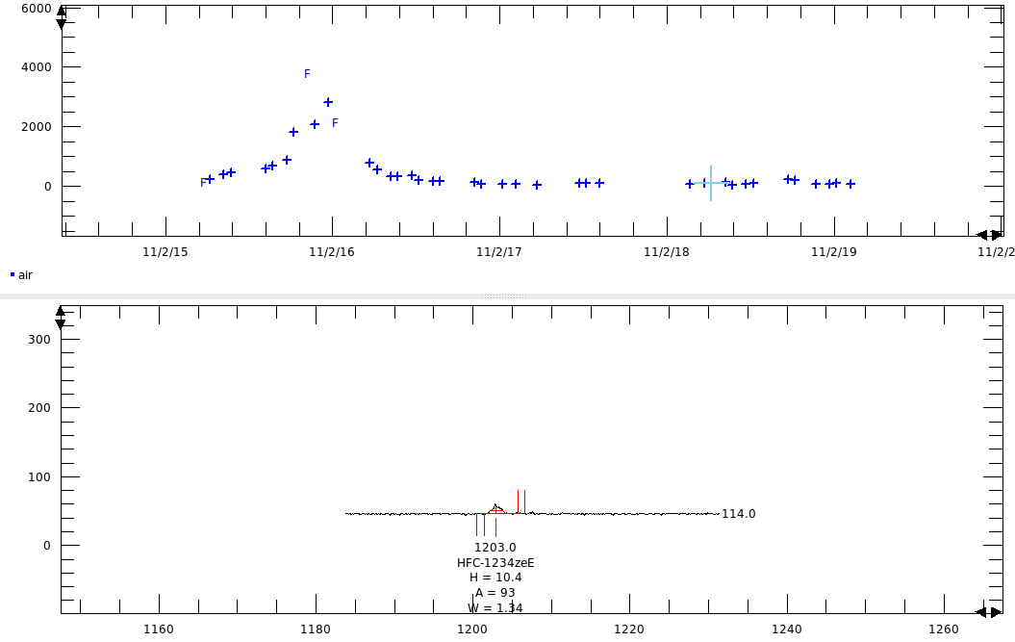
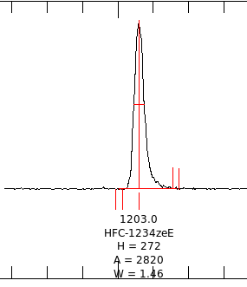
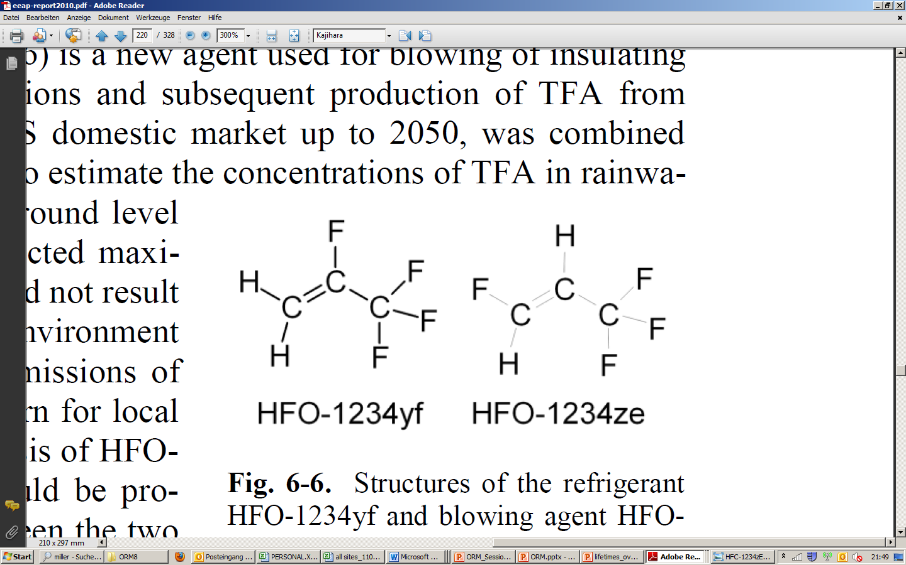
HFC-1234ze: the first peak world-wide
Jungfraujoch, Switzerland, 2011
Foam production
GWP₁₀₀: 7

Slide 30
Tall towers
& fluxes
Flux measurements at tall towers
Linking tall and small towers
Footprint models
55
87%
75%
30%
Cabauw 60 m CH₄ flux

Slide 31
Some products (out of 96 deliverables)
Unified and improved historic dataset of NCGHG’s
Datasets…
Databases for flux and concentration observations
Traveling FTIR and Rn system
Many reports and workshops
2 Summer schools
Top down emission estimates for Europe
Website:
  http://www.ingos-infrastructure.eu

Slide 32
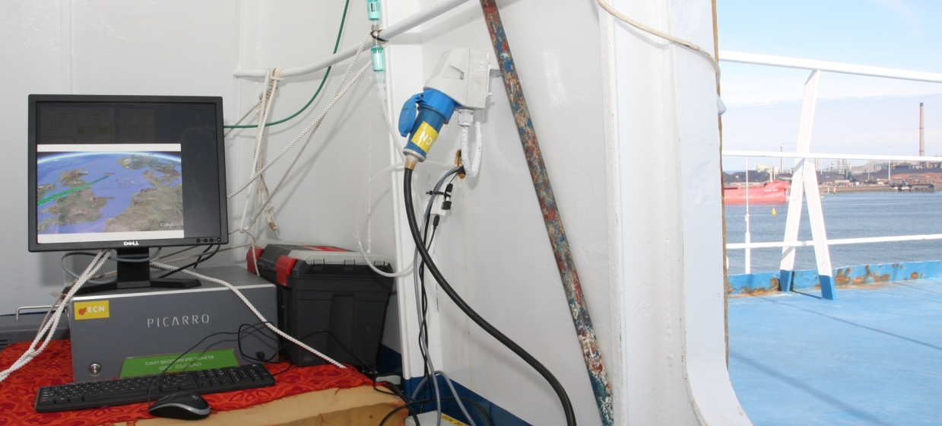
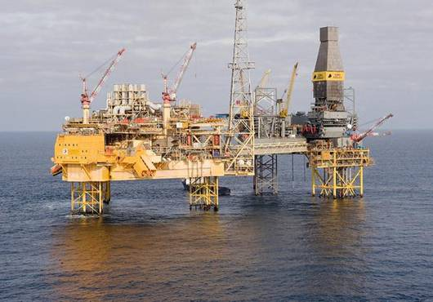
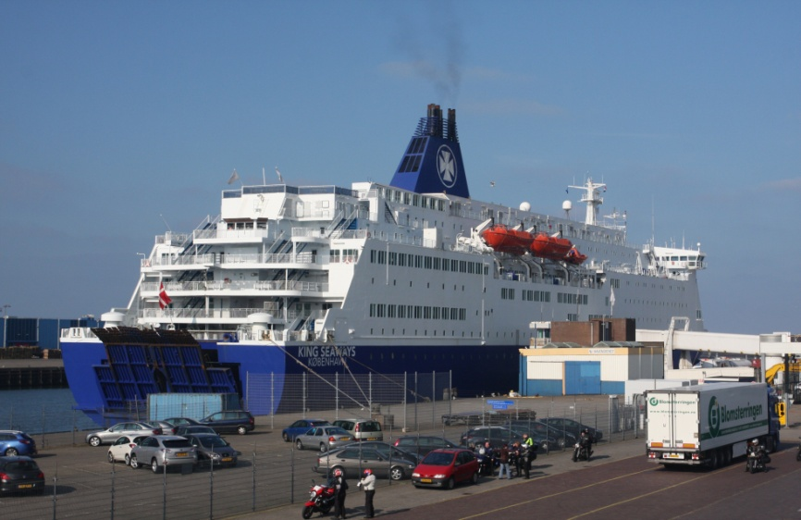
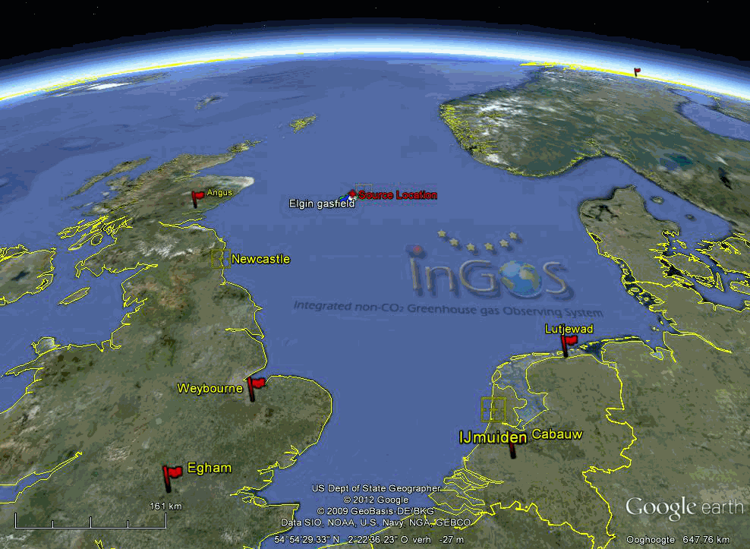
Elgin plume

Slide 33
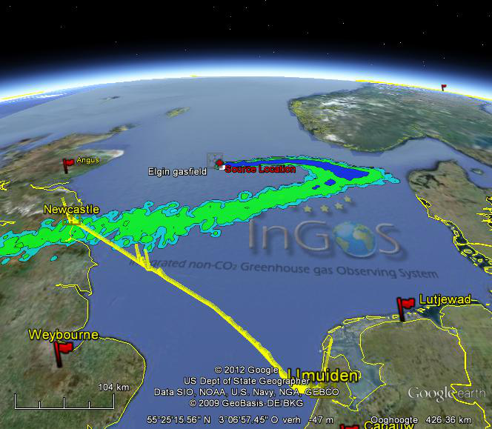
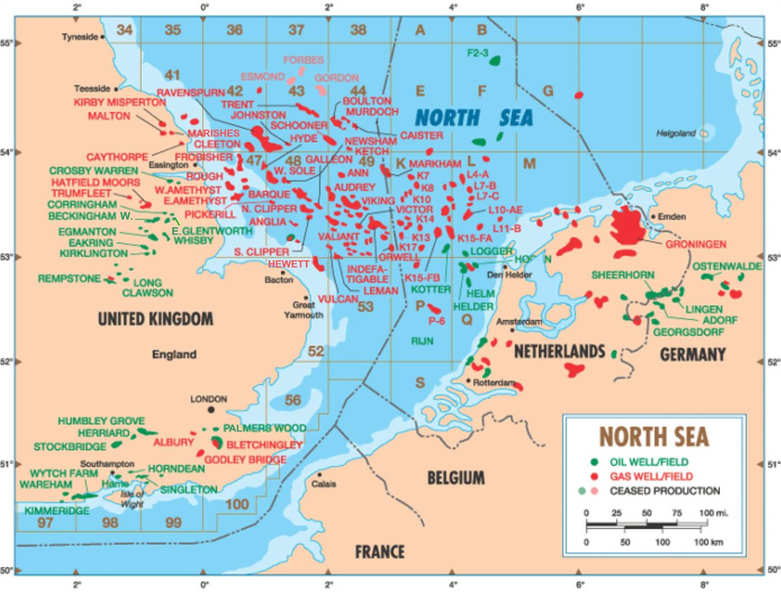
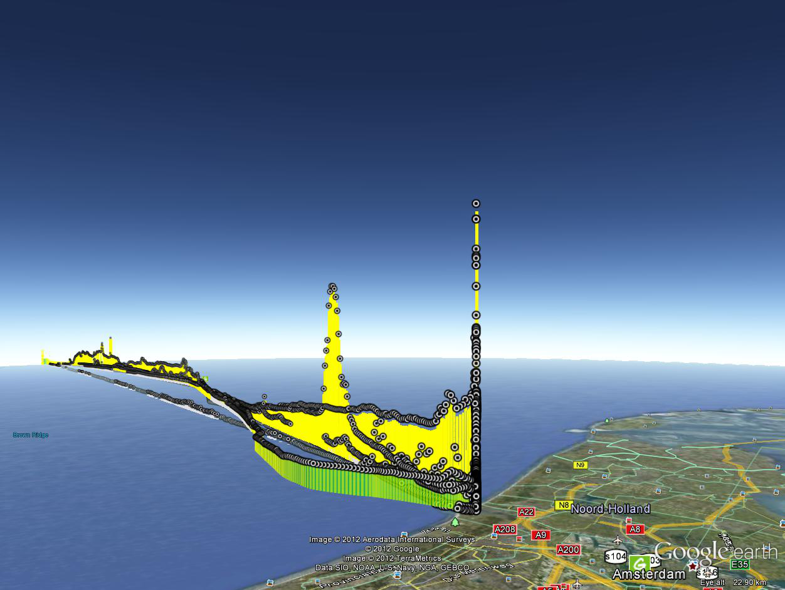

Slide 34
More info..
http://www.ingos-infrastructure.eu
Coordinator: a.vermeulen@ecn.nl hensen@ecn.nl

