Slide 1
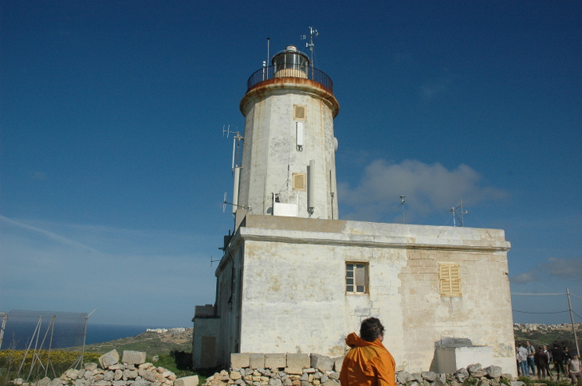
Status on preparation of the EMEP ”booklet”
Kjetil Tørseth
Kjetil Tørseth, EMEP/CCC, NILU

Slide 2
History
Request by TFMM (Zürich) for a note which could be used nationally in arguing the importance of EMEP observations
to include a discussion on AQD vs EMEP monitoring requirements
Draft presented at the SB in Sept 2012
Well received (?), and sent back to TFMM for finalization and to be approved SB Sept 2012

Slide 3
Webpage of AQD vs EMEP

Slide 5
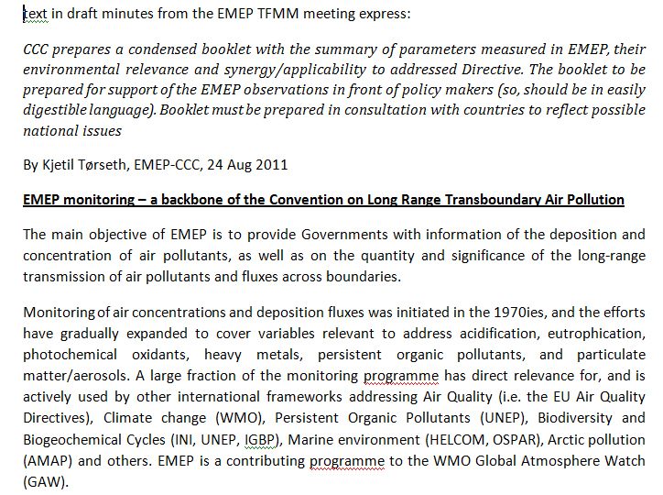

Slide 6
Content
Introduction – history, organization, relation to other programes etc
Fundamentals of monitoring: siting, trend, temporal resolution, methodologies, comprehensive list of variables, level approach, relaxations, national competance
AQD vs EMEP: PM2,5, VOC siting, (+methods)
Short lived climate forcers (note regarding ”BC”)
Precipitation chemistry
Nitrogen + Carbon cycle
POPs
HMs (Hg)
-> 6-7 pages

Slide 7
The 1st version of the booklet is partly ”problem oriented”
Several efforts made to address the mismatch between AQD and EMEP monitoring requirements (ref presentation given on day 1)
Remaining text is quite glossy, may serve as a nice introduction to EMEP monitoring, but can not really serve as a basis for documenting the importance of EMEP observations.

Slide 8
-> 26 papers

Slide 9
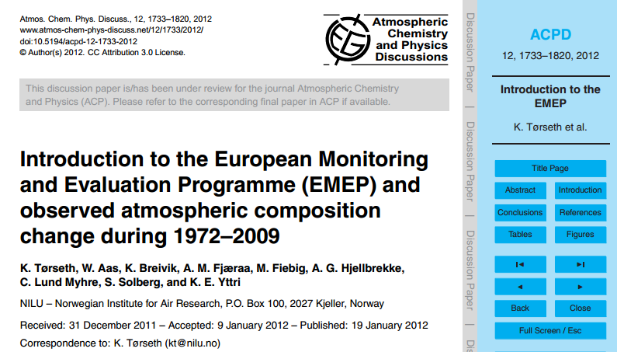

Slide 11
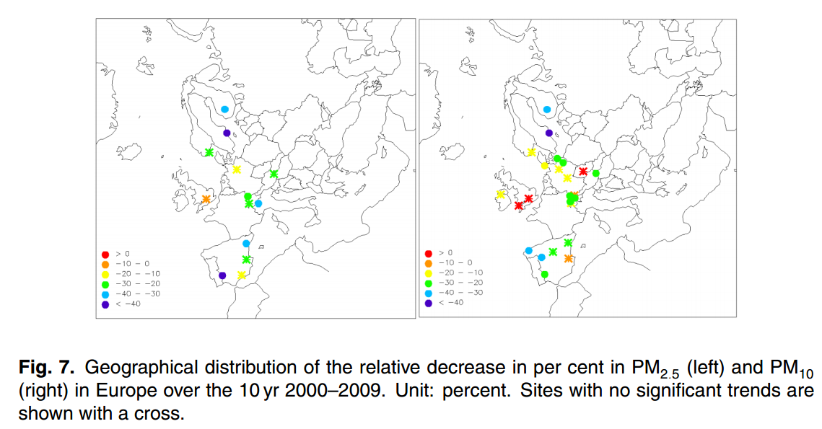

Slide 12
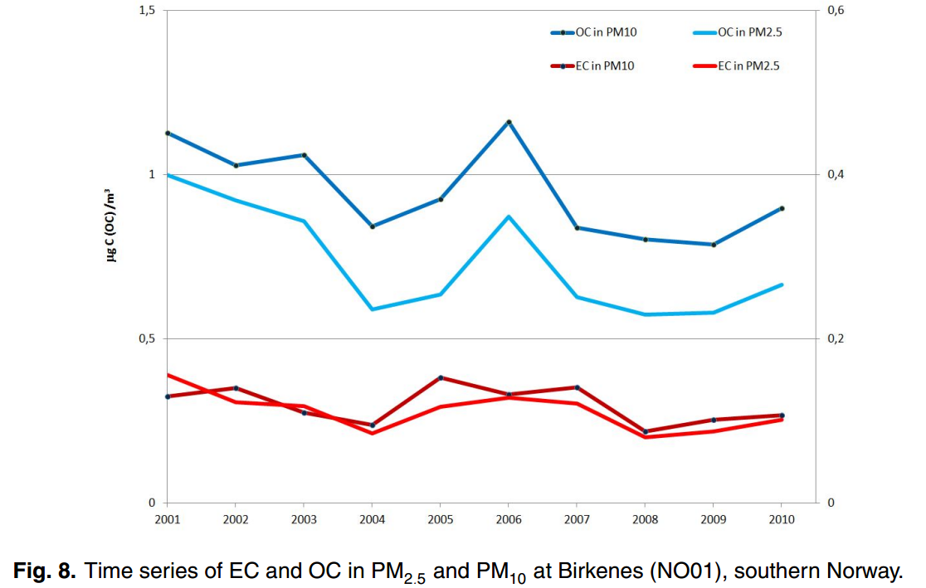

Slide 13
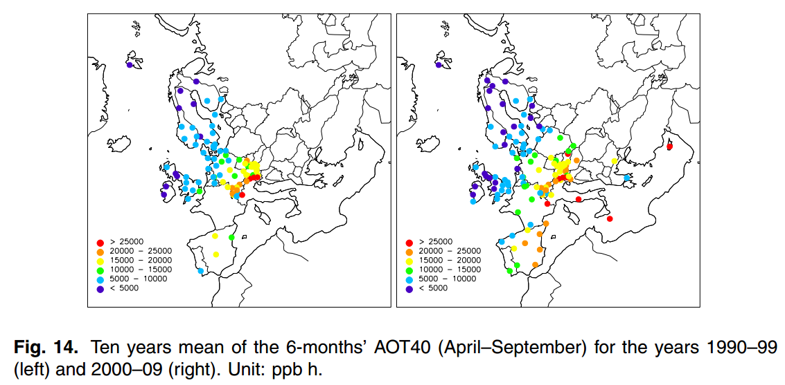

Slide 14
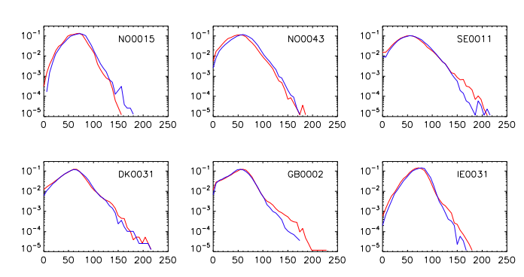

Slide 15
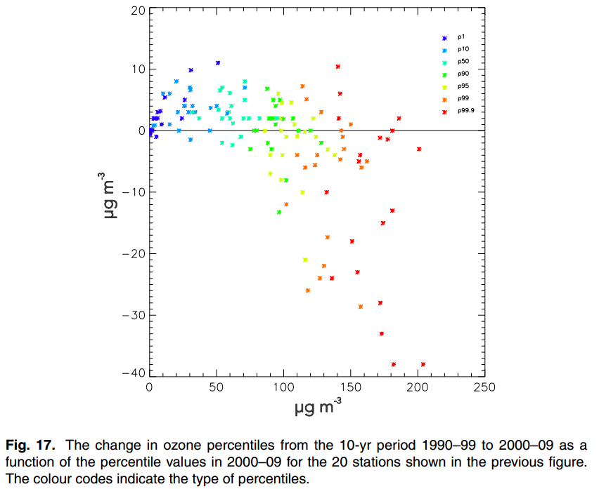

Slide 16
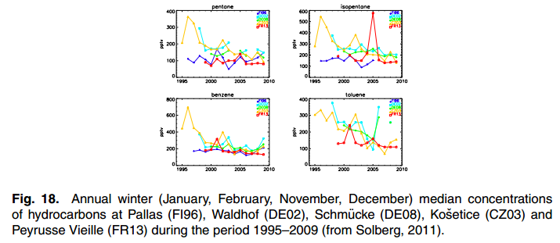

Slide 17
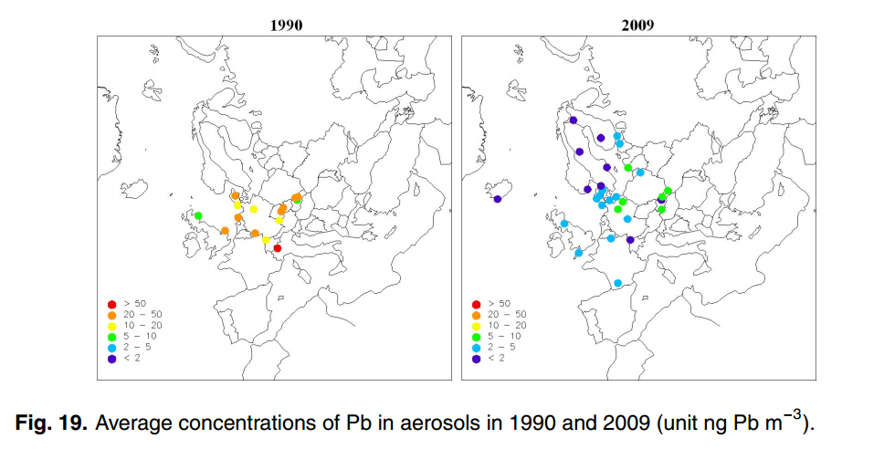

Slide 18
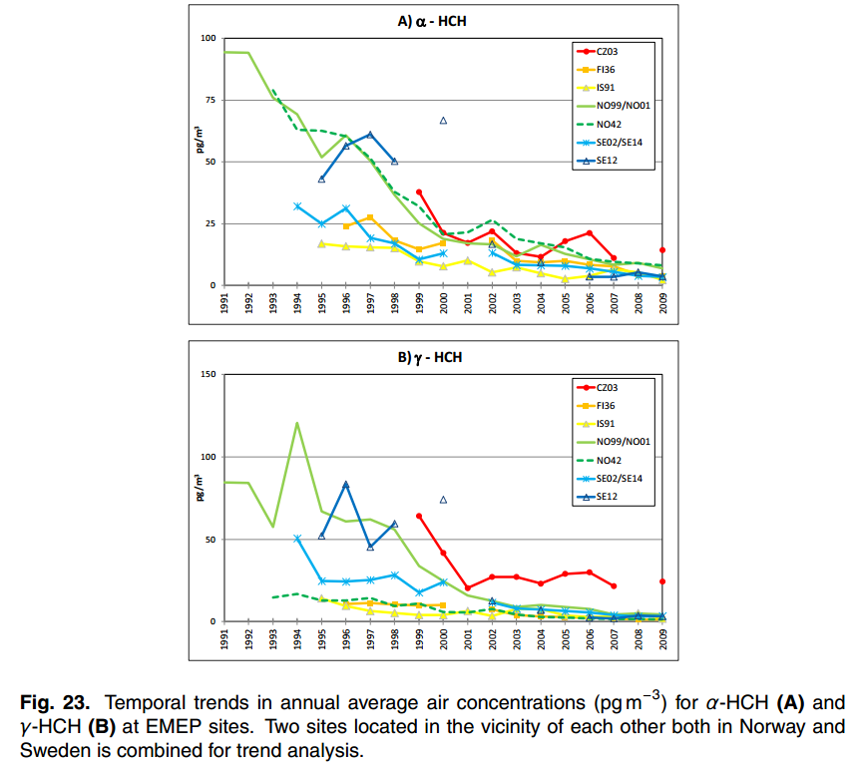

Slide 19
What next ?
Based on ACP paper -> a revised boklet can be prepared.
Targeted discussions (?)
More than observations (?)
What are the national needs
Process – SB2012

