Slide 1

Developments in downscaling methodology within the EC4MACS project
Chris Heyes
B. Bessagnet¹, E. Terrenoire¹, P. Thunis², K. Cuvelier²,
G. Kiesewetter³, J. Borken-Kleefeld³, W. Schöpp³,
M. Amann³
¹ INERIS, ² JRC, ³ IIASA
TFMM, Gozo(Malta), 17-19 April 2012

Slide 2
EC4MACS: European Consortium for Modelling of Air Pollution and Climate Strategies

Slide 3
Linkage between AQ limit values and transboundary pollution
EC4MACS: Improved modelling of compliance with air quality limit values
New methodology for European-scale compliance assessment with CHIMERE/EMEP models for PM, NO₂, O₃.
Improved ‘City-delta’ methodology:
  Fine-scale CHIMERE calculations with fine-scale meteorology used for adjusting urban background concentrations
  Additional estimate of maximum contribution of vehicles within street canyons, depending on emission strength
  Should allow comparison of various statistics with AQ limit values to indicate potential for violation of limit values

Slide 4
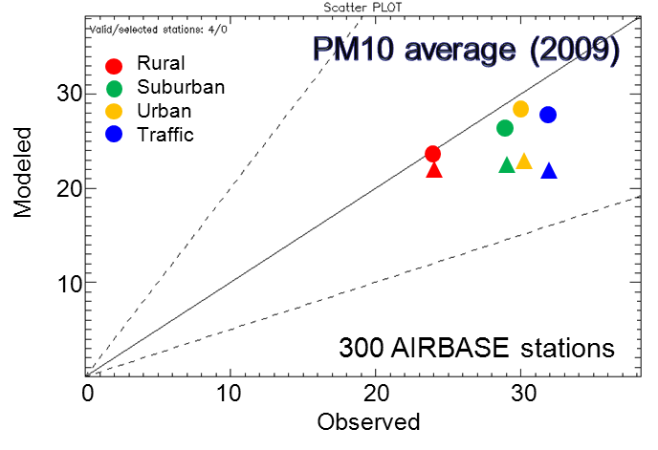
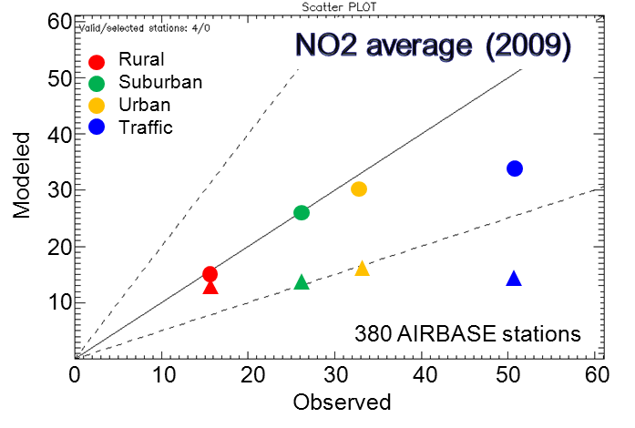
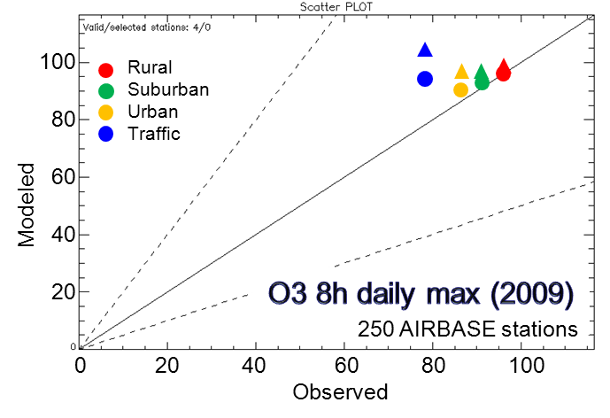
Added value of Fine resolution modelling
50 km
7 km
Consistent behaviour for rural stations.
Significant resolution increments for PM10 and NO2 at urban and suburban stations.
Improved representation of the spatial correlation
Net gain but problems remain with traffic stations (not so important for PM10)

Slide 5
Modelling street level NO₂ with a simple NO/NO₂ model (Düring et al, 2011)
In addition to the direct dispersion of NO₂ emissions,
NO – NO₂ – O₃ chemistry is relevant at such short timescales (minutes)
⇒ Photochemical steady state [NO₂]_{ss} at roadside station:
Urban background:
[NO2]_{B}, [NOx]_{B}, [O3]_{B}
Mixing time τ (≈40-100s)
[NO₂]_{ss}=?
Input parameters:
local [NOx]
p=NO₂/NO_{x} emission share
background [NO₂]_{B}, [NO_{x}]_{B}, [O₃]_{B}
Traffic station:
[NOx], p

Slide 6
NO₂/NO_{x} model: Setup
At street level, only fast chemistry is relevant: NO – NO₂ – O₃ chemistry
Rates of change in a system coupled to background (mixing time τ):
Equilibrium is attained within minutes ⇒ calculate steady-state solution (d/dt [ ]= 0)
cf: Düring et al., Meteorol. Z. 20, 67-73 (2011)

Slide 7
NO₂/NO_{x} model: Solution
Steady state solution [NO₂]_{ss}:
where
…total oxidants
…[NO₂] from background + NO₂ emissions
…[NO₂] increment from NO₂ emissions
…NO₂ share in NO_{x} emissions
… background
… local
cf: Düring et al., Meteorol. Z. 20, 67-73 (2011)

Slide 8
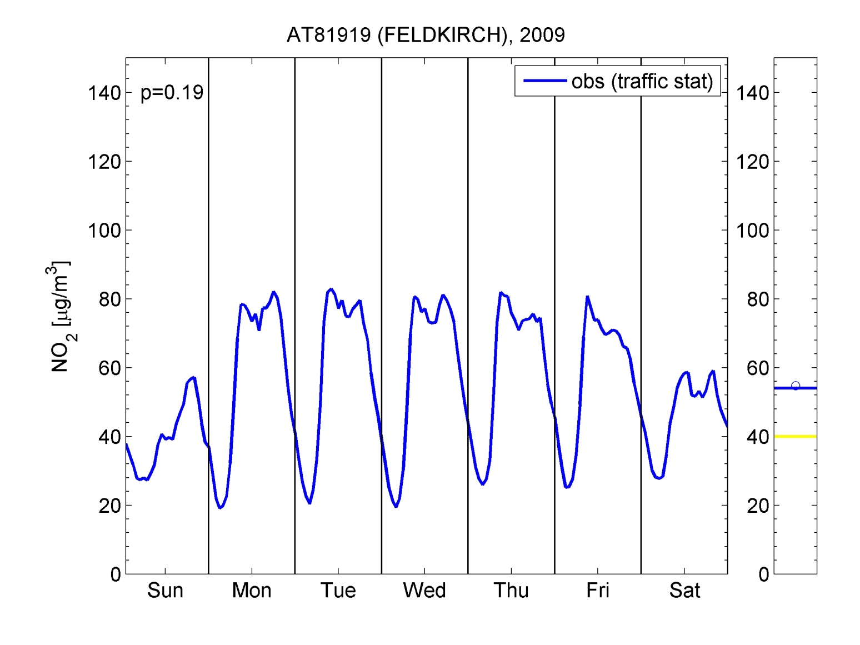
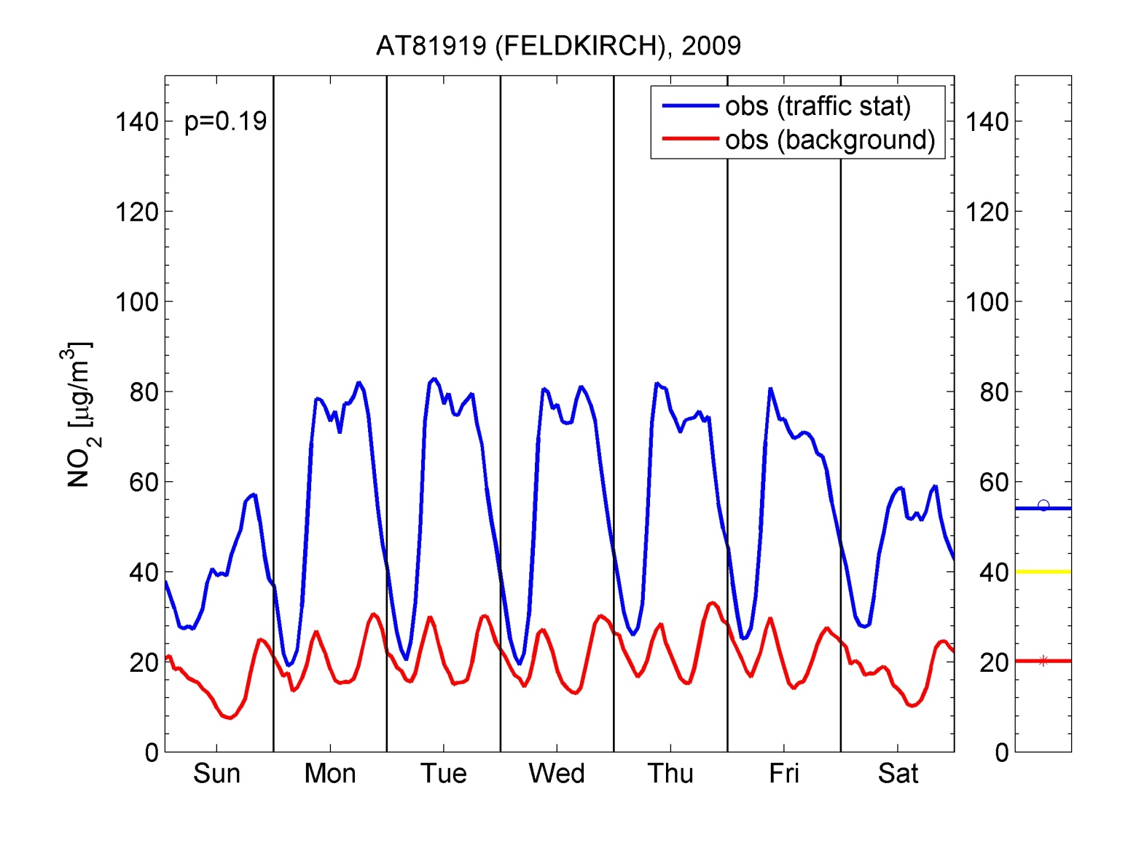
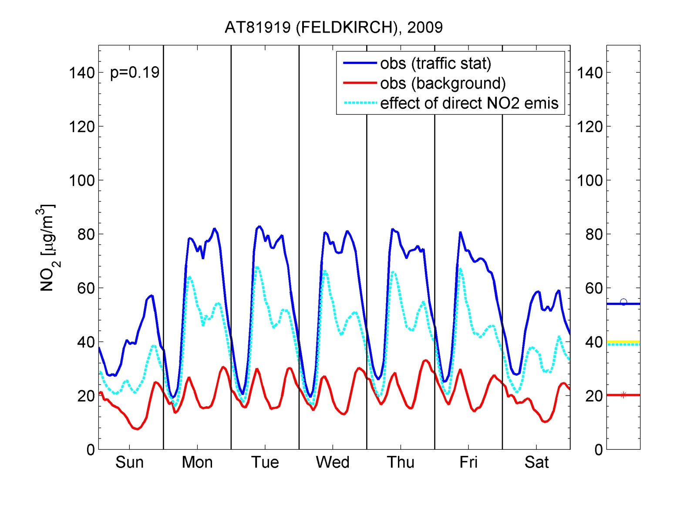
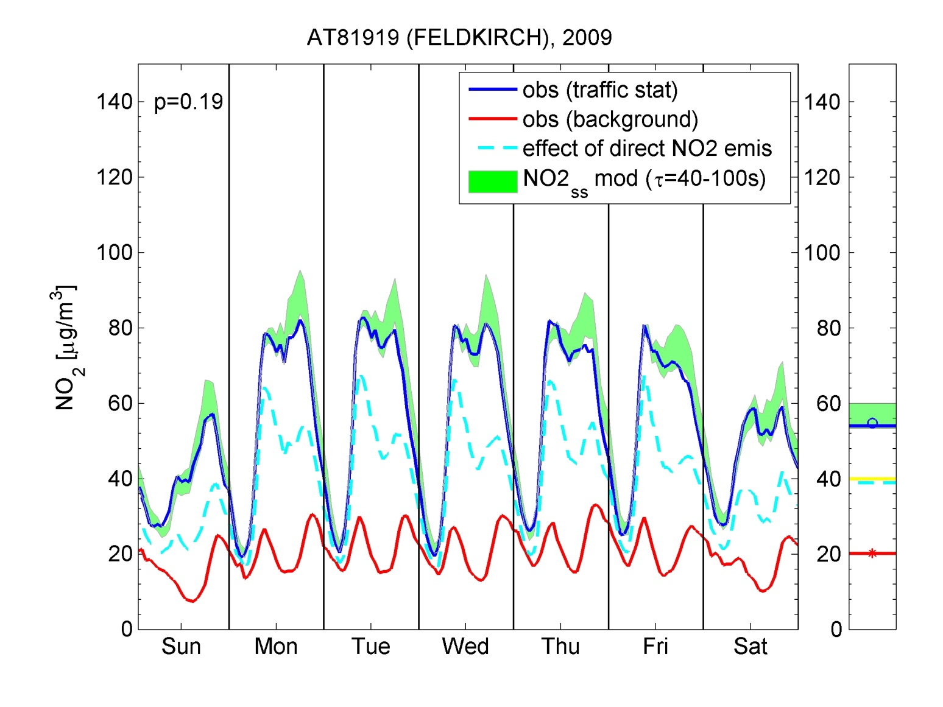
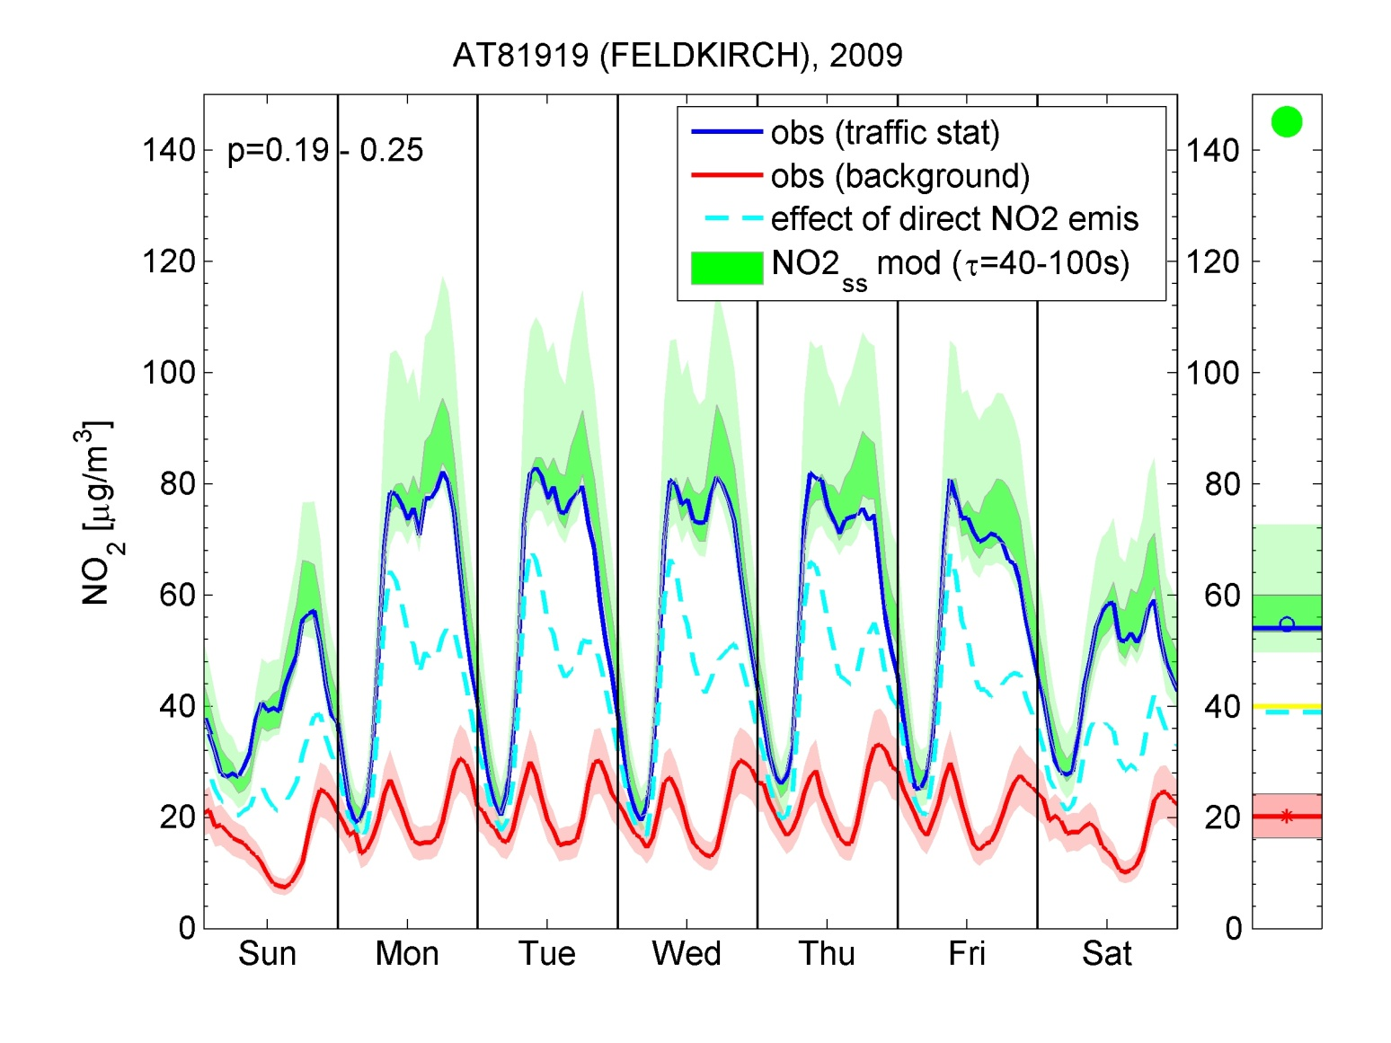
Extension to the weekly pattern (hourly resolution)
Extension of annual mean model to weekly pattern:
Needs daily cycle of J (solar irradiation) and k (temperature).
J: observed daily cycle for Juelich (DE) scaled with country average radiation
k: German value scaled with temperature
annual mean
[NO₂]_{B} upper limit + τ=100s + higher p (0.25)
[NO₂]_{B} lower limit + τ=40s + national avg. p (0.17)

Slide 9
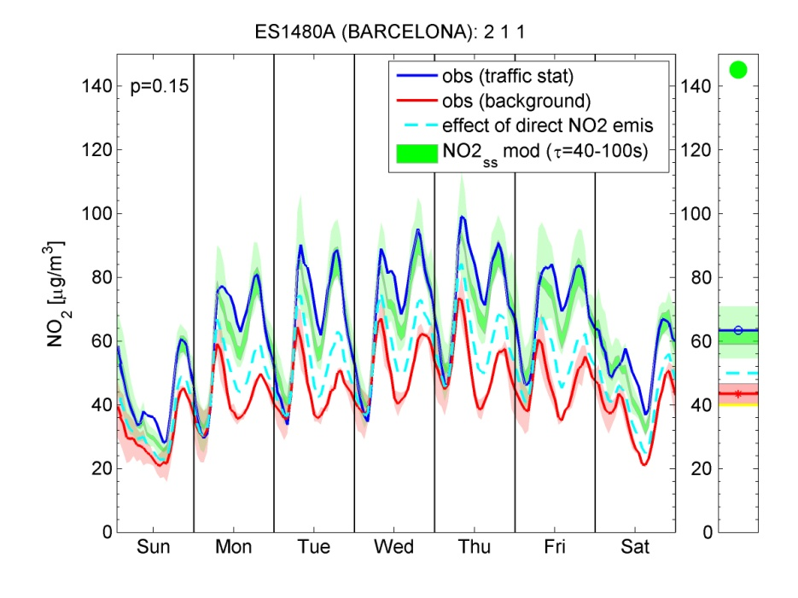
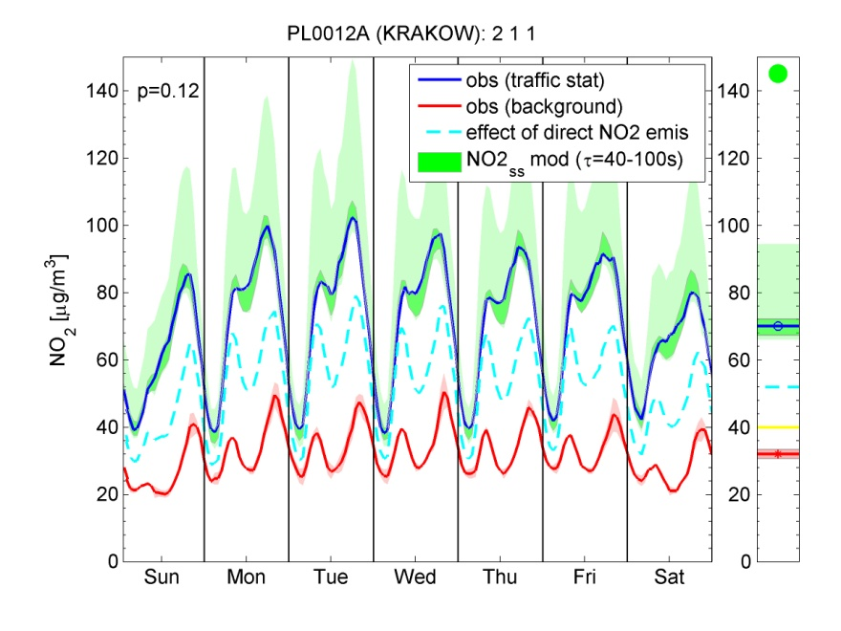
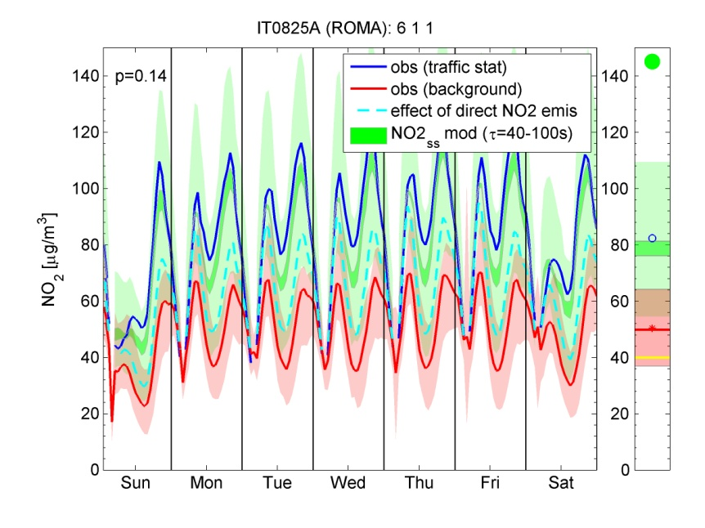
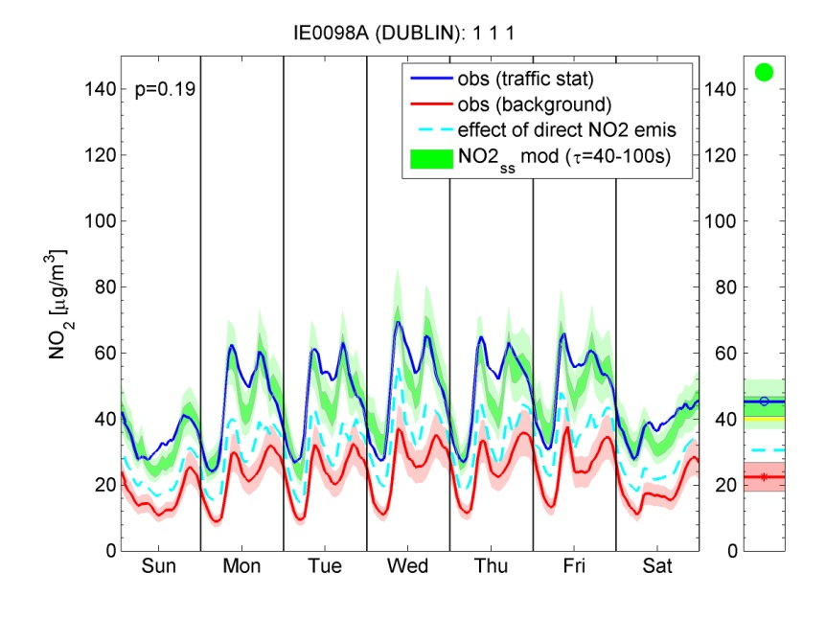
Performance for weekly pattern
ES1480A (Barcelona)
PL0012A (Krakow)
IT0825A (Rome)
IE0098A (Dublin)
>80% of non-background exceedance stations with sufficient data are explained well!

Slide 10
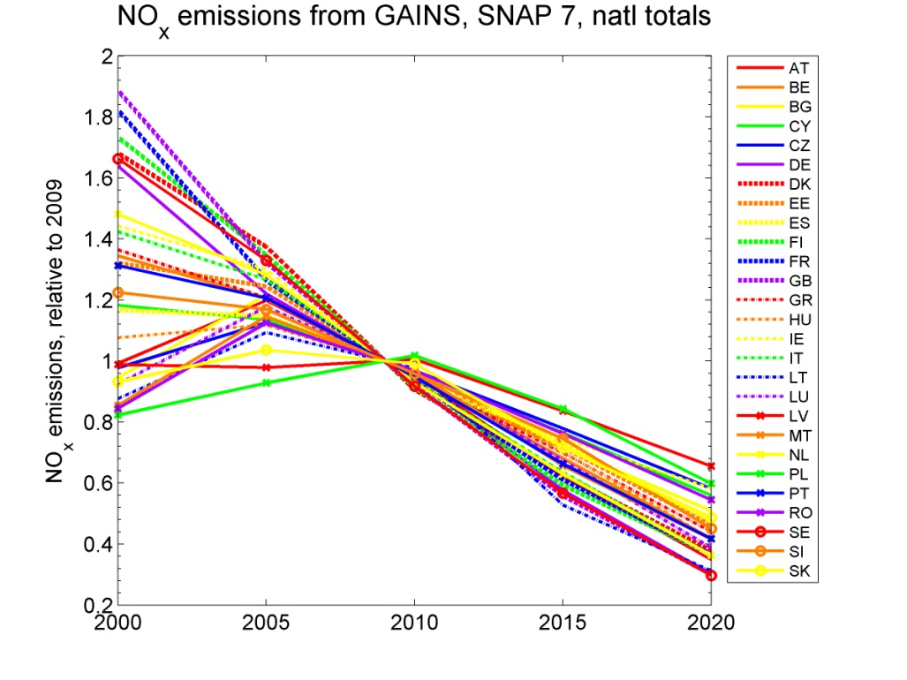
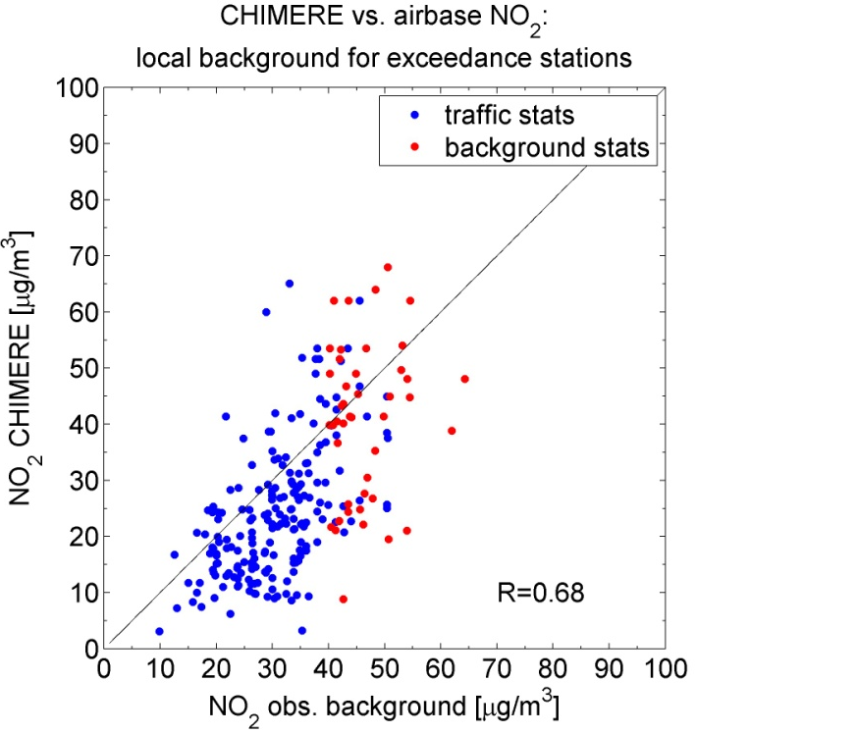
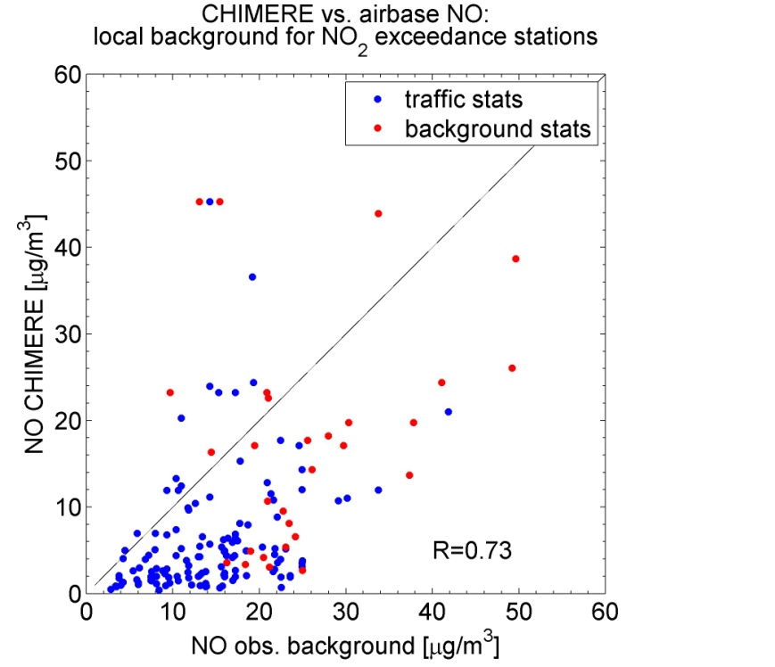
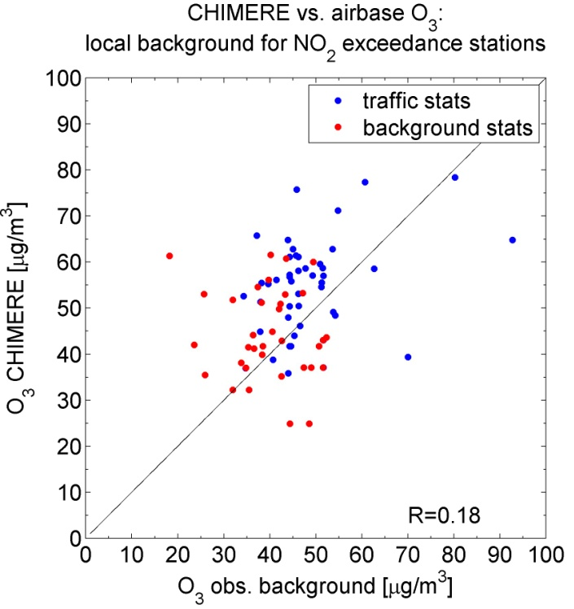
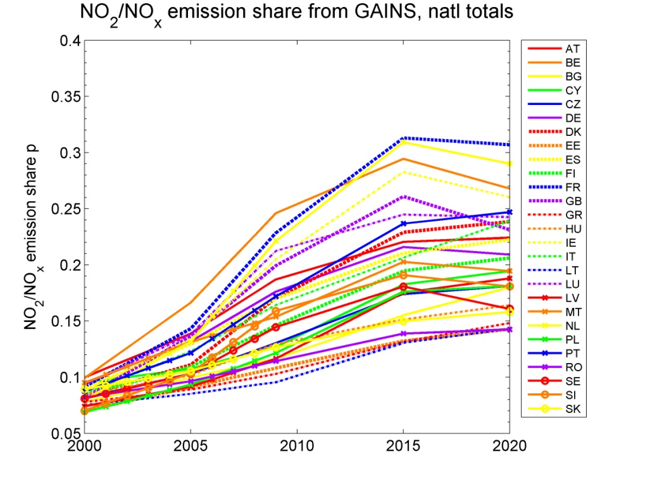
Scenario Analysis: Inputs
[NO₂]_{ss} = f([NO_{x}], τ, p, [NO₂]_{B}, [NO_{x}]_{B}, [O₃]_{B})
unknown!
⇒ parameterise with evolution of emissions
Site specific!
⇒ tune
available from dispersion models (EMEP + CHIMERE downscaling), possibly site-specific correction
CHIMERE as local background:
Evolution of national NO_{x} traffic emissions:
Evolution of NO₂ traffic emission share p:
NO₂
NO
O₃

Slide 11
Implementation in GAINS: PM10 and PM2.5 for all grid cells (population exposure) and all AIRBASE exceedance stations (compliance)
Annual mean for compliance and population exposure:
  Starting point: PM10/2.5 computed for a particular scenario
  with the source-receptor relationships derived from the EMEP model at regional-scale resolution
  Urban increment for the 7km grid cell:
  the difference between the CHIMERE fine- and regional-scale runs for 2009 will be scaled proportional to
  changes in urban low-level PM emissions
  (traffic and heating) in the grid cell
Urban background
Regional background

Slide 12
Implementation in GAINS: NO₂
Annual mean, for all AIRBASE exceedance stations
  ‘Roadside’ component (assuming constant traffic counts and 2009 meteorology):
  Scale the station-specific increment derived with the simple chemistry model from the 2009 observations
  with the EMEP/Chimere S/R estimates of
  (urban background) NO₂, NO and O₃, and
  GAINS info on trends of urban traffic NOx emissions
  and NO₂ /NO_{x} ratio
Roadside
Downscaling to the 7km (‘urban background’) grid cell of the station:
  based on the 2009 difference in NO₂ concentrations
  between the CHIMERE fine- and regional-scale runs,
  scaled proportional to changes in low-level urban traffic emissions of the particular scenario.
Urban background
Regional background
Starting point for a future scenario:
  NO₂ computed with EMEP S/R for the regional scale

Slide 13
Next steps
Review of existing model results
Improvements in emissions inventory
Model assessment of new approach

