Slide 1
Air pollution assessment in France
and Europe
Recent results from the CHIMERE model

Slide 2
Outline
Presentation of the main CHIMERE results in EC4MACS
Scenarios study on NH3 emissions with CHIMERE
Towards the improvment of dust emissions in CHIMERE

Slide 3
CHIMERE results in EC4MACS

Slide 4
CHIMERE general settings in EC4MACS
CHIMERE : chemistry transport model
Aerosols (SO4, NO3, NH4, SOA, PPM, Sea Salts)
Gas species
Usual chemistry, microphysics, deposition
Domain : Large part of Europe (~7-8 km and ~50 km resolution)
ECMWF/IFS meteorology (20 km resolution) for 2009
EMEP emission inventory (0.5 x 0.5°)
Wildfires : monthly GFED3 data
Boundary conditions
monthly climatologies from global models
O3, dust, sulfate, carbonaceous species
Main missing processes :
Road trafic resuspension, wind blown dust inside Europe
No coarse nitrate formation
No SVOC chemistry for aerosols

Slide 5
Model improvement for the urban scale
Z
NO2, PM
O3
URBAN SURFACE LAYER
Improvement of emission injection heights
WIND
3H
URBAN SUBLAYER
Kz and wind speed correction
factor of 0.5 over urban areas
20m CHIMERE first layer
H
URBAN
CANOPY
LAYER
C
Urban background observations
Trafic emissions
Residential emissions

Slide 6
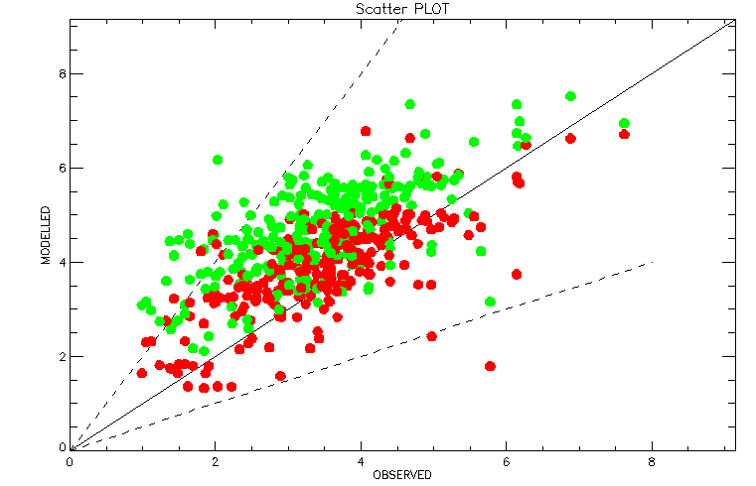
Differences between meteorological drivers
WIND SPEED m/s
Old met. (Reanalysis/WRF 7km)
New met (direct IFS 20km)
CHIMERE
MODELLED
OBSERVED

Slide 7
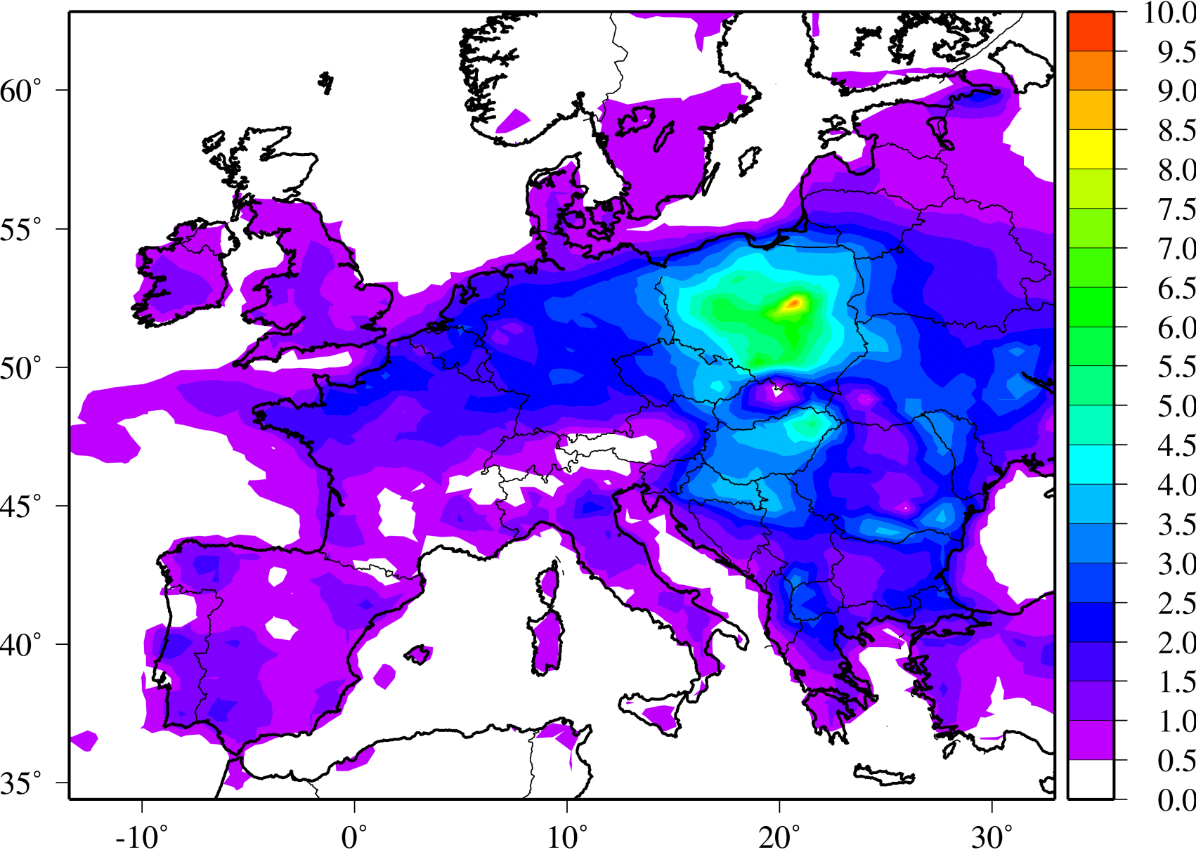
New SNAP2 emission time profile
SNAP2 represents 42% of total PM10 emissions in EU27 (2009)
New emission time profile adjusted with heating degree days
µg/m³
Difference in PM10 between the new
and old time profiles (January)

Slide 8
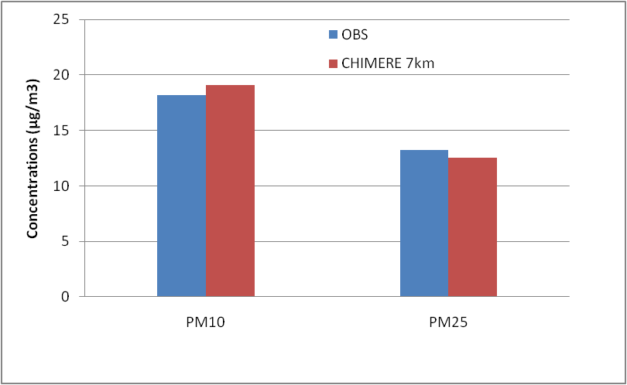
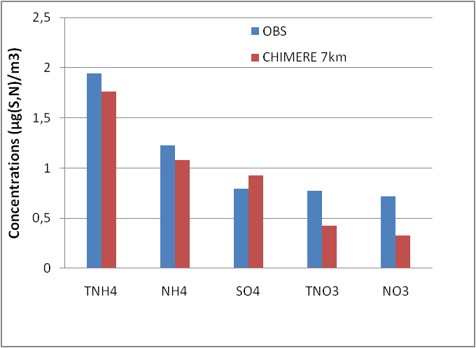
Evaluation against EMEP observations – PM speciation
EMEP
EMEP
PM10 : slight overestimate
PM2.5 : good performances
NH4 : good performances
NO3 : systematic underestimate
SO4 : slight overestimate

Slide 9
CHIMERE (PM10) 7 km versus observations
ANNUAL MEAN
2009
µg/m³
Coloured circles are the observations (AIRBASE – rural & urban background)

Slide 10
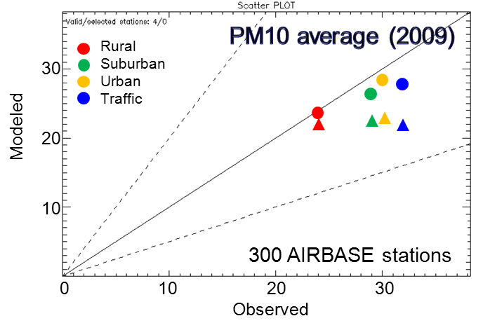
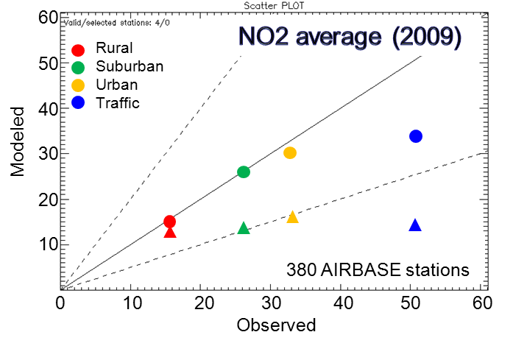
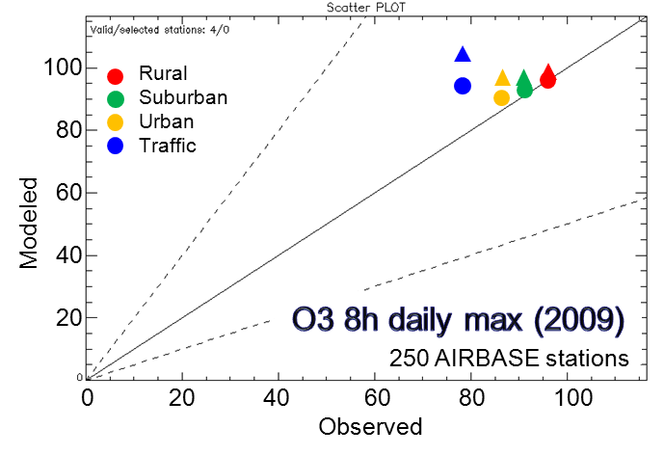
Added value of fine resolution modelling
50 km
7 km
Consistent behavior for rural stations.
Significant resolution increments for PM10 and NO2 at urban and suburban stations.
Improved representation of the spatial correlation
No gain in terms of temporal correlation → Depending on quality of emission temporal profiles
Net gain but problems remain with traffic stations (not so important for PM10)

Slide 11
Scenario studies on ammonia emission reductions with CHIMERE over the year 2007

Slide 12
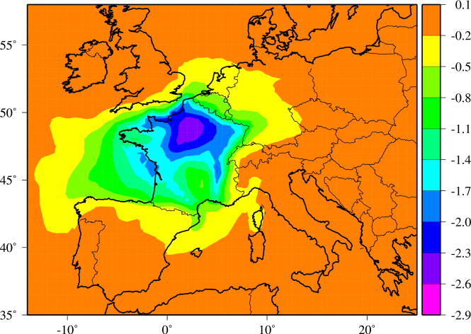
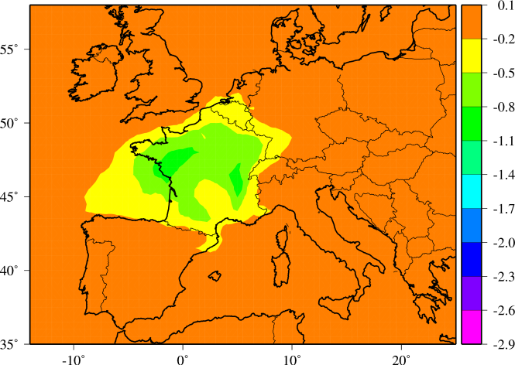
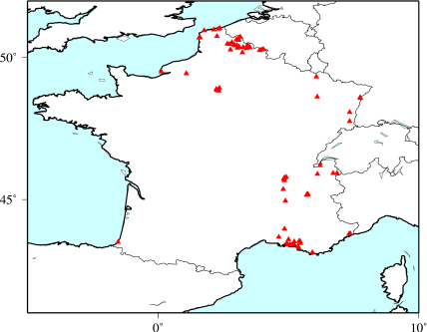
Scenario study : ammonia emission reductions
Agricultural NH3 emission reduction (–50% or -125 kT)
versus road traffic NOx emission reduction (-50% or -113kT) in France
PM10 decrease (µg/m3) over January-April 2007
NH3 reduction
NOx reduction
Exceedances in 2007
>35 times the 50µg/m3
threshold

Slide 13
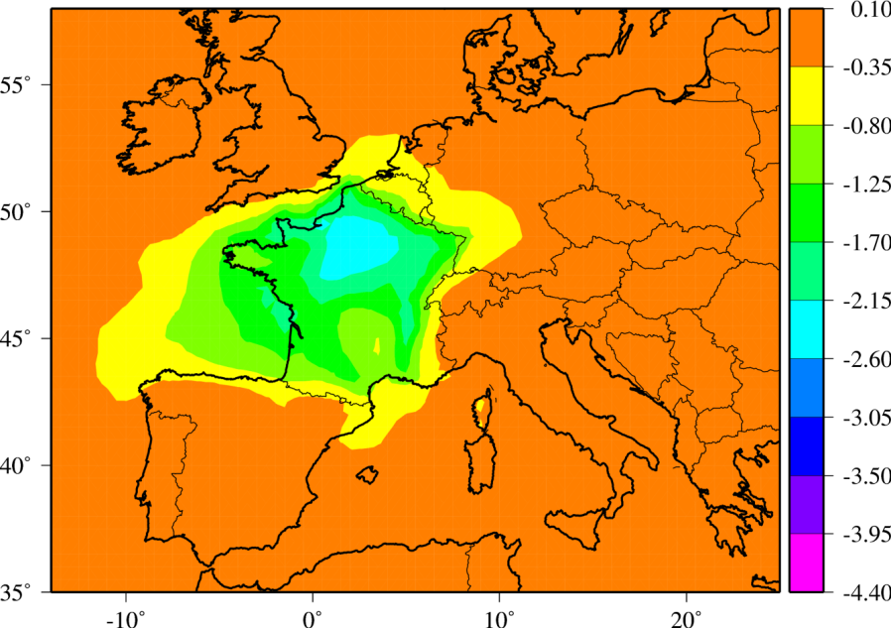
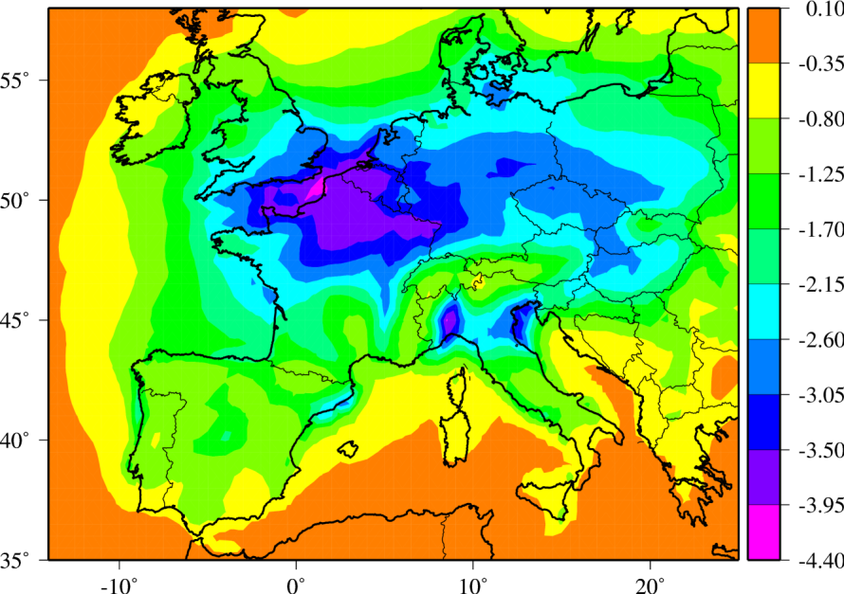
Scenario study : ammonia emission reductions
Agricultural NH3 emission reduction (–50%) in France
versus agricultural NH3 reduction (-50%) over the whole Europe
PM10 decrease (µg/m3) over January-April 2007
-50% NH3 reduction in France
-50% NH3 reduction in Europe

Slide 14
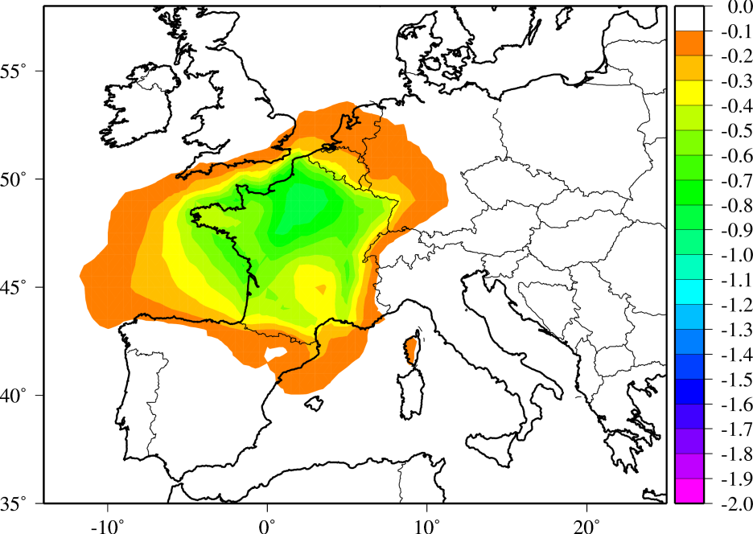
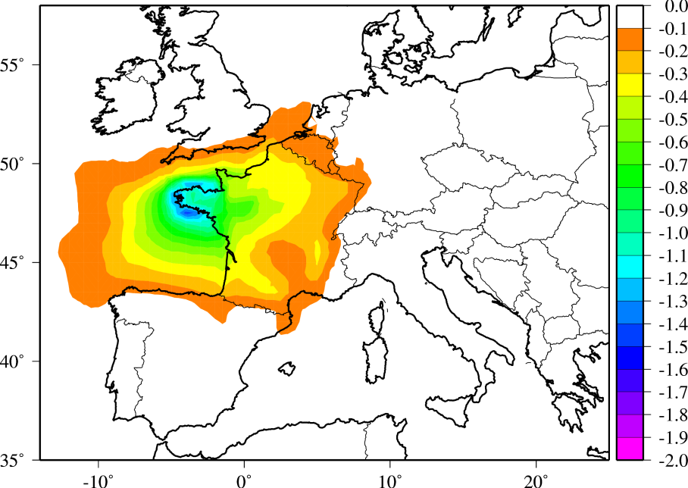
Scenario study : ammonia emission reductions
Homogeneous -30% NH3 emission reduction in France versus heterogeneous -30% NH3 emission reduction with more reductions over the most NH3 emitting french regions
Same absolute emission reduction (-125kT)
PM10 decrease (µg/m3) over January-April 2007
NH3 reduction in France
(homogeneous way)
NH3 reduction in France
(heterogeneous way)

Slide 15
Improvement of ammonia emissions in CHIMERE
Dynamic emissions of NH3
Impact of T° and wind speed

Slide 16
Improvement of dust prediction
Road dust emissions
50% of PM10 road traffic emission is due to road dust in dry conditions
90% in salting / sanding cases
Modulation with humidity and precipitation
Wind blown dust emissions
Extention of desert dust models to Europe
Meteorological variable to modulate the emission
Evolution of vegetation
Agricultural practices over arable lands

Slide 17
Conclusions and perspectives
An improved version for CHIMERE has been designed
Meteorology
SNAP2 emissions (for better wintertime calculations)
CHIMERE performances are improved 50km → 7km
Coherent performances at EMEP sites (PM and speciation)
Remaining problems in Eastern countries in winter (PM underestimate)
Scenarios studies : NH3 reduction looks more efficient to reduce PM compare to NOx reductions
Additional improvement to be done
Emission inventories (in progress for EC4MACS)
Urban meteorology
POA chemistry for SOA production
Dust is difficult to estimate at background sites

