Slide 1



Source apportionment of PM across the Netherlands and Europe using LOTOS-EUROS
M. Schaap, C. Hendriks, R. Kranenburg, H. Denier van der Gon, A. Segers, R. Wichink Kruit, A. Manders, J. Beltman, J. Kuenen, F. Amato, L. Curier, R. Timmermans, P. Builtjes, and others.
BOP II

Slide 2
Introduction

Slide 3
New LOTOS-EUROS model version
LOTOS-EUROS v1.8 contains updates on:
  Cloud chemistry
  Heterogeneous chemistry
  Aerosol deposition
  Ammonia compensation point
  Mineral dust
  Coarse mode nitrate
  Source apportionment module

Slide 4
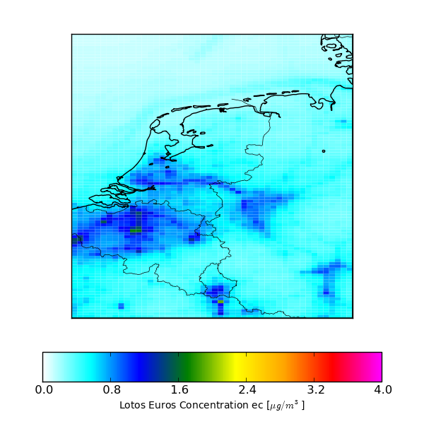
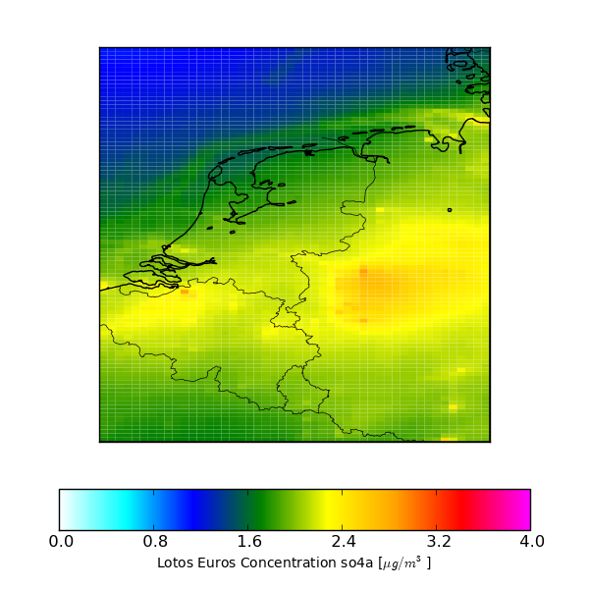
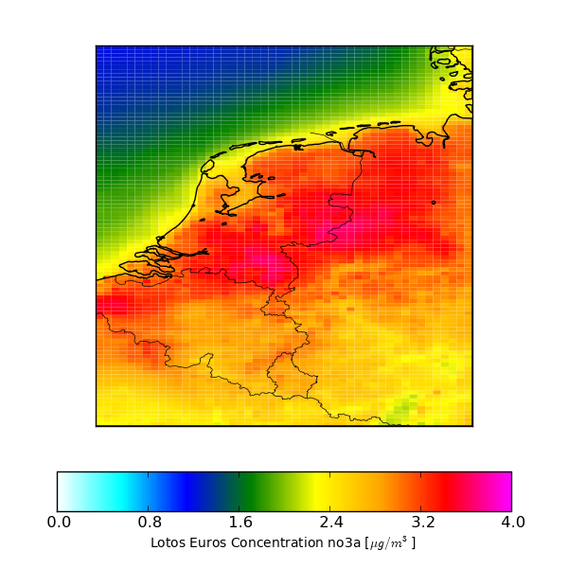
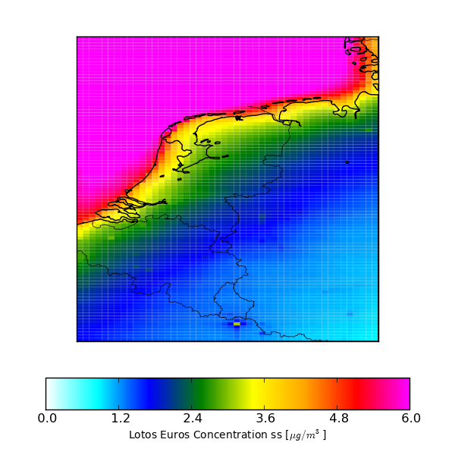
EC
SO4
NO3
SS

Slide 5
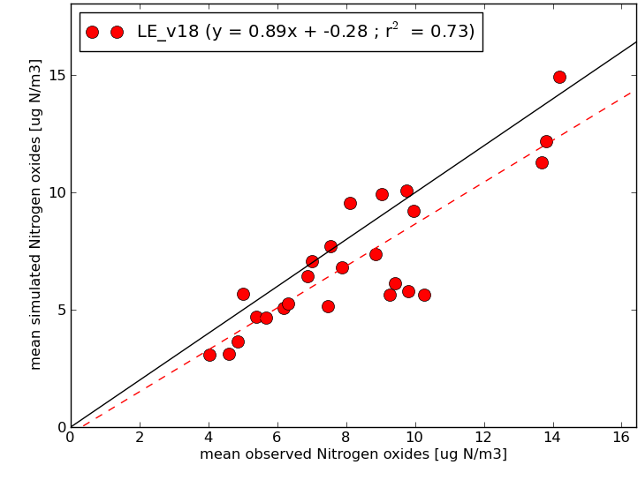
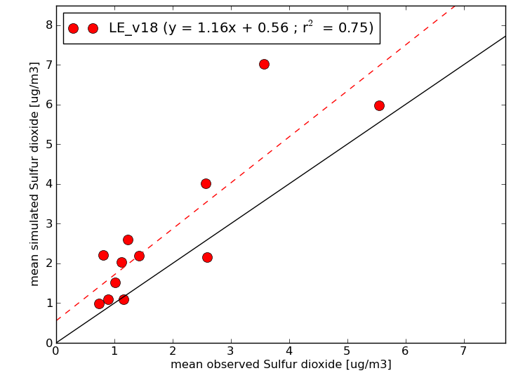
NO2 and SO2 compared to measured annual means across the Netherlands
NO2
SO2

Slide 6
Comparison of average component concentrations

Slide 7
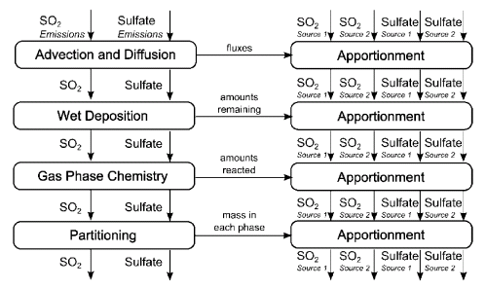
Particulate Source Apportionment Technology
Processes
in LE
Apportionment
in new routine
Data exchange
Wagstrom et al., 2008
Example of two source classes and the SO2-sulfate system

Slide 8
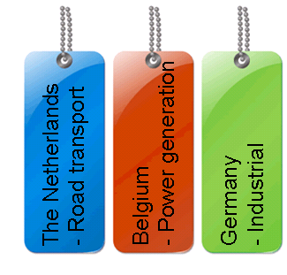
Simulation set-up
European domain
Dutch zoom domain
24 Labels:
  SNAP 1 sectors
  National & foreign
  Initial, boundary, natural
SNAP level 1 sectors
1 | Energy industries
2 | Non-industrial combustion
3 | Industrial combustion
4 | Industrial processes
5 | Fugitives from fuels
6 | Solvent/product use
7 | Road transport
8 | Non-road transport
9 | Waste
10 | Agriculture

Slide 9
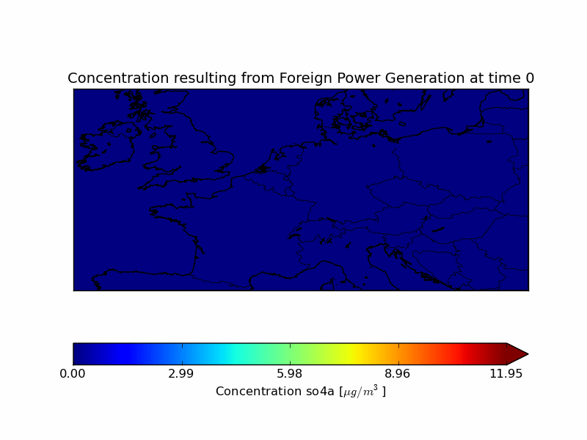
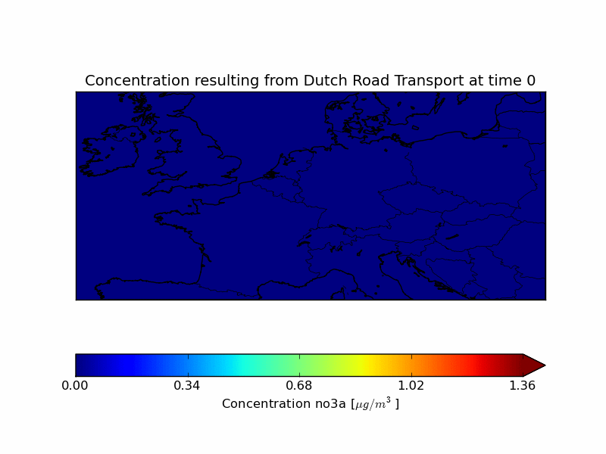
Simulation set-up: illustration

Slide 11
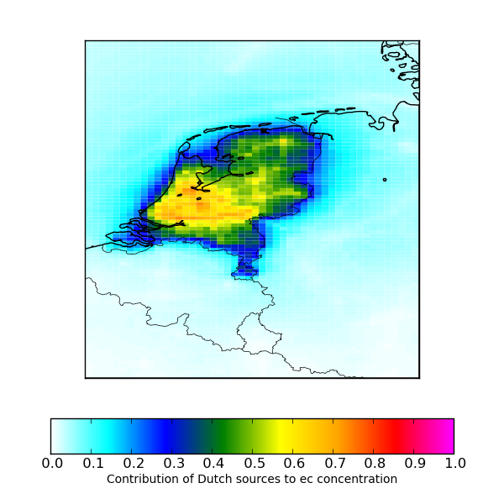
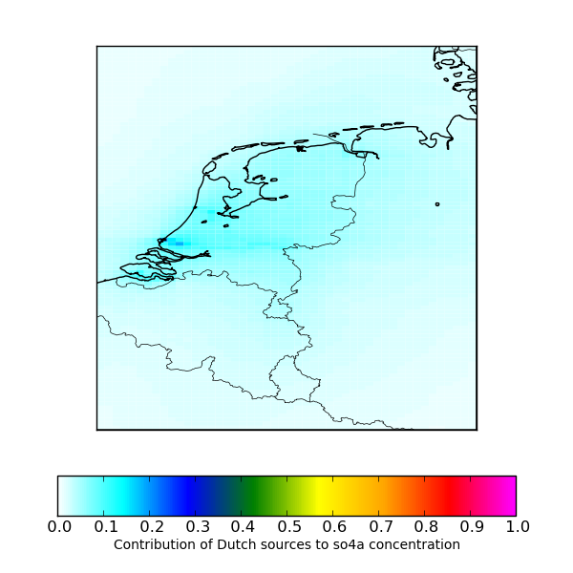
Results – National fractional contribution to EC and SO4
EC
SO4

Slide 12
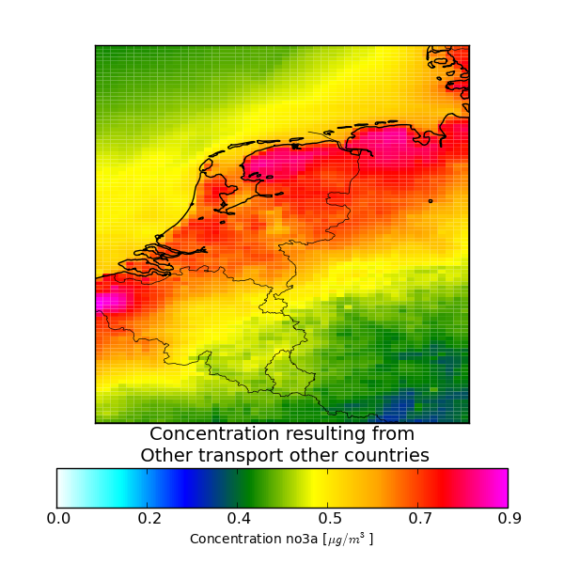
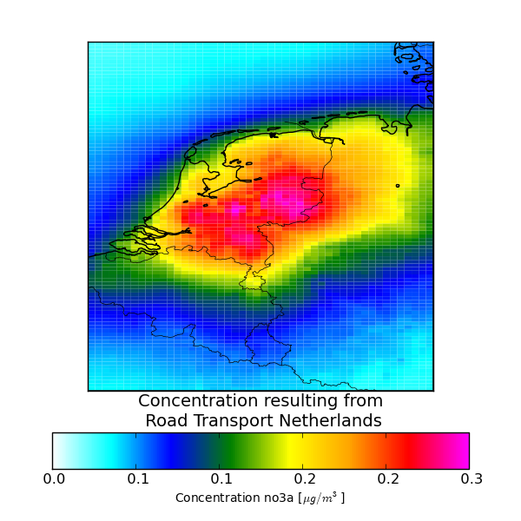
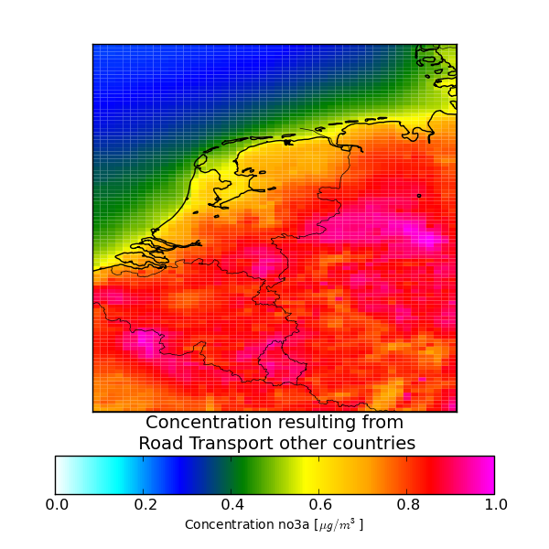
Absolute nitrate contributions for three labels
Foreign non-road transport
Dutch road transport
Foreign road transport

Slide 13
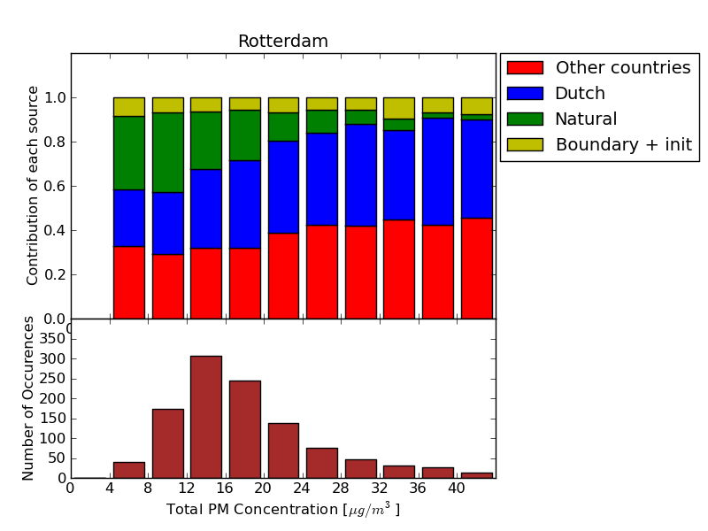
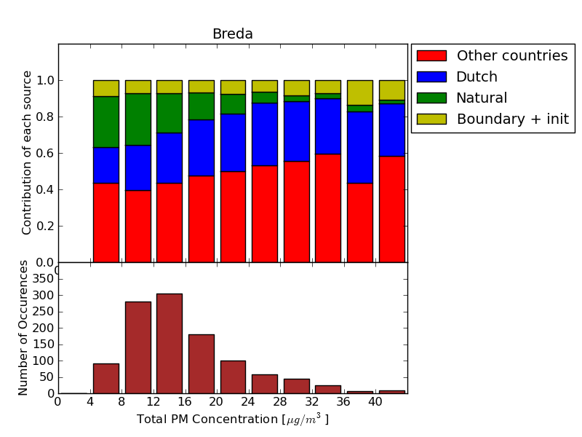
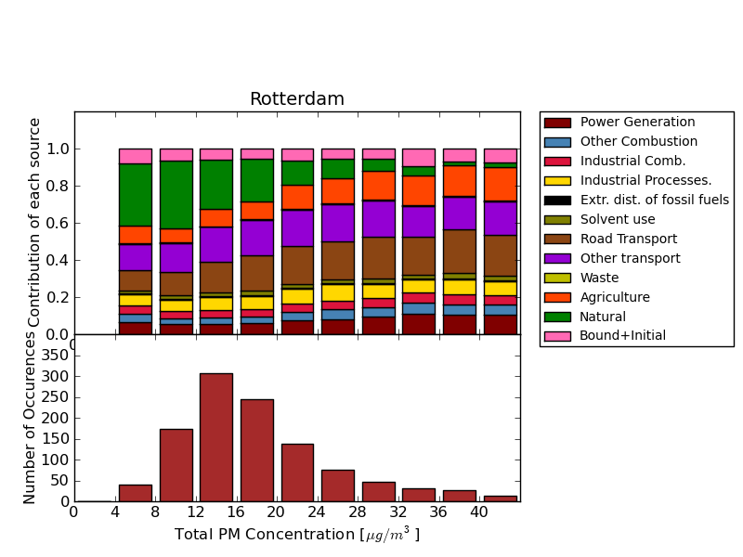
Rotterdam, source apportionment as function of PM10

Slide 14
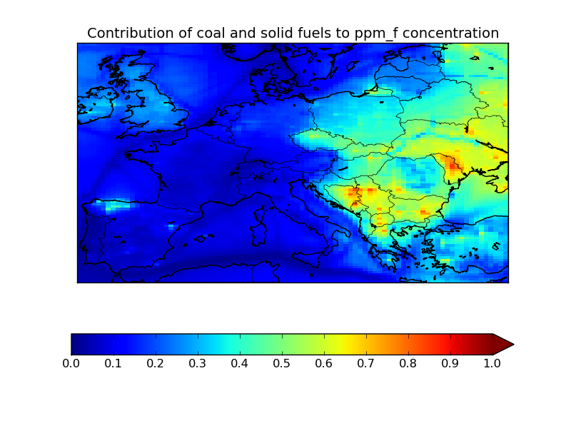
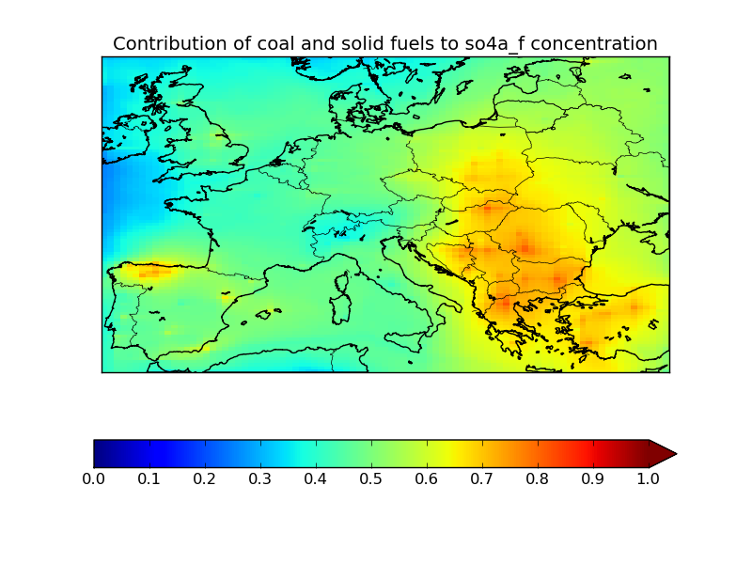
Application of labeling: EnerGEO
Labeling applied to get information on contributors to PM concentrations in Europe
Labels used:
  Split in fuel types (Solid, Liquid, Gas, Biomass, Waste and Unknown)
  Per fuel type split in 2 main sectors and a rest sector

Slide 15
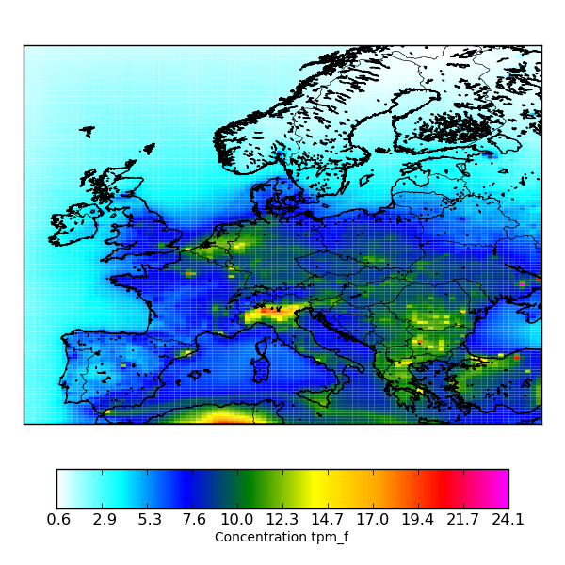
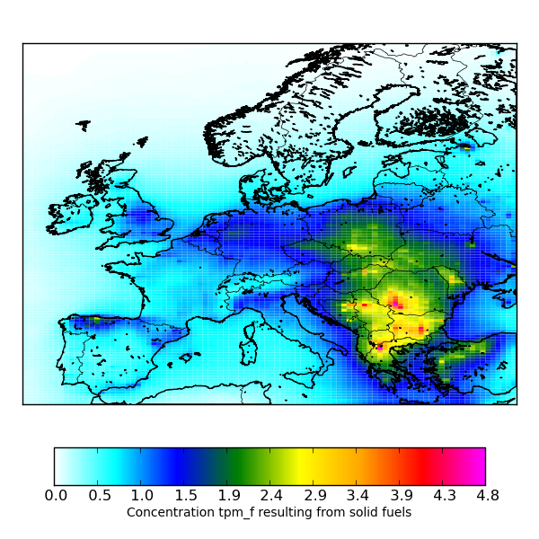
Application of labeling: EnerGEO
  Split in fuel types (Solid, Liquid, Gas, Biomass, Waste and Unknown)
Modelled PM2.5
Modelled PM2.5 due to solid fuels

Slide 16
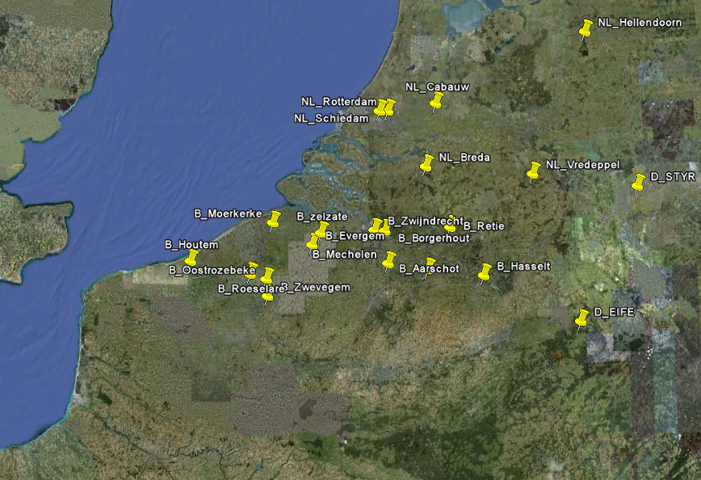
Combination with PMF modelling and tracer data
Concentration V-Ni-Factor [µg/m³]

Slide 17
Comparison to Selenium data in north western Spain for summer 2007
Observed Selenium concentration
Modelled EC from coal combustion

Slide 18
Conclusions
Source apportionment tool developed and successfully applied
New tool provides new insight and many potential applications
Evaluation should include detailed chemical speciation data
Impacts of uncertainties and inconsistencies in emission data magnified in source apportionment studies
Consistent European bottom-up emission inventory highly needed

Slide 19
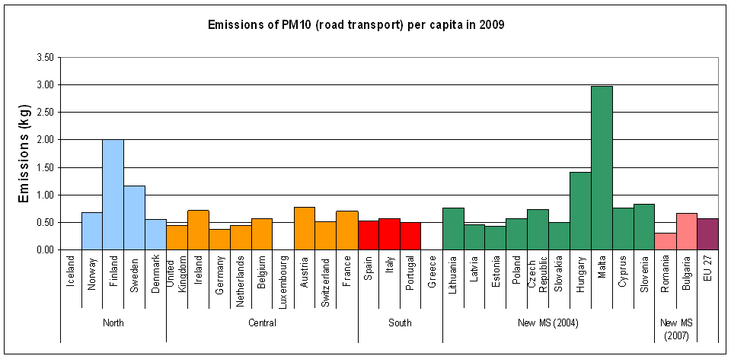
Case 2: Emissions per capita in member states
Emissions of PM10 (road transport) per capita in 2009
Emissions of NMVOC (national totals) per capita in 2009
Notes:
Road transport is a very important source
We expect more or less the same since we drive the same cars
The methodology is quite well understood
Differences: pple driving more, use different fuels (diesel –more PM)
Finland, Norway – Non exhaust emission, studded tires
Austria Germany factor 2

Slide 20
Sulfate and nitrate compared to measured annual means across the Netherlands

Slide 21
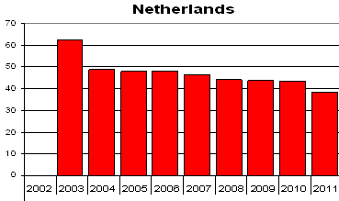
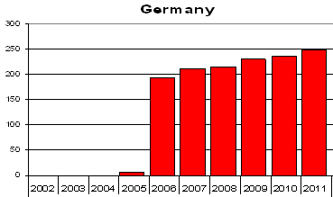
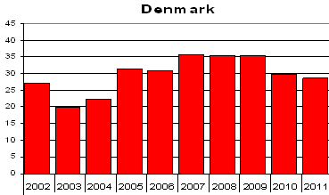
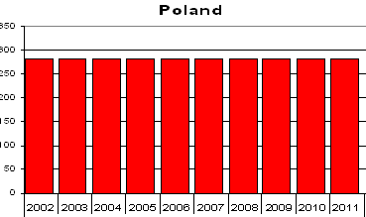
Case 1: Officially reported PM10 emissions (Gg) for year: 2000
- 40%
+ 20%
+ 45%
0%
Notes:
Methods changes a lot, no clear pattern
Changes have different characters
PL doesnt change historical inventories

Slide 22
