Slide 1
The impact of thermodynamic module on the CTM performances: a case study in Northern Italy
C. Carnevale¹, G. Finzi¹, E. Pisoni¹, P. Thunis², M. Volta¹
¹Dept. of Information Engineering, Faculty of Engineering, University of Brescia, Italy
²European commission, DG JRC, Institute for Environment and Sustainability

Slide 2
Outlines
The GAMES modelling system
The TCAM model
ISORROPIA/SCAPE2 Thermodynamic modules
Case Study
  PM10 performance impact
  PM10 chemical composition impact
Conclusion

Slide 3
GAMES: Gas Aerosol Modelling Evaluation System
Land use
Topography
MM5
output
Emission inventories
PROMETEO
POEM-PM
Temporal
Profiles
3D wind and temperature fields
Turbolence and Boundary Layer parameters
Emission Fields
Boundary and
Initial condition
TCAM
VOC /PM speciation
Profiles
3D concentration
fields
BOUNDY
System
Evaluation
Tool
EMEP
output
Notes:
An air quality modelling
system is composed by (i) a meteorological preprocessor,
simulating the wind and temperature
fields and the turbulence parameters over the domain,
(ii) an emission processor, estimating emission
fields for the emitted species alternative emission
scenarios, (iii) a photochemical model that
describes the transport and the chemical transformations
taking place in the atmosphere.

Slide 4
TCAM: overview
TCAM
Horizontal Transport
3D wind and temperature fields
Turbolence and Boundary Layer parameters
Vertical Transport
Deposition
3D concentration
fields
Boundary and
Initial condition
Gas phase chemistry
Emission Fields
Aerosol module
Notes:
An air quality modelling
system is composed by (i) a meteorological preprocessor,
simulating the wind and temperature
fields and the turbulence parameters over the domain,
(ii) an emission processor, estimating emission
fields for the emitted species alternative emission
scenarios, (iii) a photochemical model that
describes the transport and the chemical transformations
taking place in the atmosphere.

Slide 5
TCAM: Overview
Eulerian 3D model
Transport Module:
  Horizontal: Chapeau Function + Forester Filter
  Vertical: Crank-Nicholson hybrid solver based on the vertical diffusivity coefficient
Deposition Module: Wet&Dry
Gas Chemistry:
  SAPRC97
  IEH solver
Aerosol:
  Condensation/Evaporation, Nucleation, Aqueous chemistry (SO2)
  21 species, 10 size classes
  ISORROPIA/SCAPE2 thermodynamic module

Slide 6
Thermodynamic module comparison
Feature | SCAPE2 | ISORROPIA-II
Chemical species | NO3-, NH4+, SO4=, Na+, Cl-, Ca+, K+, Mg | NO3-, NH4+, SO4=, Na+, Cl-, Ca+, K+, Mg
Activity coefficients | Pitzer (multicomponent) Zdanovskii, Robinson and Stokes (water) | Bromley/Precomputed table
Temperature dependance | Equilibrium constants, DRHs | Equilibrium constants, DRHs, activity coefficients
Solution of thermodynamic equilibrium | Bisectional | Analitical/Bisectional

Slide 7
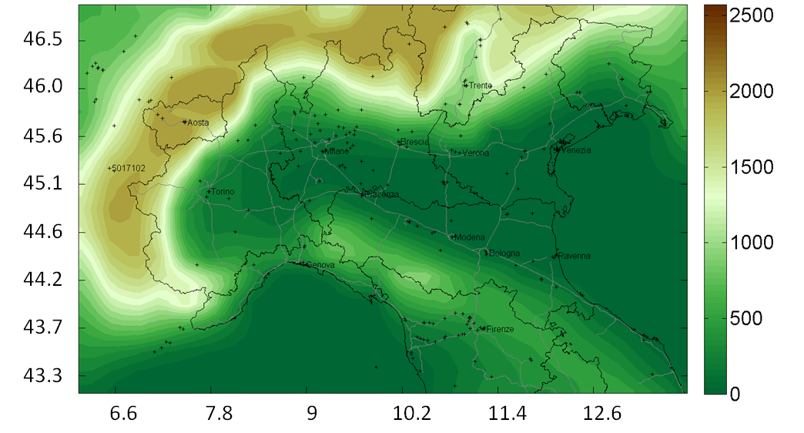
Simulation domain
95x62 cells
11 vertical layer up to 4000 mt a.g.l.;
6x6 km
POMI exercise

Slide 8
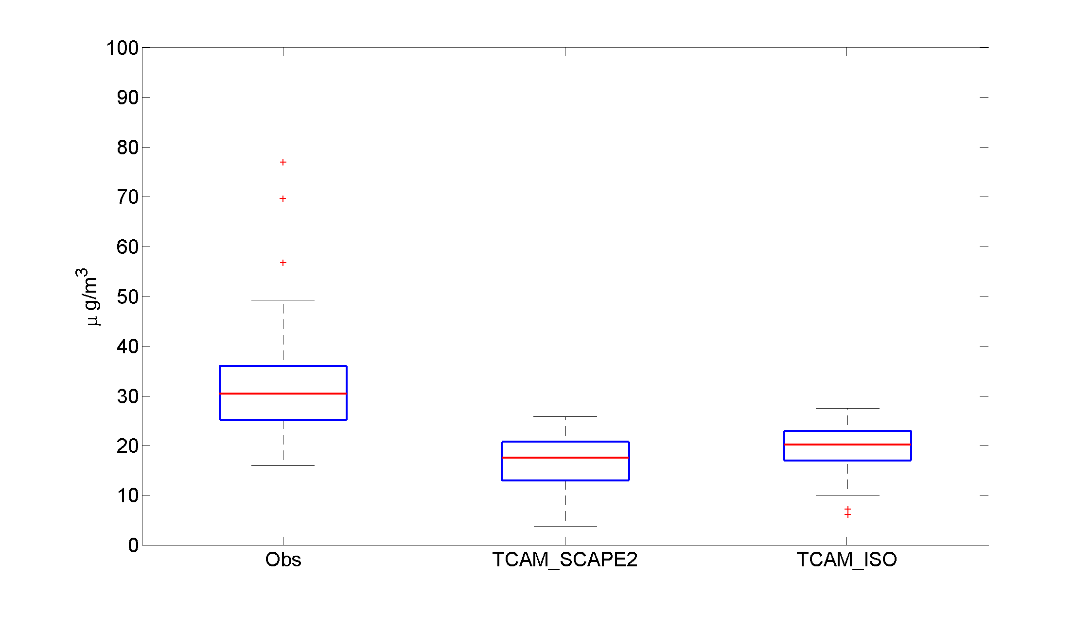
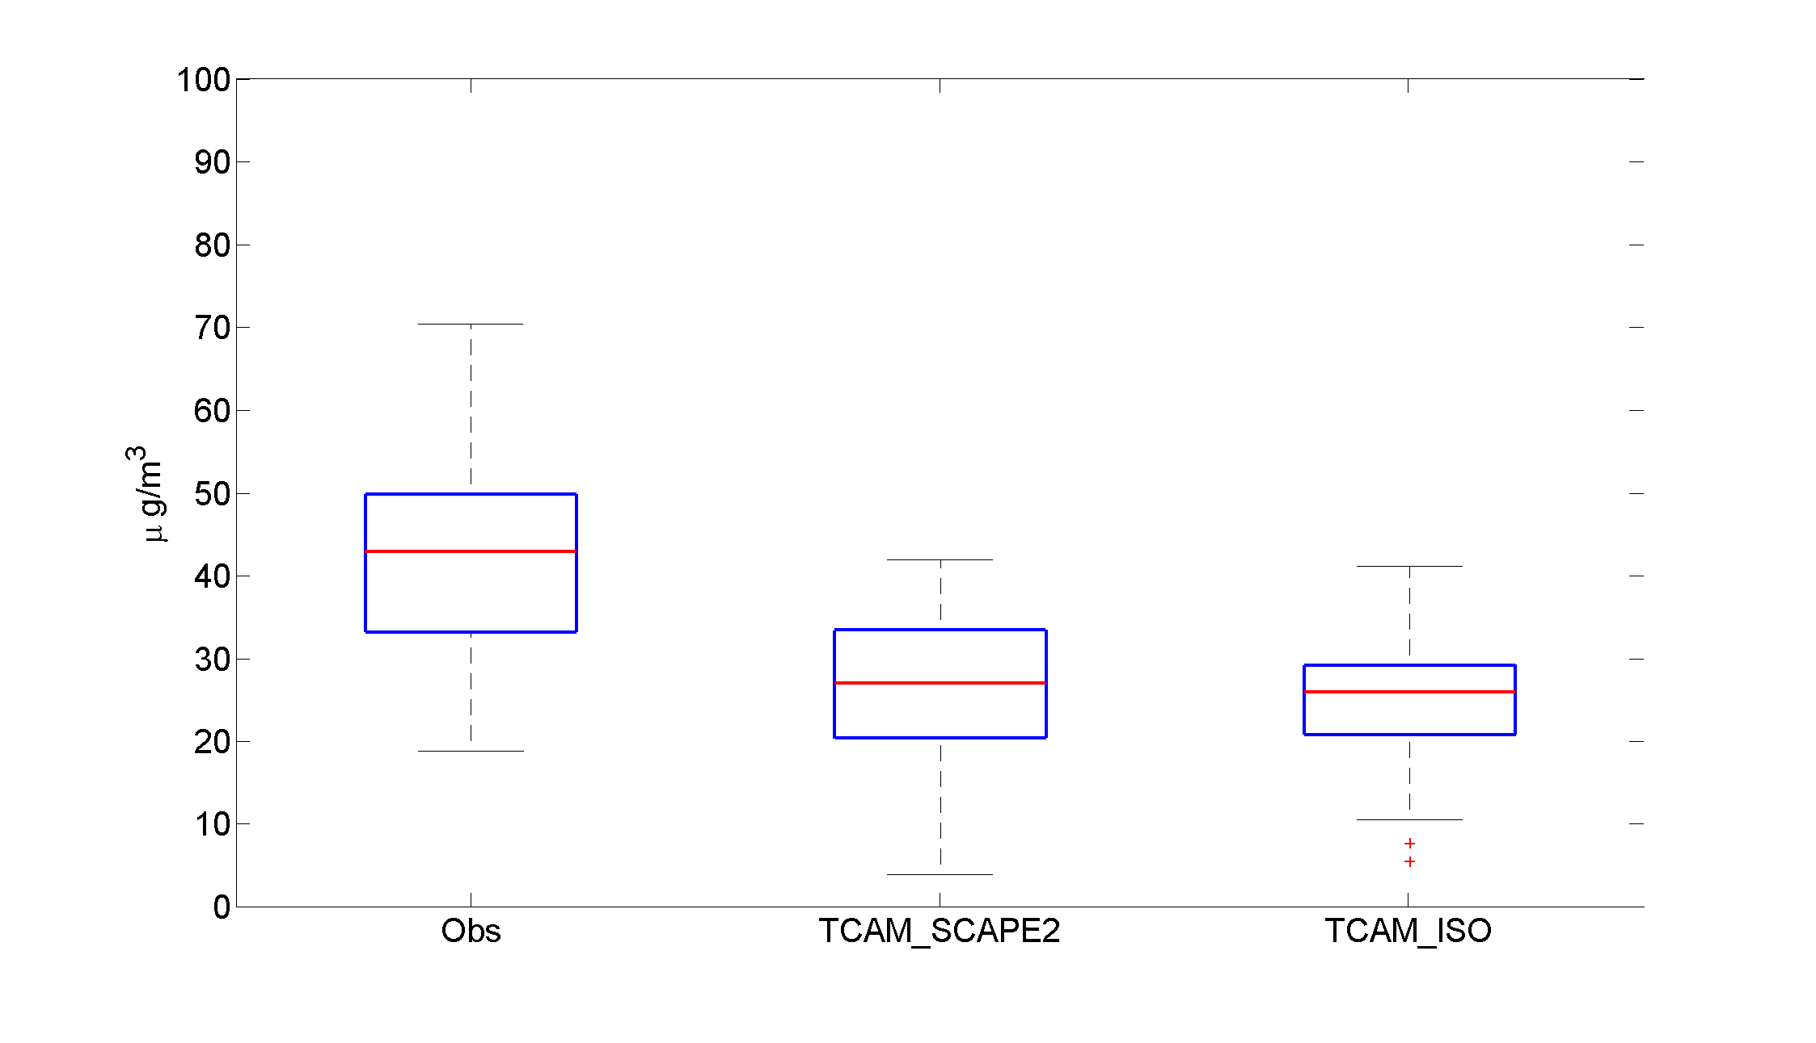
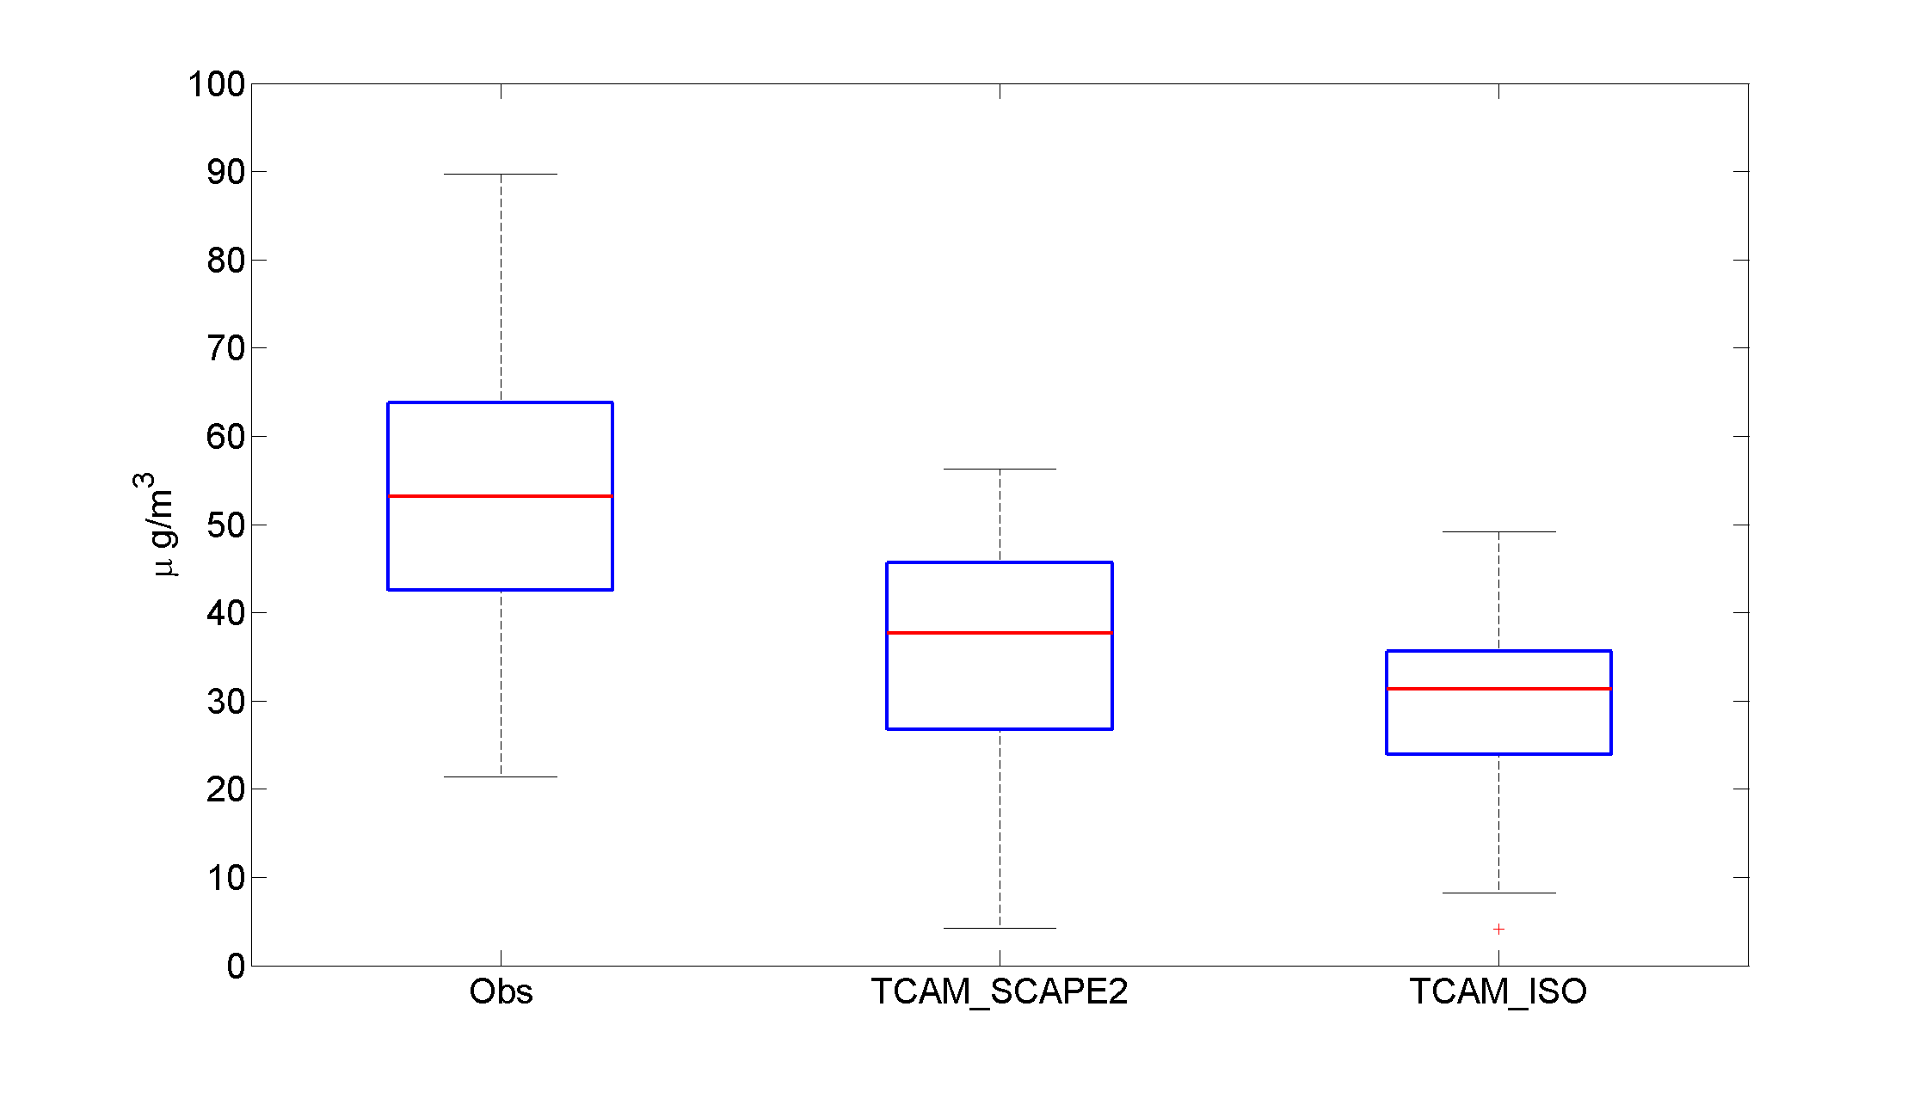
Performance Comparison: PM10 Mean Value
Summer
Year
Winter

Slide 9
Performance Comparison: PM10 Monthly Trend

Slide 10
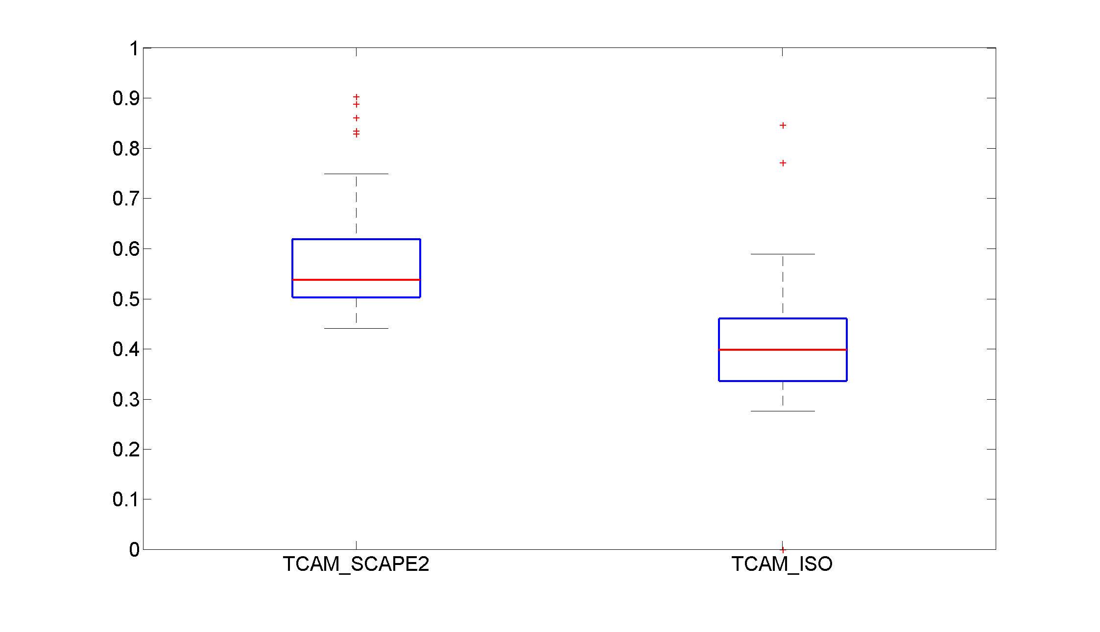
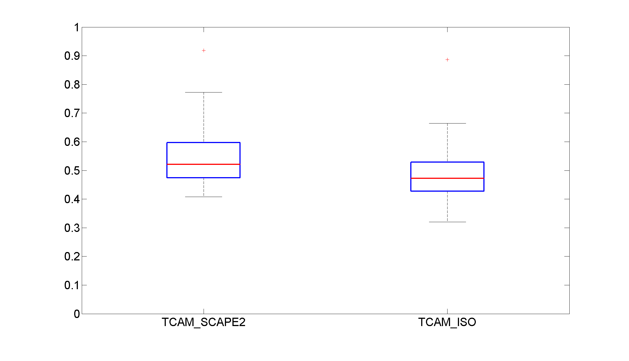
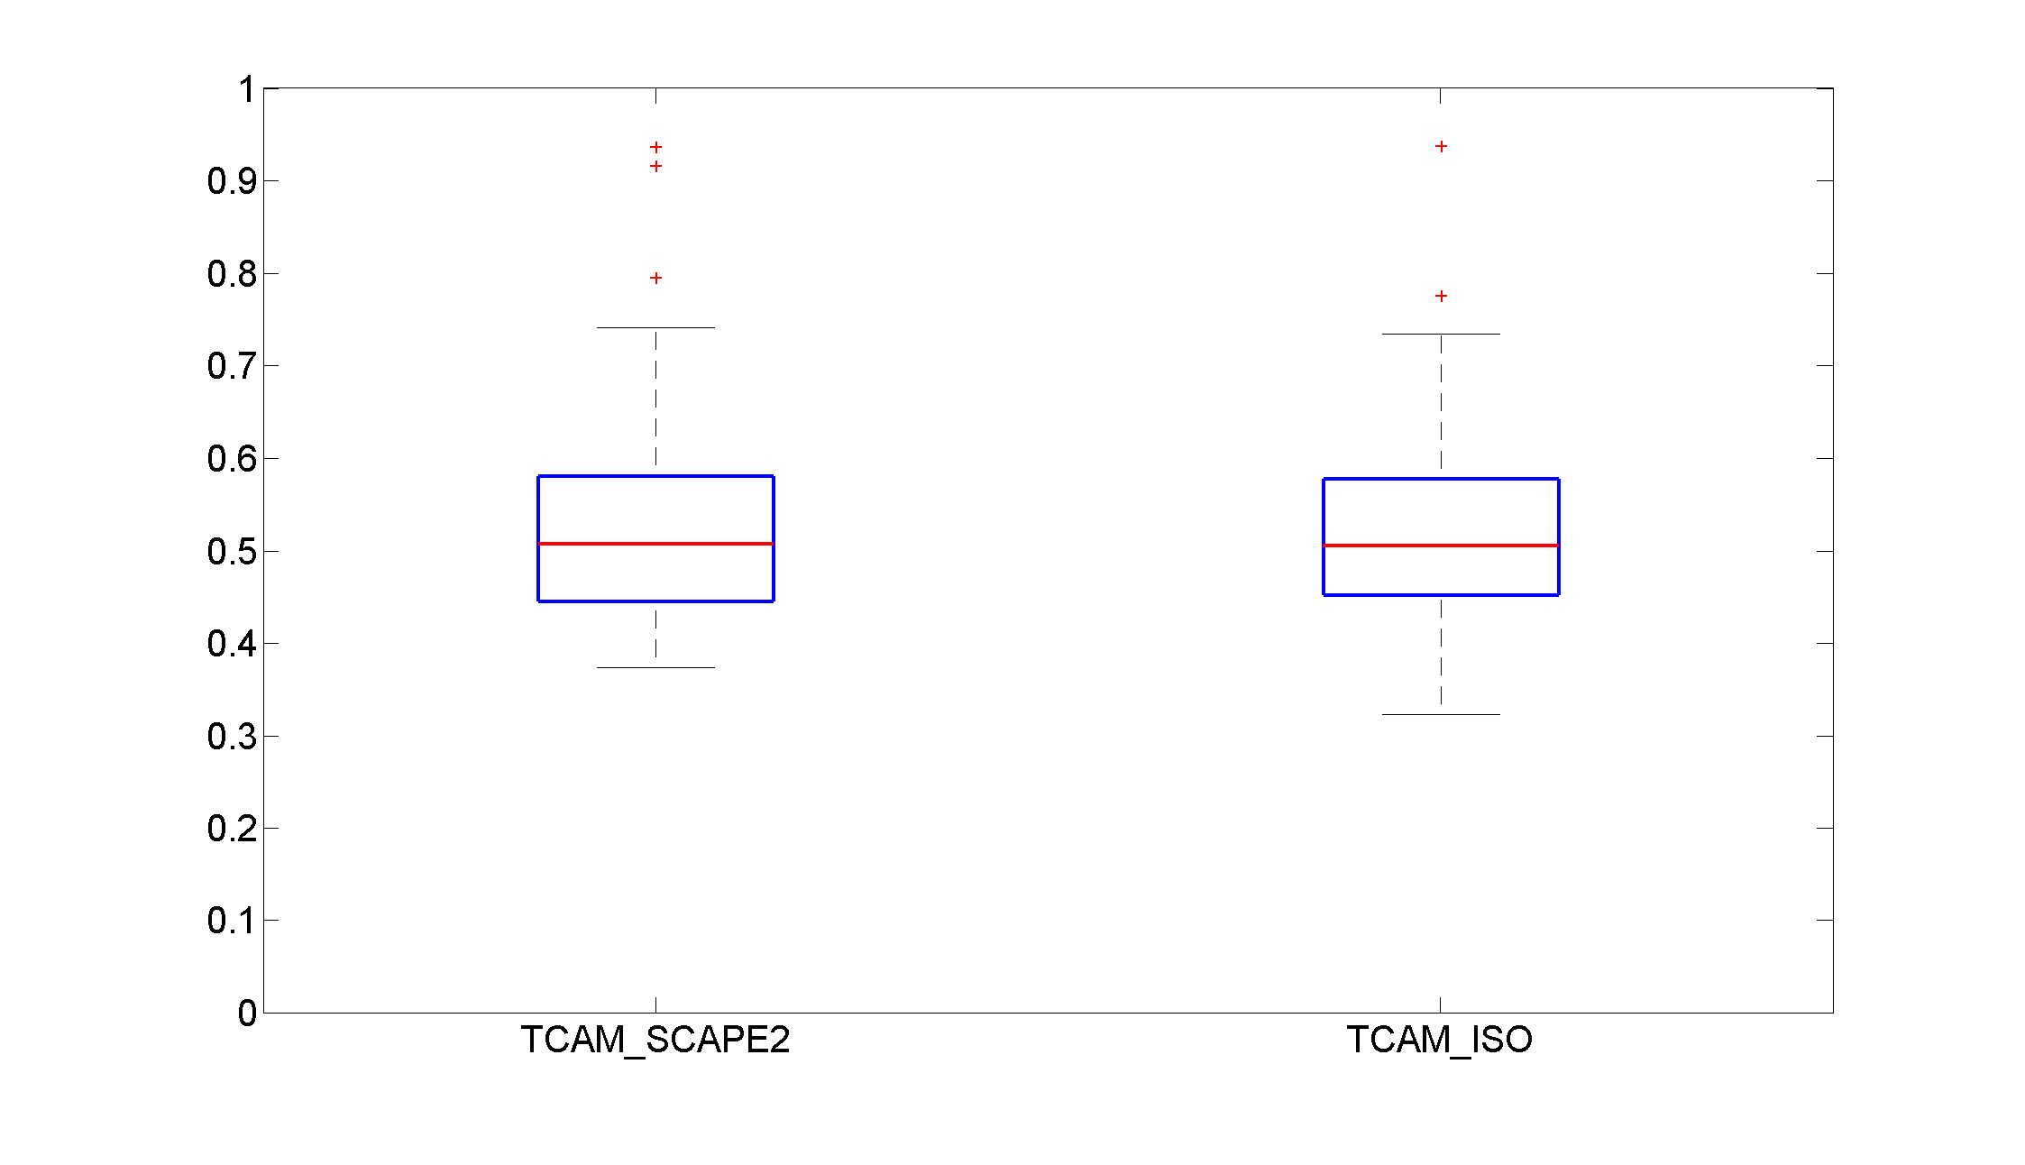
Performance Comparison: PM10 NMAE
Summer
Year
Winter

Slide 11
Performance Comparison: PM10 Taylor Diagram
Summer
Year
Winter
* TCAM_ISO
+ TCAM_SCAPE

Slide 12
Inorganic ion evaluation
Station | Summer | Winter
Bosco Fontana* | 27 | 14
Brescia | 26 | 17
Saronno | 25 | 27
Varese | 24 | 32
* No NH4+ data

Slide 13
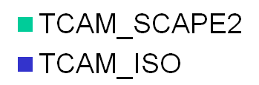
Performance Comparison: NO3- NMAE
Summer
Winter

Slide 14
Performance Comparison: SO4= NMAE
Summer
Winter

Slide 15
Performance Comparison: NH4+ NMAE
Summer
NME-Summer
Winter

Slide 16
Conclusions
PM10
  Mean Value: Similar results (underestimation of measured PM10).
  NMAE/Correlation: remarkable differences (SUMMER!), with better performaces obtained through ISORROPIA.
INORGANICS
  SCAPE2: (quite) large overestimation of NH4+.
  NMAE is lower for ISORROPIA but too few data to state a general behavior!

