Slide 1

EMEP-WRF (EMEP4UK) model used to simulate a decade (2001-2010)
of UK atmospheric composition
Vieno Massimo^{1,2},
Stefan Reis¹, Peter Wind³,
Mat Heal², Ruth Doherty²,
Tony Dore¹, and Mark Sutton¹, et al.
NERC CEH Edinburgh
University of Edinburgh
Norwegian Met Institute
Notes:
EMEP4UK development state of the art high res model

Slide 2
Outlook
EMEP4UK model - project
    AQ0702 Defra project 2007-2011
    New Defra AQ0727 project started in 2012 focused on PM and SOA
Model results
EMEP4UK applications
    Spring of 2003 UK high nitrate
    Regional emissions reduction
    Ozone for the decade 2001 - 2010

Slide 3
EMEP4UK framework
EMEP
rv3.7
Unified model
WRF landuse
MODIS
WRF version 3.4
GFS
ECMWF
GIS
interface
EMEP4UK
WRF/EMEP
interface
NAEI
GB national grid
EMEP
Polar stereographic
EMISSIONS
Shipping
Notes:
Not say largest

Slide 4
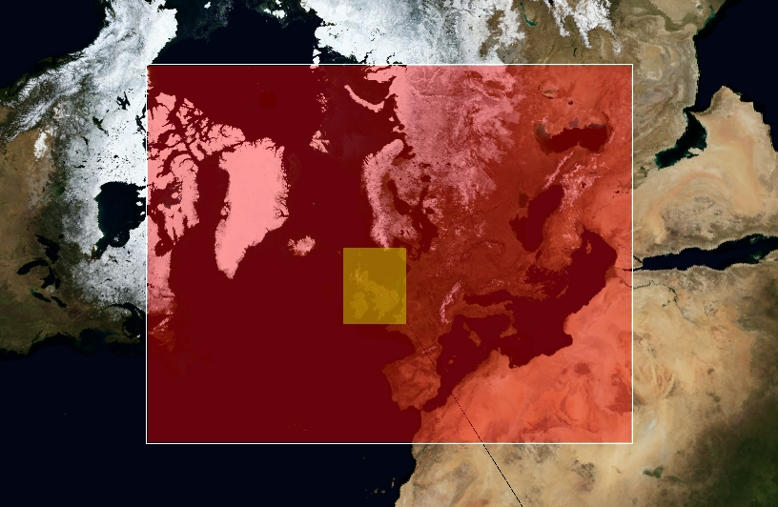
Meteorology:
WRF 3.1.1 (now 3.4) using GFS re-analysis and 6h nudging
Horizontal resolution:
5 km² over UK (yellow), nested within EMEP domain (red)
Vertical resolution:
20 layers up to ~16 km. Surface layer depth 90 m
Chemistry: EMEP Unified rv3.7
Emissions:
Outer uses 50 km² EMEP UM; inner uses NAEI 1 km².
EMEP4UK model
Based on the rv3.7 EMEP Unified model
EMEP4UK 5 km
EMEP4UK 50 km
ACP Vieno et al., 2010
Notes:
High nitrate episodes in the observations can be simulated with the model, numerical stability

Slide 5
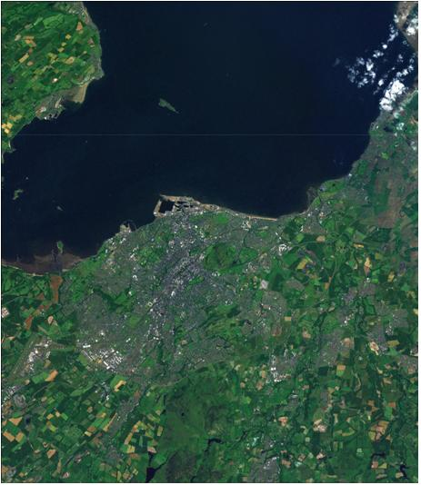
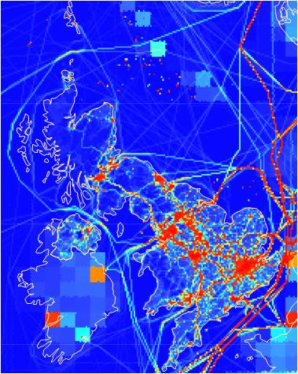
EMEP4UK domain - emissions example for 2010 NO_{x}
UK emissions derived form 1 km² NAEI 2009
+
Shipping derived from 5 km² 2007 ENTEC estimate
+
Everywhere else EMEP 50 km² emissions
Red high blue low

Slide 6
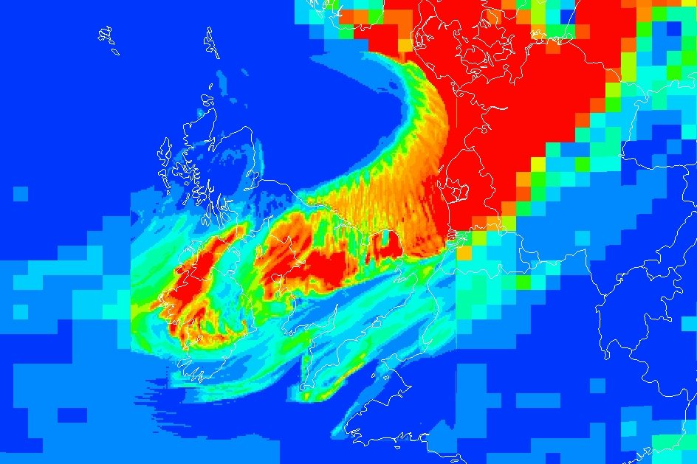
EMEP4UK final product:
Example of EMEP4UK nested model to the UK at 5 km²
NH₄⁺ on 02/01/2003 12:00 GMT
NH₄ 0
3 ppb

Slide 7
EMEP4UK surface UK composition 2001 - 2010

Slide 8
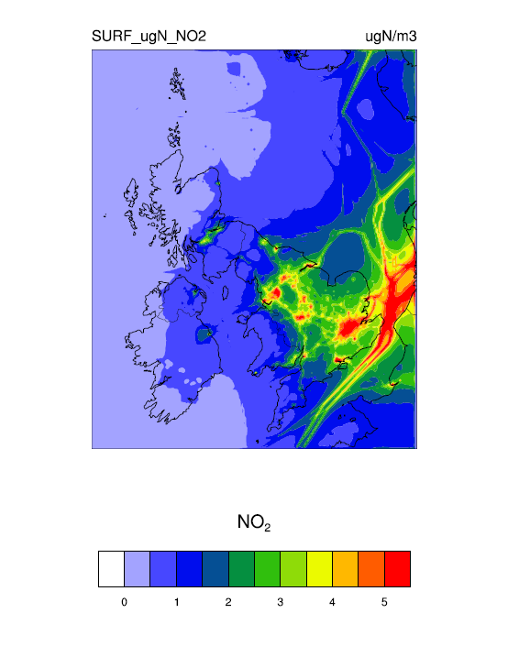
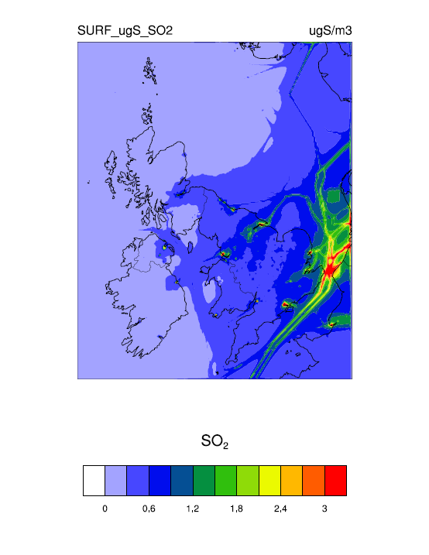
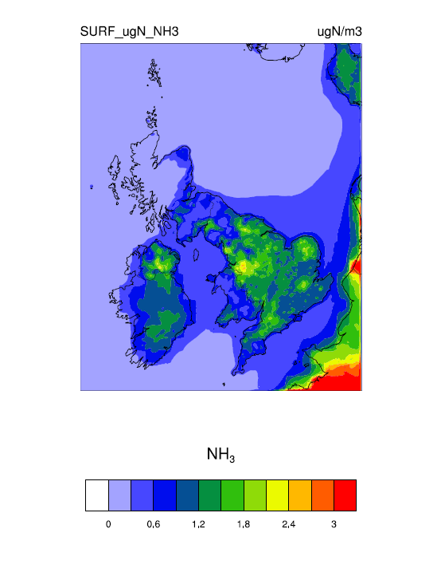
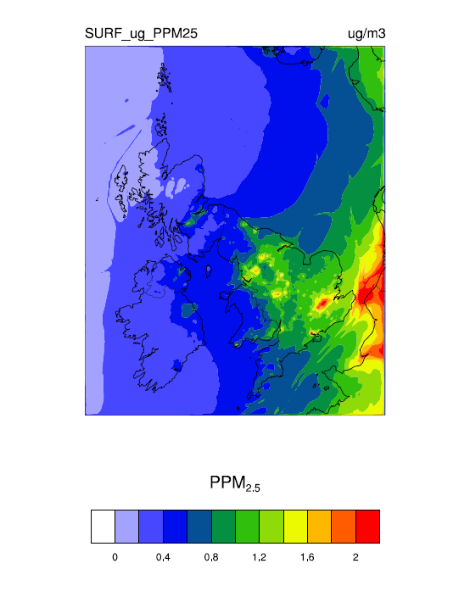
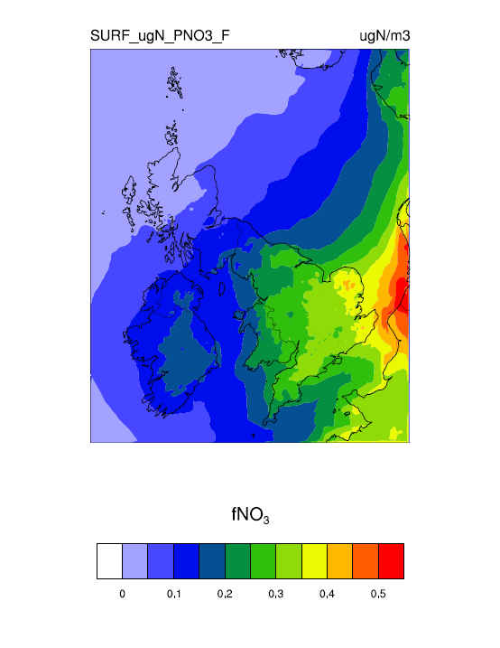
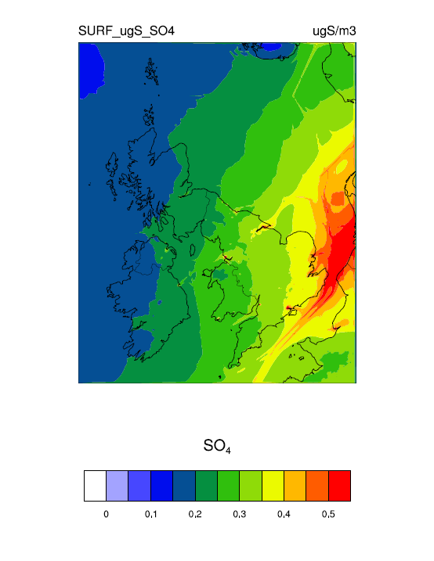
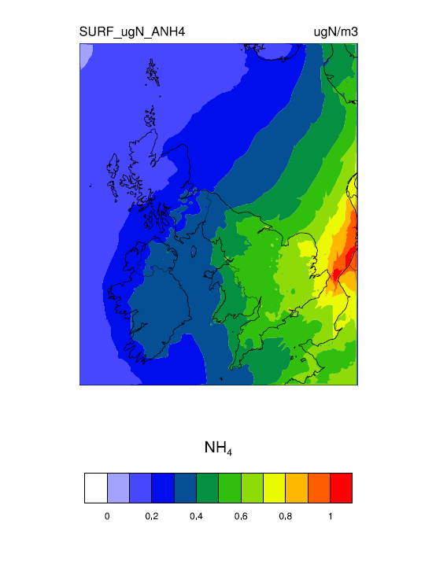
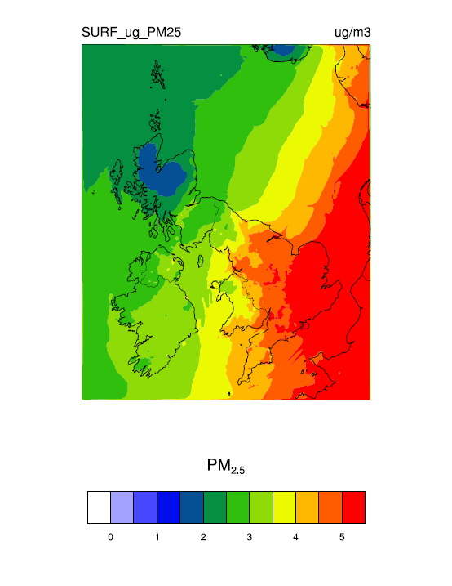
EMEP4UK rv3.7 and WRF 3.1.1 - 2008 annual average surface concentration for:
NO₂, SO₂, NH₃, NH₄, PPM_{2.5}, fNO₃, SO₄, and PM_{2.5}

Slide 9
Monthly obs from 30 AGANET sites and 90 NAMN sites covering the UK
Example site – CEH Edinburgh Bush Estate, Scotland
UK Acid Gases and Aerosols Monitoring Network (AGANET – Tang et al., 2009)

Slide 10
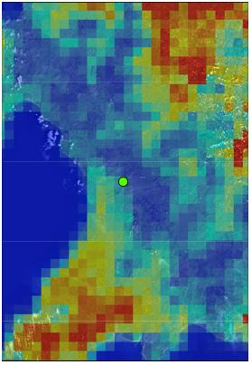
30 AGANET sites and 90 NAMN sites covering the UK
Example site – Wales
2010 NH₃ emissions
blue low red high

Slide 11
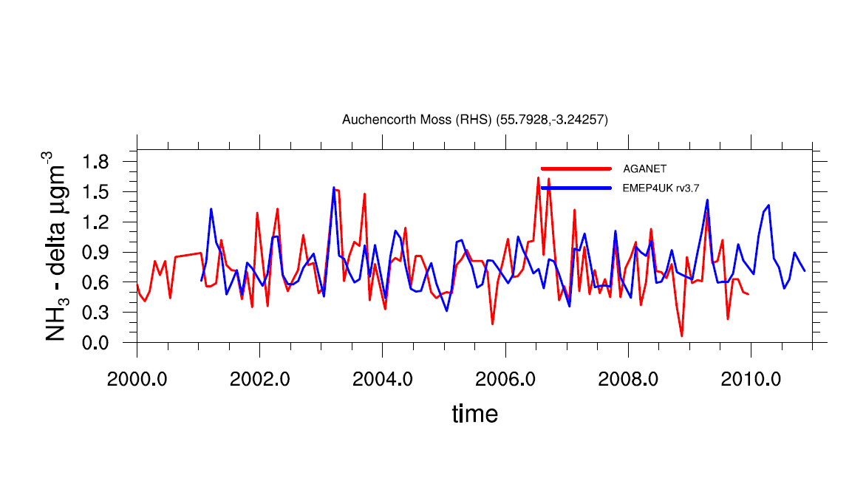
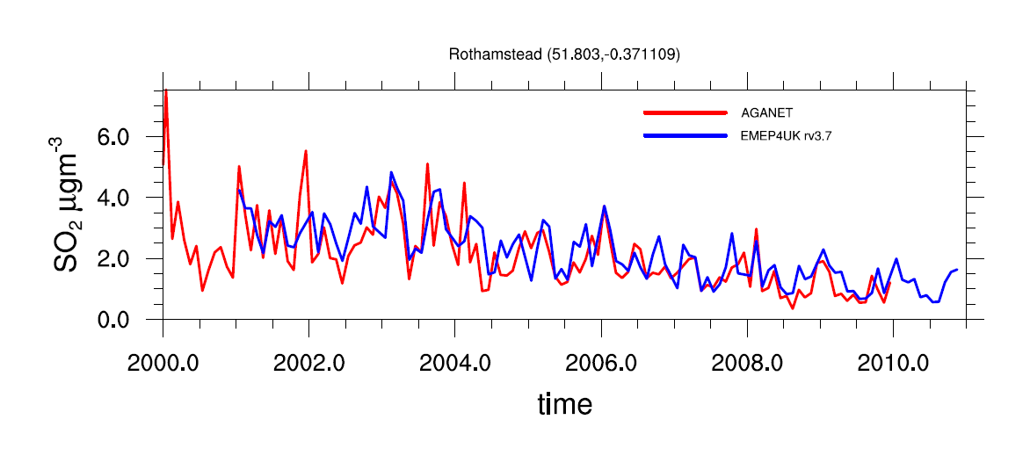
Auchencorth Moss - Edinburgh
NH₃ ok if the
site is representative
Rothamsted - England
SO₂ trend

Slide 12
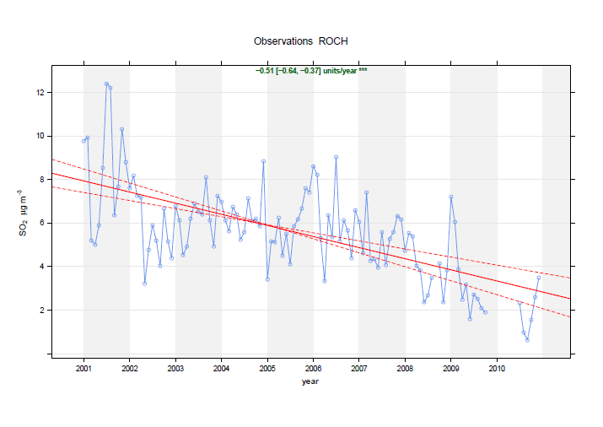
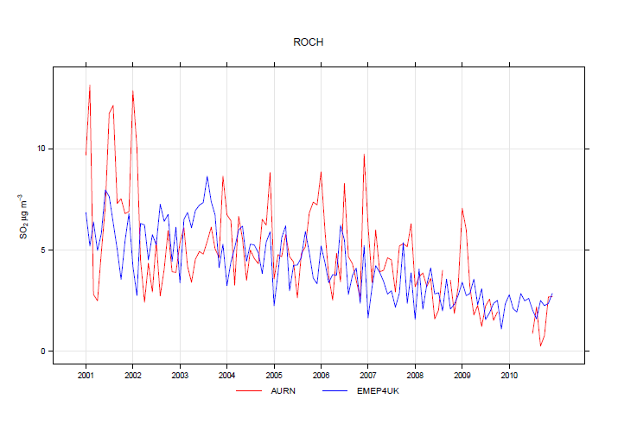
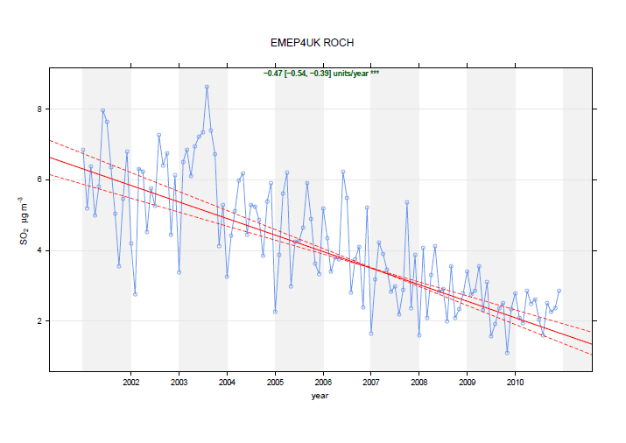
Rochester SE England units are µgm⁻³
AURN observations, averaged form
hourly to monthly.
Automatic Urban and Rural Network (AURN - http://uk-air.defra.gov.uk/networks/)

Slide 13
EMEP4UK nitrogen and sulphur UK deposition 2001 - 2010

Slide 14
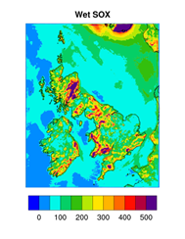
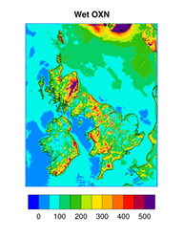
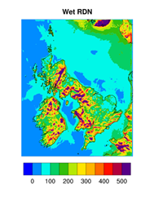
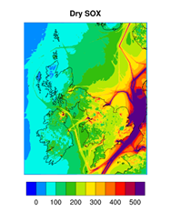
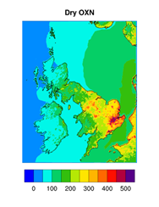
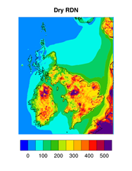
2006 EMEP4UK calculated deposition – units are mgN/S m⁻²

Slide 15
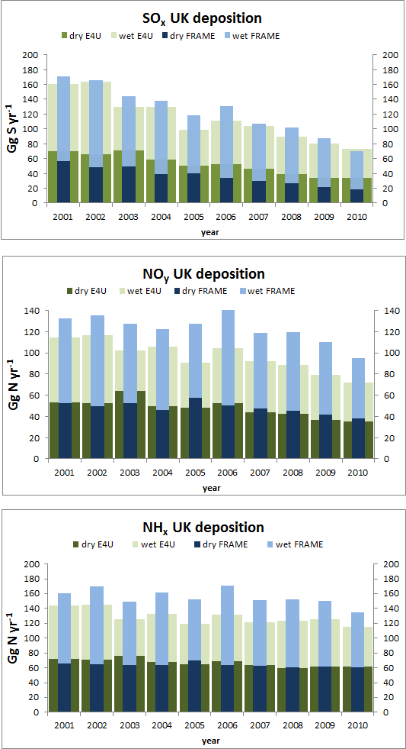
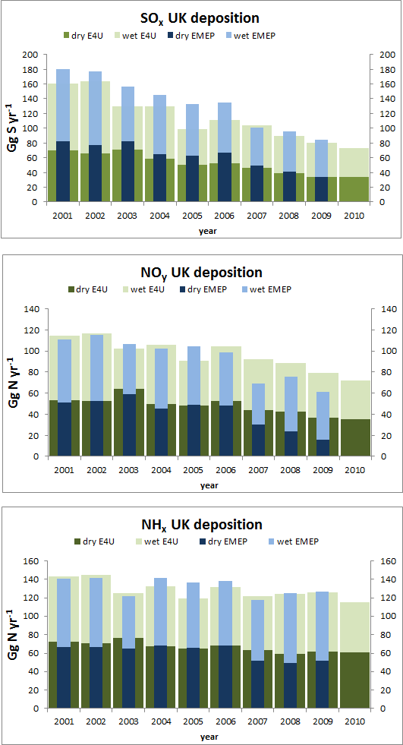
UK wet and dry deposition for the years 2001 - 2010
EMEP4UK 5 km² vs. FRAME (left) and EMEP 50 km² (right)
Fine Resolution Atmospheric Multi-pollutant Exchange model, Dore et., al 2012

Slide 16
EMEP4UK ozone and NO₂ hourly observations 2001 – 2010

Slide 17
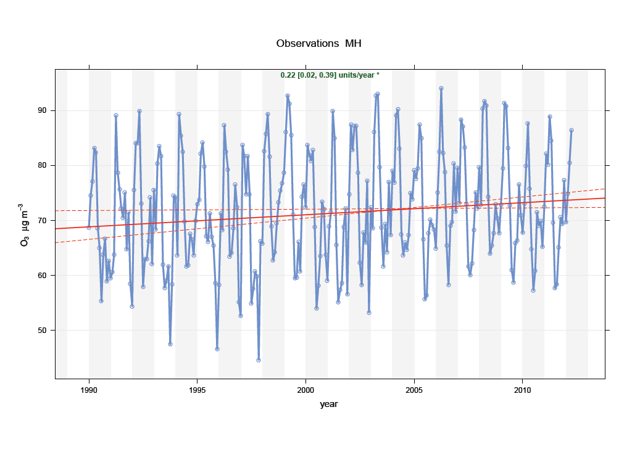
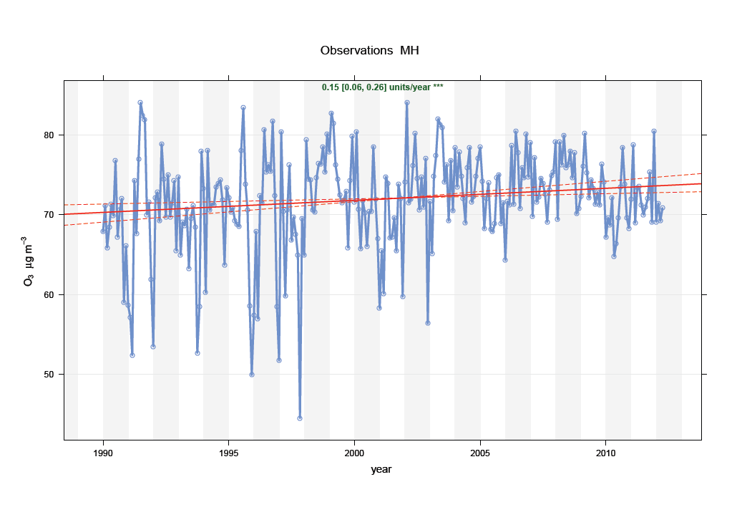
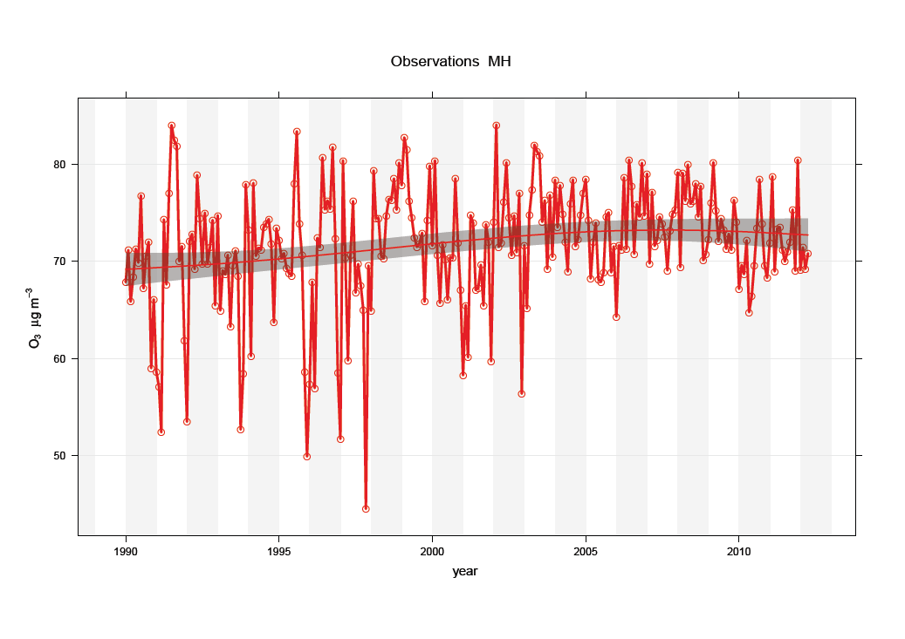
Mace Head from 1990 – 2012
Automatic Urban and Rural Network (AURN - http://uk-air.defra.gov.uk/networks/)

Slide 18
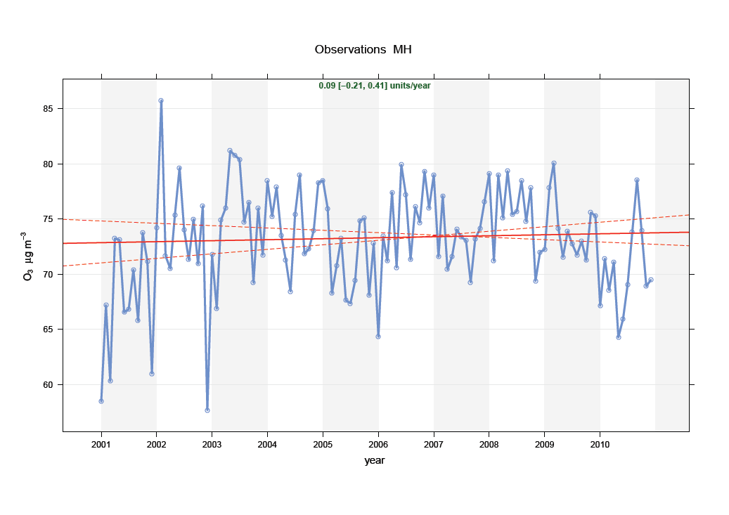
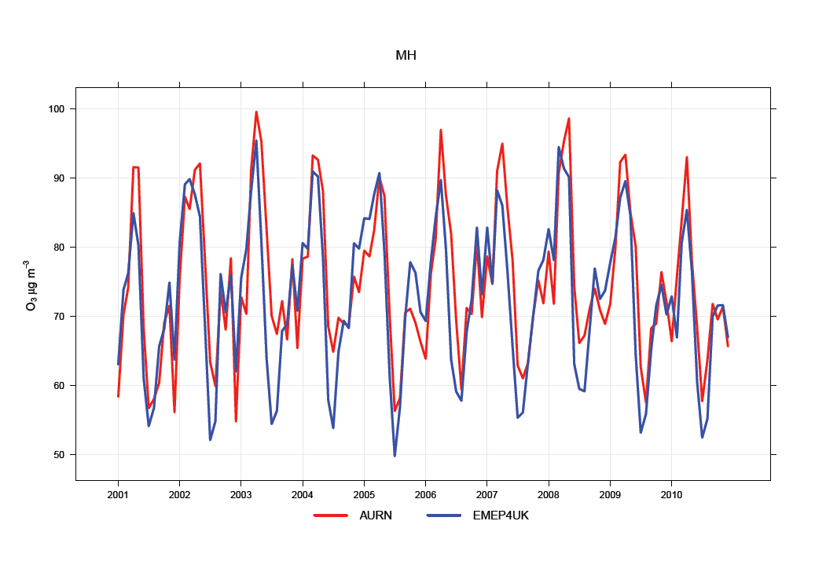
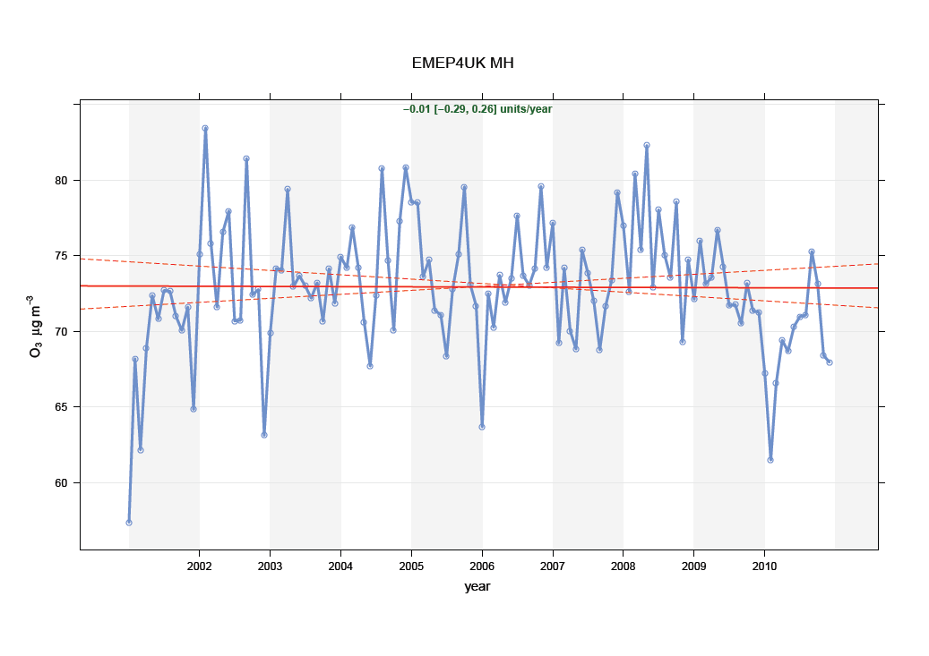
Mace Head (Ireland)

Slide 19
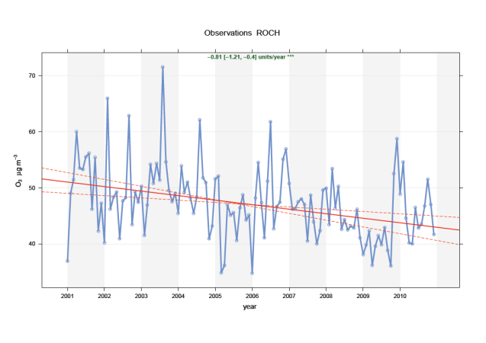
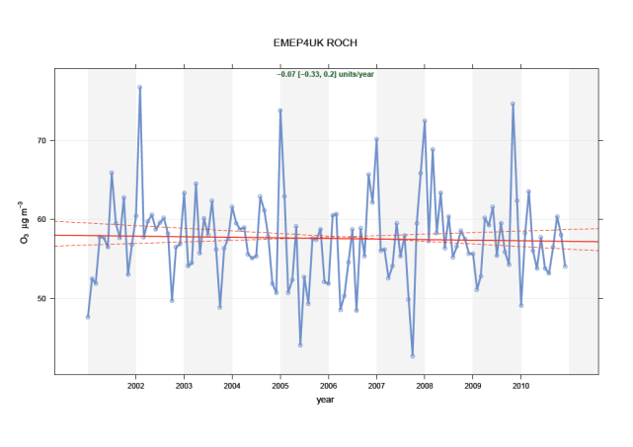
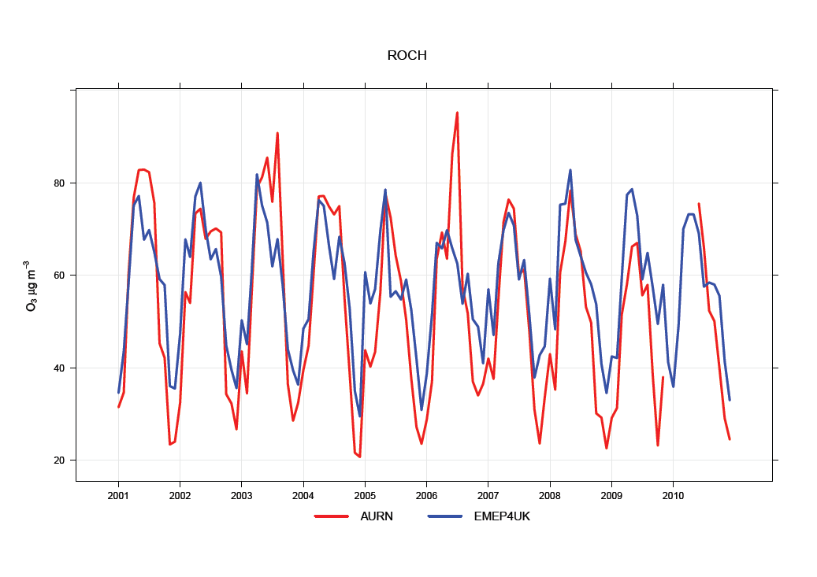
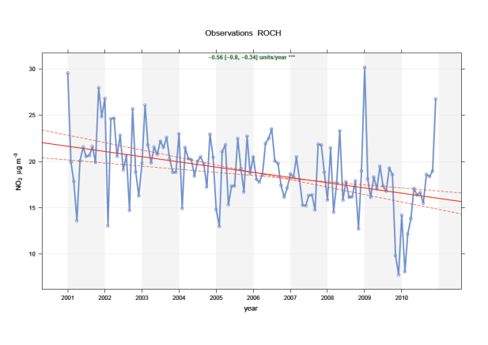
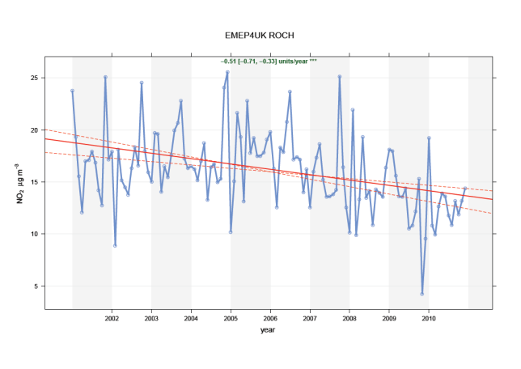
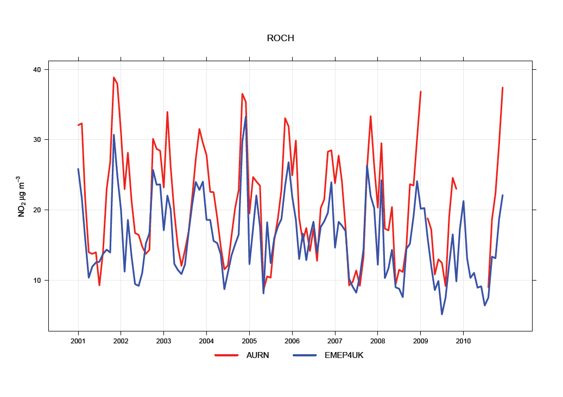
2001 – 2010 Rochester SE England units are µgm⁻³
Observations trend
EMEP4UK trend
Model vs. Obs
ozone
NO₂

Slide 20

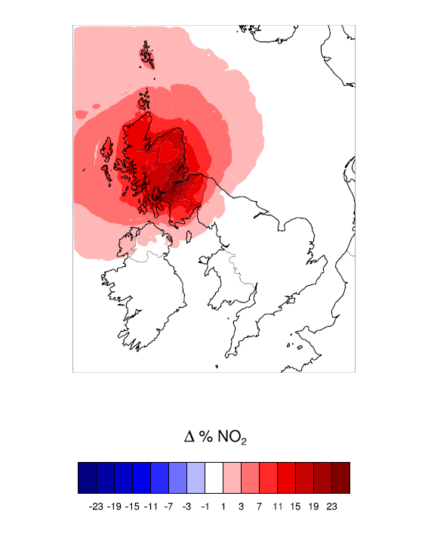
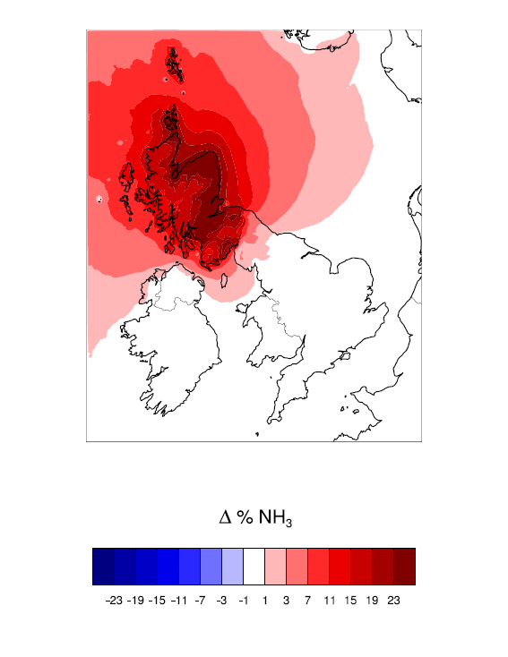
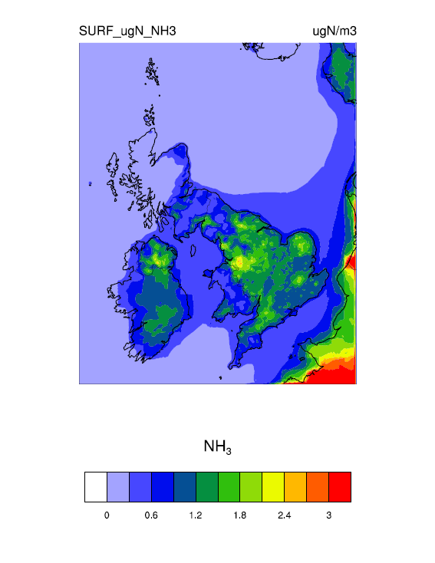
Scottish 30% emissions reduction experiment
%NO₂ reduction With a 30%emissions
reduction (base – experiment)
%NH₃ reduction With a 30%emissions
reduction (base – experiment)

Slide 21
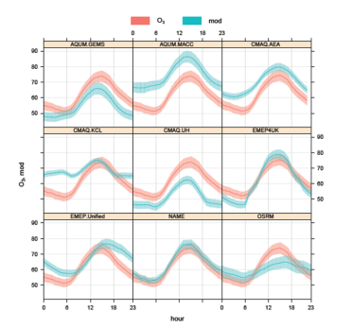
Conclusions
  Model and observations are used to estimate a decade of UK surface concentration, production and transport of various pollutant using the EMEP4UK model at a 5km² grid resolution
  Different factors controls UK nitrate, i.e. long range transport (even to north UK).
  High nitrate events in spring are linked to meteorology
  Long-term average network AGANET provides a valuable snap shot in time and space
  Emissions reduction from a small region analysis
Further work
    SOA
    PM
Defra organised model inter-comparison (EMEP Unified, EMEP4UK, NAME, CMAQ, OSRM, PTM, FRAME, AQUM,…):
Carslaw, D. C.: Defra regional and transboundary model evaluation analysis – Phase 1, http://uk-air.defra.gov.uk/reports/cat20/, 2011.
Notes:
Re-written this slide you may want to add numbers e.g. 20 ppb as on David’s conclusions slides
Didn’t have time to include all our results but another factor …dry dep.

