Slide 1
Title
Recent developments of the EMEP/MSC-W model aiming at PM improvement
Work by MSC-W modelling group
presented by Svetlana Tsyro
TFMM 13th meeting, Malta, 17-19 April 2012

Slide 2
Motivation and starting point
Model evaluation with observations in 2009, as reported in EMEP Report 4/2011
 | Bias (%) | R
PM10 | -41 | 0.62
PM2.5 | -52 | 0.78
SO4 | -45 | 0.77
NO3 | -27 | 0.85
NH4 | -39 | 0.66
Na | -2 | 0.83
Model underestimated PM and its major components
Meteorologisk Institutt met.no
Notes:
2

Slide 3
Joint endeavours (dugnad, субботник)
Updates and tests (Simpson et al., ACPD, 2012):
SO4
acidity of cloud water (pH)
temporal profile of S0x emissions
emission heights
NO3, NH4
changing equilibrium model (EQSAM -> MARS)
ammonia compensation point
Secondary Organic Aerosol
Implementation of SOA
Primary PM
Temperature dependent emissions from residential/ commercial combustion (S2)
Meteorologisk Institutt met.no
Notes:
3

Slide 4
Updates with minor effects:
Temporal profile of energy sector emissions (S0x)
Grennfelt & Hov (2005): changes in activity patterns of electricity consumption due to use of air conditioning and cooling systems
The ratio winter/summer emissions decreases by about 1% per yr from 1990
Emission heights:
re-distribution (Bieser et al., Env. Poll., 2010)
plume rise calculations – more detailed and accurate description of LPS is necessary
Crude accounting for ammonia compensation point
no NH3 dry deposition on growing crops
Temperature dependent emissions from residential/ commercial combustion (S2)
Meteorologisk Institutt met.no
Notes:
4

Slide 5
Updates which has made considerable (positive) effects:
Explicit calculation of cloud water pH
MARS equilibrium thermodynamic model
for gas-aerosol partitioning calculations
Implementation of SOA
Volatility Basis Set (VSB) approach
Meteorologisk Institutt met.no
Notes:
5

Slide 6
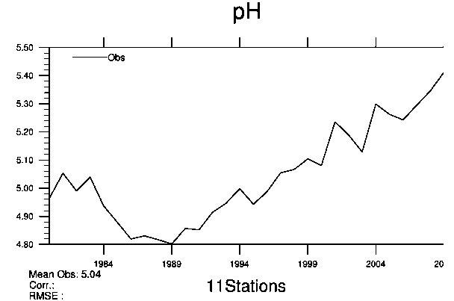
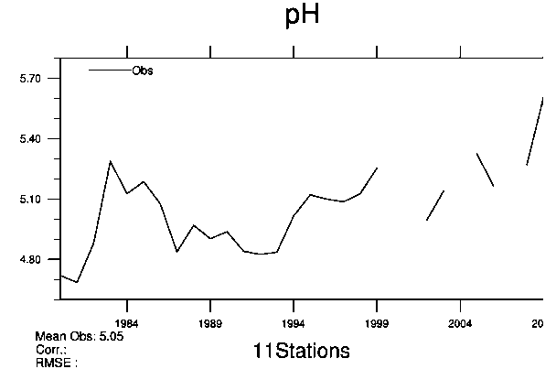
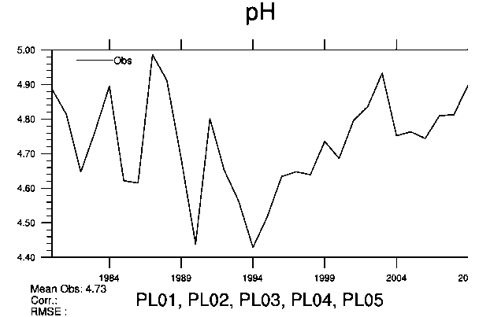
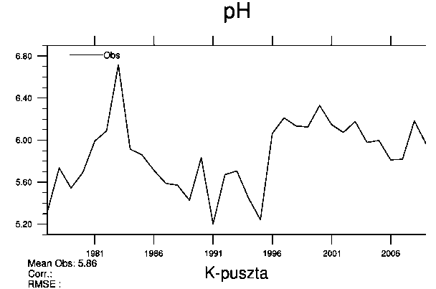
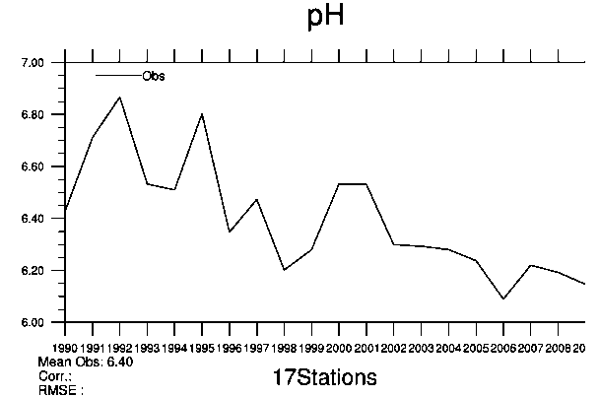
pH of cloud water
Old: constant value of 4.3
New: calculated based on the ion balance –
SO₄²⁻, NO₃⁻/ HNO₃, NH₄⁺/NH₃, CO2
Effect for less acid environment:
more efficient SO₂ oxidation with O₃ to form SO₄²⁻
esp. pronounced in winter and for pH > 5
GB
PL
NO
HU02
ES
Meteorologisk Institutt met.no
Notes:
6

Slide 7
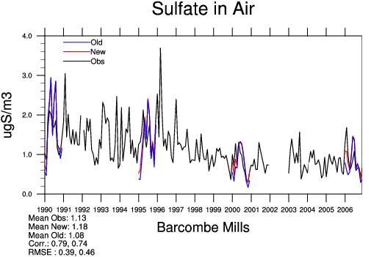
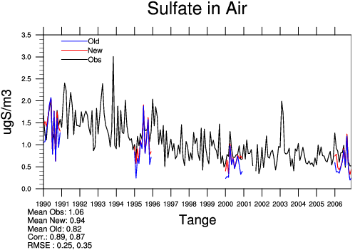
pH of cloud water
The effect on model results - more efficient SO4 production, especially in winter. The effect increases between 1990 and 2006
For 2006:
SO₄²⁻ bias improves from -33 to -23% (23 EMEP sites),
from -23 to -12% (63 sites if sea salt SO4 included)
Spatial correlation: from 0.85 to 0.92 (0.78 to 0.80)
IOA: from 0.82 to 0.90 (0.81 to 0.87)
Also NH₄⁺ bias improves from -22 to -12% (slightly better correlation)
Meteorologisk Institutt met.no
Notes:
7

Slide 8
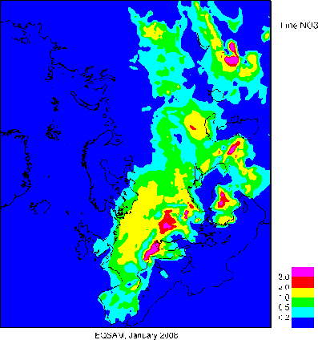
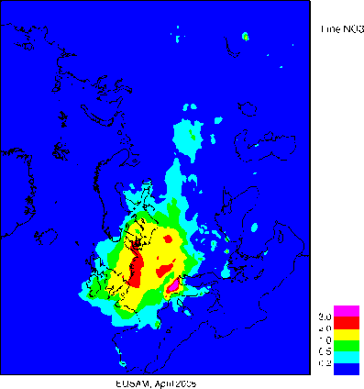
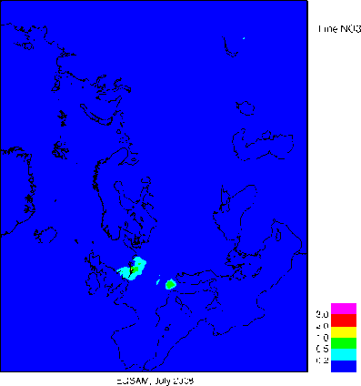
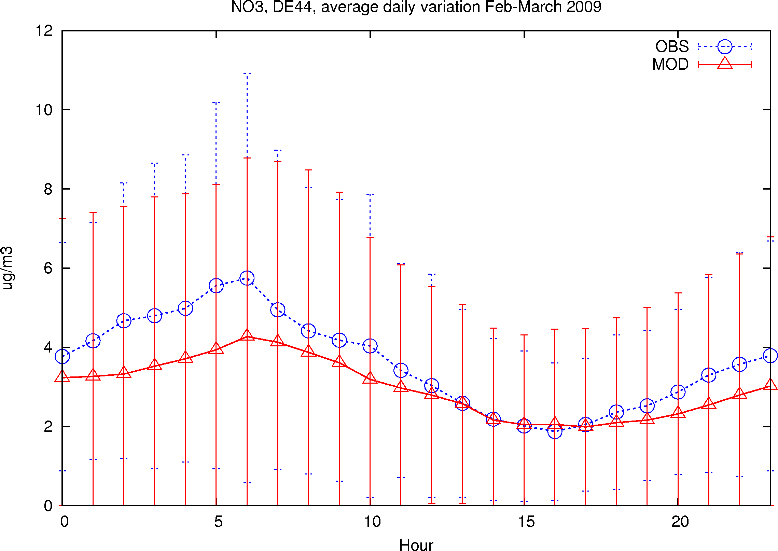
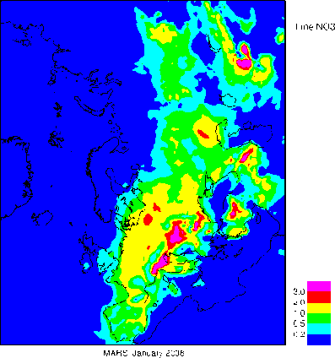
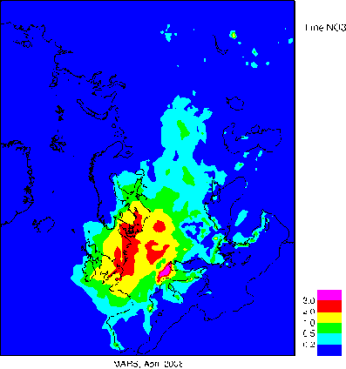
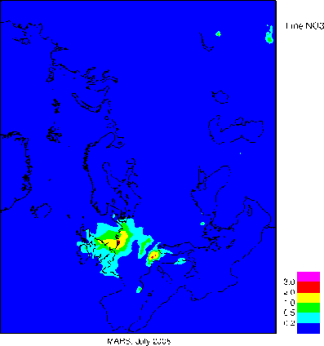
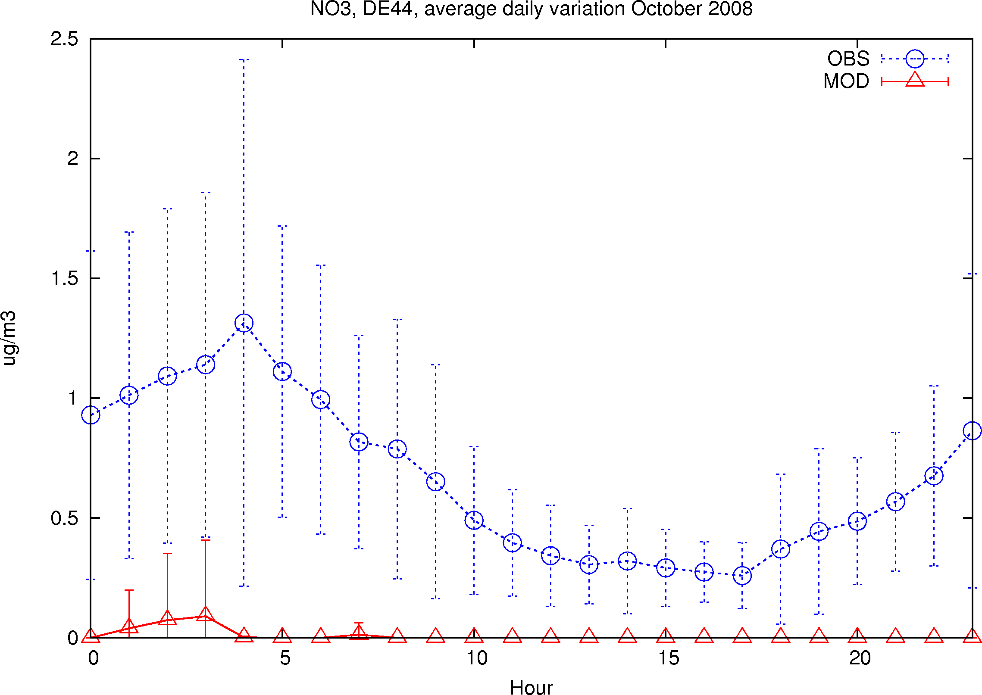
Gas/aerosol partitioning
from EQSAM back to MARS (Binkowski)
EQSAM has troubles to reproduce HN4NO3 at warm conditions
Test indicated a very large sensitivity of equilibrium to temperature, leading to too efficient aerosol evaporation with increasing T (and some over-predicting HN4NO3 at low T )
January
April
July
Fine NO3 at DE44
Feb-March
EQSAM
May-June
MARS
Meteorologisk Institutt met.no

Slide 9
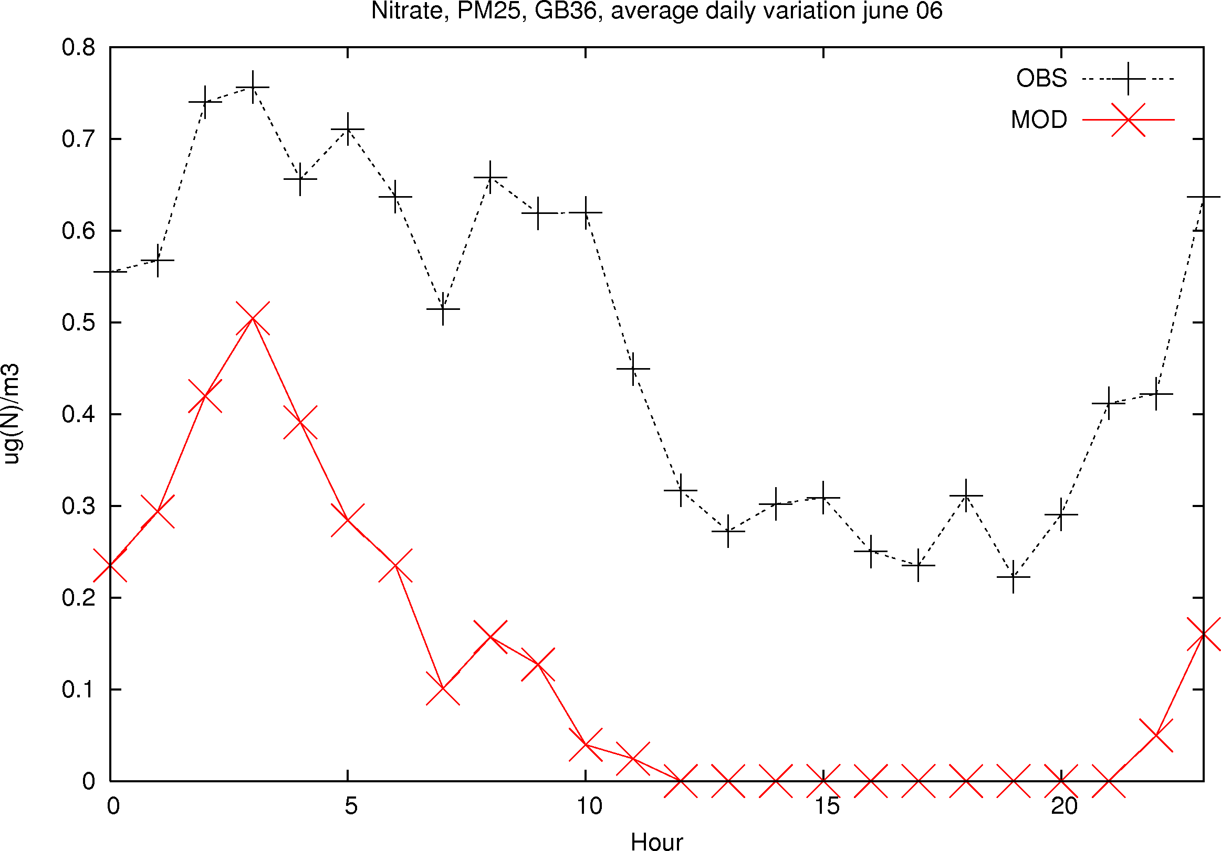
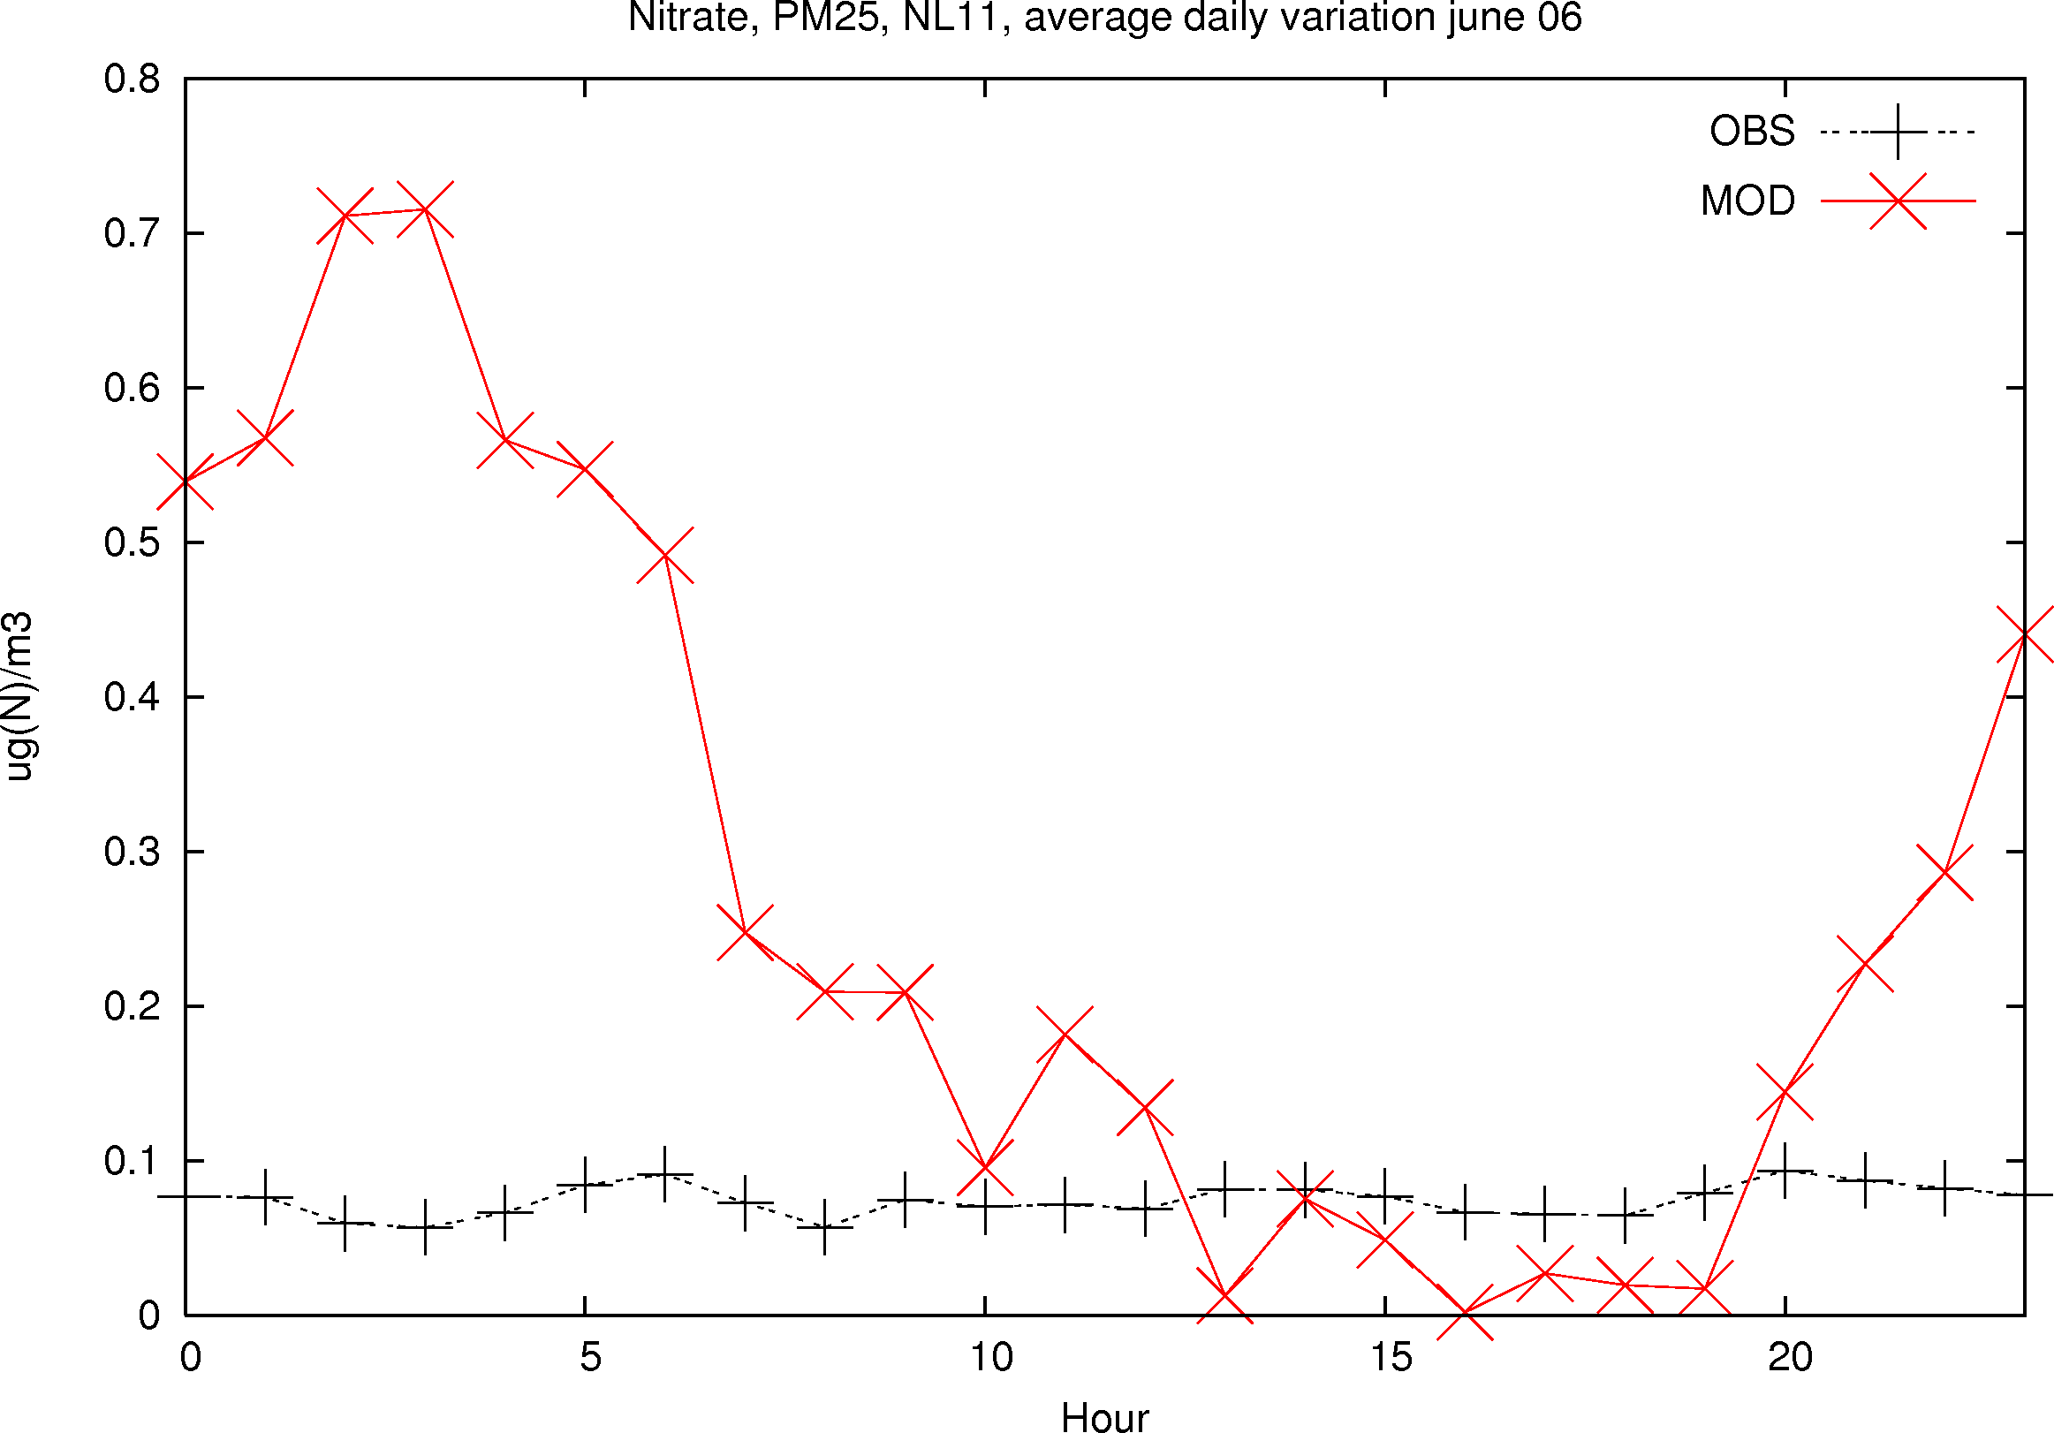
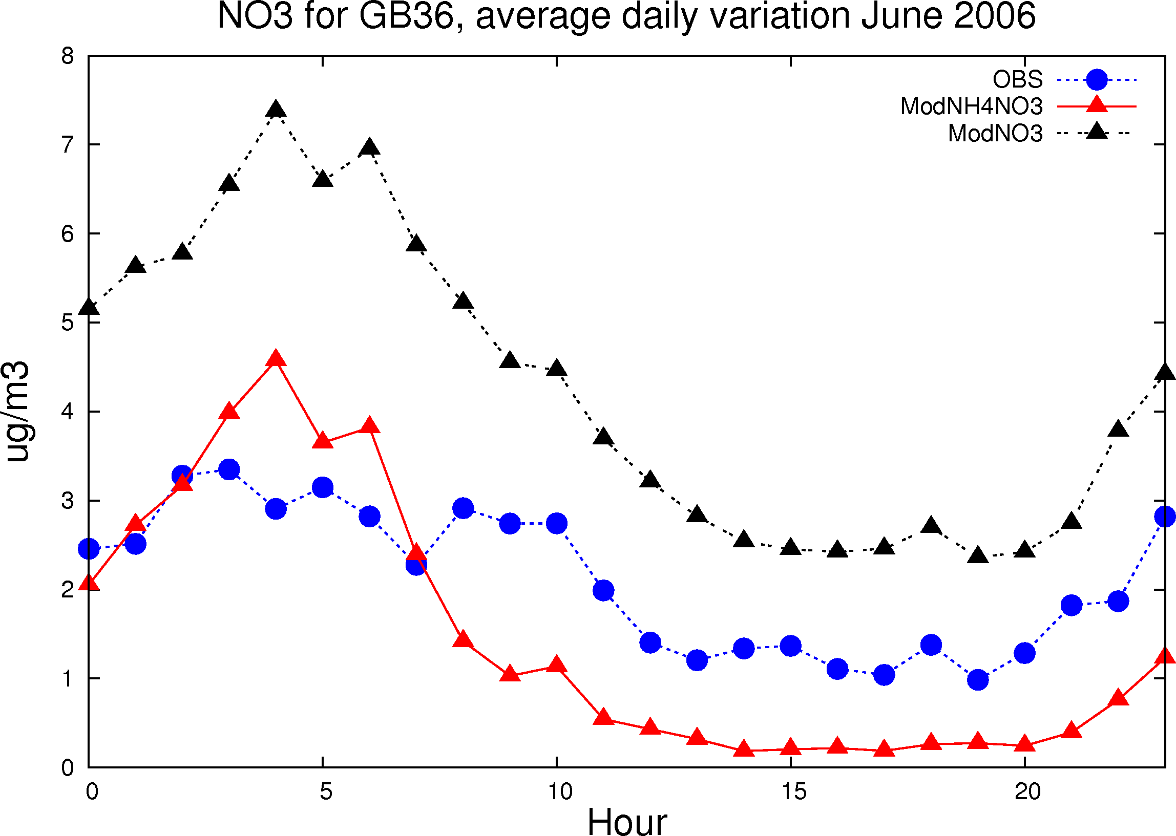
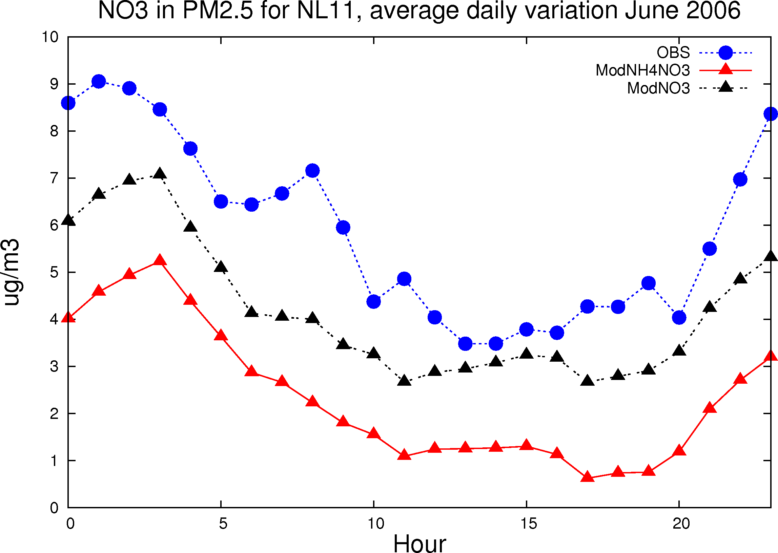
June 06: Harwell GB36
Cabau NL11
EQSAM
MARS:
more NH4NO3,
esp. at warm conditions
Improved NO3 calculations for spring/summer (PARLAM)
Larger underestimation with ECMWF
Meteorologisk Institutt met.no

Slide 10
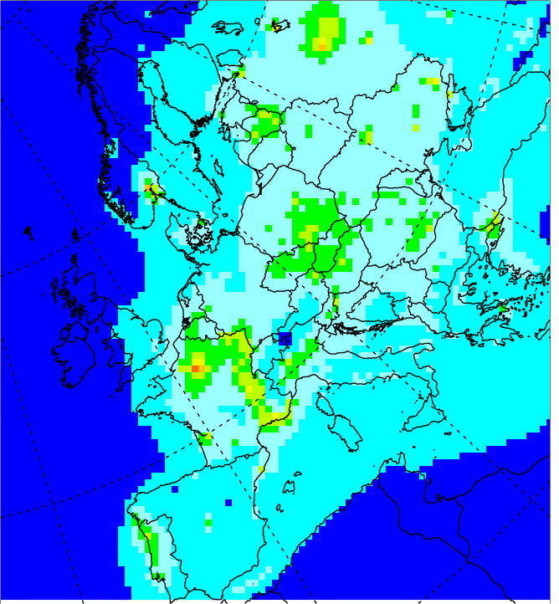
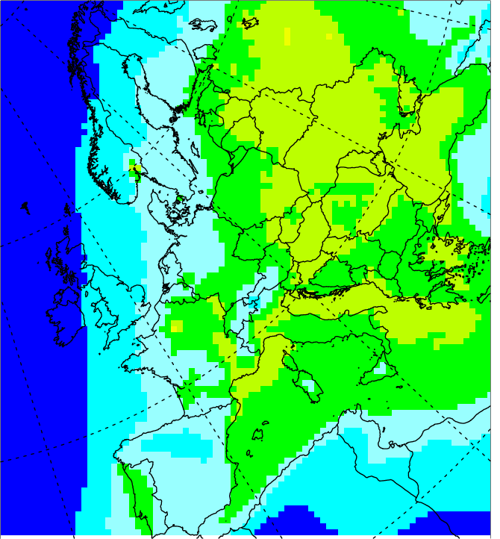
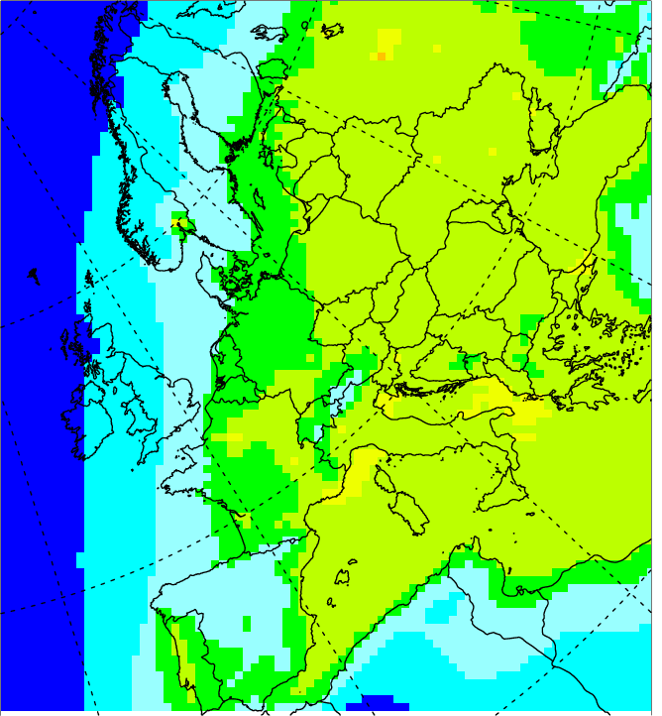
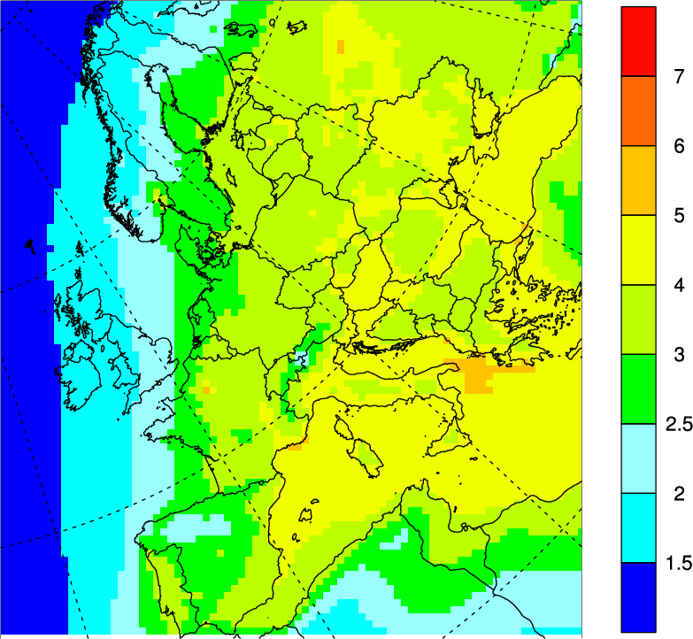
Secondary Organic Aerosols (SOA)
Volatility Basis Set (VBS) approach (Bergström et al., ACPD, 2012)
Four schemes were tested, differing in treatment of POM and OA ageing
Total OM in PM_{2.5} (2002-2007)
VBS-PAP
Emissions: POA + OC gases of varying volatility + ageing
Nonvolatile POA emissions
(μg / m³)
VBS-PAP+
aging of
ASOA
7
6
5
4
3
2.5
2
1.5
VBS-PAP+
aging of
all SOA
Meteorologisk Institutt met.no

Slide 11
Effect of SOA on PM levels
Bias = -41%
R = 0.62
RMSE = 7.10
Bias = -24%
R = 0.64
RMSE = 5.28
Bias = -52%
R = 0.78
RMSE = 6.48
Bias = -31%
R = 0.72
RMSE = 4.71
Meteorologisk Institutt met.no
Notes:
11

Slide 12
Current model performance for 2009
 | Bias (%) | R | RMSE | IOA
PM10 | -19 | 0.66 | 4.7 | 0.71
PM2.5 ^{*)} | -22 | 0.82 | 3.76 | 0.74
SO4 ^{**)} | -23 | 0.78 | 0.65 | 0.83
SO4 ^{***)} | -18 | 0.78 | 0.65 | 0.83
NO3 | -7 | 0.84 | 1.09 | 0.85
NH4 | -21 | 0.85 | 0.39 | 0.88
Na | 8 | 0.83 | 0.53 | 0.90
HNO3 | -28 | 0.50 | 0.17 | 0.57
NH3 | -16 | 0.33 | 0.55 | 0.58
^{**)} PM fine + ½ coarse NO3 ^{**)} Non Sea salt ^{***)} Sea salt corrected
Meteorologisk Institutt met.no
Notes:
12

Slide 13
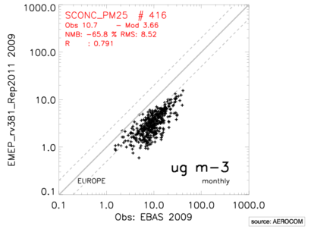
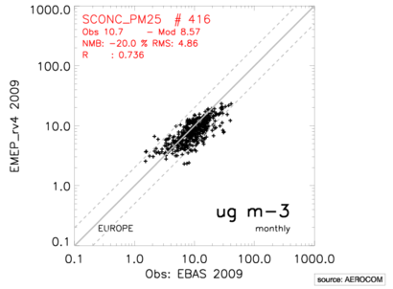
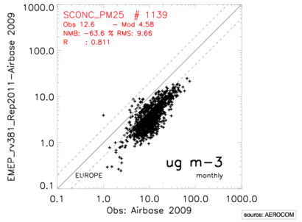
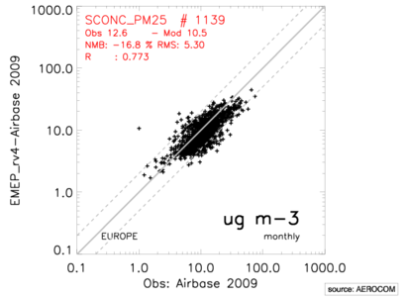
Model performance for PM2.5
Report 1/2011
Current version
EMEP
AirBase
Meteorologisk Institutt met.no

Slide 14
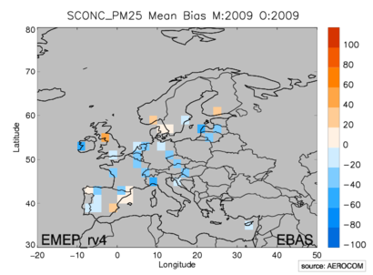
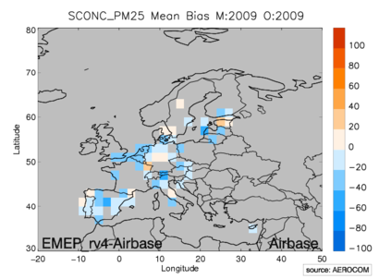
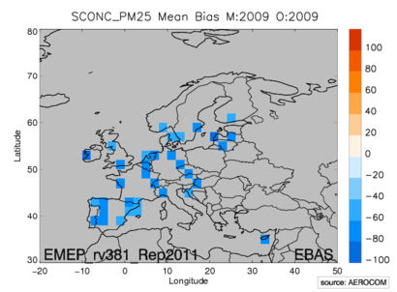
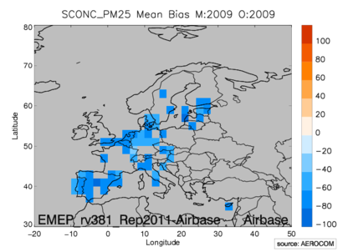
NEW PM2.5
OLD PM2.5 (Report 1/2011)
Meteorologisk Institutt met.no

Slide 15
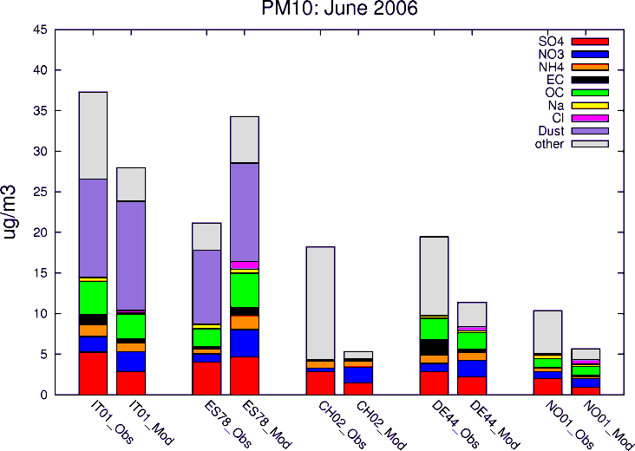
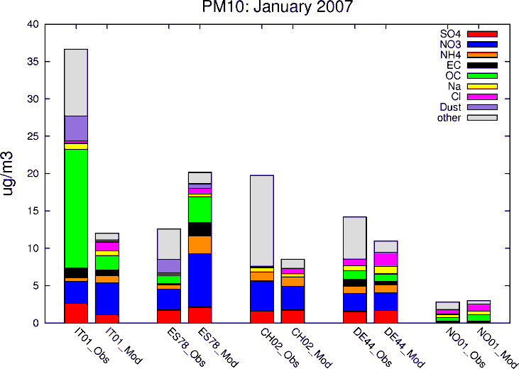
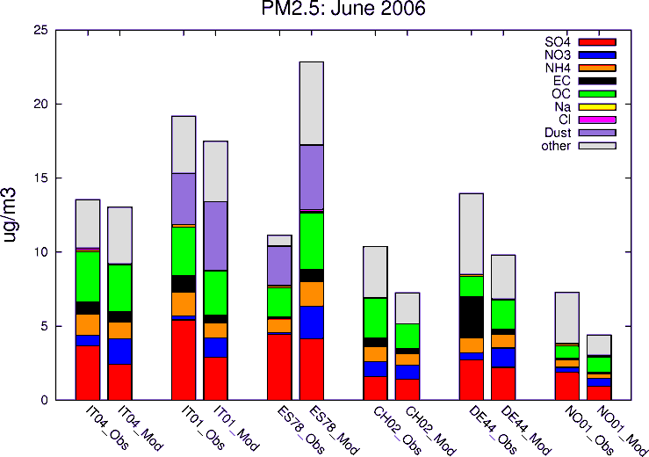
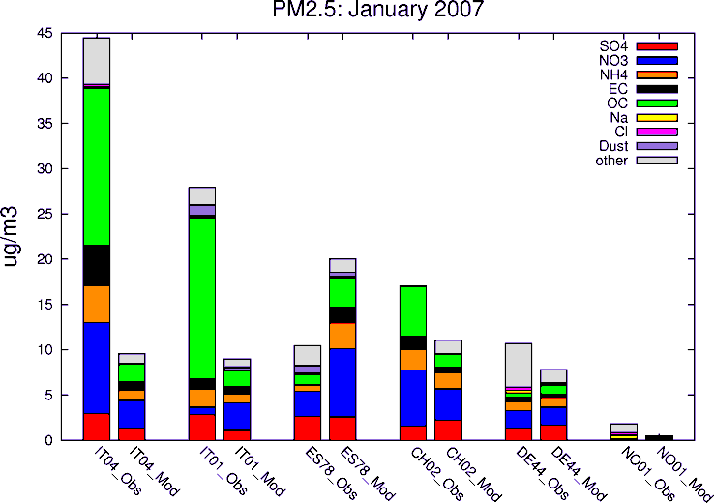
PM chemical composition
from “Lessons learnt..”(Aas, Tsyro et al., ACPD, 2012)
Meteorologisk Institutt met.no

Slide 16
On-going works towards further model improvement
NO3 formation on sea salt and dust
Improvements of dust calculations
Finer horizontal resolution (down to ca. 7x7 km)
Better resolved surface layer (presently ca. 90m)
New data for model evaluation within AEROCOM:
AirBase (more and different types of sites)
AERONET (sun photometers) - AOD
Satellites AOD
CALIOP – extinction profiles
Meteorologisk Institutt met.no
Notes:
16

Slide 17
Formation of NO3 on sea salt and dust
Kinematic approach
Uptake rate: k$={\left(\frac{d_{p}}{2D_{HNO3}}+ \frac{4}{ν∙γ}\right)}^{−1} ∙A$
Uptake coefficient
Aerosol surface area
Measured uptake coefficient values vary by several orders of magnitude;
For dust γ depends on soil composition (HNO3 reacts with calcite, dolomite, but not with gypsum, silica and alumina-silicates)
Depends on Rh: γ increases with Rh (some measurements show γ maximum at Rh 50-55% for sea salt)
Decreases with HNO3 increase
Requires accurate calculations of sea salt and mineral dust!
Meteorologisk Institutt met.no

Slide 18
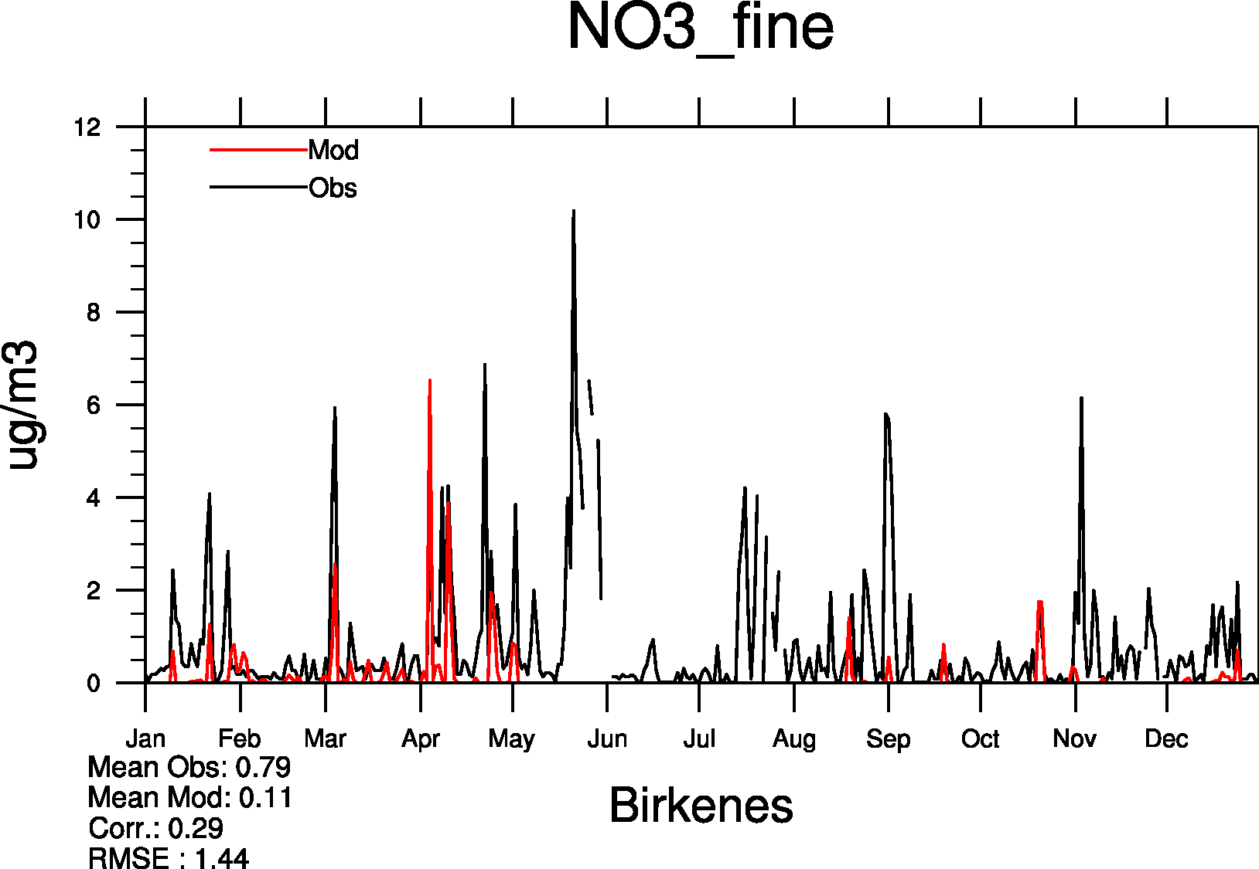
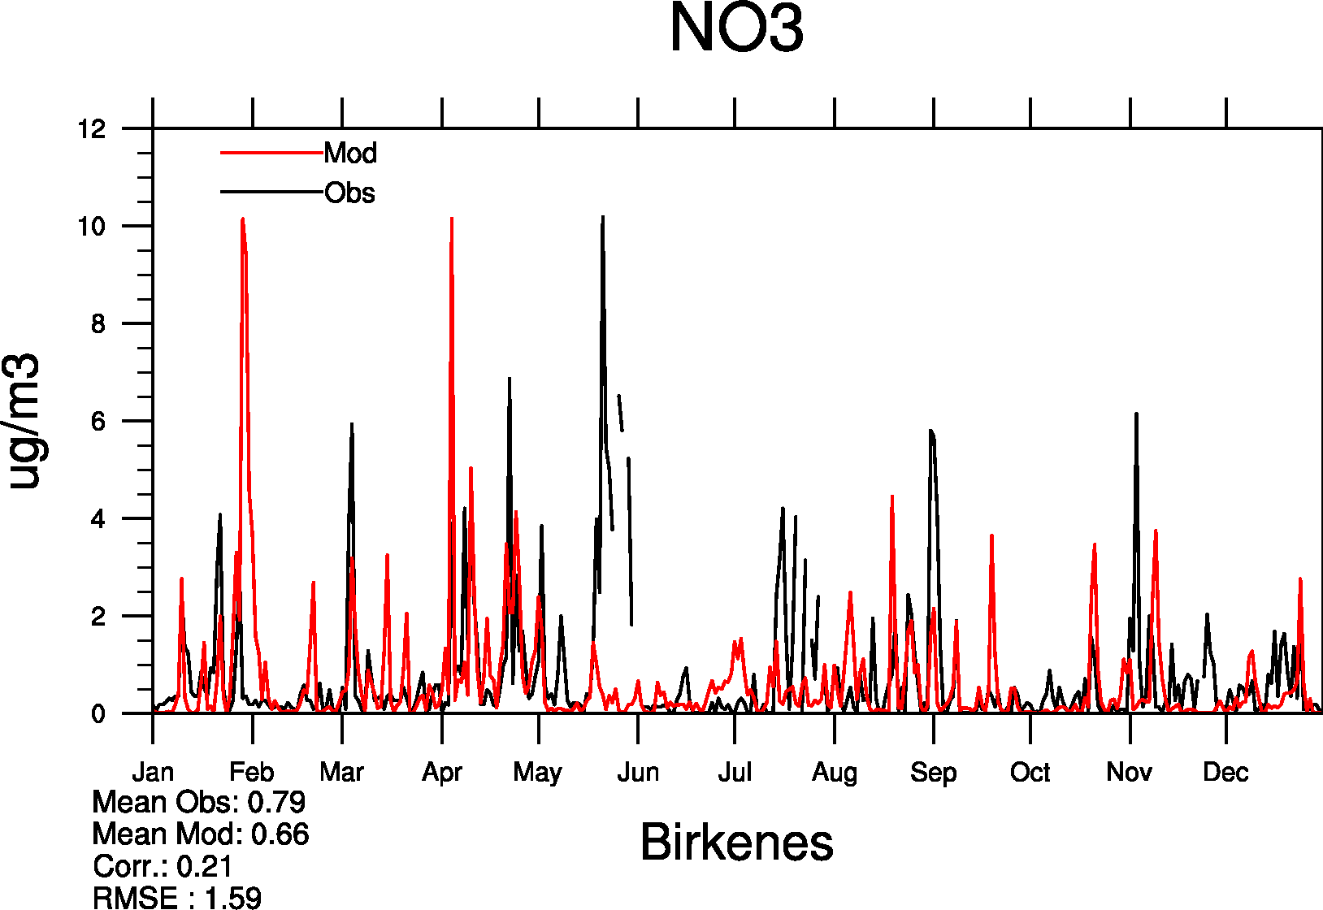
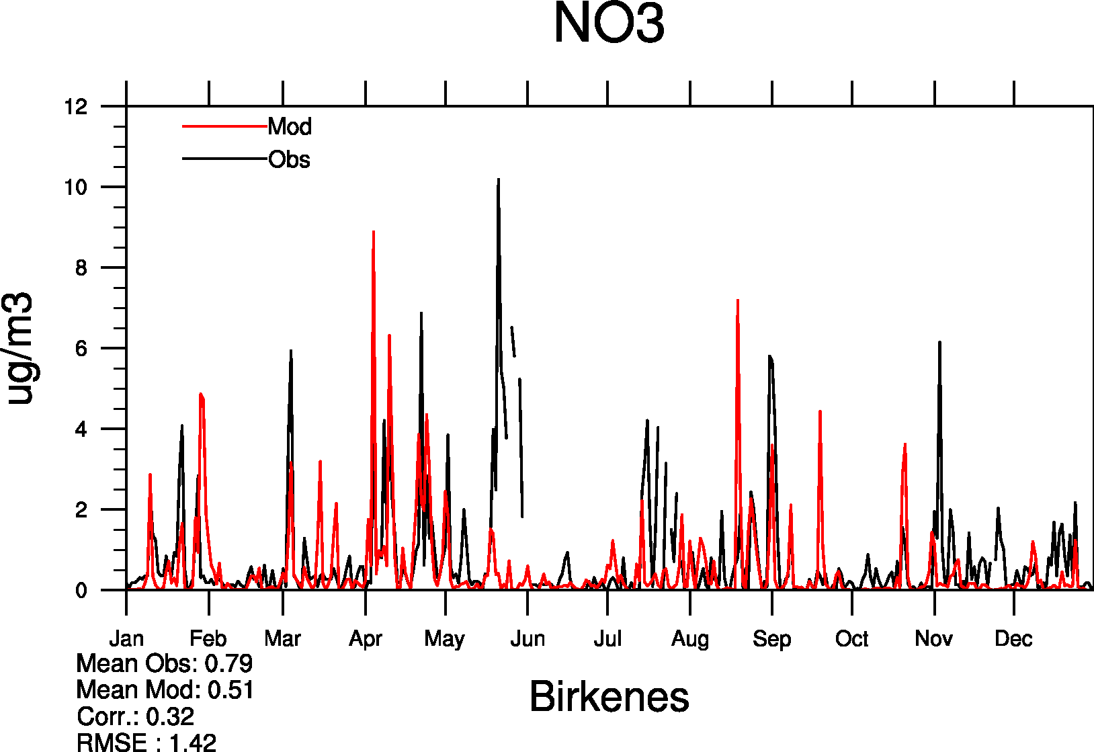
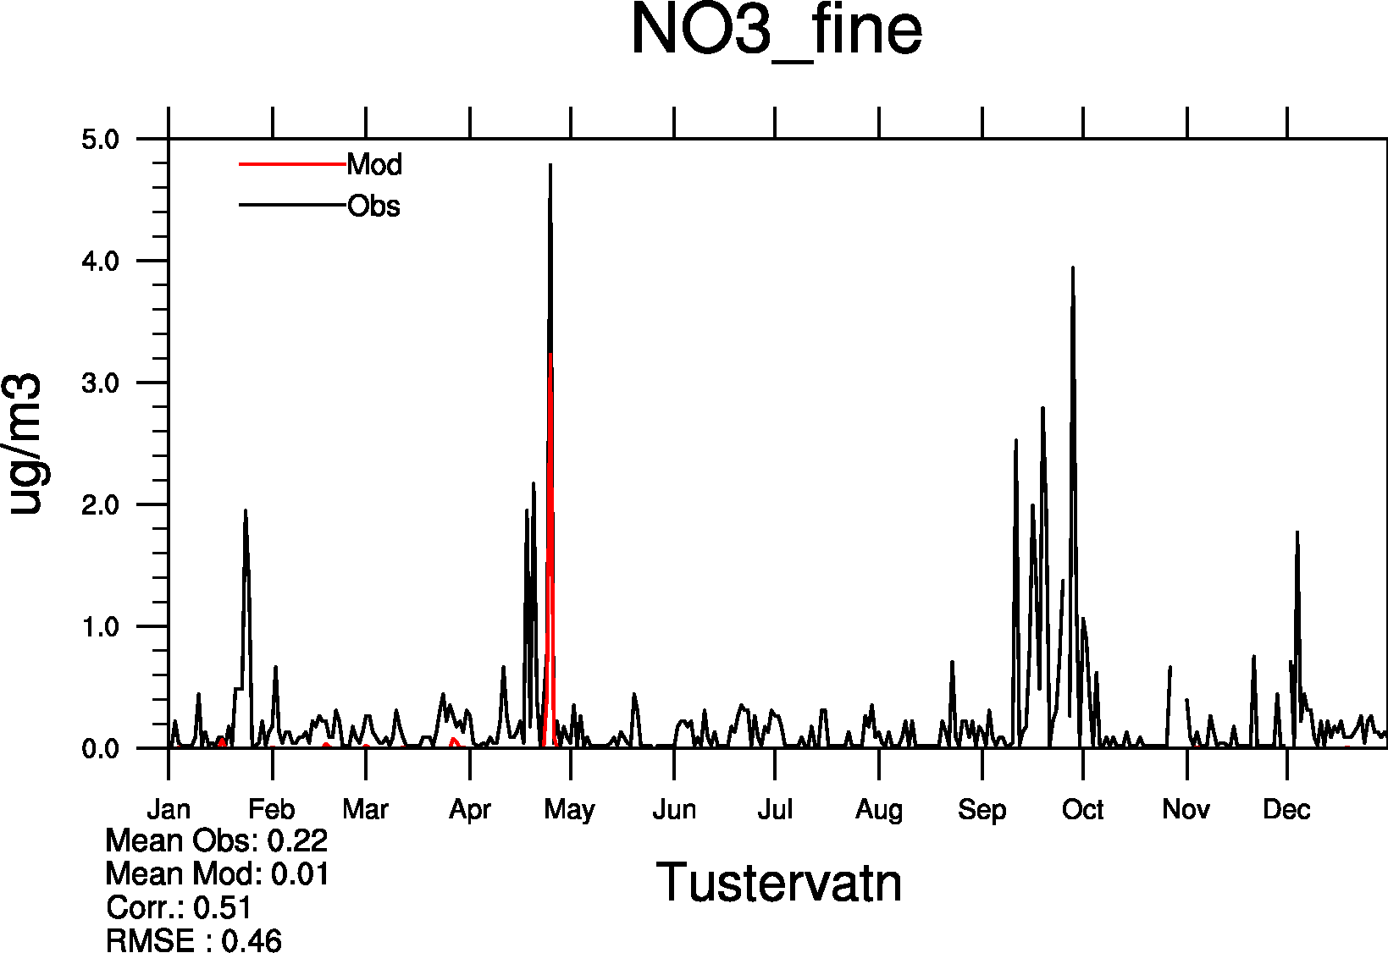
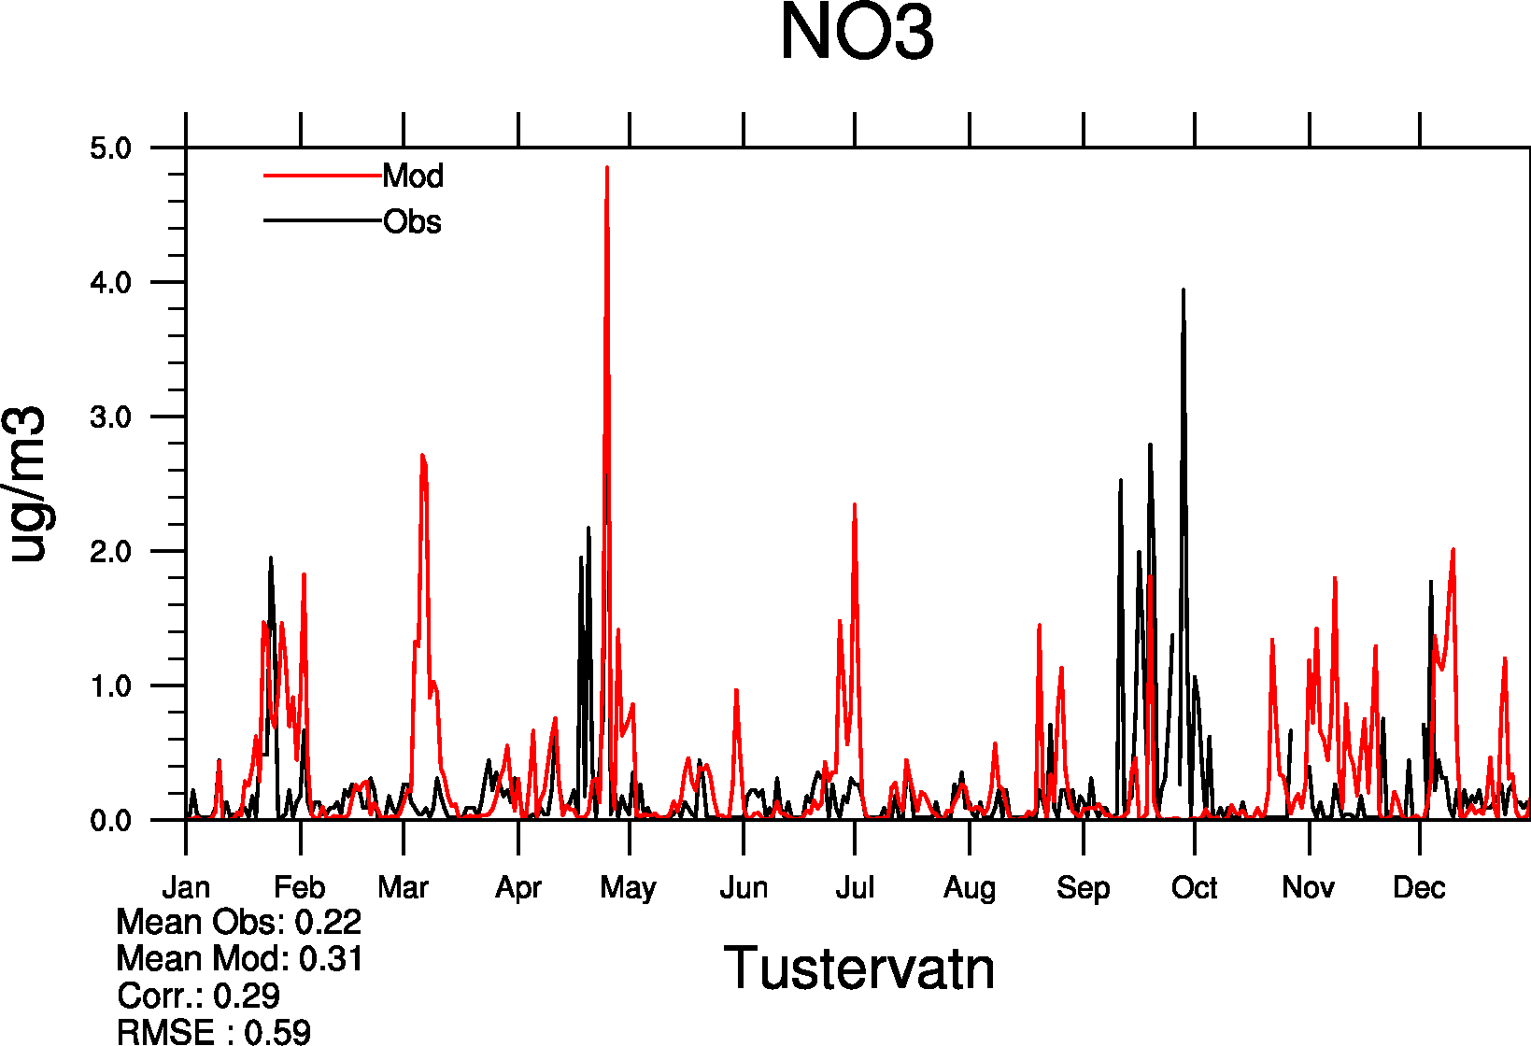
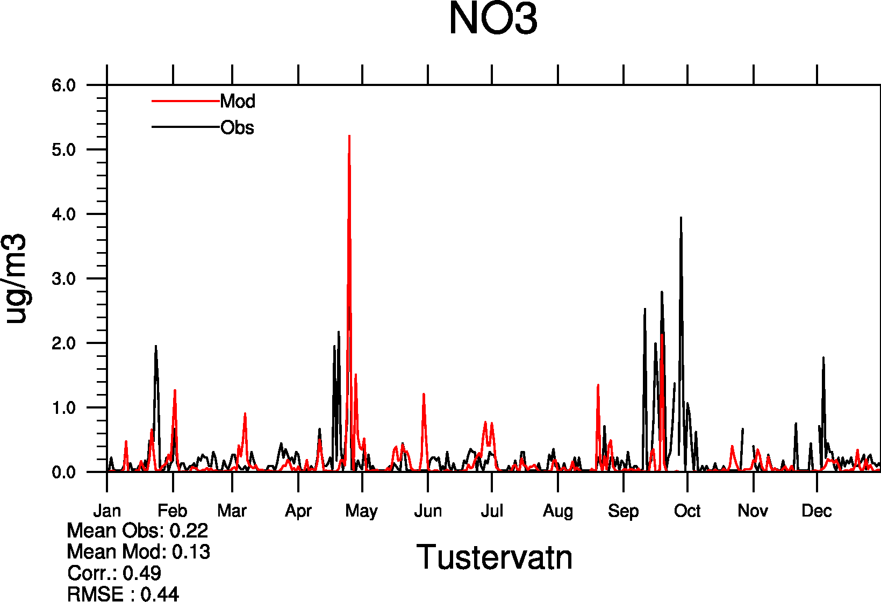
Model vs. measured NO3
Norway
CURRENT
NEW
fNO3 + 0.5⋅ coaNO3
fNO3 + coaNO3 (SS&dust)
Meteorologisk Institutt met.no

Slide 19
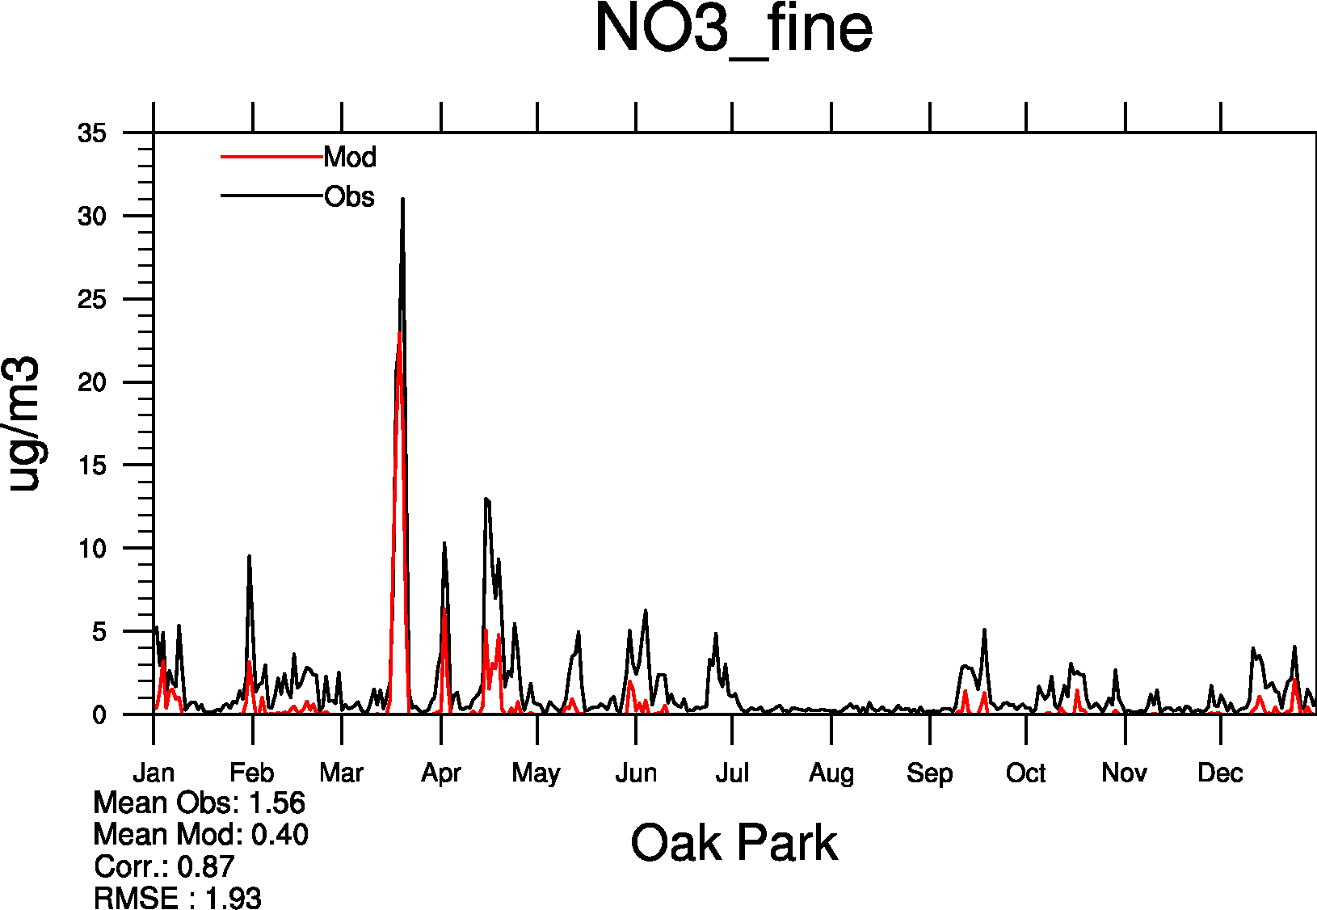
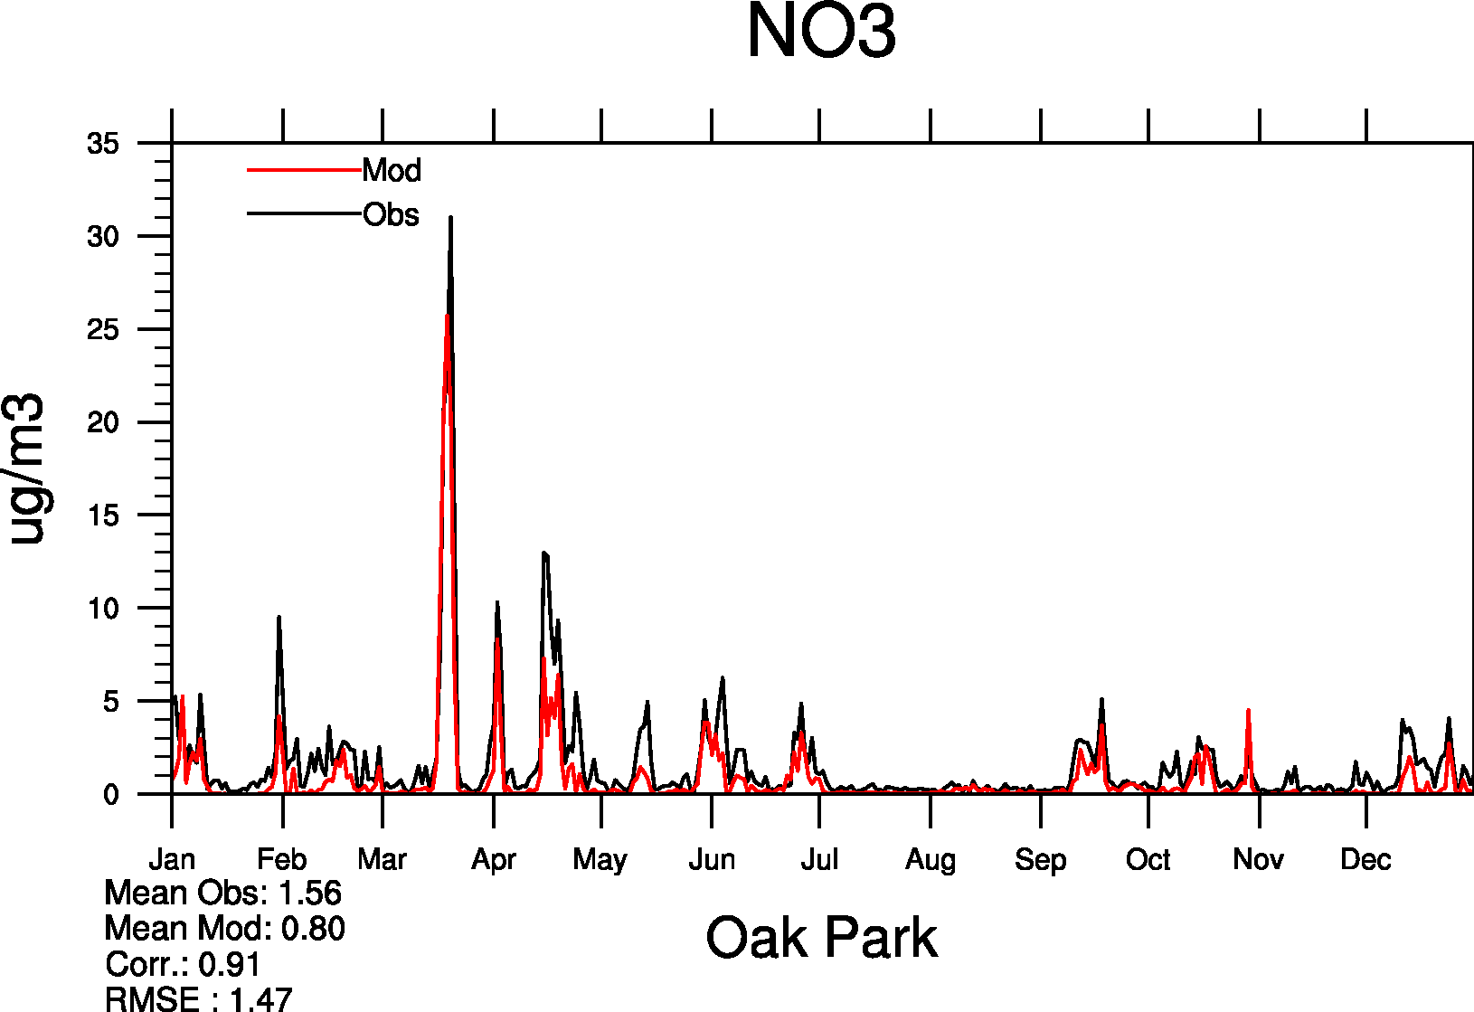
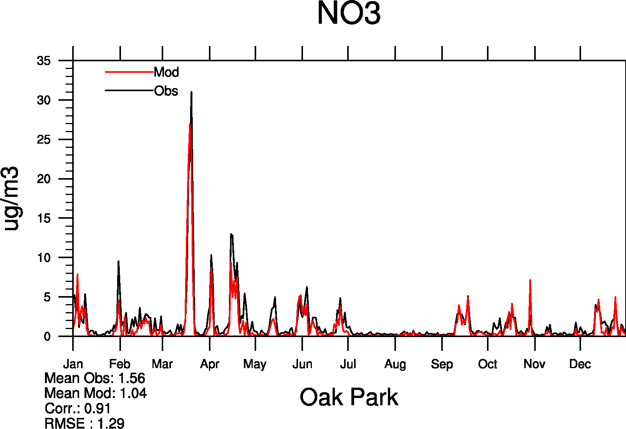
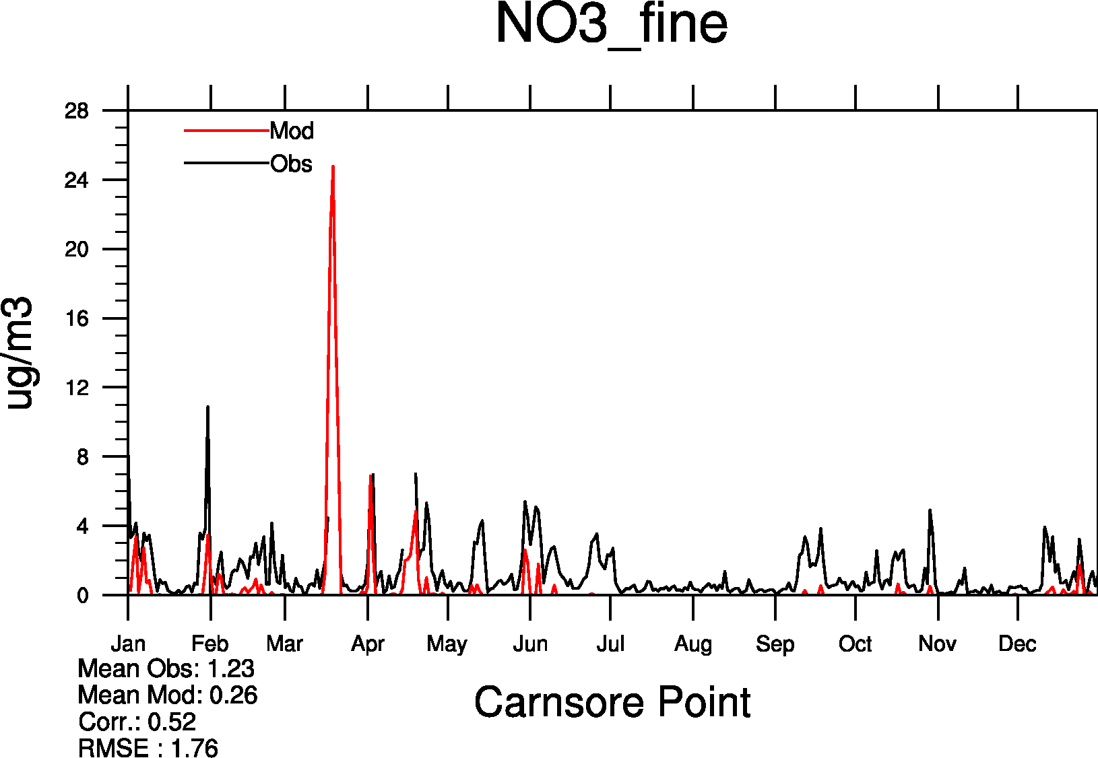
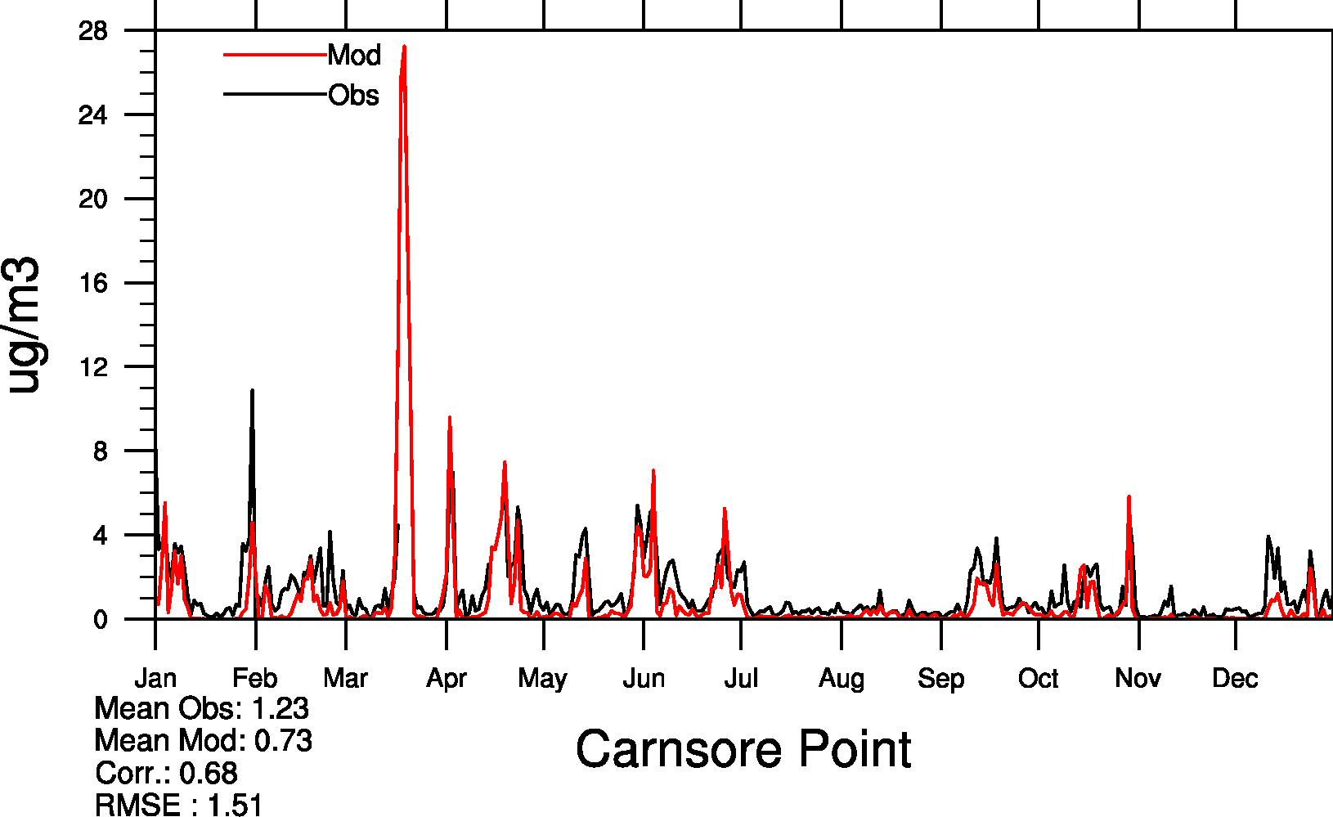
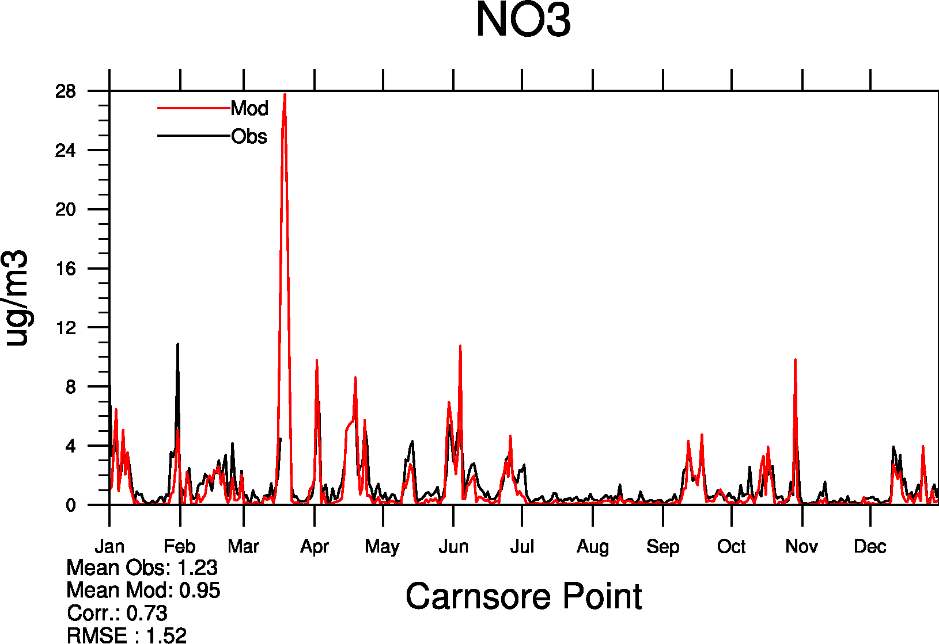
Model vs. measured NO3
Ireland
CURRENT
NEW
fNO3 + 0.5⋅ coaNO3
fNO3 + coaNO3 (SS&dust)
Meteorologisk Institutt met.no

Slide 20
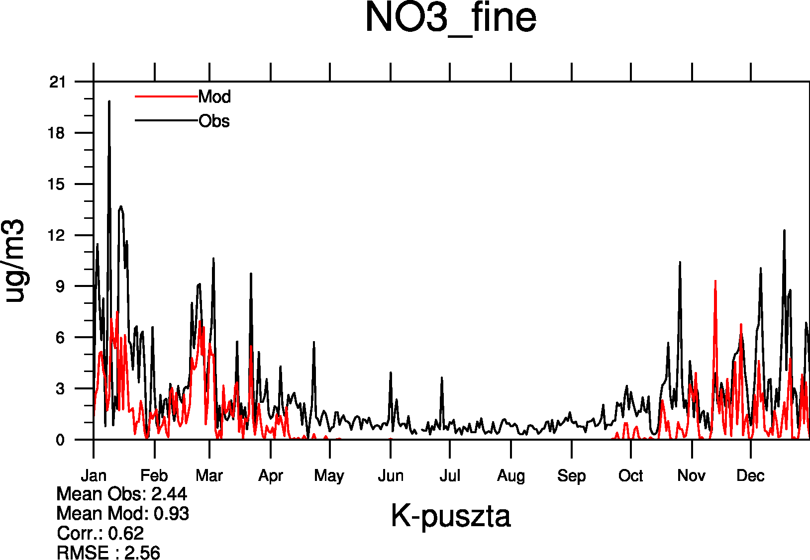
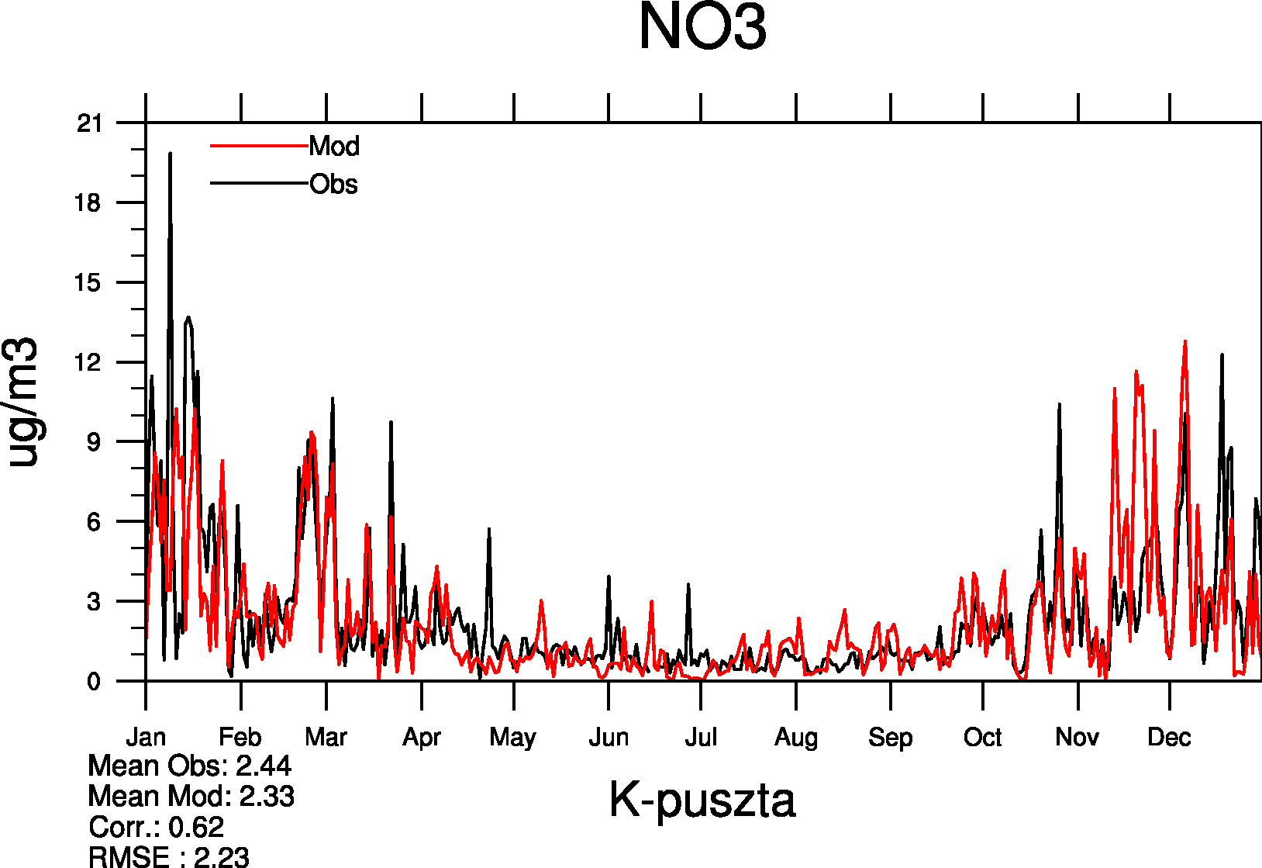
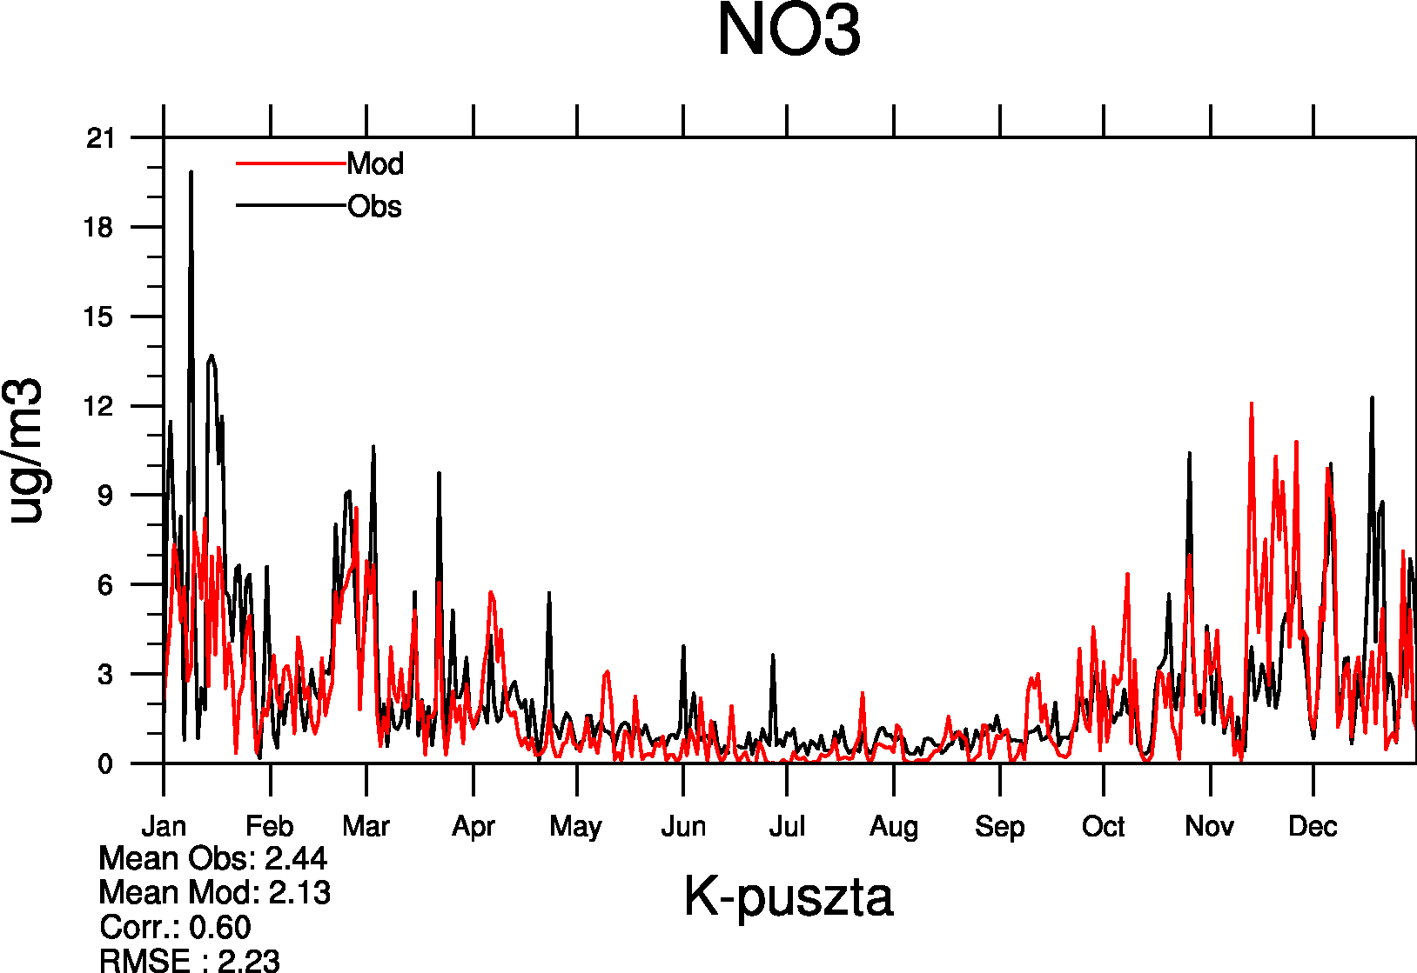
Model vs. measured NO3
C. Europe
CURRENT
NEW
fNO3 + 0.5⋅ coaNO3
fNO3 + coaNO3 (SS&dust)
Meteorologisk Institutt met.no

Slide 21
NO3 at Birkenes, June 2006
Due to sea salt NO3
NH4NO3
vs.NH4NO3
vs. NH4NO3+ NO3 on fine SS

Slide 22
Na⁺ at Birkenes, June 2006
Meteorologisk Institutt met.no

Slide 23
Montelibretti June 2006
???
Meteorologisk Institutt met.no

Slide 24
NO3 = fine NO3 + coar NO3 (on SS & dust)
NO3 = fine NO3f + ½ coar NO3
Na is calculated fairly well (Tsyro et al., ACP 2011)
Dust is difficult to verify, but is likely underestimated in C and N Europe
Bias = -24%
R = 0.89
RMSE = 1.11
Bias = -7%
R = 0.84
RMSE = 0.84
Bias = -46%
R = 0.87
Bias = -30%
R = 0.88
Bias = -24%
R = 0.68
Meteorologisk Institutt met.no

Slide 25
Improvement of dust calculations
Implementation of road dust and dust from agricultural land management (co-operation between met.no, TNO and SMHI)
Improvement of dust will facilitate more accurate calculations of coarse NO3
Improvement of input soil moisture
New dust measurements from up-coming intensives will facilitate ……
Meteorologisk Institutt met.no

Slide 26
First evaluation of aerosol vertical profiles
Comparison of model aerosol extinction with data from CALIOP LIDAR (on board CALIPSO)
Meteorologisk Institutt met.no

Slide 27
SUMMARY
Several parameterizations has been revisited and updated in the EMEP/MSC-W model, which reduced model bias for PM from –(40-50)% to about -20%
The major improvements are due to:
implementation of SOA
on-line calculation of cloud water pH
MARS for gas/aerosol partitioning
Further improvements are expected due to:
improvements in dust calculations
implementation of coarse NO3 formation on sea salt and dust
In addition to EMEP monitoring data, all new observations will be made use of for testing of new developments and general model evaluation
Meteorologisk Institutt met.no
Notes:
27

Slide 28
Appreciate your attention!
Meteorologisk Institutt met.no
Notes:
28

Slide 29
Calculated vs observed Na⁺, Ca²⁺, Mg²⁺ in 2009
Accurate calculations of sea salt and mineral dust are important for coarse NO3 formation
Calculated concentrations from the EMEP/MSC_W model:
Ca² ⁺ = 5% Natural dust + 8% anthrop. dust + 1.2% sea salt
Mg²⁺ = 2 % Natural dust + 0.8% anthrop. dust + 3.7% sea salt
Meteorologisk Institutt met.no
Notes:
29

