Slide 1

Changing the EMEP grid: proposal for a new domain, projection and resolution
  MSC-W, MSC-E, CEIP & CIAM
Notes:
1

Slide 2
SB 2011 requested MSC-W, MSC-E, CCC, CEIP and CIAM to elaborate a note on the needs and options for modifications of the EMEP grid projection and grid domain, with a transfer to geographical coordinates, and for an increase of the grid resolution, and to provide the relevant rationale

Slide 3
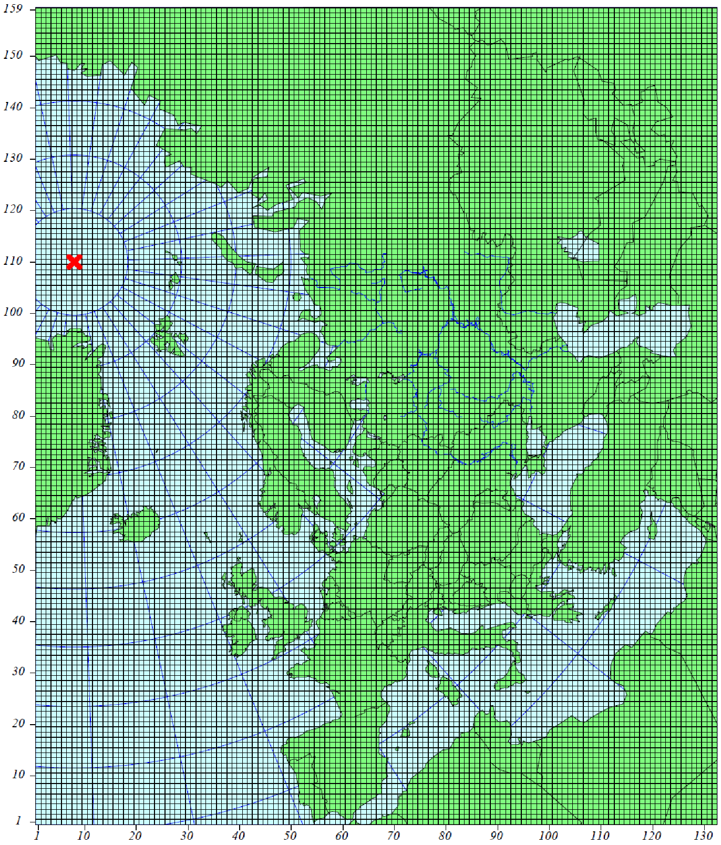
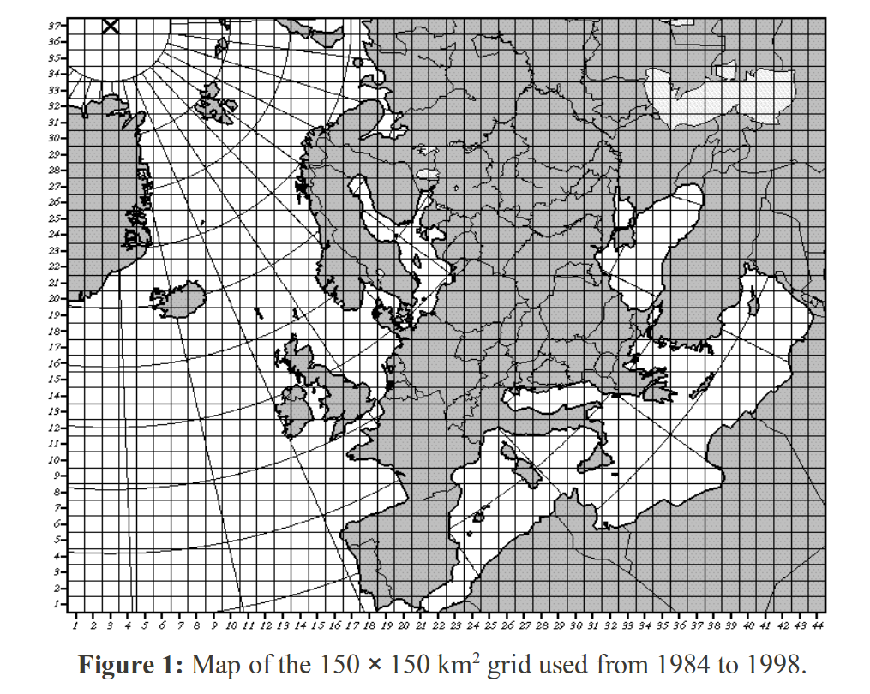
History
|1998-2007: Same domain, 50 x 50 km
From 2008-> Extended EMEP domain (50x50km)

Slide 4
New EMEP grid
Can be divided into 3 parts:
  Projection
  Resolution
  Gridding of emissions

Slide 5
FROM POLAR STEREOGRAPHIC TO LAT/LONG?
 | Pros | Cons
Lat/lon | 1. Consistent model studies from regional to global scale | 1. Strongly varying grid size
 | 2. Most used grid in scientific community (e.g. TFHTAP, Climate Community) i.e. easier exchange of data (Increased usefulness of EMEP data) | 2. Transition phase to another projection implies substantial change of software, creating addition error sources. ‘Cut’ in trend series
 | 3. Easily comparable to other emission data (e.g. EDGAR, TNO,APMoSPHERE)
Polar-stereographic | 1. Grid size does not vary significantly over the model domain | 1. Different from common projection of other input data such as meteorology, land use, population density etc.
 | 2. All the systems/input data set up for this

Slide 6
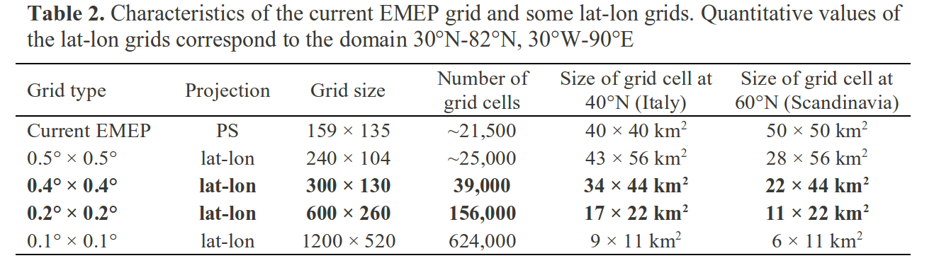

Slide 7
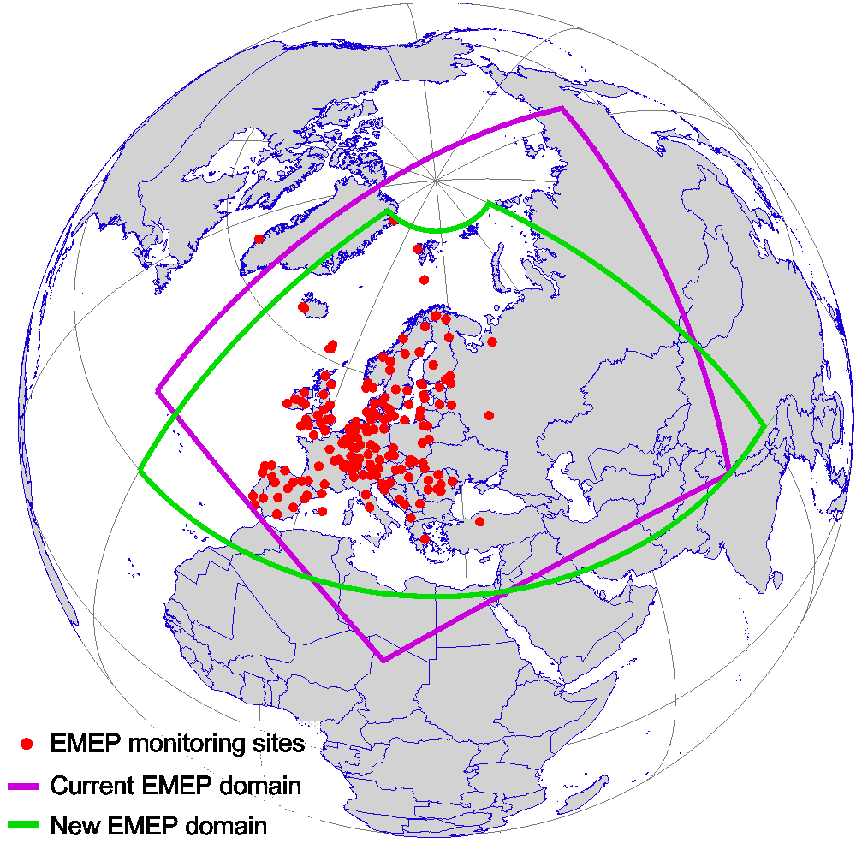
Smaller part of
(non-European) Russia included
Changed part of
North-Atlantic Sea
30°-82°N latitude
30°W-90°E longitude

Slide 8
Resolution

Slide 9
Why higher resolution?
Better comparison with measurements & more accurate results (e.g for ecosystem exceedances)
Fine scale emissions and models already exists and are run on European domain – EMEP should be 'state of the art'

Slide 10
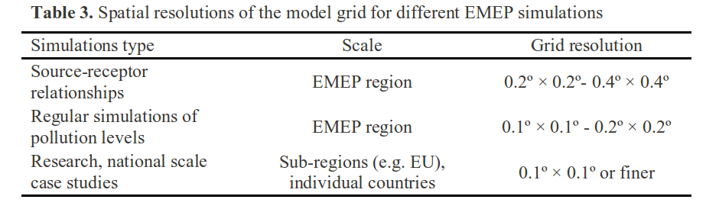
Different needs for different purposes

Slide 11
Emissions

Slide 12
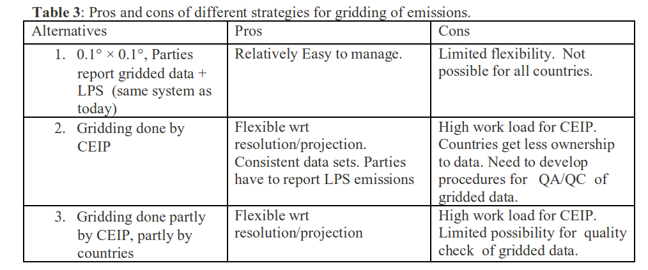
Different strategies for gridding of emissions

Slide 13
Conclusions/questions
Projection = lat/long
Domain ≈ as before (with modifications)
Resolution:
  As long as emissions and CL are reported in fine enough resolution (ca 0.1°), EMEP model runs can be performed on aggregated data
  Should we align the choice of resolution/grid with already available emissions data (e.g. TNO on 1/8x1/16)?

Slide 14
Preparations
EMEP model set up for 1/4°x1/8 (ca 14 km) and 1/8°x1/16° (ca 7 km) due to availability of emissions on this scale (TNO)
Work to make the EMEP model vertical structure flexible (thinner vertical layers near ground) not finished..

