Slide 1
Position of the GAW Scientific Advisory Group on the use of Black Carbon terminology
DRAFT
GAW/WMO SAG – AEROSOL

Slide 2
Black Carbon and Radiative Forcing
BC Radiative Forcing is significant
+0.34 W/m2 [Forster et al., 2007] - +0.9 W/m2 [Ramanathan and Carmichael, 2008]. –
+ 0.05 W/m2 Black Carbon on snow
Locally, BC forcing can be much higher
Schreekant et al., 2007, + 40 W/m2 for wintertime in Northern India
Marcq et al., 2010 : + 12 W/m2 Nepal Pyramid Observatory (5100 m)
BC forcing dependent upon injection height in models :
BC RF increases by 70% if injected at 5 km in a global model (Haywood and Ramaswamy, 1998)

Slide 3
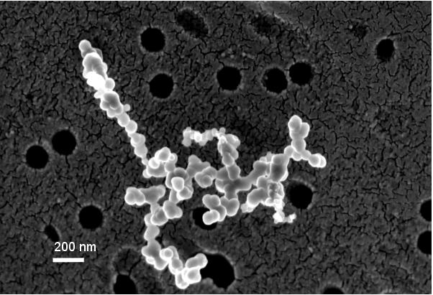
Radiative Forcing, morphology, mixing state
Absorption coefficient is strongly dependent upon:
Fractal dimension (Kahnert and Devasthale, 2011)
State of mixing (Jacobson, 2002).
Globally the BC RF can reasonably be of the order of = + 0.41 W/m2 when considering state of mixing and other BC properties

Slide 4
Black Carbon : a tool for climate policies?
A likely candidate for linking climate and air quality policies
Main emission sources:
- Biomass combustion
- Other man-made combustion
- Transport
BUT still a lot of uncertainties
Variability between emission inventories linked to emission factors
Differences between from -30 to +120 % (man-made emissions) and -50 to +200% (biomass burning).
Limited information from in-situ observations

Slide 5
Black Carbon: in-situ Observations
37 observation sites in WDCA/EBAS Number of participating sites is increasing in particular from EU station after EUSAAR/ACTRIS (24/37)
Additional measurements exist from IMPROVE (US) and China networks. Data from the latest are not public
Problem with intercomparisons of information from the different sites
remote sensing observations are even more limited.

Slide 6
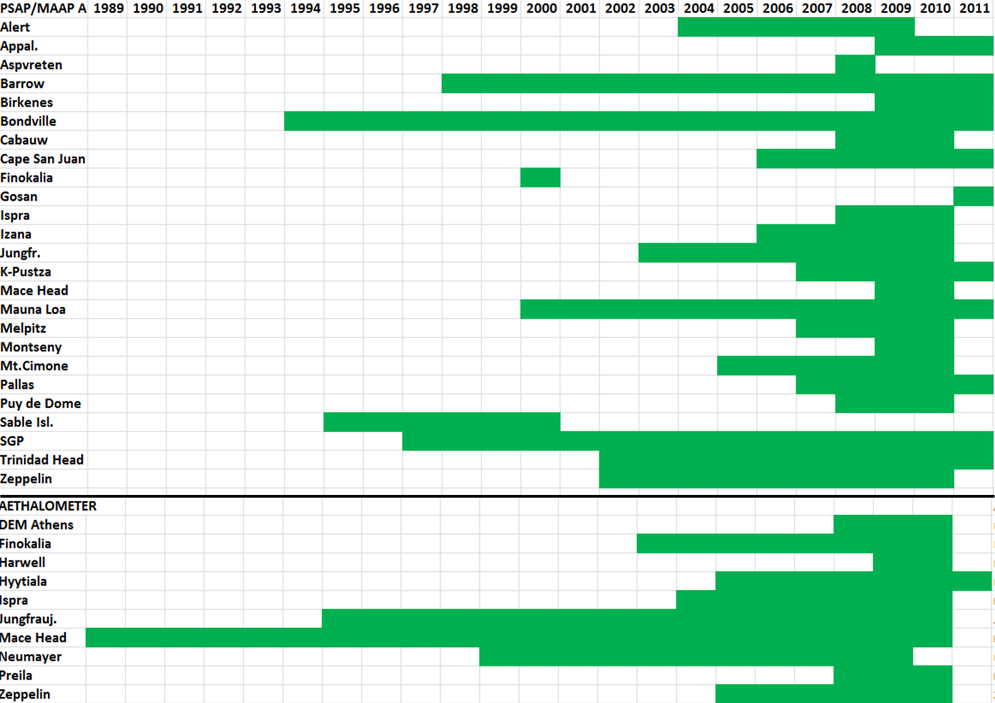
In-situ observation: spatial and temporal coverage (WDCA/EBAS)

Slide 7
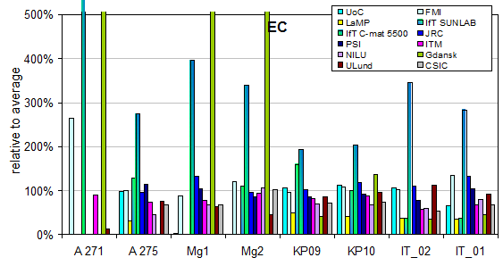
Problem with BC metrology and terminology
Inconsistency example: Guillaume et al., Atmos. Envir. 2008
(but many others can be found)
Pic du Midi : Thermo-optics with DRI method
Compared with modelled BC concentrations derived from emission factors of a poorly-defined substance
PDD, Sonnblick: Thermo-optic with Sunset/EUSAAR
First EUSAAR intercomp 2007

Slide 8
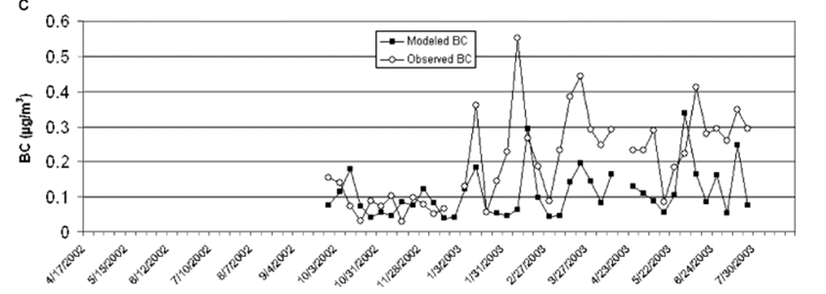
BC terminology: metrology and semantics
Inconsistency example: Guillaume et al., Atmos. Envir. 2008
(but many others can be found)
Referred to as BC referencing Pio et al., 2008
Referred as EC in the original paper of Pio et al

Slide 9
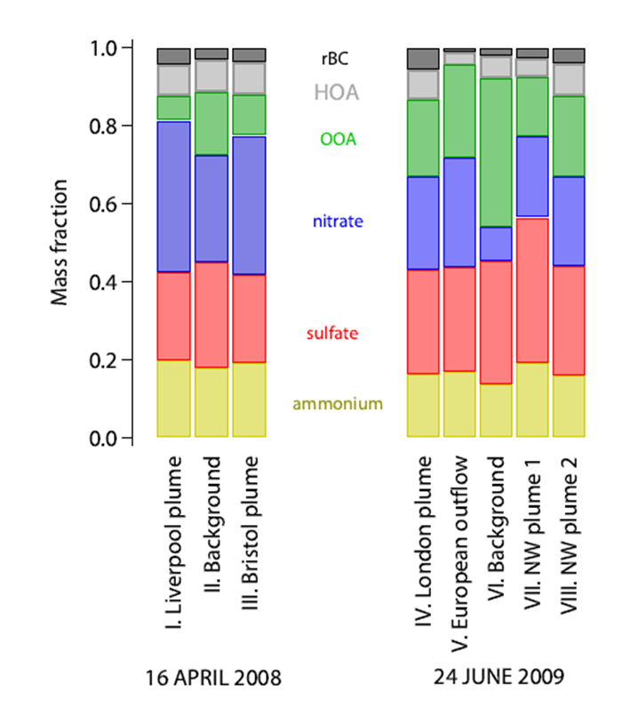
BC terminology: metrology and semantics
Inconsistency example 2: SP2 measurements
(but many others can be found)
Mc Connell, Science (2008)
Measurement performed with similar instrumentation (SP2), but different terminology used (Black Carbon in McConnel and Refractory Black Carbon in Mc Meeking
McMeeking, et al., (2011)

Slide 10
Terminology proposed by Andreae and Gelencser, 2006
« Total carbon » (TC): Total particulate carbonaceous material –
“Soot carbon” (Csoot): Carbon particles with the morphological and chemical properties typical of soot particles from combustion: Aggregates of spherules made of graphene layers, consisting almost purely of carbon.
“Brown carbon” (Cbrown): Light absorbing organic matter (other than Csoot) in atmospheric aerosols of various origins,
“Light-absorbing carbon” (LAC): General term for light absorbing carbonaceous substances in atmospheric aerosol, includes Csoot and Cbrown.
“Light-absorbing aerosol” (LAA): General term for light absorbing particulate substances in atmospheric aerosol, includes Csoot, Cbrown and other light absorbing particles such as inorganic dust.
“Elemental carbon” (“EC”): fraction of particulate carbon that is oxidized in combustion analysis above a certain temperature threshold, and only in the presence of an oxygen-containing atmosphere.

Slide 11
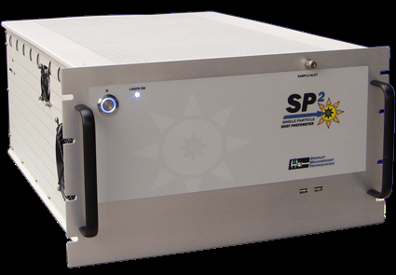
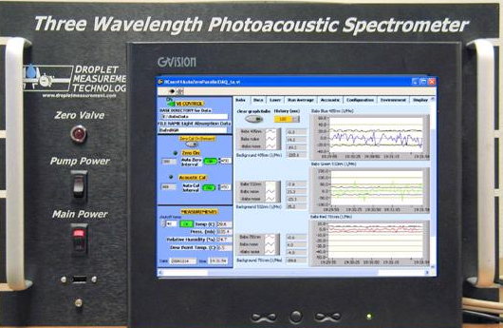
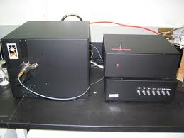
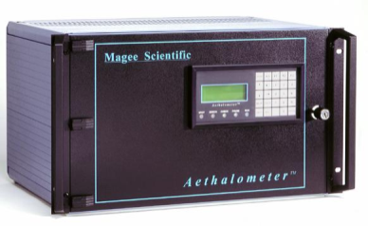
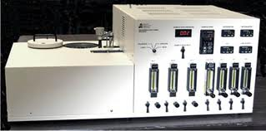
Absorption sur filtre Thermo-optique
BC-related Measurements from commercial instrumentation
Incandescence SP2 Photo-acoustic PASS
PSAP
AETHALOMETER
MAAP
SUNSET
DRI
Direct measurement of EC but difference between SUNSET and DRI protocols
required corrections
to derive light-absorption coefficient

Slide 12
Terminology and measurement capability
« Total carbon » (TC):– Measurable with thermo-optic methods (OC+EC) with good precision
“Soot carbon” (Csoot): Possibly measurable by incandescence technique
“Brown carbon” (Cbrown): Not measurable directly with existing techniques
“Light-absorbing carbon” (LAC):
“Light-absorbing aerosol” (LAA):
Light absorption coefficient of LAA is measurable with filter-based techniques (using adequate corrections), but not the mass concentration.
LAA=LAC if mass fraction of dust is negligible
“Elemental carbon” (“EC”):
Measurable with thermo-optical methods (but not all methods use the same protocols – discussion within CEN)

Slide 13
How do we define Black Carbon ?
Draft statement from SAG-AEROSOL
“Black carbon” (“BC”) is a useful qualitative description that is however unsuitable for quantitative determination
“Black carbon” has the following characteristics :
Insoluble in water
Refractory (up to several thousand Kelvins)
Strong broad band absorption
Agglomerate of microspheres
None of the currently-available methods quantify all four of those properties simultaneously

Slide 14
Draft Recommendations from SAG - AEROSOL
Use more precise terminology, with the directly measured variables of different instruments being light absorption coefficient and elemental carbon mass concentration.
A regulatory parameter, which can be measured by thermo-optical methods, could be elemental carbon (EC), which is also more closely linked to emission inventories than optically-determined “BC”.
Sun/sky radiometer absorption measurements are considered as derived products.

Slide 15
Recommendation from SAG – AEROSOL
Towards reference methods
Reference methods for EC: thermo/optical methods with different protocols (to be documented in metadata).
For light absorption coefficient: no standard reference method exists yet (uncertainties too high), but the photo-acoustic and/or extinction-minus-scattering techniques are likely candidates.
Calibration of incandescence instruments must be performed using referenced carbon material such as fullerene. In absence of alternative propositions, recommendations from Baumgartner et al. (AMTD), could be followed.

Slide 16
Recommendation from SAG – AEROSOL
terminology
Equivalent Black Carbon (EBC) should be used instead of Black Carbon for measurements derived from optical methods. Much care must be taken in deriving EBC from light absorption measurements.
Equivalent refractory Carbon should be used instead of Black Carbon for measurement derived from incandescence methods
Elemental Carbon should be used for measurements derived from thermo-optical methods
Measurements from filter-based techniques must be documented in data bases following recommendations from WDCA

