Slide 1
UK (CEH) and ACTRIS
WP3: In-situ chemical, physical and optical properties of aerosols
WP4: Trace gases networking: Volatile organic carbon and nitrogen oxides

Slide 2
UK (CEH) and ACTRIS
WP3: In-situ chemical, physical and optical properties of aerosols
Implementation of existing and development of new protocols for particle number size distributions and aerosol optical properties
Implementation of sampling and analysis of organic and elemental carbon and organic tracers for source identification
Development of measurement protocols for cloud condensation nuclei measurements

Slide 3
UK (CEH) and ACTRIS
WP4: Trace gases networking: Volatile organic carbon and nitrogen oxides
integrate and harmonise trace gas measurements in Europe
implement standardised measurement protocols (SOPs) and common European calibration scales for VOCs and NOxy in support of the European EMEP and global GAW strategy and according to data quality objectives formulated by these initiatives.

Slide 4
UK (CEH) and ACTRIS
WP4: Trace gases networking: Volatile organic carbon and nitrogen oxides
Two UK ‘rural’ sites: Auchencorth and Harwell,
plus NCAS observatory in Cape Verde Islands
Both UK sites are EMEP ‘supersites’ funded by Defra
First round-robin calibrations for NOx and VOCs in progress

Slide 5
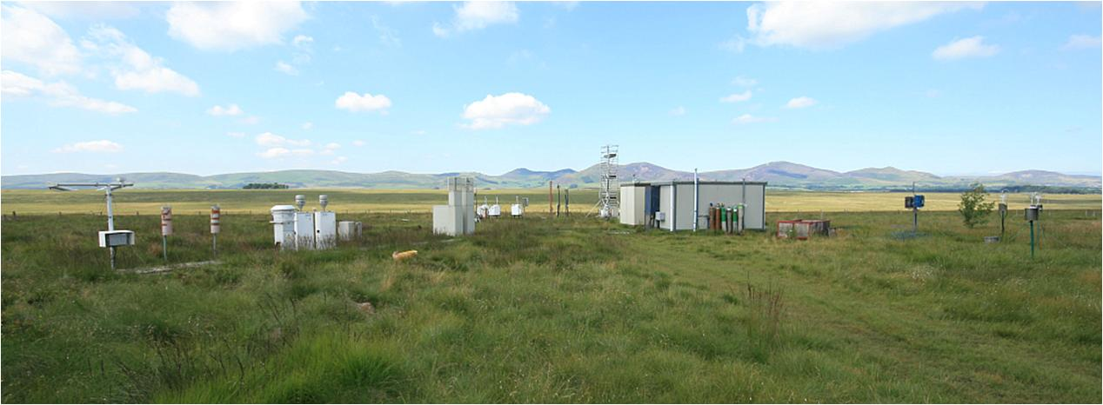
UK (CEH) and ACTRIS
Auchencorth: EMEP ‘Level 3’ south Scotland
Available for transnational access under ACTRIS

Slide 6
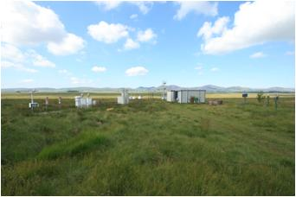
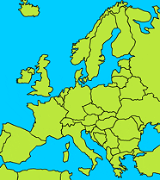
Auchencorth (UK): current status (VOC)
NMHCs (from 2006)
C2: ethane, ethene, ethyne
C3: propane, propene
C4: n-butane, isobutane, 1,3-butadiene, 1-butene, cis/trans-2-butene
C5: n-pentane, isopentane, cis-2-pentene, isoprene
C6: n-hexane, 2/3-methyl pentane
C7+: n-heptane, n-octane, isooctane
Arom: benzene, toluene, xylenes, trimethyl benzene, ethyl benzene
Quality assurance:
Instrument: GC-FID
Preconcentration: PE TurboMatrix
Sample volume: 0.6 liter, trap at -30 °C, trap material CarbosorbB/Carbosieve SIII
Water removal: Nafion dryer
Scale: NPL, ppb standard, 30-components
Calibration interval: 4x 1h every 2 wk
Quality checks:
routine checks: daily chromatography
final checks: quarterly
Database: UKAIR, EMEP
Measurement instruction: no
Other issues: operated remotely by VNC

Slide 7
Auchencorth (UK) current status (No_{xy})
from 2011
 | NO | NO2 | HONO/HNO3
instrument/ measurement principle | ECO Physics CLD 770 AL ppt O₃ chemiluminescence | ECO Physics CLD 770 AL ppt with PLC 760 (Xe-Lamp) | MARGA (x2) Wet denuder/IC
scale | BOC ppm in N₂ | Permeation tube | Int std
calibration interval | monthly | monthly | Hourly int.std.
quality checks | check of chamber temp, pressure, flow, on daily basis; lab journal (electronic) |  | Daily operation check; weekly chroatogram check
intercomparisons | On-site with thermal converter NOX calibrated from same standards |  | Monthly with integrating denuder
database | UKAIR, EMEP
measurement instruction | yes
other issues (thermal NOx) | 2 instruments | Mo-conv. | PM2.5 and PM10 channels

Slide 8
Auchencorth (UK) current status (Aerosols)
Instrument/ measurement principle | SMPS (from May2012) | Aethalometer (2-channel) | MARGA (x2) Wet denuder/IC | Q-AMS (aerosol mass spectrometer) Only during intensive field campaigns
What they measure | Size distribution of particles in the size range from 10n to 800 nm | Black carbon (PM2.5) | NO₃⁻,SO₄²⁻,Cl⁻,NH₄⁺,Na⁺,K⁺, Mg⁺, Ca²⁺ (PM10, PM2.5 inlets) | Chemical speciation and size distribution of non-refractory <1μm particles
Time resolution | 1 min | 5 min | hourly | Up to 10Hz
database | UKAIR, EMEP
+ TEOM/FDMS PM_{2.5} and PM₁₀ hourly, + gravimetric PM₁₀ daily
+ PM₁₀ heavy metals weekly, + speciated mercury 3-hourly, + EC/OC weekly filter

Slide 9
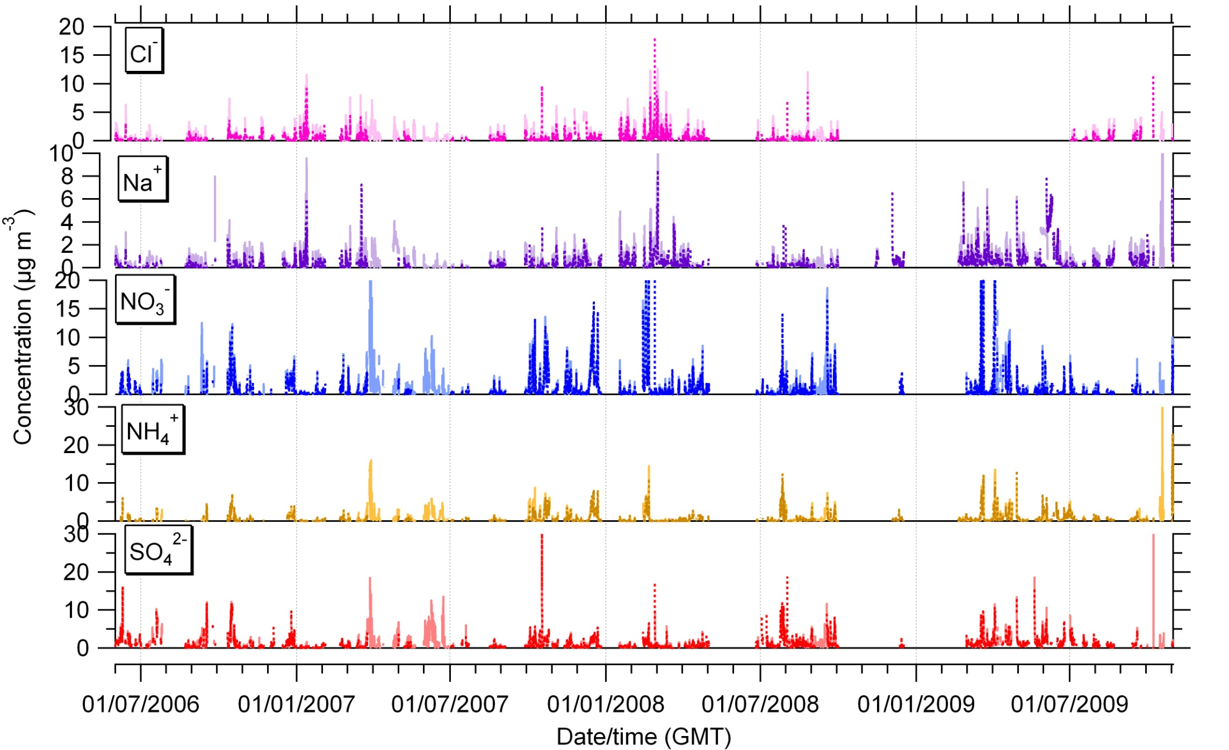
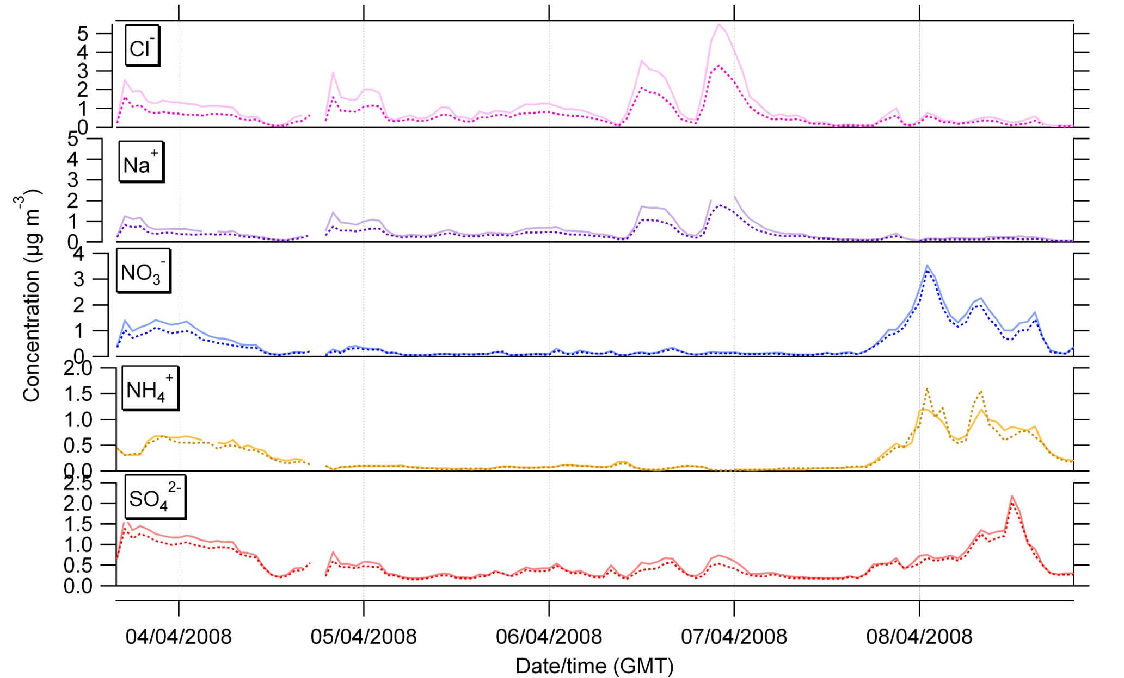
Time Series
Notes:
Cl -

Slide 10
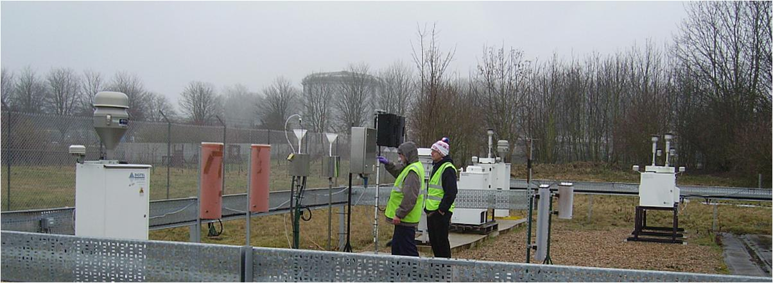
UK (CEH) and ACTRIS
Harwell: EMEP ‘Level 2’ south England

Slide 11
HARWELL(UK) current status (Aerosols)
Instrument/ measurement principle | SMPS (from May2012) | MARGA (x2) Wet denuder/IC | Aethalometer (2-channel) | ToF-AMS (aerosol mass spectrometer) Only during intensive field campaigns
What they measure | Size distribution of particles in the size range from 10n to 800 nm | NO₃⁻,SO₄²⁻,Cl⁻,NH₄⁺,Na⁺,K⁺, Mg⁺, Ca²⁺ (PM10, PM2.5 inlets) | Black carbon (PM2.5) | Chemical speciation and size distribution of non-refractory <1μm particles
Time resolution | 1 min | hourly | 5 min | Up to 10Hz
database | UKAIR, EMEP
+ TEOM/FDMS PM_{2.5} and PM₁₀ hourly, + gravimetric PM₁₀ daily
+ PM₁₀ heavy metals weekly, + mercury 3-hourly , + EC/OC weekly filter

