Slide 1
Implementing the EMEP monitoring strategy and relation to the AQD-revision process
Kjetil Tørseth
EMEP/CCC, NILU

Slide 2
Introduction
”new” EMEP monitoring strategy entered into force in 2010, Parties have an obligation to comply with requirements
Challenging to implement and sustain level 1, level 2 activities strengthened throug EC-infrastructures projects (albeit no funding for monitoring), fever process oriented RTD opportunities
Parties have expressed concern that EC Directive requirements take priority over traditional EMEP monitoring
”Mismatch” of Directive vs EMEP monitoring strategies
Identified need to raise the awarness of the importance of EMEP monitoring

Slide 3
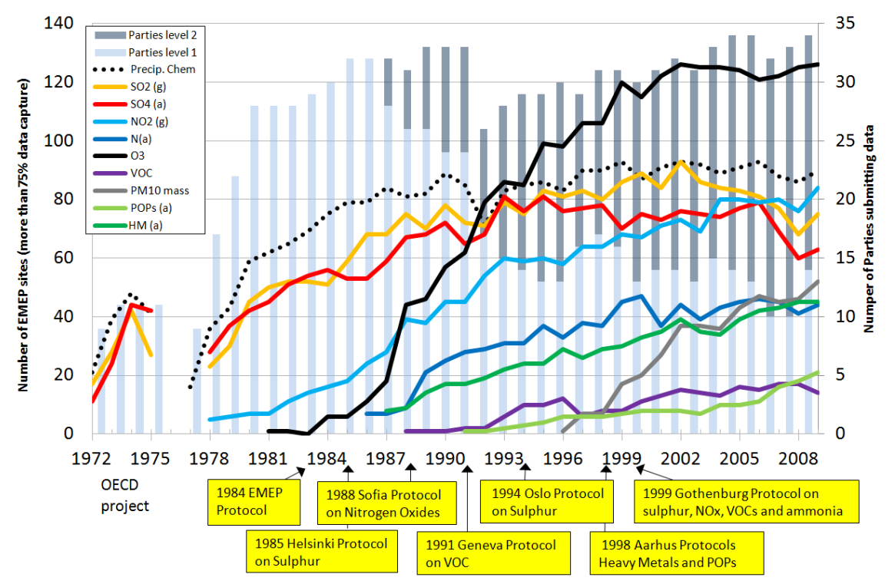

Slide 4
EU Air policy implementation and review
AIM:
“a robust EU Clean Air package, updating existing policies and directives including the National Emission Ceilings Directive according to latest science, and outlining further cost-effective measures to move much closer to the related 6EAP's objective:
to achieve levels of air quality that do not result in unacceptable impacts on, and risks to, human health and the environment."

Slide 5
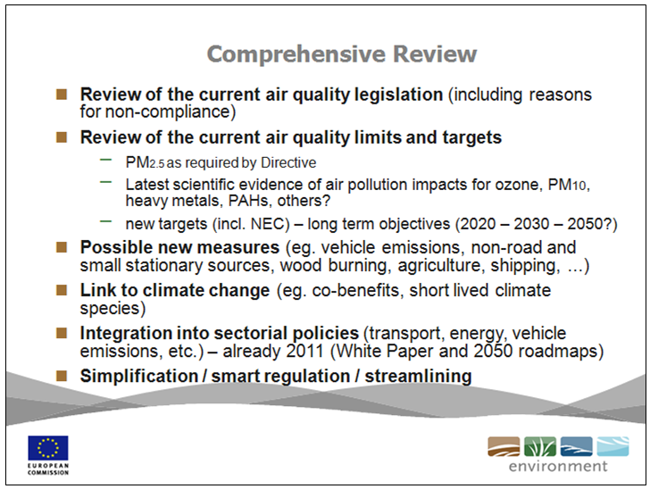

Slide 6
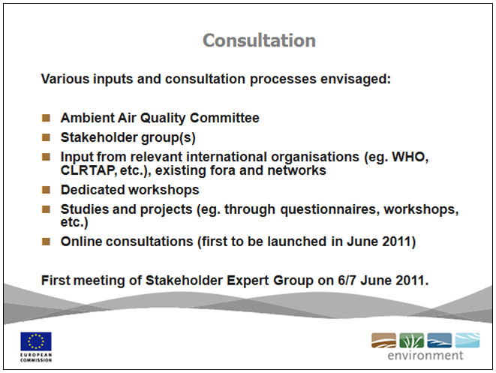

Slide 7
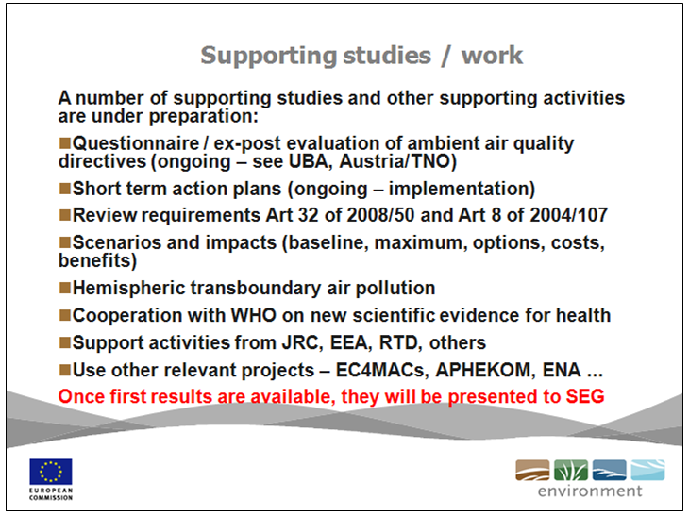

Slide 8
EMEP monitoring vs EC Directives
TFMM discussions
Guidance from EMEP SB -> EMEP workplan (e.g. collaboration with AQUILA).
AQD revision process
  CLRTAP as a Stakeholder
  Input via AQUILA (-> JPP)
  Input via national agencies and public consultations (?)
  Input via the DG Research contribution

Slide 9
Air policy related research outputs from the EU RTD projects
EC-funded projects in the field of air quality, climate change and health are asked to provide science-based evidence relevant for the review process.
Latest scientific findings relevant to the EU Air Quality policy will be gathered into a single report to be completed by the end of 2012

Slide 10
Structure of report
The report will contain a very brief introduction outlining the key instruments for control of Air Quality and the specific need for input from the research programme
A list of key references and an executive summary will be included so that the overall size of the document is expected to be <40 pages.

Slide 11
The issues for Nitrogen
a) Nitrogen & climate change (esp net N effect and opportunities for climate-air quality co-benefits from improving N use efficiency in agriculture
b) Health effects of NO2 and reviewing the AQ limit value.
c) Could ecosystem effects of NH3 and the potential of a new AQ limit value be used in delivering Habitats Directive commitments ?
d) What is the overall economic cost of nitrogen in the EU environment?
e) How can we improve the valuation of air pollution threats to ecosystems: demonstrating the dose-response-valuation chain?
f) What is the relative importance of reduced and oxidized N in effects on health and ecosystems?

Slide 12
The issues for Particulate Matter
a) PM size, PM10, 2.5 or 1…what matters and which PM size fraction should be the focus of new regulatory effort?
b) Composition, do we know the link between aerosol composition and health effects?
c) What are the most important sources to control and in what order?
d) Can the control of PM sources be regulated to maximise the benefits for health
e) Hot spots or the background, which should be the priority for control of PM sources and precursors?

Slide 13
The issues for Ozone
a) Can the background contribution to AOT40 or SUM035 be quantified?
b) What is the contribution of background ozone to effects on human health and ecosystems?
c) What is the relationship between control of NOx and VOC sources within Europe and changes in ozone exposure, and effects?
d) How much benefit would control of methane deliver in mitigating ozone effects in Europe?
e) Can the control of ozone precursors in Europe be regulated to maximise the benefits for health and climate effects?

Slide 14
The issues for Air Quality and Climate:
a) Can the climate change and air quality antagonism (eg with regard to NOx reductions) be quantified?
b) What are the synergies between Air Quality and Climate Change and are they incorporated in Integrated Assessment?
c) What is the effect of Climate change scenarios on achievement of Air Quality objectives? (and vice versa)
d) Will the effects of Climate Change this century increase or decrease emissions of air pollutants in Europe
e) Will the effects of Climate Change this century increase or decrease the lifetimes and transport distances of air pollutants in Europe

Slide 15
The issues for Air Quality and Health:
a) Do we know the components of PM responsible for health effects?
b) Do we know the relative importance of natural and anthropogenic components of PM for health effects?
c) What is the relative importance of background ozone and peak ozone for health effects?
d) What is the relative importance of background ozone and peak ozone for ecosystem health effects?
e) Is a single health-related objective covering all pollutants scientifically credible? And could it be used to drive policy?
f) Are the relative contributions to health effects from indoor and outdoor exposure correctly coupled to the sources of the pollutants responsible?
*** Input to WHO that will co-ordinate all health impact related issues.

Slide 16
The issues for Integrated Assessment
What are the synergies between Air Quality and Climate Change and are they incorporated in Integrated Assessment?
Are the scales of assessment for the different pollutants (eg. local scales of urban air quality versus global scale assessment of radiative forcing by GHG) properly considered in IA?
Systematic review of IAM available in MS for Air Quality (APPRAISAL)
Is it possible to integrate Climate change, human health and ecosystem damage into a single model?

Slide 17
Chapters and Lead Authors
Coordinated by David Fowler
Nitrogen Mark Sutton CEH Edinburgh
Particulate matter Sandro Fuzzi CNR Bologna
Ozone Paul Monks Univ Leicester
Air quality and climate Guy Brasseur Climate Service Cr
Air quality and health Bert Brunekreef Univ Utrecht
Integrated Assessment Rainer Friedrich Univ Stuttgart

Slide 18
Air policy related research outputs from the EU RTD projects
October 2011
January 2012
2nd Stakeholder meeting
(DG ENV)
Kickoff meeting
June2012
End of 2012
Drafting the general outline of the report
Presentation of the first outline
Writing the report
Consultation and iteration
Delivery of the report
First draft for discussion

Slide 19
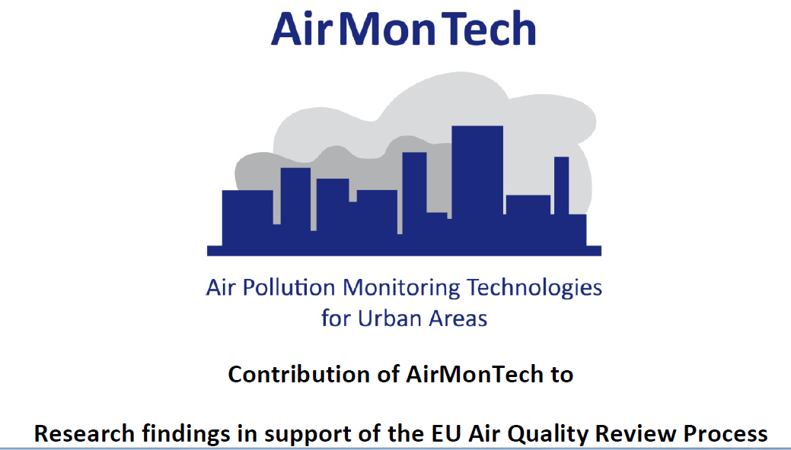
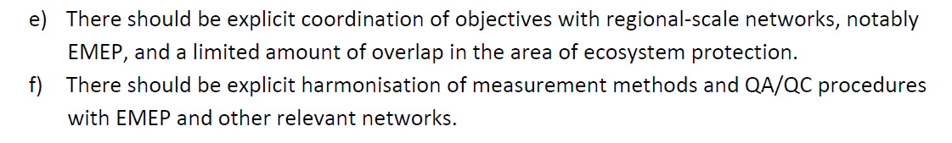
Example of input for the RTD report:

Slide 20
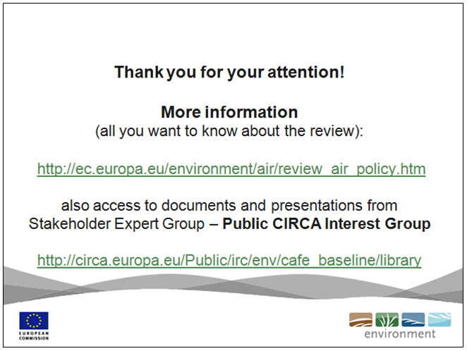

Slide 21
Situation now…
Opportunities for input have been utilizied, impact not yet known
AQD vs EMEP not any longer the most important issue (?)
Climate change is driving the political agenda
Less appreciation for the need to understand atmospheric processes (?)
Caotic situation where very many different programmes and organizations argue their importance to address climate change (largely driven by research institutes). Most of these rely however on the EMEP network
Views and wishes on how the EMEP bodies and centers can support national needs? -> dicussion session to follow.

