Slide 1
emep 2012 -
Sonja Vidič
EMEP SB Chairperson

Slide 2
Focus
Long-Term Strategy (LTS) for the Convention
Implementation plan for the LTS
Work plans to be linked to the strategic goals
Visibility: web profiling, publications, leaflets, booklets
Mapping systems, incompatibilities, efficiency
Enhance coordination and cooperation within UNECE
EMEP-WGE cooperation
Revised mandate for HTAP
Geographical outreach beyond UNECE region
CLRTAP work and EU policy sinergies
CLRTAP and cooperation with other UNECE Conventions

Slide 3
Decision 2011/14
Action Plan for the Implementation
of the Long-term Strategy for the Convention
I. Improve ratification and compliance
II. Prioritize work and increase efficiency of operation of the Convention
III. Future direction of Protocols
IV. Links with climate change and delivery of co-benefits
V. Outreach, communication and resources

Slide 4
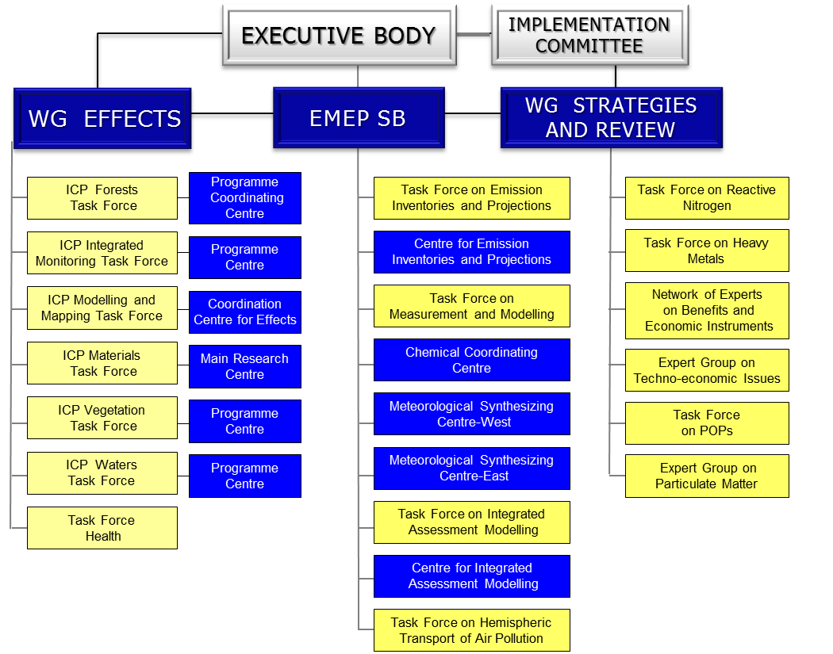

Slide 5
Decision 2011/13
Reporting of persistent organic pollutants emissions
The Executive Body,
Acting under paragraph 11 of the structure and functions of the Implementation Committee (Executive Body decision 2006/2),
1. Notes the findings of the Implementation Committee regarding its review of the reporting under the Protocol on Persistent Organic Pollutants (Protocol on POPs), and in particular the apparent overall lack of adequate guidance and priority on persistent organic pollutant (POP) reporting;
2. Requests the secretariat to write a letter to all Parties to the Protocol on POPs informing them about the considerations of the Implementation Committee regarding its review of the reporting under the Protocol, and reminding them of the invitation in paragraph 3 below;

Slide 6
Decision 2011/13
Reporting of persistent organic pollutants emissions
3. Invites all Parties to the Protocol on POPs to:
(a) Raise the priority on POP reporting;
(b) Improve and complete the emission inventories of POPs, where needed; and
(c) Provide detailed information on their national methods for estimating POP emissions or plans to revise these methods to the Task Force on Emission Inventories and Projections of the Cooperative Programme for Monitoring and Evaluation of the Longrange Transmission of Air Pollutants in Europe (EMEP) Steering Body;

Slide 7
Decision 2011/13
Reporting of persistent organic pollutants emissions
4. Instructs EMEP to raise the priority of POP reporting and in particular:
(a) To start an in-depth review of reported POP emissions by Parties to the Protocol on POPs with, inter alia, attention to:
(i) The completeness of the POP emission inventories;
(ii) The reliability of current national methods (including accuracy of emission factors) used to estimate POP emissions;
(iii) The different use of notation keys among Parties;
(iv) The consistency of reported POP emission estimates with the reporting guidelines, the EMEP/EEA2 Air Pollutant Emission Inventory Guidebook and among Parties;
(b) To elaborate a programme to initiate the update of the EMEP/EEA Guidebook with further and more adequate guidance on POPs, in particular for residential combustion;

Slide 8
(c) To provide a progress report and timetable to the next annual session of the Executive Body concerning the requests in (a) and (b) of this paragraph;
(d) To consider organizing a workshop on improving emission estimation from key sources of POP emissions (hexachlorobenzene, polycyclic aromatic hydrocarbon, dioxins), with a special focus on the residential combustion sector and engaging participants from other relevant expert groups and task forces under the Convention on Long-range Transboundary Air Pollution;
5. Reiterates its instruction to EMEP to provide assistance to the Implementation Committee upon its request;
6. Requests the Implementation Committee to continue to review the issue in the light of the information provided, and to report to it thereon at its thirty-first session in 2012.

Slide 9
EMEP-WGE co-operation
More direct exchange of information
Focus and direction, more efficient work
Developments to support WGE work (resolution, modelling of sea sulphates and basic cations, support to dynamic modelling)
Concentrate on most relevant issues
Joint workshops and meetings
Create one scientific body (emep-wge),

Slide 10
emep and wge
Measurements
Modelling
Mapping
Integration
Emissions

Slide 11
TF HTAP 2012 - 2015 and Beyond
The focus of the Task Force’s work remains on characterizing regional vs. extra-regional influences on air quality and its impacts.
While HTAP 2010 presented the significance of intercontinental transport with very coarse resolution, goal now is to improve the resolution by linking analyses at the global and regional scale.
New developments:
Nesting regional analyses within global analyses, working with regionally-focused efforts including AQMEII, MICS, and POLMIP.
Greater emphasis on model-observation comparison
Improving assessment of impacts in terms of air quality standards, human health, crop and ecosystem damage, and climate effects
Providing policy-relevant information as frequently as possible.

Slide 12
Themes of Cooperative Activities Under TF HTAP
Emissions Inventories and Projections
Expansion of the Data Network and Analysis Tools
Source Apportionment and Source/Receptor Analysis
Model-Observation Evaluation and Process Diagnosis
Assessment of Health, Ecosystem, & Climate Impacts
Assessment of Climate Change Impacts on Pollution
Initial focus is on laying the foundation for new cooperative simulations and analyses.

Slide 13
Issues
Black carbon (BC) - consequences for EMEP work: emissions, monitoring, modelling (regional, hemispheric), integrated assessment modelling
Consideration of BC and ozone precursors including methane in the long-term by all groups within the Convention

Slide 14
Thank you for your attention

Slide 15
Decision 2011/14
Action Plan for the Implementation of the Long-term Strategy for the Convention
The Executive Body,
Recognizing the importance of implementing the Long-term Strategy for the Convention on Long-range Transboundary Air Pollution,
Noting that the Strategy will be implemented through actions and decisions of the Executive Body,
Aware of the need to work to ensure the Convention is undertaking its activities in an efficient, and to the extent possible, streamlined fashion,
Recalling its decision 2010/18,
Taking note of informal document No. 9, on an action plan for the Long-term Strategy for the Convention, submitted to the twenty-ninth session of the Executive Body,
Decides to create a time-limited ad hoc group of experts to undertake tasks identified for it in the Action Plan for the Long-term Strategy for the Convention;
2. Further decides that the ad hoc group of experts will be made up of all members of the Bureau of the Executive Body, or their alternates, and include appropriate regional representation, plus four to six additional members. Parties may provide additional nominations to the Chair of the Executive Body by 13 January 2012. The Chair and additional members will be appointed by the Bureau of the Executive Body on the basis of appropriate expertise by 31 January 2012;

Slide 16
Decision 2011/14
Action Plan for the Implementation of the Long-term Strategy for the Convention
3. Requests the ad hoc group of experts to finalize and submit a report in time for the Executive Body session in December 2012;
4. Further requests that actions identified for other bodies of the Convention in the Action Plan for the Implementation of the Long-term Strategy for the Convention be undertaken as part of their regular workplans, in accordance with timelines specified for those actions in the Action Plan, where such timelines are specified;
5. Identifies the need for all Convention bodies to consider the entire Long-term Strategy when undertaking their work;
6. Hereby adopts the Action Plan as contained in the annex to this decision.

