Slide 1
EMEP intensive measurement periods
Wenche Aas (EMEP/CCC)
With input from several persons

Slide 2
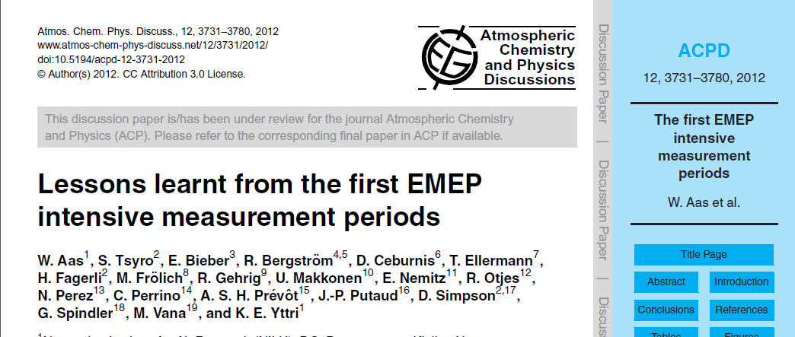
Intensive periods in 2006 and 2007

Slide 3
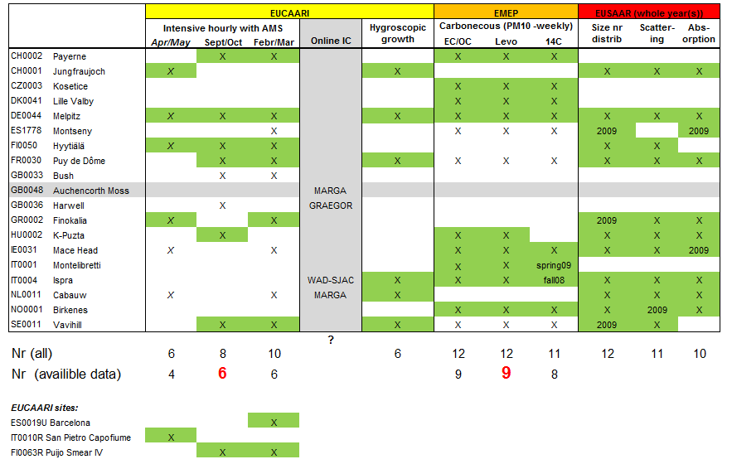
Intensive periods 2008 and 2009
Reported and more or less available data marked in green

Slide 4
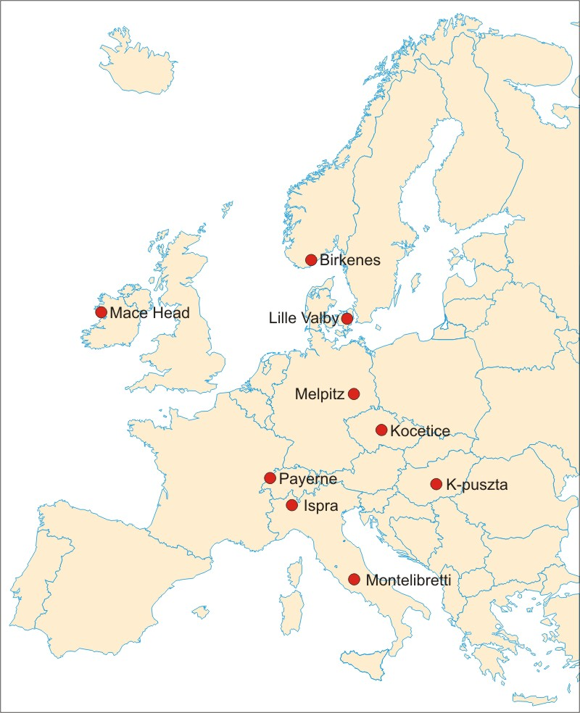
EMEP Intensives – Carbonaceous
9 participating sites with weekly samples of EC og OC, 14C and Levoglucosan)
Status
¹⁴C-analysis: needed more elaboration due to some strange results, reanalysis of some samples have been done at different lab
Source apportiment etc beeing finalised and paper aim to be submitted this summer

Slide 5
Status for the 2008 and 2009 intensive periods
More or less all data are analyzed and reported.
Need UK data to be submitted (EUCAARI)
Doesn’t seem like there were much of the online chemistry as originally planned.
For modelers (and others) there is a need for the higher level results like source apportionment of the:
AMS with PMF and ME-2 methods. Done by PSI –available from André Prevot (EUCAARI product)
EC/OC , tracers and 14C combined with latin hypercube statistical tools. Done by David Simpson (MSC-W). Results will be availible probably the coming summer

Slide 6
Intensive periodes 2012 and 2013
Scheduled for June 8 to July 12(7) 2012, and jan/febr 2013
High resolution, and extended measurements of aerosols and its precursors. EMEP has a special focus on mineral dust.
A cooperation between
EMEP TFMM (http://www.nilu.no/projects/ccc/tfmm/
ACTRIS (http://www.actris.net/)
ChArMeX (http://charmex.lsce.ipsl.fr).
Pegasos (http://pegasos.iceht.f orth.gr/)

Slide 7
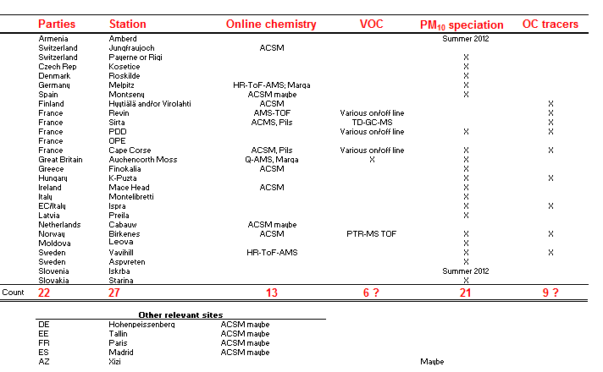
Intensive periodes 2012 and 2013

Slide 8
Draft measurements plan
ACSM one year campaign from june 2012
Coordinated by ACTRIS (talk by André Prevot)
Some additional measurements with wet chemistry (Pils and Marga)

Slide 9
Draft measurements plan
Not clear (to me) which sites will be able to provide VOC measurements and which VOC to be prioretized
Coordinated by ACTRIS (ChristianPlaß-Dülmer and Stefan Reimann)

Slide 10
Draft measurements plan
Off line analysis of :
Mineral dust: centralized lab using PIXE or XRF/PIXE combination. Possible also ICP-MS analysis if lack of resources for PIXE
Inorganic ions (regular EMEP)
Carbonaceous fraction
EC/OC (EUSAAR-2 protocol)
Carbonate (Done by JRC)
Tracers (ACTRIS NA-3)

Slide 11
Draft measurements plan
NA3 ACTRIS will use filters from the EMEP intensive from some sites to to more analysis of organic tracers
Not clear which sites and which compounds. Though there are several initiatives:
terpene oxidation products and organosulfates in aerosols (Marianne Glasius a DK and FI)
13C (Darius Ceburnis (IE/LT)
French initative by Jean-Luc Jaffrezo
…
Coordinated by Erik Swietlicki

Slide 12
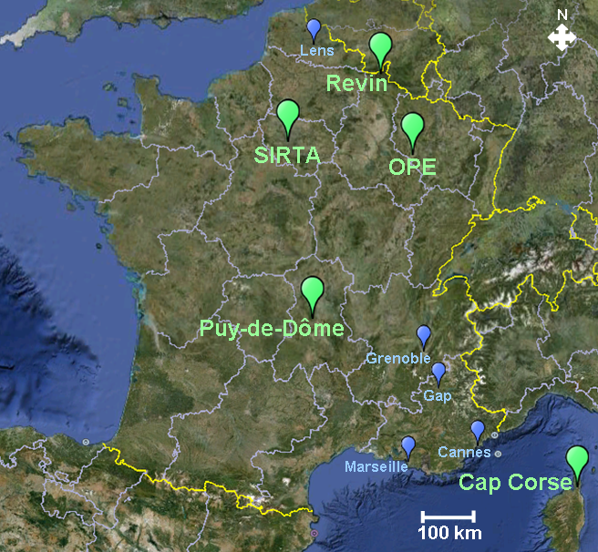
Ekstensive plans in France

Slide 13
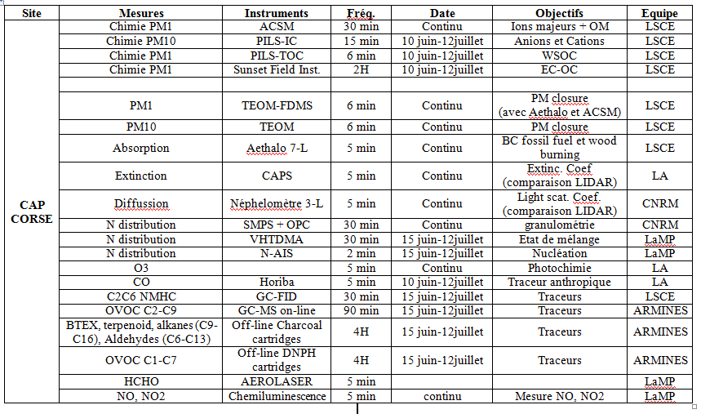
Measurements at Cape Corse
From the French proposal, by Jean-Luc Jaffrezo:

Slide 17
PEGASOS
Flights with a Zeppelin and some ground measurements:
campaign Friedrichshafen to Cabauw with 4-5 measurement days in Cabauw; 14.5.-1.6.2012)
campaign Friedrichshafen to Po-Valley 8.6.2012 - 17.7.2012)
campaign Friedrichshafen to Hyytiälä via Perstorp and Aspvreten, with excursion to Pallas in the time frame 18.4.2013 - 17.6.2013
“ The measurements will include photochemical/organic aerosol/nucleation packages for the Zeppelin, mobile lab measurements from PSI, and ground measurements in Cabauw, Lyon, and four sites in the Po Valley (Bologna, San Pietro Capofiume, Monte Cimore and the ECLAIRE site).”

Slide 18
Summary
2006/2007. Finally submitted “Lessons learnt. Learned a lot!!
2008/2009. Data analysis more or less finished and several papers have been or will be written
Successful cooperation between EUSAAR/EUCAARI/EMEP
“Raw” data available through ebas.nilu.no. Password protected for some of the non-regular EMEP data
higher level results will be available in the near future
June/july 2012 and jan/febr2013. Very soon approaching!!
Lots of interest and potential very fruitful cooperation with ACTRIS, ChArMeX and the PEGASUS projects
Several issues still too be solved and decided upon in the very near future:
What to be measured in more details (especially need input on what is required regarding VOC and OC speciation
Sampling protocol (frequency, filter types, denuders or not etc)
Centralized labs
Costs

