Slide 1
Ministry of Ecology and Natural Resources of Ukraine
«Compliance with international obligations under the Convention on Long-range Transboundary Air Pollution and its Protocols»
Liliia Kozak
Department of air protection Tel / Fax: 8 044 206 31 30
kozak@menr.gov.ua
Task Force on Measurements and Modelling; 13rd Annual Meeting:17th–19th April 2012 - Gozo – MALTA

Slide 2
Convention on long-range transboundary air pollution, adopted 1979 in Geneva, Ukraine ratification in 1980, entered into force in 1983.
The normative legal basis of Ukraine to regulate emissions of pollutants in the air. Regulatory mechanism for the protection of atmospheric air is the Law of Ukraine "On Protection of Atmospheric Air", which passed in 2001. The Act streamlined relationships in this area and it meets the system, pollution prevention and combat, as well as the legislation of the European Union. Pursuant to the provisions of the "On Protection of Atmospheric Air" adopted a series of government decisions which have been approved:
List the most common and dangerous pollutants, emissions are to be regulated;
The implementation of state accounting for the protection of atmospheric air;

Slide 3
The normative legal basis of Ukraine to regulate emissions of pollutants in the air
- The procedure for developing and approving standards for allowable emissions from stationary sources; - The order to harmonize and permits to conduct activities related to artificial changes in the atmosphere and atmospheric phenomena in the economic purposes; - The procedure for developing and approving standards of environmental safety of atmospheric air; - The procedure for developing and approving regulations the limit the influence of physical and biological factors, stationary sources of pollution on the air;
- The procedure for developing and approving standards for the content of pollutants in the exhaust gases and the influence of physical factors of mobile sources of air pollution; - The issuance of permits to operate the equipment with a certain level of influence physical and biological factors on the air; - Approved standards of limit value emissions from stationary sources; - Located on the approval the technological standards of production of cement, coke ovens, rolling mills, for incinerators, more than 50 MW, etc.

Slide 4
The Protocol on the reduction of sulfur emissions in 1985 (ratified by Ukraine in 1986)
An Energy Strategy of Ukraine for the period up to 2030 and beyond. The strategy developed by the main provisions of cleaner fuel and energy complex, which aim to reduce emissions of sulfur oxides in Ukraine.
In 2006, approved arrangements for the reconstruction and modernization of thermal power plants for the period up to 2016, which provides activities for the reconstruction of thermal power plants to reduce sulfur oxides in Ukraine.
Government of Ukraine adopted a concept on Acidification, Evtrophication and Ground-level ozone. Has the organizational direction for reducing emissions of pollutants into the atmosphere, leading to acidification, evtrophication and ground-level ozone Education, 2005-2015.

Slide 5
Protocol on nitrogen oxides in 1988
For the category of "major stationary source" written and continue to be imposed technical decisions relating to the limitation of nitrogen oxides by introducing:
- Energy efficiency; - Switch to other fuels / cleaning fuel; - New combustion technologies; - Changes in processes and combustion; - Flue gas treatment.

Slide 6
Protocol on nitrogen oxides 1988 (Ukraine ratified in 1989)
An Energy Strategy of Ukraine for the period up to 2030 and beyond. The strategy developed by the main provisions of cleaner fuel and energy complex, which aim to reduce emissions of nitrogen oxides in Ukraine.
In 2006, approved arrangements for the reconstruction and modernization of thermal power plants for the period until 2016 to reduce emissions of nitrogen oxides in Ukraine. Reducing emission NOx in the period up to 2016, primarily achieved through optimization mode equipment for TES and boiler rooms. As a further term, the main focus of reducing the emission of nitrogen oxides will introduce the latest technology in thermal energy and rather than expensive plants purification of nitrogen with a moderate level of efficiency.
Government of Ukraine adopted a Concept on acidification, Evtrophication and Ground-level ozone.

Slide 7
The Protocol on Volatile Organic Compounds 1991 (Ukraine signed 1991)
A draft regulations for the prevention of emission of light fractions (vapor) oil, petroleum products into the environment at the sites of oil and gas complex.
Approved standards limit value VOC emissions from stationary sources

Slide 8
Sulfur Protocol of 1994 (Ukraine signed in 1994)
An Energy Strategy of Ukraine for the period up to 2030 and beyond. The strategy developed by the main provisions of cleaner fuel and energy complex, which are aimed at reducing emissions of sulfur oxides in Ukraine. In 2006, approved arrangements for the reconstruction and modernization of thermal power plants for the period up to 2016, which provides for reduction of sulfur oxides in Ukraine.
The plan envisaged the construction of reconstruction of thermal power plants for desulphurization. In the period 2011 - 2020 estimates. the main factor in reducing these emissions will be the introduction of chemical binding of sulfur in the reconstruction of the existing TES with a moderate level of efficiency (50-70%) and the use of boilers with circulating plastom which boils. As a further term, the main factor in reducing the impact of emission of sulfur oxide in the atmosphere will depend on the introduction of advanced coal technologies
Comprehensive reconstruction of Ukraine's coal-fired power plants will be built in the future on the introduction of improved coal steam power plants equipped with reducing emissions of NOX, SO2, and dust that are much better techno-economic performance than the existing ones.

Slide 9
The 1998 Protocol on Persistent Organic Pollutants (Ukraine signed in 1998)
The law "On a national program of treatment of toxic waste"
Draft Law of Ukraine "On the concept of cleaner production"
Carried out a preliminary assessment of POPs
25 Sept, 2007 Ukraine ratified the Stockholm Convention on POPs.
Currently, in Ministry of Ecology and Natural Recources of Ukraine is working to assess the possibility of ratifying the Protocol on Persistent Organic Pollutants.

Slide 10
The 1998 Protocol on heavy metals (Ukraine signed 1998)
Government of Ukraine adopted the concept of reducing emissions of heavy metals in the air. A program to reduce emissions of heavy metals in the air. In 2001, an inventory of emissions of heavy metals in the air. As a result of an inventory of emissions of heavy metals will be decided on the definition of the reference year for each of the metals listed in Annex I Protocol. There are technological standards for existing major stationary sources.
There are regulations limit value emissions from stationary sources. In compliance with the European Strategy phase out leaded petrol approved program phase out leaded petrol. The law of Ukraine to ban the importation and sale on the Ukrainian territory of leaded gasoline and lead. A program of reducing the negative impact of vehicles on the environment. Starting from 1 January 2003 halted the production, importation and use of leaded gasoline in Ukraine.
According to acting in Ukraine national standard for gasoline, lead content in petrol product must not exceed 0.013 grams per liter. In 2005, the technical conditions for commercial gasoline that meets the requirements of EN 228:2004. According to the technical conditions of the lead content in petrol product must not exceed 0.005 grams per liter.

Slide 11
The 1998 Protocol on heavy metals
Ukraine has developed a national model for assessing the impact of heavy metal emissions from stationary and mobile sources in the environment, using indices transport Completed pilot calculations to determine the effects of cross-border transport of cadmium and lead into the territory of Ukraine to move from emissions to concentrations and deposition.

Slide 12
Protocol to the Convention Geneva Protocol on the long-term funding for the Cooperative program for monitoring and evaluation spread transmission of air pollutants in Europe long distance (EMEP), Geneva 1984, (ratified by Ukraine in 1985)
In Ukraine, have been a work to establish an international station monitoring program EMEP in the Karadag Nature Reserve of the National Academy of Sciences of Ukraine in accordance with the new strategy of monitoring the EMEP:
analyzed the spatial distribution of local pollution sources in the Karadag, to create the station monitoring program EMEP . This is the location of the station is tentatively agreed with the Chemical Coordinating Center EMEP.
A place of location of the station have been reasonable in terms of physical-geographical, topographical, climatic and meteorological conditions.
Purchased of equipment for testing: ion chromatograph, a portable pH meter, conduktometr.
In the Karadag were selected sample air and precipitation and the concentrations of certain pollutants.
Developed a program of sampling and analysis of rainfall

Slide 13
Environmental Background Monitoring Station of the Karadag Nature Reserve of the National Academy of Sciences of Ukraine

Slide 14
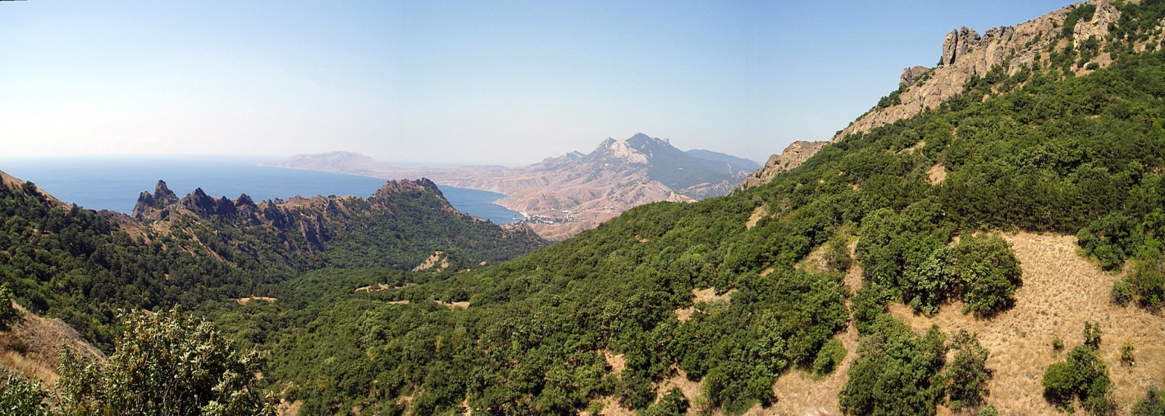
Environmental Background Monitoring Station (EBMS) of the Karadag Nature Reserve (KNR) of the National Academy of Sciences of Ukraine was established in 1988.
KNR is located in the south to Ukraine in a southeast part of the Crimean peninsula. It occupies the territory of the Karadag Mountains and surrounding aquatorium of the Black Sea.

Slide 15
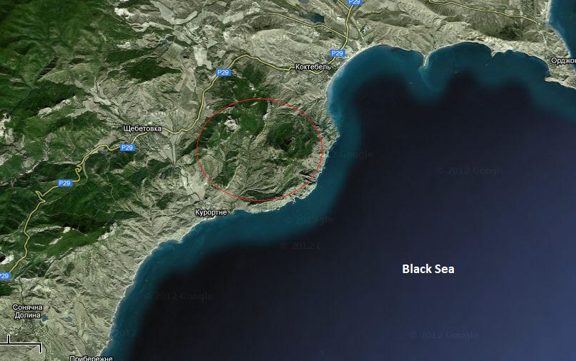
The area of the reserve is 28,742 sq km, which includes 8, 091 sq km of the Black Sea aquatorium. KNR location at the crossroads of land and sea, mountains and plains, forests and steppes is unique. It has determined the great diversity of natural conditions and landscapes of this part of Crimea. The station is located on the northern slope of Mountain “Sviataja” at an altitude of 180 m above the sea level (44 ° 55 'N, 35 ° 14' VD). Distance to nearest industrial centers (the city of Kerch and Simferopol) is more than 100 km, and to the settlement of Koktebel - 2.5 km.

Slide 16
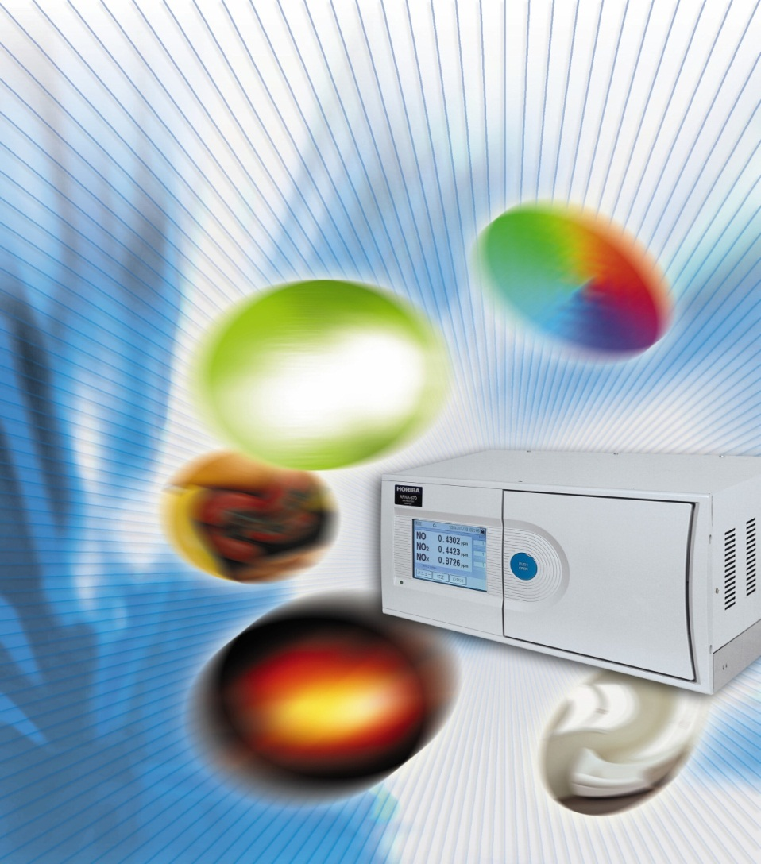
Gas analyzer HORIBA AP-370 Series
APMA-370: CO (Cross-modulation, NDIK
APSA-370: SO2 (UV luminescence)
APNA-370: NO, NO2, NOx (chemical luminescence)
APOA-370: O3 (UV absorption)
APHA-370: THC, CH4, NMHC (PID method)

Slide 17
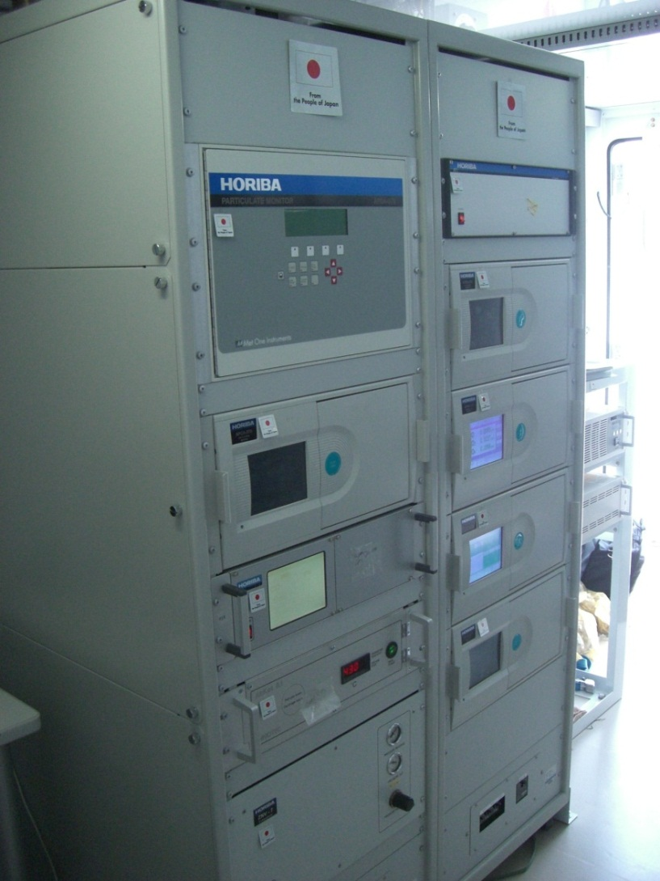
Compliance with the requirements of EN
Uptime.
The zero drift.
The drift of the scale.
The minimum detection limit.
Time to treatment (heating) effect of temperature, cross-sensitivity, reproducibility, effect of voltage.

Slide 18
Information about policies and activities in the field of air posted on the website of the Ministry of Ecology and Natural Resources of Ukraine Thank you for your attention! Ukraine - 2012 www.menr.gov.ua

