Slide 1
Trends in atmospheric ammonia and particulate ammonium in Sweden and its causes.
Martin Ferm and Sofie Hellsten 2012-04-17

Slide 2

NH₃/NH₄⁺
HNO₃/NO₃⁻
SO₂/SO₄²⁻

Slide 3
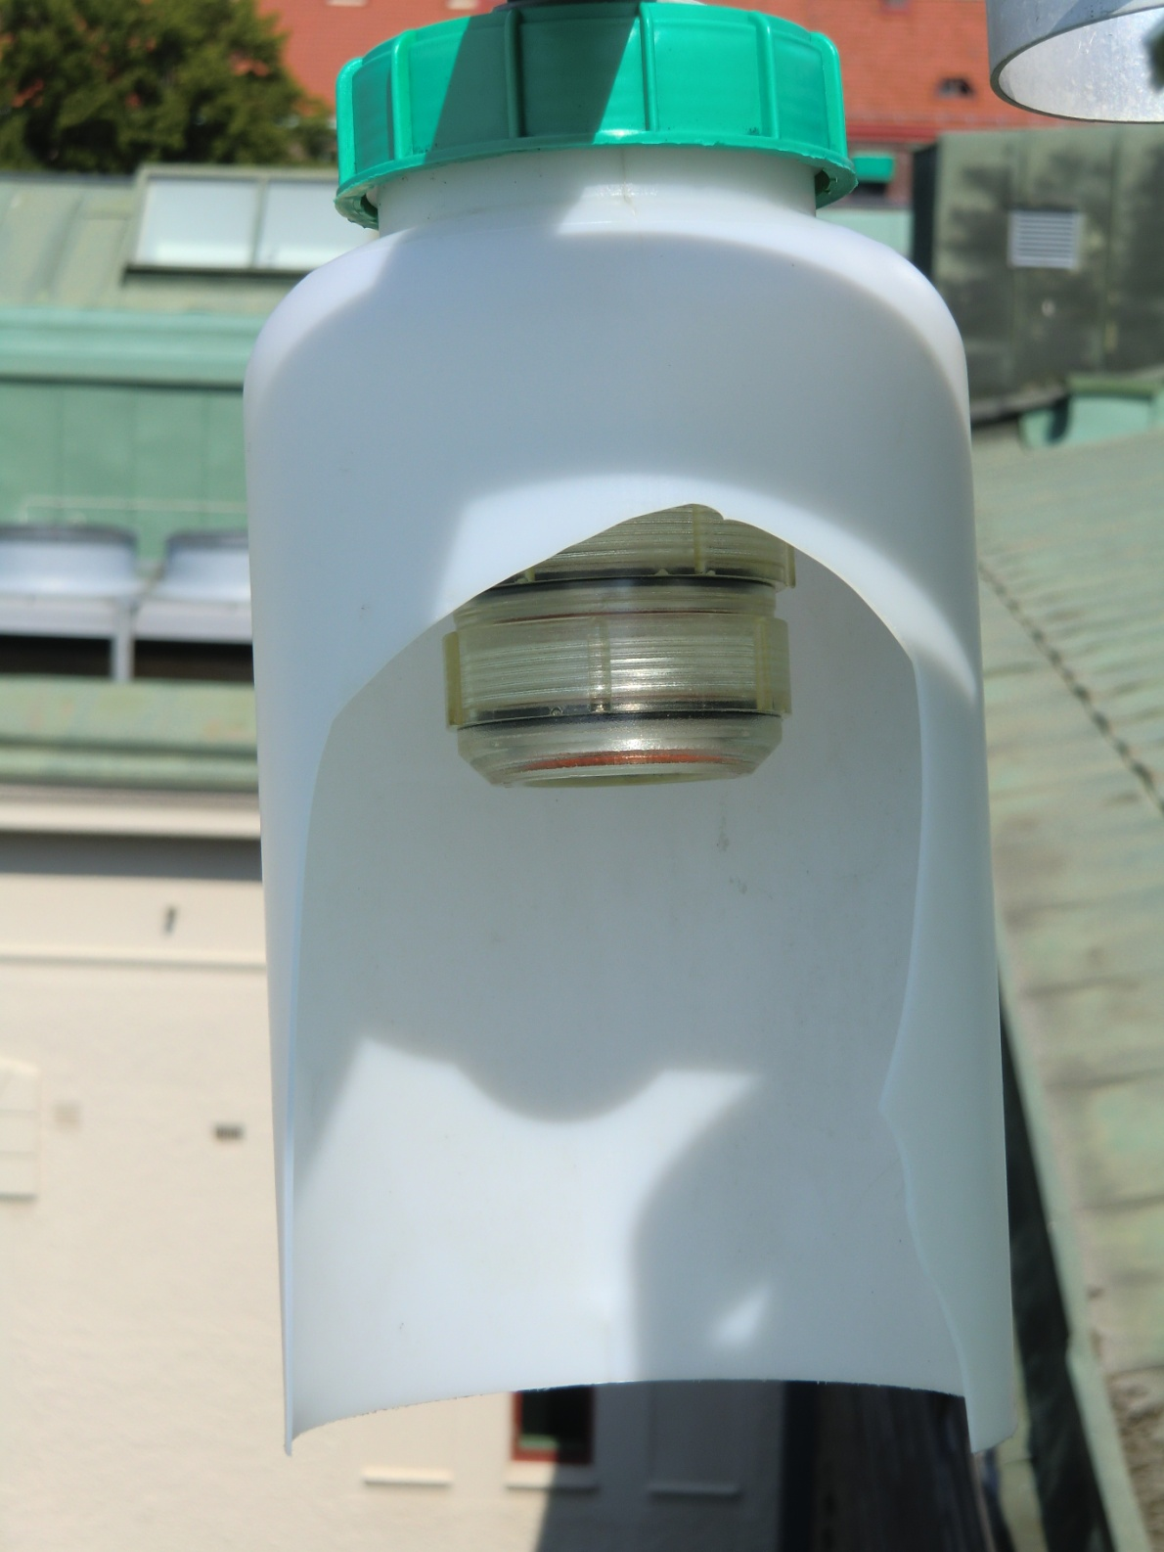

Slide 4
NH₃
HNO₃, SO₂
NO₃⁻, NH₄⁺, SO₄²⁻

Slide 5
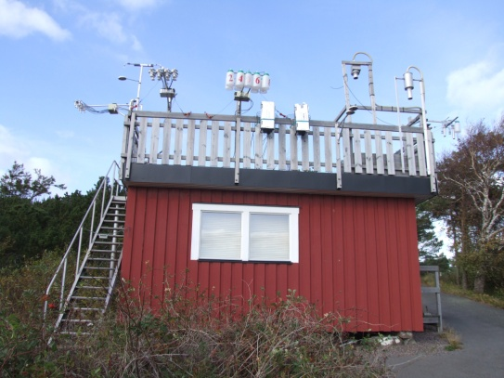
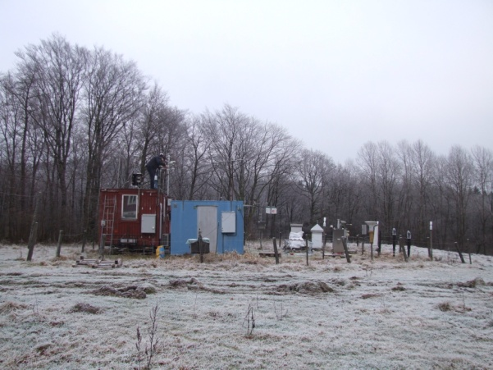
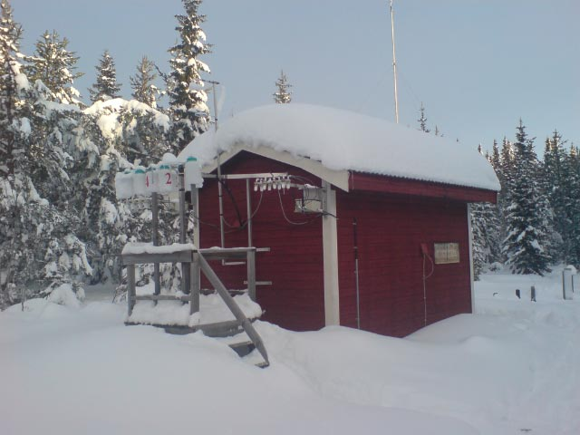
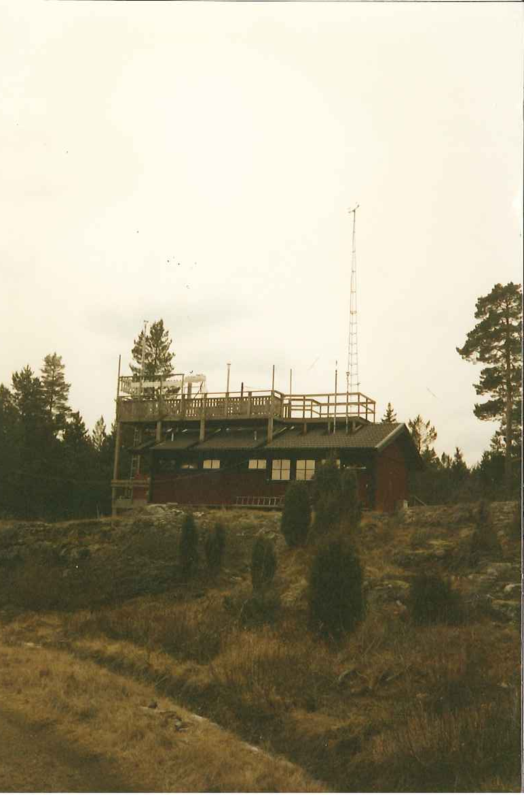

Slide 6
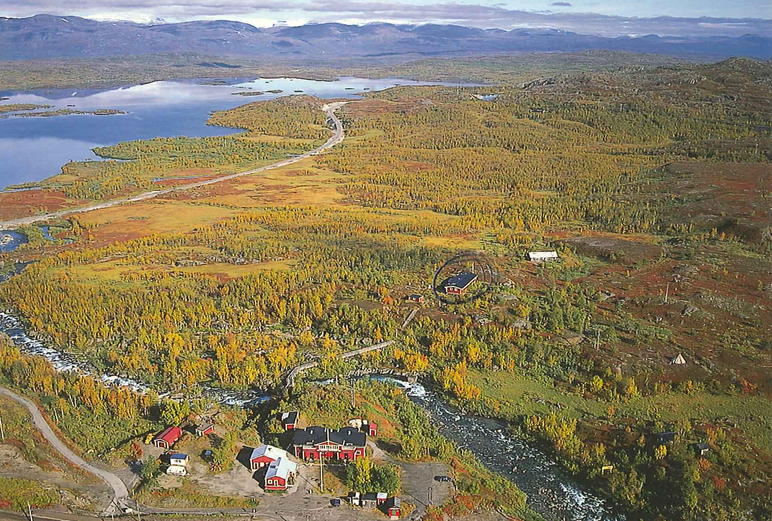
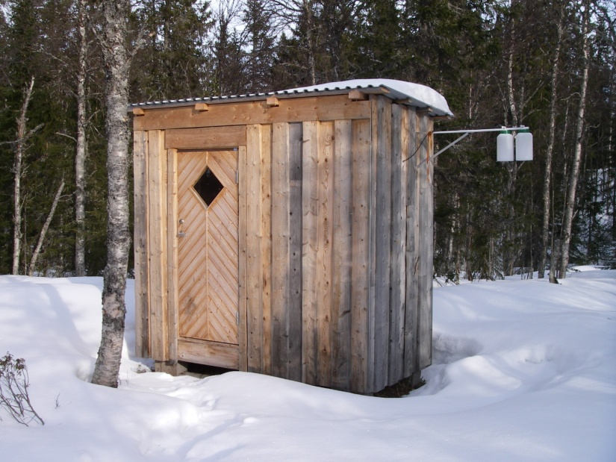
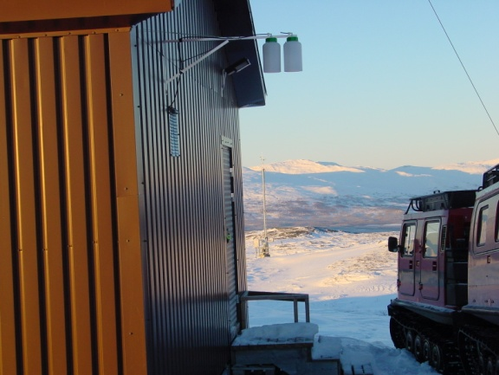
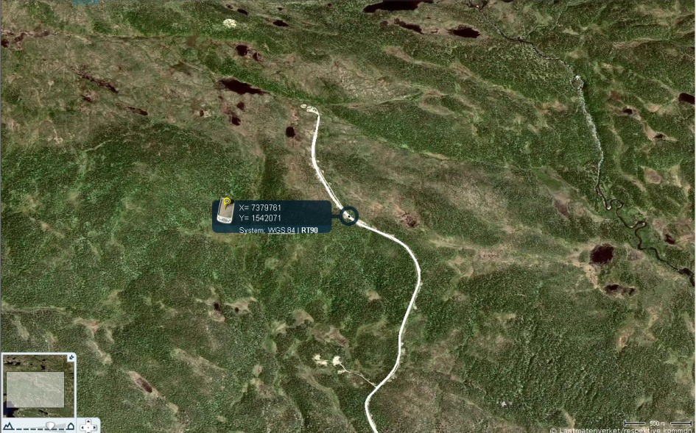

Slide 7
Coordinates and height above sea level for the stations used.
*High altitude sites

Slide 8
Vavihill

Slide 9
Råö

Slide 10
Aspvreten

Slide 11
Bredkälen

Slide 12
Prästbodarna

Slide 13
Seasonal Kendall analysis of monthly average concentrations of particulate ammonium and gaseous ammonia during 1993-2010.

Slide 14
Contribution (%) of the total deposition of reduced nitrogen in Sweden 2000, from the 18 most important countries (EMEP, 2003) and the emission reduction in ammonia in these countries during 1993-2009, based on officially reported EMEP emission data (www.EMEP.int).

Slide 15
Changes in average ambient air concentration at the Swedish EMEP sites 2009 relative to 1993. The changes in emissions from Sweden and our closest neighbours are weighted using the contribution from each country to the deposition in Sweden.

Slide 16
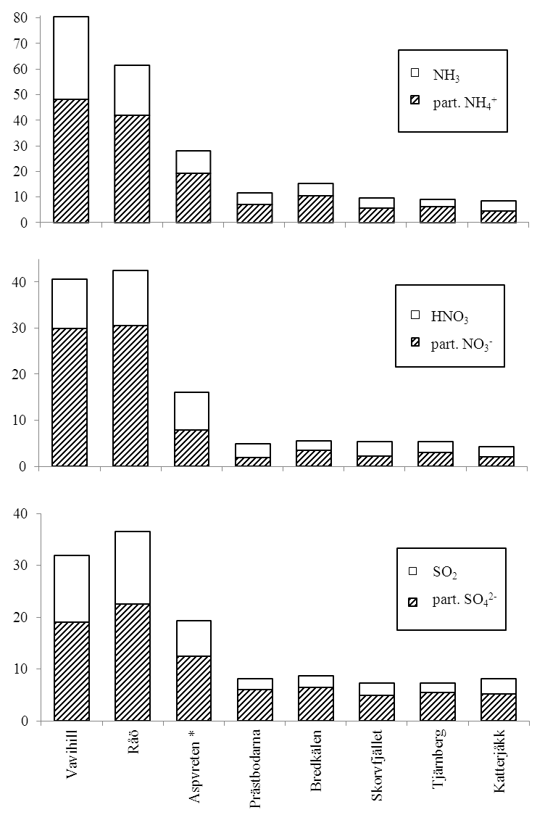
Average water soluble particulate and gaseous concentrations (nmol m⁻³) of nitrogen and sulphur compounds during 2003-2008.
*At Aspvreten measurements represent 2009-2010.

Slide 17
Råö
Bredkälen
Vavihill
Aspvreten
Trajectory roses of average ammonia concentration (grey sectors) and particulate ammonium concentration (white sectors) during 1993-2009 (nmol m⁻³).

Slide 18
Vavihill
Seasonal average ammonia and ammonium concentration in air at Vavihill during 1993-2010.

Slide 19
Råö

Slide 20
Aspvreten

Slide 21
Bredkälen

Slide 22
Katterjåkk
Seasonal average ammonia and ammonium concentration in air at Katterjåkk during 2003-2008.

Slide 23
Vavihill
Episode with elevated concentration of particles at Bredkälen Sept-Oct 2010.

Slide 24
Vavihill
Clean air episode at Vavihill during October 1995.

Slide 25
Vavihill
Annual average charge balance between particulate ammonium and the anions sulphate and nitrate at Vavihill during 18 years (1993-2010).

Slide 26
Vavihill
Average charge balance between average particulate ammonium concentrations in the eight trajectory sectors and the charge of anions sulphate and nitrate at Vavihill 1993-2009.

Slide 27
Correlation between particulate ammonium and the charge of particulate anions (two times sulphate plus nitrate) on a 24h basis at Vavihill in 1996.

Slide 28
Formation of other nitrates
HNO₃ + NaCl → NaNO₃ + HCl

Slide 29
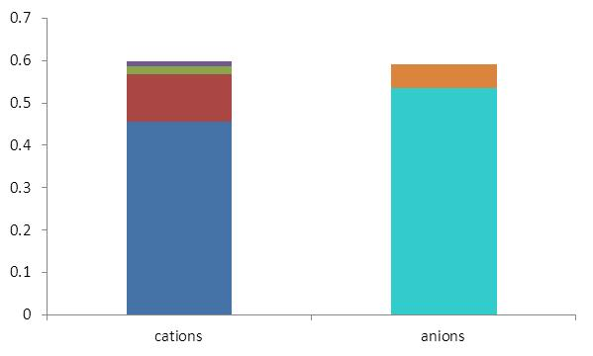
HNO₃
equivalents/l
in the sea
K⁺
Ca²⁺
SO₄²⁻
Mg²⁺
HCl
NO₃⁻
Na⁺
Cl⁻
1.17·Na⁺

Slide 30
Ion balance on particle filter at Råö for the year 2010.

Slide 31
Ion balance on particle filter at Skorvfjället for the years 2003-2008.

Slide 32
Correlation coefficient r² between particulate ammonium concentration and different combinations of particulate anions and also gaseous ammonia. Non-NaNO₃ means that the calculated concentration of NaNO₃ has been subtracted from the particulate nitrate concentration. nm denotes non-marine. Calculations were made on a daily basis 2010 at all EMEP stations.

Slide 33
NE
Aspvreten
Vavihill
SW

Slide 34
C₂ = f·C₁+C_{NE}
f=0.54 (46% is deposited)
C_{NE}=17 nmol m⁻³
Average concentrations of particulate ammonium and gaseous ammonia during south westerly wind trajectories at both sites (128 days) or north easterly wind trajectories (66 days). The markers show the station that the wind first passes. Data represent the period 1993-1999.

Slide 35
Main conclusion
Long-range transport of particulate ammonium is limited by the availability of particulate sulphate and nitrate.

Slide 36
Thank You!

