Slide 1


CONVENTION ON LONG-RANGE TRANSBOUNDARY AIR POLLUTION
13th annual Meeting – Task Force on Measurement and Modelling
May 17th – 19th 2012 in Gozo (Malta)
Experiences with the MARGA at the EMEP site Melpitz in Germany –
Evaluation of long-time measurements of PM₁₀ and trace gases
B. Fahlbusch¹, G. Spindler¹, A. Grüner¹, K. Müller¹, M. Wallasch², H. Herrmann¹
¹ Leibniz-Institut für Troposphärenforschung e. V. (IfT), Leipzig
² Umweltbundesamt (UBA), Dessau-Roßlau

Slide 2
Content
Experimental description: The MARGA
Results:
  Time series of the measured gases and particles
  Comparison of the MARGA with other instruments
  Influence of the air mass origin on the aerosol concentrations
  Comparison of MARGA measurements with ISORROPIA calculations
Summary
Notes:
2

Slide 3
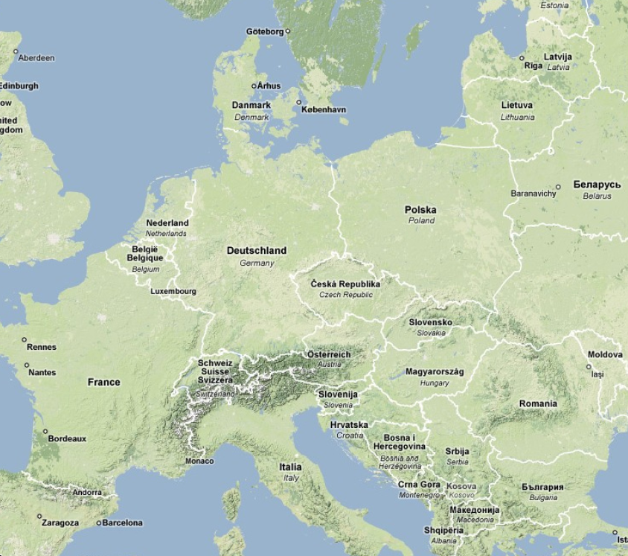
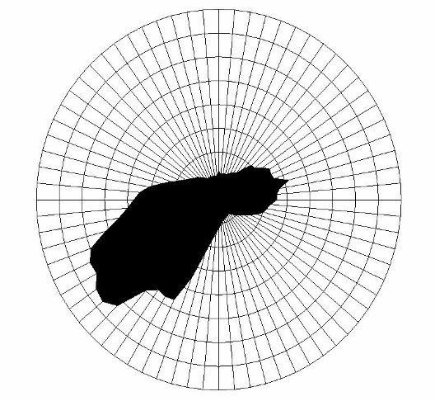
Location of the IfT and EMEP station Melpitz in Europe
Melpitz site
(12°56‘ E, 51°32‘ N,
Altitude 86 m
above see level)
emep station DE44
Berlin
google
3

Slide 4
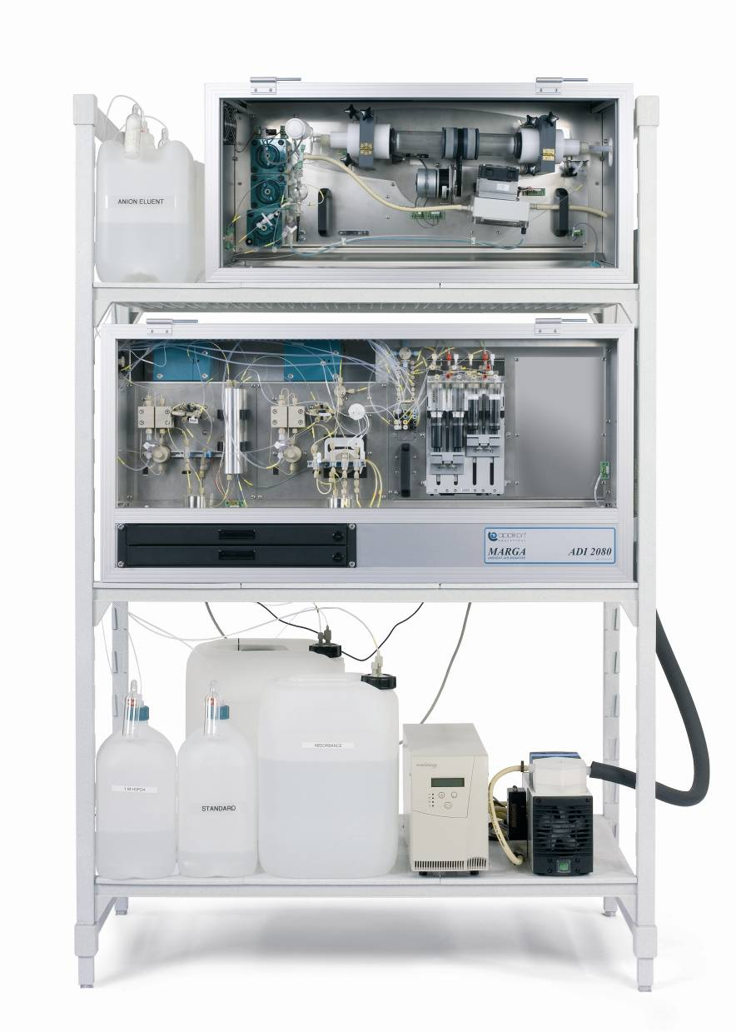


The MARGA
MARGA
“Online Monitor for AeRosols and GAses in ambient air”
Time resolution | 1h
Measured gases | HCl
 | HONO
 | HNO₃
 | NH₃
 | SO₂
Measured anions | Cl⁻
 | NO₃⁻
 | SO₄²⁻
Measured cations | Na⁺
 | NH₄⁺
 | K⁺
 | Mg²⁺
 | Ca²⁺
Objective: Online quantification of gases and particles in ambient air
Project funded by the Umweltbundesamt (UBA, 351 01 070)
Suitability test for the measuring network of the UBA and scientific evaluation of the instrument in Germany at the IfT research station (Melpitz)

Slide 5
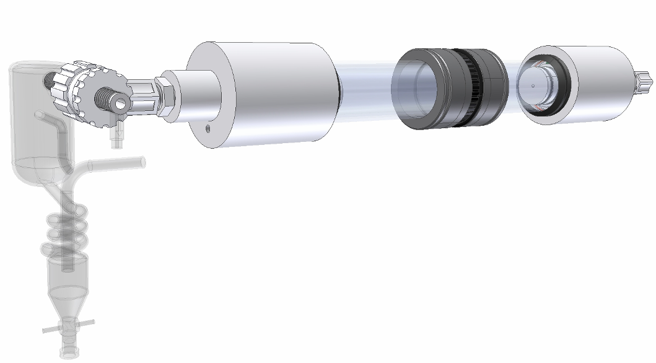
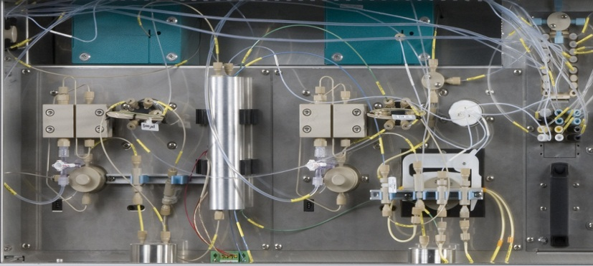
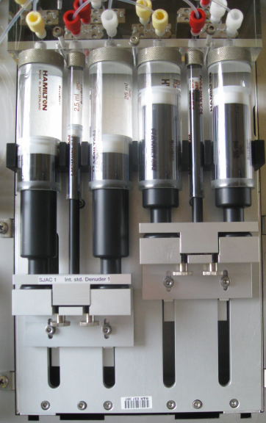
Experimental description of the MARGA
WRD
Air in (PM₁₀ inlet)
SJAC
Ion chromatography
Internal standard LiBr
Particle sample (SJAC)
Syringe system
Gas sample (WRD)

Slide 6
Content
Experimental description: The MARGA
Results:
  Time series of the measured gases and particles
  Comparison of the MARGA with other instruments
  Influence of the air mass origin on the aerosol concentrations
  Comparison of MARGA measurements with ISORROPIA calculations
Summary
Notes:
6

Slide 7
Overview MARGA measurements
Gas phase concentrations
HCCT campaign Sep/Oct 2010

Slide 8
Overview MARGA measurements
Particle phase concentrations
HCCT campaign Sep/Oct 2010

Slide 9
Overview MARGA measurements
Particle phase concentrations
HCCT campaign Sep/Oct 2010

Slide 10
Content
Experimental description: The MARGA
Results:
  Time series of the measured gases and particles
  Comparison of the MARGA with other instruments
  Influence of the air mass origin on the aerosol concentrations
  Comparison of MARGA measurements with ISORROPIA calculations
Summary
Notes:
10

Slide 11
MARGA vs a filter based method
NO₃⁻ concentration comparison
High temperatures in the summer months may cause a negative artifact in the filter-based collection of NO₃⁻

Slide 12
MARGA vs AMS during HCCT 2010
NO₃⁻ and NH₄⁺ concentration comparison
NO₃⁻
NH₄⁺

Slide 13
MARGA vs AMS during HCCT 2010
SO₄²⁻ concentration comparison
SO₄²⁻
Very good correlation between MARGA and AMS during HCCT
Differences in the nitrate concentration were observed during days with western air masses
AMS measurements during HCCT 2010 were done by Laurent Poulain

Slide 14
MARGA vs a gas monitor
SO₂ concentration comparison

Slide 15
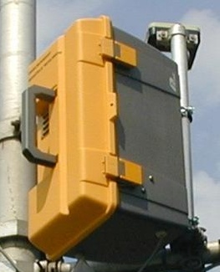
MARGA vs a minidenuder
NH₃ concentration comparison

Slide 16
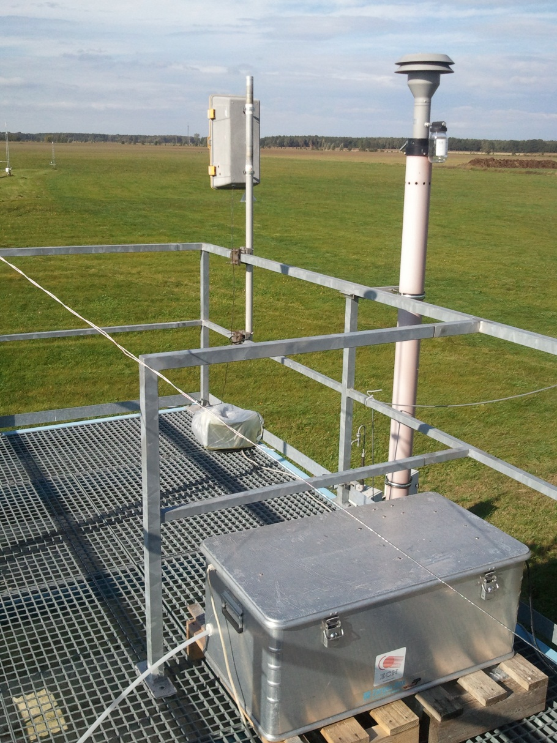
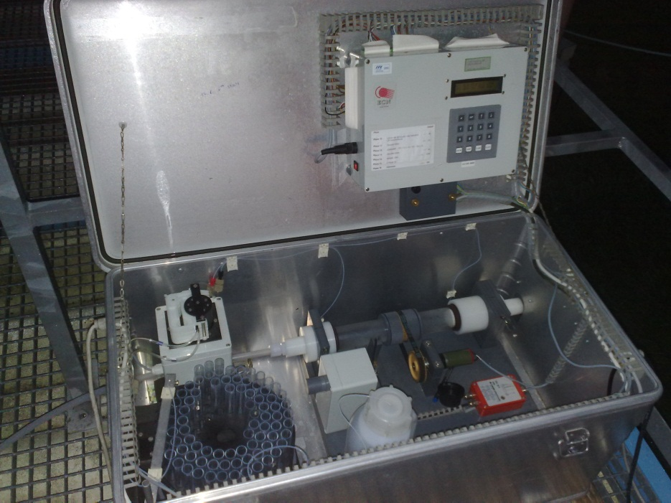
Batchdenuder for HONO and HNO₃ measurements
Offline system with autosampler

Slide 17
MARGA vs Batchdenuder
Comparison of HONO and HNO₃ concentrations
HONO
HNO₃

Slide 18
Content
Experimental description: The MARGA
Results:
  Time series of the measured gases and particles
  Comparison of the MARGA with other instruments
  Influence of the air mass origin on the aerosol concentrations
  Comparison of MARGA measurements with ISORROPIA calculations
Summary
Notes:
18

Slide 19
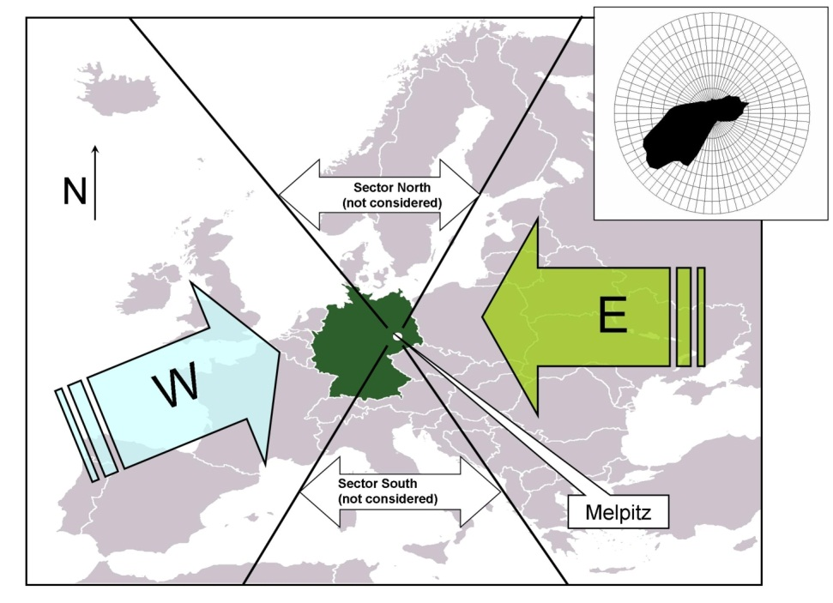
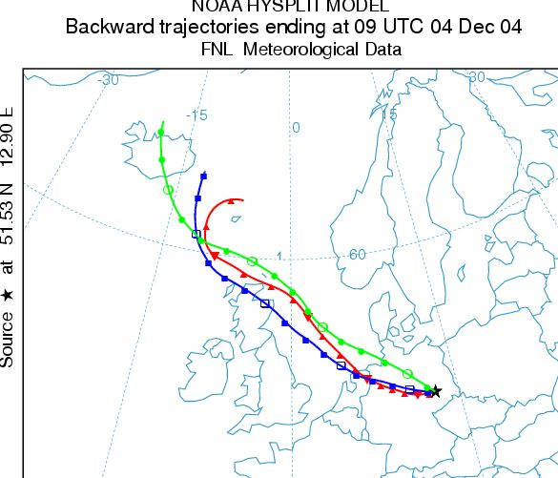
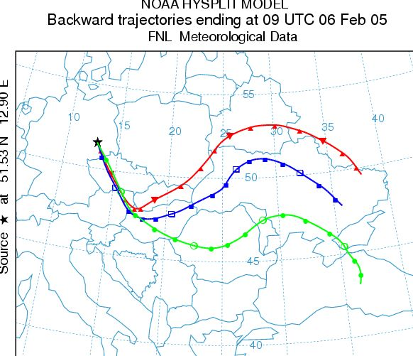
Determination of air mass origin
Air mass origin
Example WEST
Example EAST
96-hour backward trajectories were calculated twice a day (10:00 and 18:00 CET) for 200, 500 und 1500 m above ground level
Source: http://www.arl.noaa.gov/ready/hysplit4.htm
Season
Sector West: 210° – 320°
Sector East: 35° – 140°
Winter: November – April
Summer: May – October
Spindler et al. (2010) Atmos. Env. 44, 164-173

Slide 20
Influence of the air mass origin
Diurnal variation of the SO₂ concentration in 2011
SO₂ concentration in 2011
West (91 days)
East (40 days)
Winter
West (130 days)
East (19 days)
Summer
Local time
Local time
Median  Interquartile range

Slide 21
Influence of the air mass origin
Diurnal variation of the NH₄⁺ concentration in 2011
NH₄⁺ concentration in 2011
West (91 days)
East (40 days)
Winter
West (130 days)
East (19 days)
Summer
Local time
Local time
Median  Interquartile range

Slide 22
Content
Experimental description: The MARGA
Results:
  Time series of the measured gases and particles
  Comparison of the MARGA with other instruments
  Influence of the air mass origin on the aerosol concentrations
  Comparison of MARGA measurements with ISORROPIA calculations
Summary
Notes:
22

Slide 23
ISORROPIA
ISORROPIA calculates the composition and phase state of NH₄⁺, SO₄²⁻, NO₃⁻, Cl⁻, Na⁺, K⁺, Mg²⁺, Ca²⁺ in thermodynamic equilibrium with gas phase precursors
Forward problem (stable state):
Input: T, RH, [SO₄²⁻], [mineral cations], [TN], [TA], [TCl]
Output: [TN] = [NO₃⁻] + [HNO₃]
[TA] = [NH₄⁺] + [NH₃]
[TCl] = [Cl⁻] + [HCl]
Nenes et al., Aquatic Geochemistry, 1998
Fountoukis and Nenes, Atmos.Chem.Phys., 2007
http://nenes.eas.gatech.edu/ISORROPIA

Slide 24
MARGA vs ISORROPIA (2011)
Forward mode
NH₃
NH₄⁺
HNO₃
NO₃⁻

Slide 25
MARGA vs ISORROPIA
3rd/4th October 2011
Possible solutions for this problem:
Isolation of the inlet-tube inside the container
Measuring without PM₁₀-inlet
Shorter inlet-tube
HNO₃ MARGA
HNO₃ Batchdenuder
HNO₃

Slide 26
Advantages and disadvantages of the MARGA
Advantages
Disadvantages
Online analysis system (fast data availability)
Time resolution of 1 hour
High data availability
Low maintenance requirements
Lower personal costs compared to offline measurements
Contamination of Ca²⁺, Mg²⁺
Negative influence of the inlet-system (i.e. HNO₃ underestimation)
No determination of the mass concentration
High price (purchase)

Slide 27
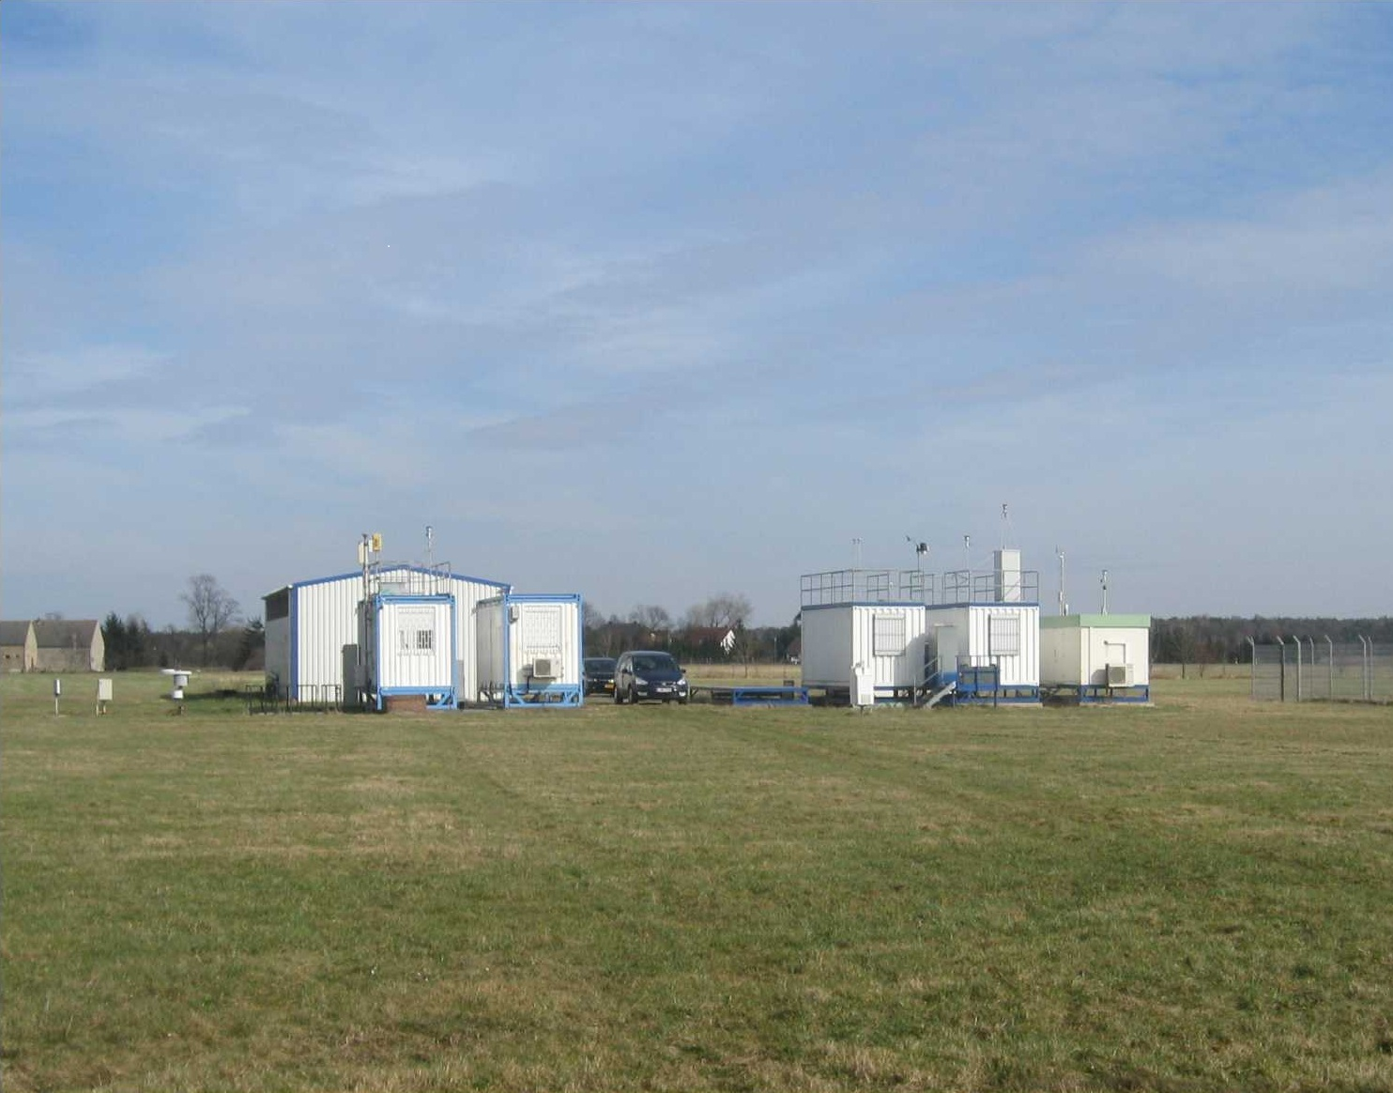
MARGA inlet
Thank you for your attention!

