Slide 1
Measurement-Model Fusion for Global Total Atmospheric Deposition (MMF-GTAD)
Oksana Tarasova
Atmospheric Environment Research Division, WMO

Slide 2
Why to look at deposition – user perspective
Billions of US$ in losses to crops worldwide due to tropospheric ozone damage – a food security problem
Nitrogen deposition poses a significant threat to sensitive natural and semi-natural habitats worldwide, despite emission reductions in some countries -threat to bio-diversity and ecosystems
Deposition of sulphur species emitted from combustion of fossil fuels - threat to human health
There is a clear need for a product that enables, on an operational or semi-operational basis, to keep track, on a global basis, of deposition of atmospheric pollutants to address the needs of the human health, food security and ecosystems studies. -> Measurement-Model Fusion for Global Total Global Atmospheric Deposition

Slide 3
What is Measurement-Model Fusion?
A method for combining observations with model output with the objective of improving the latter, or…
Data assimilation applied retroactively, i.e. based on past measurements
Method: Data Optimization: classical [variational] and statistical [sequential]
Notes:
Defined MMF as data assimilation applied retroactively, based on past measurements (we don’t measure wet and dry deposition on the fly). Simplest view is that data assimilation is “…an approach for combining observations with model output with the objective of improving the latter”. We seek an optimum match between model simulations and measurements taken by the system that we are trying to elucidate. Two families of data optimisation: classical or variational, statistical or sequential.
“…we need to rely on models. But when models are not corrected periodically by reality, they can be of little value. Thus, we need to fit the model state in an optimal way to the observations, before an analysis or prediction is made.”
“This optimization takes two forms: classical [variational] and statistical [sequential].”
“…Classical optimization involves minimization of a positive, usually quadratic cost function that expresses the quantity that we seek to optimize. In most of the cases that we will deal with, this will be a function of the error between model and measurements—in this case we will speak of least-squares error minimization.”
“The second form, statistical optimization, involves minimization of the variability or uncertainty of the model error and is based on statistical estimation theory.”

Slide 4
MMF-TAD Approach
Measured precipitation concentrations
Modelled precipitation concentrations
Measured air concentrations
Modelled air concentrations
Fusion method
Fusion method
Precipitation concentration maps
Air concentration maps
Total deposition maps
Wet deposition maps
Dry deposition maps
Modelled dry deposition of unmeasured species
Precipitation depth map
Fusion method
Modelled dry deposition velocities
Measured precipitation depth
Modelled precipitation depth
Notes:
This flow chart shows the general methodology behind MMF-TAD. Wet deposition (left side) and dry deposition (right side) are treated separately. In this chart, the inputs to the analysis are shown at the top and bottom. As you can see, both modelled and measured values are used, except for dry deposition velocities, which are entirely from the model. Also entirely from the model are the concentrations of species such as N2O5 and PAN that are not systematically measured but do contribute to total nitrogen deposition.
Sweden (and Norway) uses a 2dVAR data assimilation method. MMF mapping is done for ozone in Sweden but not by the other countries.
UK method does not use a chemical transport model to provide its background field, but rather combines concentration fields (interpolated via conventional or Bayesian kriging), climatic fields, land use maps, and inferential dry deposition calculations to map wet and dry deposition.
USA: precipitation concentration fields are generated by spatial interpolation between measurement sites.
Canada merges measured and modelled values via optimal interpolation, which is a statistical way of merging where you input the differences between the model and measured values at the measurement sites, as well as the errors associated with those values, and generate a final analysis product that minimizes the combined error.

Slide 5
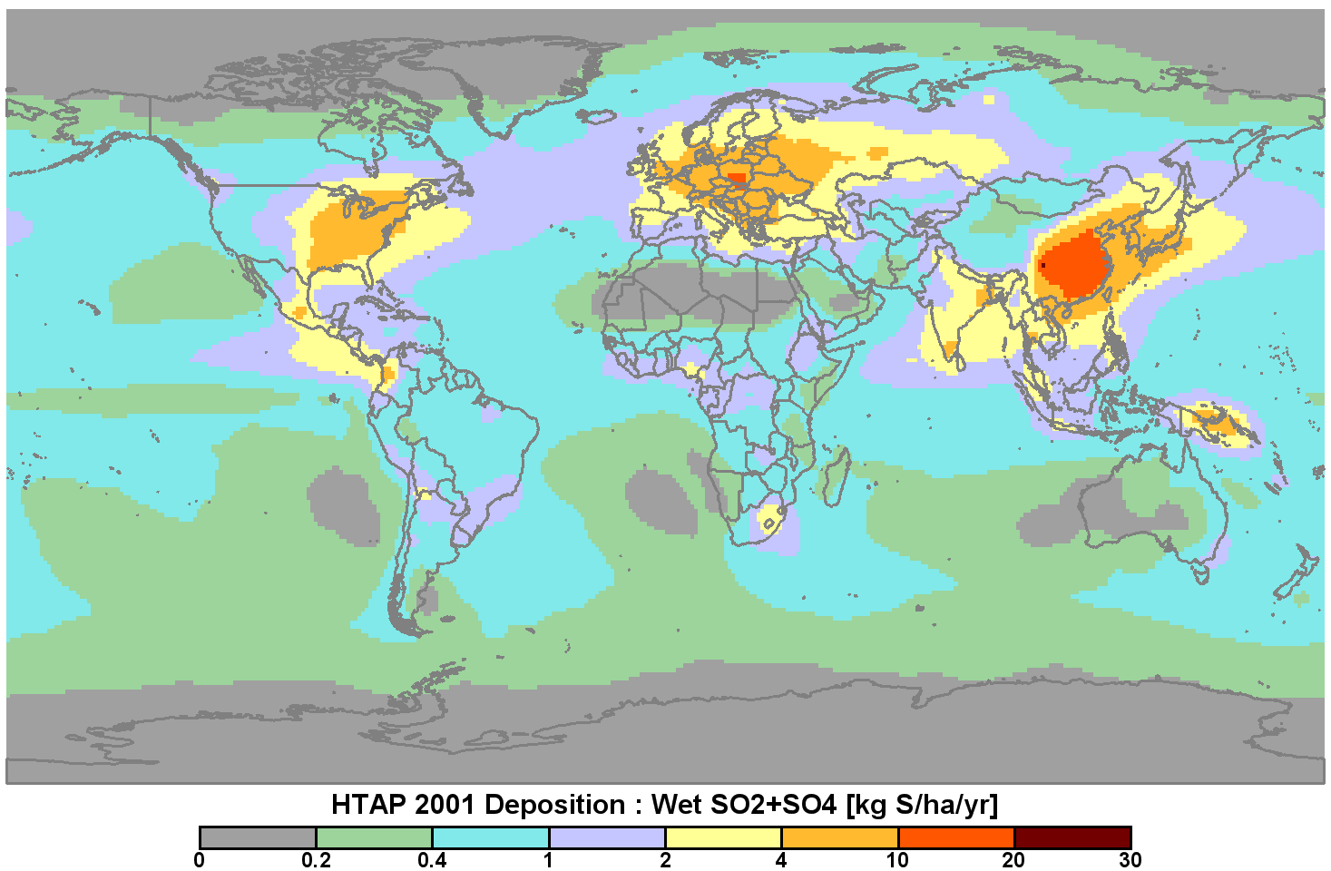
Combined measurement-model global maps of atmospheric deposition
Measurement (2000-2002)
Model (2001 Ensemble Mean)
Vet et al. 2014. A global assessment of precipitation chemistry and deposition of sulfur, nitrogen, sea salt, base cations, organic acids, acidity and pH, and phosphorous, Atmospheric Environment, 93: 3-100.
Notes:
First attempt to combine measurements and model outputs. For Global Assessment we overlapped wet deposition measurements and models to see where they matched or did not match but we could not fuse them. Did the same regionally for dry and total deposition. A although generally not bad there were many biases in dry deposition and corrections that need to be done. Did same exercise for N deposition.
Wet deposition of nssS: Slight model over-prediction in North America and Europe and under-prediction in Asia.
Dry dep and total dep of S: Largest model differences (over prediction) appear in the US and a couple of sites in eastern Canada but good agreement with other Canadian sites

Slide 6
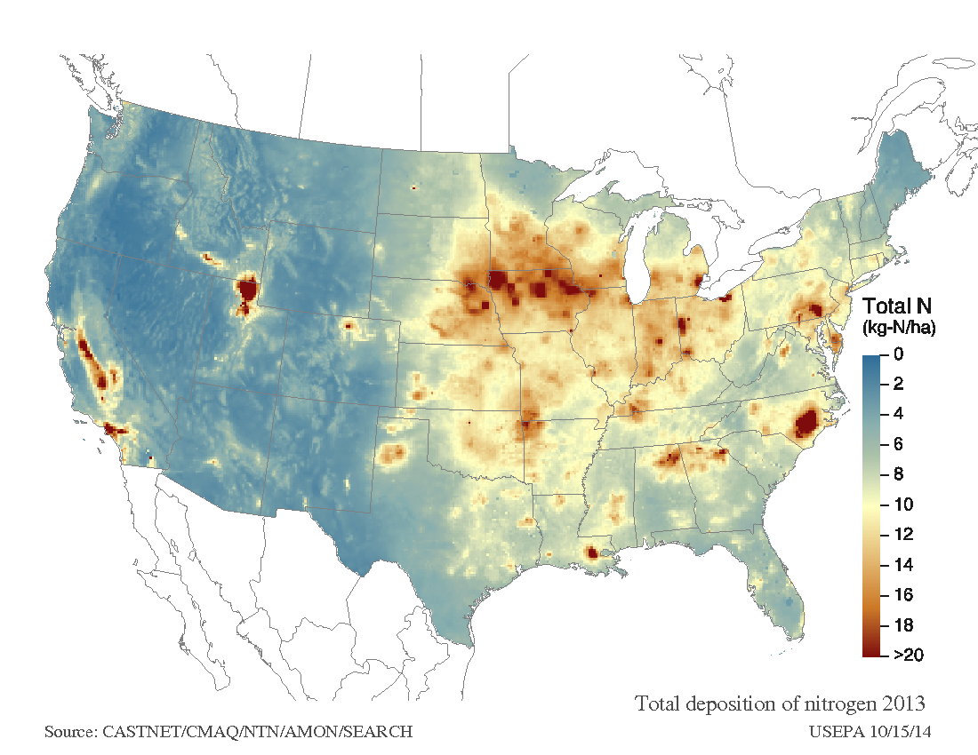
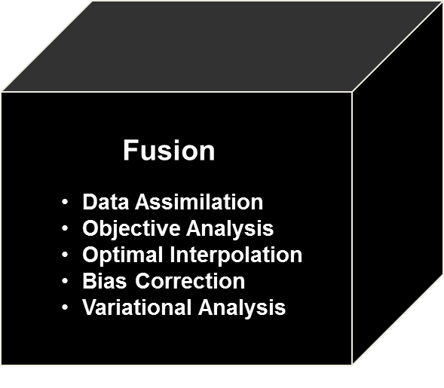
Measurement-Model Fusion of Total Atmospheric Deposition: Sweden and U.S.A.
2013 Total Deposition of Sulfur
Source: Alpfjord, H. and Andersson, C., 2015. Nationell miljöövervakning med MATCH Sverige-systemet - ny metodik, utvärdering och resultat för åren 2012-2013, Swedish Meteorological and Hydrological Institute, Nr 2015-7
Source: Schwede D. and Lear G., 2014. Atmospheric Environment, Volume 92, August 2014 and http://nadp.sws.uiuc.edu/committees/tdep/tdepmaps/ .
Notes:
Fusion is like a black box (only few really understand the mathematics behind it) and includes data assimilation, objective analysis, optimal interpolation, bias correction, variational analysis) to get some form of fused map. This black box is no longer a black box. People already doing this for TAD (Sweden and US, and Canada and UK).

Slide 7
2019 Expert Meeting on MMF-GTAD
Held at WMO, Geneva on 26 and 27 February 2019
Objectives:
Updated knowledge of stakeholder activities/needs, the state of global measurement databases, the state of MMF-related science including chemical transport modelling activities (global and hemispheric), global reanalysis activities and measurement-model fusion/mapping activities​
A reality check on the suitability of the 3 goals and other key recommendations from the 2017 Workshop​
​Updated realistic goals and a path forward for the Global MMF-GTAD Project​
Development of the Project's Implementation Plan
Development of strategies to obtain the necessary funds to finance the project’s objectives

Slide 8
MMF-GTAD Project: Goals
Agreement to establish a formal WMO/GAW MMF-GTAD Project , with initial focus on S, N and O₃.
A plan for a three-goal project:
Goal 1a (Short Term) MMF of existing 2010 ensemble global model results with existing data sets (e.g. HTAP).
Product: comprehensive data set and model ensemble output files and gridded MMF maps
Goal 1b (Medium Term) “Stitching” together existing and new national/regional/global MMF-TAD maps (AQMEII, TFMM, Asia, Canada, USA, UK, Sweden, Norway) to produce global maps
Goal 2 (Long Term) Ongoing operational/semi-operational re-analysis using data assimilation (ECMWF/Copernicus)

Slide 9
MMF-GTAD Project: Goal 1a (~2 years)
Goal 1a is global in scope
Model runs for year 2010
2010 measurement data collection activity (NILU and WMO data centers)
Collection of multiple ensemble model runs
Evaluation of ensemble model runs and how to use them
MMF: evaluation of MMF methods and application to 2010
Notes:
Phase 1 (Short Term). Ensemble Model-Measurement Fusion for the Year 2010. Multiple existing model and data activities will be used to fuse model-ensemble outputs with measurement data for the year 2010. The products will include a comprehensive global data set and model ensemble output files, as well as measurement-model fusion global maps of concentrations and wet, dry and total deposition of important gas, aerosol and precipitation concentrations.
Phase 2 (Medium Term). Stitching of Global/Regional Measurement-Model Products. Existing and newly-developed regional and global MMF products will be stitched together to produce merged global maps of gas, aerosol and precipitation concentrations as well as wet, dry and total deposition fluxes. The approach will require the development of new MMF methods and products for Europe (David Simpson and Camilla Anderson as contacts) and Asia (Greg Carmichael as contact for MICS-Asia; Kevin Hicks as contact for the Asian Integrated Assessment for Air Quality) and merging them together with existing Swedish (Camilla Andersson), United Kingdom (Ron Smith), United States (Donna Schwede), and Canadian (Amanda Cole) MMF products.
Phase 3 (Long Term). Global Reanalysis/Assimilation of Concentrations and Deposition Fluxes. One or more global modelling systems will be developed involving the operational reanalysis and data assimilation of observations of concentration, column burdens, and deposition fluxes.
A number of associated model-related projects were identified to contribute to the development of the project including: an investigation of the dry deposition algorithms and predictive capabilities in the contributing chemical transport models; a study of the feasibility of fusing model results with both urban (i.e., high spatial resolution) and regional/global (i.e., low spatial resolution) data; and an evaluation of reasonable temporal resolution for the measurement-model fusion activities (e.g., weekly, monthly, or seasonally).

Slide 10
MMF-GTAD Project: Goal 1b (~2 years)
Goal 1a is Regional in scope
Regional MMF maps:
-Europe
-Asia (potentially)
+ several national maps (USA, Canada)
Europe: Apply MMF method using model outputs from HTAP, TFMM and/or AQMEEII and wet deposition data for Europe
USA: MMF under TDEP project (currently ongoing)
Canada: MMF under ADAGIO project (currently ongoing
Inputs: MMF maps from Goal 1a, observational data
Notes:
Phase 1 (Short Term). Ensemble Model-Measurement Fusion for the Year 2010. Multiple existing model and data activities will be used to fuse model-ensemble outputs with measurement data for the year 2010. The products will include a comprehensive global data set and model ensemble output files, as well as measurement-model fusion global maps of concentrations and wet, dry and total deposition of important gas, aerosol and precipitation concentrations.
Phase 2 (Medium Term). Stitching of Global/Regional Measurement-Model Products. Existing and newly-developed regional and global MMF products will be stitched together to produce merged global maps of gas, aerosol and precipitation concentrations as well as wet, dry and total deposition fluxes. The approach will require the development of new MMF methods and products for Europe (David Simpson and Camilla Anderson as contacts) and Asia (Greg Carmichael as contact for MICS-Asia; Kevin Hicks as contact for the Asian Integrated Assessment for Air Quality) and merging them together with existing Swedish (Camilla Andersson), United Kingdom (Ron Smith), United States (Donna Schwede), and Canadian (Amanda Cole) MMF products.
Phase 3 (Long Term). Global Reanalysis/Assimilation of Concentrations and Deposition Fluxes. One or more global modelling systems will be developed involving the operational reanalysis and data assimilation of observations of concentration, column burdens, and deposition fluxes.
A number of associated model-related projects were identified to contribute to the development of the project including: an investigation of the dry deposition algorithms and predictive capabilities in the contributing chemical transport models; a study of the feasibility of fusing model results with both urban (i.e., high spatial resolution) and regional/global (i.e., low spatial resolution) data; and an evaluation of reasonable temporal resolution for the measurement-model fusion activities (e.g., weekly, monthly, or seasonally).

Slide 11
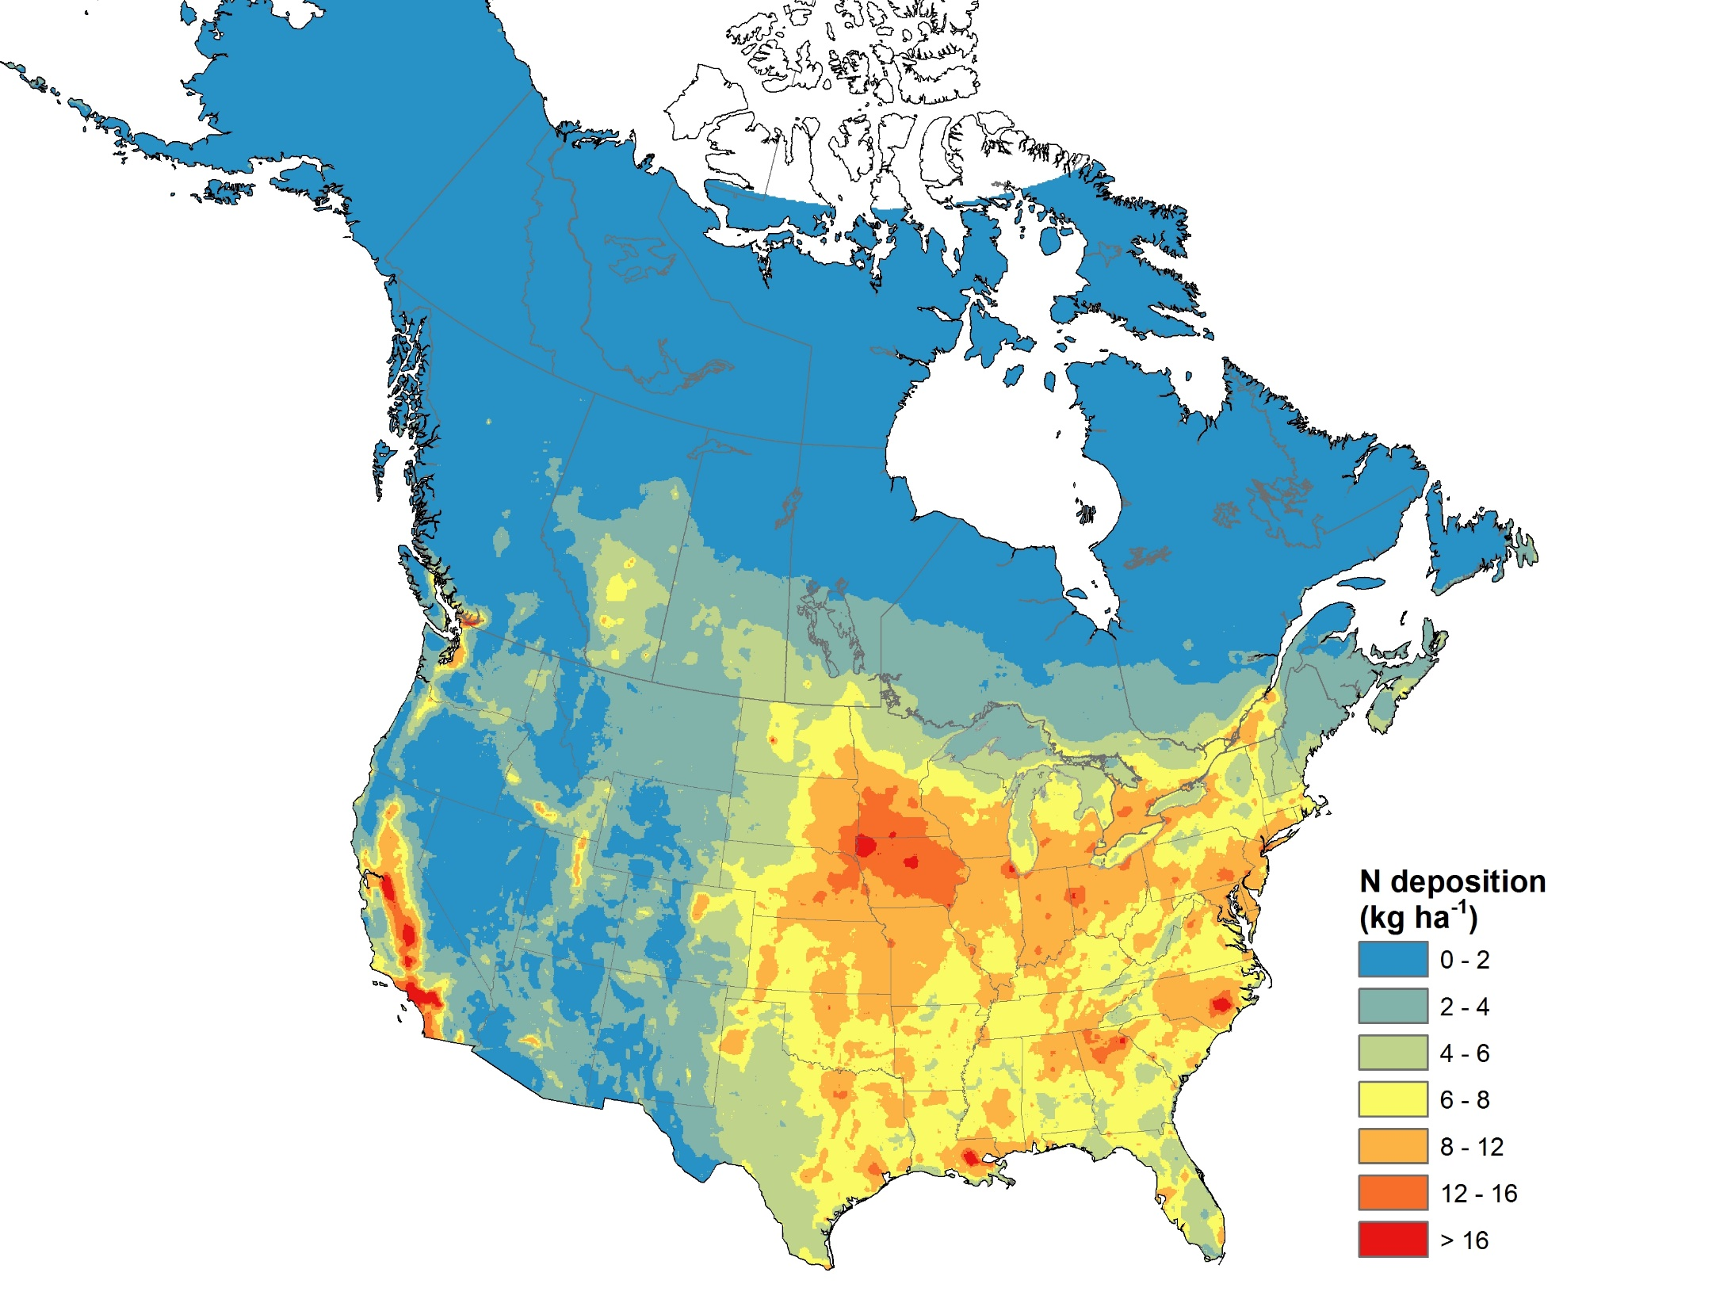
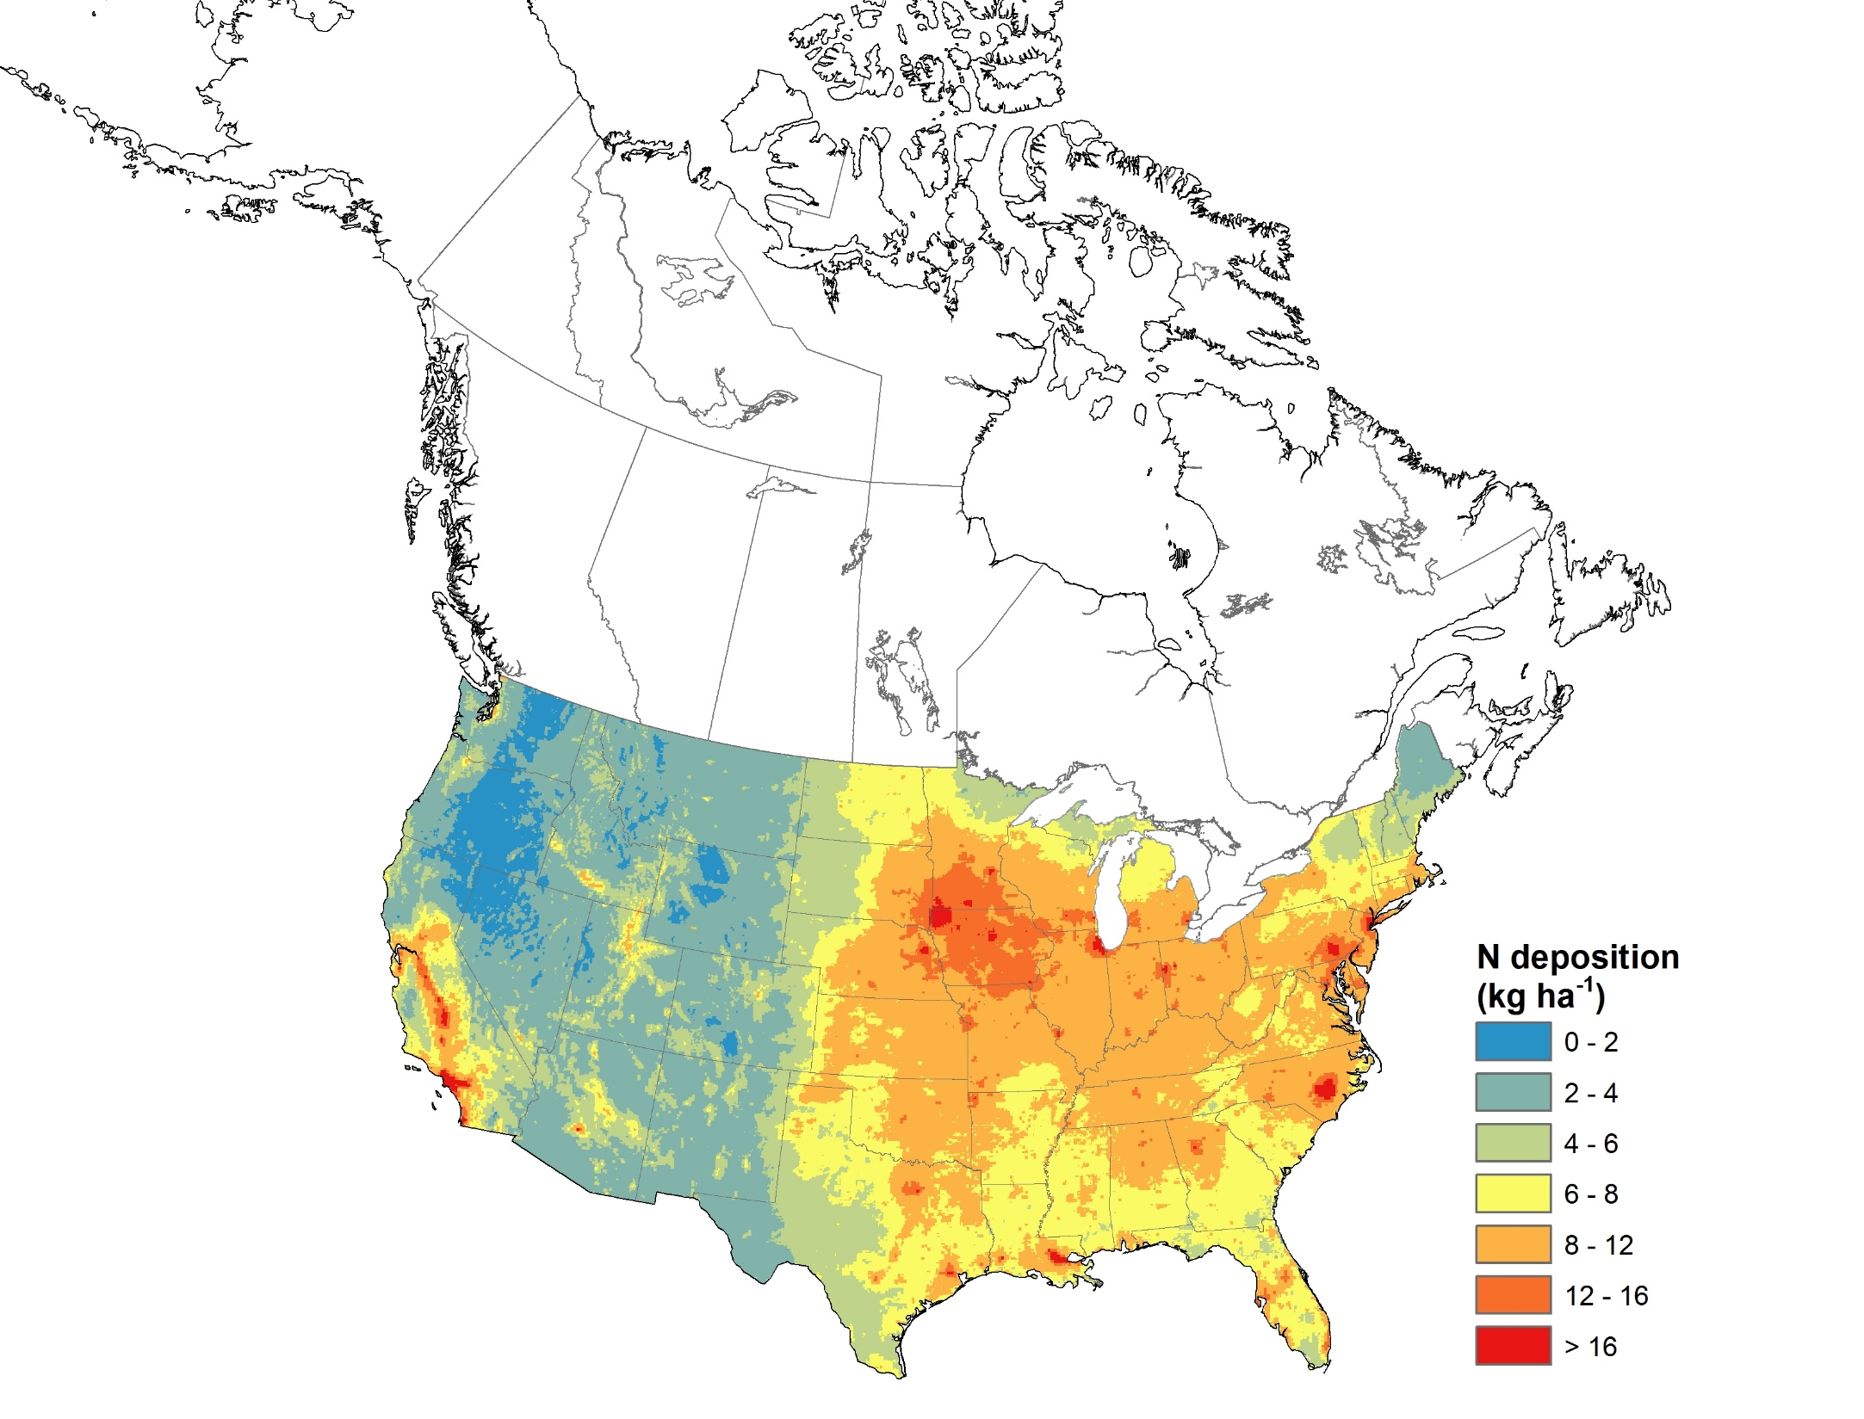
Regional MMF maps: ADAGIO and Tdep, N deposition
ADAGIO
TDep
Schwede, D., A. S. Cole, R. Vet, G. Lear. Ongoing US-Canada
collaborations on nitrogen and sulfur deposition, Environmental Management, June 2019 (anticipated).
Notes:
Dry deposition velocities are calculated differently in the two models; this has been shown in other studies to give significantly different fluxes for species like ozone, and likely impacts dry deposition of N species as well
- NH3 is treated differently: CMAQ (the model TDep uses) includes a bidirectional treatment of NH3, while GEM-MACH (the model used by ADAGIO) keeps the emission and deposition parametrization separate.
- Wet deposition is calculated differently: without CMAQ model input in TDep (precipitation is from PRISM, which takes into account landscape features and precip gauge data, and ion concentrations are from spatial interpolation between stations), and with GEM/GEM_MACH model input in ADAGIO (GEM model combined with precip gauge data for precipitation, and MMF for ion concentrations similar to air conc)

Slide 12
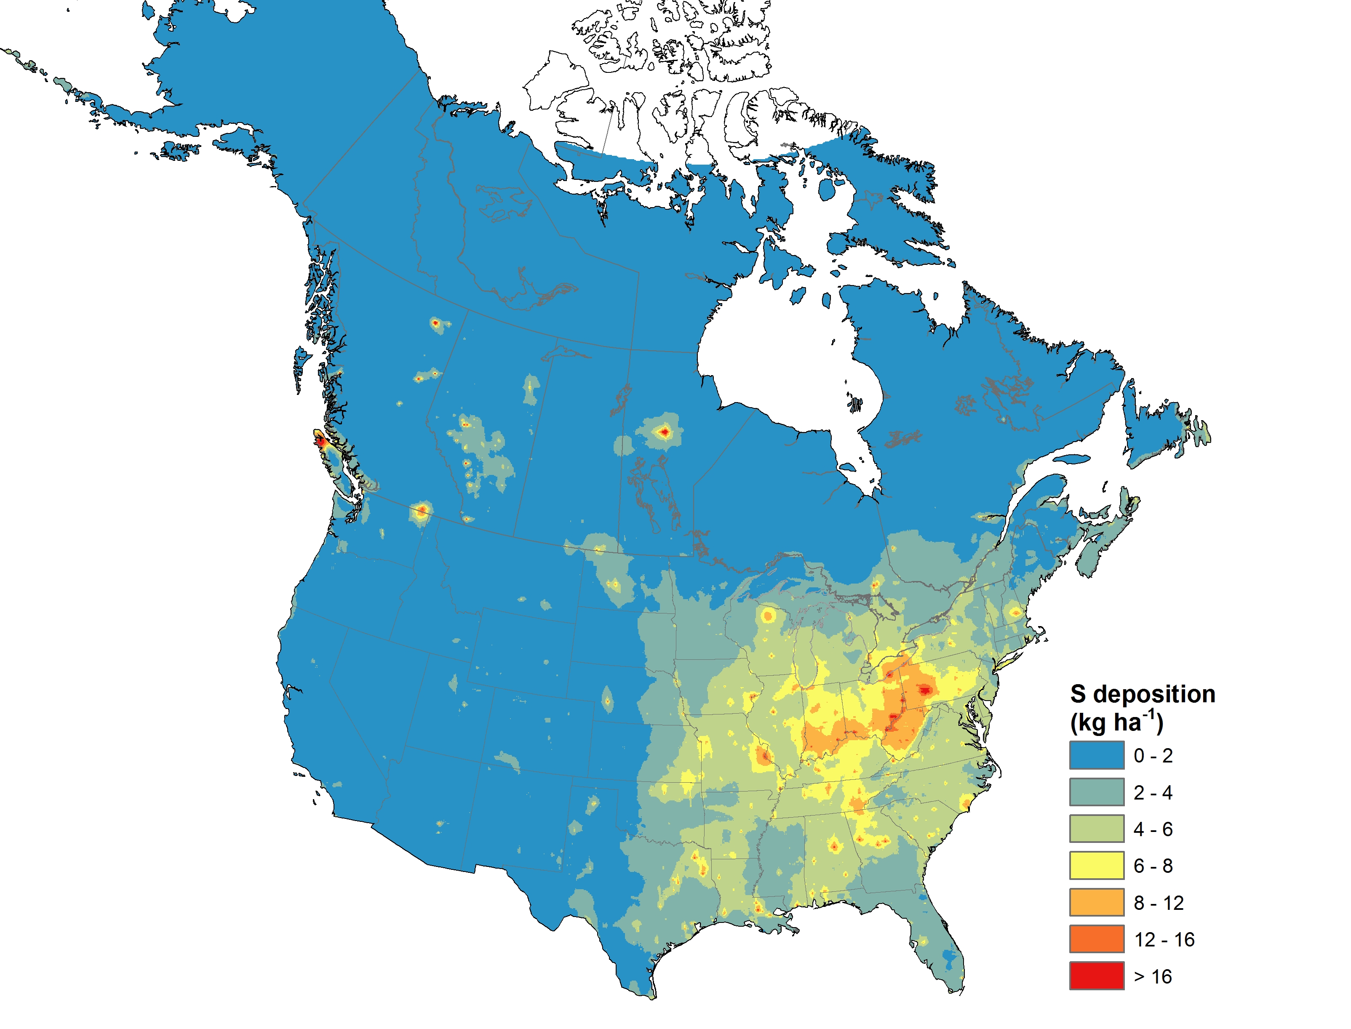
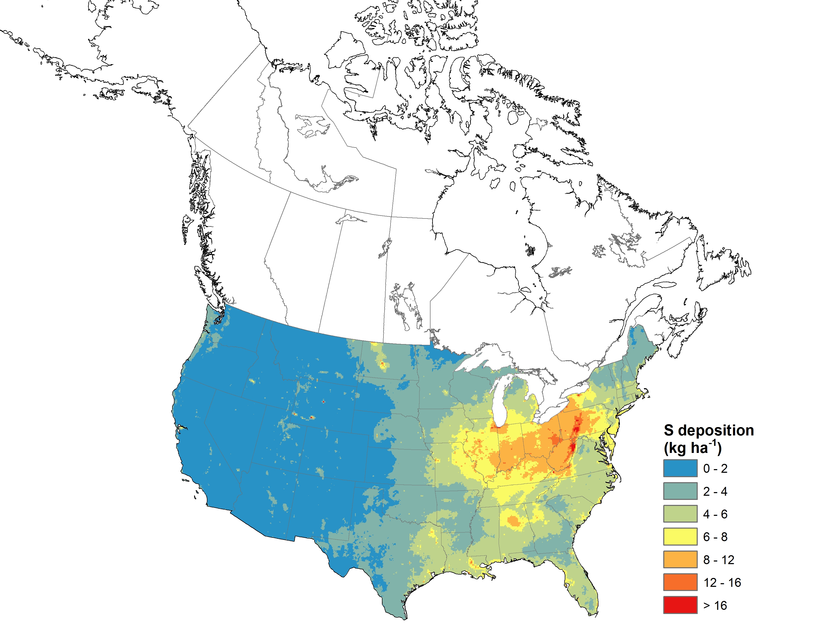
Regional MMF maps: ADAGIO and Tdep, S deposition
ADAGIO
TDep
Schwede, D., A. S. Cole, R. Vet, G. Lear. Ongoing US-Canada
collaborations on nitrogen and sulfur deposition, Environmental Management, June 2019 (anticipated).

Slide 13
MMF-GTAD Project: Goal 2 Reanalysis / MMF (Longer term)
Product in the near term: CAMS
-Existing runs of global output maps will feed into paper from Goal 1a/b
Project to evaluate CAMS’s deposition scheme vs data.
Long-term Goal: MMF operational global annual maps with CAMS deposition runs incorporating a wet deposition MMF technique/operation into CAMS. Required:
a) Data processing, operationally
b) Development and application of a suitable MMF technique (to be determined)
Notes:
Phase 1 (Short Term). Ensemble Model-Measurement Fusion for the Year 2010. Multiple existing model and data activities will be used to fuse model-ensemble outputs with measurement data for the year 2010. The products will include a comprehensive global data set and model ensemble output files, as well as measurement-model fusion global maps of concentrations and wet, dry and total deposition of important gas, aerosol and precipitation concentrations.
Phase 2 (Medium Term). Stitching of Global/Regional Measurement-Model Products. Existing and newly-developed regional and global MMF products will be stitched together to produce merged global maps of gas, aerosol and precipitation concentrations as well as wet, dry and total deposition fluxes. The approach will require the development of new MMF methods and products for Europe (David Simpson and Camilla Anderson as contacts) and Asia (Greg Carmichael as contact for MICS-Asia; Kevin Hicks as contact for the Asian Integrated Assessment for Air Quality) and merging them together with existing Swedish (Camilla Andersson), United Kingdom (Ron Smith), United States (Donna Schwede), and Canadian (Amanda Cole) MMF products.
Phase 3 (Long Term). Global Reanalysis/Assimilation of Concentrations and Deposition Fluxes. One or more global modelling systems will be developed involving the operational reanalysis and data assimilation of observations of concentration, column burdens, and deposition fluxes.
A number of associated model-related projects were identified to contribute to the development of the project including: an investigation of the dry deposition algorithms and predictive capabilities in the contributing chemical transport models; a study of the feasibility of fusing model results with both urban (i.e., high spatial resolution) and regional/global (i.e., low spatial resolution) data; and an evaluation of reasonable temporal resolution for the measurement-model fusion activities (e.g., weekly, monthly, or seasonally).

Slide 14
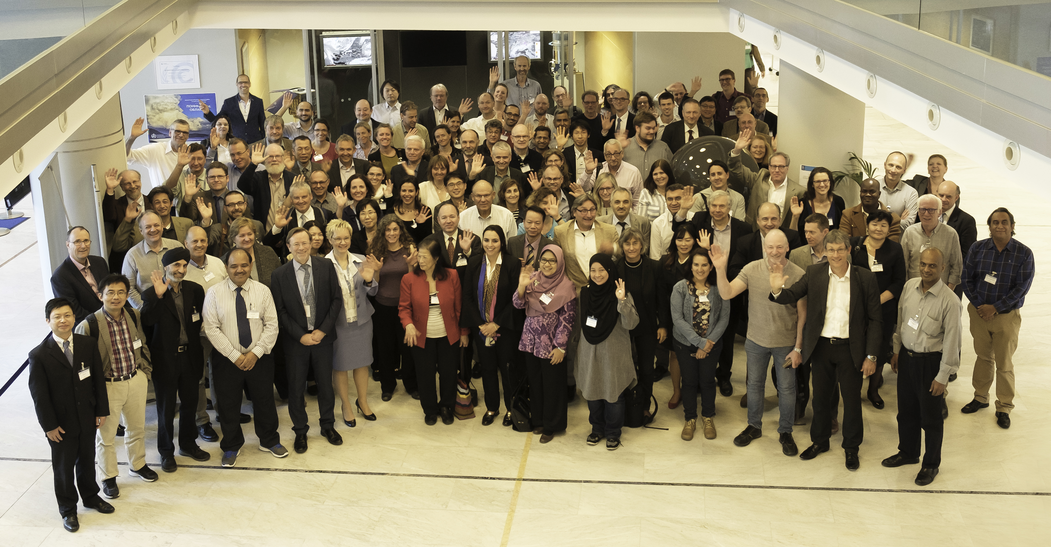
Thank you!

