Slide 1
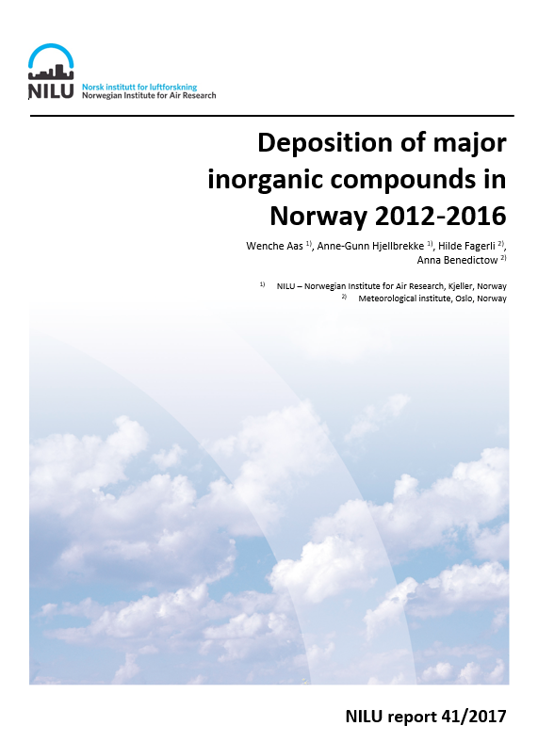
Comparing different methods for estimating atmospheric deposition in Norway, and the effects on the critical load exceedances
Wenche Aas, Kari Austnes and Hilde Fagerli

Slide 2
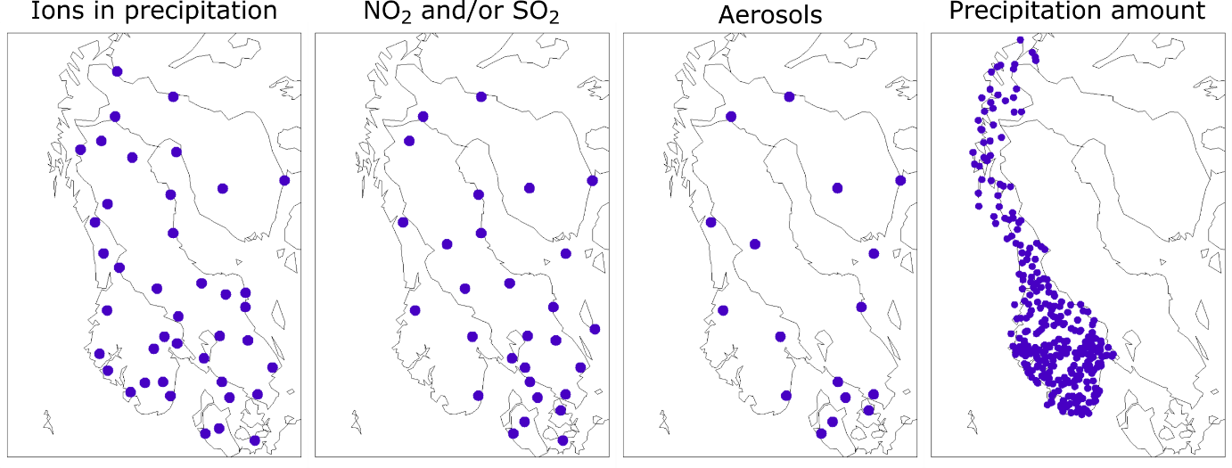
Background
Estimates if atmospheric deposition of N and S used for calculating exceedences of critical load in Norway have traditionally been done using a method based on observations combined with statistical kriging techniques and theoretical dry deposition velocities, main problems:
Large uncertainties in areas with few sites (low spatial resolution)
Dry deposition rates based on very crude estimates
Depositions in Europe for critical load calculations based on the EMEP model.
Uncertainties in emissions
model parametrisations (gas/particle and size distribution; deposition processes etc)
representation of hydrological cycle (precipitation amount is hard to model)
Sites used
Sites used

Slide 3
Background
Estimates if atmospheric deposition of N and S used for calculating exceedences of critical load in Norway have traditionally been done using a method based on observations combined with statistical kriging techniques and theoretical dry deposition velocities, main problems:
Large uncertainties in areas with few sites
Dry deposition rates based on very crude estimates
Depositions in Europe for critical load calculations based on the EMEP model.
Uncertainties in emissions
model parametrisations (gas/particle and size distribution; deposition processes etc)
representation of hydrological cycle (precipitation amount is difficult)
Combining model and observations, measurement model fusion (MMF) to utilize the best of the two world. I.e. use the observations are used to correct/adjust the model results. Regularly done in North America and a global initiative in WMO/GAW (c.f. Oksana’s talk)

Slide 4
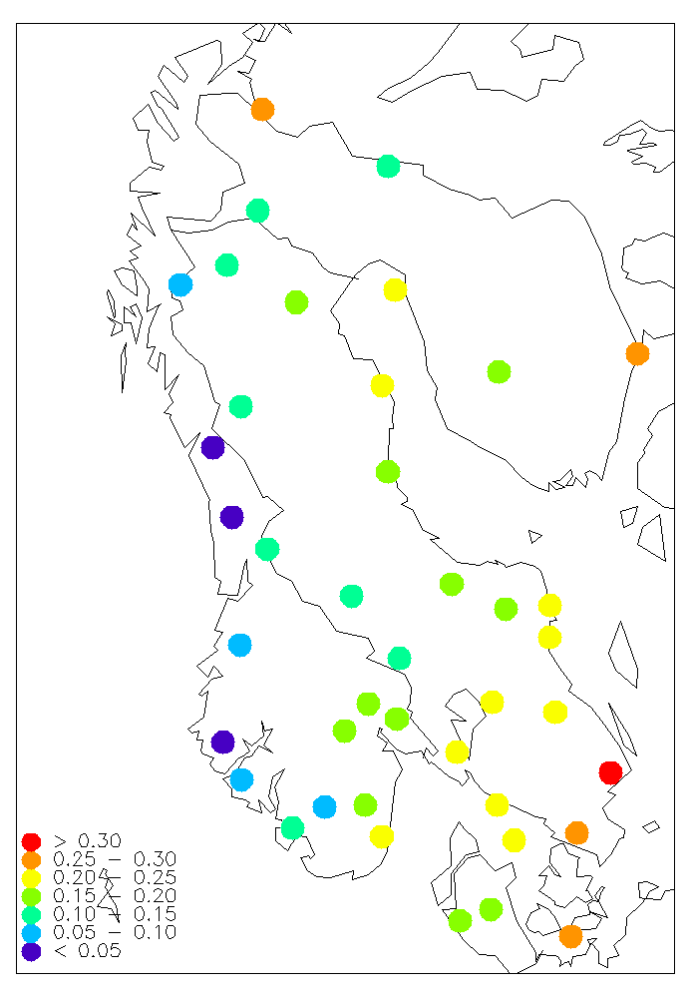
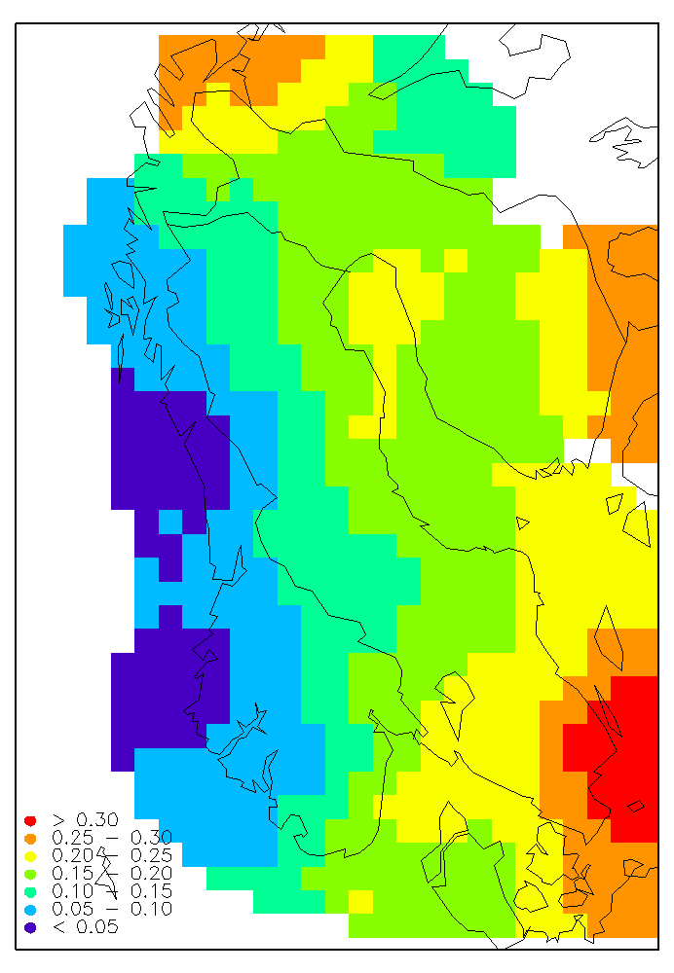
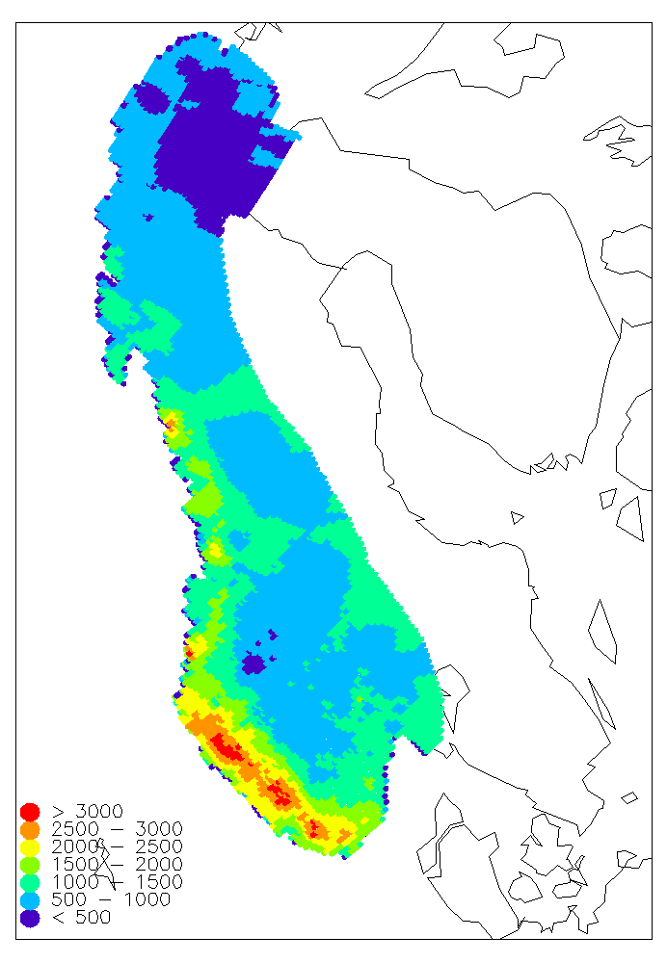
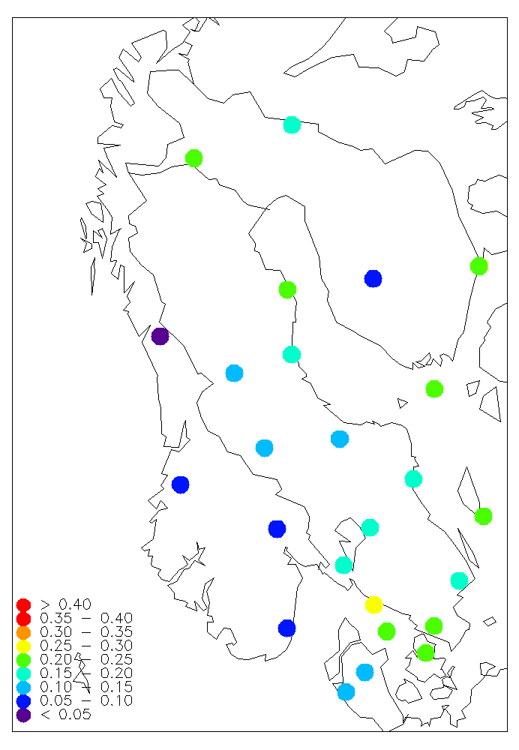
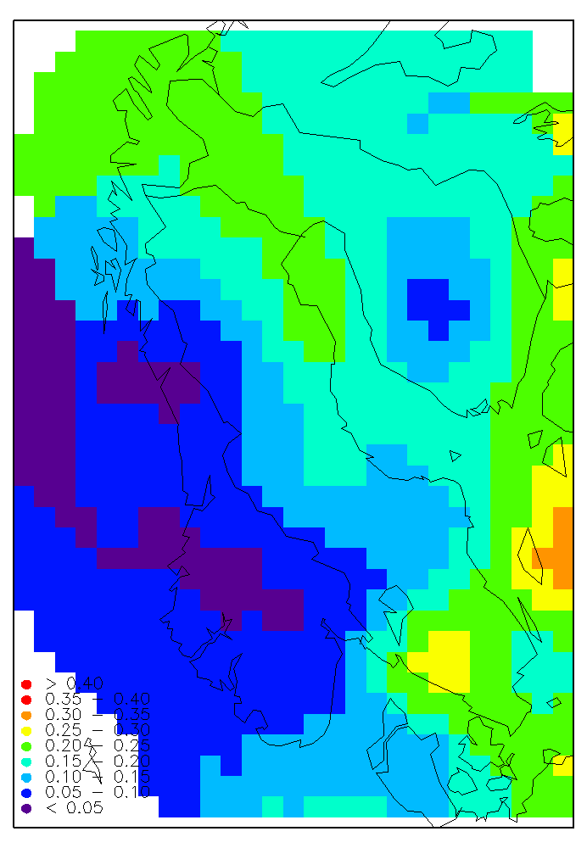
Calculation of deposition, old method (obs. based)
Annual concentration in precipitation
Kriged conc. fields, 50x50 km
Precip. amount from MET sites
Total wet deposition
Total deposition
(annual average for a 5 year period)
5 year averages of winter/summer air concentrations
Kriged conc. fields, 50x50 km
Total dry deposition
Dry deposition
rates from literature

Slide 5
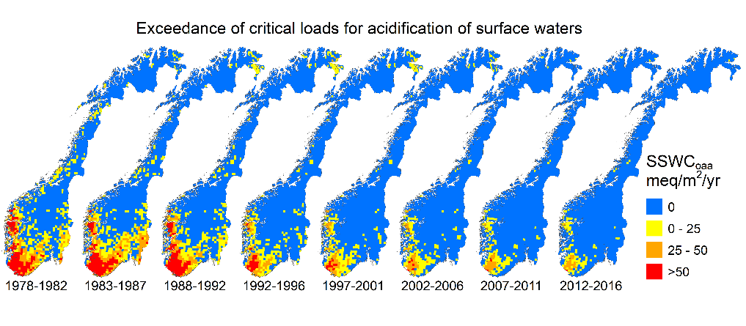
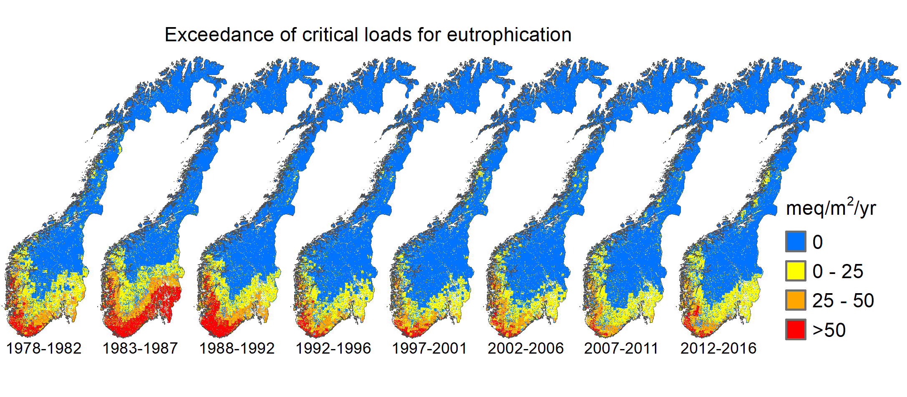
Consistent results from 1980 to 2015
Exceedances
Total ssc sulfur deposition
Total nitrogen deposition

Slide 6
Examples of operative Measurement model fusion (MMF)
Common key points:
MMF on concentrations and NOT deposition
A need for high spatial resolution of precipitation amount, using observations from regular meteorological measurements and radar (combined with models)
Dry deposition velocities from models with high resolution land surface information
In US, NADP Total Deposition (TDEP)
Combined observation of chemical composition in precipitation with precipitation amount from PRISM. CMAQ model combined with air data to develop bias adjusted air concentrations and using CAQ dry deposition velocities
Weekly gridded maps of total deposition at a 4km resolution
In Canada, ADAGIO
Using observations to adjust modelled concentrations from GEM-MACH using optimal interpolation techniques. Dry deposition velocities from model. Wet deposition fluxes are calculated using precipitation amounts CaPA
weekly values averaged on a seasonal basis at a 10km resolution
In Sweden, MATCH Sweden
Combining measurements and model (MATCH) using a 2-dim variational analysis (2dvar). Dry deposition velocities derived from model, and wet deposition using high resolution precipitation fields (model and observations).
monthly calculation on a 11km resolution

Slide 7
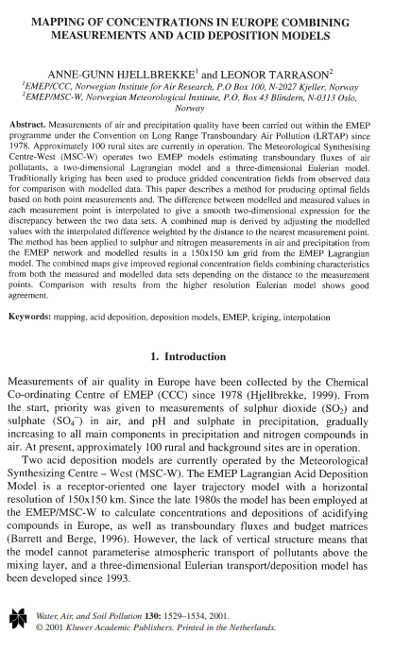
Combined method used in EMEP (2001-2011)
Calculate the difference between observations and model:
The differences are interpolated using a radial basis function:
New optimal maps are produced by adjusting the model calculations with interpolated differences. Close to the sites the measurements give larger weight than model.
Ex So4 in precipitation in 2010:

Slide 8
EMEP/MSC- W model used for MMF in Norway
0.1 degree x 0.1 degree, run for 5 years: 2012-2016
Emissions:
For 2015 and 2016 the emissions reported to EMEP for 2015 has been used
For 2012, 2013 and 2014 emissions has been scaled to the total country emissions reported to EMEP for the respective years. (due to a coarser resolution (50x50km²), in the reported the emissions )
For ship emissions, the FMI AIS data for 2016 has been used as basis. The 2015 ship emissions has been set equal to 2016, whilst the ship emissions for the Baltic Sea and the North Sea for the previous years have been scaled with 0.8 for SO_{x}
Volcanic emissions (mostly SO₂) from the Holuhraun eruption (August 2014 to the end of February 2015) has been implemented in the model runs.
The EMEP/MSC-W model has been used to generate the following output:
Air concentrations of SO₂, NO₂, NH₃, NH₄⁺, HNO₃, fine and coarse NO₃⁻
Dry deposition velocities of SO₂, NO₂, NH₃, NH₄⁺, HNO₃, fine and coarse NO₃⁻
Wet deposition of sulfur, reduced nitrogen and oxidized nitrogen
Dry deposition of sulfur, reduced nitrogen and oxidized nitrogen

Slide 9
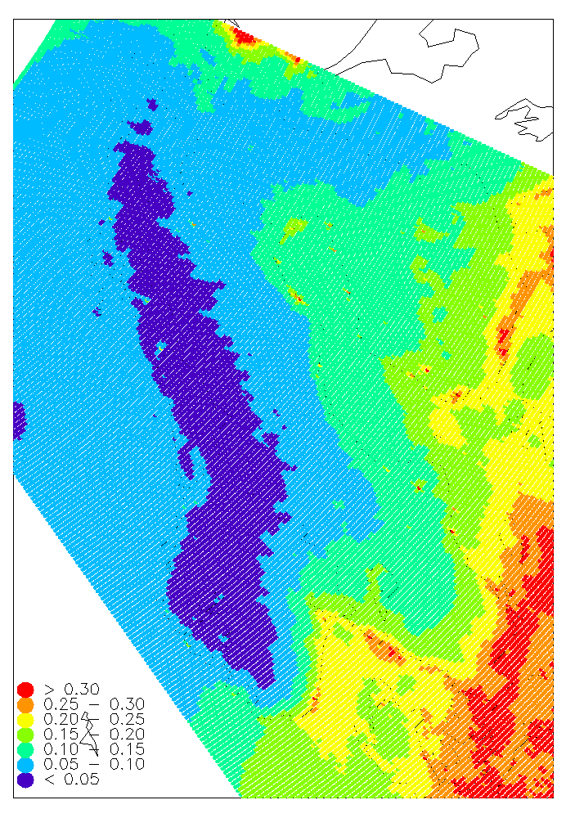
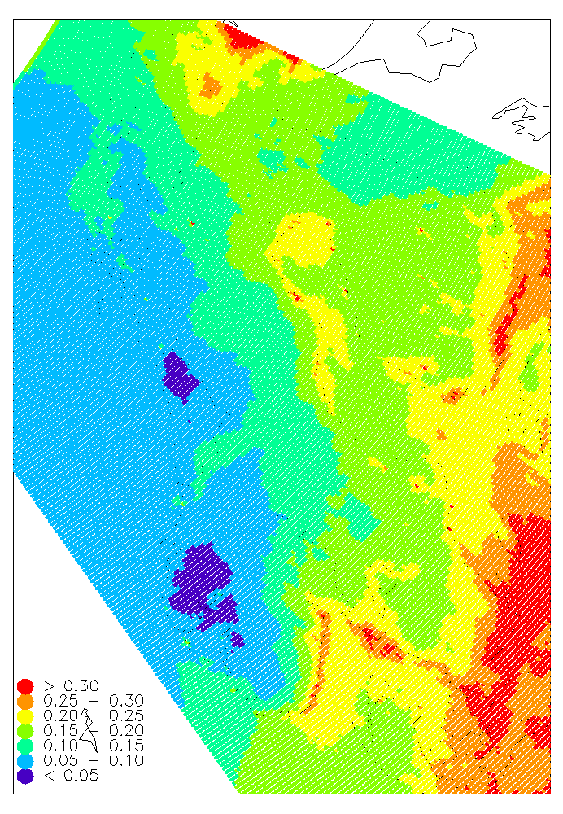
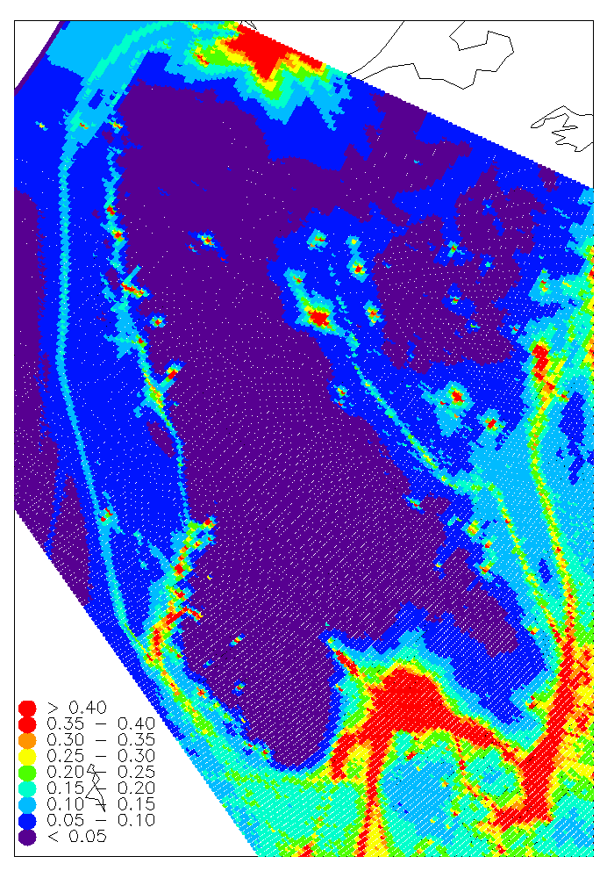
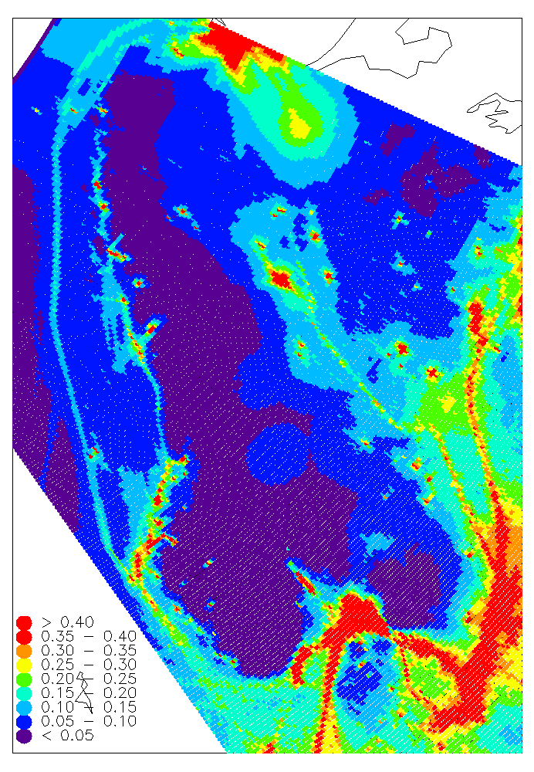
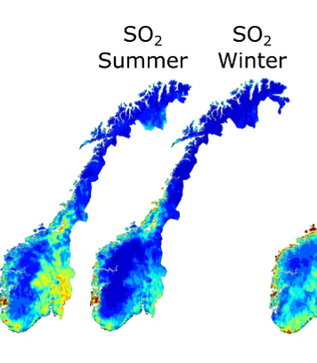
Calculation of deposition, MMF Norway (2012-2016)
EMEP model, 0.1^{O} x 0.1^{O}
concentration field
Corrected conc. field. Obs. influence radius 500km
Precip. amount from ca 500 MET sites, interpolated to 1km
concentration in precipitation
Total wet deposition
Total deposition
EMEP model, 0.1^{O} x 0.1^{O}
concentration field
Corrected conc. field. Obs. influence radius 500km
Seasonal dry deposition rates from EMEP model
concentration in air
Total dry deposition

Slide 10
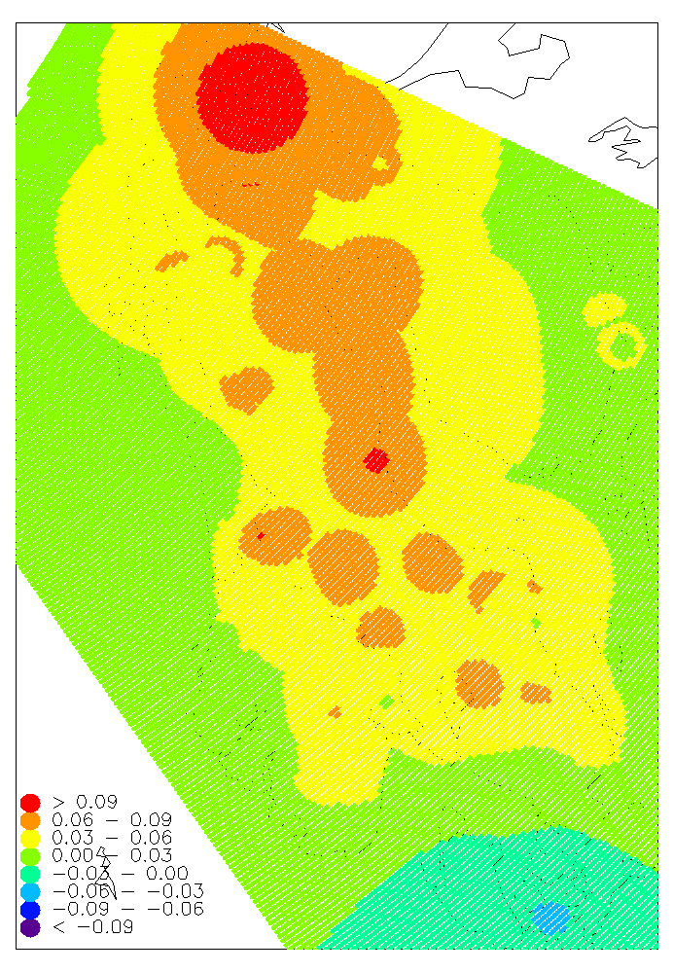
Example on wet deposition correction
Obs
EMEP
Difference radius 500km
Combined concentration
xSO4 wet dep,
mm

Slide 11
Comparing wet deposition
Observational method with statistical kriging
Combined MMF method

Slide 12
Dry deposition of sulfur
Observations
MMF SO2
Total dry dep comb
MMF SO4 aerosol
Total dry dep S
MMF suggest highest dry deposition of So2 compared to SO4
Larger deposition along the coastline

Slide 13
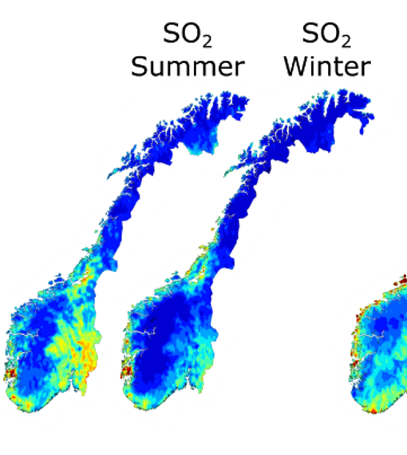
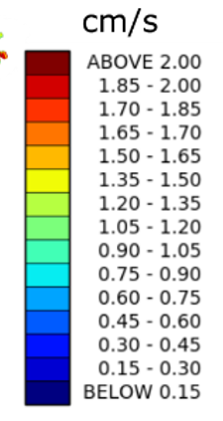
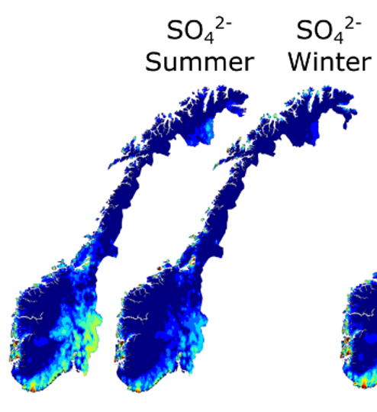
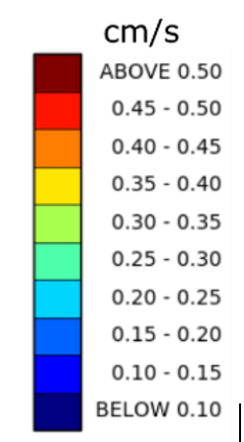
Differences in dry deposition velocities for sulfur
Vd used in obs. method
 | Forest |  | Other
 | summer | winter | summer | Winter
SO₂ | 0.8 | 0.1 | 0.4 | 0.02
SO₄²⁻ | 0.4 | 0.4 | 0.2 | 0.1
Large spatial differences
Differences in gas/aerosol

Slide 14
Total N dep.
2012-2016
Observations
Total N
dry dep
Total N
wet dep
Total N
dep
Note different scales
Total N dep.
2012-2016
Combined
MMF
Total N
dry dep
Total N
wet dep
Total N
dep

Slide 15
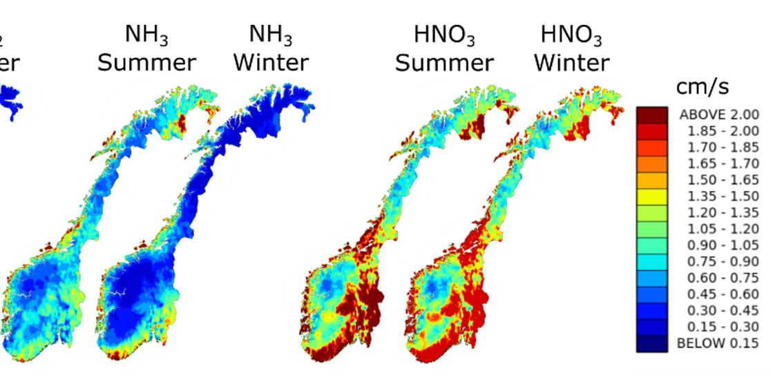
Differences in dry deposition velocities for N
 | Vd used in obs. method
 | Forest |  | Other
 | summer | winter | summer | Winter
NO₂ | 0.4 | 0.02 | 0.2 | 0.02
sum (NH₃+NH₄⁺) | 0.4 | 0.4 | 0.2 | 0.1
Sum (HNO₃+NO₃⁻) | 2.0 | 2.0 | 1.0 | 0.25

Slide 16
Differences between the methods (observational method – combined method)
Differences due to distribution of concentration fields
Observation method higher in SW, and lower in mountains and coast. Kriging distribute the concentration fields longer and probably biased compared to the EMEP model which assumes wash out of the air pollution faster
Differences due to emissions
Observational method give higher deposition in the Finnmark county but lower nitrogen depositions in the inland of eastern Norway,
In Finnmark there might be emissions in the region i.e. in Russia which is not included in the model.
High NH₃ emissions reported in East Norway, which is not found by the observational method.
Differences due to the dry deposition velocities
The combined method is giving a generally lower deposition for oxidised nitrogen than the observational method, but higher dry deposition of NH₃ along the coast in Northern Norway
Very different dry deposition rates used for nitrate.
High dry deposition of NH₃ in Northern Norway caused by the relatively high NH₃ observed at Tustervatn and Kårvatn combined with a high dry deposition velocity from the model

Slide 17
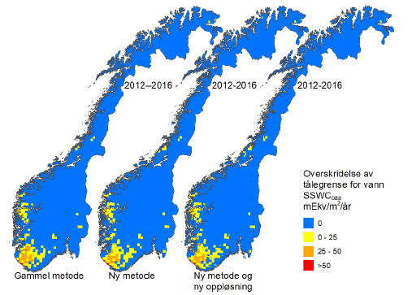
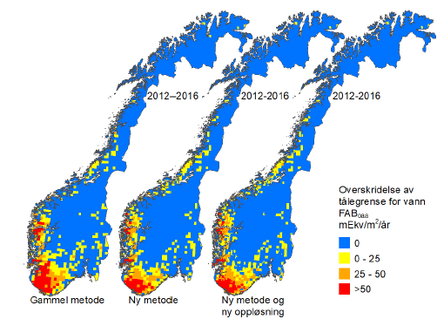
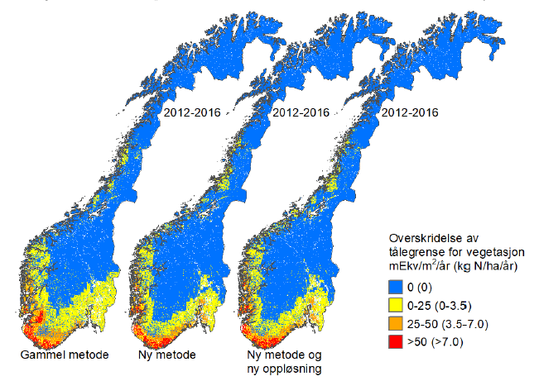
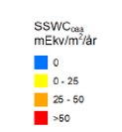
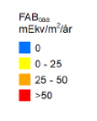
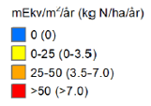
Effect on exceedance, 2012-2016
Acidification of surface water
Vegetation
Obs. based deposition
MMF method
Obs. based deposition
MMF method
Obs. based deposition
MMF method
Norwegian area exceeded
 | Obs. | MMF
SSWC_{oaa} | 7% | 7%
FAB_{oaa} | 20% | 19%
Norwegian area exceeded
 | Obs. | MMF
vegetation | 25 % | 20 %

Slide 18
Summary for the Norway case
the methods are comparable and resemble the same general pattern of deposition throughout the country with higher deposition closer to the main emission sources in Europe, but with some regional differences.
The combined method has improved the spatial information of the deposition pattern and for wet deposition it probably gives more realistic deposition than the old observation method.
For dry deposition there are quite large uncertainties in the estimated dry deposition velocities in both methods.
Further, there are also quite large uncertainties in the observations as well as the reported emissions of especially NH₃.
The methods give similar resukls regarding area of exceedences

Slide 19
Follow up on a European scale?
Should we explore MMF on a European case. If yes:
Explore which assimilation method more suitable for Europe than used in ex for Norway (i.e. not the simple gradient approach, but 2dvar used in MATCH Sweden, or 3 dvar)
Time resolution on observations. Original or aggregated?
Dry deposition velocities from models (ensemble or specific model?)
Critical to get high spatial distribution of precipitation measurements
Post processing for selected years (i..e 2010) and not NRT
Explore possibilities for higher resolutions in model and emissions (for part of Europe where this is possible)
To be discussed as input to the MMF activity in WMO/GAW (Oksana’s talk)

Slide 20
GAW Training course on total deposition
https://www.gawtec.de

