Slide 1
Climate change due to air quality regulation
Hans-Christen Hansson¹⁾, Annica Ekman³⁾ Srinath Krishnan³⁾, Anna Lewinschal³⁾, Maria Sand²⁾, Tanja Dallafior¹⁾, Terje Bentsen²⁾, Ilona Riipinen¹⁾
¹⁾ACES and Bolin Centre for Climate Research, Stockholm University, Sweden.
²⁾CICERO, Norway
³⁾Department of Meteorology and Bolin Centre for Climate Research, Stockholm University, Sweden.
Thanks to: Laura Wilcox, Reading University, UK.

Slide 2
Anthropogenic Climate Forcing 2011 - 1750
cooling
warming
Radiative Forcing
[Wm⁻²]
1.68
+2.62 Wm⁻²
1.01
0.35
-0.35
-0.8 Wm⁻²
-0.45
IPCC, 2013
Notes:
Since aerosols act as seeds for water droplets, i.e. cloud condensation nuclei, they are also rapidly scavenged by rain.
They typically have a residence time of a few days up to perhaps a few weeks in the atmosphere.
Their short residence time, large size range and complex composition are some of the reasons why they are so difficult to describe in models.
Another implication is that due to their short residence time, the climate effect form aerosols is also varying a lot in time. So even if we knew the value, it would probably not be the same year to year.

Slide 3
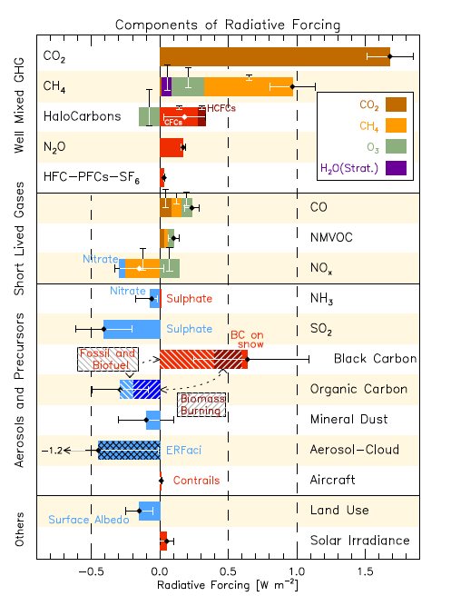
Present climate forcing by Air Pollutants

Slide 4
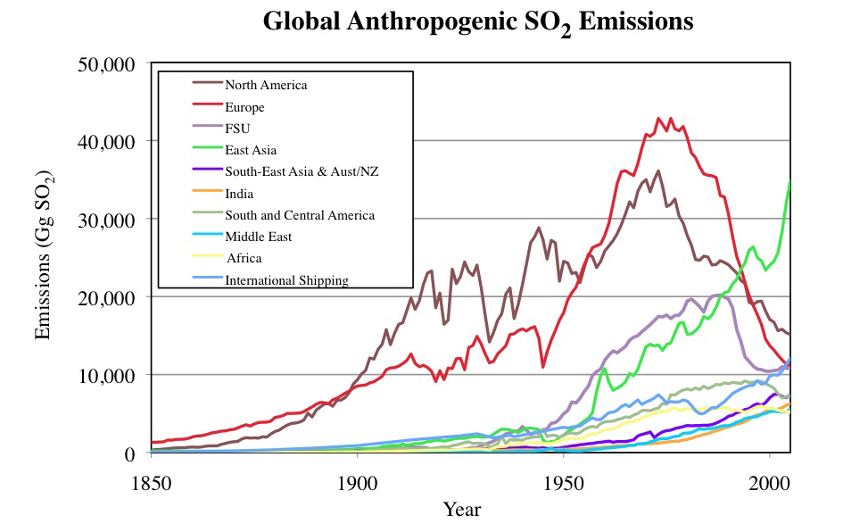
Rapid reduction of SO₂ emissions in North America and Europe since1980’s
CLRTAP
Europe
30% reduction agreement
N. America
S. Asia
E. Asia
Smith et al. (2013)
Notes:
A while ago, we did a study looking at the implications of the massive reduction in SO2 (and sulfate particle) emissions in Europe since the 1980’s
Convention on Long-Range Transboundary Air Pollution. Signed in 1979. And enforced in 1983. 70% drop in Europe until 2005. Partly due to the collapse of the Soviet Union. More than 30 % drop over the US.
Tremendous success. From air pollution and health perspective.
But how did these changes affect climate?
While the sulfur emissions went up and down the same time CO2 emissions steadily increased.
Did the sulfur emission reductions enhance European warming? Or even global warming?
We used an earth system model called NorESM to study this, I will talk more about the model in a little bit.

Slide 5
Rapid reduction of SO₂ emissions in North America and Europe since1980’s
CLRTAP
Europe
30% reduction agreement
N. America
S. Asia
E. Asia
Smith et al. (2013)
Notes:
A while ago, we did a study looking at the implications of the massive reduction in SO2 (and sulfate particle) emissions in Europe since the 1980’s
70% drop in Europe. Partly due to convention of long-range transport air pollution. Partly due to the collapse of the Soviet Union.
Tremendous success. From air pollution and health perspective.
But how did these changes affect climate?
While the sulfur emissions went up and down the same time CO2 emissions steadily increased.
Did the sulfur emission reductions enhance European warming? Or even global warming?
We used an earth system model called NorESM to study this, I will talk more about the model in a little bit.

Slide 6


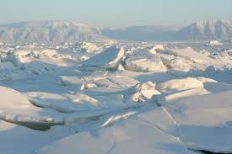

Norwegian Earth System Model (NorESM)
CAM4-Oslo
Atm. Chemistry and Physics
1.9°X 2.5°
26 levels in vertical
CLM4-CN
snicar: snow albedo
CPL 7 Coupler
MICOM
~ 1° along the equator
gx1v6
CICE4
sea-ice albedo
Bentsen et al., 2013; Iversen et al., 2013; Kirkevåg et al., 2013
Aerosol module:
Five aerosol compounds: sea salt, black carbon (BC), organic matter (OM), sulfate and mineral dust
Aerosols can be both internally and externally mixed.
Chemical and physical processing (i.e. the size distribution) of the aerosol population is described using 44 size bins.
Aerosols are simulated online, i.e. they interact with radiation, meteorology etc.
Both direct and indirect (cloud albedo and lifetime) aerosol effects are simulated.
Notes:
In order to look at this issue, we conducted a number of simulations with the Earth System Model NorESM.
The atmospheric component of NorESM is based NCAR-CAM4. But with modified, quite sophisticated, aerosol cloud interaction parameterizations.

Slide 7
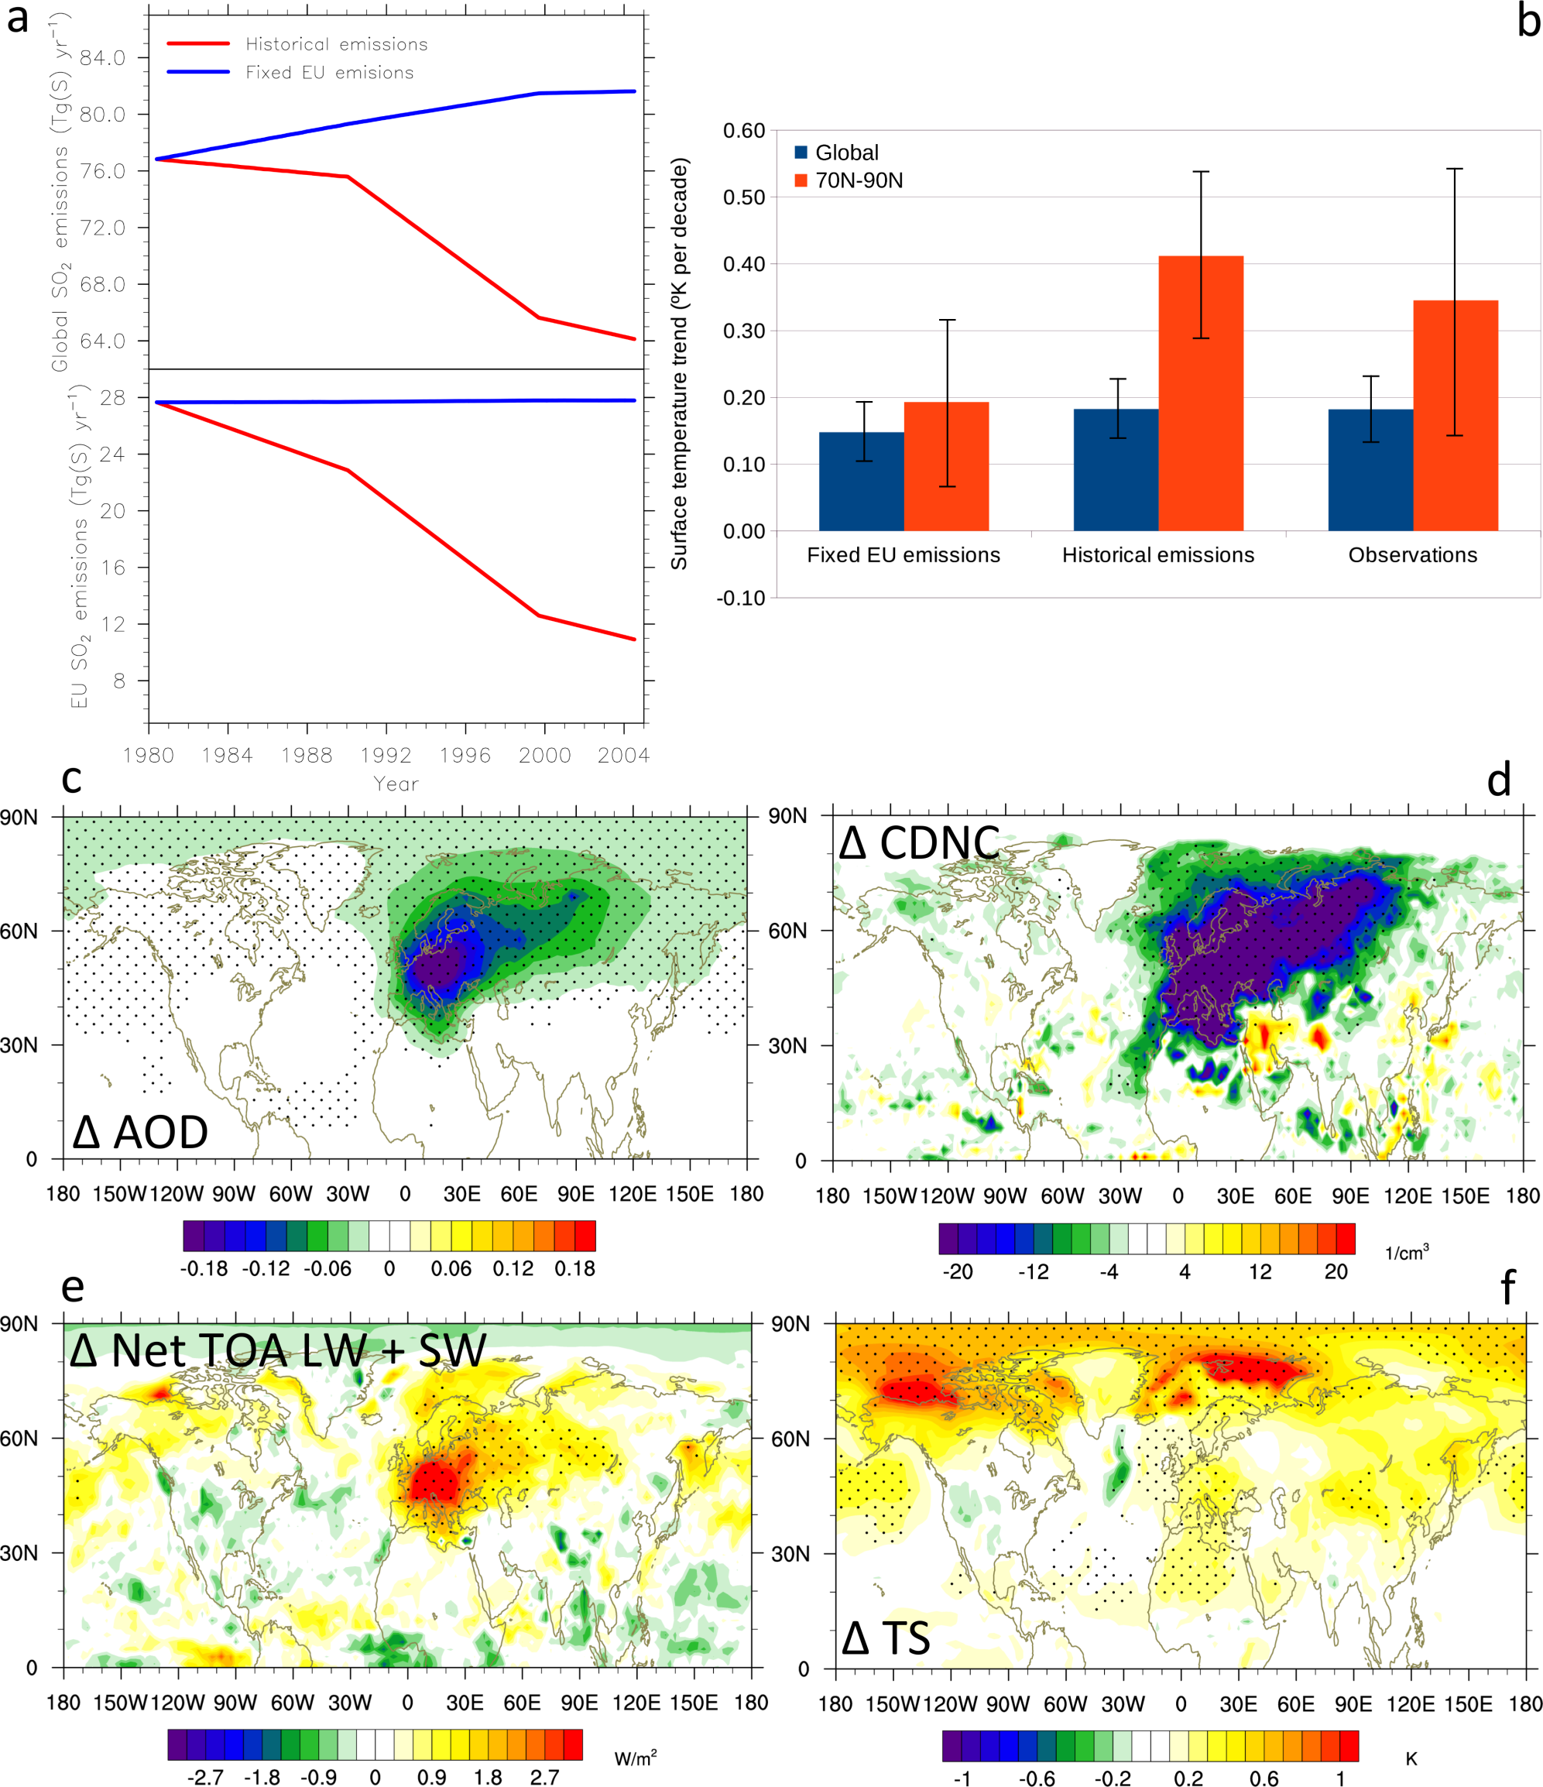
Effect of reduced European SO₂ emissions
SO₂ emissions
[Tg(S) yr⁻¹]
Aerosol optical depth
Historical
Fixed EU
80
Cloud droplet number concentration
72
World
64
1980
1988
1996
2004
[cm⁻³]
Year
Dotted areas indicate significance
at 95% level (student’s t-test)
Acosta Navarro et al. (2016)
Notes:
For Europe, in the Historical simulation, emissions decreased rapidly during this time period
This also influenced strongly the global average emissions that decreased with about 17%.
If we fix the European emissions at the 1980’s level, the SO2 emissions increase slightly with time from 1980 to 2005
This influences the AOD strongly, it decreases with about -0.2 ove rEurope, and also the cloud droplet number concentration (at lowest model level 981hPa) decreases strongly.

Slide 8
Effect of reduced European SO₂ emissions
Top of the atmosphere
net radiation change
Surface temperature change
[Wm⁻²]
[K]
Dotted areas indicate significance at 95% level (student’s t-test)
 | Europe (35N-70N) | Arctic (70N-90N)
TOA Radiation change [Wm⁻²] | 1.19 | 0.26
Surface temperature change [K] | 0.13 | 0.54
Acosta Navarro et al. (2016). See also Shindell and Faluvegi (2009); Yang et al. (2014); Westervelt et al. (2015); Gagné et al. (2015)
Notes:
Note that the temperature response is only due to the changes in SO2 emissions – it’s not the actual simulated temperature change in the Arctic.
The temperature response does not follow the radiation change.
If we look at it in numbers it is quite clear. The main reason is not transport of aerosols and a local radiative effect.
The main reason is that the extra input of energy over Europe, the extra heat, is transported from the region towards the Arctic.
Once in the Arctic, the signal gets amplified just as it is for GHG forcing.
The effective radiative forcing is .24 - 0.54 = +0.70 W/m2 for the Arctic and 1.92 - 0.22 = +1.7 W/m2 for Europe.
For fixed SSTs, the TOA net radiation is slightly positive in the Arctic.

Slide 9
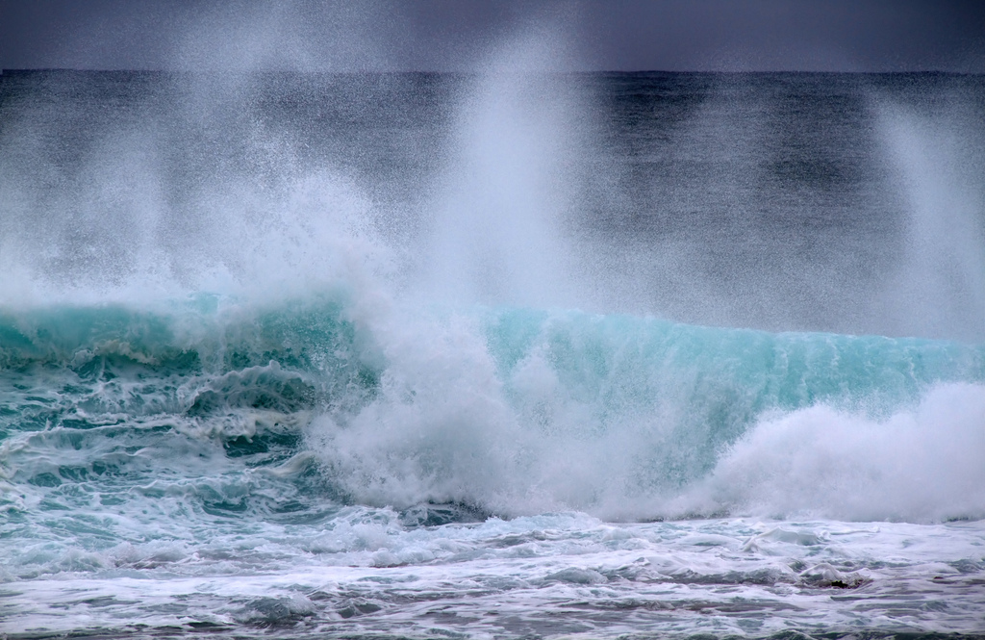
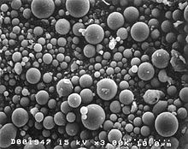
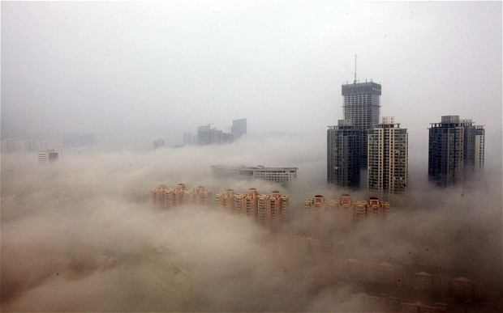

Questions
Does the emission region and magnitude matter?
Is the response different for other types of aerosol than sulfate?
What drives the enhanced Arctic warming induced by European aerosol reductions? Is it the ocean or the atmosphere?

Slide 10
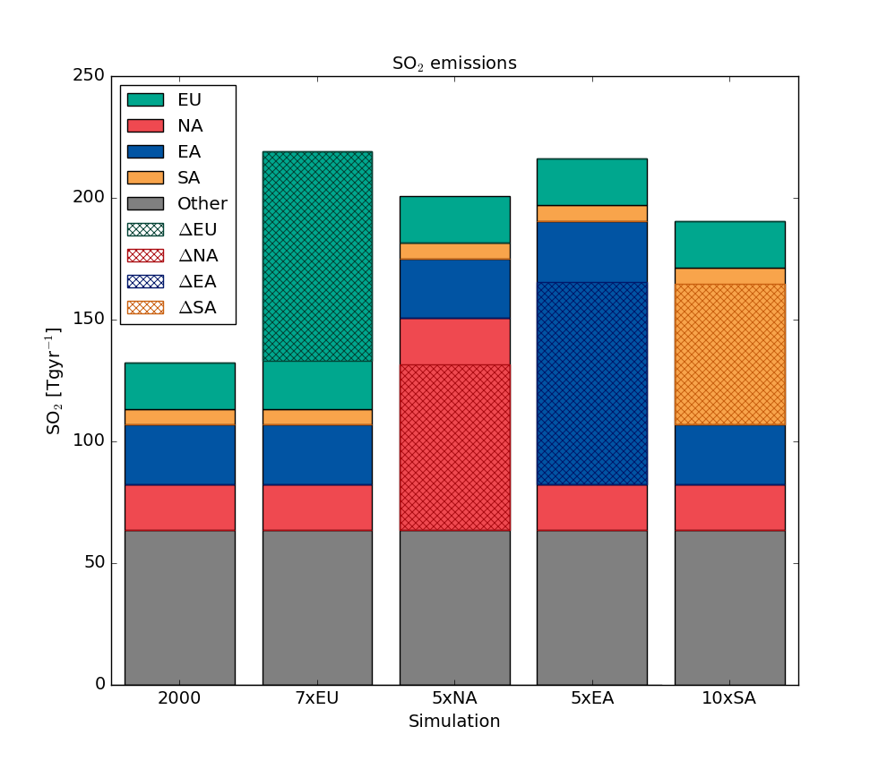
Does the emission region matter?
Emission regions (HTAP v2)
SO₂ emissions [Tg yr⁻¹]
250
200
150
100
50
0
2000
7×EU
5×NA
5×EA
10×SA
Emission changes normalized to give approximately the same radiative forcing
Lewinschal et al. (2019)
Notes:
Similar change in global average temperature distribution irrespective of region
Radiative forcing is about -0.5Wm-2 in all simulations
However, the actual magnitude of the T response per S emission, seems to be model dependent.
See also Weum-Stjern 2016

Slide 11
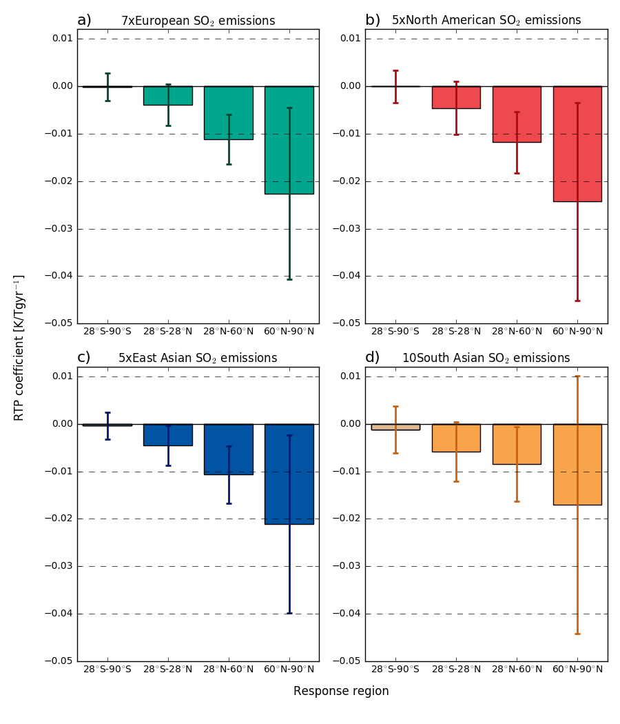
0.01
0.01
European emissions
North American emissions
0.00
0.00
-0.01
-0.01
-0.02
SH
-0.02
-0.03
Tropics
Mid-
latitudes
-0.03
-0.04
-0.04
Arctic
-0.05
-0.05
Temperature change per unit emission
[ºC / TgS year⁻¹]
90ºS-20ºS
20ºS-20ºN
20ºN-60ºN
60ºN-90ºN
90ºS-20ºS
20ºS-20ºN
20ºN-60ºN
60ºN-90ºN
0.01
East Asian emissions
0.01
South Asian emissions
0.00
0.00
-0.01
-0.01
-0.02
-0.02
-0.03
-0.03
-0.04
-0.04
-0.05
-0.05
90ºS-20ºS
20ºS-20ºN
20ºN-60ºN
60ºN-90ºN
90ºS-20ºS
20ºS-20ºN
20ºN-60ºN
60ºN-90ºN
Lewinschal et al. (2019)
See also e.g. Shindell and Faluvegi (2009); Shindell (2012); Weum-Stjern et al. (2016)
Notes:
Similar change in global average temperature distribution irrespective of region
The response in the Arctic is lower for South Asian emissions.
However, the actual magnitude of the T response per S emission, seems to be model dependent.
See also Weum-Stjern 2016

Slide 12
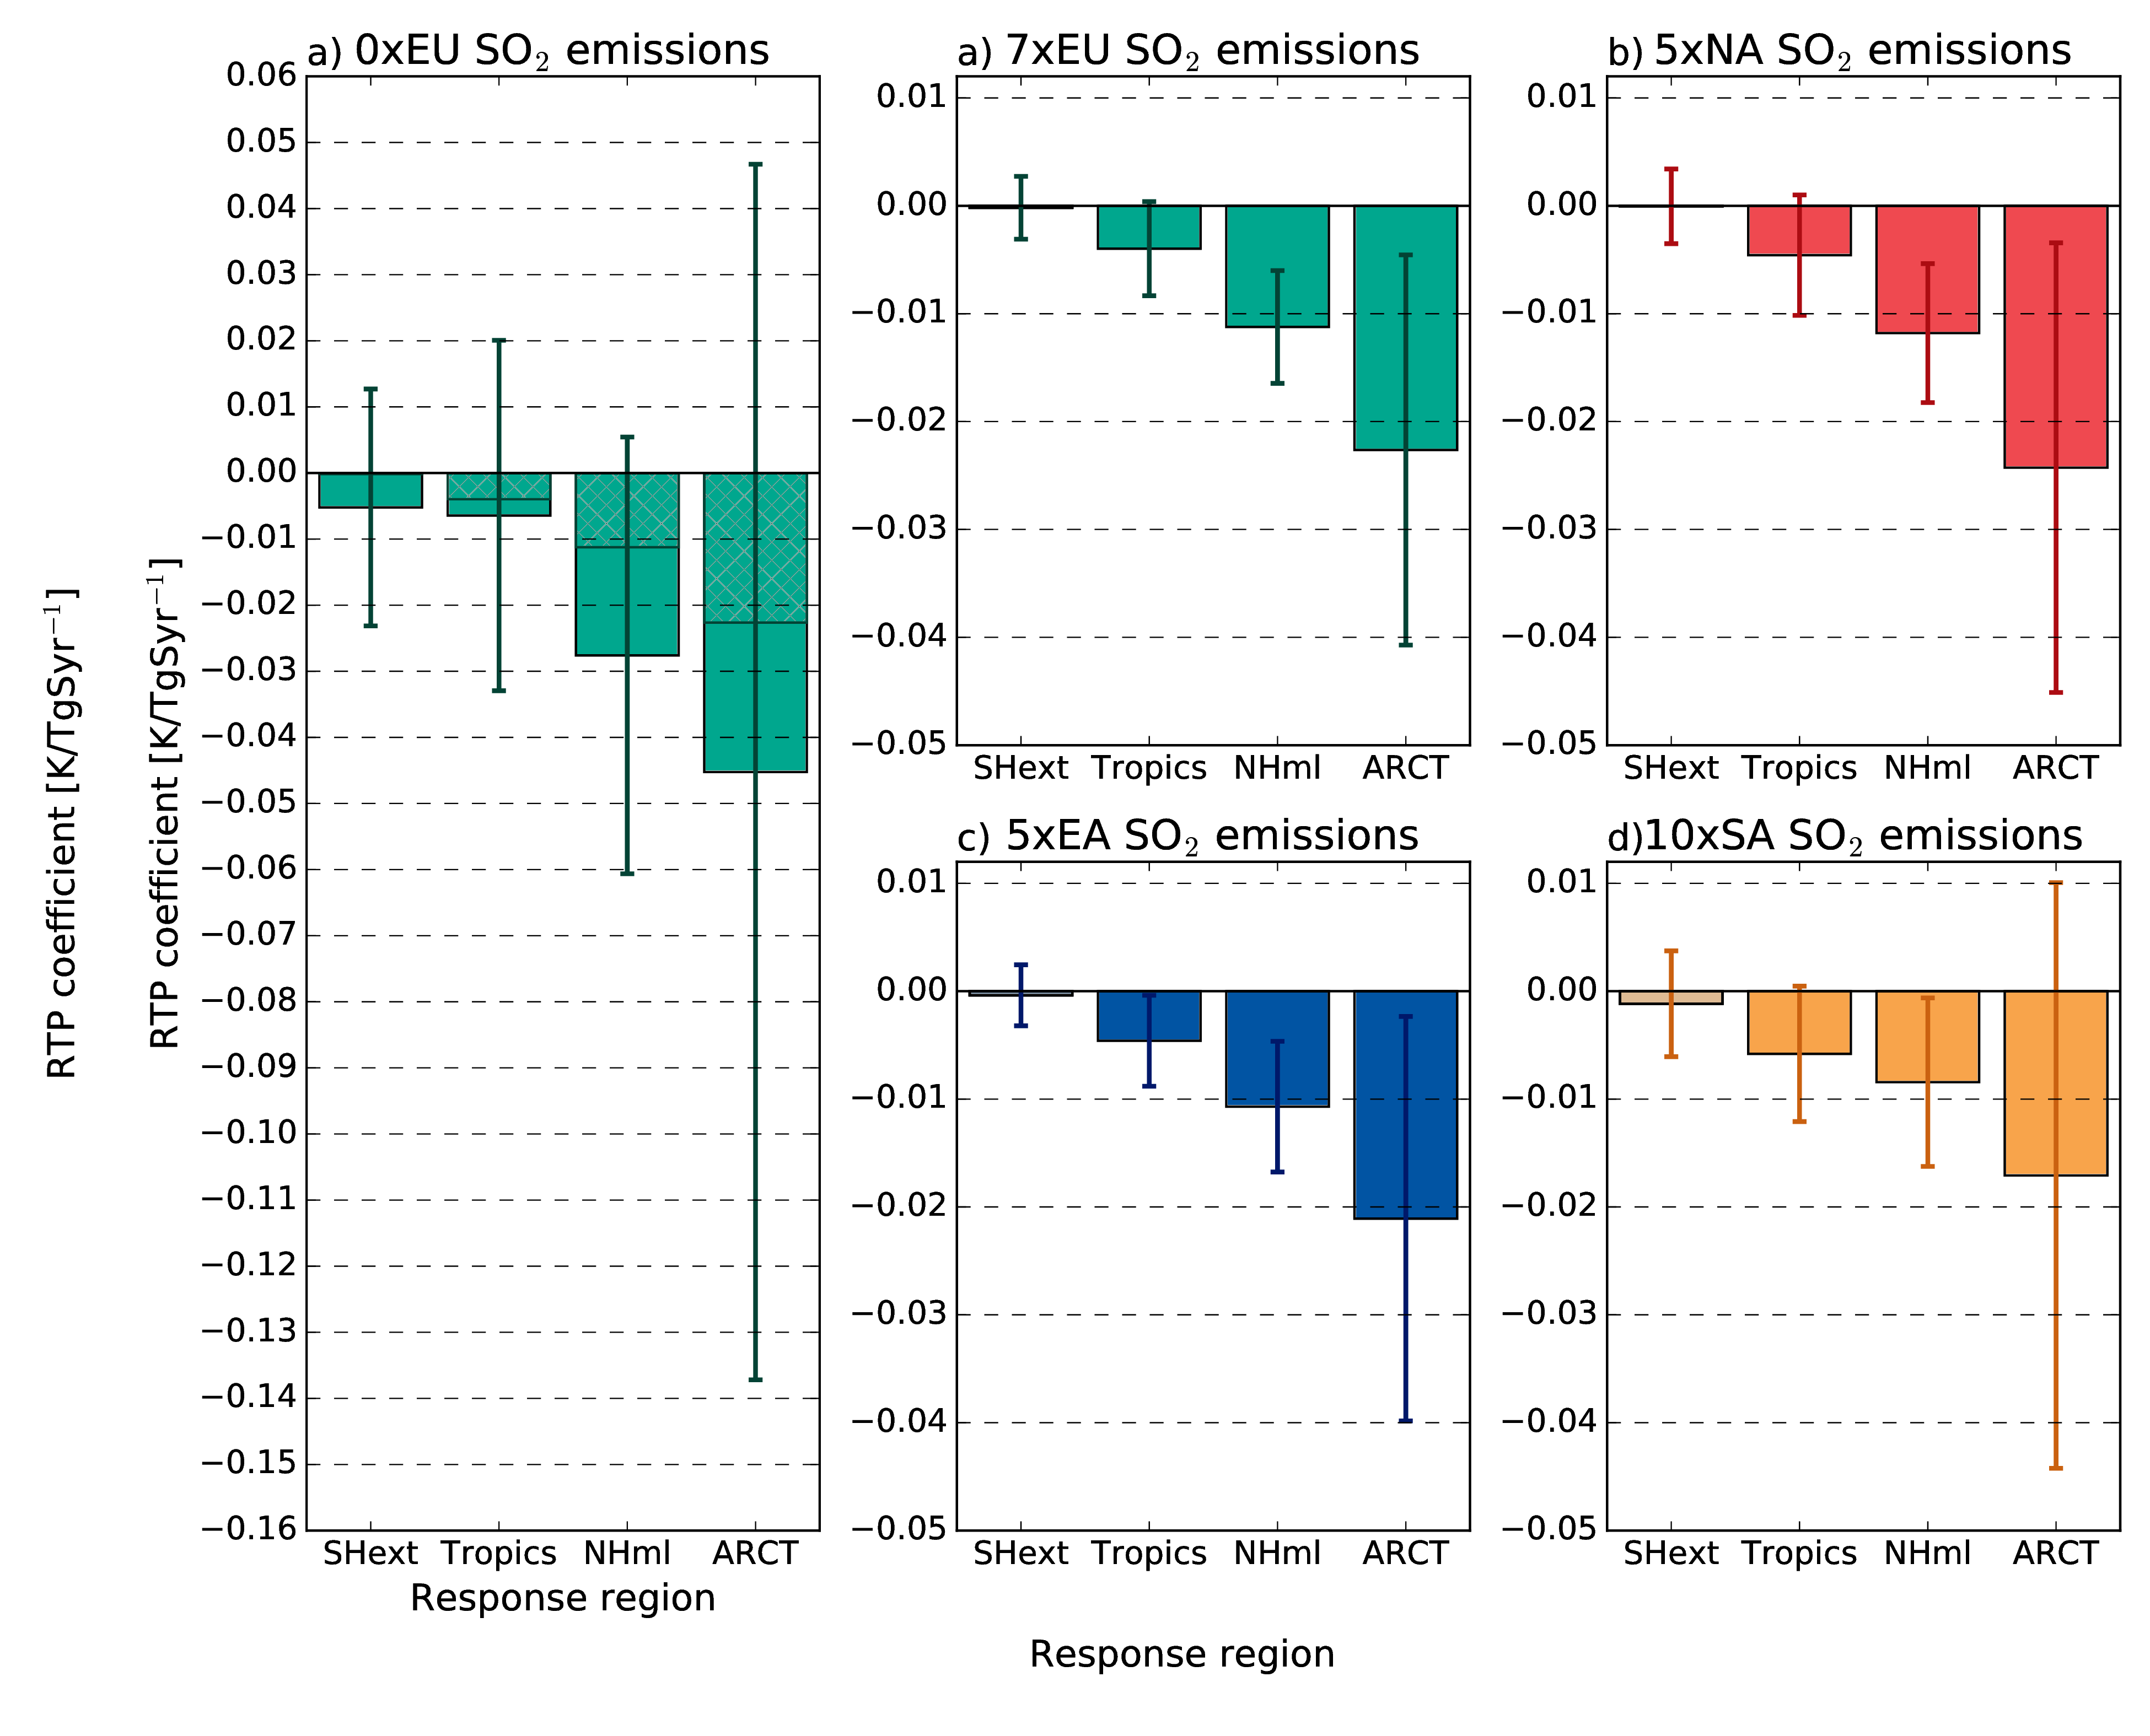
Does the emission magnitude matter?
7x EU emissions
Temperature change per unit emission
[ºC / TgS year⁻¹]
Lewinschal et al. (2019)

Slide 13
Similar Results In Three Different Earth System Models
HadGEM3-GC2
NorESM1-M
CLE – MFTR scenario (2015-2050)
GFDL-CM3
Dotted areas indicate significance at < 10% level (student’s t-test)
Wilcox et al., in prep.
Notes:
Dots are where changes are NOT statistically significant at 10% LEVEL

Slide 14
The indirect effect is saturated at higher aerosol burden in the three Earth System Models
Effective cloud droplet radius depends on the aerosol burden
Optical depth
Wilcox et al., in prep.
Notes:
Dots are where changes are NOT statistically significant at 10% LEVEL

Slide 15
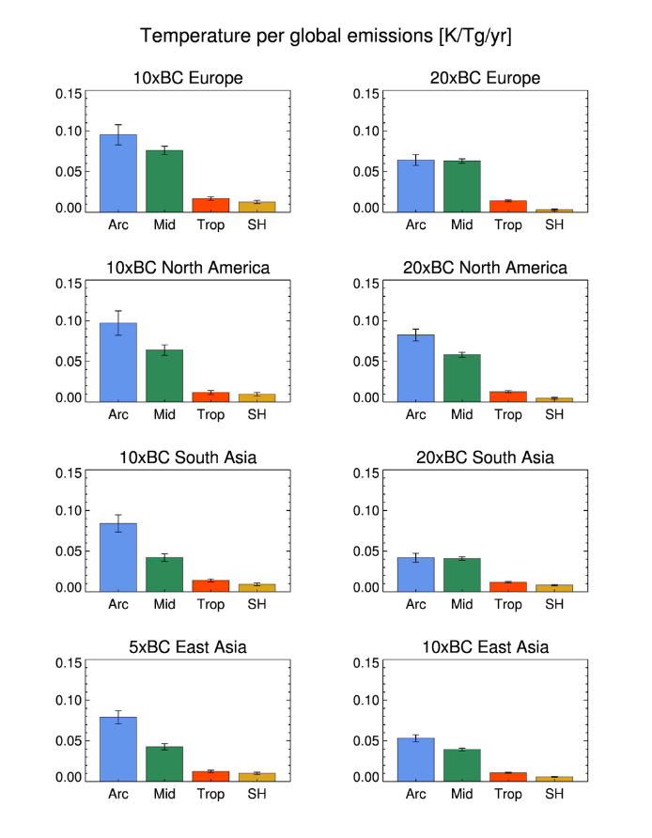
Is the response different for BC?
Temperature change per unit emission
[ºC / TgS or BC year⁻¹]
Sand et al., in prep.

Slide 16
Temperature change per unit emission
(simulations using NorESM)
Effect of SO₂
Effect of BC
Climate neutral emission mix is possible!!
1 ton reduction of sulfur can be climate compensated by a 250 kg BC reduction.
[ºC / TgS year⁻¹]
[ºC / TgBC year⁻¹]
Lewinschal et al. (2019)
Sand et al., in prep.
Notes:
Reference year is 2000
Simulations are equilibrium simulations for 160-200 years.
Each subplot is for a certain emission region (i.e. top left is when changes are done within the European domain)
Y-axis shows temperature response
X-axis shows response region (Arctic, Mid-latitudes, tropics, southern hemisphere)
The temperature response is always the largest in the Arctic
It doesn’t matter where the emission changes are done. Slightly weaker response for South Asian emissions
Temperature response for BC is ~5 times temperature response for SO2.

Slide 17
Questions and Answers
Does the emission region and magnitude matter?
  Region do not really matter but magnitude do.
Is the response different for other types of aerosol than sulfate?
  Yes! This opens possibility for climate neutral air quality regulation.
What drives the enhanced Arctic warming induced by European aerosol reductions? Is it the ocean or the atmosphere?
  The answer is in the wind.

Slide 18

Thanks for listening!

Slide 21
Heat convergence; increased into the Arctic

Slide 22
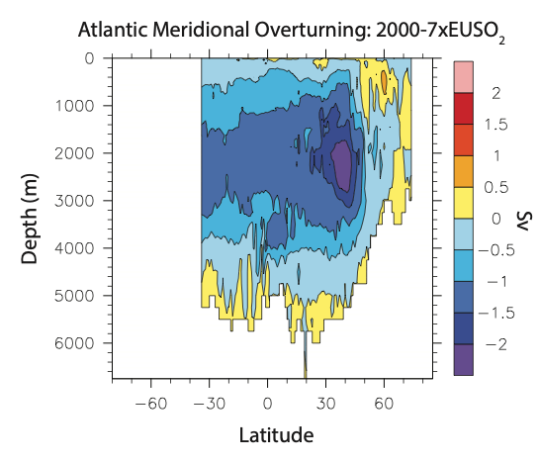
Aerosol-ocean circulation changes: the heat goes deep
Krishna et al., unpulished

Slide 23
Difference in mean sea level pressure between periods 1993–2003 and 2004–2014, for
winter months December- January-February and
Summer months June–July-August from ERA-interim reanalyses
Maturilli and Kayser, 2017

Slide 24
The monthly temperature change over the period 1993 to 2014 for each 50 m altitude level, retrieved from the linear regression of the monthly mean temperature profiles.
Statistical significance is given where the regression uncertainty is smaller than the regression coefficient, a condition met only in January and February (marked by dashed black line)
Maturilli and Kayser, 2017

Slide 27
Conclusions
The amplified warming in the Arctic induced by sulfur aerosol reductions is initiated and driven by atmospheric heat transport while the ocean acts to dampen the warming.
The exchange of heat between the ocean and atmosphere largely determines the pattern of temperature response.
In the slab ocean model, the exchange of heat is correlated to the fraction of sea ice. In the fully coupled model, there is no correlation between the fraction of sea ice and heat fluxes.
Amplified Arctic warming induced by reduced sulfur emissions over Europe (as well as other regions) is robust but non-linear.
Sulfur and BC aerosols give similar pattern of temperature response, but the warming efficiency is ~5x stronger for BC.

Slide 28
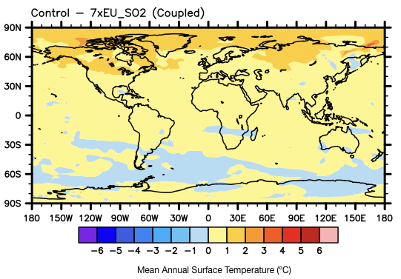
Effect of reduced SO₂ emissions (7×SO₂ vs. 2000)
SO₂ emissions [Tg yr⁻¹]
250
200
150
100
50
Temperature change: -0.0056ºC/TgS year⁻¹
0
2000
7×EU
See also Lewinschal et al. (2019)
Notes:
Corresponds to a radiative forcing of -0.45Wm-2
All other forcing agents (GHGs, ozone,…) are set to values corresponding to year 2000
Ran the model, with the same forcing conditions for 160 years, and analyzed the last 110 years.

Slide 29
Isolating the effect from the atmosphere and ocean:
Simulations with simplified “slab” ocean model
Atmospheric GCM
Slab ocean
Interactive fluxes
Prescribed fluxes

Slide 30
Slab ocean simulations
Simulation name | Atmosphere | Ocean
Control | 2000 Sulfate emissions | 2000 Ocean heat fluxes
Perturbed Atmosphere | 7×EU Sulfate emissions | 2000 Ocean heat fluxes
Perturbed Ocean | 2000 Sulfate emissions | 7×EU Sulfate Ocean heat fluxes
Perturbed Atmosphere + Ocean | 7×EU Sulfate emissions | 7×EU Sulfate Ocean heat fluxes
Krishnan et al., in prep.
Notes:
The simulations were 80 years, and the last 60 years were used for analysis.

Slide 31
Change in surface temperature
(control vs. sensitivity experiment)
Fully Coupled
Perturbed Atmosphere
Perturbed Ocean
Perturbed Atmosphere + Ocean
Dotted areas indicate significance at < 5% level (student’s t-test)
[ºC]
Krishnan et al., in prep.
Notes:
Pertrubed atmosphere+ocean: change the atmospheric aerosol concentration according to the year 2000 (it gets warmer) and the ocean fluxes according to our year 2000 simulation (horizontal transport as in a warmer climate).
What is the main difference between fully coupled and slab atm+ocean? The ocean model. NorESM ocean model tends to dampen the warming.
Pertrubed atmosphere: warmer atmosphere, but ocean fluxes according to “reference/cold simulation”. Stronger warming than in the pert. Atm+ocean.
Perturbed ocean: reference atmosphere, but ocean fluxes according to “warm simulation”. Shows that the ocean model tends to dampen the warming induced by the aerosol changes.
-> indicates that warming is driven by the atmosphere.

Slide 32
Change in sea ice fraction
(control vs. sensitivity experiment)
Fully Coupled
Perturbed Atmosphere
Perturbed Ocean
Perturbed Atmosphere + Ocean
Dotted areas indicate significance at <5% level (student’s t-test)
[%]
Krishnan et al., in prep.
Notes:
visually: seems to be a good correlation between change in sea ice fraction and largest temperature changes.
If this is true, we would also expect to see a good correlation between surface temperature changes and horizontal heat convergence

Slide 33
Change in temperature and heat convergence
(control vs. sensitivity experiment)
Perturbed Atmosphere
Perturbed Ocean
Perturbed Atmosphere + Ocean
Temperature
[ºC]
Horizontal heat convergence
[Wm⁻²]
Krishnan et al., in prep.
Notes:
What is then driving the changes in the horizontal heat convergence?

Slide 34
Change in horizontal heat convergence
(Perturbed atmosphere + ocean vs. control)
Horizontal Heat Convergence
=
Radiative Fluxes
+
Turbulent Fluxes
+
Heat transport
Heat Fluxes [Wm⁻²]
Krishnan et al., in prep.

Slide 35
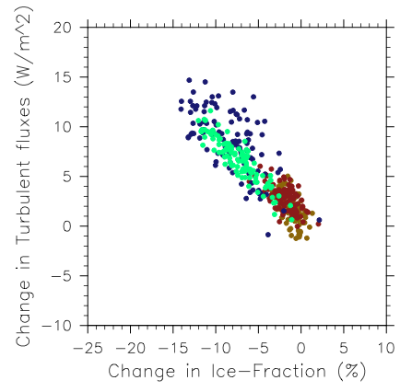
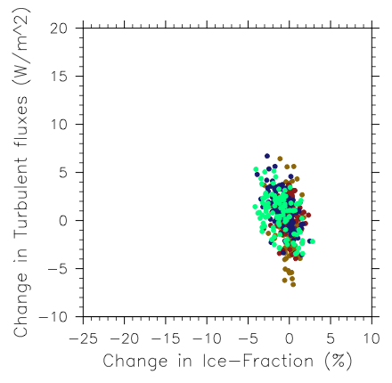
Change in turbulent fluxes and sea ice
(control vs. sensitivity experiment)
Slab ocean model
Fully coupled ocean model
Summer
Fall
Spring
Winter
R²_{annual}=0.55
R²_{annual}=-0.02
Krishnan et al., in prep.
Notes:
R2 for perturbed atmosphere + ocean is 0.38

Slide 36
Change in sea ice fraction
Slab ocean
Fully Coupled
[%]
Krishnan et al., in prep.

Slide 37
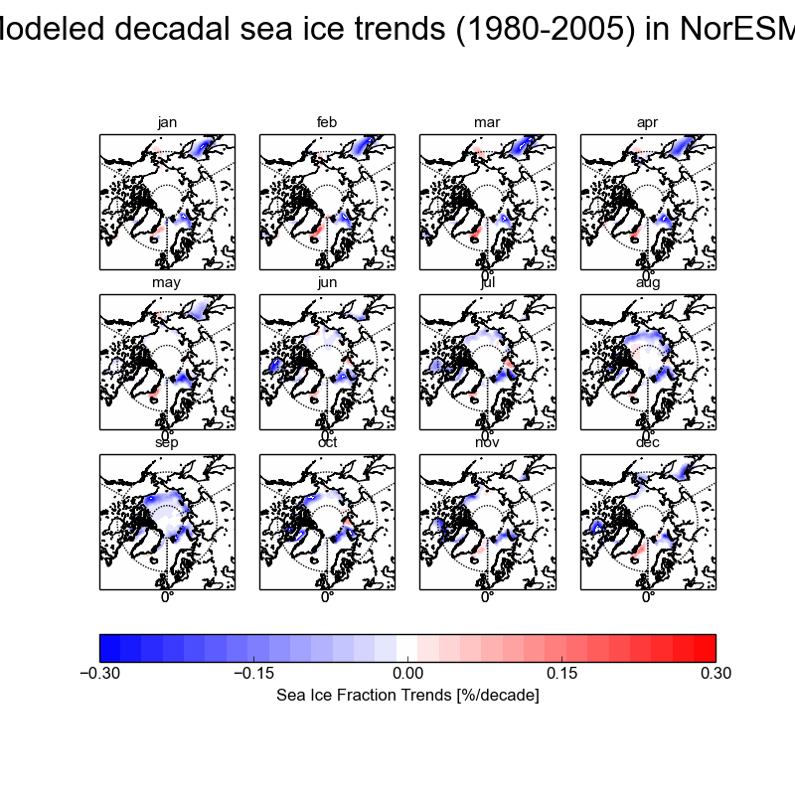
Modeled and Observed Decadal Sea Ice Trends
May
June
July
August
September
October
NorESM (1980 - 2005)
-0.3
-0.15
0
0.15
0.3 % per decade
OSI-SAF (1982-2015)
Observational Analysis of OSI-SAF courtesy of Abhay Devasthale, SMHI
Dallafior et al., in prep.

Slide 38
Fully coupled ocean vs. Slab ocean
Horizontal Heat Convergence
=
Radiative Fluxes
+
Turbulent Fluxes
+
Heat transport
Slab ocean
Fully Coupled
[Wm⁻²]
Krishnan et al., in prep.
Notes:
Heat convergence is mostly governed by turbulent fluxes but modulated by radiative fluxes and heat transport
With a fully coupled ocean, the tturbulent fluxes are smaller and dominate less.
They are not well correlated with sea ice fraction.

Slide 39
Norwegian Earth System Model (NorESM)
CAM4-Oslo
Atm. Chemistry and Physics
1.9°X 2.5°
26 levels in vertical
CLM4-CN
snicar: snow albedo
CPL 7 Coupler
MICOM
~ 1° along the equator
gx1v6
CICE4
sea-ice albedo
Bentsen et al., 2013; Iversen et al., 2013; Kirkevåg et al., 2013
Aerosol module:
Five aerosol compounds: sea salt, black carbon (BC), organic matter (OM), sulfate and mineral dust
Aerosols can be both internally and externally mixed.
Chemical and physical processing (i.e. the size distribution) of the aerosol population is described using 44 size bins.
Aerosols are simulated online, i.e. they interact with radiation, meteorology etc.
Both direct and indirect (cloud albedo and lifetime) aerosol effects are simulated.
Notes:
In order to look at this issue, we conducted a number of simulations with the Earth System Model NorESM.
The atmospheric component of NorESM is based NCAR-CAM4. But with modified, quite sophisticated, aerosol cloud interaction parameterizations.

Slide 40
Is the regional response different for BC?
Temperature change per unit emission
[ºC / Tg BC year⁻¹]
Sand et al., in prep.

Slide 41
Effect of reduced European SO₂ emissions
Top of the atmosphere
net radiation change
[Wm⁻²]
Dotted areas indicate significance at 95% level (student’s t-test)
Acosta Navarro et al. (2016). See also Shindell and Faluvegi (2009); Yang et al. (2014);
Westervelt et al. (2015); Gagné et al. (2015)
Notes:
Note that the temperature response is only due to the changes in SO2 emissions – it’s not the actual simulated temperature change in the Arctic.
The temperature response does not follow the radiation change.
If we look at it in numbers it is quite clear. The main reason is not transport of aerosols and a local radiative effect.
The main reason is that the extra input of energy over Europe, the extra heat, is transported from the region towards the Arctic.
Once in the Arctic, the signal gets amplified just as it is for GHG forcing.
The effective radiative forcing is .24 - 0.54 = +0.70 W/m2 for the Arctic and 1.92 - 0.22 = +1.7 W/m2 for Europe.
For fixed SSTs, the TOA net radiation is slightly positive in the Arctic.

