Slide 1
An Introduction to GHOST.
Dene Bowdalo
09/05/2019
TFMM, Madrid

Slide 2
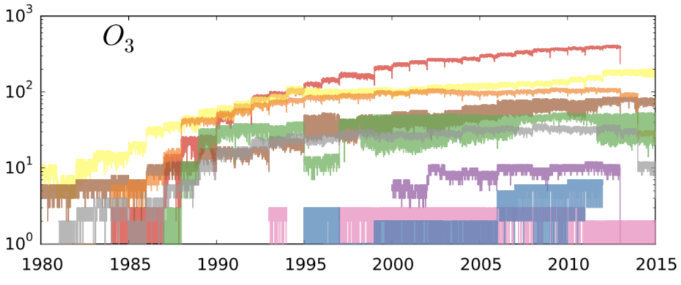
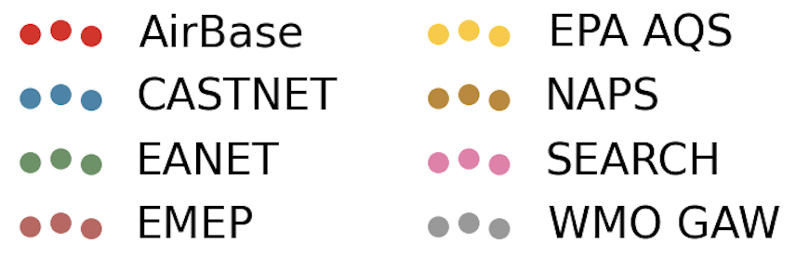
More and more available measurements
With time, more and more observations from different reporting networks are becoming available to the atmospheric chemistry community.

Slide 3
“You say tomato, I say tomato!”
However, with each new network typically comes a new format of data/metadata to parse. Variable names, units, number of metadata fields, etc. may all be radically different between networks.
Conjunctive use of this data with any standard analysis tool is problematic as it requires the tool to have the flexibility to handle the multiple different data/metadata formats.
A standardised processed output is required to solve this issue, but the plethora of different format options typically limits the detail of this standardised output.

Slide 4
GHOST: Globally Harmonised Observational Surface Treatment
A project dedicated to the harmonisation of global surface observations and metadata, for the purpose of facilitating a greater quality of observational/model comparison in the atmospheric chemistry community.
GHOST provides a framework for the harmonisation of an exhaustive number of data/metadata fields that may provide some use to scientists when using the observations in analyses.
Notes:
Data = information that is variable per measurement
Metadata = information that holds for a large swath of measurements.

Slide 5
GHOST Scope
Time Period: 1970 – Present Day
Currently available network data: EMEP, EEA AQ (EIONET)
Data available soon: AirBase, CAPMoN, CASTNET, EANET, EPA AQS, NAPS, SEARCH, WMO GAW
> 5 billion processed observations
> 150 available parameters

Slide 6
GHOST Pipeline
8 stages taking data from specific network:parameter pair from raw network files to fully standardised monthly chunked netCDFs.
Each stage is a fully parallelised standalone python module (using MPI4PY).
Primary parsing stages (P) : 6 stages that take data from raw network files to fully standardised data by station.
Temporal gridding stages (T): 2 stages that temporally grid data onto desired resolution (H, D, M), and write it out to monthly chunked netCDFs.

Slide 7
P1: Primary Parsing Stage
P1:
Parse each raw measurement file for network:species pair
All different temporal resolution data is parsed.
All data/metadata fields are mapped to standard fields (approx. 200 standard fields).
Units (data + metadata) are converted on the fly to standard variable units.
All relevant measurement process information, network flags and station classification information is ingested and returned with completely standard output.
Duplicate/overlapping times are resolved.
Data file is saved into station group (where station is defined as station reference + standard measurement method).

Slide 8
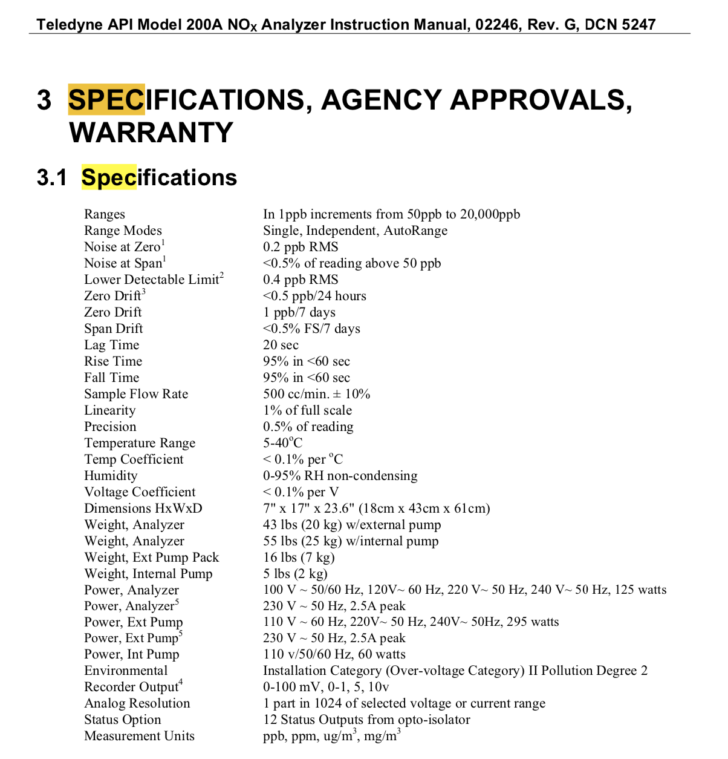
A typical Measuremental Instrument Manual…

Slide 9
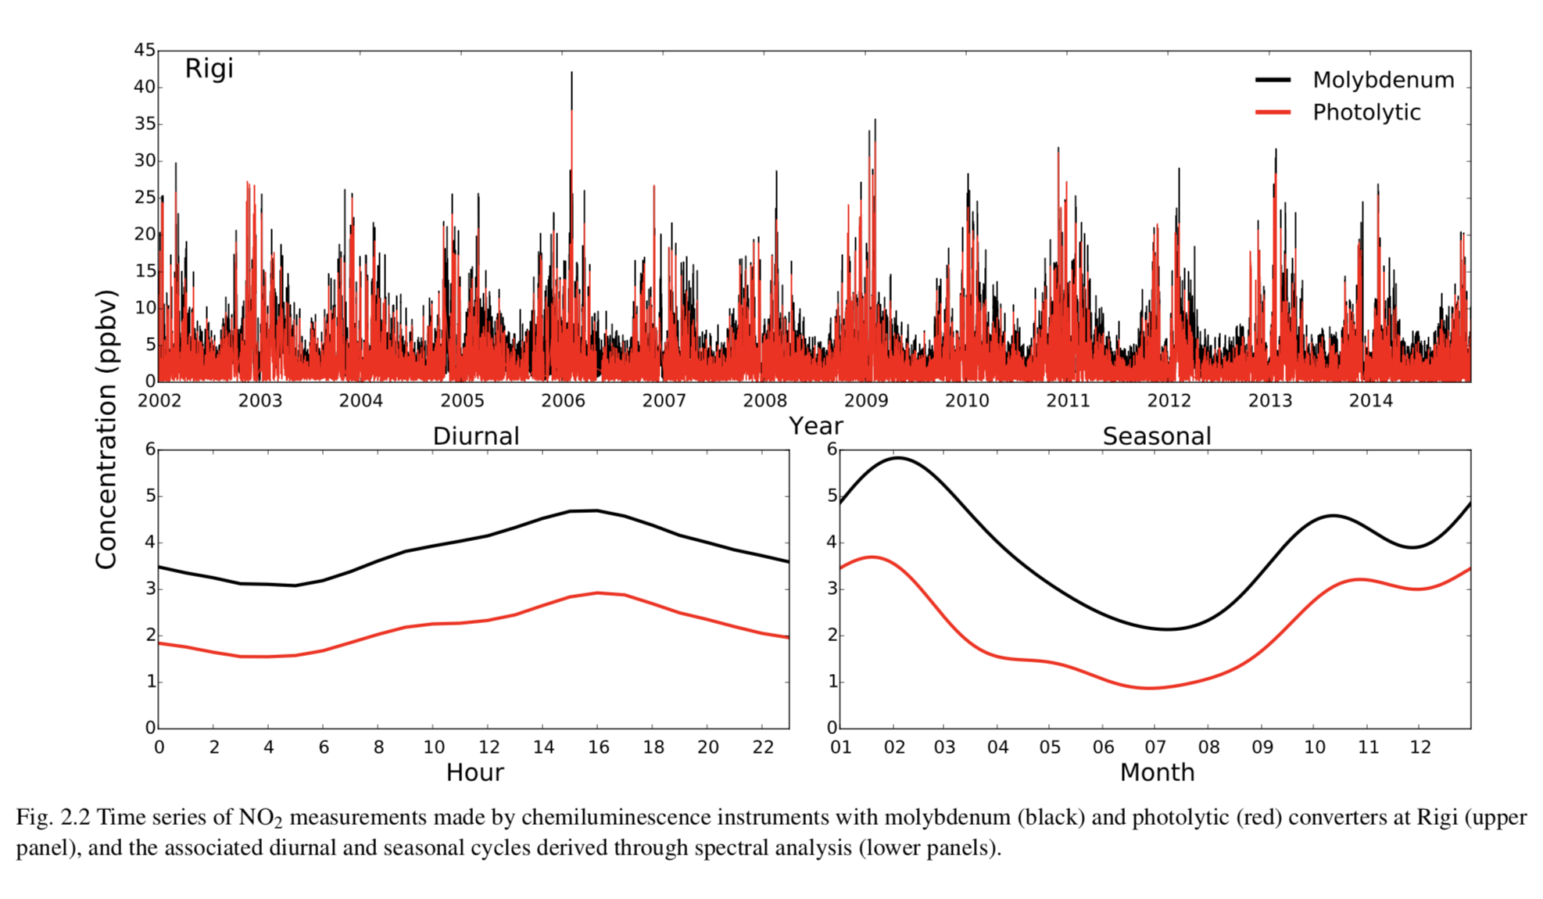
NO₂ Measurement Bias – Chemiluminescence (internal Molybdenum converter)

Slide 10
P2: Primary Parsing Stage
P2:
Concatenate all parsed files by station.
Duplicate/overlapping file data is handled using algorithm (prioritising consistent metadata through record).
Metadata is handled dynamically (i.e. allowed to vary with time).

Slide 11
P2: Primary Parsing Stage
Instrument:T300
Resolution: H
Spurious Gaps
Instrument:T200
Resolution: Variable
No Gaps
Instrument:T195
Resolution: H
No Gaps
Instrument:T300
Resolution: D
No Gaps
2015
2016
Annual Single Station Data Reporting for NO₂
Notes:
All duplicate periods resolved taking into account s

Slide 12
P3: Primary Parsing Stage
P3:
Measurement position is evaluated through time to see if moves significantly (>=11m, horizontally or vertically).
Horizontal position = Latitude + Longitude coordinates
Vertical position = Altitude + Sampling Height (where available)
If have significant movement, station data is split out.

Slide 13
P4: Primary Parsing Stage
P4
Multiple globally gridded products are processed to provide additional metadata sources per station.
Products include:
-- GSFC coastline proximity
-- GPW population density
-- ETOPO1 altitude
-- MODIS MCD12C1 v6 IGBP land use
-- NOAA-DMSP-OLS v4 average nighttime stable lights
-- Koppen-Geiger WorldClim Classifications
-- UMBC modal anthrome classification
-- ESDAC modal Iwahashi landform classification
-- and many more!
Notes:
Advantage of metadata being globally consistent

Slide 14
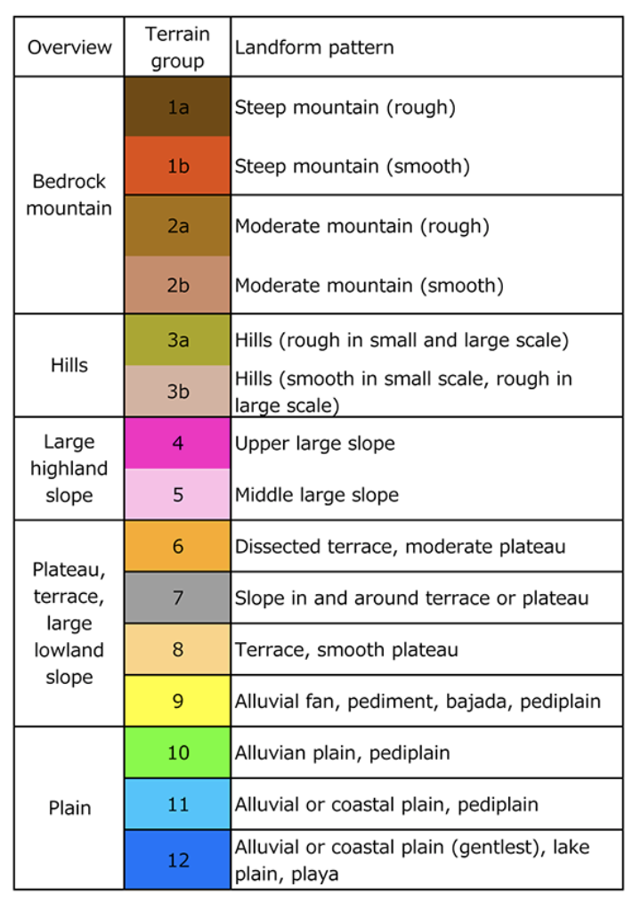
P4: Primary Parsing Stage
European Soil Data Centre (ESDAC) Iwahashi landform classification (0.01 x 0.01 degrees.)
Notes:
Advantage of metadata being globally consistent

Slide 15
P4: Primary Parsing Stage
NOAA DMSP-OLS version 4 nighttime stable lights (0.0083 x 0.0083 degrees).
Given as a brightness index ranging from 0 to 63.
Notes:
Advantage of metadata being globally consistent

Slide 16
P5: Primary Parsing Stage
P5:
Multiple quality control checks are performed.
Any data of suspicion is flagged using the QA flags field, which varies per measurement. Approx. 120 unique flags.
Quality Control checks include:
-- basic checks (negative measurements, zero/infinity
measurements)
-- violation of detection limits check
-- recurring values check
-- coarse measurement resolution checks (using
reported/documented metadata + empirical)
-- extreme data checks (fixed limits per species +
adjusted boxplot screening + manually flagged)
-- non-integer timezone checks
-- and many more!

Slide 17
P6: Primary Parsing Stage
P6:
Data is classified in several ways based on standardised station metadata.
These classifications are saved per measurement using classification flags (i.e. allowing classifications to change with time). Approx. 40 unique flags.
Classifications include: high altitude (absolute measurement altitude) high altitude (terrain determined), near coast, urban representative (station metadata derived), urban representative (global metadata derived) etc.
network:species station files are finalised and written.

Slide 18
T: Temporal Gridding Stages
T1:
Station data is temporally gridded onto desired resolution (H, D, M), and saved in monthly chunks.
QA flags informing on temporal representation of data across different measurement windows (H, D, W, M, A), are wrote out in this process.
T2:
Temporally gridded monthly chunked station data is grouped together by month, and written to netCDF.
Metadata fields are set as the modal occurring values across the written month.

Slide 19
Dissemination
Data Access
Complicated!
Spatial/temporally gridded options being considered.
Publications
2 papers currently being written for submission to Earth System Science Data (ESSD)

Slide 20
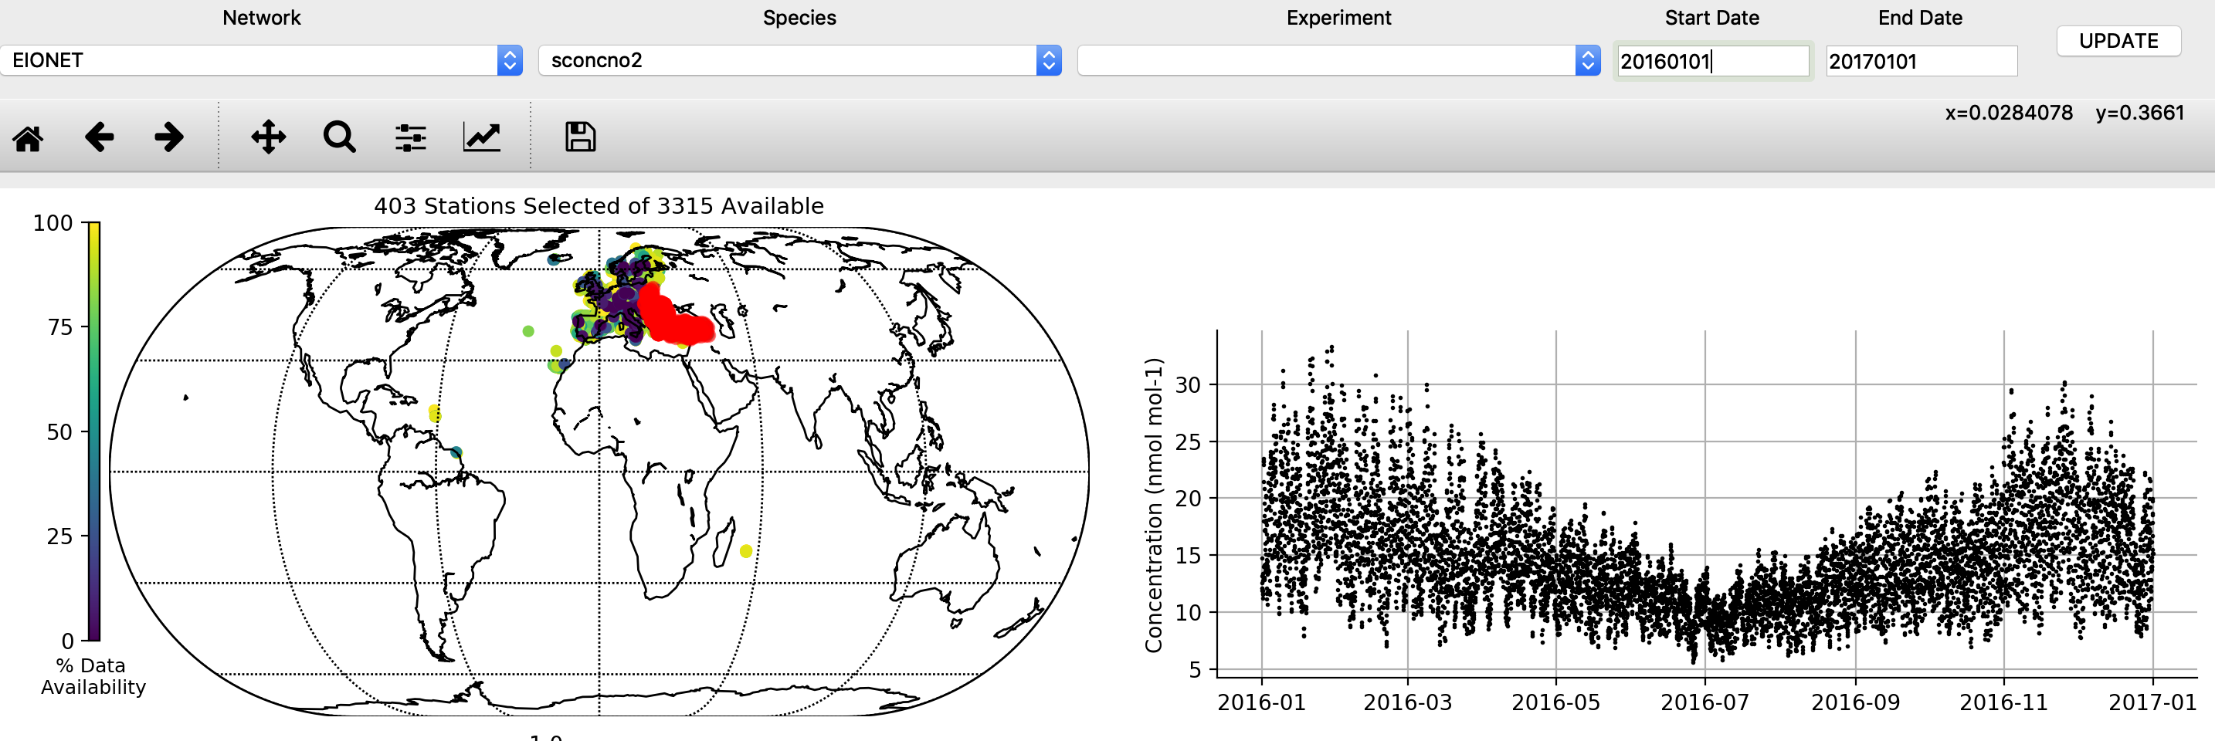
Interactive Tool

Slide 21
Conclusions
GHOST provides a detailed framework for the standardisation of atmospheric chemistry observations.
GHOST is one of the first efforts (to our knowledge) to attempt to standardise measurement process and classification information cross-network.
Great care needs to be taken in our evaluation efforts to ensure the observations that we use are fit for purpose.
The output QC/classification flags, allow enormous flexibility in the screening of data by the end user, based on their specific needs and wants.
Data will soon be available to the community!

Slide 22
Thank you
dene.bowdalo@bsc.es

