Slide 1

Recent developments in screening and monitoring of airborne contaminants of emerging concern
Martin Schlabach, Wenche Aas, Pernilla Bohlin-Nizzetto, Kjetil Tørseth
NILU-Norwegian Institute for Air Research, Norway

Slide 2
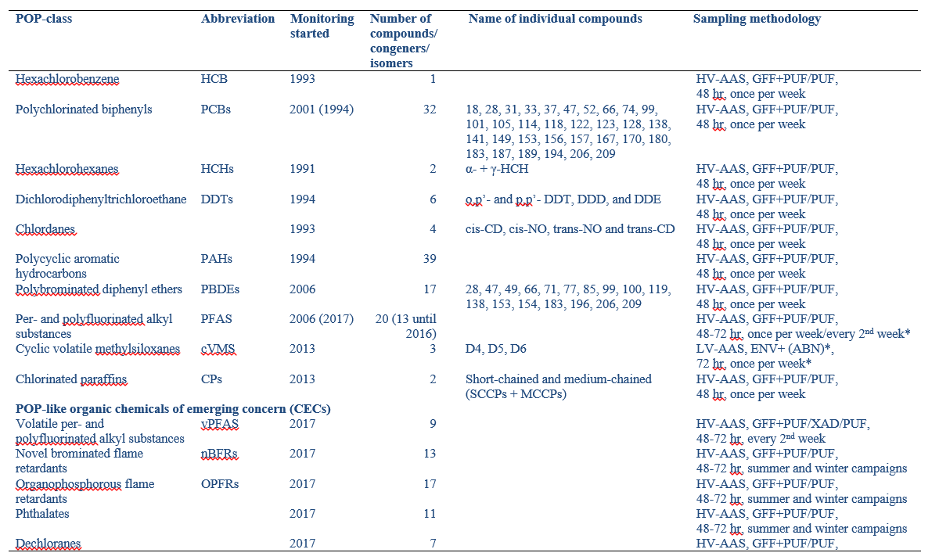
POPs: Approx 180 components monitored, ca 120 are regulated, 60 are «CECs»

Slide 3
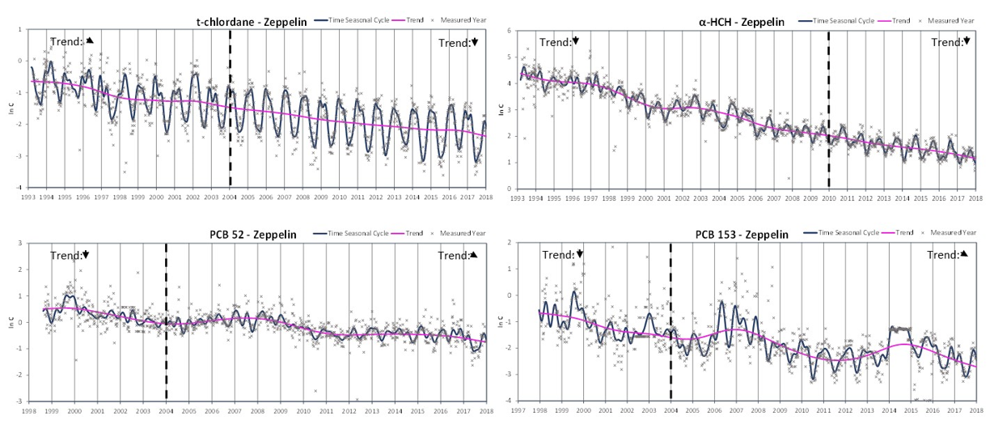
Chlorinated POPs (banned for years)

Slide 4
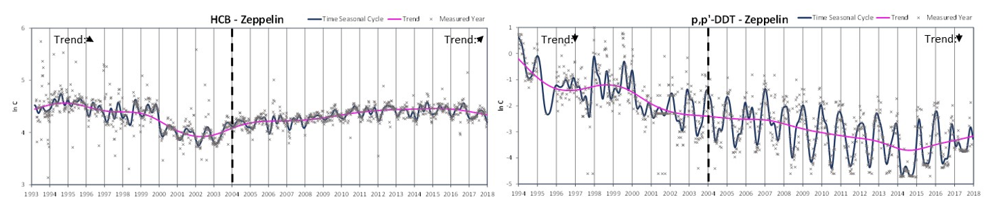

Slide 5

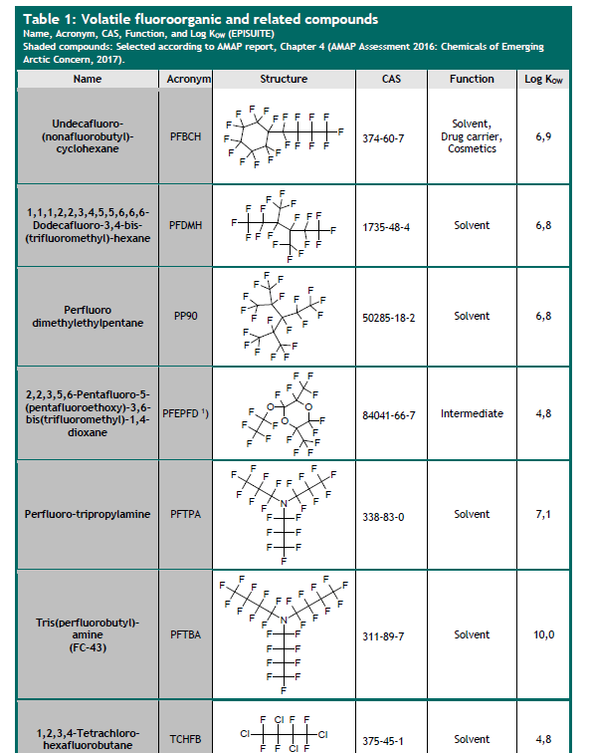

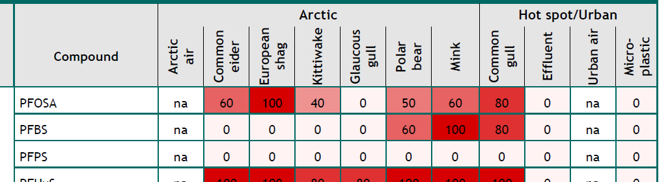
AMAP has a priority list of 25 substances listed in REACH and IUR (North Amerika) with POP properties

Slide 6

Long-term time series exist motivated by the needs of CLRTAP and AMAP

Slide 7
Daily exposure to chemical cocktail
Pharmaceuticals,
Cosmetics
Food additives
Household chemicals
Polymers and polymer additives
Building materials, paints, etc.
Pesticids
Unintentional byproducts (PAHs, dioxins etc)
Modern life based on chemicals
Increasing number of chemicals
Complex mixtures
Most chemicals are mobile and find their way to environment and humans
Some of these chemicals might be harmful to health or environment and therefore of concern
Contaminants of emerging concern (CECs)

Slide 8
Contaminants of emerging concern (CECs)
Compounds not routinely monitored
Contaminants -> Unwanted compound with potentially negative effect on health or environment
Emerging concern -> New or earlier not measured and with reasonable potential to be harmful

Slide 9
CECs - Challenges
  Substitutes regulated POPs
  Fulfill new needs
  May be less persistent, more polar, less hydrophobic, more/less volatile, etc.
  Not yet subject to international control strategies
  May have long-range transport potential – important to sample in air.
  BUT
  How to sample in air?
  How to detect on an early stage?

Slide 10
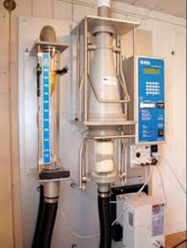
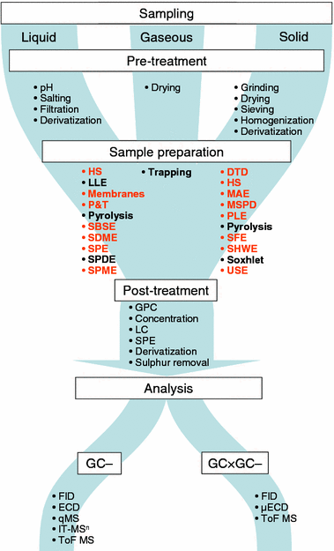
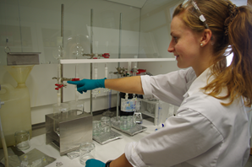

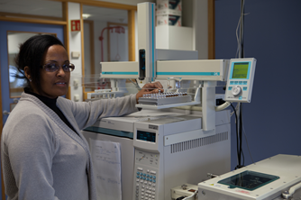
de Koning, S., Janssen, H.-G., & Brinkman, U. A. T. (2009). Modern Methods of Sample Preparation for GC Analysis. Chromatographia, 69(1), 33. doi:10.1365/s10337-008-0937-3

Slide 11
Analytical approaches
Traditional – targeted screening approach
    HM and legacy POPs
    CECs like PFAS, siloxanes or PFR
    But time consuming, specialised method for each compound
Suspect screening approach
    General approach for many CECs, possible to be used in monitoring
Non-targeted (non-specific) screening approach
    Specialized approach, not for routinely monitoring

Slide 12
Developments in mass spectrometry I
Quadrupol MS: Low mass resolution, reasonable sensitivity in single ion monitoring mode, but very low sensitivity in full scan mode
Sector field MS: High mass resolution, ultimate sensitivity in single ion monitoring mode, low sensitivity in full scan mode
Both types best in targeted approach
(selection of analytes before instrumental analysis)

Slide 13
Developments in mass spectrometry II
ToF MS: High mass resolution, reasonable sensitivity in both single ion monitoring and full scan mode
OrbiTrap MS: High/ultrahigh mass resolution, reasonable sensitivity in both single ion monitoring and full scan mode
Both types allow both targeted approach
(selection of analytes before instrumental analysis)
and suspect/non-targeted approach
(selection of analytes AFTER instrumental analysis)

Slide 14
NORMAN Network
Network of reference laboratories, research centres and related organisations for the monitoring of emerging environmental substances
Workshops on analysis and effects of CECs
Databases on monitoring data and effects of CECs
Intercalibrations and standardization of methods for CECs
Information of policy makers on CECs
NILU is a member of the Steering Committee of NORMAN
https://www.norman-network.net/

Slide 15
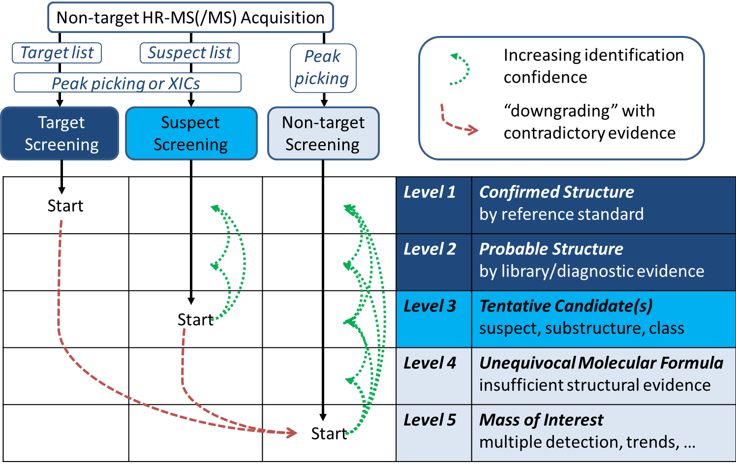
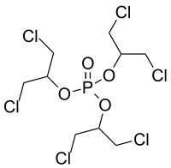
Work flow Norman approach
N
C
H
3
O
O
H
O
H
O
NO
2
O
C₉H₁₅Cl₆O₄P
428.8912
Adapted from Schymanski et al., 2015

Slide 16
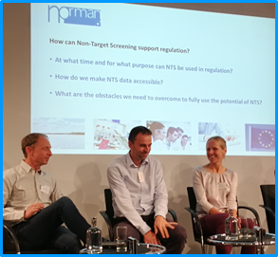
Workshop for regulators
Brussels 25 October 2018
Peter Korytár
Policy officer
European Commission
DG Environment

Slide 17

Suspect/Non-target screening
Allows to detect wide range of compounds in a single analysis,
but is often less sensitive than targeted screening and often not quantitative
Important tool for identification of emerging compounds
Retrospective analyses possible

Slide 18
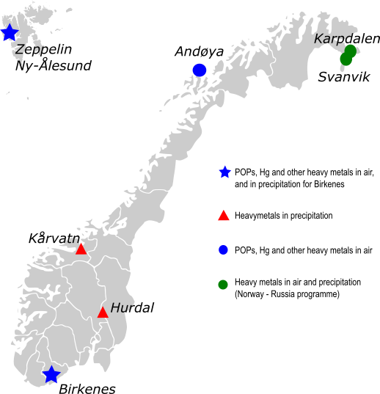

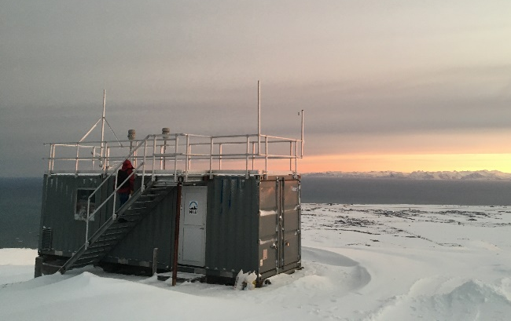
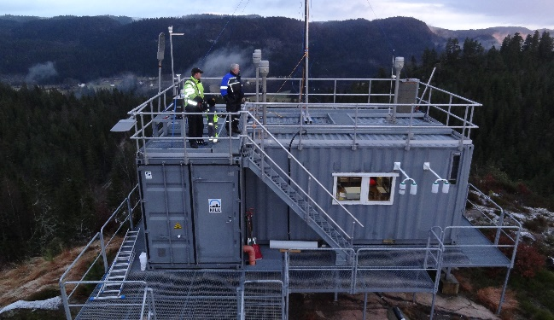
Monitoring programme in Norway
Zeppelin - AMAP
Chemicals of emerging concern (CECs):
cVMS (cyclic volatile methyl siloxanes)
S/MCCPs (Short and medium chain chlorinated paraffins)
Phthalates
New brominated flame retardants
Organophosphorous flame retardants
Dechloranes
Bisphenols
Suspect/non-target screeening
Andøya
Birkenes - CAMP

Slide 19
Chemicals of emerging concern (CECs)

Slide 20
Chemicals of emerging concern (CECs)
Zeppelin

Slide 21
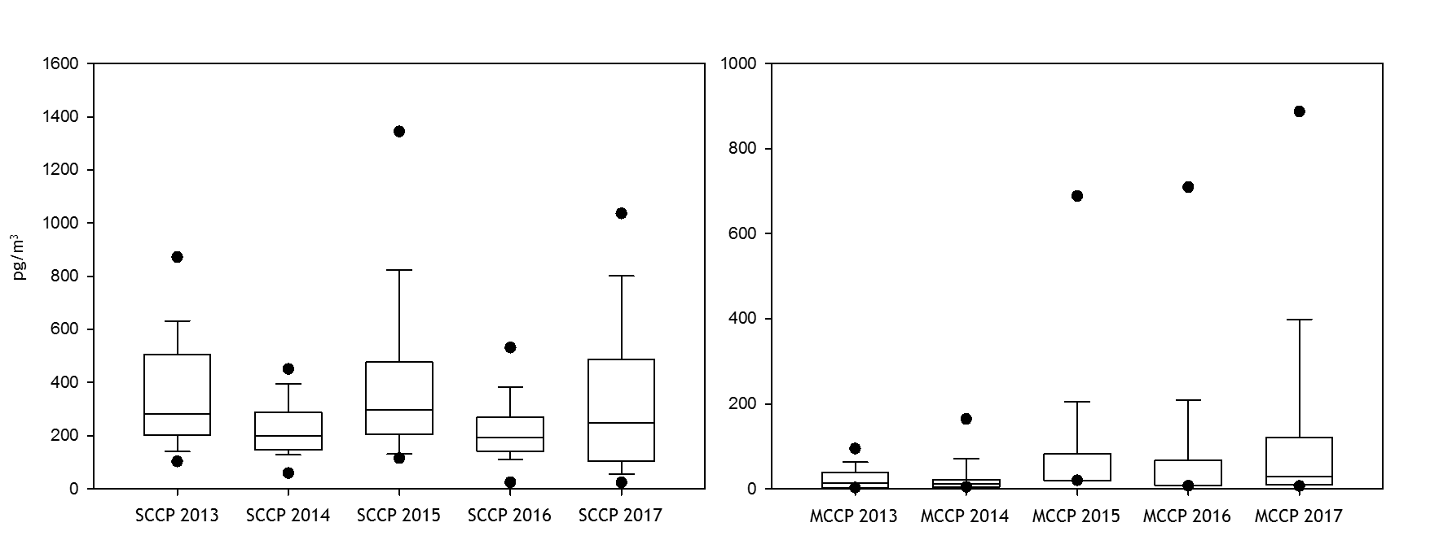
Chemicals of emerging concern (CECs)
Short and medium chain chlorinated paraffins (S/MCCPs)
Notes:
High concentrations, consistant over time.

Slide 22
NORMAN Dust intercalibration

Slide 23
Analytical challenges
GCxGC plot: non-target analysis of air sample (PUF/PUF)
PUF matrix
Notes:
GCxGC plot viser at matriksen har samme egenskaper som komponentene som skal bestemme. Derfor veldig vanskelig å bli kvitt uten å kvitte seg med komponentene.

Slide 24
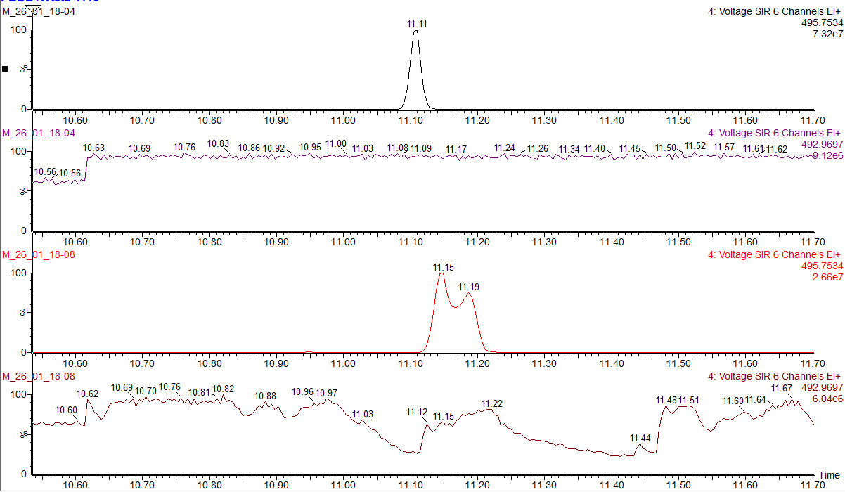
Analytical challenges
Without acid clean-up – target analysis of less persistent SVOCs
13C BDE47 in standard
Lock mass in standard
13C BDE47 in blank PUF
Lock mass in blank PUF
Additionally; Maintenance of the GC system necessary (injector, column replacement etc.)
Notes:
You may think that there can not be a lot matrix when dealing with background air. But actually, it is.
When extracting the analytes, also the PUF material partly dissolve and may cause trouble when acid treatment should be avoided for e.g. the novel flame retardants.
Even if the samples look fairly blank after clean-up, there might be analytical challenges associated with target GC-MS determination. (Note: High-resolution)
In the example above, BDE 47 in a standard solution are compared to a not exposed PUF disk.
While a distinct peak is observed in the standard, the peak is splitted when PUF matrix are presented, indicating that the GC chromatography are affected.
This may affect the accuracy when quantifying the concentration.
In mass spectrometry, we use a MS lock mass standard to adjust the mass calibration during analysis.
The standard is constantly injected, giving a constant signal as you can see for the lock mass close to 13C BDE when a standard is analyzed.
However, when matrix gets into the detector, the sensitivity of the instrument may drop temporarily. The problem is when the drop happens at the same retention time as a compound of interest is eluted.
The abnormalities observed in lock mass signal when the PUF sample is analyzed, indicate interferences from matrix.
Not sufficiently removed PUF matrix, may also cause instrument problems with a need for maintenance in order to remain good instrument conditions.

Slide 25
Specially adapted facilities at NILU
Clean room with particle controlled atmosphere
Clean cabinet/ laminar flow cabinet with particle control
Strict non-contamination procedures including considerable number of control samples
Benchtop FTIR for polymer determination of particles > 500 µm
Several MS technologies for additive- and leackage determination
Part of strong international networks
Part of Teaching- and outreach

Slide 26



Microplastic in air
NILU
Particulate Fallout Collector (p.no. 9721)
… now available at NILU at modified sampler with all parts in stainless steel
https://innovation.nilu.no/ProductsServices.aspx

Slide 27
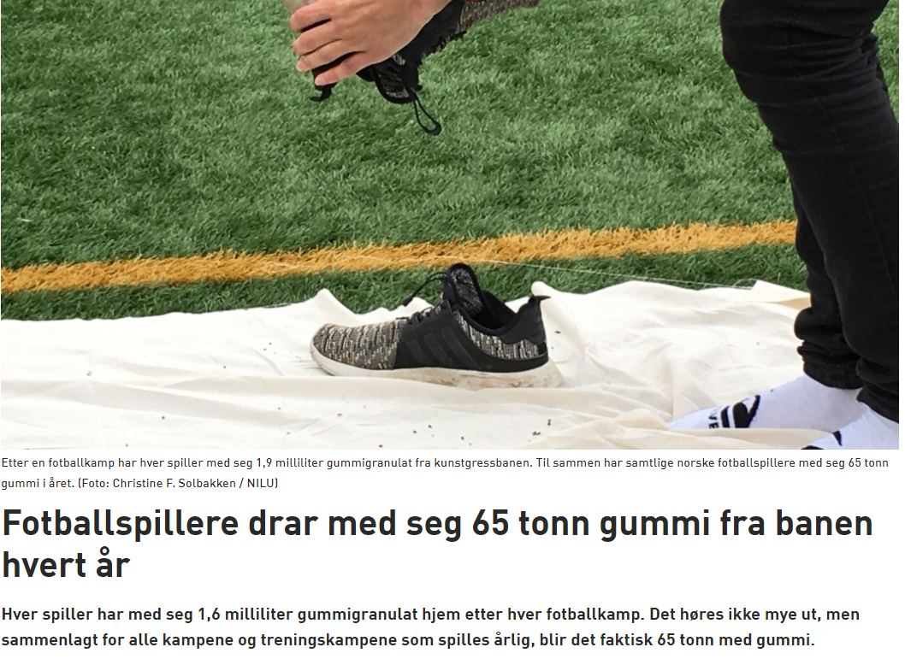


Slide 28
Thank you for your attention!

