Slide 1
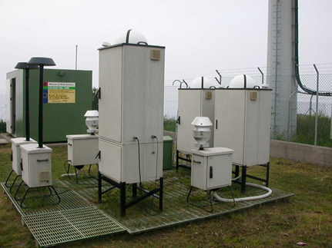
Alberto González Ortiz | 9 May 2019 | 20 Task Force on Measurement and Modelling Meeting, Madrid (Spain)
The EMEP Monitoring Strategy 2020 – 2029:
Links with the EU Air quality Directives
and the European Environment Agency database

Slide 2
Why do we need coordination with EU AQD?
EMEP STRATEGY
Harmonization with other initiatives and networks still very important
Regional vs local measurements, links to AQD
AIR QUALITY DIRECTIVES
Ask to coordinate some measurements with the EMEP Strategy
PM_{2.5} speciation
Indicative monitoring of HMs and PAHs in air and their total deposition
Optimization of resources
Avoidance of duplications
Fitness check of the AQ Directives

Slide 3
Why do we need coordination with AQD?
Third strategy since 2004-2009
Lack of coordination at national level
Different purposes, but common generic objectives

Slide 4
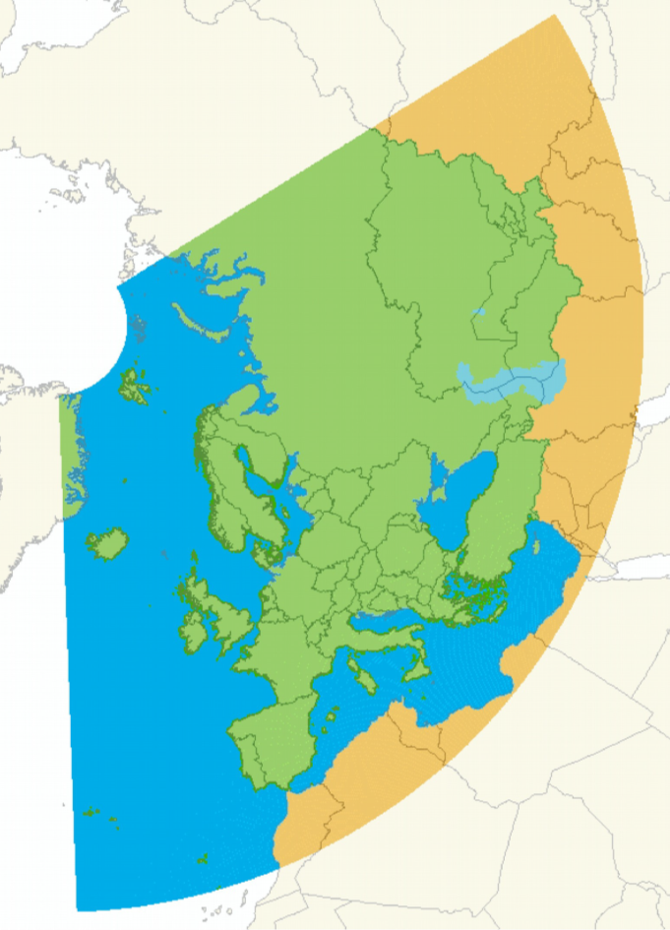
Geographical coverage
EEA
EMEP

Slide 5
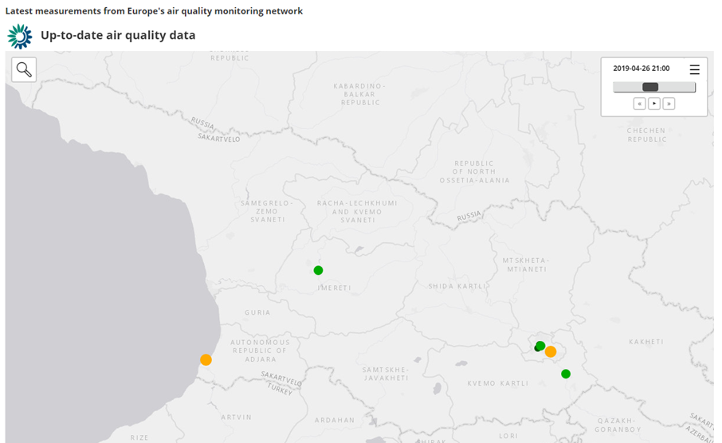
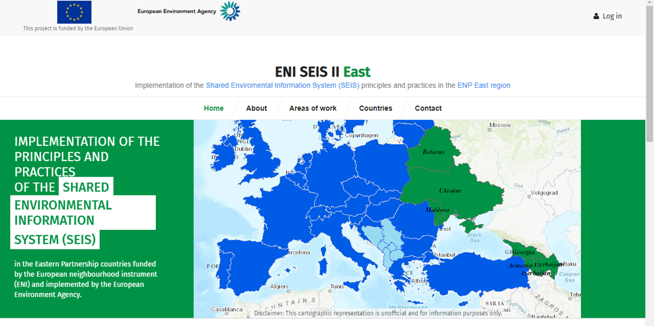
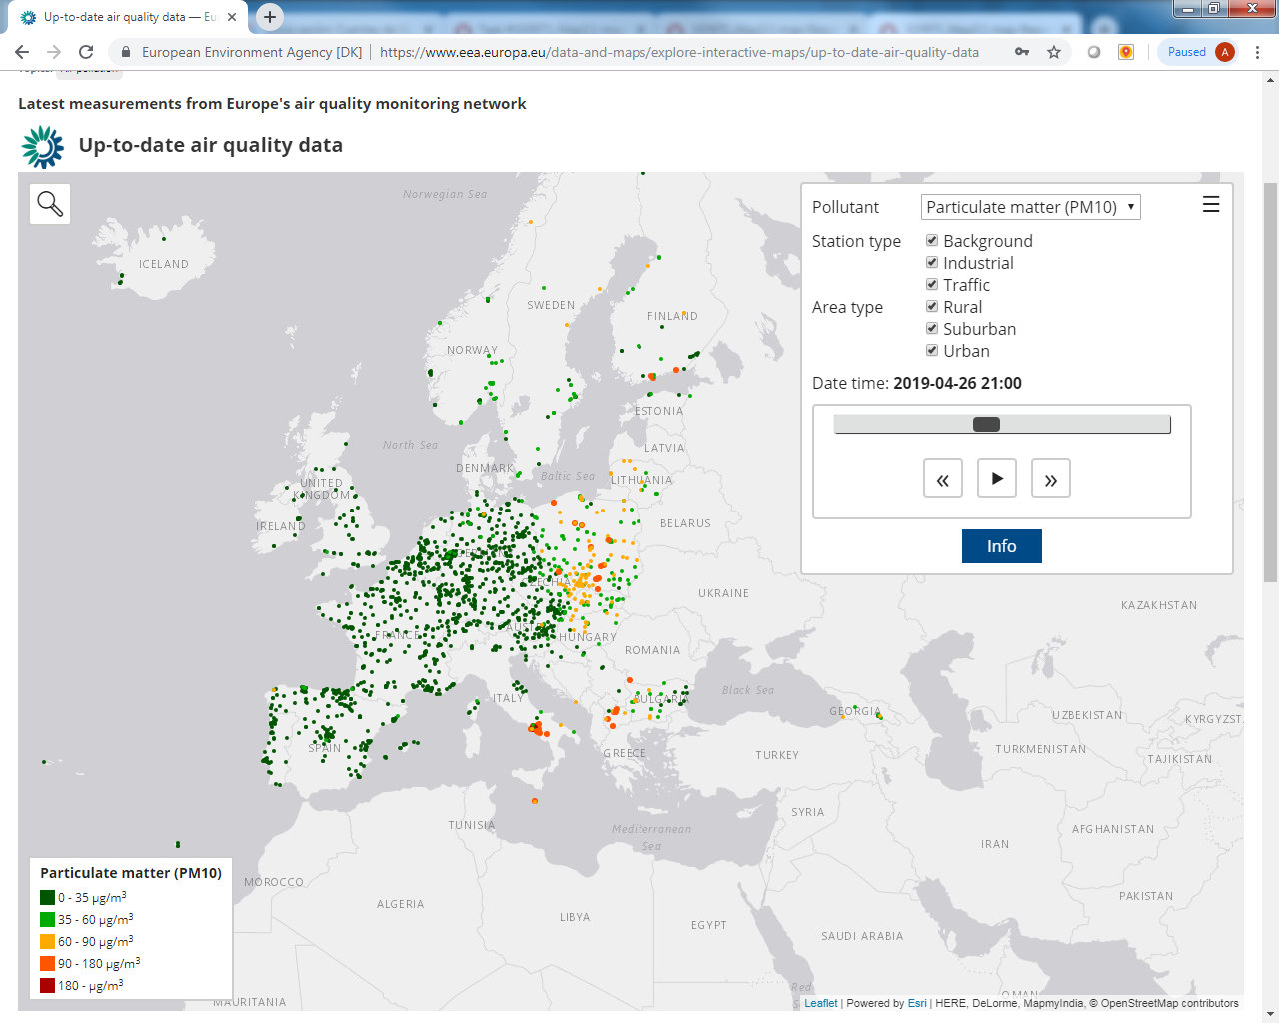
Geographical coverage

Slide 6
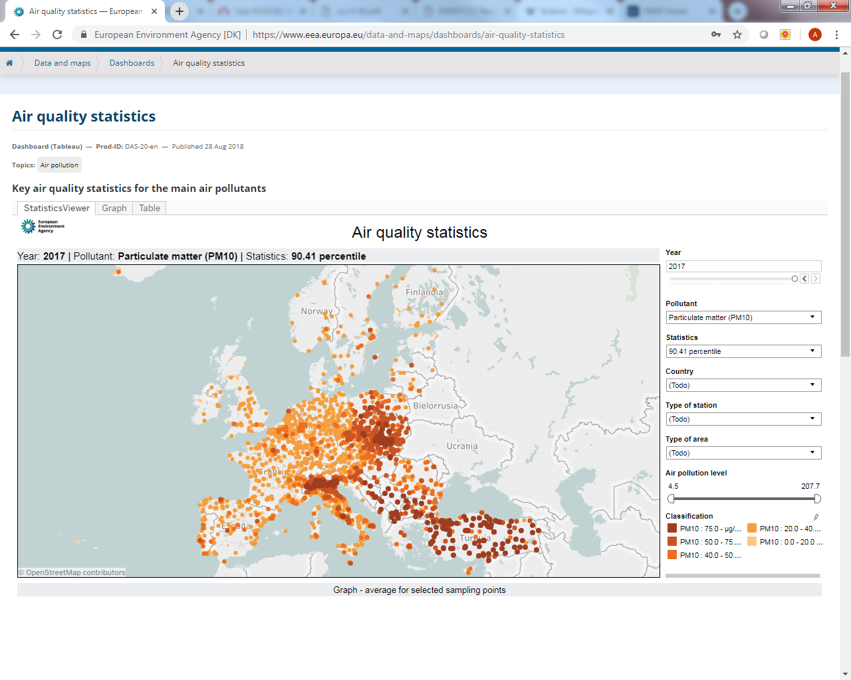
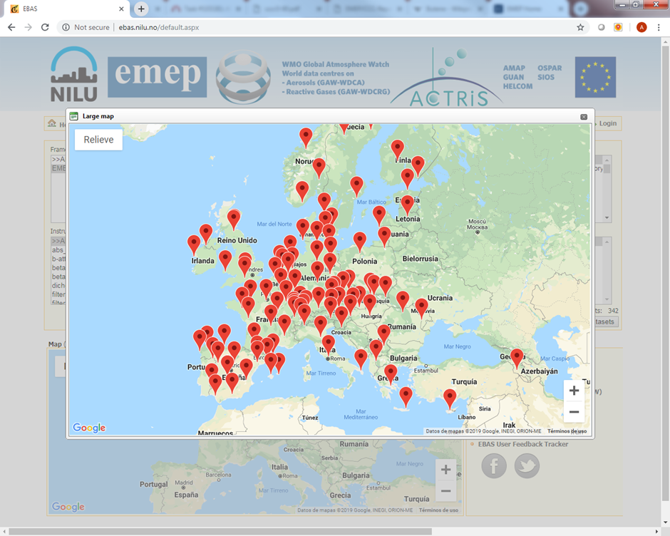
Type of monitoring stations
2934 stations
104 EMEP stations
360 rural background stations

Slide 7
Pollutants
Level 1 |  |  |  | EU obligations
 | Inorganic compounds in precipitation | SO4 2-, NO3 - , NH4 + , H+ (pH), Na+ , K+ , Ca2+, | Daily | not included
 | Heavy metals in precipitation | Cd, Pb (1st priority), Cu, Zn, As, Cr, Ni (2nd priority) | Daily/weekly | Total deposition of As, Cd, Ni (Directive 2004/107/EC, indicative measurements every third day)
 |  |  |  | SO2 in air (Directive 2008/50/EC, hourly)
 | Inorganic compounds in air | SO2, SO4 2-, NO3 - , HNO3, NH4 + , NH3, (sNO3, sNH4), HCl, Na+ , K+ , Ca2+, Mg2+ | Daily | SO4 2-, NO3 - , NH4 + , Na+ , K+ , Ca2+, Mg2+ in PM2.5 (Directive 2008/50/EC, indicative measurements weekly)
 |  |  |  | HNO3, NH3, (sNO3, sNH4), HCl not included. Cl- (as above)
 | NO2 in air | NO2 | Hourly/Daily | Directive 2008/50/EC (hourly)
 | Ozone in air | O3 | Hourly | Directive 2008/50/EC (hourly)
 | PM mass in air | PM2.5, PM10 | Hourly/Daily | Directive 2008/50/EC (daily)
 | Gas particle ratios of Nspecies | NH3, NH4 + ,HCl, HNO3, NO3 - (in combination with filtre pack sampling) | Monthly | not included
 | Meteorology | Precipitation amount (RR), temperature (T), wind direction (dd), wind speed (ff), relative humidity (rh), atmospheric pressure (pr) | Daily (RR), Hourly | not included

Slide 8
Pollutants
Level 2
 | Acidification and eutrophication observations contributes to the assessment of nitrogen chemistry, influence by local emissions and dry deposition fluxes (see also para. 18b)
 | Gas particle ratio | NH3/NH4 + , HNO3/NO3 - (artifact-free methods) | Hourly/Daily | not included
 | Ammonia in emission areas (optional) | NH3 | Monthly | not included
 | Photochemical oxidants observations contributes to the assessment of oxidant precursors (see also paragraph 18b)
 | NOx | NO, NO2 | Hourly | Directive 2008/50/EC (hourly)
 | Light hydrocarbons | C2-C7 | Hourly | Benzene (Directive 2008/50/EC)
 |  |  |  | Other 19 (in at least one station in urban or suburban areas)
 | Carbonyls | Aldehydes and ketones | 8hourly twice a week | In the EU Directive 2002/3/EC,
 | CH4 | Methane | hourly | not included
 | Heavy metals observations contributes to the assessment of mercury and heavy metals fluxes (see also paragraph 18b)
 | Mercury in precipitation | Hg | Weekly | Total deposition (Directive 2004/107/EC, indicative measurements every third day)
 | Mercury in air | Hg (TGM), | Hourly/Daily | Directive 2004/107/EC (as above)
 | Heavy metals in air | Cd, Pb (1st priority), Cu, Zn, As, Cr, Ni (2nd priority) |  | Pb in PM10 in Directive 2008/50/EC (daily)
 |  |  |  | Cd, As, Ni in PM10 in Directive 2004/107/EC (daily). Cu, Zn and Cr not included

Slide 9
Pollutants
Level 2
 | Persistent organic pollutants observations contributes to the assessment of persistent organic pollutants (see also paragraph 18b)
 | POPs in precipitation | PAHs, PCBs, HCB, chlordane, HCHs, DDT/DDE | Weekly | Total deposition of BaP and six other PAHs (Directive 2004/107/EC, indicative measurements every third day)
 | POPs in air | PAHs, PCBs, HCB, chlordane, HCHs, DDT/DDE | Daily/Weekly | BaP in EU Directive 2004/107/EC.
 |  |  |  | Six other PAHs
 | Particulate matter observations contributes to the assessment of particulate matter and its source apportionment (see also paragraph 20 (c))
 | PM mass in air | PM1 | Hourly/Daily | not included
 | Mineral dust in PM10 | Si, Al, Fe, Ca | Daily/Weekly | not included
 | EC and OC in PM10 | Elemental and Organic Carbon | Daily/Weekly | EC and OC in PM2.5 (Directive 2008/50/EC, indicative measurements weekly)
 | Aerosol absorption | Light absorption coefficient | Hourly/Daily | not included
 | Aerosol size/number distribution | dN/dlogDp | Hourly/Daily | not included
 | Aerosol scattering | Light scattering coefficient | Hourly/Daily | not included
 | Aerosol Optical Depth | AOD at 550 nm | Hourly | not included
 | Tracers observations contributes to the assessment of individual long-range transport events and their source apportionment (see also paragraph 18b)
 | Carbon Monoxide | CO | Hourly | not included
 | Halocarbons | CFCs, HCFCs, HFCs, PFCs, SF6 | Hourly | not included

Slide 10
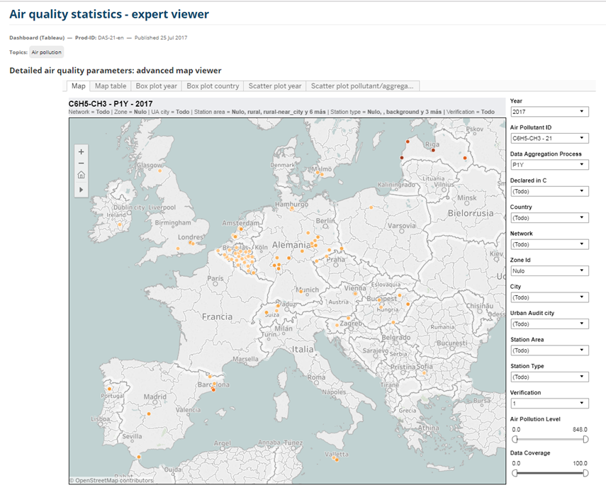
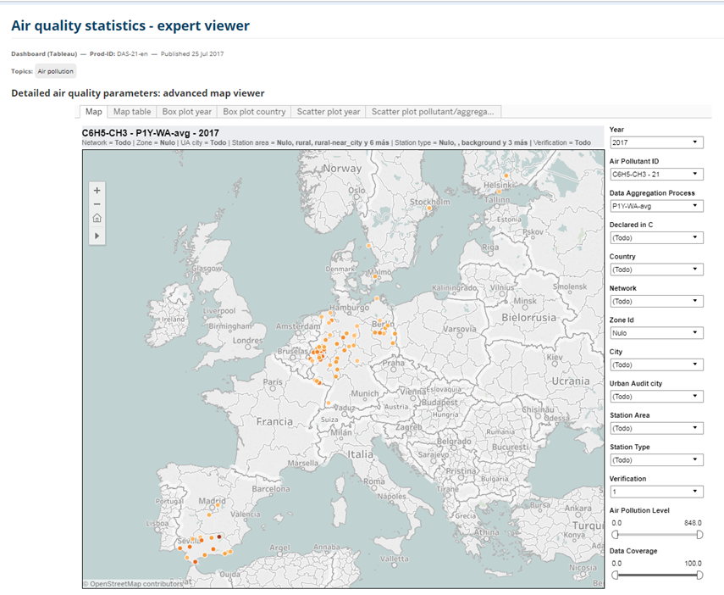
Pollutants
Toluene annual mean, 2017
19 countries
Acetaldehyde
Acetone

Slide 11
Spatial coverage
Level 1:
1 or 2 EMEP stations per 100 000 km² vs. EU Directives’ minimum requirements.
Level 2:
At least one EMEP station vs. EU requirements for PM speciation; VOCs; HM and PAHs (in air and total deposition).

Slide 12
Other issues
Measurement techniques, procedures, analysis…
Reference methods in AQD vs. EMEP Manual
Quality assurance/Quality control:
National responsibility
National Reference Laboratories (AQUILA)
Legal consideration:
Long-term continuity and funding
Reporting of measurements:
Streamlining

Slide 13
Conclusions
Need of coordination recognized in the EMEP Strategy and the EU AQ Directives.
EMEP could take stock of existing projects to expand the network to the East.
EMEP could take advantage of existing stations to expand the monitoring programme.
More attention should be put in aligning the pollutants to be measured under both programmes.
More cooperation needed at national level between the networks.
Further cooperation would avoid duplication and would assure long-term performance and synergies.

Slide 14
Thanks for your attention!!
Alberto.GonzalezOrtiz@eea.europa.eu
www.eea.europa.eu/air

