Slide 1



Contribution of COST Action CA16109 Chemical On-Line cOmpoSition and Source Apportionment of fine aerosoL, COLOSSAL
María Cruz Minguillón
  Institute of Environmental Assessment and Water Research (IDAEA), CSIC
20th Task Force on Measurement and Modelling Meeting
Madrid, Spain
May 7-9, 2019

Slide 2


What is COST
COST: European Cooperation in Science & Technology
COST is the longest-running European framework supporting trans-national cooperation among researchers, engineers and scholars across Europe.
COST Mission:
COST aims to enable breakthrough scientific developments leading to new concepts and products. It thereby contributes to strengthening Europe’s research and innovation capacities.

Slide 3
What is COST
COST: European Cooperation in Science & Technology
COST is an EU-funded programme.
COST funds pan-European, bottom-up interdisciplinary research networks across all science and technology fields in Europe and beyond: COST Actions.
COST Actions promote international coordination of nationally-funded research.
COST provides funds for organising conferences, meetings, training schools, short scientific exchanges or other networking activities in a wide range of scientific topics.

Slide 4
COST Action COLOSSAL
Chemical On-Line cOmpoSition and Source Apportionment of fine aerosoL, CA16109
Challenge:
To optimize and harmonize fine atmospheric aerosols online measurements, guaranteeing the transfer of knowledge. To coordinate overarching analyses to assess the spatial variability (across Europe), temporal variability (at a one hour time resolution or better), seasonality (using long term datasets), phenomenology (chemical composition) and sources of fine atmospheric aerosol.

Slide 5
Structure
Chemical On-Line cOmpoSition and Source Apportionment of fine aerosoL
Non-refractory fine aerosol
Fine aerosol
WG1
Quality assurance of on-line chemical composition of non-refractory fine aerosol measurement
Sulfate
Nitrate
Chloride
European overview of fine atmospheric aerosols
Management Committee
Organic matter
Ammonium
WG4
WG2
Source apportionment of OA
WG3
Refractory fine aerosol fraction
Black carbon
Main instrumentation:
WG1
Aerosol Chemical Speciation Monitor (ACSM)
WG2
WG4
Aethalometer
WG3

Slide 6
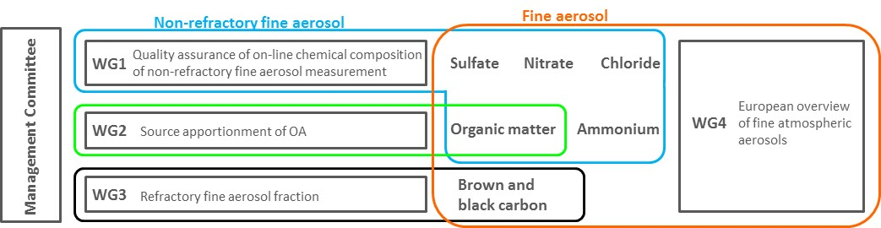
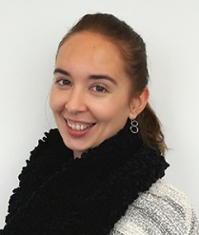
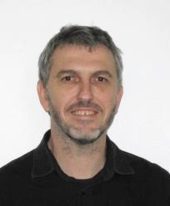
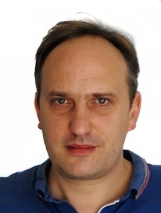
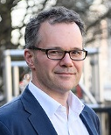
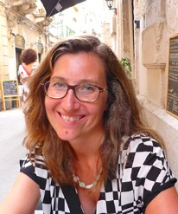
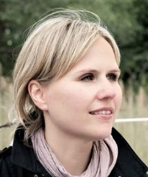
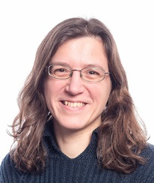
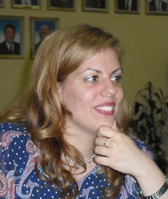
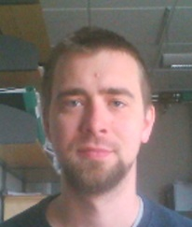
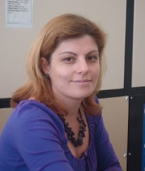
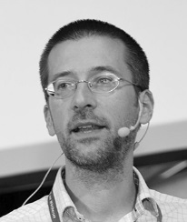
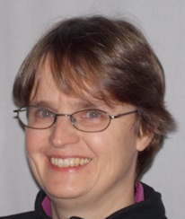
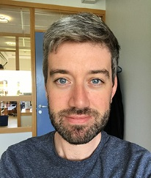
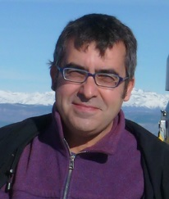
Structure
Chair
María Cruz
Minguillón
Vice-Chair
André
Prévôt
WG1
WG2
WG1 Leader
Olivier
Favez
WG1 Sub-Leader Twitter Manager
David Green
WG2 Leader
Stefania
Gilardoni
WG2 Sub-Leader ITC CG Coord
Jurgita Ovadnevaite
STSM Coordinator
Véronique
Riffault
Dissemination
Dunja
Sokolovic
WG3
WG4
ECIs
Axel
Eriksson
Gender Balance
Luminita
Marmureanu
WG3 Leader
Griša
Močnik
WG3 Sub-Leader
Anne
Kasper-Giebl
WG4 Leader
Stephen
Platt
WG4 Sub-Leader
Andrés
Alastuey

Slide 7


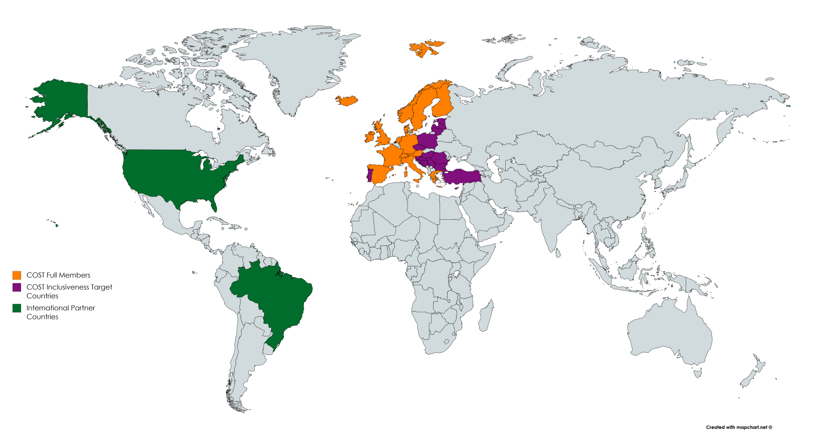
Participants
32 countries
76 institutions
+230 participants
Austria, Bosnia and Herzegovina, Bulgaria, Croatia, Cyprus, Czech Republic, Denmark, Estonia, Finland, France, Germany, Greece, Hungary, Iceland, Ireland, Italy, Latvia, Lithuania, Netherlands, Norway, Poland, Portugal, Romania, Serbia, Slovenia, Spain, Sweden, Switzerland, Turkey, United Kingdom, Brazil, United States of America

Slide 8
Objectives
    Research Coordination Objectives (1-5)
To provide clear, evidence-based guidelines for real-time chemical characterization of fine atmospheric aerosols, in terms of measurement protocols and data treatment, which ensures consistent, reproducible and comparable results across Europe.
To provide a homogenized protocol to determine the source apportionment of fine organic aerosol and black carbon, based on real-time measurements of organic mass spectra and light absorption at different wavelengths, respectively.
To coordinate and reinforce exchanges of scientific research necessary to understand factors influencing the concentrations and chemical composition of fine atmospheric aerosols.
To ensure the good performance of the instrumentation used by undertaking intercomparison exercises.
To develop quality control and assurance criteria and methodologies for the above-mentioned activities and promote their use Europe-wide and globally.

Slide 9
Objectives
    Research Coordination Objectives (6-10)
To promote the joint interpretation of results at different European sites.
To maintain and further build a network of experts, researchers, Early Career Investigators (ECI), and PhD students that allows the achievement of the previous objectives. This will also contribute to the overall skills base.
To provide data for air quality model evaluation and model development which are the basis of air quality related policies.
To bring together the communities dealing with black and brown carbon with the ones dealing with chemical composition and source apportionment.
To recommend to manufacturers desirable features of instrumentation for the determination of real-time chemical characterization and source apportionment of fine atmospheric aerosols.

Slide 10
Objectives
    Capacity Building Objectives (11-12)
To train less-experienced researchers (mainly PhD students and ECI) on the use of techniques for real-time chemical characterization and source apportionment of fine atmospheric aerosols and interpretation of results and data treatment.
To support and training of researchers (including PhD students and ECI) from Participating Countries and Inclusiveness Target Countries who might have a need for such knowledge and might lack other means to achieve such experience.

Slide 11

Action timeline
Action started 3 March 2017
4 years duration
2 March 2021
We are at the beginning of 3rd year

Slide 12
WG1 Activities
WG1
Quality assurance of on-line chemical composition of non-refractory fine aerosol measurements
Training Schools
  ToF-ACSM, Prague, 12-14 Feb 2018
Intercomparison exercise ACSM and co-located instruments
  Nov 2018, coordinated with ACTRIS2
Workshops (data treatment and discussion of intercomp output + best practices)
  Mar 2019
Next meeting: Oct 2019
WG1 Leaders
Olivier Favez
David Green

Slide 13
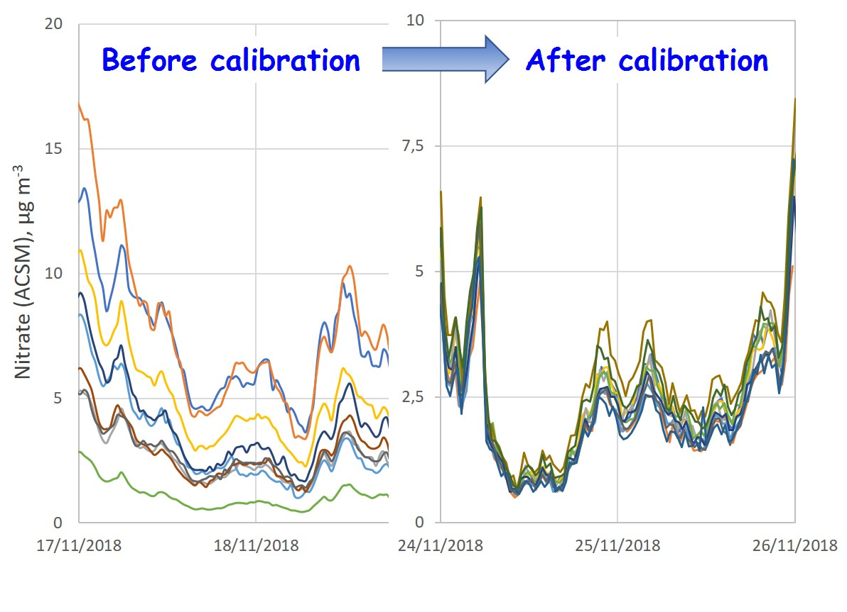
WG1 Activities
WG1
Quality assurance of on-line chemical composition of non-refractory fine aerosol measurements

Slide 14
WG2 Activities
WG2
Source apportionment of organic aerosol
Training Schools on Source apportionment OA high time resolution
  Prague, 15-17 Feb 2018
  Bologna, 28-31 May 2019
Workshops (advanced OA SA) and Working group meetings
Next meeting: Oct 2019
WG2 Leaders
Stefania Gilardoni
Jurgita Ovadnevaite

Slide 15
WG2 Activities
WG2
Source apportionment of organic aerosol
From Crippa et al. (2014),
Atmos. Chem. Phys., 14, 6159-6176

Slide 16
WG3 Activities
WG3
Refractory fine aerosol fraction
Training Schools
  Black and brown carbon, Ljubljana, 15-17 Jan 2018
Intercomparison exercise
  Leipzig, 14-25 Jan 2019, coordinated with ACTRIS2
Workshops
Next meeting: Oct 2019
WG3 Leaders
Grisa Mocnik
Anne Kasper-Giebl

Slide 17
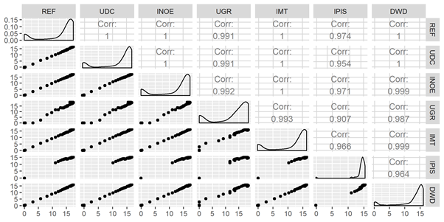
WG3 Activities
WG3
Refractory fine aerosol fraction
Intercomparison performed at Tropos ACTRIS research infrastructure / GAW WCCAP of different Aethalometers with regressions and frequency distribution of concentrations.

Slide 18
WG4 Activities
WG4
European overview of fine atmospheric aerosol
Workshops (to gather existing datasets in Europe, discuss the results, and possibly decide on the additional datasets)
Common activities
  Participation to the EMEP/ACTRIS/COLOSSAL winter campaign (2017-2018)
Contribution to EBAS
  Stations can report data within framework COLOSSAL
WG4 Leaders
Stephen Platt
Andrés Alastuey

Slide 19
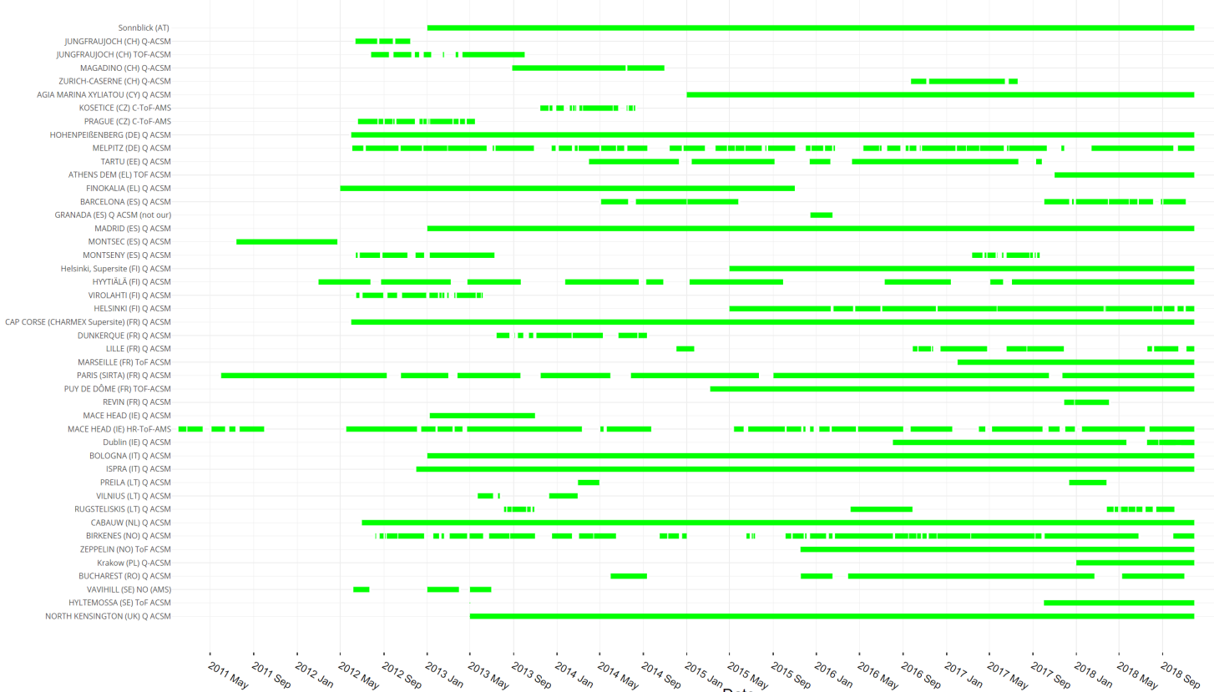
WG4 Activities
WG4
European overview of fine atmospheric aerosol

Slide 20
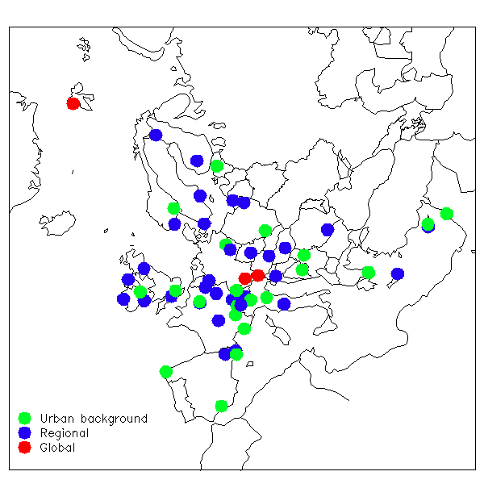
WG4 Activities
WG4
European overview of fine atmospheric aerosol
EMEP/ACTRIS/COLOSSAL:
22 Countries. 57 sites
AE + OC/EC + levo
Additional measurements
18 sites with ACSM
12 with MAAP
Contact persons: Wenche Aas, Stephen Platt

Slide 21
Activities
Short Term Scientific Missions
Short Term Scientific Missions (STSM)
Strengthening existing networks and fostering collaborations within COST partner. A STSM should specifically contribute to the scientific objectives of the COST Action
29 grants awarded so far
5th Call: deadline for applications 3 June 2019
STSM Coordinator
Véronique Riffault

Slide 22
Activities
ITC Conference Grants
ITC Conference Grants
Aimed at supporting PhD students and Early Career Investigators (ECI, PhD + up to 8 years) researchers from participating Inclusiveness Target Countries (ITC) to attend international science and technology related conferences.
5 grants awarded so far
Next Call: coming soon
ITC CG Coordinator
Jurgita Ovadnevaite

Slide 23



How to follow
Twitter @cost_colossal
http://www.costcolossal.eu/
Research Gate

Slide 24
How to join
Thank you for your attention
http://www.costcolossal.eu/contact-us/
https://www.cost.eu/cost-actions/how-to-participate/
  Email: mariacruz.minguillon@idaea.csic.es
  contact your COST National Coordinator (CNC)

