Slide 1





Results from EMEP/COLOSSAL/ACRTIS intensive measurement campaign
Stephen M. Platt, Karl Espen Yttri, Wenche Aas, Many Others
03/05/2019
TFMM, Madrid. SP@nilu.no

Slide 2
Motivation
Ambient black carbon has serious health consequences
  Focus on BC and its sources (wood burning / traffic)
Increasing number of high time resolution multi-wavelength aethalometers employed in Europe
  Good timing to test source apportionment approaches from these instruments
  Possibility to create one harmonized, quality controlled dataset of observations across a wide range of sites over the same period

Slide 3
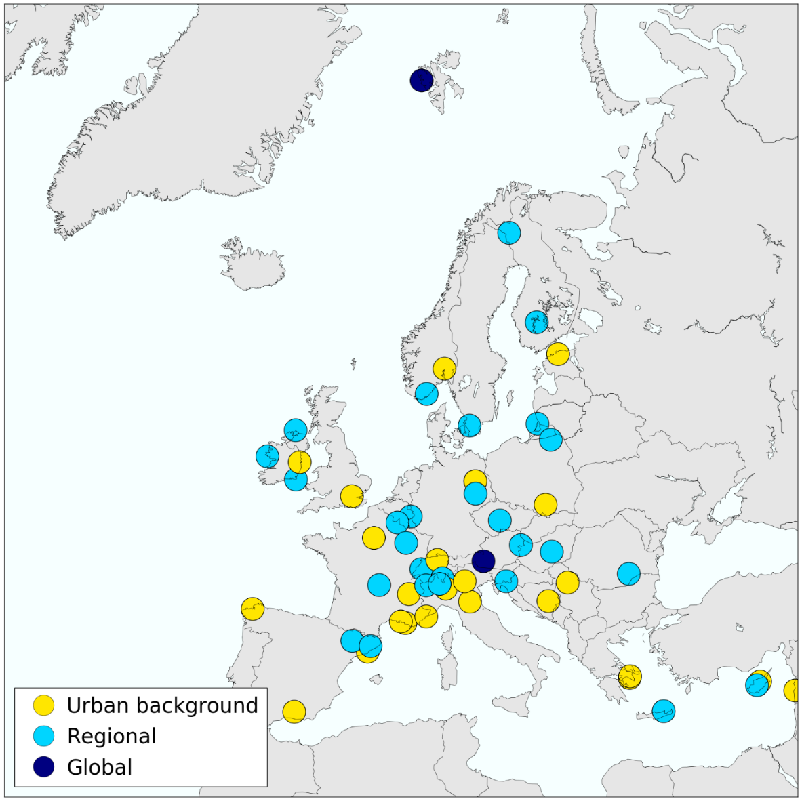
Methodology: study design
59 sites across 24 countries:
  multi-wavelength aethalometer (AE31,42,33)
  filter sampler for off line EC/OC and levoglucosan analysis
Timing
  Winter (dec 2017-march 2018), or part of whole period

Slide 4
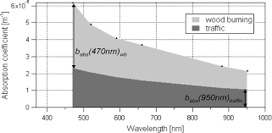
Methodology: Source apportionment
Aethalometer model (Sandradewi et al.) uses the different wavelength dependence of the sources for apportionment
Requires a priori Ångstrøm exponents
Often leads to periods with poorly fitted data (negative values)
Limited to two factors
Quick. Simple. Robust
-Sandradewi et al.
Positive matrix factorization fit of data to yield combination of profile and tie series with minimized weighted residual
Requires no a priori assumptions to run
Yields time series and Ångstrøm exponents (= factor profile)
Possible to go to more than two factors
No negative values (poorly fitting data go to a residual)
Requires variation in time and across the profiles to work (independent information)
Difficult to remove need for user input when evaluating results (rotational ambiguity)
Requires an error matrix
-Moschos et al.

Slide 5
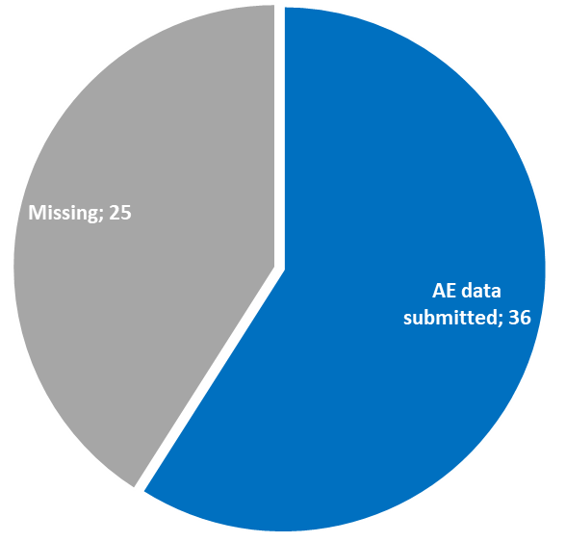
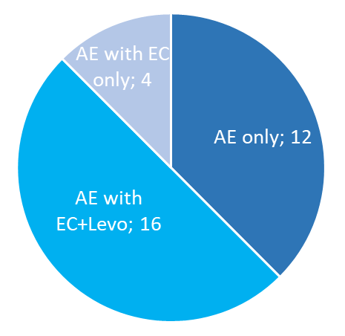
Status of the reporting
2 out of 3 submitted in a format that could be analysed. Half of those with both EC and Levo
Note: submitted is any kind of file that I was able to open/ import/ analyze. Many are not in the NASA AMES format

Slide 6
Results: levoglucosan

Slide 7
Results: elemental carbon

Slide 8
Results: Equivalent black carbon

Slide 9
Results: Biomass burning fraction
Aethalometer model, over AAE fossil;biomass burning 0.9;1.6 and 1.1;2.1
Nonsense values and wide range demonstrate the need for other approaches

Slide 10
PMF with aethalometer data
Example PMF output profile
Running using SOFI, although commands (setting up runs, import etc.) are called from an external script for faster user analysis
We can calculate an aerosol aangstroem exponent (AAE) from the profile
Factors then mapped using the factor derived AAEs (lowest is factor 1 , next is factor 2)
AAEs not physical results from ‘first principals’, rather, a best fit to the observed data
New approach (not done with pure aethalometer data before)

Slide 11
Investigation of solution space
AAE provides a very convenient way to investigate the range of solutions, e.g. via multiple repeats/ bootstrapping:
Binned factors after mapping
Resolve rotational ambiguity (e.g. poor factor shape in the small low AAE mode, pink, occurs when the model finds a local minimum by apportioning most low wavelength absorption to factor 2 only)
We average the runs in the modal bins to present ideal solutions
(This can be demonstrated as reasonable with synthetic data with known AAE)
Re-modelled output from Bucharest with new AAE pair

Slide 12
PMF model validation

Slide 13
Biomass burning fraction form PMF

Slide 14
Options for dissemination
We have a consistent dataset: exact same time period, consistent application of methodology which we hope can be useful to the modeling community including traditional and novel approaches and a large number of sites
Aim is to have all data on EBAS as the best solution for long term archiving with accessible meta data
You can also send me / Wenche an email and we can try to provide a customized output file (wrt. components, time resolution, formats etc.)

Slide 15

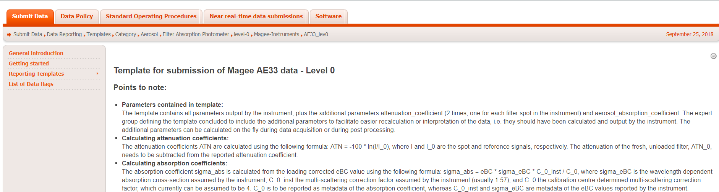
Challenges with the data
Template new and somewhat overwhelming
  Need skills in scripting: convert the files to Nasa Ames format and calculate attenuation- and absorption coefficients
Metadata not always intuitive
  Sometimes default template values used and not the instrument specific ones (i.e. the multi-scattering correction factor )
Units not same in instrument as defined in EBAS
Missing flags, especially 684 (zero air span)
https://ebas-submit.nilu.no/Submit-Data/Data-Reporting/Templates/Category/Aerosol/Filter-Absorption-Photometer/level-0/Magee-Instruments/AE33_lev0

Slide 16
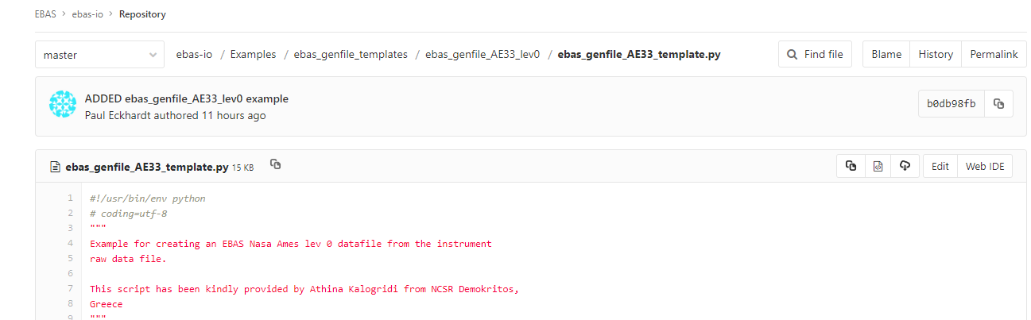
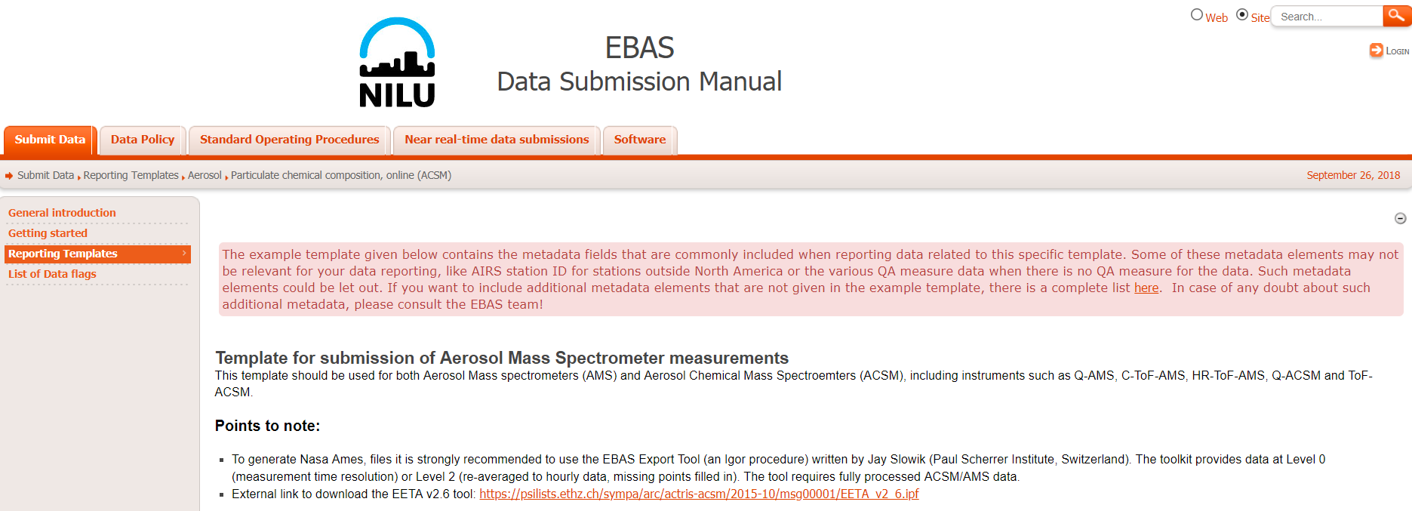
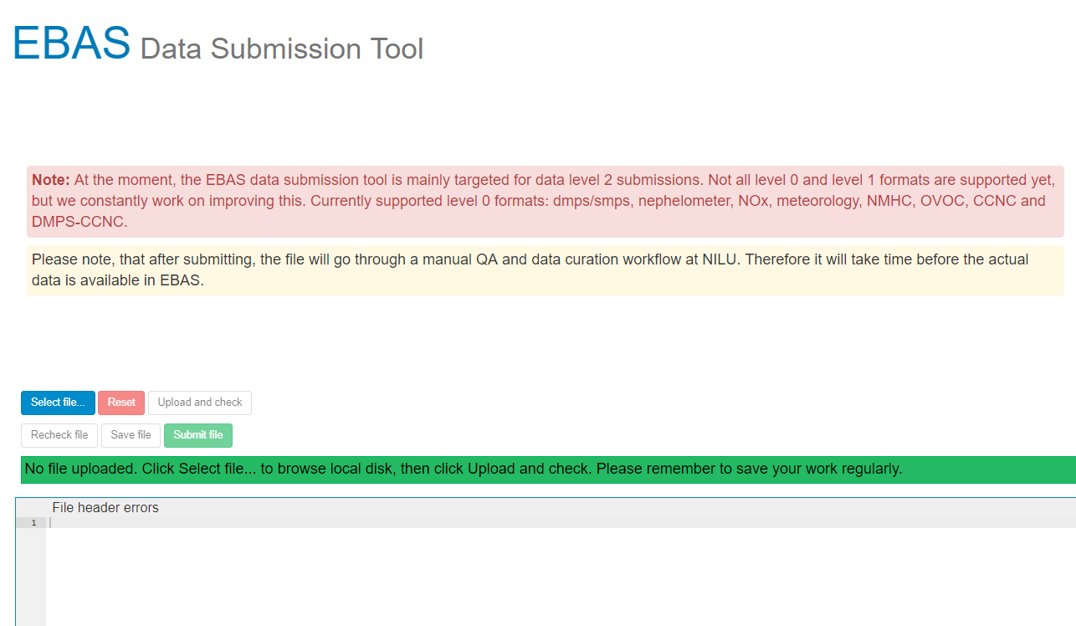
Software to help with data reporting
New python example script to convert AE33 files to Nasa Ames. Thanks to Athina Kalogridi from NCSR Demokritos!
  https://git.nilu.no/ebas/ebas-io/blob/master/Examples/ebas_genfile_templates/ ebas_genfile_AE33_lev0/ebas_genfile_AE33_template.py)
  ebas-io module (https://git.nilu.no/ebas/ebas-io/wikis)
Script for converting AE31 in LabView
  https://ebas-submit.nilu.no/software-tools
Tool for reporting ACSM (EETA v2.6)
  to be updated
Check files using submission tool
  https://ebas-submit-tool.nilu.no
  Update the error meassages for ACSM
If you have scripts to be shared, especially non-Igor! contact the ebas team (ebas@nilu.no)

Slide 17
Summary
All sites with correct data format have been analysed with respect to absorption, levo, EC.
Aethalometer model source apportionment also done for these sites, dependence on a priori inputs demonstrates the need for new approaches
PMF successfully applied to many sites to yield information on both the time series and the Aangstroem exponents
Challenges remain, particularly with getting all sites included in a format suitable for archiving on EBAS, though there is still time..

Slide 18


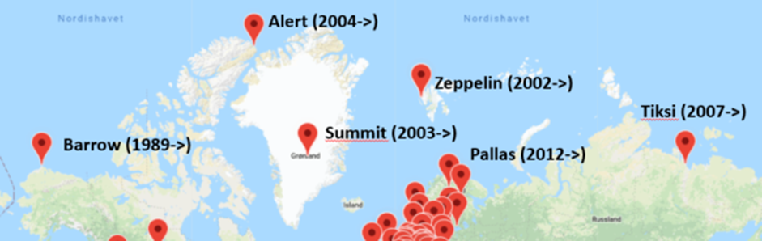
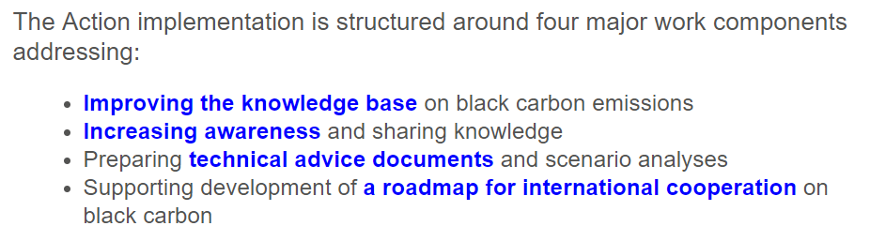

www.amap.no/eu-black-carbon-action
Report in preparation:

Slide 19
Thank you for your attention
References
Backman, J., Schmeisser, L., Virkkula, A., Ogren, J. A., Asmi, E., Starkweather, S., Sharma, S., Eleftheriadis, K., Uttal, T., and Jefferson, A. J. A. M. T.: On Aethalometer measurement uncertainties and an instrument correction factor for the Arctic, 2017.
Moschos, V., Kumar, N. K., Daellenbach, K. R., Baltensperger, U., Prévôt, A. S., El Haddad, I. J. E. S., and Letters, T.: Source Apportionment of Brown Carbon Absorption by Coupling Ultraviolet–Visible Spectroscopy with Aerosol Mass Spectrometry, 5, 302-308, 2018.
Sandradewi, J., Prévôt, A. S., Szidat, S., Perron, N., Alfarra, M. R., Lanz, V. A., Weingartner, E., Baltensperger, U. J. E. s., and technology: Using aerosol light absorption measurements for the quantitative determination of wood burning and traffic emission contributions to particulate matter, 42, 3316-3323, 2008.

Slide 20
Back up slides

Slide 21
Methodology: Post processing
Fixed attenuation step to calculate absorption, (rounded for integer number of steps, fixed factor of zero values for that period), similar to Bachman et al.
All absorption above detection limit even at low loading sites
Increased signal to noise vs. pure time averaging
Trade-off is often reduced points for low loading sites
~constant
Not constant

Slide 22
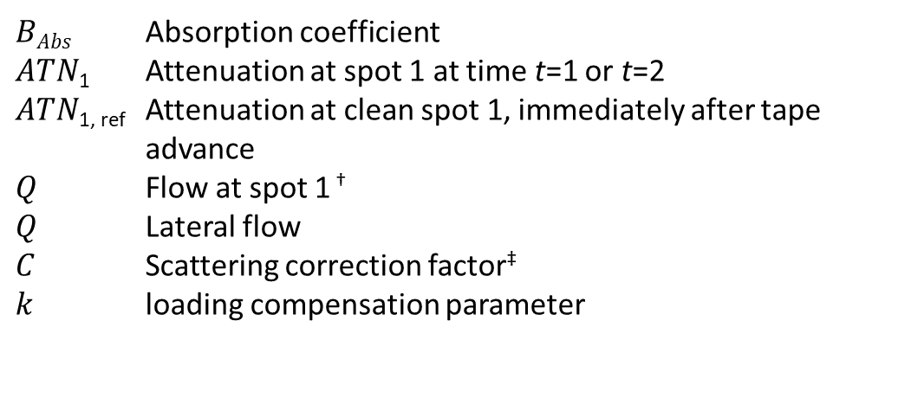
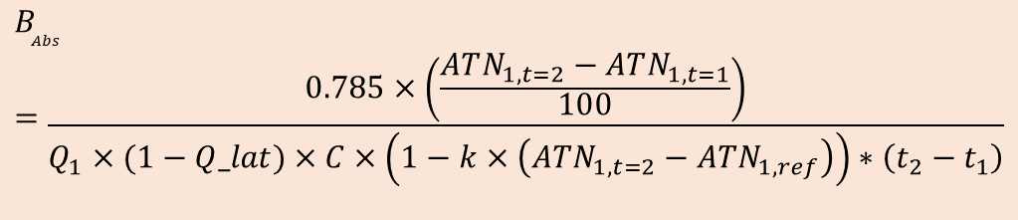
We recalculate Babs:
$BAbs$ Absorption coefficient
$ATN$₁ Attenuation at spot 1 at time t=1 or t=2
$ATN$_{1, ref} Attenuation at clean spot 1, immediately after tape advance
$Q$ Flow at spot 1 †
$Q$ Lateral flow
$C$ Scattering correction factor‡
$k$ loading compensation parameter
$$B_{Abs}=\frac{0.785×\left(\frac{ATN_{1,t=2}−ATN_{1,t=1}}{100}\right)}{Q_{1}×(1−Q_lat)×C×\left(1−k×\left(ATN_{1,t=2}−ATN_{1,ref}\right)\right)∗\left(t_{2}−t_{1}\right)}$$
‡e.g. 4 for AE33 (ACTRIS)
We are recalculating Babs from the raw data, not using submitted Babs or EBC
Submitted data still needs Babs/ EBC for EBAS submission
Note that attenuation is used 4 times in calculating Babs

Slide 23
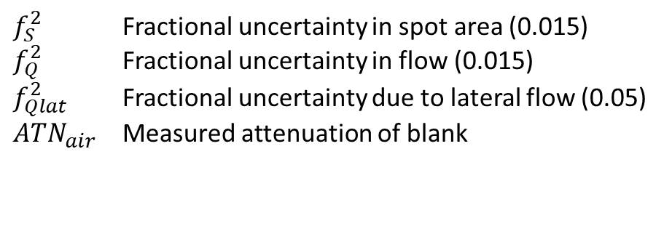
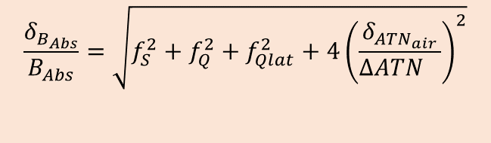
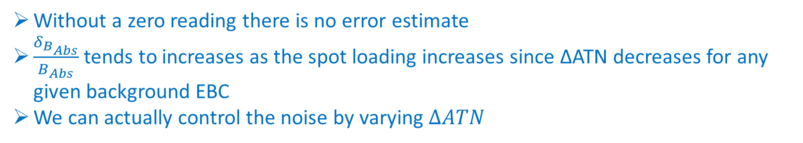
For the error matrix we use an expanded uncertainty including blank standard deviation and measurement uncertainty:
$$\frac{δ_{B_{Abs}}}{B_{Abs}}=\sqrt{f_{S}^{2}+f_{Q}^{2}+f_{Qlat}^{2}+4{\left(\frac{δ_{{ATN}_{air}}}{{ΔATN}_{}}\right)}^{2}}$$
$f_{S}^{2}$ Fractional uncertainty in spot area (0.015)
$f_{Q}^{2}$ Fractional uncertainty in flow (0.015)
$f_{Qlat}^{2}$ Fractional uncertainty due to lateral flow (0.05)
${ATN}_{air}$ Measured attenuation of blank
Without a zero reading there is no error estimate
$\frac{δ_{B_{Abs}}}{B_{Abs}}$ tends to increases as the spot loading increases since ΔATN decreases for any given background EBC
We can actually control the noise by varying $ΔATN$

Slide 24
Results: MAC Values

Slide 25
Example over-compensation

Slide 26
Recalculating Babs also allows for post processing
Similar to Backman et al. we take a fixed ΔATN
Data processed adaptively, i.e. we adjust the ΔATN step by the minimum amount required to obtain an integer number of points for each filter spot
Harmonizes data in terms of signal to noise, removes concerns about down-weighting in PMF
Pre and post processed data from the Zeppelin Observatory

