Slide 1
Changing supersites: Assessing the impact of the southern UK EMEP supersite relocation on measured atmospheric composition
H.L. Walker^{1,2}, M. R. Heal², C. F. Braban¹, S. Ritchie³, C. Conolly³, A. Sanocka³, U. Dragosits¹, M. M. Twigg¹
¹Natural Environment Research Council, Centre for Ecology & Hydrology, Penicuik, UK
²School of Chemistry, The University of Edinburgh, UK
³Ricardo Energy & Environment, Harwell, UK
Hannah L Walker et al 2019 Environ. Res. Commun. in press https://doi.org/10.1088/2515-7620/ab1a6f

Slide 2
Introduction
The UK has 2 level II supersites
Harwell site closed on 31st December 2015
Edinburgh
Auchencorth Moss
Harwell
London

Slide 3
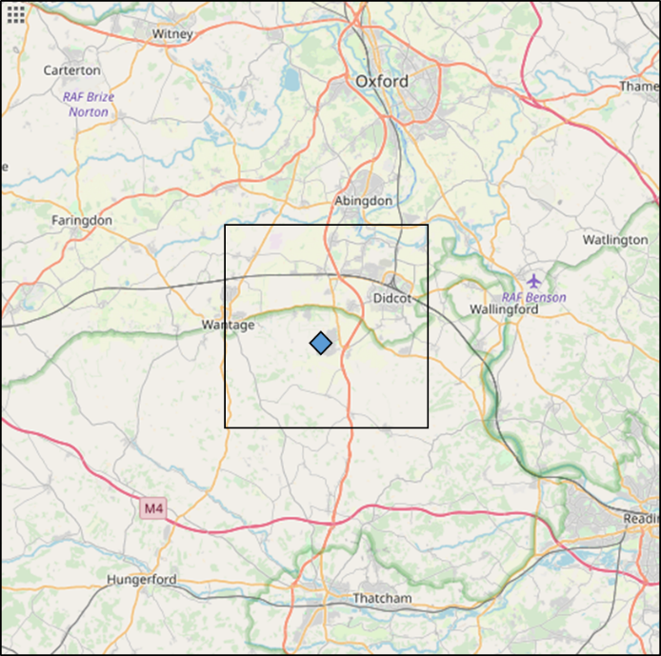
Harwell
Monitoring site operational since 1976
Primarily surrounded by agricultural land
Nearest dual carriage way road ~ 400 m west and a dual carriage way ~ 2 km east
8 km North East there is a natural gas power station

Slide 4
Introduction
The UK has 2 level II supersites
Harwell had been a level II supersite in 2009
Site closed on 31st December 2015
Chilbolton site
Monitoring commenced on 11th January 2016
Edinburgh
Auchencorth Moss
Harwell
Chilbolton
London

Slide 5
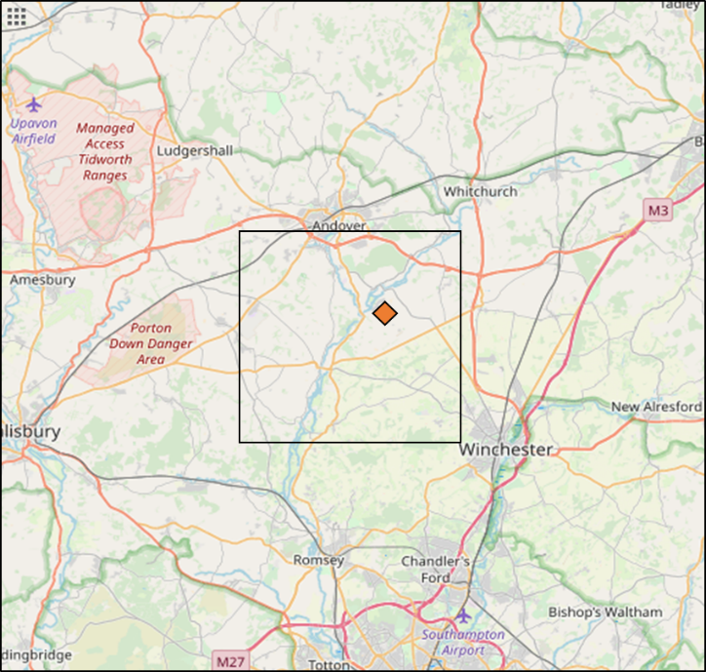
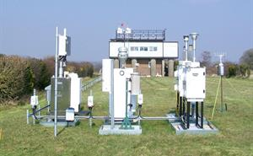
Chilbolton Observatory
50 km south of Harwell
Been a research infrastructure since the 1960s
Agricultural landscape (mainly arable)
Single carriage way roads
1 km west and 3 km south

Slide 6
Aim
To investigate if the move from Harwell to Chilbolton led an impact on the long term trends of atmospheric pollutants
2 years prior to closure of Harwell (2014-2015) and the first 2 years at Chilbolton (2016 -2017) are presented.
Pollutants studied: O₃, PM₁₀ and PM_{2.5} , NO_{x}, SO₂ and NH₃
Hannah L Walker et al 2019 Environ. Res. Commun. in press https://doi.org/10.1088/2515-7620/ab1a6f

Slide 7
Measurement data
All air pollutant measurement data were obtained from DEFRA UK-Air website (also available on EBAS)
NO_{x} - Chemiluminescence
O₃ - UV absorption
PM₁₀ and PM_{2.5} – TEOM-FDMS
NH₃ and speciated PM – Monitor for AeRosols and Gases in Air (MARGA)
SO₂ – MARGA and UV Fluorescence
Meteorological data
Data from Harwell, Chilbolton and Benson (Oxfordshire)

Slide 8
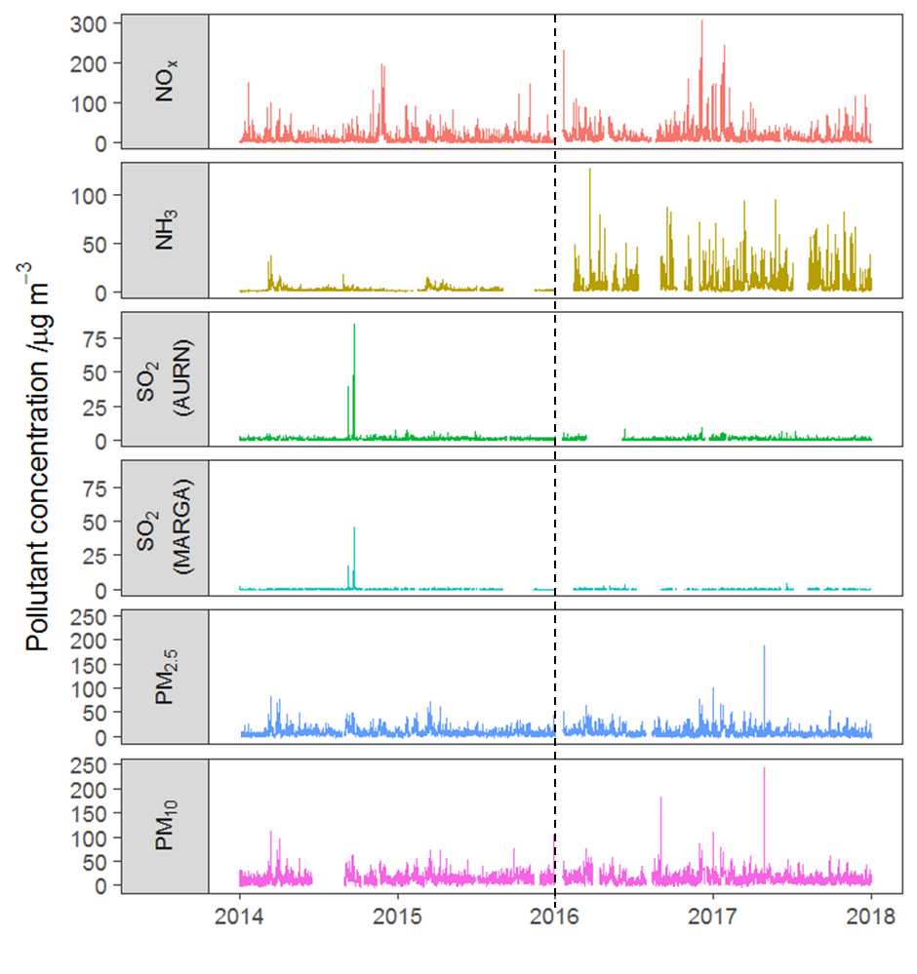
Raw time series

Slide 9
Deweather function (OpenAir)
Statistical tool removes influence of meteorology from pollutant concentration measurements
Uses a boosted regression tree approach for modelling air quality data for both meteorology and other variables
Model parameters used:
Meteorology: wind speed/direction/relative humidity/temperature and pressure
Temporal: eg hour-of-day, day-of-week (to account for car usage in rush hours and weekdays)
Further information on the method:
Carslaw, D. C. and Taylor, P. J.: Analysis of air pollution data at a mixed source location using boosted regression trees, Atmos. Environ. 43, 3563–3570, 2009.

Slide 10
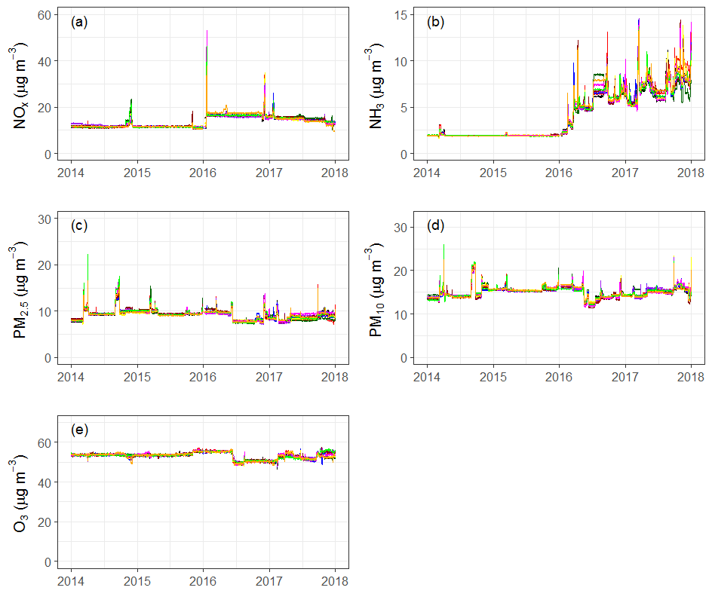
Application of deweather function

Slide 11
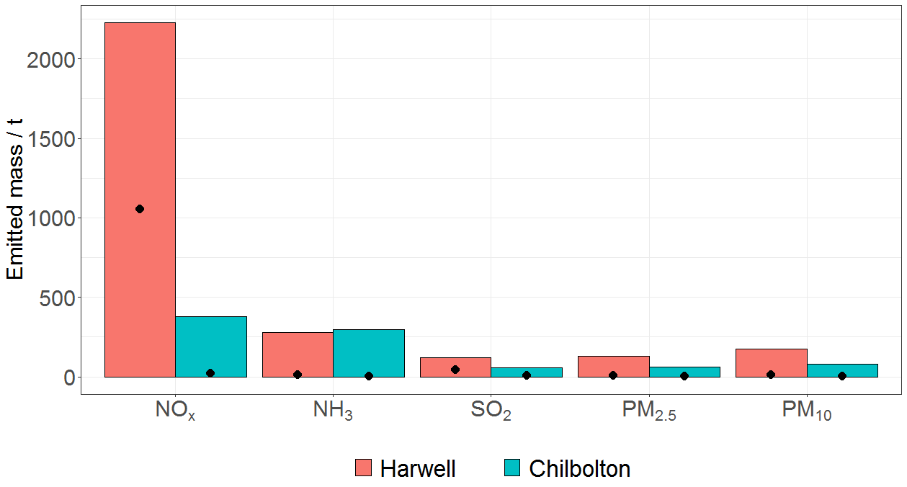
Comparison to NAEI
Annual Emissions from the National Atmospheric Emission Inventory data bases (NAEI, http://naei.beis.gov.uk)
for 15 km x 15 km surrounding sites.
NO_{x} emissions are higher in Harwell
Very little difference for NH₃
PM is higher at Harwell too

Slide 12
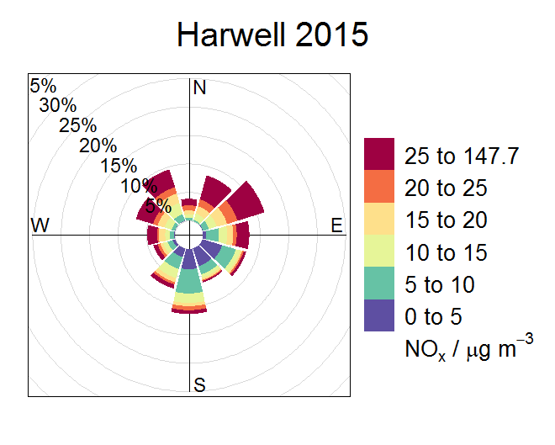
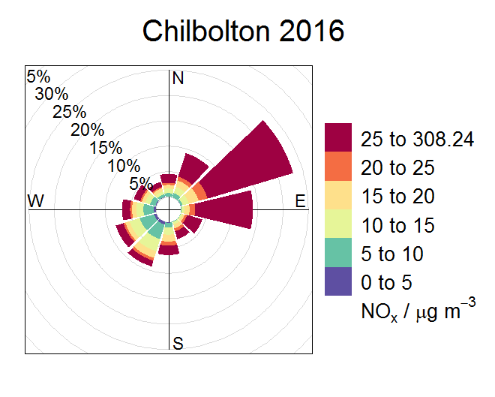
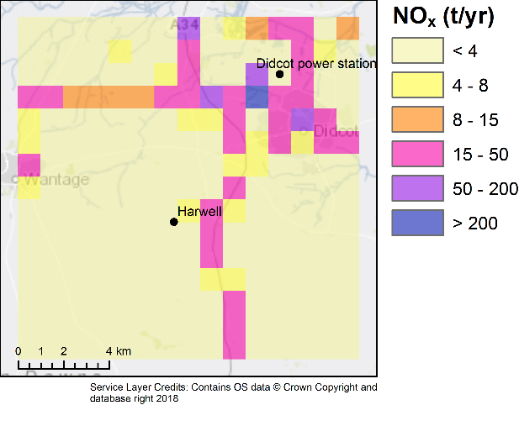
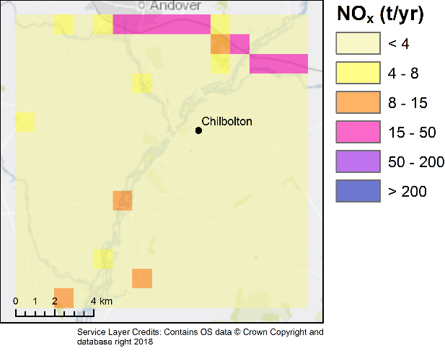
NO_{x}
Site and year | Annual mean [NO_{x}] / μg m⁻³
Harwell 2014 | 10.5 ± 14
Harwell 2015 | 9.20 ± 10
Chilbolton 2016 | 18.5 ± 22
Chilbolton 2017 | 13.8 ± 16

Slide 13
NO_{x}
Edinburgh
Auchencorth Moss
Site and year | Annual mean [NO_{x}] / μg m⁻³
Harwell 2014 | 10.5 ± 14
Harwell 2015 | 9.20 ± 10
Chilbolton 2016 | 18.5 ± 22
Chilbolton 2017 | 13.8 ± 16
Harwell
Chilbolton
London

Slide 14
NO_{x}
Site and year | Annual mean [NO_{x}] / μg m⁻³
Harwell 2014 | 10.5 ± 14
Harwell 2015 | 9.20 ± 10
Chilbolton 2016 | 18.5 ± 22
Chilbolton 2017 | 13.8 ± 16

Slide 15
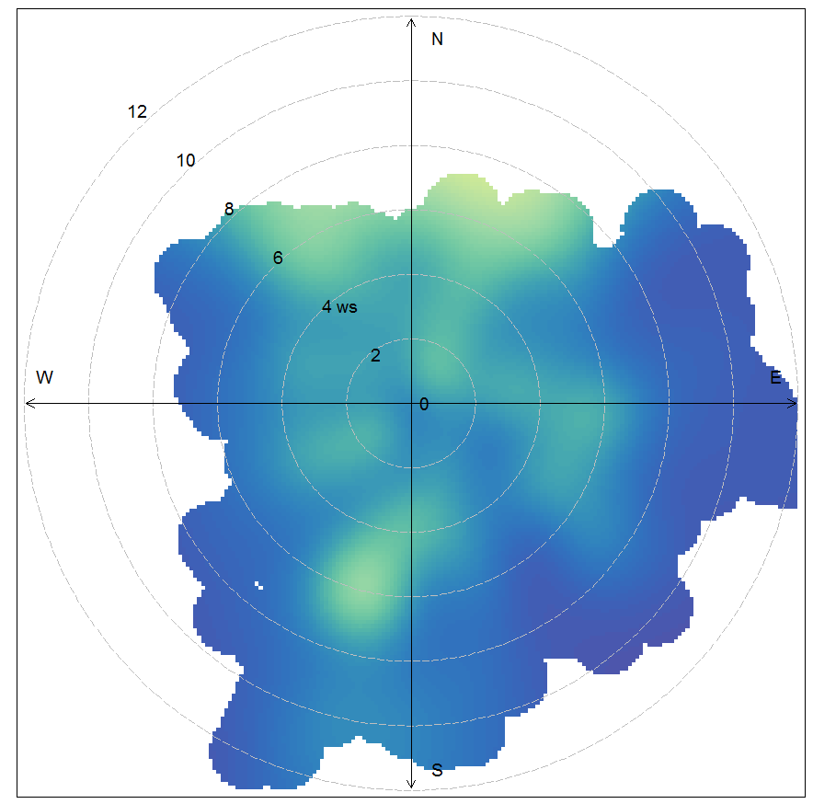
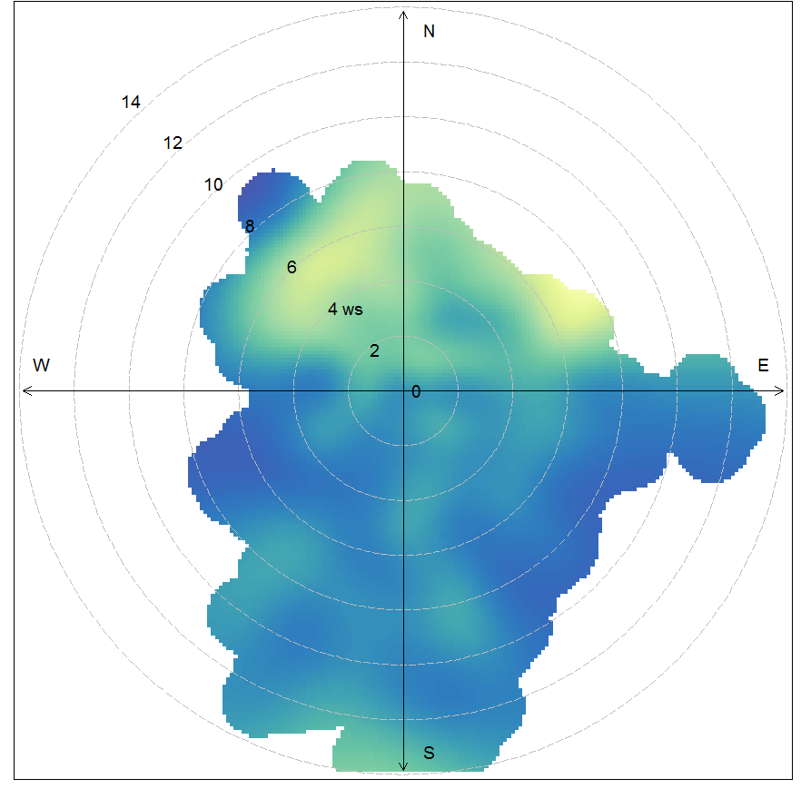
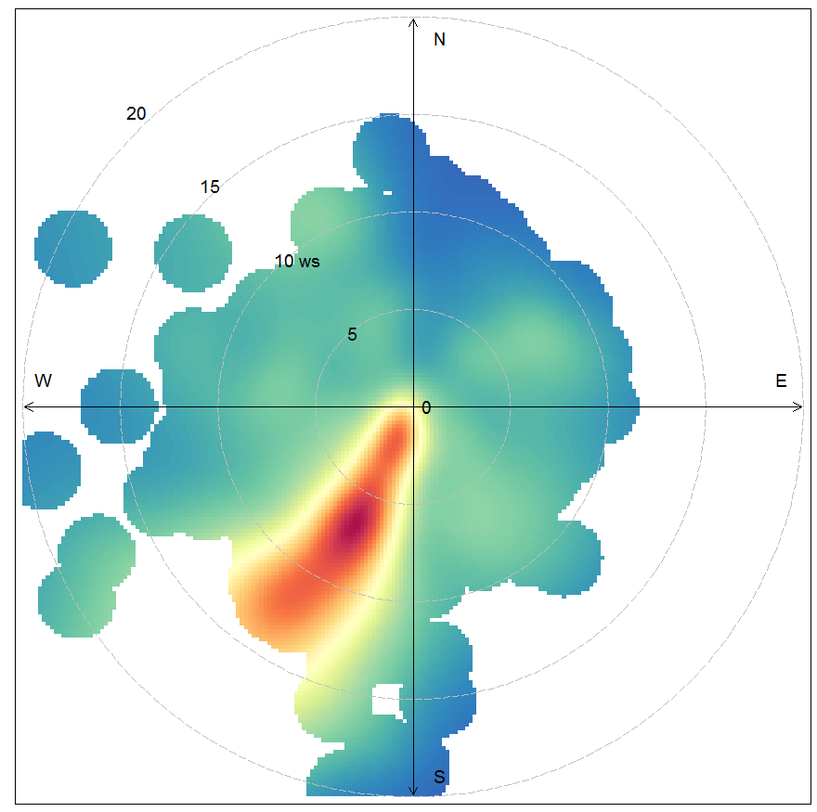
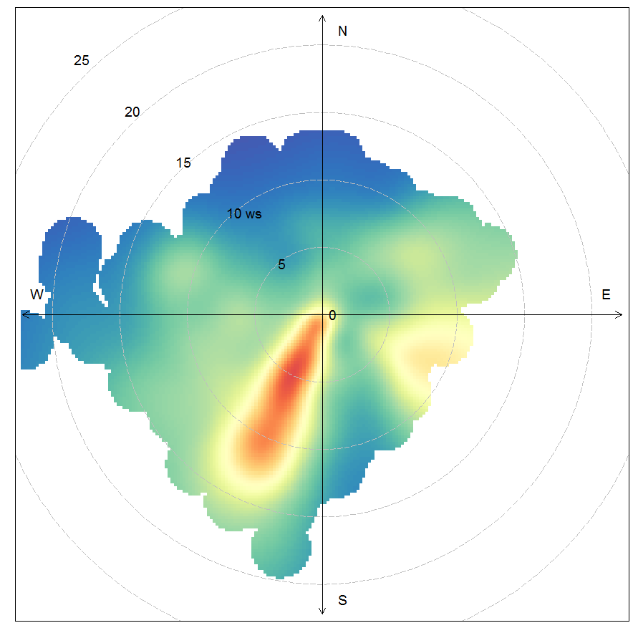
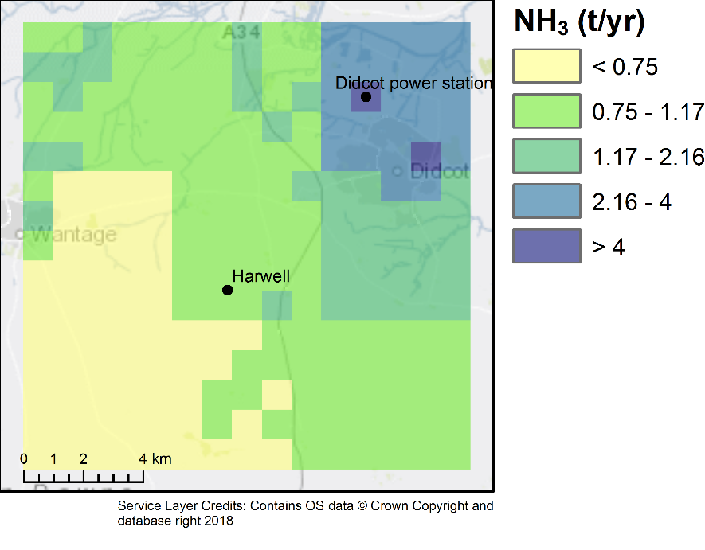
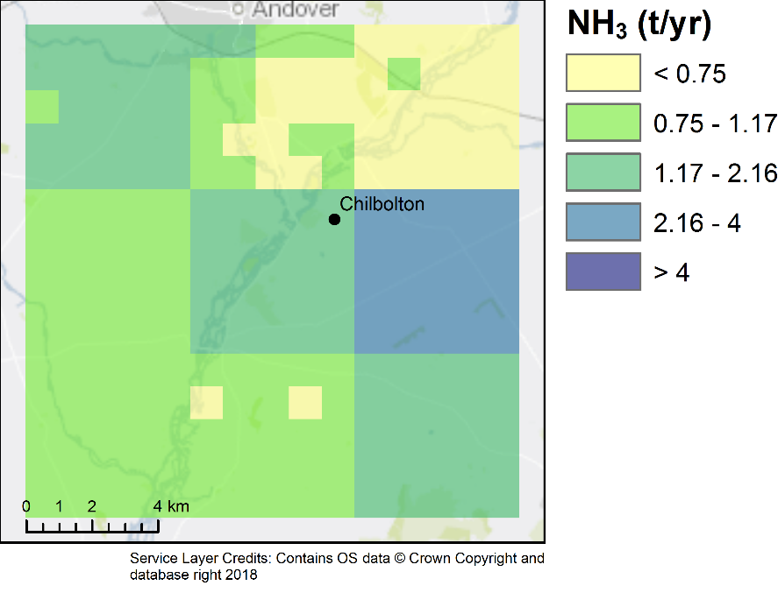
NH₃
NH₃
NH₃ / μg m⁻³
Harwell 2015
2.05 ± 1.7 µg m⁻³
(70%)
Chilbolton 2016
5.88 ± 7.7 µg m⁻³
(54%)
Chilbolton 2017
6.23 ± 7.7 µg m⁻³
(82%)
Harwell 2014
1.96 ± 2.3 µg m⁻³
(95%)

Slide 16
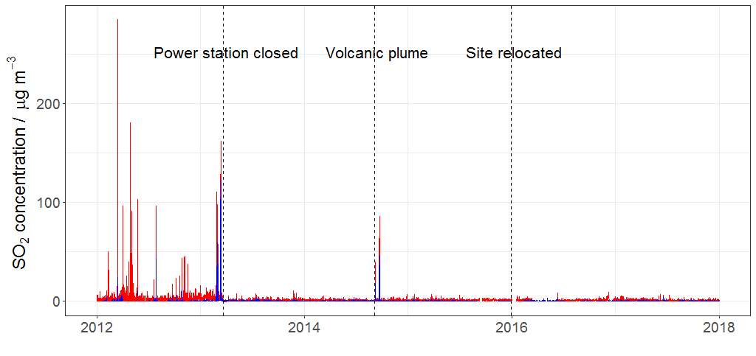
SO₂
Annual mean concentration ± 95% confidence intervals / μg m⁻³ (Data capture / %)
 | Harwell 2014 | Harwell 2015 | Chilbolton 2016 | Chilbolton 2017
MARGA | 0.245 ± 0.028 (94%) | 0.150 ± 0.0027 (70%) | 0.157 ± 0.0044 (58%) | 0.131 ± 0.0032 (79%)
UV fluorescence | 1.01 ± 0.054 (98%) | 0.939 ± 0.013 (93%) | 0.876 ± 0.017 (64%) | 0.763 ± 0.013 (89%)

Slide 17
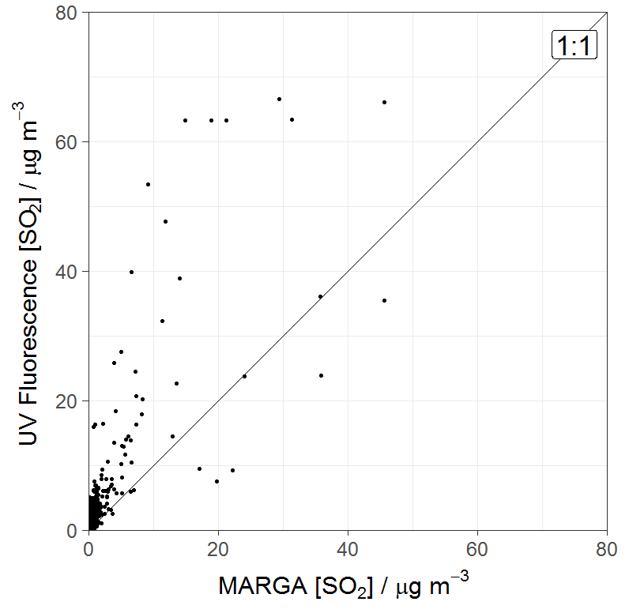
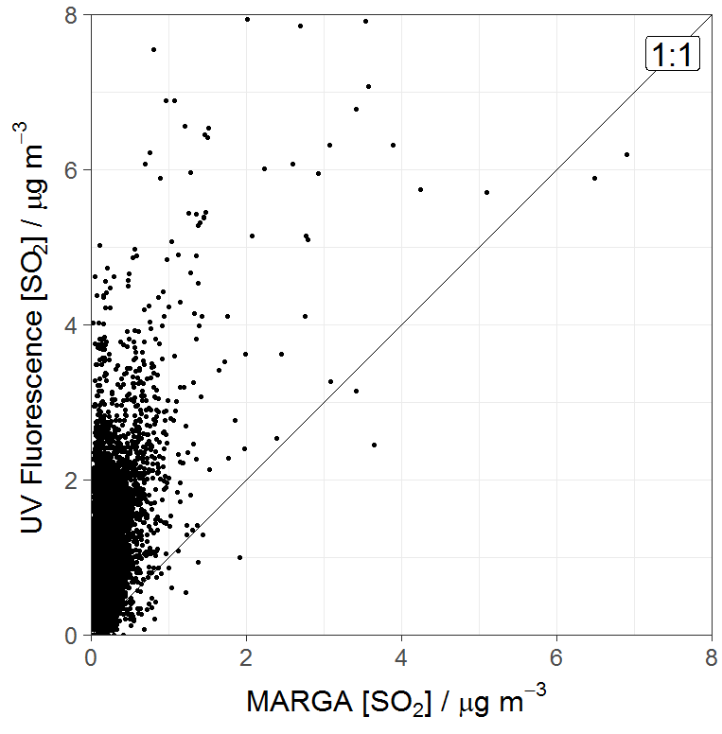
SO₂
UV fluorescence analyser LOD ~ 4 µg m⁻³
MARGA LOD ~ 0.04 µg m⁻³
UV fluorescence set-up to measure exceedances.
MARGA primarily used to measure PM and monitor changes in the UK background concentrations.

Slide 18
O₃
The annual mean is lower after the relocation
The deweather model does not show a step change associated with the relocation.
The decrease in mid 2016 is also reflected in the PM
It is possible that the annual average is a reflection on inter- annual variability
Site and year | Annual mean O₃ / μg m⁻³
Harwell 2014 | 56.0 ± 0.45 (99%)
Harwell 2015 | 57.1 ± 0.42 (98%)
Chilbolton 2016 | 48.9 ± 0.53 (97%)
Chilbolton 2017 | 51.5 ± 0.48 (98%)

Slide 19
PM
Site and year | Annual mean PM₁₀ / μg m⁻³ | # Daily mean exceedance of 50 µg m⁻³
Harwell 2014 | 14.3 ± 0.27 | 2
Harwell 2015 | 15.1 ± 0.21 | 2
Chilbolton 2016 | 14.9 ± 0.25 | 3
Chilbolton 2017 | 13.3 ± 0.19 | 1
Secondary inorganic aerosol contribution to total mass (PM_{2.5}) is similar
58 % at Harwell
59 % at Chilbolton
More acidic aerosol was observed at Harwell in 2014 due to the Icelandic fissure eruption¹
Chilbolton on occasions has an excess of NH₄⁺ reported
Both sites show a slight bias towards basic aerosol
¹ Twigg et al. 2016 Impacts of the 2014-2015 Holuhraun Eruption on the UK atmosphere. Atmospheric Chemistry and Physics 11415 -11431

Slide 20
Conclusions
No discontinuities in the average measured concentrations of PM_{2.5}, PM₁₀, SO₂ and O₃
Substantial increases in NO_{x} by a factor of ~1.6
Expected that M3 motorway and Greater London are the source
NH₃ also increased by a factor of ~ 3
Local sources in the south-west of Chilbolton
To look at long-term trends for the southern UK supersite two sites should be treated separately for NH₃ and NO_{x}

Slide 21
Conclusions
No discontinuities in the average measured concentrations of PM_{2.5}, PM₁₀, SO₂ and O₃
Substantial increases in NO_{x} by a factor of ~1.6
Expected that M3 motorway and Greater London are the source
NH₃ also increased by a factor of ~ 3
Local sources in the south-west of Chilbolton
To look at long-term trends for the southern UK supersite the two sites should be treated separately for NH₃ and NO_{x}

Slide 22
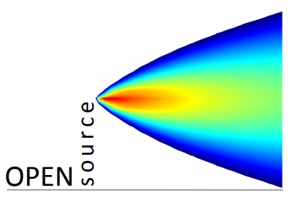
Acknowledgements
Project funding:
Data and R packages:
A. Solocka
S. Ritchie
C. Conolly
Dr David Carslaw
openair and deweather packages
Thank you for listening!
Hannah L Walker et al 2019 Environ. Res. Commun. in press https://doi.org/10.1088/2515-7620/ab1a6f

